Slide 1

MAULANA AZAD NATIONAL INSTITUTE OF TECHNOLOGY
Submitted By :
Sujeet Kumar
Sample web template

Slide 2
Introduction
I Have Created only a Web Template, There In This Template I divide it In Sub Divisions Like first I Divide it for only Title Of The Template Next I Divide For a Navigation Bar, I had Also Used Some Bootstrap Framework With CSS.I Create This template for An Image Gallery. In This Image Gallery I had Also use Some Buttons Like Search Bar Button And Message button Also And Some Button Looks Likes a Hyperlinks So This Is My Web Template.

Slide 3
Technology Used
Html5
CSS5
PHP4
Bootstrap 4.0.0
Xammp Server
Bracket Editor
Chrome Browser

Slide 4
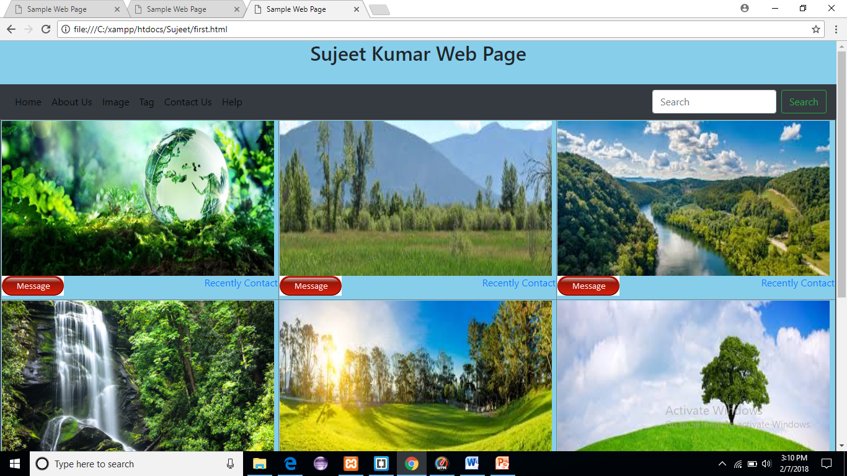

Slide 5
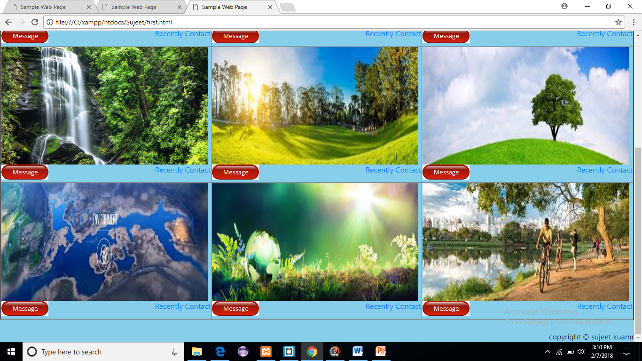

Slide 6
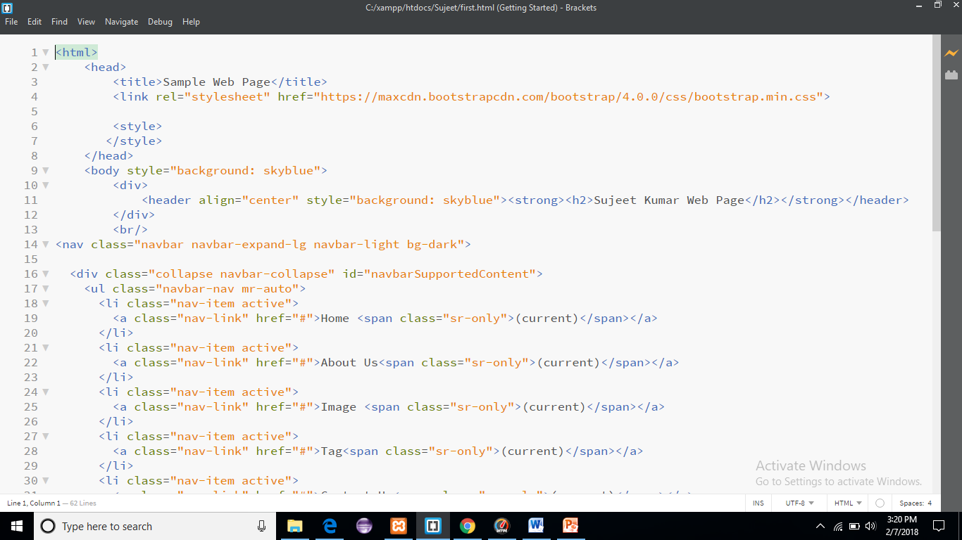

Slide 7
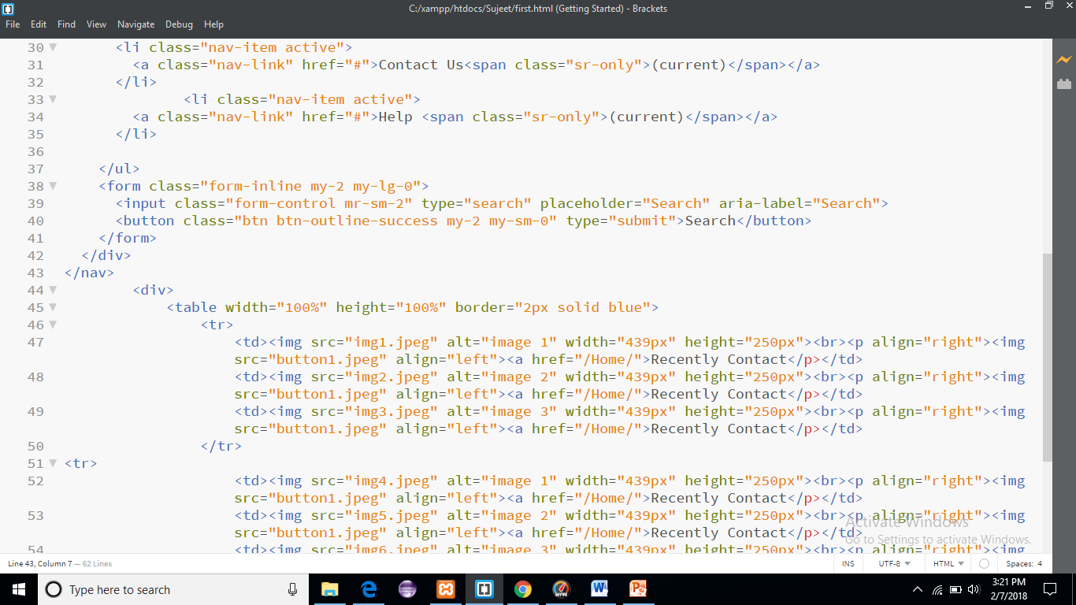

Slide 8
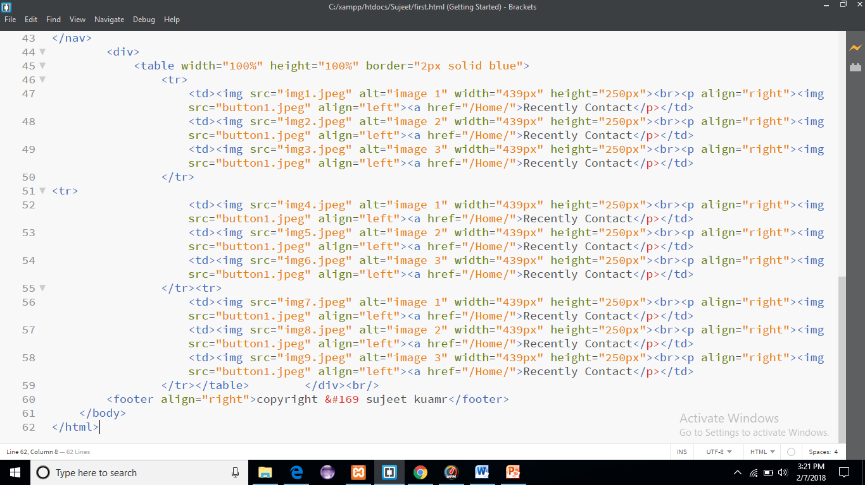

Slide 9
Software Requirment
Braket editor
Google chrome
Xammp Server
Hardware Requirment:
I3 And Above System
512 MB Ram

Slide 10


