Slide 1


PLEDGE TO PROGRESS Sustainability Hackathon
Sponsored By
Your Team Name : HOMO - SAPIENS
Your team bio : We are team of 4 members with good cooradination, role clarity and posses innovative skills.
Date : 20/04/2023

Slide 2
Problem Statement?
One of the main concerns with our environment has been solid waste management which impacts the health and environment of our society. The detection , monitoring and management of waste is one of the primary problems of the present era. The traditional way is inefficient . So this is our solution where waste management is automated with the use of IoT.
To address these challenges, there is a need for a smart garbage monitoring system that can accurately measure garbage levels, transmit data in real-time, and provide insights to users to optimize waste collection and reduce waste output. The system should be user-friendly, secure, and easily integrated with existing waste management systems. With such a system in place, waste management can become more efficient, cost-effective, and environmentally sustainable.

Slide 3
User Segment & Pain Points
Municipality and Apartment residents will be the user segment, they will be using the product early.
Municipality will use the product to check on the garbage bin limit to pick it up on correct time.
Apartment residents will be using the product to put their garbage in the bin as their default garbage bin.
Overfilling of garbage bins: When garbage bins are overfilled, it can lead to overflowing and littering. This can cause unsightly and unsanitary conditions, as well as attract pests.
Inefficient waste collection: Waste collection can be inefficient if garbage trucks are sent to empty bins that are not yet full. This can waste time, fuel, and money.
Lack of transparency: Many waste management systems lack transparency, making it difficult for users to track their waste output and identify areas for improvement.
A smart garbage monitoring system can address these pain points by providing real-time information on garbage levels, allowing for more efficient waste collection, and providing transparency and data to help users reduce their waste output.

Slide 4
Pre-Requisite
There are several prerequisites for a smart garbage monitoring system. Here are some important ones:
Sensors: Smart garbage monitoring systems rely on sensors to detect the level of garbage in the bins. These sensors can be ultrasonic, infrared, or capacitive sensors, among others.
Connectivity: The system requires connectivity to transmit the data collected by the sensors. This can be achieved through Wi-Fi, cellular networks, or other communication technologies.
Data processing: The system must be able to process the data collected by the sensors and provide meaningful insights to the users. This can be achieved through machine learning algorithms or other data processing techniques.
User interface: The system must have a user interface that allows users to monitor the garbage levels in real-time and receive alerts when the bins are full.
Integration with garbage collection systems: The system must be integrated with garbage collection systems to ensure timely pickup of the garbage when the bins are full.

Slide 5
Tools or resources
Ultrasonic bin sensors
Geolocation
RFID bin tags
GSM module
Arduino uno microprocessor

Slide 6
Any Supporting Functional Documents
SYSTEM PROCESS FLOW
Ultrasonic sensor detects the height of garbage in each bin.
Arduino uno receives and process the information from the sensors.
There are two threshold levels, 70% and 90% of bin , at 70% the green LED light is switched on as an alert to residents and the first warning message generated and sent to the municipality.
At 90% the red LED light is switched on as an alert to residents and second warning message is generated and sent to the municipality, these warning messages are generated and sent by GSM module.

Slide 7
Any Supporting Functional Documents
HARDWARE COMPONENT
The hardware connection setup for the system. An Arduino Uno board is connected to the HC-SR04 ultrasonic sensor via digital I/O pin. Besides, the SIM900A GSM Module is serially connected to the Arduino Uno board, where the TX port of the GSM Module is connected to the RX port (PIN 2) of the Arduino Uno, while RX port of the former is tied to the TX port (PIN 3) of the latter. Moreover, a green LED and a red LED are also connected to the Arduino Uno.

Slide 8
Key Differentiators & Adoption Plan
ADVANTAGES
We can stop the overflow of garbage as most of the diseases are spread due to open degrading wastes
We can automate the process of separating the degradable and non-degradable waste.
When a garbage bin is full, the nearby garbage collector will receive a notification so that garbage overflow can be reduced.
So, Our Whole Idea’s Advantage is to make our city clean starting right from the overflowed garbage bins
Mainly the resultant product is cost efficient and further we have planned to give website support for the product.
We intend to implement this solution in main cities.

Slide 9
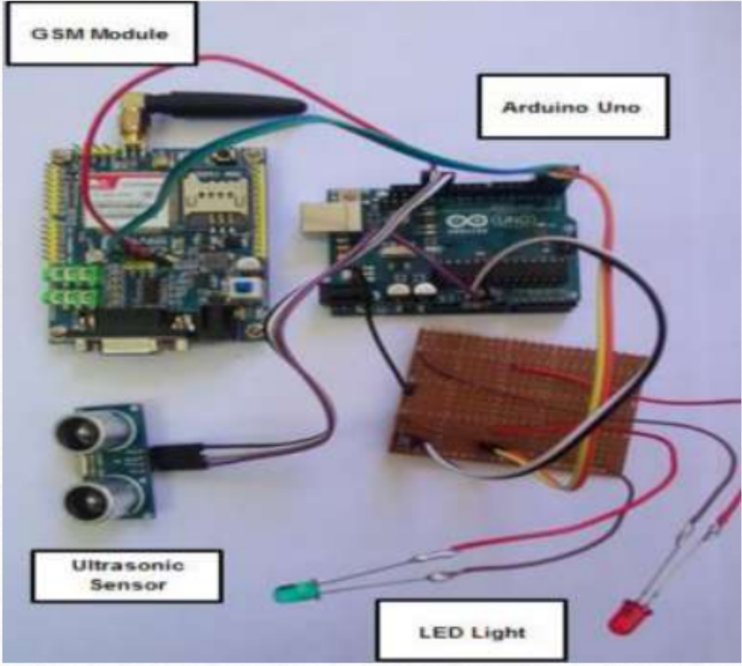
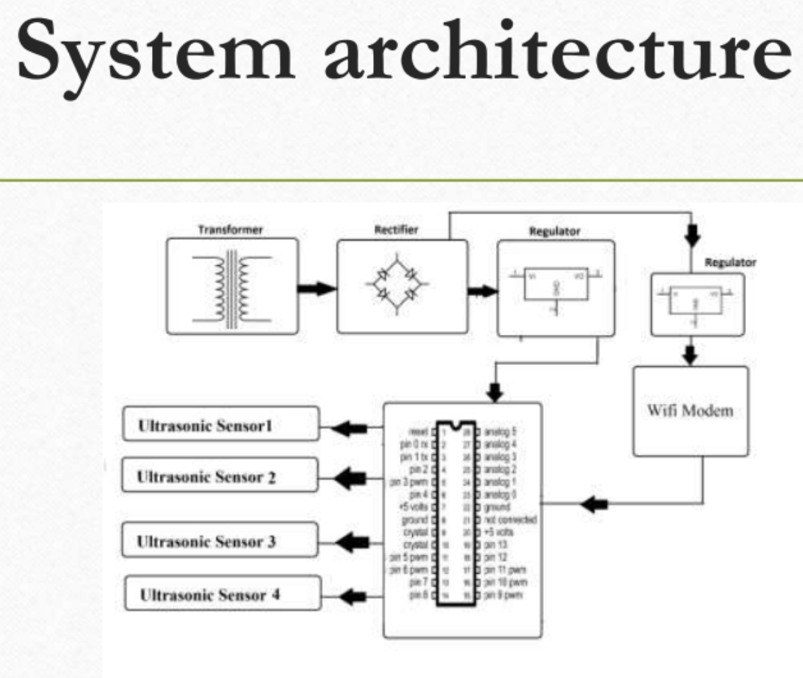
GitHub Repository Link & supporting diagrams, screenshots, if any
Github repository link : https://github.com/sudharsan0911/Homo-Sapiens

Slide 10
Thank You
Team member names:
SUDHARSAN S
SUJEETH K
SANJEEV KAVARA T
VIKRAM SARAVANAN S

