Slide 1


D2N Internship

Slide 2
Introduction to CNN

Slide 3
CNN architectures
The conventional linear structure, linear list of layers, feedforward
Generally a DAG, directed acyclic graph
ResNet simply adds back
Different terminology: complex layer and simple layer
A complex (complete) convolutional layer, including different stages such as convolution per se, batch normalization, nonlinearity, and pooling
Each stage is a layer, even there are no parameters
The traditional CNNs are just a few complex convolutional layers to extract features, then are followed by a softmax classification output layer
Convolutional networks output a high-dimensional, structured object, rather than just predicting a class label for a classiciation task or a real valuefor a regression task, it it an output tensor
S_i,j,k is the probability that pixel j,k belongs to class I
Notes:
http://cs231n.github.io/neural-networks-1/

Slide 4
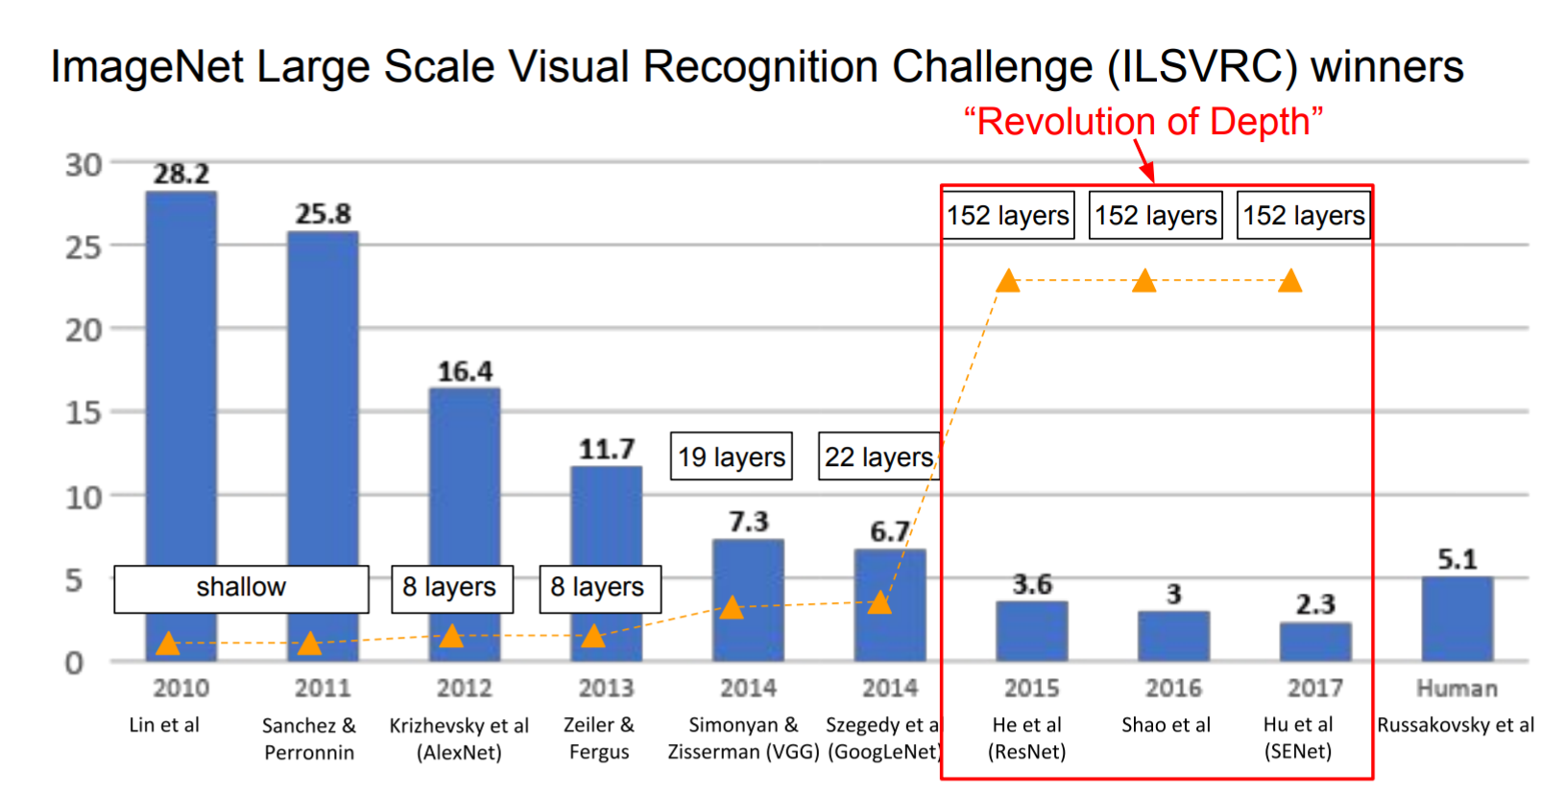
The popular CNN
LeNet, 1998
AlexNet, 2012
VGGNet, 2014
ResNet, 2015
Notes:
http://cs231n.github.io/neural-networks-1/

Slide 5
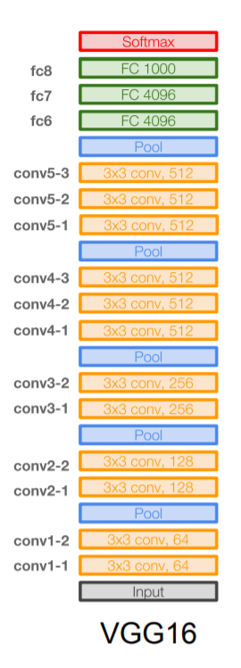
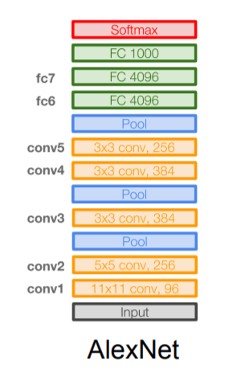
VGGNet
16 layers
Only 3*3 convolutions
138 million parameters

Slide 6
CNN applications

Slide 7
CNN applications
Transfer learning
Fine-tuning the CNN
Keep some early layers
Early layers contain more generic features, edges, color blobs
Common to many visual tasks
Fine-tune the later layers
More specific to the details of the class
CNN as feature extractor
Remove the last fully connected layer
A kind of descriptor or CNN codes for the image
AlexNet gives a 4096 Dim descriptor
Notes:
http://cs231n.github.io/neural-networks-1/

Slide 8
CNN classification/recognition nets
CNN layers and fully-connected classification layers
From ResNet to DenseNet
Densely connected
Feature concatenation
Notes:
http://cs231n.github.io/neural-networks-1/

Slide 9
Fully convolutional nets: semantic segmentation
Classification/recognition nets produce ‘non-spatial’ outputs
the last fully connected layer has the fixed dimension of classes, throws away spatial coordinates
Fully convolutional nets output maps as well
Notes:
http://cs231n.github.io/neural-networks-1/

Slide 10
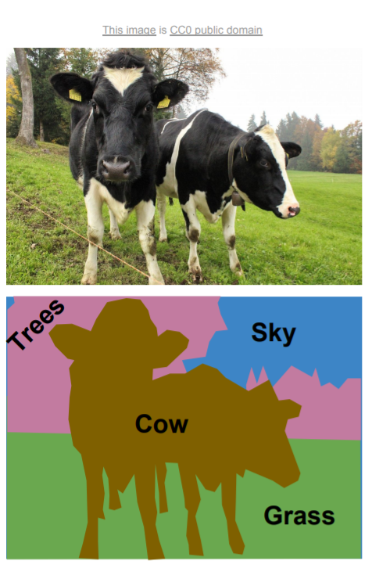
Semantic segmentation

Slide 11
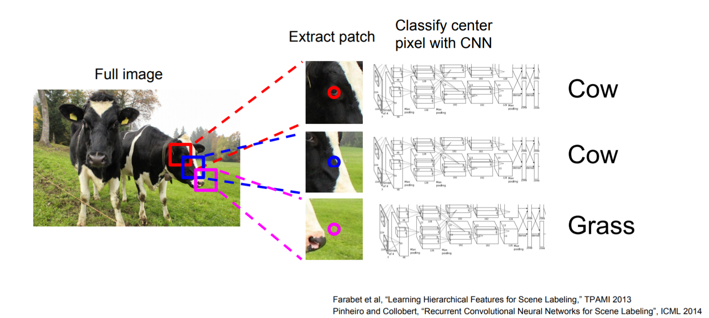
Using sliding windows for semantic segmentation

Slide 12
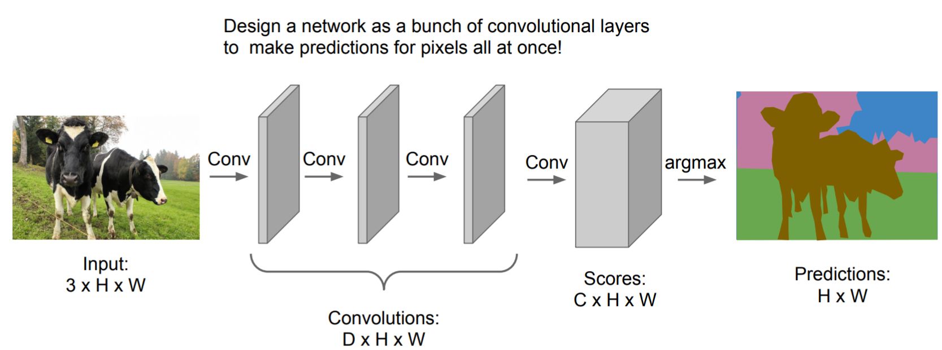
Fully convolutional

Slide 13
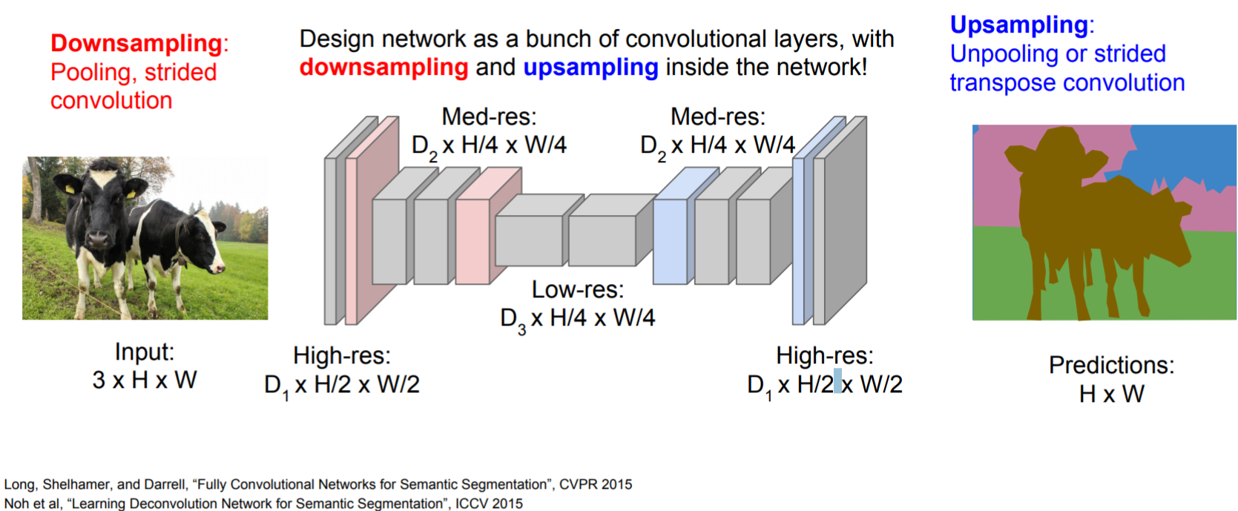
Fully convolutional

Slide 14
Detection and segmentation nets: The Mask Region-based CNN (R-CNN):
Class-independent region (bounding box) proposals
From selective search to region proposal net with objectness
Use CNN to class each region
Regression on the bounding box or contour segmentation
Mask R-CNN: end-to-end
Use CNN to make proposals on object/non-object in parallel
The old good idea of face detection by Viola
Proposal generation
Cascading (ada boosting)
Notes:
HOG features, Histogram of Gradients, by Triggs

Slide 15
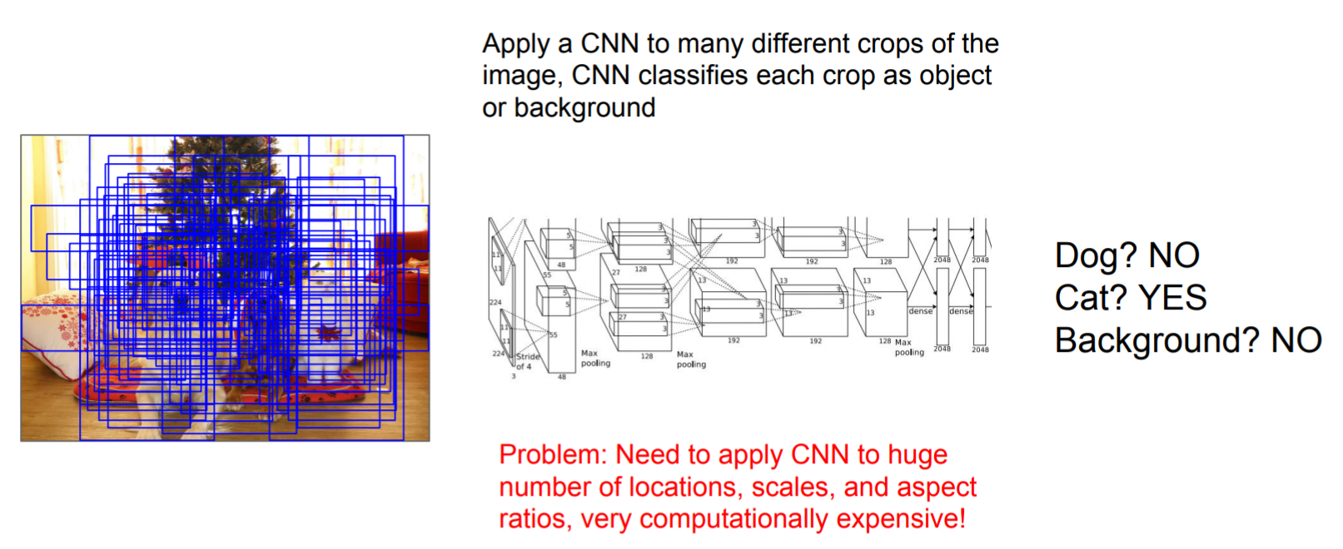
Using sliding windows for object detection as classification

Slide 16
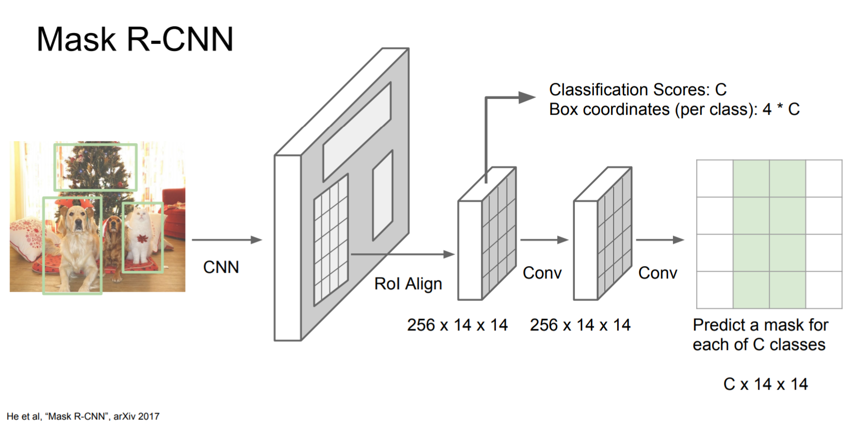
Mask R-CNN

Slide 17
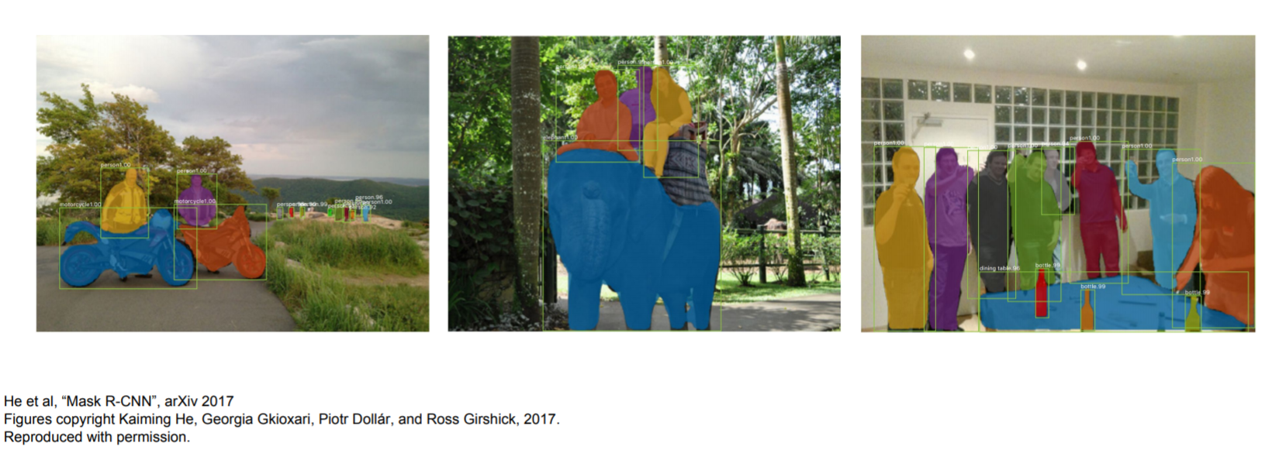
Excellent results

Slide 18
End.

