Slide 1


D2N Internship

Slide 2
Introduction to CNN
A Convolutional Neural Network (CNN, or ConvNet) are a special kind of multi-layer neural networks, designed to recognize visual patterns directly from pixel images with minimal preprocessing.. The ImageNet project is a large visual database designed for use in visual object recognition software research. The ImageNet project runs an annual software contest, the ImageNet Large Scale Visual Recognition Challenge (ILSVRC), where software programs compete to correctly classify and detect objects and scenes. Here I will talk about CNN architectures of ILSVRC top competitors .

Slide 3
CNN architectures
The conventional linear structure, linear list of layers, feedforward
Generally a DAG, directed acyclic graph
ResNet simply adds back
Different terminology: complex layer and simple layer
A complex (complete) convolutional layer, including different stages such as convolution per se, batch normalization, nonlinearity, and pooling
Each stage is a layer, even there are no parameters
The traditional CNNs are just a few complex convolutional layers to extract features, then are followed by a softmax classification output layer
Convolutional networks output a high-dimensional, structured object, rather than just predicting a class label for a classiciation task or a real valuefor a regression task, it it an output tensor
S_i,j,k is the probability that pixel j,k belongs to class I
Notes:
http://cs231n.github.io/neural-networks-1/

Slide 4
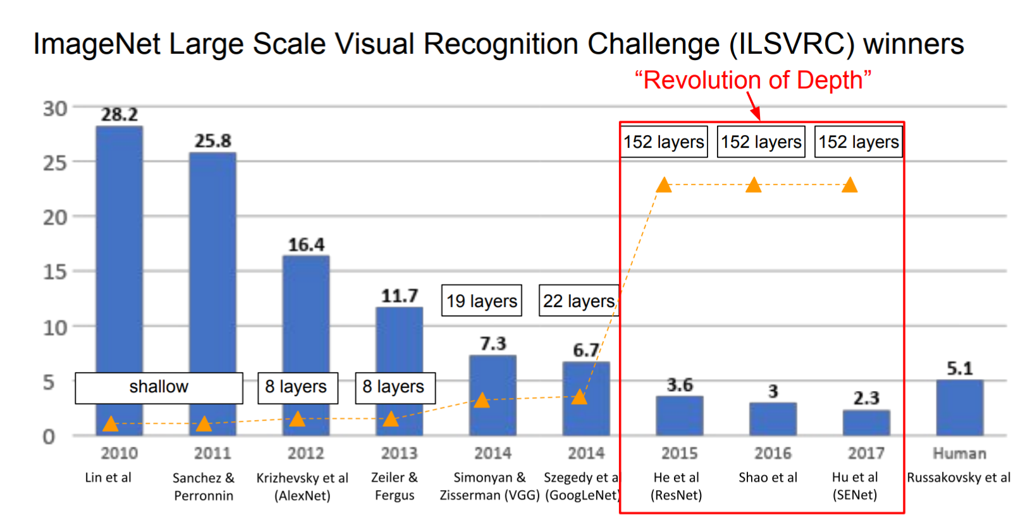
The popular CNN
LeNet, 1998
AlexNet, 2012
VGGNet, 2014
ResNet, 2015
Notes:
http://cs231n.github.io/neural-networks-1/

Slide 5
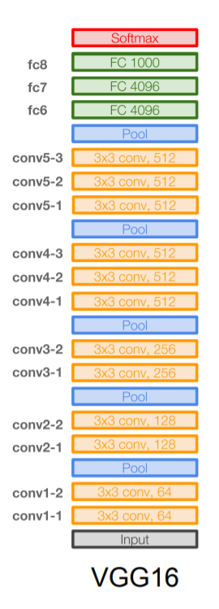
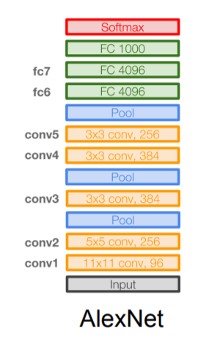
VGGNet
16 layers
Only 3*3 convolutions
138 million parameters

Slide 6
CNN applications

Slide 7
CNN applications
Transfer learning
Fine-tuning the CNN
Keep some early layers
Early layers contain more generic features, edges, color blobs
Common to many visual tasks
Fine-tune the later layers
More specific to the details of the class
CNN as feature extractor
Remove the last fully connected layer
A kind of descriptor or CNN codes for the image
AlexNet gives a 4096 Dim descriptor
Notes:
http://cs231n.github.io/neural-networks-1/

Slide 8
CNN classification/recognition nets
CNN layers and fully-connected classification layers
From ResNet to DenseNet
Densely connected
Feature concatenation
Notes:
http://cs231n.github.io/neural-networks-1/

Slide 9
Fully convolutional nets: semantic segmentation
Classification/recognition nets produce ‘non-spatial’ outputs
the last fully connected layer has the fixed dimension of classes, throws away spatial coordinates
Fully convolutional nets output maps as well
Notes:
http://cs231n.github.io/neural-networks-1/

Slide 10
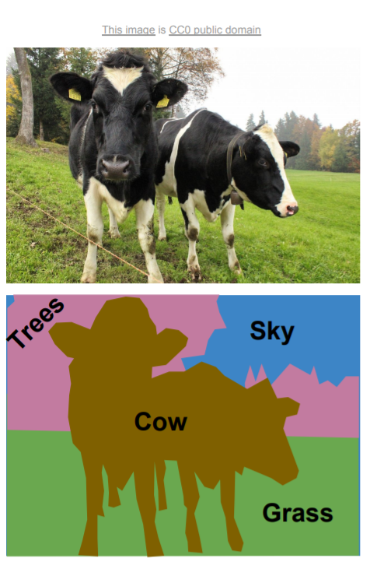
Semantic segmentation

Slide 11
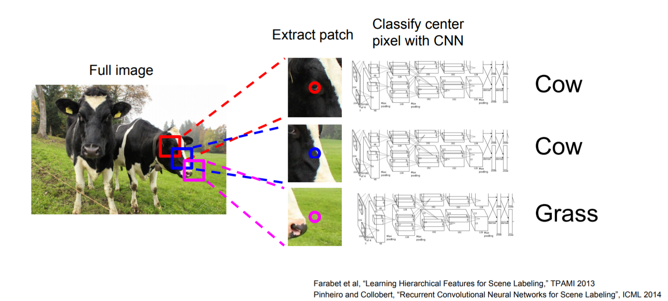
Using sliding windows for semantic segmentation

Slide 12
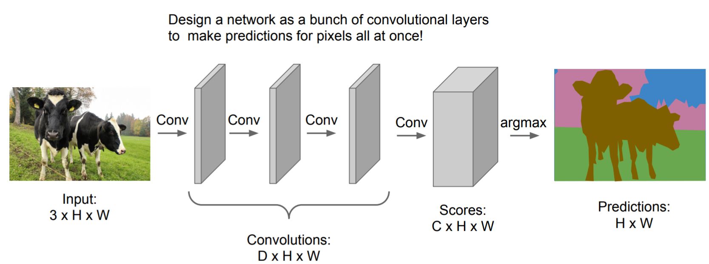
Fully convolutional

Slide 13
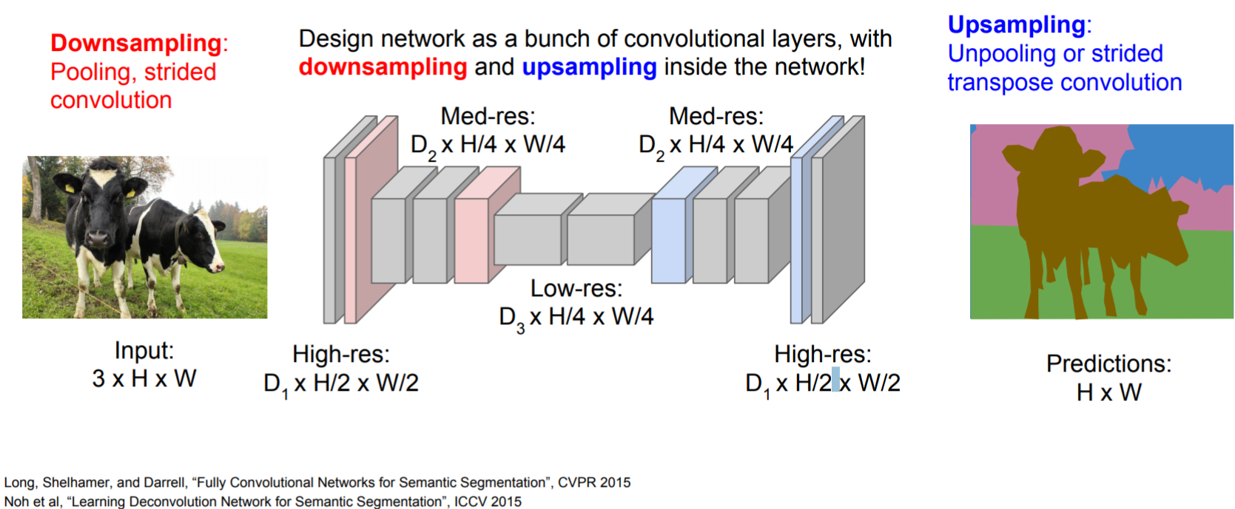
Fully convolutional

Slide 14
Detection and segmentation nets: The Mask Region-based CNN (R-CNN):
Class-independent region (bounding box) proposals
From selective search to region proposal net with objectness
Use CNN to class each region
Regression on the bounding box or contour segmentation
Mask R-CNN: end-to-end
Use CNN to make proposals on object/non-object in parallel
The old good idea of face detection by Viola
Proposal generation
Cascading (ada boosting)
Notes:
HOG features, Histogram of Gradients, by Triggs

Slide 15
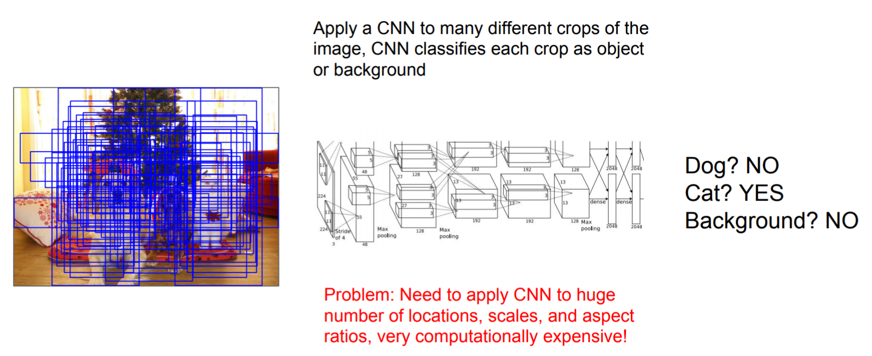
Using sliding windows for object detection as classification

Slide 16
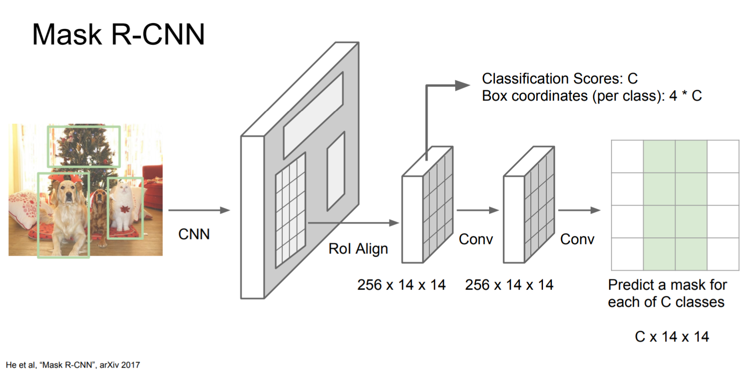
Mask R-CNN

Slide 17
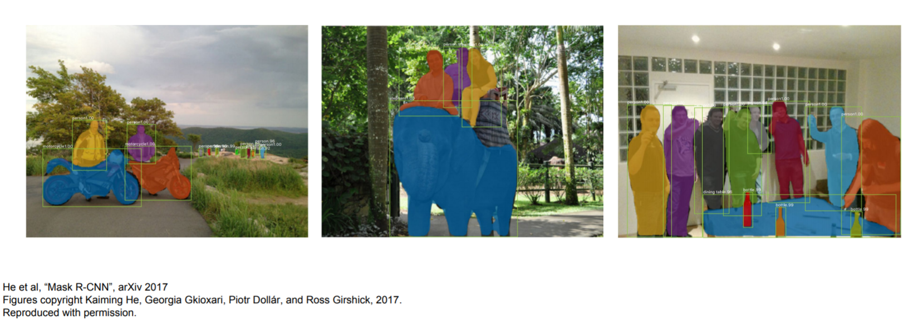
Excellent results

Slide 18
End.

