Slide 1
BizCardX: Extracting Business Card Data with OCR
NAME : SUJITHA S

Slide 2
EXTRACTING BUSINESS CARD INFORMATION
This project is about developing a streamlit application that allows users to upload an image of a business card and extract relevant information from it using easyocr.
the extracted information should include the company name, card holder name, designation, mobile number, email address, website url, area, city, state, and pin code.
the extracted information should then be displayed in the application’s graphical user interface (gui).

Slide 3
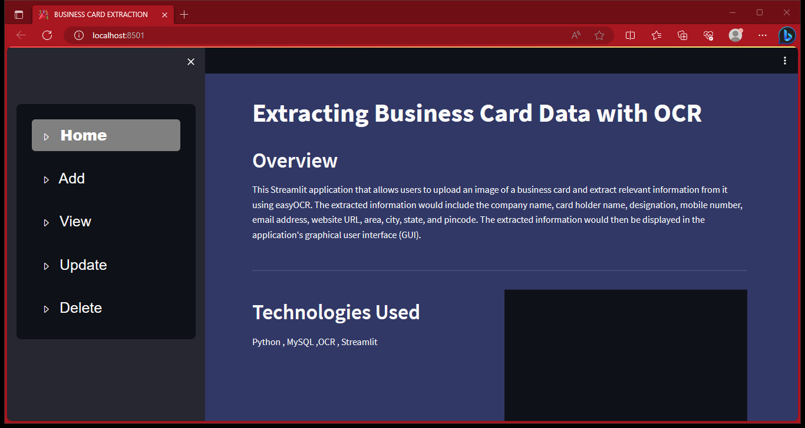
STREAMLIT HOME PAGE

Slide 4
EASYOCR
OCR is formerly known as optical character recognition which is revolutionary for the digital world nowadays.
OCR is actually a complete process under which the images/documents which are present in a digital world are processed and from the text are being processed out as normal editable text.
OCR is a technology that enables you to convert different types of documents, such as scanned paper documents, pdf files, or images captured by a digital camera into editable and searchable data.
EasyOCR is actually a python package

Slide 5
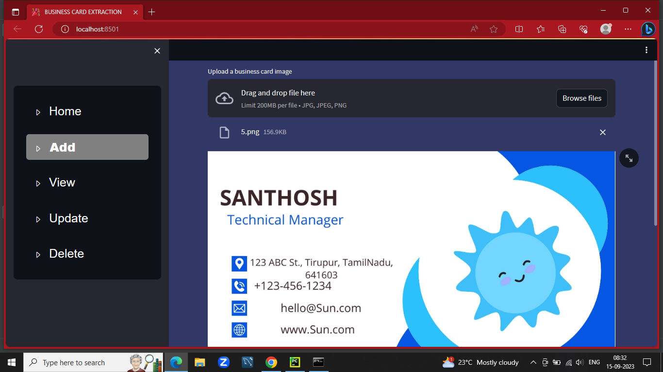
UPLOADING IMAGE

Slide 6
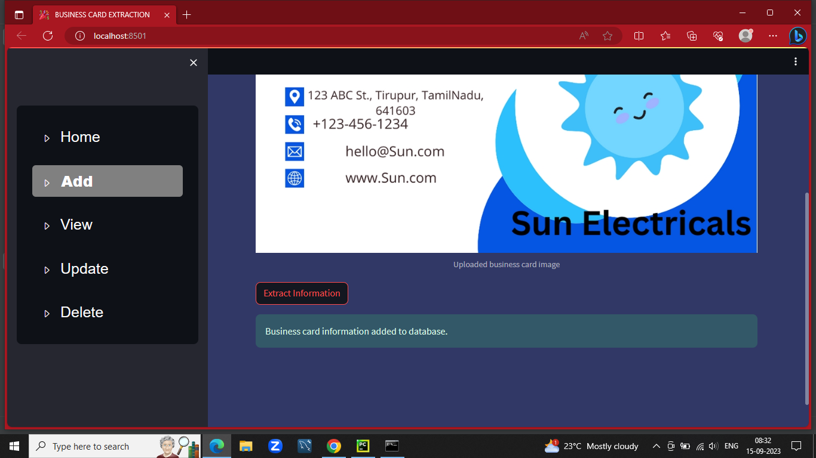
EXTRACTING DETAILS FROM IMAGE

Slide 7
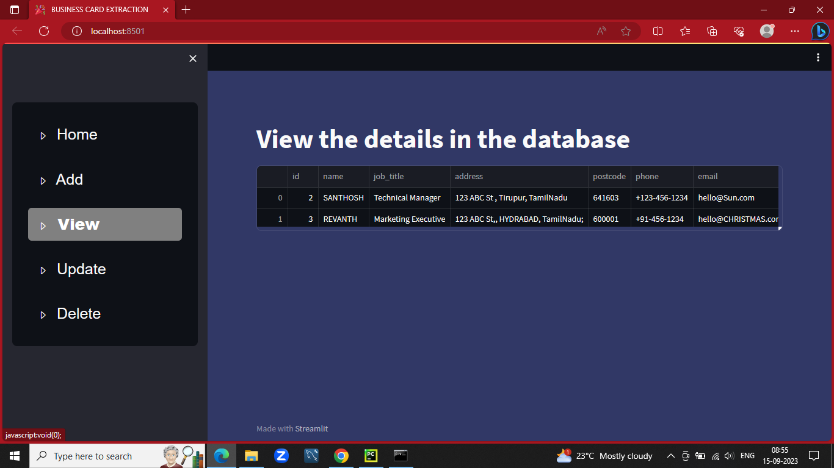
DATABASE VIEW

Slide 8
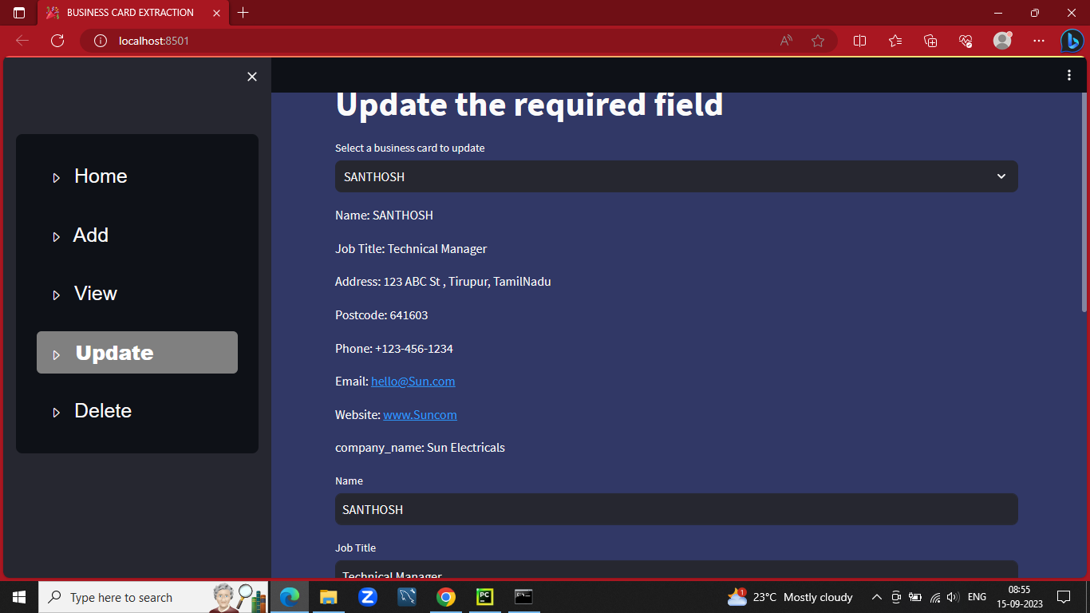
UPDATING

Slide 9
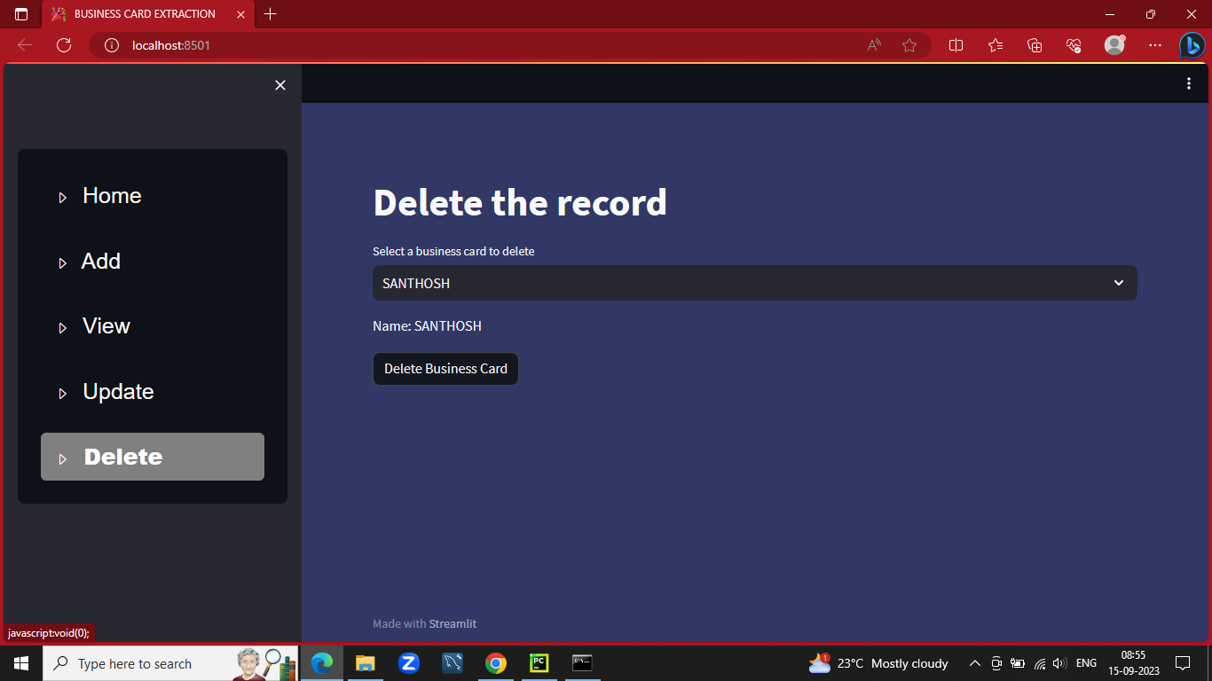
DELETE THE RECORD

Slide 10
THANK YOU

