Slide 1
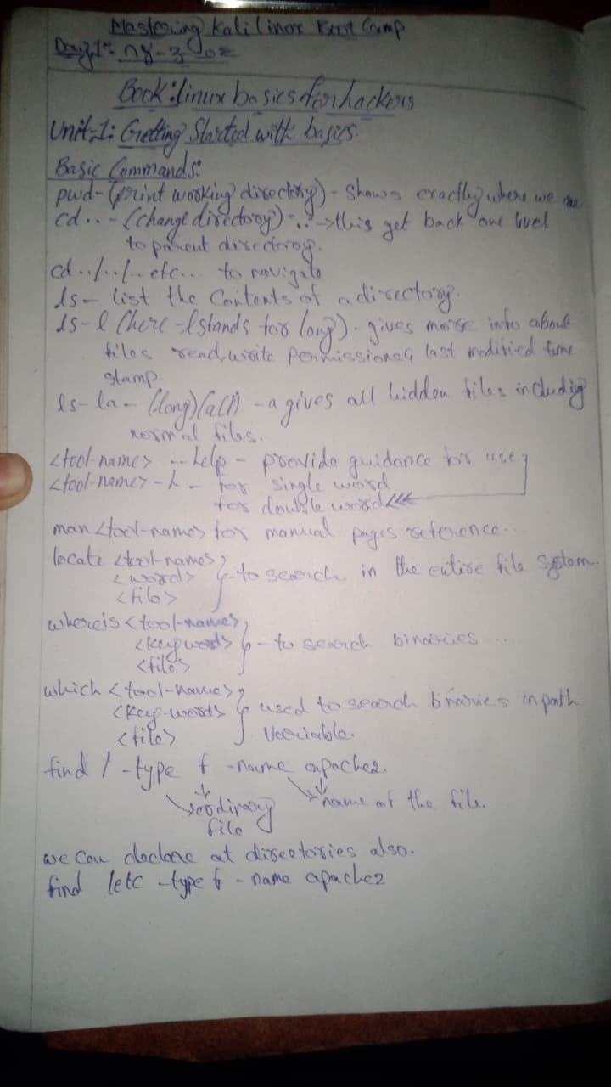
Linux Basics
A beginner-friendly PowerPoint to teach navigation, searching, files, directories, pipes, grep, cp, mv, rm, and permissions.
From handwritten notes → clean teaching slides
$ whoami
student
$ pwd
/home/student
$ echo "Let's master Linux step by step"
Made for explaining to absolute beginners
Linux Basics Bootcamp
Beginner friendly command-line guide

Slide 2
What you will master
The deck follows the same flow as your notes: navigate → search → filter → create → manage.
1
Understand the Linux terminal and filesystem
2
Move around using pwd, cd and ls
3
Use help, man, which, whereis and locate
4
Search deeply using find and filter using grep
5
Create, copy, move, rename and remove files/directories
6
Read permissions and avoid dangerous beginner mistakes
# By the end, you should be able to explain commands like:
find /home -name "*.txt" -type f -mtime -7
ls -l | grep "apache"
cp -rp project backup/
Linux Basics Bootcamp
Beginner friendly command-line guide

Slide 3
Terminal mental model
A terminal is a text interface where you send commands to the shell.
You
Shell
Kernel
Output
type commands
interprets them
talks to hardware
results/errors
The shell reads your command line and launches programs.
Every command has: command name + options/flags + arguments.
Most commands print output, errors, or silently finish successfully.
$ command -option target
$ ls -l /home
│ │ └── argument/path
│ └────── option/flag
└─────────── command
Linux Basics Bootcamp
Beginner friendly command-line guide

Slide 4
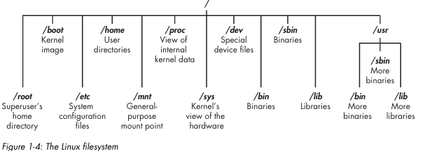
Linux filesystem hierarchy
Linux stores everything under one root directory: /.
/ is the top of the filesystem tree.
/home stores user directories; /etc stores configuration files; /bin and /usr/bin store commands.
/var stores changing data like logs; /dev represents devices; /proc shows process/kernel info.
$ cd /
$ ls
bin boot dev etc home lib proc root sbin tmp usr var
Linux Basics Bootcamp
Beginner friendly command-line guide

Slide 5
Navigation commands: pwd, cd, ls
These three commands answer: Where am I? Where do I go? What is here?
pwd
cd
ls
Print Working Directory
Change Directory
List Directory
Shows your current folder path.
Moves from one directory to another.
Lists files and folders in a location.
$ pwd
/home/student
$ cd /var/log
$ cd ..
$ cd ~
$ ls
$ ls -l
$ ls -la
Beginner rule: always run pwd when you are confused.
Linux Basics Bootcamp
Beginner friendly command-line guide

Slide 6
Understanding paths
A path is the address of a file or directory.
Absolute path
Relative path
Starts from / root.
Works from anywhere.
Example: /home/student/docs/report.txt
Starts from current directory.
Shorter and faster to type.
Uses . for current and .. for parent directory.
$ cd /home/student/projects
$ pwd
/home/student/projects
$ cd docs
$ cd ..
$ cd ../Downloads
~ means your home directory
. means current directory
.. means parent directory
Linux Basics Bootcamp
Beginner friendly command-line guide

Slide 7
Reading ls -l output
Long listing shows type, permissions, owner, group, size and modified time.
$ ls -l
-rw-r--r-- 1 sujith students 1200 Jun 11 notes.txt
drwxr-xr-x 2 sujith students 4096 Jun 11 projects
file type
permissions
owner
group
size
modified time
First character: - means regular file, d means directory, l means link.
r = read, w = write, x = execute.
ls -a shows hidden files; ls -la combines hidden files with long listing.
$ ls -a # include hidden files
$ ls -lh # human readable sizes
$ ls -ltr # sort by time, reverse order
Linux Basics Bootcamp
Beginner friendly command-line guide

Slide 8
Getting help inside Linux
Good Linux users do not memorize everything; they know how to ask the system.
<tool> --help
Quick usage guidance for a command
ls --help
man <tool>
Full manual page reference
man find
which <tool>
Shows command path used by shell
which ls
whereis <tool>
Shows binary, source and manual locations
whereis bash
$ man ls
# press q to quit, /word to search inside a manual page
Linux Basics Bootcamp
Beginner friendly command-line guide

Slide 9
Search tools: what to use when?
Each search command has a different purpose.
Command
Best for
How it works
which
Exact executable in PATH
Checks shell command locations only
whereis
Binary + source + man page
Searches standard system locations
locate
Fast filename search
Uses a prebuilt database
find
Live and powerful search
Scans directories in real time
Rule: use locate for speed, find for accuracy and conditions
$ locate report.pdf
$ find /home -name "report.pdf"
Linux Basics Bootcamp
Beginner friendly command-line guide

Slide 10
find command syntax decoded
find searches files in live time using path + tests + actions.
find [starting-path] [expression]
find /home -name "*.txt" -type f -mtime -7
starting path
test
test
test
/home
-name "*.txt"
-type f
-mtime -7
Where search begins
What to match
Only regular files
Modified in last 7 days
Expressions can combine many tests: name, type, size, time, owner, group, permissions, empty.
Actions run on matches: -print, -delete, -exec command {} ;
Always test with -print before using -delete.
Linux Basics Bootcamp
Beginner friendly command-line guide

Slide 11
find examples: name, type, size, time
These are the most useful beginner search patterns.
By name
find /home -name "file.txt"
Case-sensitive exact filename match.
Case-insensitive
find /home -iname "file.txt"
Matches File.txt, FILE.TXT, file.txt.
Files only
find /home -type f
f means regular file. Use d for directories.
By size
find /home -size +100M
+ greater than, - smaller than. Units: c, k, M, G.
By modified time
find /home -mtime -7
Modified within the last 7 days.
$ find /home -type d -name "apache2"
$ find /home -size -500k
Linux Basics Bootcamp
Beginner friendly command-line guide

Slide 12
find: permissions, owners and actions
Search by metadata or run commands on matching files safely.
find /home -perm 755
Files/directories with permission 755
find /home -user sujith
Owned by user sujith
find /home -group students
Owned by group students
find /tmp -empty
Empty files or directories
find /home -maxdepth 2
Limit search to 2 directory levels
Action example
find /home -name "*.txt" -exec cat {} \;
find /tmp -name "*.tmp" -delete
Safety rule: preview matches before delete
Linux Basics Bootcamp
Beginner friendly command-line guide

Slide 13
locate: fast filename search
locate is faster than find because it searches a database, not the live filesystem.
locate
find
Very fast
Live/deeper search
locate file.txt searches filenames quickly.
locate -c file.txt counts matches.
locate -n 10 file.txt limits results.
locate -b "\file.txt" matches only the basename.
sudo updatedb updates the locate database.
$ locate notes.txt
$ locate -c notes.txt
$ locate -n 10 notes.txt
$ sudo updatedb
Linux Basics Bootcamp
Beginner friendly command-line guide

Slide 14
Pipes and grep: filter command output
A pipe sends the output of one command into the input of another command.
Command 1
|
Command 2
produces output
pipe connects
filters/uses it
$ ls -l | grep ".txt"
$ ps aux | grep "apache"
$ cat access.log | grep "404"
grep scans text and prints only matching lines.
Use quotes around patterns with special characters or spaces.
grep is useful for logs, process lists, and command output.
Linux Basics Bootcamp
Beginner friendly command-line guide

Slide 15
Creating files
Linux gives you many ways to create or write text files.
touch
echo >
cat >
Create empty file
Create/overwrite with one line
Type content manually
touch notes.txt
echo "hello" > notes.txt
cat > notes.txt
tee
heredoc
editor
Write and display output
Write multi-line content
Create/edit interactively
echo "hello" | tee notes.txt
cat > notes.txt << EOF
nano notes.txt
Remember: > overwrites, >> appends
Linux Basics Bootcamp
Beginner friendly command-line guide

Slide 16
Creating directories with mkdir
mkdir creates folders. Options help with nested folders, permissions and confirmation output.
mkdir [options] directory-name
mkdir mydir
Create one directory
mkdir dir1 dir2 dir3
Create multiple directories
mkdir -p project/{src,bin,docs,tests}
Create nested project structure
mkdir -m 700 private_dir
Set permissions while creating
mkdir -v mydir
Show confirmation message
Result of mkdir -p project/{src,bin,docs,tests}: project/ contains src, bin, docs, tests
Linux Basics Bootcamp
Beginner friendly command-line guide

Slide 17
Removing files and directories safely
Deleting is powerful. Use the correct command and preview first.
rmdir
rm
Removes empty directories only.
Safer for beginners.
Useful with -p to remove empty parents.
Removes files or directories.
-r removes directories recursively.
-i asks before removing.
-f forces deletion.
rmdir mydir
rmdir -p a/b/c
rm file.txt
rm -ri mydir
rm -rf mydir
Never run rm -rf / or commands you do not understand
Linux Basics Bootcamp
Beginner friendly command-line guide

Slide 18
Moving and renaming with mv
mv changes a file/directory location or name.
mv [options] source destination
mv dir1 dir2
Rename dir1 to dir2 if dir2 does not exist
mv dir1 /path/to/dir2
Move dir1 into an existing location
mv dir1 dir2/
Move dir1 inside dir2
mv -i file.txt old.txt
Prompt before overwrite
mv -n file.txt old.txt
Do not overwrite destination
mv -v dir1 dir2
Show what is being moved
mv dir1 dir2 dir3 /target/
Move multiple sources into target
mv can overwrite. Use -i when practicing.
Linux Basics Bootcamp
Beginner friendly command-line guide

Slide 19
Copying files and directories with cp
cp duplicates files or folders from source to destination.
cp [options] source destination
cp [options] source1 source2 source3 directory/
cp file1.txt file2.txt
Copy a file with a new name
cp a.txt /home/Downloads/practice/
Copy a file into another folder
cp a.txt b.txt /home/Documents/
Copy multiple files into a folder
cp -r newdir backupdir
Copy a directory recursively
cp -u source.txt dest.txt
Copy only if source is newer
cp -T source.txt dest.txt
Treat destination as a normal file, not a directory
Linux Basics Bootcamp
Beginner friendly command-line guide

Slide 20
Important cp flags
These flags protect files, preserve metadata, and control links/backups.
-r / -R
recursive: copy folders and contents
-i
interactive: ask before overwrite
-f
force: replace files
-v
verbose: show what is copied
-u
update: copy only newer files
-a
archive: preserve attributes, useful for backups
-p
preserve timestamps/permissions/ownership if possible
-n
no-clobber: do not overwrite existing files
-l
hard link instead of copying
-s
symbolic link / shortcut-like link
--parents
keep folder structure
--backup
make backup before overwriting
cp -rp /home/sujith/docs backup/
# Recursive + preserve permissions/timestamps while copying
Linux Basics Bootcamp
Beginner friendly command-line guide

Slide 21
Permissions basics: rwx and 755
Permissions decide who can read, write and execute a file or directory.
User
Group
Others
7 = rwx
5 = r-x
5 = r-x
-rwxr-xr-x means 755
read = 4, write = 2, execute = 1
7 = 4+2+1, 5 = 4+0+1
For files: x means executable program/script.
For directories: x means you can enter/traverse the directory.
Use find /home -perm 755 to search by permission.
Linux Basics Bootcamp
Beginner friendly command-line guide

Slide 22
Practice lab 1: navigate and search
Use these tasks as live demonstrations for beginners.
1
Show current location and move to /home
$ pwd
$ cd /home
$ ls -la
$ find /home -name "*.txt" -type f
$ find /home -type d -name "apache2"
$ ps aux | grep "apache"
2
List files in long format and include hidden files
3
Find all .txt files under home
4
Find directories named apache2
5
Search running processes containing apache
Ask learners to predict output before running each command
Linux Basics Bootcamp
Beginner friendly command-line guide

Slide 23
Practice lab 2: create, copy, move, remove
A safe mini-project that uses most commands from the notes.
# Create a practice workspace
mkdir -p linux_lab/{notes,backup,empty}
cd linux_lab
touch notes/one.txt notes/two.txt
echo "hello linux" > notes/one.txt
cp -r notes backup/
mv notes/two.txt notes/renamed.txt
find . -name "*.txt" -print
rmdir empty
rm -ri backup
mkdir -p creates nested directories safely.
touch and echo create files.
cp -r copies directories.
mv renames/moves files.
find verifies your work.
rm -ri removes interactively.
Teaching tip
After each command, run ls or find to show what changed.
Linux Basics Bootcamp
Beginner friendly command-line guide

Slide 24
Common beginner mistakes
Knowing mistakes early makes learners confident and safe.
Running commands in the wrong directory
Use pwd before copy/delete operations.
Confusing relative and absolute paths
Absolute starts with /; relative starts from current folder.
Using rm -rf without checking matches
Use find ... -print first and rm -ri while practicing.
Forgetting quotes around patterns
Use "*.txt" so the shell does not expand too early.
Thinking locate is always up-to-date
Run sudo updatedb or use find for live results.
# Safe pattern
find /tmp -name "*.tmp" -print
# Only after verifying matches:
find /tmp -name "*.tmp" -delete
Linux Basics Bootcamp
Beginner friendly command-line guide

Slide 25
Beginner cheat sheet
Keep this slide at the end as a quick reference.
Navigate
Help
Search
pwd
cd /path
cd ..
ls -la
cmd --help
man cmd
which cmd
whereis cmd
find /path -name "*.txt"
locate file
grep "word" file
Create
Manage
Inspect
touch file
echo "hi" > file
mkdir -p a/b
cp -r src dst
mv old new
rm -ri folder
cat file
ls -l
ps aux | grep name
Linux Basics Bootcamp
Beginner friendly command-line guide

Slide 26
Which command should I use?
A simple decision guide for beginners.
Need to know where you are?
Need to move folders?
Need to see contents?
pwd
cd
ls
Need to find by name/size/time?
Need fast filename search?
Need to filter output text?
find
locate
grep + pipe
Need to duplicate?
Need to rename/move?
Need to delete?
cp
mv
rm / rmdir
Linux Basics Bootcamp
Beginner friendly command-line guide

Slide 27
Final recap
Linux becomes easy when you think in workflows, not isolated commands.
Navigate
pwd → cd → ls
Search
locate for speed, find for conditions
Filter
pipe output into grep
Create
touch, echo, cat, tee, mkdir
Manage
cp, mv, rmdir, rm carefully
Verify
always check with pwd, ls, find -print
Your next step:
1. Open a terminal
2. Create a linux_lab folder
3. Practice every command in this PPT
4. Explain each command aloud like you are teaching someone
Linux Basics Bootcamp
Beginner friendly command-line guide

