Slide 1
Linux Networking Study Deck
01
Analyzing & Managing Networks
LAB COMMANDS
$ ifconfig -a
$ iwconfig wlan0
$ dig google.com
$ sudo nano /etc/resolv.conf
From your Unit‑3 notes: ifconfig, iwconfig, IP addressing, DNS, dig, and practical troubleshooting.
Beginner-friendly
Cybersecurity-ready
Command-focused
Goal: understand what the system is telling you before changing anything.

Slide 2
Unit 3 · Analyzing & Managing Networks
02
Learning outcomes
By the end, you can inspect, configure, and troubleshoot Linux network settings with confidence.
Read interfaces
Manage settings
Analyze wireless
Identify active/down interfaces, IPs, MAC addresses, MTU, packet counters, and flags.
Bring interfaces up/down, assign IP/netmask/broadcast, request DHCP, and adjust MTU.
Understand SSID/ESSID, mode, frequency, access point, bit rate, tx power, encryption, and signal strength.
Investigate DNS
Troubleshoot like a pro
Use dig to query records and change DNS/name mapping through resolv.conf and hosts.
Move from interface state → addressing → gateway → DNS → application-level checks.

Slide 3
Unit 3 · Analyzing & Managing Networks
03
Network admin workflow map
A strong hacker/admin follows a repeatable order instead of guessing randomly.
01
02
03
04
05
Identify
Inspect
Change
Verify
Document
Find interfaces and their names.
→
Check IP, MAC, flags, counters, and DNS.
→
Apply IP, MTU, DNS, wireless, or mode changes.
→
Ping, dig, scan, or check counters again.
→
Record commands and final working state.
Golden rule: first observe, then modify. Many network problems are solved by comparing “before” and “after” output.

Slide 4
Core concept
04
What is a network interface?
An interface is the operating system’s connection point to a network.
Physical interface
Virtual interface
Loopback interface
Real hardware: Ethernet card, Wi‑Fi adapter, USB network adapter.
Created by software: Docker networks, VPN tunnels, virtual machines, bridges.
Internal system interface used by the machine to talk to itself: 127.0.0.1.
START HERE
$ ifconfig
$ ifconfig -a
$ ip link show

Slide 5
ifconfig
05
Analyzing networks with ifconfig
ifconfig means interface configuration: view, enable, disable, and configure interfaces.
Syntax
Meaning
ifconfig
Shows active interfaces only
ifconfig -a
Shows all interfaces, including down/disabled ones
ifconfig eth0
Shows details for one interface
ifconfig eth0 [options]
Changes settings on a selected interface
ifconfig eth0 192.168.1.50 netmask 255.255.255.0
Assigns IPv4 + netmask
Modern Linux often prefers the `ip` command, but ifconfig is still heavily used in older books, Kali tutorials, and many labs.

Slide 6
Interface names
06
Understanding network interface names
Names tell you what kind of connection you are inspecting.
Interface
Meaning / common use
lo
Loopback: your own system, commonly 127.0.0.1
eth0
First Ethernet interface; classic naming style
wlan0
Wireless interface
enp0s3
Ethernet interface; newer predictable Linux naming
ens33
Common VMware Ethernet interface
docker0
Docker virtual bridge network
tun0
VPN tunnel interface
virbr0
Virtual bridge used by virtualization tools

Slide 7
Interface flags
07
Flags show interface state and capabilities
Flags are quick status labels in ifconfig output.
UP
DOWN
RUNNING
BROADCAST
Interface is enabled
Interface is disabled
Active link/connection exists
Supports broadcast communication
LOOPBACK
MULTICAST
PROMISC
POINTOPOINT
Internal system interface
Supports multicast communication
Promiscuous mode enabled
Point-to-point link, common in VPN/PPP
Tip: PROMISC is important in packet capture labs because the adapter accepts packets not directly addressed to its own MAC.

Slide 8
MTU
08
MTU: Maximum Transmission Unit
MTU is the largest packet/frame payload an interface can send without fragmentation.
Standard Ethernet
Jumbo frames
VPN / tunnel networks
MTU 1500
Most common default for LANs and home networks.
MTU 9000
Used in controlled high-performance networks where all devices support it.
1400 or lower
Extra tunnel headers reduce available payload size.
CHECK & CHANGE
$ ifconfig eth0 | grep mtu
$ sudo ifconfig eth0 mtu 1400
Why it matters: MTU mismatch can cause slow loading, broken VPNs, and packet fragmentation problems.

Slide 9
IPv4
09
IPv4 address + netmask
The IP identifies a host; the netmask decides which part is the network.
EXAMPLE
Network portion
IP address : 192.168.1.25
Netmask : 255.255.255.0
Network : 192.168.1.0/24
Host range : 192.168.1.1 – 192.168.1.254
For 192.168.1.25/24, the 192.168.1 part identifies the local network.
Host portion
The final number, 25, identifies a specific device inside that network.
169.254.x.x warning
Usually means DHCP failed and Linux assigned a link-local address automatically.

Slide 10
Addresses
10
Broadcast address and MAC address
Both appear in interface output, but they solve different problems.
Broadcast address
MAC address
Used to send a message to all devices in the local subnet. Example: 192.168.1.255 for 192.168.1.0/24.
Physical hardware address of a network interface. Example format: 08:00:27:ab:cd:ef.
Address type
Layer
Main use
IPv4
Network layer
Reach a host across networks
MAC
Data link layer
Identify a device on the local network
Broadcast
Local network
Reach every host in the subnet

Slide 11
Counters
11
RX/TX packets, errors, and dropped packets
Interface counters expose traffic and possible link problems.
RX packets
TX packets
Errors/dropped
Received packets. If this increases, your system is receiving network traffic.
Transmitted packets. If this increases, your system is sending network traffic.
Can indicate bad cable, congestion, driver issues, MTU mismatch, or hardware problems.
HEALTHY EXAMPLE
RX packets 10500 errors 0 dropped 0
TX packets 8630 errors 0 dropped 0
• If RX increases: receiving traffic
• If TX increases: sending traffic
• If errors/dropped increase continuously: investigate link quality

Slide 12
ifconfig commands
12
Essential ifconfig inspection commands
Use these before changing network settings.
READ-ONLY COMMANDS
$ ifconfig # active interfaces
$ ifconfig -a # all interfaces, including down
$ ifconfig eth0 # one interface
$ ifconfig -s # short summary view
$ ifconfig -v # verbose info, useful for errors
Beginner habit
Save output before changing anything:
ifconfig -a > before-network.txt

Slide 13
ifconfig changes
13
Enable, disable, and assign IP addresses
These commands modify interface state and addressing.
INTERFACE CHANGES
$ sudo ifconfig eth0 up
$ sudo ifconfig eth0 down
$ sudo ifconfig eth0 192.168.1.50
$ sudo ifconfig eth0 192.168.1.50 netmask 255.255.255.0 broadcast 192.168.1.255
Remember
Temporary changes may reset after reboot or NetworkManager restart. For permanent setup, use your distro’s network configuration method.

Slide 14
DHCP
14
Assigning IP from DHCP
DHCP automatically gives your system an IP address, gateway, DNS, and other network details.
DHCP + VERIFY
01
02
03
$ sudo dhclient eth0
$ ifconfig eth0
$ ping -c 4 192.168.1.1
$ ping -c 4 8.8.8.8
$ dig google.com
Request
Receive
Test
dhclient asks the DHCP server for a lease.
→
System receives IP, netmask, gateway, DNS.
→
Ping gateway, internet IP, then DNS name.
If you get 169.254.x.x, DHCP probably failed. Check cable/Wi‑Fi, DHCP server, adapter state, and logs.

Slide 15
Advanced interface options
15
ARP, promiscuous mode, multicast, and MAC changes
Useful in labs, packet capture, virtualization, and troubleshooting.
Action
Command example
Use
ARP on/off
sudo ifconfig eth0 arp / -arp
Maps IP addresses to MAC addresses
Promiscuous
sudo ifconfig eth0 promisc / -promisc
Receive all visible frames for packet capture
Multicast
sudo ifconfig eth0 multicast / -multicast
Control multicast support
MAC change
ifconfig eth0 hw ether 00:11:22:33:44:55
Spoof MAC in an authorized lab
TX queue
sudo ifconfig eth0 txqueuelen 1000
Set transmit queue length
Ethics note: only change MAC/promiscuous settings on your own systems or authorized lab networks.

Slide 16
Wireless
16
Checking wireless devices with iwconfig
iwconfig is used to view and configure wireless network interfaces.
What it shows
Modern note
SSID/ESSID, mode, frequency/channel, access point, bit rate, tx power, encryption, power management, and signal strength.
Many modern Linux systems prefer `iw`, but `iwconfig` is still common in beginner networking and Kali learning materials.
WIRELESS INSPECTION
$ iwconfig
$ iwconfig wlan0
$ ip link show

Slide 17
Wireless fields
17
Important iwconfig output fields
These values explain how the Wi‑Fi connection behaves.
Field
Meaning
wlan0
Wireless network interface name
IEEE 802.11
Wi‑Fi standard/family
ESSID
Wi‑Fi network name
Mode
Managed, Monitor, Ad‑Hoc, Master
Frequency / Channel
2.4 GHz, 5 GHz, 6 GHz or channel number
Access Point
MAC address of connected router/AP
Bit Rate
Current wireless link speed
Tx-Power
Wireless transmit power
Encryption key
Whether Wi‑Fi encryption is enabled
Power Management
Battery-saving feature; can sometimes slow Wi‑Fi

Slide 18
Wireless commands
18
Practical iwconfig commands
Commands from your notes, organized for real lab use.
SET WIRELESS VALUES
MONITOR
$ sudo iwconfig wlan0 mode managed
$ sudo iwconfig wlan0 essid "Home_WiFi"
$ sudo iwconfig wlan0 channel 6
$ sudo iwconfig wlan0 freq 2.437G
$ sudo iwconfig wlan0 rate 54M
$ sudo iwconfig wlan0 txpower 20
$ sudo iwconfig wlan0 power off
$ iwconfig wlan0 | grep -i signal
$ watch -n 1 iwconfig wlan0
$ sudo iwlist wlan0 scan
$ sudo iwlist wlan0 scan | grep ESSID
Tip: signal strength is often shown in negative dBm. Closer to 0 is better; for example, −35 dBm is stronger than −75 dBm.

Slide 19
DNS
19
Manipulating the Domain Name System
DNS translates human-readable names into machine-readable IP addresses.
01
02
03
04
You type
DNS resolves
System connects
Admin learns
example.com
→
Finds the matching IP address.
→
Browser/tool connects to that IP.
→
Records reveal mail servers, name servers, aliases, and structure.
Why security learners care
DNS can expose subdomains, mail infrastructure, cloud services, and misconfigurations during authorized reconnaissance.

Slide 20
dig
20
Examining DNS with dig
dig is a command-line DNS query tool used to ask DNS servers for records.
BASIC SYNTAX
$ dig [@dns-server] domain-name [record-type] [options]
$ dig example.com
$ dig google.com A
$ dig google.com AAAA
$ dig google.com MX
$ dig google.com NS
$ dig @8.8.8.8 example.com
Question to ask
What IP address does this domain point to? Which mail server handles email? Which DNS server is authoritative?

Slide 21
dig output
21
dig output sections and status values
Read the output like a report: header → flags → question → answer → server.
Output part
Meaning
Header
Operation, query ID, status, and warning info
Status: NOERROR
Query worked
Status: NXDOMAIN
Domain does not exist
Status: SERVFAIL
DNS server failed
Status: REFUSED
DNS server refused the query
Flags
qr, rd, ra, aa show query/recursion/authority behavior
Question
What you asked
Answer
Returned DNS answer
Authority
Server responsible for the domain
Additional
Extra useful IP addresses
Server
Which DNS server answered

Slide 22
DNS records
22
Common DNS record types
Different DNS records answer different questions.
Record
Purpose
Example question
A
Maps domain to IPv4 address
What IPv4 does google.com use?
AAAA
Maps domain to IPv6 address
What IPv6 does google.com use?
CNAME
Alias to another domain
Is this hostname an alias?
MX
Mail server record
Where should email be delivered?
NS
Name server record
Who manages DNS for this domain?
TXT
Text records
SPF, verification, policies
SOA
Start of authority
Primary DNS authority and zone info

Slide 23
DNS configuration
23
Changing your DNS server
On Linux, /etc/resolv.conf can define which DNS server your system uses.
/ETC/RESOLV.CONF
$ cat /etc/resolv.conf
# edit manually
$ sudo nano /etc/resolv.conf
nameserver 8.8.8.8
# or write carefully using sudo shell
$ sudo sh -c 'echo "nameserver 8.8.8.8" > /etc/resolv.conf'
Important caution
Some systems regenerate /etc/resolv.conf using NetworkManager, systemd-resolved, or DHCP. If it resets, configure DNS through the active network manager.
Use case
If websites load slowly or DNS fails, try another trusted resolver and test again with dig.

Slide 24
Name mapping
24
Mapping IP addresses with /etc/hosts
Before DNS, Linux checks local name mappings in /etc/hosts.
/ETC/HOSTS
What mapping means
$ sudo nano /etc/hosts
127.0.0.1 localhost
192.168.1.25 target
$ ping target
Mapping means giving a readable hostname to an IP address. Example: `target` becomes easier to remember than 192.168.1.25.
Lab example
Instead of typing http://127.0.0.1 you can map a local test name such as mybox.lab or app.local.
This is local to your machine. It does not change public DNS for other people.

Slide 25
Troubleshooting
25
Network troubleshooting playbook
Use this order to find the failing layer quickly.
01
02
03
04
05
Link
Address
Gateway
Internet
DNS
Is interface UP/RUNNING? Cable/Wi‑Fi connected?
→
Does it have correct IP/netmask? Not 169.254.x.x?
→
Can you ping router/gateway?
→
Can you ping a public IP?
→
Can dig resolve a domain name?
MINIMUM TOOLKIT
$ ifconfig -a
$ sudo dhclient eth0
$ ping -c 4 192.168.1.1
$ ping -c 4 8.8.8.8
$ dig google.com

Slide 26
Cheat sheet
26
One-slide command cheat sheet
Keep this slide near you during labs.
Task
Command
Show active interfaces
ifconfig
Show all interfaces
ifconfig -a
Show wireless
iwconfig / iwconfig wlan0
Bring interface up/down
sudo ifconfig eth0 up / down
Request DHCP
sudo dhclient eth0
Set IP/netmask/broadcast
sudo ifconfig eth0 192.168.1.50 netmask 255.255.255.0 broadcast 192.168.1.255
Set MTU
sudo ifconfig eth0 mtu 1400
DNS query
dig google.com A
DNS record query
dig google.com MX / NS / AAAA
Edit DNS server
sudo nano /etc/resolv.conf
Map hostname
sudo nano /etc/hosts

Slide 27
Practice
27
Practice lab exercises
Try these in Kali/Ubuntu on your own network or a safe virtual lab.
Lab 1 — Interface audit
Lab 2 — DHCP recovery
Run ifconfig -a and list every interface, state, IP, MAC, MTU, and flags.
Disable/enable an interface, request DHCP, then verify with ping and dig.
Lab 3 — Wireless observation
Lab 4 — DNS investigation
Use iwconfig and iwlist scan to identify ESSID, signal strength, channel, and AP MAC.
Use dig A, AAAA, MX, NS, and @8.8.8.8 queries for a domain and compare outputs.
Write your commands + outputs in a lab notebook. That habit becomes your future troubleshooting evidence.

Slide 28
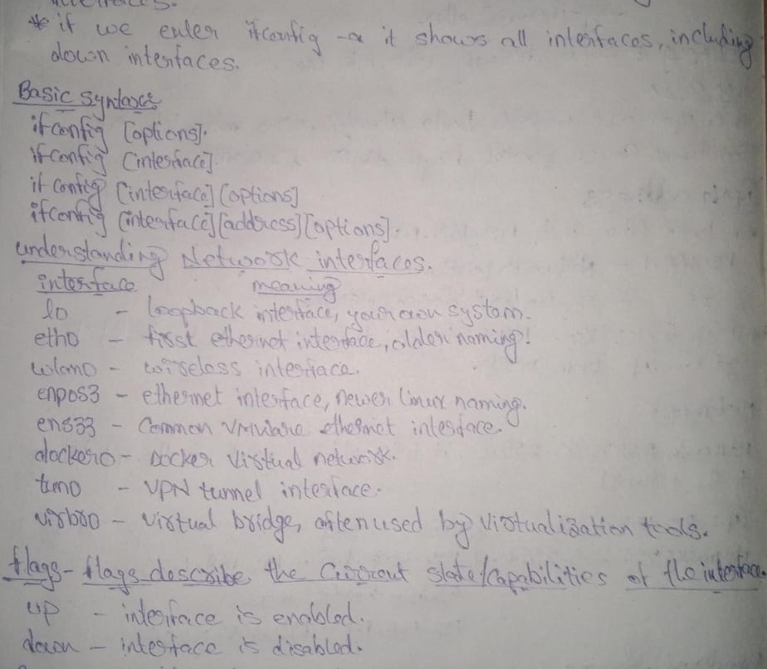
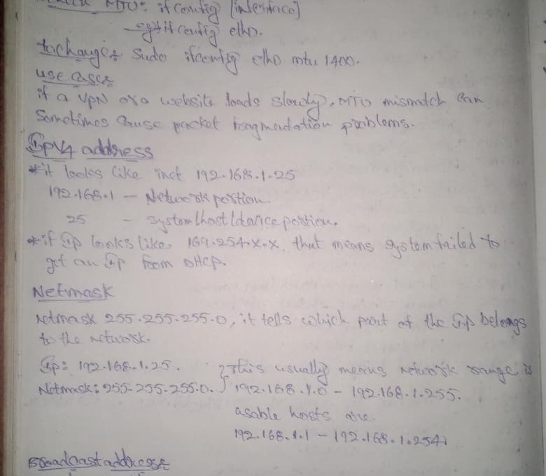



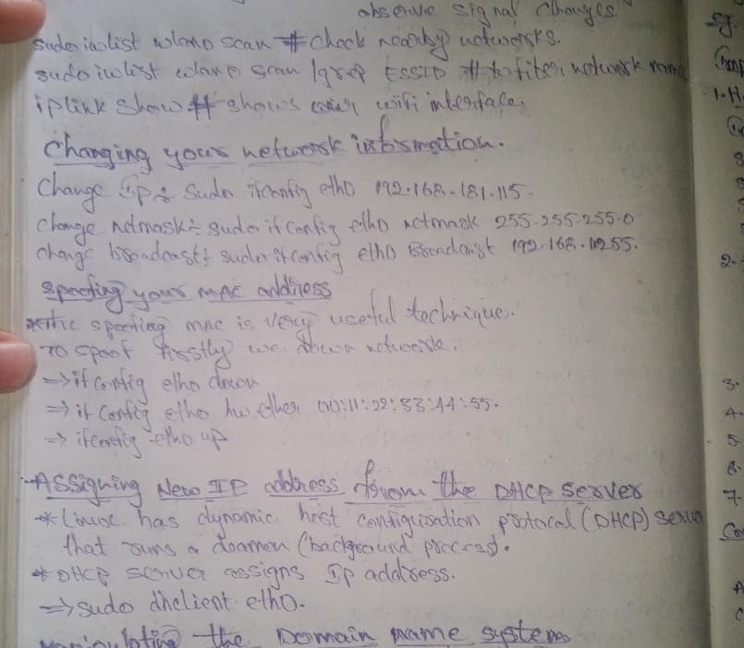


Appendix
28
Original study notes reference
Thumbnails of the handwritten pages used to build this deck.
Page 1
Page 2
Page 3
Page 4
Page 5
Page 6
Page 7
Page 8

