Slide 1

Python + SQL
SQL
Bryan Cafferky
https://github.com/bcafferky/shared

Slide 2


Python SQL
SQL
Bryan Cafferky
https://github.com/bcafferky/shared
https://docs.microsoft.com/en-us/learn/

Slide 3

Python SQL
SQL
Bryan Cafferky

Slide 4

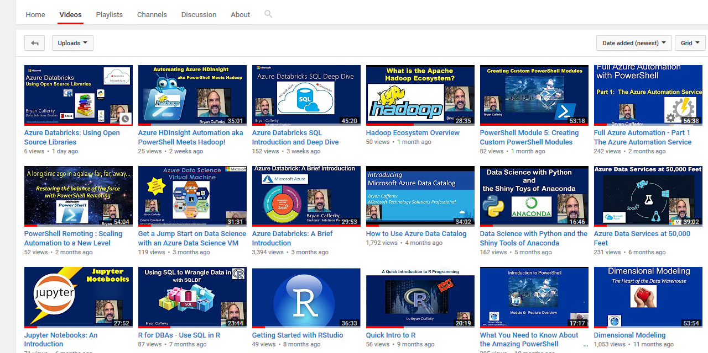
Subscribe to my YouTube Channel
https://www.youtube.com/c/BryanCafferky

Slide 5
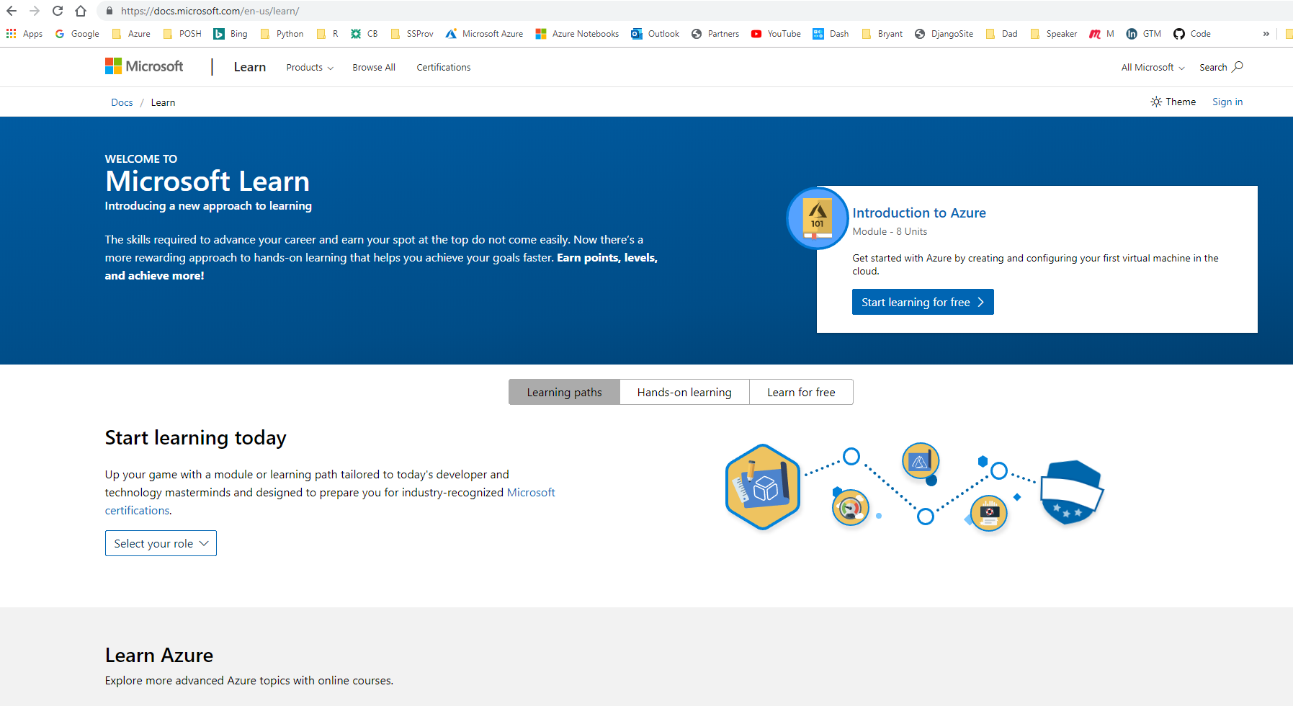
The Cool Way to Learn
https://docs.microsoft.com/en-us/learn/

Slide 6

Important Information Follows

Slide 7


Presentation Goals
Pandas and SQL
Why SQL in Python?
The Easiest Way to SQL
More Robust SQL
Accessing SQL Databases
Wrapping Up
SQL
https://www.clipartmax.com/download/m2i8K9H7G6b1i8H7_cute-cartoon-panda-cute-panda/

Slide 8
Presentation Goals
Lightning Intro to Python
Why SQL in Python?
The Easiest Way to SQL
More Robust SQL
Accessing SQL Databases
Wrapping Up
SQL
https://www.clipartmax.com/download/m2i8K9H7G6b1i8H7_cute-cartoon-panda-cute-panda/

Slide 9
Python review
Python is a scripting language like many other languages.
Two modes of running Python.
A command prompt REPL (Read, Eval, Print and Loop)
Programs can be developed in a Text editor (IDE) and run
Multiple Paradigms:
Functional
Object Orientated
Procedural

Slide 10

Why is PyPi also called The Cheese Shop?
https://www.123rf.com/photo_9295813_funny-mouse-sitting-on-the-piece-of-cheese.html

Slide 11

Getting Python
Best Method: Install the Anaconda Distribution of Python
https://www.anaconda.com/download/
Install with Miniconda
https://conda.io/miniconda.html
Just Python
https://www.python.org/downloads/

Slide 12
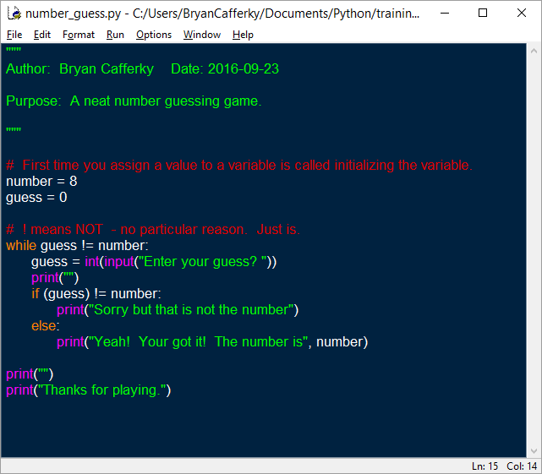
Lightning Introduction
!!! Indentation is Critical !!!
Comment block.
Inline comment.
Declare and initialize variables. Dynamic typing.
Case sensitive!
While loop with code
block.
Readability is Paramount!!!!

Slide 13

What is Pandas?
Open Source Python Package
Rich Features for Data Manipulation Like R Data Frames
Read Data from Many Formats
Fast and Memory Efficient
“The” Standard Python Data Wrangling Library
Built-In SQL Support
https://pandas.pydata.org/pandas-docs/stable/overview.html

Slide 14

Importing Pandas
Standard Module Prefixes
Numpy is for fast array handling
Visualizations Support
https://pandas.pydata.org/pandas-docs/stable/10min.html

Slide 15
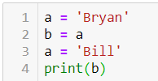
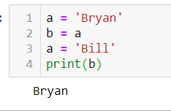
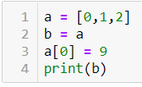
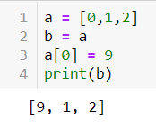
What will be displayed?
Python Challenge

Slide 16

Why SQL?
Jump Start Your Data Query and Wrangling Capability
SQL Just Makes Sense
Scalability and Performance
Why Not?

Slide 17
#1 The Easiest Way to Use SQL - pysqldf
Uses SQLite under the covers
Can treat Pandas data frames as if they were tables
Good for small workloads
SQL is somewhat limited
Jump start data wrangling with Python

Slide 18
Demo Time!
pysqldf

Slide 19

#2 A More Robust Approach -
Automatically Installed with Python. Batteries Included.
Built-in Fully Functional Database.
Good SQL Support.
Great for local application or analysis work.

Slide 20
Demo Time!
SQLite

Slide 21
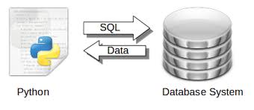
#3 Querying a Full-Scale DBMS
Using ODBC to Connect to Popular Databases
Python Favors PostgreSQL
A Production Grade Solution
Maximum Flexibility
https://pythonspot.com/tag/sql/

Slide 22

What does BFDL stand for?

Slide 23
Demo Time!
#3 Querying a Full-Scale DBMS

Slide 24

The Name That Shall Not Be Spoken
Used by developers for the ORM
Supports three modes (ORM, function API, SQL pass through)
Production scale performance (be wary) ?
Very Popular but too much to cover here

Slide 25

Wrapping Up
Lightning Intro to Python
Why SQL in Python?
The Easiest Way to SQL
More Robust SQL
Accessing SQL Databases
Wrapping Up

