Slide 1
NDVI
Normalized Difference Vegetation Index Abdullah SUKKAR Bora AKSOY

Slide 2
Healthy vegetation can be discriminated from stressed vegetation by using NDVI.
Healthy vegetation reflects strongly in NIR band.
NDVI is a standardized way to measure healthy vegetation. When you have high NDVI values, you have healthier vegetation. When you have low NDVI, you have less or no vegetation.

Slide 3
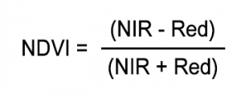
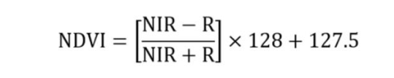
NDVI always ranges from -1 to +1, when you have negative values, it’s highly likely that it’s water. On the other hand, if you have a NDVI value close to +1, there’s a high possibility that it’s dense green leaves. But when NDVI is close to zero, there isn’t green leaves and it could even be an urbanized area.
To scale the result into the range 0 to 255:

Slide 4
in agriculture, farmers use NDVI for precision farming and to measure biomass.
in forestry, foresters use NDVI to quantify forest supply and leaf area index.
NASA states that NDVI is a good indicator of drought. When water limits vegetation growth, it has a lower relative NDVI and density of vegetation.

Slide 5




Threshold Binary:
Threshold Binary, Inverted:
Truncate:
Threshold to Zero:

