Slide 1




Title Page
Idea Title - Smart Support System For Teachers
Domain - Web Development
PS ID - PS1003
Team Name - Dev Dynasty
@HACKIT 2026

Slide 2
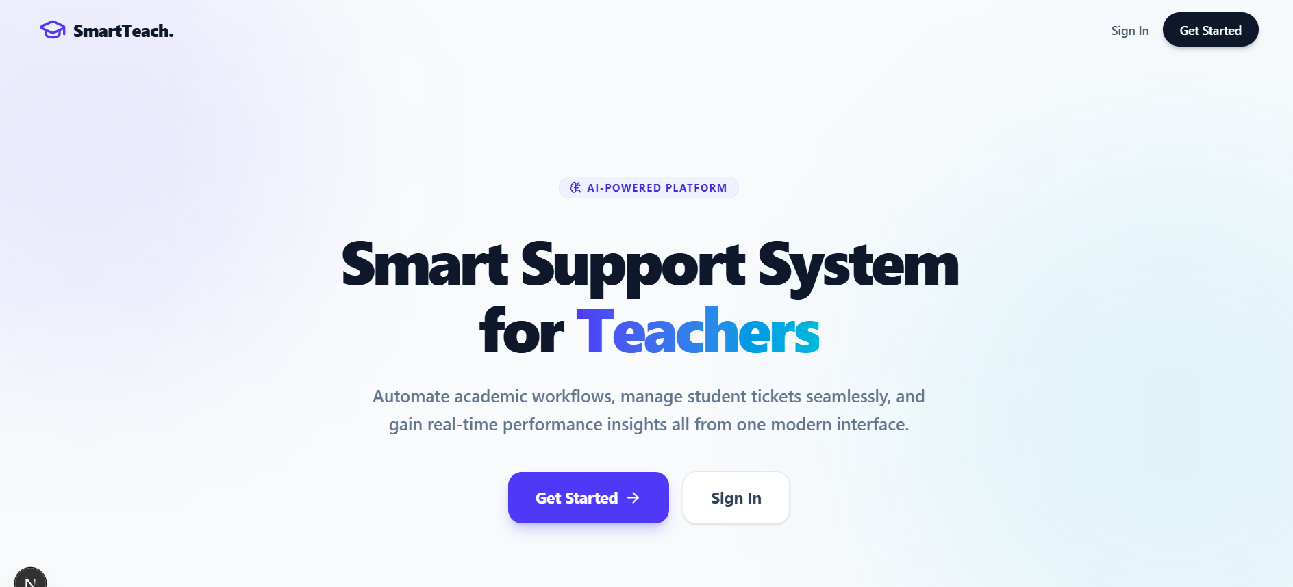
Dev Dynasty
Smart Support System for Teachers
Proposed Solution
AI-powered academic assistant for teachers
Automates lesson planning and grading
Provides rubric-based evaluation
Tracks student performance (internal + semester)
Enables resource sharing
Built using MVC architecture
Prototype – Landing page
@HACKIT 2026

Slide 3
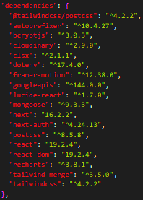
Dev Dynasty
TECHNICAL APPROACH
Technology Used:
Frontend: NextJs,Typescript, Tailwind CSS v4,framer-motion,lucide-react
Backend: NextJs,next-auth, googleapis, bcryptjs
Database: MongoDB
AI Integration: Open Router API
Architecture: MVC
Methodology / Process:
1. User login and redirected to his dashboard according to the role set up by admin(Admin/Faculty/Student).
2. AI takes required input ,processes it and generates lesson plan & grading
3. Dashboard contains information based on their roles.
@HACKIT 2026

Slide 4
Dev Dynasty
FEASIBILITY AND VIABILITY
Feasibility:
1. It is easy to access because of web-based interface and user-friendly, anyone can easily utilize it.
2. It uses modern and scalable technology (NextJs and MongoDB).
Challenges & Risks:
1. AI accuracy in grading – Ai may not generate desirable output.
2. Data privacy issues – database credentials may be leaked.
3. Internet dependency – It can’t be utilized offline.
Solutions:
1. Human validation option (like admin can approve,edit or reject).
2. Secure database handling.
3. Offline data backup (option to save it in database).
@HACKIT 2026

Slide 5
Dev Dynasty
IMPACT AND BENEFITS
Impact on Users:
1. It helps teachers save time and focus more on lecture delivery.
2. It Improves teaching quality.
3. Better student performance tracking can be done easily.
Benefits:
1. Educational improvement
2. Reduced manual work
3. Efficient academic management
@HACKIT 2026

Slide 6
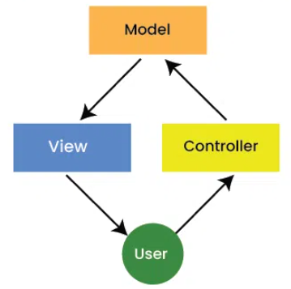


Dev Dynasty
RESEARCH AND REFERENCES
Research / References:
Open Router AI documentation - https://openrouter.ai/
NextJS documentation-https://nextjs.org/
MVC architecture implementation-https://www.geeksforgeeks.org/system-design/mvc-architecture-system-design/
@HACKIT 2026

