Slide 1
STUDENTS’ ACADEMIC PERFORMANCE
- A study based on Logistic Regression & Multiple Linear Regression

Slide 2
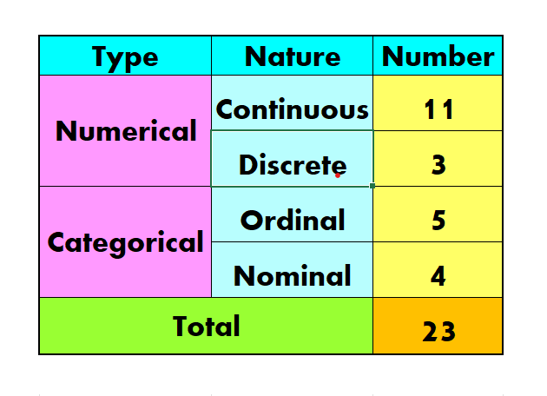
DATA SET DESCRIPTION
The concerned raw dataset has n=8000 observations on p=23 variables corresponding to n=8000 students.
The variables have the following classification as per their nature-

Slide 3
DATA SET DESCRIPTION CONTINUED…
Sl. No. | Abbreviation | Description | Nature
1 | age | Age (years) | Numerical (Continuous)
2 | gender | Gender (Female, Male, Other) | Categorical (Nominal)
3 | grade_level | Level of Grade (10th,11th,12th,1st Yr, 2nd Yr,3rd Yr) | Categorical (Ordinal)
4 | study_hours_per_day | Daily Average Duration of Study (hrs) | Numerical (Continuous)
5 | ai_usage_time_minute | Daily Average Duration of AI Usage (mins) | Numerical (Continuous)
6 | ai_tools_used | AI tools used (ChatGPT, ChatGPT+Gemini, Claude, Copilot, Gemini, None) | Categorical (Nominal)
7 | ai_usage_purpose | AI Usage Purpose (Coding, Doubt Solving, Exam Prep, Homework, None, Notes) | Categorical (Nominal)
8 | ai_dependency_score | AI Dependency Score (1 to 10) | Categorical (Ordinal)
9 | ai_generated_content_percentage | Percentage of the content generated by AI | Numerical (Continuous)
10 | ai_prompts_per_week | Weekly number of AI prompts | Numerical (Discrete)
11 | ai_ethics_score | Score as per AI ethics (1 to 10) | Categorical (Ordinal)
12 | last_exam_score | Percentage of Last Exam Score | Numerical (Continuous)
13 | assignment_scores_avg | Average of all Assignment Scores | Numerical (Continuous)
14 | attendance_percentage | Percentage of Attendance | Numerical (Continuous)
15 | concept_understanding_score | Score as per Concept Understanding (1 to 10) | Categorical (Ordinal)
16 | study_consistency_index | Index as per Study Consistency (1.0 to 10.0) | Numerical (Discrete)
17 | improvement_rate | Index/Rate of Improvement (-20.0 to 0 to 40.0) | Numerical (Discrete)
18 | sleep_hours | Daily Average Duration of Sleep (Hrs) | Numerical (Continuous)
19 | social_media_hours | Daily Average Duration of Social Media Usage (Hrs) | Numerical (Continuous)
20 | tutoring_hours | Daily Average Duration of Attending Tuitions (Hrs) | Numerical (Continuous)
21 | class_participation_score | Score as per Class Participation (1 to 10) | Categorical (Ordinal)
22 | final_score | Percentage of Final Score | Numerical (Continuous)
23 | Passed | Passing Status (Passed, Failed) | Categorical (Nominal)

Slide 4
CLASSIFICATION OF VARIABLES
Here the last 2 variables –
final_score
Passed
are our responses and all the other 21 variables are our predictors.
Here using the same set of predictors we will carry out –
Logistic Regression using the response : Passed
Multiple Linear Regression using the response : final_score
AIM | LOGISTIC REGRESSION | MULTIPLE LINEAR REGRESSION
RESPONSE | Passed | final_score

Slide 5
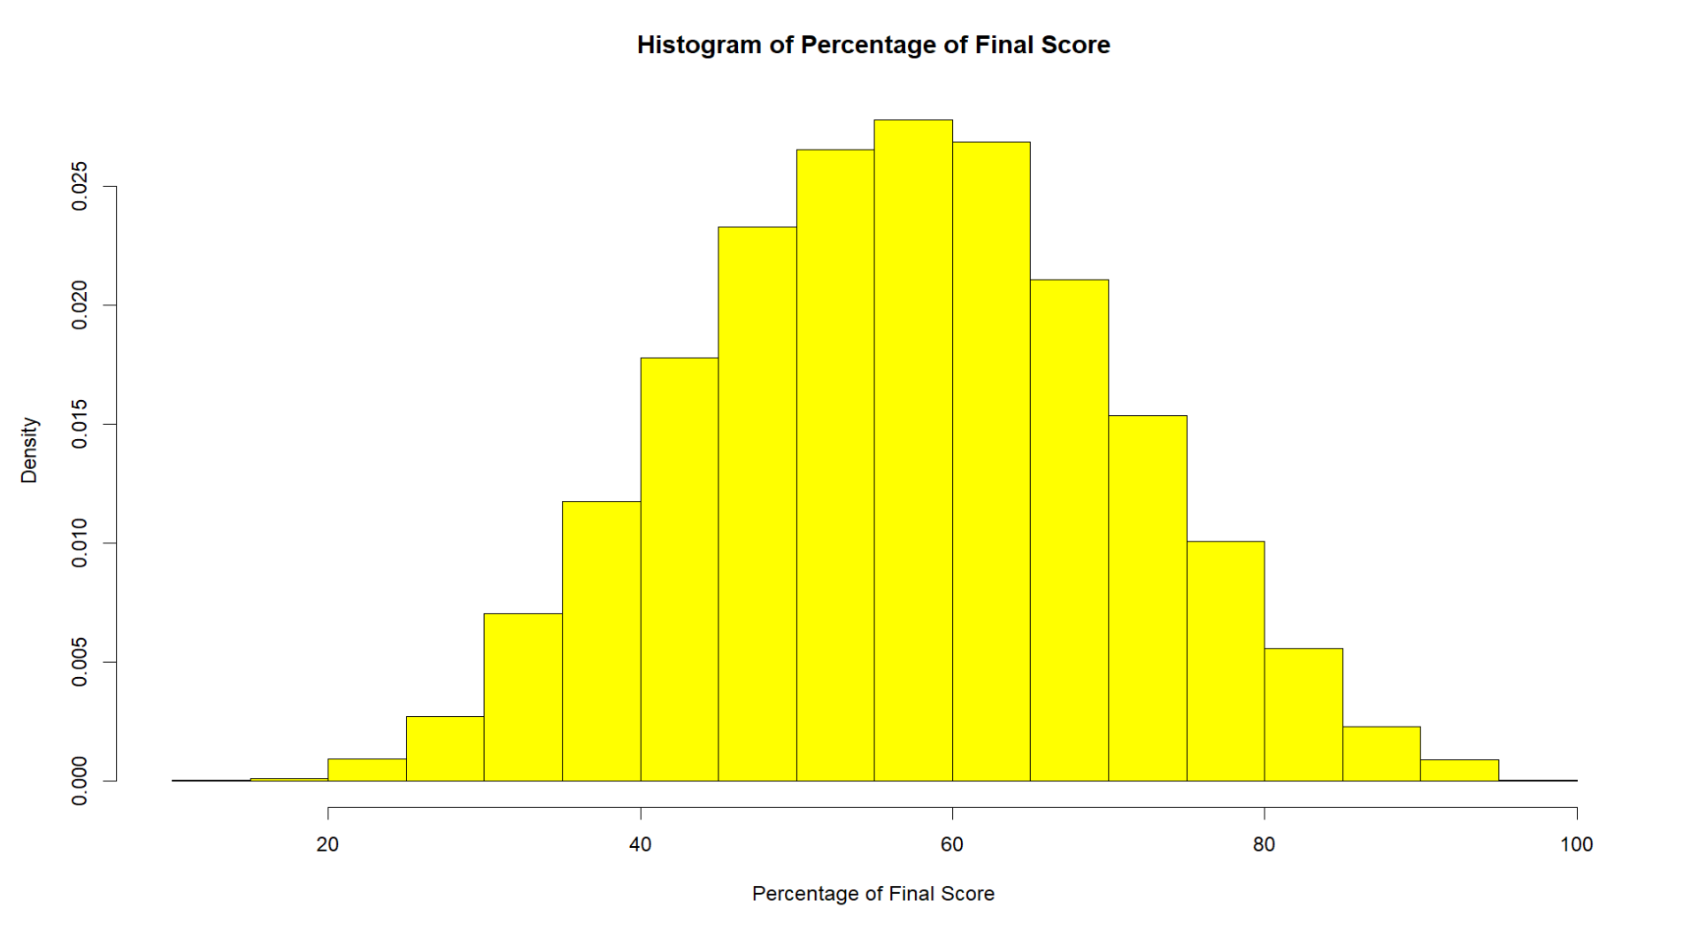
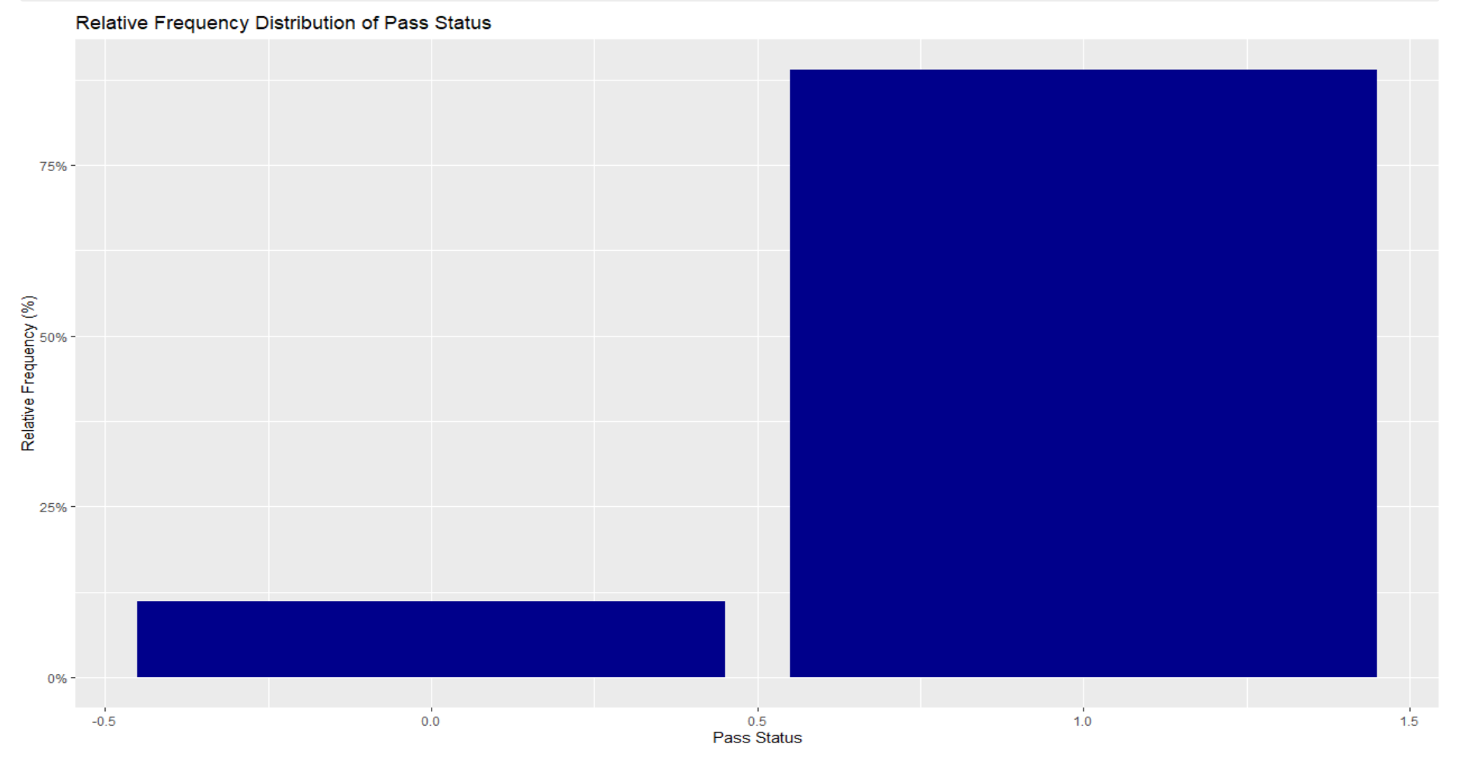
GRAPHS

Slide 6
CODING OF CATEGORICAL VARIABLES
1. Gender of a Student:
Mother Variable: gender
Categories: 3 (Female, Male, Other)
Let, us classify gender into 2 variables
(F,M) defined as-
3. AI tools used:
Mother Variable: ai_tools_used
Categories: 6 (ChatGPT, ChatGPT+Gemini, Claude, Copilot, Gemini, None)
Let, us classify grade_level into 5 variables (ai_tool_1, ai_tool_2, ai_tool_3, ai_tool_4, ai_tool_5) defined as-
Case No. | Case | F | M
1 | Other | 0 | 0
2 | Female | 1 | 0
3 | Male | 1 | 1
Case No. | Case | ai_ tool_1 | ai_ tool_ 2 | ai_ tool_ 3 | ai_ tool_4 | ai_ tool_ 5
1 | ChatGPT | 0 | 0 | 0 | 0 | 0
2 | ChatGPT +Gemini | 1 | 0 | 0 | 0 | 0
3 | Claude | 1 | 1 | 0 | 0 | 0
4 | Copilot | 1 | 1 | 1 | 0 | 0
5 | Gemini | 1 | 1 | 1 | 1 | 0
6 | None | 1 | 1 | 1 | 1 | 1
2. Level of Grade:
Mother Variable: grade_level
Categories: 6 (10th, 11th, 12th, 1st year, 2nd year, 3rd year)
Let, us classify grade_level into 5 variables
(grade_level_11, grade_level_12, grade_level_13, grade_level_14, grade_level_15) defined as-
Case No. | Case | grade_level_11 | grade_level_12 | grade_level_13 | grade_level_14 | grade_level_15
1 | 10th | 0 | 0 | 0 | 0 | 0
2 | 11th | 1 | 0 | 0 | 0 | 0
3 | 12th | 1 | 1 | 0 | 0 | 0
4 | 1st year | 1 | 1 | 1 | 0 | 0
5 | 2nd year | 1 | 1 | 1 | 1 | 0
6 | 3rd year | 1 | 1 | 1 | 1 | 1

Slide 7
CODING OF CATEGORICAL VARIABLES CONTINUED…
4. AI Usage Purpose:
Mother Variable: ai_usage_purpose
Categories: 6 (Coding, Doubt Solving, Exam Prep, Homework, None, Notes)
Let, us classify ai_usage_purpose into 5 variables (Code, Doubt, Exam, HW, Note) defined as-
Case No. | Case | Code | Doubt | Exam | HW | Note
1 | None | 0 | 0 | 0 | 0 | 0
2 | Coding | 1 | 0 | 0 | 0 | 0
3 | Doubt Solving | 1 | 1 | 0 | 0 | 0
4 | Exam Prep | 1 | 1 | 1 | 0 | 0
5 | Homework | 1 | 1 | 1 | 1 | 0
6 | Notes | 1 | 1 | 1 | 1 | 1
5. AI Dependency Score:
Mother Variable: ai_dependency_score
Categories: 10 (1 to 10)
Let, us classify ai_dependency_score into 9 variables
(AIDS2, AIDS3, AIDS4, AIDS5, AIDS6, AIDS7, AIDS8, AIDS9, AIDS10) defined as-
Case No. | Scores | AIDS 2 | AIDS3 | AIDS4 | AIDS5 | AIDS6 | AIDS7 | AIDS 8 | AIDS 9 | AIDS10
1 | 1 | 0 | 0 | 0 | 0 | 0 | 0 | 0 | 0 | 0
2 | 2 | 1 | 0 | 0 | 0 | 0 | 0 | 0 | 0 | 0
3 | 3 | 1 | 1 | 0 | 0 | 0 | 0 | 0 | 0 | 0
4 | 4 | 1 | 1 | 1 | 0 | 0 | 0 | 0 | 0 | 0
5 | 5 | 1 | 1 | 1 | 1 | 0 | 0 | 0 | 0 | 0
6 | 6 | 1 | 1 | 1 | 1 | 1 | 0 | 0 | 0 | 0
7 | 7 | 1 | 1 | 1 | 1 | 1 | 1 | 0 | 0 | 0
8 | 8 | 1 | 1 | 1 | 1 | 1 | 1 | 1 | 0 | 0
9 | 9 | 1 | 1 | 1 | 1 | 1 | 1 | 1 | 1 | 0
10 | 10 | 1 | 1 | 1 | 1 | 1 | 1 | 1 | 1 | 1

Slide 8
CODING OF CATEGORICAL VARIABLES CONTINUED…
6. Score as per AI ethics:
Mother Variable: ai_ethics_score
Categories: 10 (1 to 10)
Let, us classify ai_ethics_score into 9 variables (AIES2, AIES3, AIES4, AIES5, AIES6, AIES7, AIES8, AIES9, AIES10) defined as-
Case No. | Scores | AIES2 | AIES3 | AIES4 | AIES5 | AIES6 | AIES7 | AIES8 | AIES9 | AIES10
1 | 1 | 0 | 0 | 0 | 0 | 0 | 0 | 0 | 0 | 0
2 | 2 | 1 | 0 | 0 | 0 | 0 | 0 | 0 | 0 | 0
3 | 3 | 1 | 1 | 0 | 0 | 0 | 0 | 0 | 0 | 0
4 | 4 | 1 | 1 | 1 | 0 | 0 | 0 | 0 | 0 | 0
5 | 5 | 1 | 1 | 1 | 1 | 0 | 0 | 0 | 0 | 0
6 | 6 | 1 | 1 | 1 | 1 | 1 | 0 | 0 | 0 | 0
7 | 7 | 1 | 1 | 1 | 1 | 1 | 1 | 0 | 0 | 0
8 | 8 | 1 | 1 | 1 | 1 | 1 | 1 | 1 | 0 | 0
9 | 9 | 1 | 1 | 1 | 1 | 1 | 1 | 1 | 1 | 0
10 | 10 | 1 | 1 | 1 | 1 | 1 | 1 | 1 | 1 | 1
7. Score as per Concept Understanding:
Mother Variable: concept_understanding_score
Categories: 10 (1 to 10)
Let, us classify concept_understanding_score into 9 variables
(CUS2, CUS3, CUS4, CUS5, CUS6, CUS7, CUS8, CUS9, CUS10) defined as-
Case | Scores | CUS2 | CUS3 | CUS4 | CUS5 | CUS6 | CUS7 | CUS8 | CUS9 | CUS10
1 | 1 | 0 | 0 | 0 | 0 | 0 | 0 | 0 | 0 | 0
2 | 2 | 1 | 0 | 0 | 0 | 0 | 0 | 0 | 0 | 0
3 | 3 | 1 | 1 | 0 | 0 | 0 | 0 | 0 | 0 | 0
4 | 4 | 1 | 1 | 1 | 0 | 0 | 0 | 0 | 0 | 0
5 | 5 | 1 | 1 | 1 | 1 | 0 | 0 | 0 | 0 | 0
6 | 6 | 1 | 1 | 1 | 1 | 1 | 0 | 0 | 0 | 0
7 | 7 | 1 | 1 | 1 | 1 | 1 | 1 | 0 | 0 | 0
8 | 8 | 1 | 1 | 1 | 1 | 1 | 1 | 1 | 0 | 0
9 | 9 | 1 | 1 | 1 | 1 | 1 | 1 | 1 | 1 | 0
10 | 10 | 1 | 1 | 1 | 1 | 1 | 1 | 1 | 1 | 1

Slide 9
CODING OF CATEGORICAL VARIABLES CONTINUED…
8. Score as per Class Participation:
Mother Variable: class_participation_score
Categories: 10 (1 to 10)
Let, us classify class_participation_score into 9 variables
(CPS2, CPS3, CPS4, CPS5, CPS6, CPS7, CPS8, CPS9, CPS10) defined as-
Case | Scores | CPS2 | CPS3 | CPS4 | CPS5 | CPS6 | CPS7 | CPS8 | CPS9 | CPS10
1 | 1 | 0 | 0 | 0 | 0 | 0 | 0 | 0 | 0 | 0
2 | 2 | 1 | 0 | 0 | 0 | 0 | 0 | 0 | 0 | 0
3 | 3 | 1 | 1 | 0 | 0 | 0 | 0 | 0 | 0 | 0
4 | 4 | 1 | 1 | 1 | 0 | 0 | 0 | 0 | 0 | 0
5 | 5 | 1 | 1 | 1 | 1 | 0 | 0 | 0 | 0 | 0
6 | 6 | 1 | 1 | 1 | 1 | 1 | 0 | 0 | 0 | 0
7 | 7 | 1 | 1 | 1 | 1 | 1 | 1 | 0 | 0 | 0
8 | 8 | 1 | 1 | 1 | 1 | 1 | 1 | 1 | 0 | 0
9 | 9 | 1 | 1 | 1 | 1 | 1 | 1 | 1 | 1 | 0
10 | 10 | 1 | 1 | 1 | 1 | 1 | 1 | 1 | 1 | 1
9. Passing Status:
Mother Variable: passed
Categories: 2 (Passes, Failed)
Case No. | Case | passed
1 | Failed | 0
2 | Passed | 1

Slide 10
TRAIN-TEST SPLIT
The concerned raw dataset has n=8000 observations on p=23 variables corresponding to n=8000 students.
We have randomly split the dataset of n=8000 rows into Training data set and Test data set in the ratio of 80:20.
Thus the Training data size is 6400,
and the Test data size is 1600.

Slide 11
MULTIPLE LINEAR REGRESSION SUMMARY
MEANING |  | VARIABLE | COEFFICIENT
 | (INTERCEPT) | (INTERCEPT) | 7.149
Gender | Female | F | -0.209
 | Male | M | -0.0004
Level of Grade | 11th | grade_level_11 | 0.331
 | 12th | grade_level_12 | -0.293
 | 1st yr | grade_level_13 | 0.050
 | 2nd yr | grade_level_14 | 0.130
 | 3rd yr | grade_level_15 | -0.145
AI Tools Used | ChatGPT+Gemini | ai_tool_1 | 0.313
 | Claude | ai_tool_2 | -0.290
 | Copilot | ai_tool_3 | 0.263
 | Gemini | ai_tool_4 | 0.131
 | None | ai_tool_5 | -0.246
AI Usage Purpose | Coding | Code | 0.460
 | Doubt Solving | Doubt | -0.317
 | Exam Preparation | Exam | 0.220
 | HW | HW | 0.069
 | Notes | Note | -0.117
AI Dependency Score | 2 | AIDS2 | 0.146
 | 3 | AIDS3 | -0.808
 | 4 | AIDS4 | 0.265
 | 5 | AIDS5 | 0.150
 | 6 | AIDS6 | 0.048
 | 7 | AIDS7 | -0.23
 | 8 | AIDS8 | 0.276
 | 9 | AIDS9 | -0.274
 | 10 | AIDS10 | 0.336
AI Ethics Score | 2 | AIES2 | -0.181
 | 3 | AIES3 | 0.274
 | 4 | AIES4 | -0.298
 | 5 | AIES5 | 0.285
 | 6 | AIES6 | 0.125
 | 7 | AIES7 | -0.104
 | 8 | AIES8 | -0.016
 | 9 | AIES9 | -0.138
 | 10 | AIES10 | 0.168
MEANING |  | VARIABLE | COEFFICIENT
Concept Understanding Score | 2 | CU2 | 2.403
 | 3 | CU3 | 1.795
 | 4 | CU4 | 1.944
 | 5 | CU5 | 1.925
 | 6 | CU6 | 2.204
 | 7 | CU7 | 2.137
 | 8 | CU8 | 1.757
 | 9 | CU9 | 1.988
 | 10 | CU10 | 1.764
Class Participation Score | 2 | CPS2 | 0.407
 | 3 | CPS3 | -0.084
 | 4 | CPS4 | 0.051
 | 5 | CPS5 | 0.090
 | 6 | CPS6 | -0.182
 | 7 | CPS7 | 0.189
 | 8 | CPS8 | -0.040
 | 9 | CPS9 | -0.308
 | 10 | CPS10 | 0.111
age |  | age | 0.004
Daily Average Duration of Study (hrs) |  | study_hours_per_day | 0.081
Daily Average Duration of AI Usage (mins) |  | ai_usage_time_minutes | 0.001
Percentage of the content generated by AI |  | ai_generated_content_percentage | -0.053
Weekly number of AI prompts |  | ai_prompts_per_week | -0.005
Percentage of Last Exam Score |  | last_exam_score | 0.397
Average of all Assignment Scores |  | assignment_scores_avg | 0.300
Percentage of Attendance |  | attendance_percentage | -0.007
Index as per Study Consistency |  | study_consistency_index | -0.026
Index/Rate of Improvement |  | improvement_rate | -0.004
Daily Average Duration of Sleep (Hrs) |  | sleep_hours | 0.027
Daily Average Duration of Attending Tuitions (Hrs) |  | tutoring_hours | -0.064

Slide 12
MULTIPLE LINEAR REGRESSION SUMMARY
Test MSE (Mean Square Error)= 25.56708
Multiple R^2 = 0.864,
implies approximately 86% of the total variability in the response of Percentage of Final Score has been explained by the fitted linear regression of it on the remaining predictors.

Slide 13
LOGISTIC REGRESSION SUMMARY
MEANING |  | VARIABLE | COEFFICIENT
 | (INTERCEPT) | (INTERCEPT) | -12.404
Gender | Female | F | 0.312
 | Male | M | 0.011
Level of Grade | 11th | grade_level_11 | 0.135
 | 12th | grade_level_12 | -0.150
 | 1st yr | grade_level_13 | -0.008
 | 2nd yr | grade_level_14 | 0.176
 | 3rd yr | grade_level_15 | -0.037
AI Tools Used | ChatGPT+Gemini | ai_tool_1 | -0.049
 | Claude | ai_tool_2 | -0.169
 | Copilot | ai_tool_3 | -0.292
 | Gemini | ai_tool_4 | 0.567
 | None | ai_tool_5 | -0.380
AI Usage Purpose | Coding | Code | 0.006
 | Doubt Solving | Doubt | -0.248
 | Exam Preparation | Exam | 0.052
 | HW | HW | -0.359
 | Notes | Note | 0.361
AI Dependency Score | 2 | AIDS2 | -0.332
 | 3 | AIDS3 | 0.022
 | 4 | AIDS4 | -0.193
 | 5 | AIDS5 | 0.058
 | 6 | AIDS6 | 0.135
 | 7 | AIDS7 | -0.394
 | 8 | AIDS8 | 0.744
 | 9 | AIDS9 | -0.308
 | 10 | AIDS10 | -0.066
AI Ethics Score | 2 | AIES2 | -0.168
 | 3 | AIES3 | 0.535
 | 4 | AIES4 | -0.572
 | 5 | AIES5 | 0.159
 | 6 | AIES6 | -0.250
 | 7 | AIES7 | 0.339
 | 8 | AIES8 | -0.192
 | 9 | AIES9 | 0.171
 | 10 | AIES10 | 0.355
MEANING |  | VARIABLE | COEFFICIENT
Concept Understanding Score | 2 | CU2 | 1.018
 | 3 | CU3 | 0.812
 | 4 | CU4 | 0.674
 | 5 | CU5 | 0.674
 | 6 | CU6 | 0.872
 | 7 | CU7 | 0.534
 | 8 | CU8 | 0.071
 | 9 | CU9 | 1.174
 | 10 | CU10 | 0.588
Class Participation Score | 2 | CPS2 | 0.139
 | 3 | CPS3 | -0.029
 | 4 | CPS4 | -0.035
 | 5 | CPS5 | 0.104
 | 6 | CPS6 | -0.375
 | 7 | CPS7 | 0.184
 | 8 | CPS8 | 0.639
 | 9 | CPS9 | 0.738
 | 10 | CPS10 | 0.073
age |  | age | -0.011
Daily Average Duration of Study (hrs) |  | study_hours_per_day | -0.002
Daily Average Duration of AI Usage (mins) |  | ai_usage_time_minutes | 0.0003
Percentage of the content generated by AI |  | ai_generated_content_percentage | -0.022
Weekly number of AI prompts |  | ai_prompts_per_week | -0.002
Percentage of Last Exam Score |  | last_exam_score | 0.157
Average of all Assignment Scores |  | assignment_scores_avg | 0.121
Percentage of Attendance |  | attendance_percentage | -0.003
Index as per Study Consistency |  | study_consistency_index | -0.040
Index/Rate of Improvement |  | improvement_rate | -0.004
Daily Average Duration of Sleep (Hrs) |  | sleep_hours | 0.068
Daily Average Duration of Social Media Usage (Hrs) |  | social_media_hours | 0.026
Daily Average Duration of Attending Tuitions (Hrs) |  | tutoring_hours | -0.059

Slide 14
LOGISTIC REGRESSION SUMMARY
Confusion Matrix based on Test Data:
Precision = 0.9504132 ,
implies out of 100 predicted passed cases classified by the classifier,
95 are actually the true passed cases.
Recall = 0.9745763 ,
implies out of 100 true passes cases of occurrences,
the classifier has been able to predict 97 passed cases.
PREDICTED | ACTUAL
 | 0:Failed | 1:Passed
0: Failed | 112 | 36
1:Passed | 72 | 1380

Slide 15
MODEL COMPARISON
AIC (AKAIKE INFORMATION CRITERION) | MULTIPLE LINEAR REGRESSION | LOGISTIC REGRESSION
 | 38803.58 | 1,714.017
CONCLUSION
Since the Logistic Regression model yields a lower AIC than that of the Multiple Linear Regression Model,
The fitted Logistic Regression Model
is a better fitted model.

