Slide 1

Power Platform
Hackathon

Slide 2
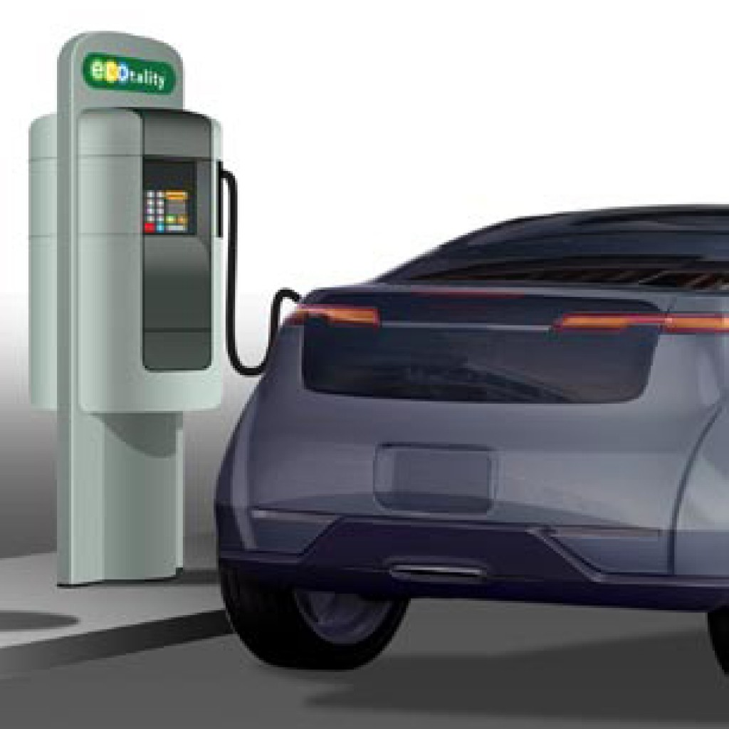
Problem Statement
Unable to utilize the EV stations at Office Parking.
Only couple of cars getting charged all day

Slide 3
Solution Overview
Have a reservation system to book the EV station
Employee must reserve at least one hour in advance
Only 1 Reservation per day
You can only prebook for Today and not future dates so its available for Everyone
No more than 2 hours of reservation is allowed
A confirmation notification to be sent when EV Station Booked
Future State – Hourly reminders before the EV Station Charging End Time

Slide 4
Features Used
Power Apps Copilot
Power Automate Copilot
Power Virtual Agent Copilot (Future State)
Microsoft Teams (Future State)

Slide 5








Architecture
Present state
1
2
3
4
1
2
3
Future state

Slide 6
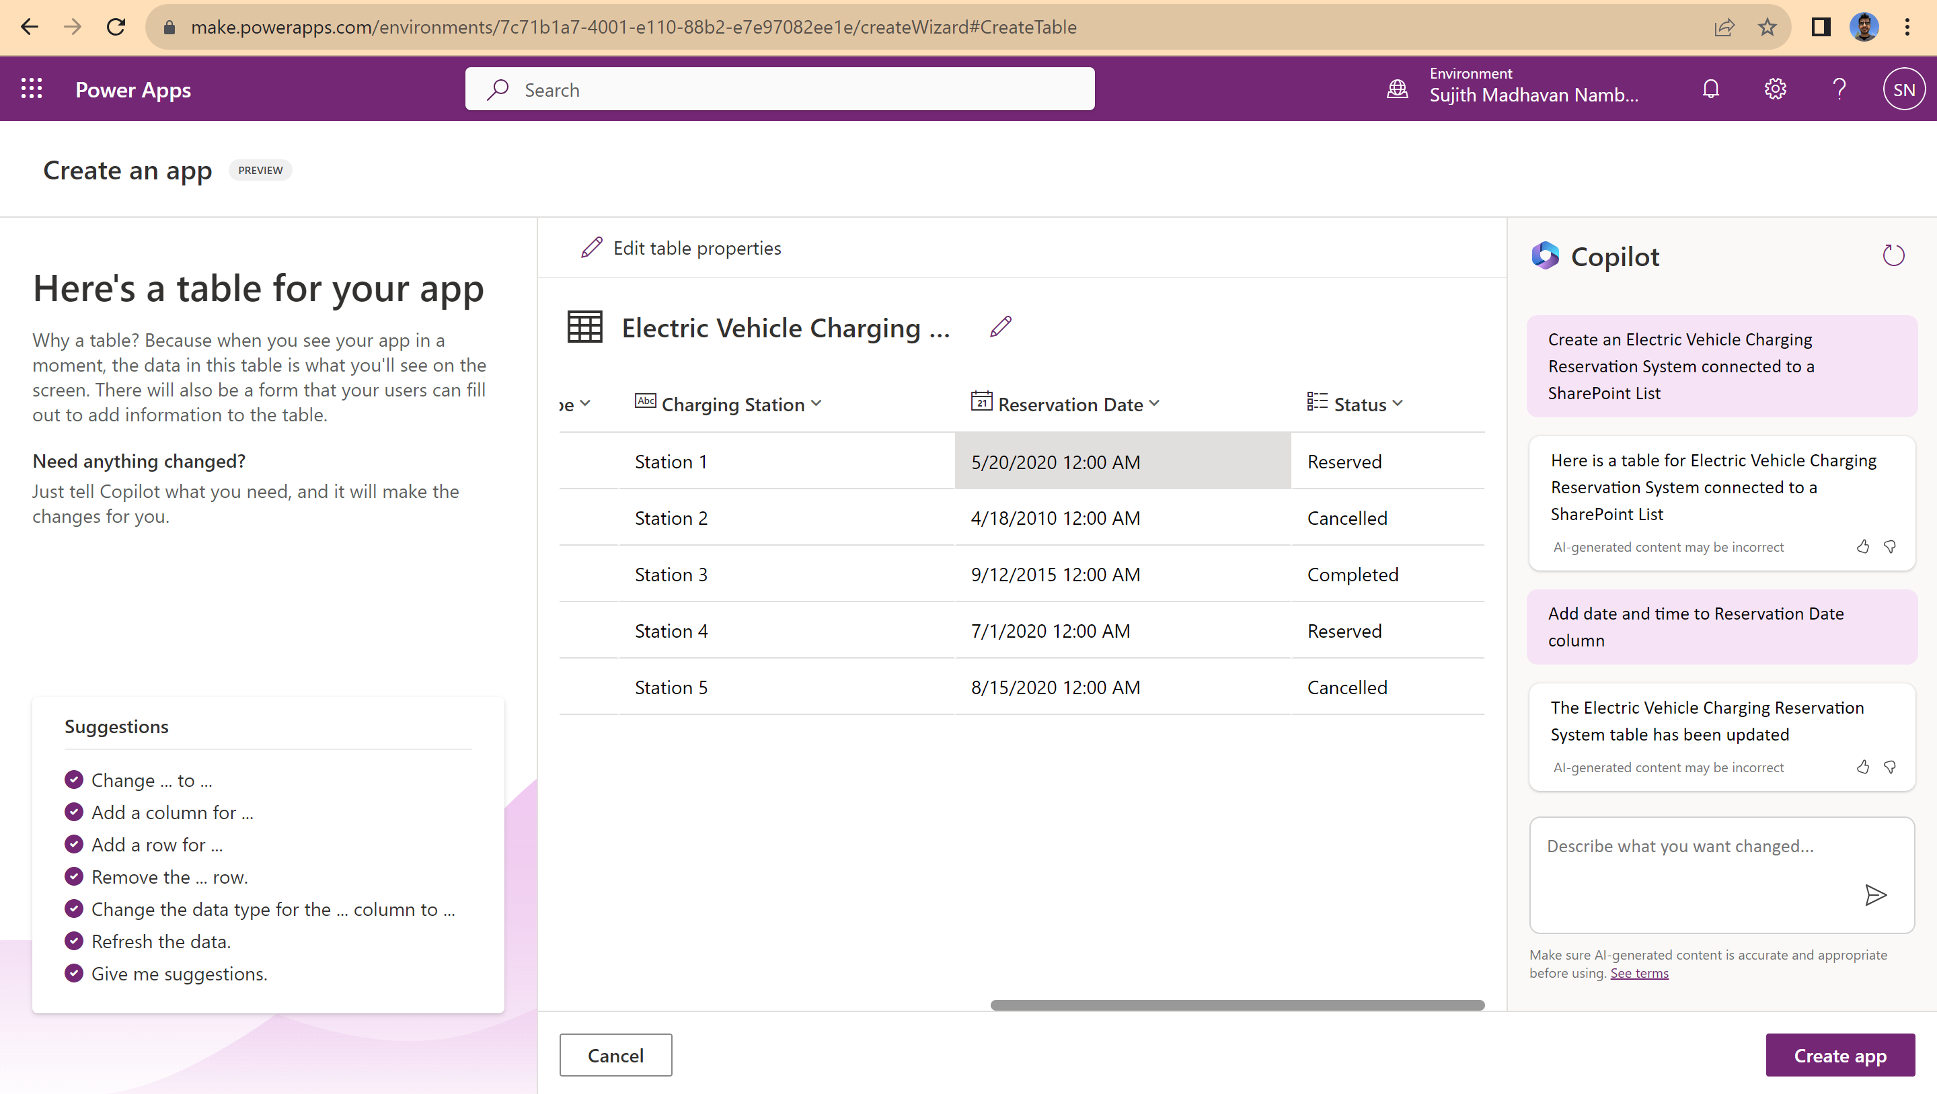

Slide 7
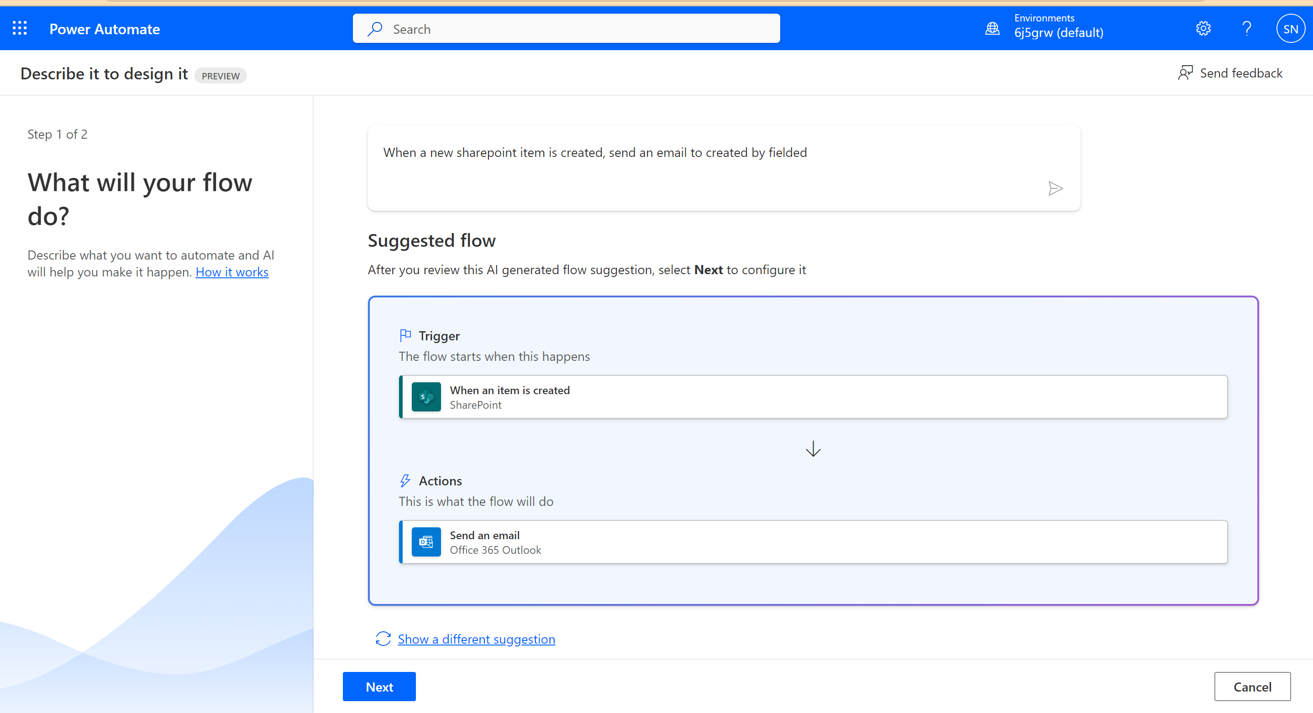

Slide 8
Future State
Uses Natural language to query reservation and new bookings
Add a calendar Screen
Add a confirmation pop up
Send an email with ACE
Send teams notification

Slide 9
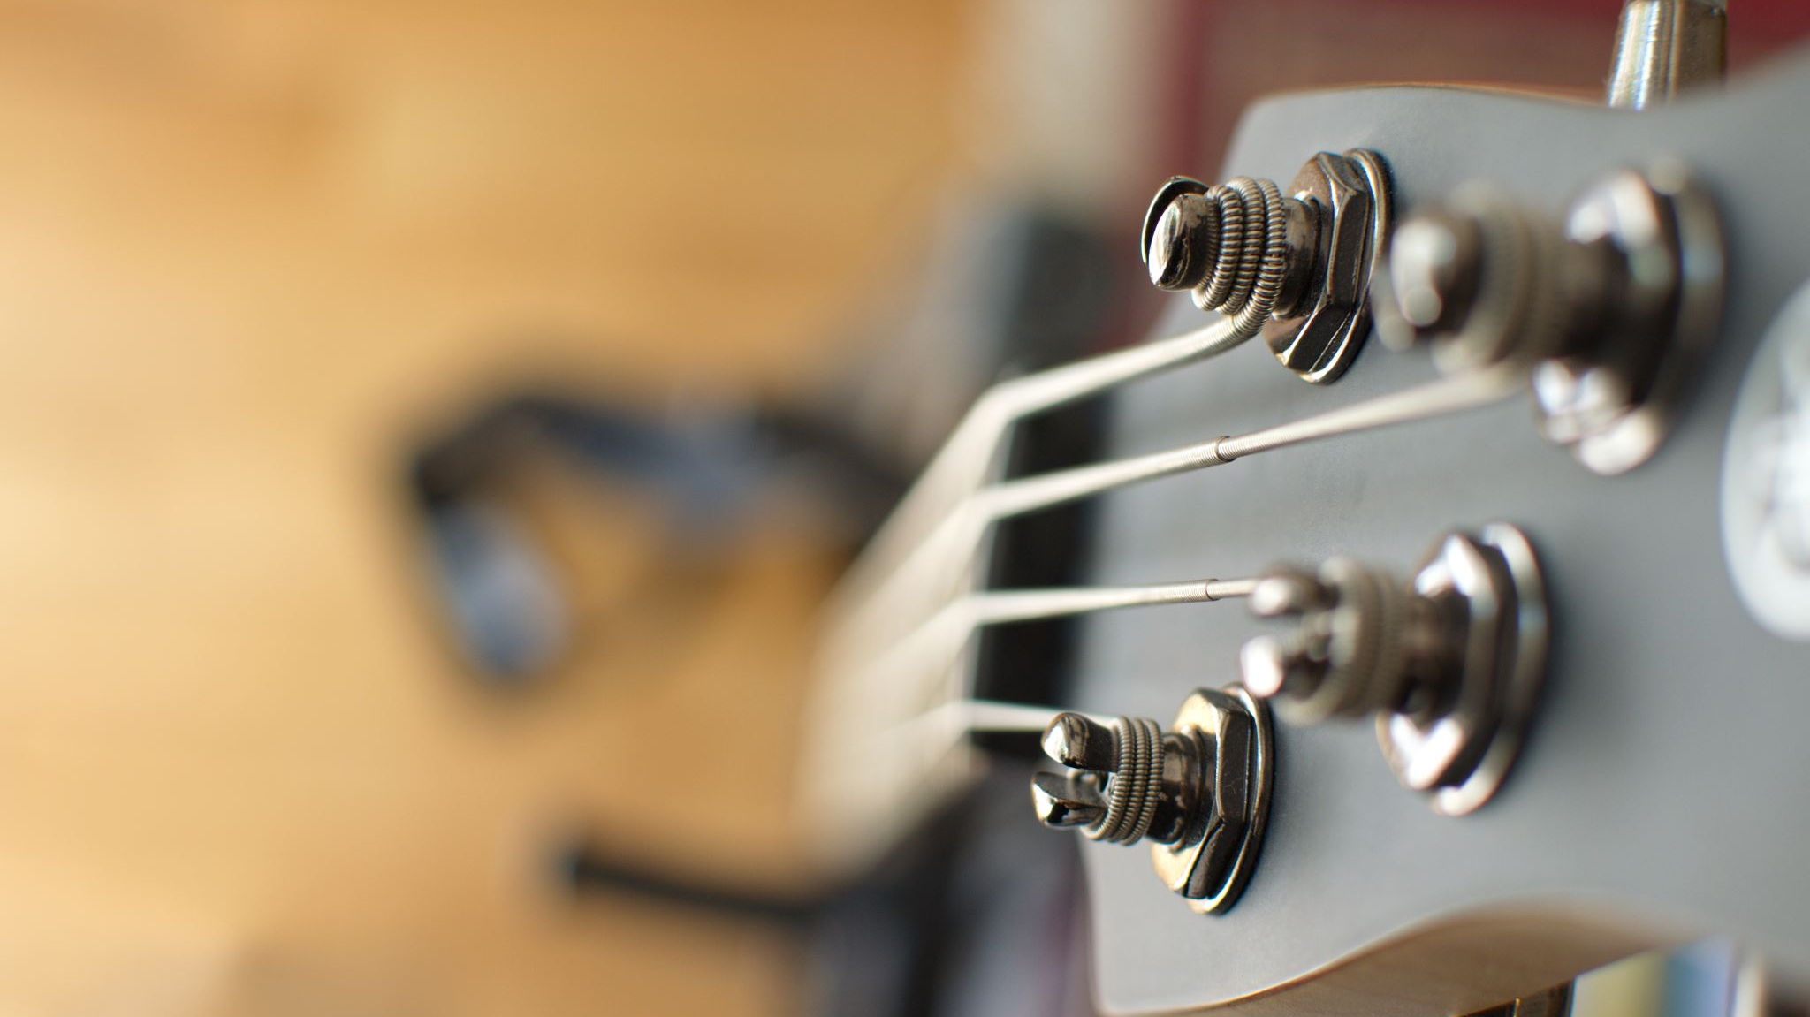
Demo

