Slide 1
Instagram Performance Analytics
What 50,000 Sugar Cosmetics posts tell us about engagement, and where to focus next
Stakeholder briefing · Data window 19 Apr 2024 – 19 Apr 2025 · Prepared by Suman
Notes:
Open with the headline: performance is healthy and steady, but the data does not show a single winning format, day or hashtag. The opportunity is reach, deeper engagement and follower conversion.

Slide 2
Healthy and steady, but no proven winner
18.54%
987.42M
< 1.2%
30%
Average engagement rate
Total reach (summed across posts)
Best-to-worst gap on every lever tested
Of profile visitors follow the account
What we found
Engagement rate holds at about 18.5% every month. Reel, Story, Video and Image differ by only 0.18 points, and no gap is statistically significant.
Where the opportunity is
Reach drives volume, likes are 81% of interactions, and 6.2% of posts were widely seen but barely engaged with.
What to do
Scale reach, deepen engagement beyond likes, lift profile-to-follow conversion, and A/B test before shifting the content mix.
Notes:
Four numbers carry the story. The best-to-worst gaps across every lever are all about one percent or less, so effort should go to reach, depth of engagement and conversion.

Slide 3
Posting and engagement are consistent month to month
147.73M
18.46M
Likes
Comments
183.16M
1.28B
Total interactions
Impressions
April 2024 and April 2025 are partial months (data runs 19 Apr to 19 Apr).
Cadence is a strength: about 4,100 records a month with no seasonal gaps, and engagement rate stays near 18.5% throughout.
Notes:
The first and last bars look low only because the file starts and ends on 19 April.

Slide 4
Format and weekday barely move engagement
Reel (18.61%) and Wednesday (18.63%) lead, but gaps are 1.0% and 1.1% and not significant (p = 0.15 and 0.57).
Notes:
Axes start at zero deliberately: the honest picture is that the bars are the same height. Hour of posting is not in the data and should be captured.

Slide 5
Hashtags and campaigns perform alike too
#VeganBeauty and Influencer Collab lead on paper, yet gaps are only 0.5% and 0.9%. Keep the brand and values hashtags; test, don't reallocate.
Notes:
Hashtag test is indicative because a post with several hashtags counts once per tag.

Slide 6
People see content but rarely go deeper
3.0%
Of reached accounts visit the profile
29.9%
Of profile visitors follow (exploratory metric)
Likes are 81% of interactions; comments, saves and shares add just 19%.
77 of every 100 impressions are unique accounts and about 12 become likes. The big drop-off is from seeing to commenting, saving and sharing.
Notes:
Comments, saves and shares signal intent and virality, so they are the quality lever. Shares and saves are shown in the order of size.

Slide 7
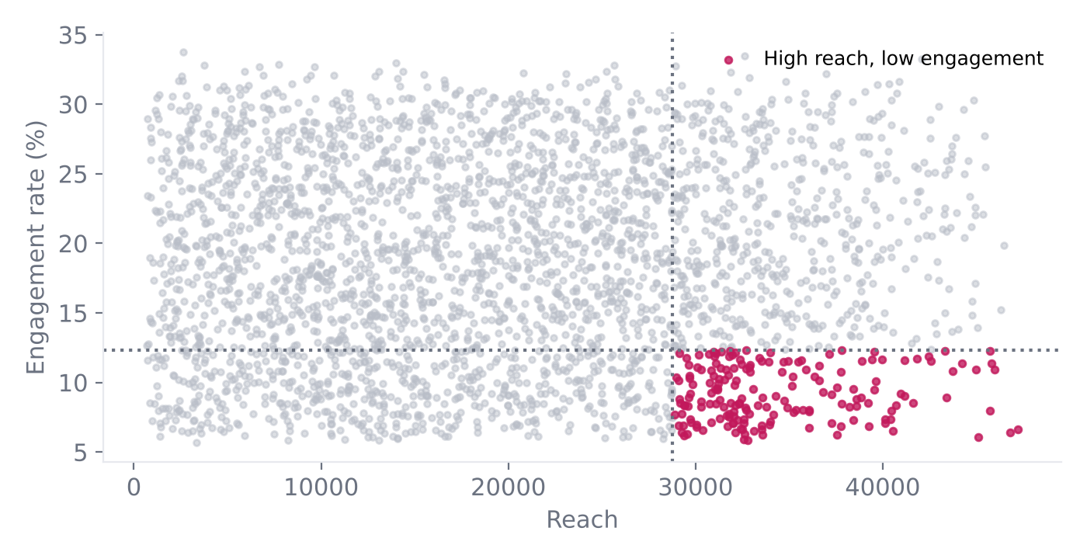
More reach brings more likes, not better engagement
3,117
Records (6.2%) with top-25% reach but bottom-25% engagement
r = 0.79
Reach vs likes. Reach vs engagement rate: r = 0.00
Top engagement-rate posts reach 34% with below-average reach (median 23,486). None of them are in the top 10 by likes.
Highly visible posts that fail to convert attention into action are the clearest content to fix first.
Notes:
Each dot is a record; the pink dots are the 6.2% of records in the high-reach, low-engagement corner.

Slide 8
Six actions to grow reach, depth and followers
1
Scale reach
2
Fix seen-but-ignored
3
Deepen engagement
Boost proven creatives and expand influencer collabs. Each 1,000 reached yields about 185 interactions.
Audit the 3,117 high-reach, low-engagement posts: stronger hooks, clear calls-to-action, polls and giveaways.
Build save-worthy tutorials and share-worthy festive and challenge content to move beyond likes.
4
Convert visitors
5
Test, don't guess
6
Close the data gaps
Refresh bio, highlights, pinned posts and link-in-bio; add 'follow for shade drops' end frames.
Run 4-week A/B tests on format, hashtag count and posting time. Act only on significant results.
Capture post ID, caption, posting hour, ad spend and follower count to unlock timing, ROI and growth analysis.
Notes:
Campaign ideas: tutorial Reels series, influencer takeovers with giveaways, festive offer Stories with polls, vegan and cruelty-free values content, profile-visit nudges on high-reach posts.

Slide 9
Next 4 weeks
Week 1
Audit high-reach, low-engagement posts; add a comment-driving call-to-action to every post.
Weeks 2–3
A/B test: same creative as Reel vs Image; 2 vs 3 hashtags; morning vs evening.
Week 4
Read results, keep only statistically significant winners, refresh profile conversion assets.
Data note: the file has no captions or post IDs and about 137 records per day with unusually flat distributions, which suggests synthetic or aggregated data. Treat these results as a validated framework and confirm them on the live Instagram Insights export.

