Slide 1

Uber Supply‑Demand Gap Analysis
Executive presentation — Data analytics with AI. A concise, actionable briefing for product, operations, and analytics leaders on where supply shortfalls are occurring and how to close them.

Slide 2
Agenda
1
1. Business context & objectives
Why supply-demand balance matters for revenue & retention
2
2. Data & methodology
Dataset, preparation, and analytics architecture
3
3. Key insights
Demand peaks, unfulfilled clusters, airport patterns
4
4. Recommendations & impact
Operational levers, incentives, forecasting
5
5. Next steps
Roadmap for analytics and deployment

Slide 3

Business Context
Ride‑hailing platforms must match real‑time passenger demand with available drivers. Persistent mismatches drive cancellations, degrade NPS, and leak revenue. This analysis quantifies gaps and identifies tactical levers to improve fulfillment.

Slide 4

Dataset & Preparation
6,745 requests (Jul 11–15, 2016). Mix of city and airport pickups with status, timestamps, driver IDs.
Timestamp parsing & timezone normalization
Feature engineering: hour-slot, origin zone, request type
Time‑slot segmentation and unfulfilled request flags
Quality checks: dedup, missing driver IDs, outlier timestamps

Slide 5




Analytical Tools
Exploratory Data Analysis
Univariate & temporal patterns, heatmaps of unfulfilled requests
SQL Analytics
Explore
Query & Aggregate
Visualize & Iterate
Aggregations by hour, zone, and pickup type for fast business queries
Pipeline: iterative EDA to identify patterns, SQL layer for ad‑hoc analysis, Streamlit for stakeholder exploration and decision support.
Interactive Dashboard
Filters: date, hour, airport vs city, driver status; live charts for ops

Slide 6
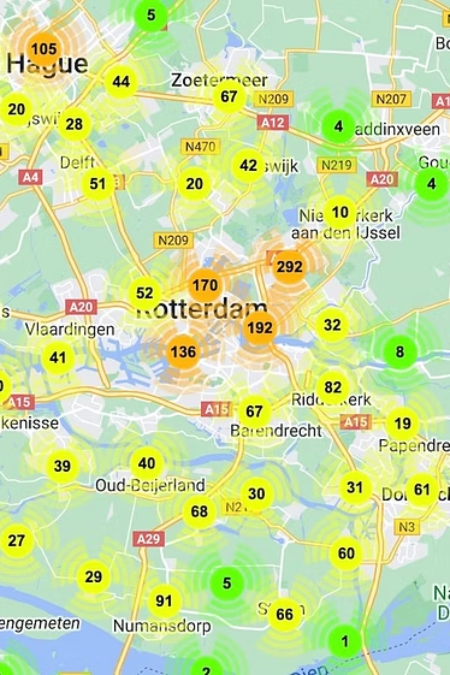
Demand & Supply Patterns (Key Insights)
Temporal Peaks
Location Clusters
Distinct morning (7–9 AM) and evening (5–8 PM) peaks with highest cancellation rates.
Unfulfilled requests concentrate in specific neighborhoods and at airport terminals.
Failure Modes
'No Cars Available' often precedes cancellations; short windows between surge events worsen availability.

Slide 7


Airport vs City Performance
Airport pickups show persistent supply shortages across multiple time slots. Contributing factors:
High simultaneous demand after flight arrivals
Driver reluctance due to airport fees, waiting time
Insufficient allocation of drivers during scheduled flight peaks
There was an error generating this image
Recommendation: dedicated airport allocation windows and pre‑positioning based on flight schedules.

Slide 8

Representative SQL Insights
Embedded SQL analyses surface rapid, actionable metrics for ops teams:
Hourly unfulfilled rate by zone — identifies 3 high‑risk hours
Driver acceptance lag distribution — median acceptance time spikes during peaks
Cancellation flow — 'No Cars Available' → cancellation within 90s in 45% of cases
These queries are exported to the Streamlit dashboard for operational use and ad‑hoc slicing by business users.

Slide 9


Recommendations (Tactical & Strategic)
Dynamic driver incentives
Airport allocation strategy
Time-limited bonuses targeted to zones and 30‑min windows with high unfulfilled rates.
Pre-position drivers using flight‑aware forecasts and guaranteed minimum earnings for airport waits.
Short‑term predictive forecasting
Operational dashboards
Lightweight ML models for 15–60 minute horizon to trigger preemptive incentives.
Real-time Streamlit views for ops with playbooks (reroute, incentives, surge adjustments).

Slide 10


Impact & Next Steps
Expected outcomes from implementing recommendations:
Higher fulfillment rate → increased completed trips and revenue
Lower cancellations → improved NPS and retention
Better airport performance → reduced wait times and operational friction
Next 90 days: deploy forecasting prototype, run A/B on targeted incentives, implement airport allocation pilot.
For the interactive slide deck: use the Streamlit dashboard to filter by date, hour, and zone; run SQL snippets to validate assumptions live.
Thank you — Questions & Discussion

