Slide 1


FOOD DELIVERY ANALYSIS
E.Punitha Shalini Devi-23P31A42F9
CH.Sumanth-24P35A4208
I.Manasa-24P35A4214
T.MadhaviLatha-24P35A4234
V.Karthikeya-23P31A42J3
BATCH-110

Slide 2
CONTENTS
Abstract
Introduction
System Requirements
Architecture
Uses of data analysis library
Advantages
Conclusion

Slide 3
ABSTRACT
The Food Delivery Analysis System aims to empower users to make informed food ordering decisions by synthesizing and comparing data from various food delivery platforms. Focusing on prominent Indian services such as Swiggy, Blinkit, Zomato, Deliveroo, and Domino's, the system analyzes critical factors including food quality, quantity, customer ratings, price, and delivery time.
By processing real-world (simulated) data, it identifies which platform offers the best overall value for a specific food item, moving beyond mere price comparison to encompass a holistic view of the customer experience. This allows users to choose services that balance cost-efficiency with superior satisfaction and timely delivery.

Slide 4
INTRODUCTION
In today's fast-paced digital world, food delivery platforms have become indispensable. However, the sheer number of options and varying service quality can make choosing the best platform a challenge. Users often base decisions solely on price, overlooking crucial aspects like food quality, portion size, delivery speed, and overall customer satisfaction
Our Food Delivery Analysis System addresses this by aggregating and analyzing data from multiple platforms (Swiggy, Blinkit, Zomato, Deliveroo, Domino’s).
The goal is to provide a comprehensive, data-driven recommendation that considers all factors influencing the food ordering experience, ensuring users get the best value for their money and time.

Slide 5

SYSTEM REQUIREMENTS
SYSTEM REQUIREMENTS
OPERATING SYSTEMS:
The analysis can be performed on windows.
Python:
Python Interpreter: Version 3.6 or higher.
pip: Python package installer.
Libraries:
Pandas: Install the pandas library using pip,a package manger for python.
pip install pandas

Slide 6

SYSTEM REQUIREMENTS
Matplotlib:For generating graphs.
pip install matplotlib
For numerical operations.
pip install Numpy
HARDWARE REQUIREMNTS :
IDE – Jupyter Notebook
Storage Space – A few hundred MBs of free disk space for the Python interpreter, libraries, and the script itself. An SSD is always preferable for faster loading, but an HDD will also work.

Slide 7
ARCHITECTURE
The system's design is modular:
Data Generation Module: Creates a simulated dataset of food delivery scenarios.
Analysis Module (FoodDeliveryAnalyzer):
Normalizes diverse data points for fair comparison.
Calculates a composite "overall value score" for each food item.
Filters and ranks food items based on user searches.
Visualization Module: Uses Matplotlib and NumPy to generate comparative graphs.
Main Execution Loop: Manages user interaction, data processing, and output display.

Slide 8
IMPORTING DATASET
Synthetic Dataset :Due to live data access limitations, the system uses a simulated dataset.
Platforms Covered:Includes Swiggy, Blinkit, Zomato, Deliveroo, and Domino's with realistic prices, ratings, and reviews.
import random
import statistics
import matplotlib.pyplot as plt
import numpy as np

Slide 9
DATA EXPLORATION
Implicit Process: Performed internally by the system, not a separate user step.
Key Actions:
Identifies minimum and maximum values (e.g., price, delivery time) for normalization.
Filters relevant data based on user's food item search.
#Top Cuisines Ordered
df['Cuisine_Type']value_counts().head(5)
#which Restaurant Delivery Fastest
df.groupby('Restaurant_Name')['Delivery_Duration'].mean().sort_values().head(5)
#Average Delivery Time
df['Order_Time'] = pd.to_datetime(df['Order_Time'])
df['Delivery_Time'] = pd.to_datetime(df['Delivery_Time'])
df['Delivery_Duration'] = (df['Delivery_Time'] - df['Order_Time']).dt.total_seconds() / 60
df['Delivery_Duration'].mean()
#Ratings vs Delivery Time
df.plot.scatter(x='Delivery_Duratin'y='Rating')
#Online Vs COD popularity
df['Payment_Method'].value_counts(normalize=True) * 100
#Distribution of order value
df['Order_Value'].hist(bins=20)
#Revenue by Restaurant
df.groupby('Restaurant_Name')['Order_Value'].sum().sort_values(ascending=False).head(5)

Slide 10
DATA CLEANING
Data cleaning is a crucial step in a food delivery analysis project that involves identifying and correcting errors or inconsistencies in the dataset to ensure accurate and reliable analysis. Since food delivery data often comes from multiple sources—such as order logs, customer feedback, and delivery records—it may contain missing values, duplicates, incorrect entries, or inconsistent formats.
# 1. Remove duplicates
df.drop_duplicates(inplace=True)
# 2. Handle missing values
df['Delivery_Time'].fillna(df['Delivery_Time'].median(), inplace=True)
df.dropna(subset=['Restaurant_Name', 'Customer_Rating'], inplace=True)
# 3. Convert data types
df['Order_Date'] = pd.to_datetime(df['Order_Date'])
df['Customer_Rating'] = df['Customer_Rating'].astype(float)
# 4. Strip white spaces and unify case
df['Restaurant_Name'] = df['Restaurant_Name'].str.strip().str.title()
df['Food_Item'] = df['Food_Item'].str.strip().str.lower()
# 5. Remove outliers in delivery time
from scipy import stats
df = df[(np.abs(stats.zscore(df['Delivery_Time'])) < 3)]
# 6. Reset index after cleaning
df.reset_index(drop=True, inplace=True)

Slide 11
DATA GROUPING
Data grouping in a food delivery analysis project involves organizing the dataset into meaningful categories or clusters to facilitate deeper insights and efficient analysis. Typically, this process is done using SQL or data analysis tools like Python, Excel etc. Grouping can be based on various attributes such as cuisine type, restaurant, customer demographics, order date, region, delivery person, or order status.
#Group by Delivery partner average time and order count
grouped = df.groupby('Delivery Partner').agg({'Delivery Time (mins)': 'mean', 'Order ID': 'count'}).rename(columns={
'Delivery Time (mins)': 'Avg Delivery Time',
'Order ID': 'Total Orders'
})
#Group by city-Total orders per city
orders_by_city = df.groupby('City')['Order ID'].count().reset_index(name='Total Orders')
#Group by city and partner average delivery time
city_partner_time = df.groupby(['City', 'Delivery Partner'])['Delivery Time (mins)'].mean().reset_index()
# Assuming df has a 'Order Time' column in datetime format
df['Hour'] = pd.to_datetime(df['Order Time']).dt.hour
orders_per_hour = df.groupby('Hour')['Order ID'].count().reset_index(name='Orders')
# Assuming df has 'Food Item' and 'Quantity' columns
item_sales = df.groupby('Food Item')['Quantity'].sum().reset_index()
# Assuming 'Customer Type' and 'Total Price' columns
customer_analysis = df.groupby('Customer Type').agg({
'Total Price': 'mean',
'Order ID': 'count'
}).rename(columns={'Total Price': 'Avg Spend', 'Order ID': 'Orders'})

Slide 12
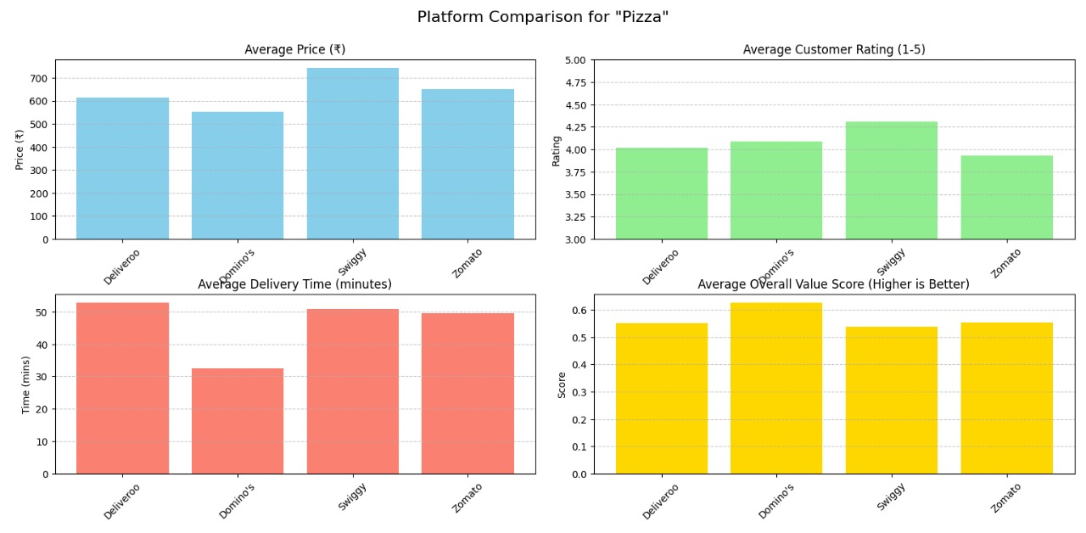
DATA VISUALISATION
In food delivery analysis by transforming raw data into meaningful insights through graphical representation. It helps identify trends, patterns, and outliers in key metrics such as customer ratings, delivery times, order volumes, and revenue comparisons across platforms like Zomato, Swiggy, Blinkit, and Uber Eats. By using visual tools like bar graphs, pie charts, line plots, and heatmaps, analysts can clearly communicate performance metrics and customer preferences. For instance, a line chart may show how delivery times vary throughout the day, while a bar graph could highlight revenue differences between platforms over a period. These visual insights assist companies in making data-driven decisions to enhance operational efficiency, improve customer satisfaction, and gain a competitive edge in the dynamic food delivery market.

Slide 13
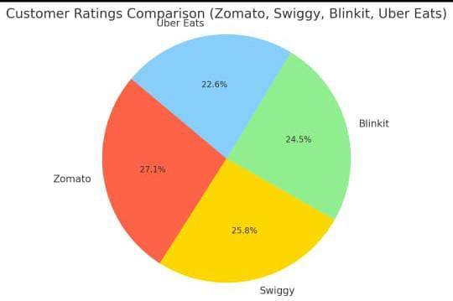
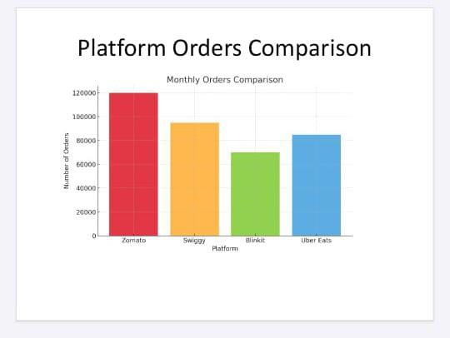
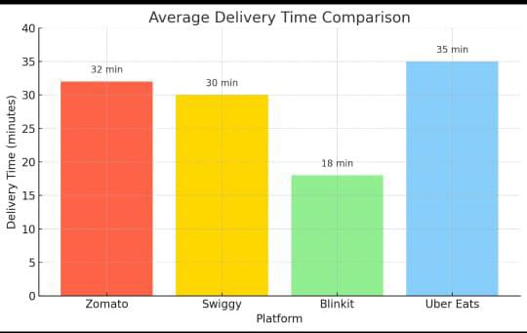
DATA VISUALISATION

Slide 14
USES OF DATA ANALYSIS LIBRARY
PANDAS
Data Manipulation:. It allows filtering, grouping, and aggregating data to derive meaningful insights.
Handling Missing Data: Pandas' functions handle missing data points effectively, ensuring data quality and preventing biases in the analysis.
Joining and Merging: Pandas is used to combine datasets when additional information, such as customer reviews or hotel amenities, is available separately.
MATPLOTLIB
Data Visualization: Matplotlib allows the creation of various visualizations like line plots, bar charts, and scatter plots to depit booking trends, revenue fluctuations, and customer distribution.
Time Series Analysis: With Matplotlib, time series plots can illustrate booking patterns over specific time intervals, highlighting seasonal variations and trends.
NUMPY
Efficient Multidimensional Arrays:
Provides the core data structure for numerical operations.
Much faster and more memory-efficient than regular Python lists.
Mathematical and Statistical
Operations: Performs element-wise operations and aggregation
Broadcasting and Vectorization Apply operations over arrays without loops faster performance.

Slide 15
ADVANTAGES
IMPROVED CUSTOMER EXPERIENCE:
Analyze delivery times, ratings, and feed back. Identify pain points like late deliveries, poor ratings, or long wait times. Enable personalized promotions based on order history.
OPERATIONAL EFFICIENCY
Optimize delivery routes and times. Predict peak hours and allocate delivery staff accordingly. Detect bottlenecks in food preparation or dispatch.

Slide 16
ADVANTAGES
COST OPTIMIZATION
Track and reduce high delivery costs or discounts. Find inefficient restaurants or locations with poor margins. Minimize refunds and cancellations by identifying root causes.
Data-Driven Decision Making:
Use data to plan restaurant partnerships, expansion areas, and delivery zones .Forecast demand during festivals, weekends, or weather events. Align inventory, staffing, and marketing based on trends.

Slide 17
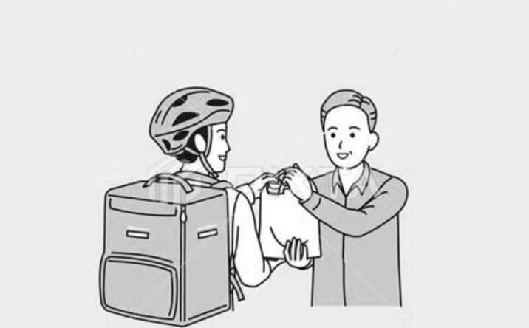
CONCLUSION
The Food Delivery Analysis System successfully demonstrates a robust approach to optimizing food ordering decisions. By simulating real-world data from key Indian platforms (Swiggy, Blinkit, Zomato, Deliveroo, Domino's) and applying a multi-factor analysis, it provides a clear "best value" recommendation alongside detailed comparisons.
The integration of matplotlib for graphical visualization further enhances user understanding, transforming complex data into actionable insights. This system serves as a powerful prototype for a tool that could significantly improve the food delivery experience by promoting smarter, more informed choices for consumers.

Slide 18
THANK YOU!

