Slide 1

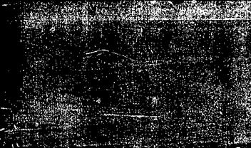
Mall-customer segmentation
Customer Segmentation using Unsupervised Learning

Slide 2
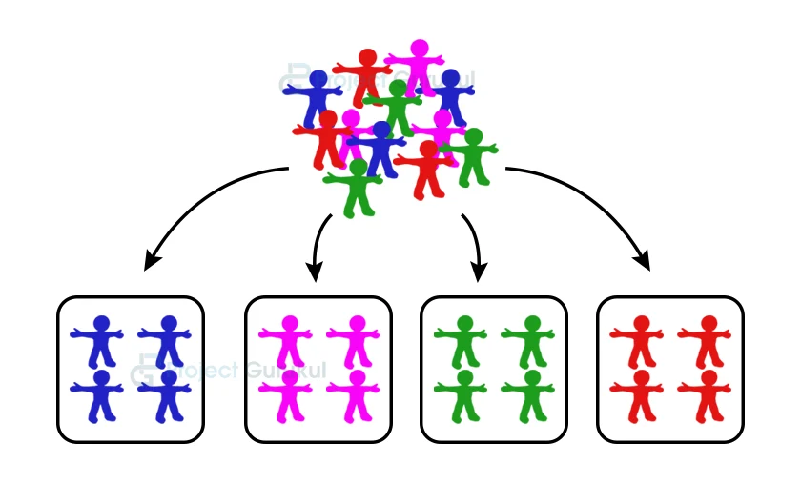
What is Customer segmentation ?
The process of segmenting the customers with similar interests and similar shopping behaviour into the same segments and with different interests and different shopping patterns into different segment

Slide 3
What is Mall-customer segmentation?
Mall customer segmentation is the process of dividing a
customer base into groups based on similar characteristics.
This process helps businesses target specific groups of
customers with tailored products, services, and marketing
strategies. Here the Key role is played by CRM

Slide 4
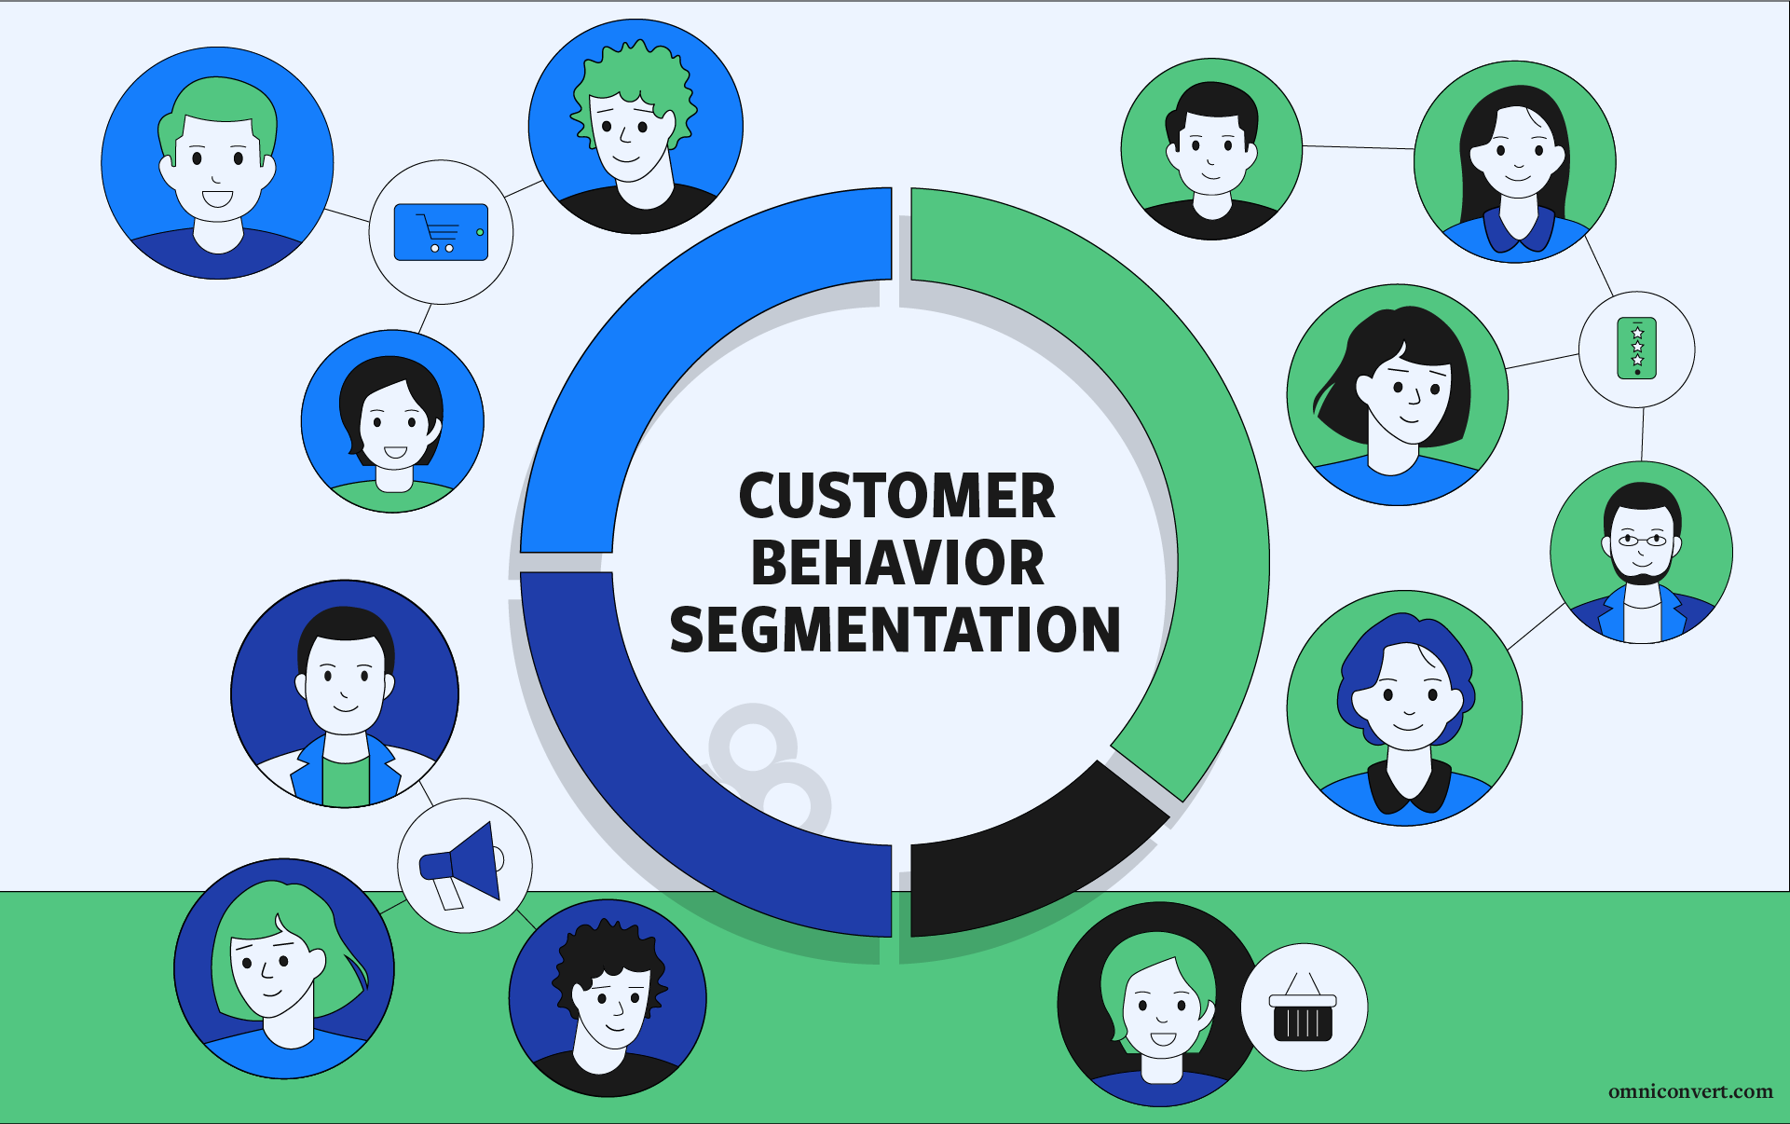
Mall-customer segmentation

Slide 5
Customer Relationship Management
What is CRM ?
The concept of CRM garners much attention since it is a
comprehensive process of acquiring and retaining customers
using business intelligence, to maximize the customer value for a
business enterprises

Slide 6
Customer Relationship Management
Why CRM ?
One of the two most important objectives of CRM is customer
development through customer insight. This objective of CRM
entails the usage of an analytical approach in order to correctly
assess customer information and analysis of the value of
customers for better customer insight.

Slide 7
PROBLEM STATEMENT
Customer Segmentation is a popular application of unsupervised learning. Using clustering, identify segments of customers to target the potential user base. They divide customers into groups according to common characteristics like gender, age, interests, and spending habits so they can market to each group effectively.

Slide 8
Problem statement
GOALS
Analyze customer data to identify segments.
Develop targeted marketing strategies and customer experience enhancements.
DATA
Report, visualizations, and presentation summarizing key findings and recommendations.
DELIVERABLES
Customer demographics, shopping behavior, purchase history, and feedback.

Slide 9
challenges
DATA RELATED
Analytical
Business

Slide 10
Challenges
DATA RELATED :
Data Quality:
Incomplete, inaccurate, or inconsistent data.
Data Integration:
Combining data from different sources and formats.
Data Privacy:
Ensuring customer data is collected and used ethically.

Slide 11

challenges
                ANALYTICS:
Segmentation Complexity:
Identifying meaningful and actionable customer segments.
Variable Selection:
Choosing relevant variables for segmentation analysis.
Model Interpretability:
Understanding and explaining complex analytical models.

Slide 12
challenges
BUSINESS :
Stakeholder Buy-In:
Gaining support from mall management and
stakeholders.
Resource Constraints:
Limited budget, time, or personnel for the project.
Implementation and Adoption:
Ensuring that insights and recommendations are implemented and
adopted by the malls

Slide 13

EXISTING system
Manual Data Collection:
Customer data is collected manually through surveys, feedback
forms, and loyalty programs.
Basic Analytics:
The mall uses basic analytics tools to track foot traffic, sales, and
customer demographics.
Mass Marketing:
The mall uses mass marketing strategies, such as email blasts and
social media promotions, to reach all customers.

Slide 14
Proposed system
Targeted Marketing
Competitive Advantage:
Enhanced Customer Experience
Improved Customer Understanding:

Slide 15
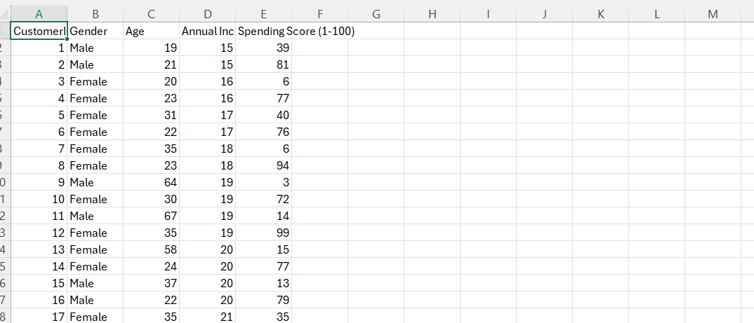
Data set
MALL CUSTOMER SEGMENTATION

Slide 16
ATTRIBUTES:
CUSTOMER
GENDER
AGE
ANNUAL INCOME
SPENDING SCORE

Slide 17
ALGORITHMS USED
1.K MEANS CLUSTERING ALGORITHM
2.HIERACHICAL CLUSTERING

Slide 18
outcome
The significance of customer segmentation in attracting the customers towards the
products which in turn aids the increase in the business scale in the market. Segmenting the customer group into the different groups according to the similarities they possess,on one hand, helps the marketers to provide customized ads, products, and offers.
Where on other hand it supports the customers by avoiding them from the confusion of the products to buy.

Slide 19
THANK YOU

