Slide 1
Mall customer segmentation
Understanding and Targeting Customer Groups for Business Growth
Presented by :
S . Suma (21C61A6626)
B.Koushik(21C61A6602)
K.Srividhya (21C61A6614)
A. Nithin Kumar(21C61A6601)
G.Kiran Kumar (22C65A6601)

Slide 2
Agenda
Introduction
Problem Statement
Segmentation Methods
Proposed System
Data Collection & Analysis
Customer Segments Identified
Benefits
Challenges
Future outcome
Visualizations
Conclusion

Slide 3
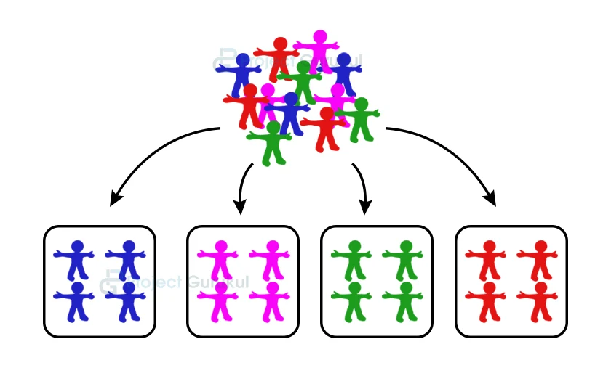
introduction
What is Customer Segmentation?
The process of dividing customers into distinct groups based on shared characteristics, such as demographics, behavior, or preferences.
Why is it important in malls?
Customer segmentation in malls is important to understand shopper preferences, tailor promotions, and optimize store layouts. It helps attract specific customer groups, enhance their shopping experience, and boost sales by offering targeted deals and services.

Slide 4

Problem statement
Malls struggle to understand diverse customer needs, leading to ineffective marketing and reduced satisfaction. Customer segmentation helps classify visitors based on behavior and preferences, enabling personalized promotions and improved customer experiences.

Slide 5
Segmentation Methods
Demographic
Behavioral
Psychographic
Age, Gender, Income
Shopping frequency, Spending patterns
Lifestyle, Preferences

Slide 6
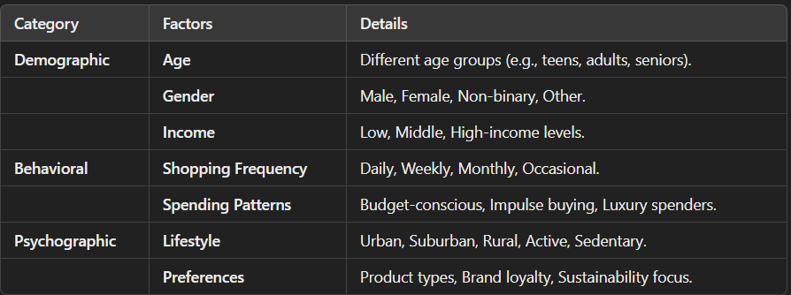
Segmentation methods

Slide 7
Proposed system
Data Gathering
Feature Extraction
K-means Classifier
Hyper Parameter Tuning
The proposed system uses data-driven techniques to segment mall customers based on demographics, shopping behavior, and preferences.
By leveraging machine learning algorithms such as K-means clustering, the system analyzes customer data (e.g., purchase history, frequency, and spending patterns). The insights generated help in creating targeted marketing strategies, optimizing store layouts, and offering personalized promotions to enhance customer satisfaction and boost mall revenue.

Slide 8
Data collection & analysis
Data Sources
Techniques Used

Slide 9
Data collection & Analysis
Data Sources :
Point-of-Sale (POS) Data
Loyalty Programs
Foot Traffic Analysis
Surveys and Feedback Forms
Online Interactions

Slide 10
Data collection & Analysis
Techniques Used:
K-Means Clustering
Hierarchical Clustering

Slide 11
Techniques used
K-Means Clustering:
A popular unsupervised learning algorithm that groups customers into clusters based on similar characteristics. It is widely used for segmentation tasks, such as categorizing customers by spending habits and frequency of visits
Hierarchical Clustering:
Builds a hierarchy of clusters, which is helpful in understanding the relationship between different customer groups and their subdivisions

Slide 12
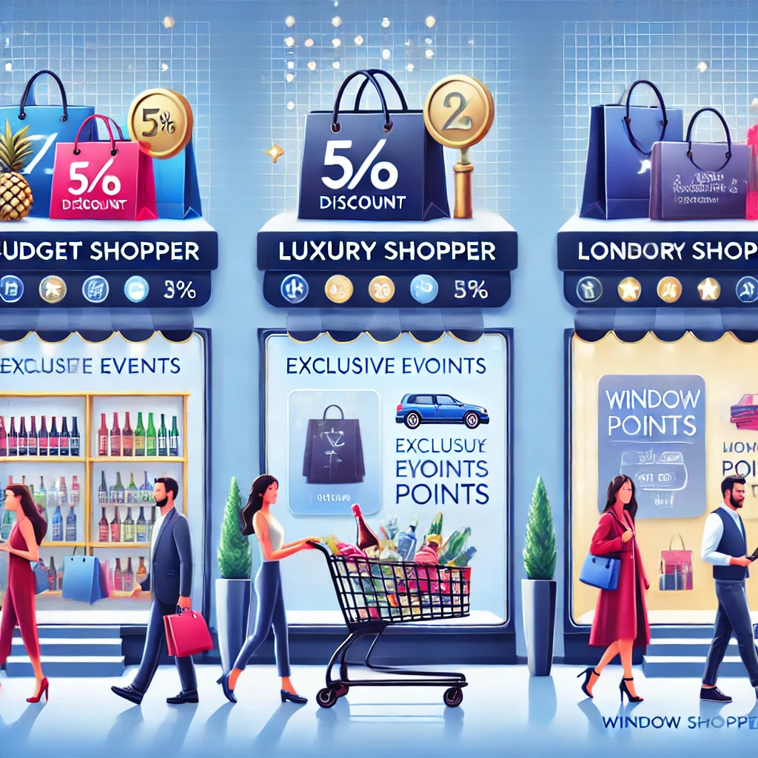
Customer Segments Identified
Budget Shoppers
Luxury Shoppers
Window Shoppers
Price-sensitive, frequent sales buyers
High-income, brand-conscious
Visit often but buy infrequently

Slide 13
Benefits
Personalized Marketing
Improved Customer Experience
Increased Sales and Revenue
Enhanced Foot Traffic Management
Customer Retention and Loyalty

Slide 14
challanges
Data Quality and Accuracy
Customer Behaviour Complexity
Segmentation Model Accuracy
Over-Segmentation
Changing Market Dynamics

Slide 15
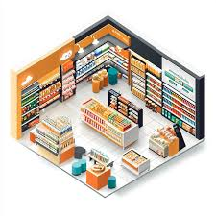
Future outcomes
Smarter Store Layouts and Product Placements
Data-driven insights from segmentation will guide store designs and product placements, optimizing traffic flow and maximizing sales for specific customer groups.
The significance of customer segmentation in attracting the customers towards the
products which in turn aids the increase in the business scale in the market.

Slide 16
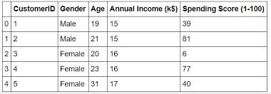
dataset
Dataset Name: Mall Customer Segmentation Data ( Mall_customers.csv)
Description: A dataset with customer demographics (age, gender, income) and spending scores, often used for customer segmentation tasks.
Source: Kaggle (e.g., "Mall Customer Segmentation Data" on Kaggle).

Slide 17
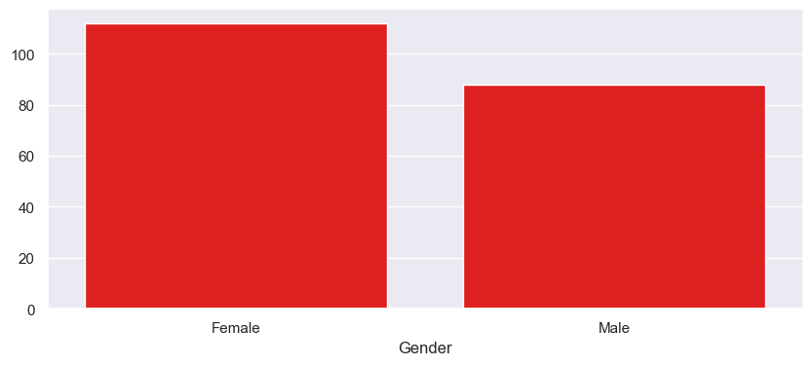
visualizations
Bar Graph:
Representing bar graph between Female and Male Customers spendings

Slide 18
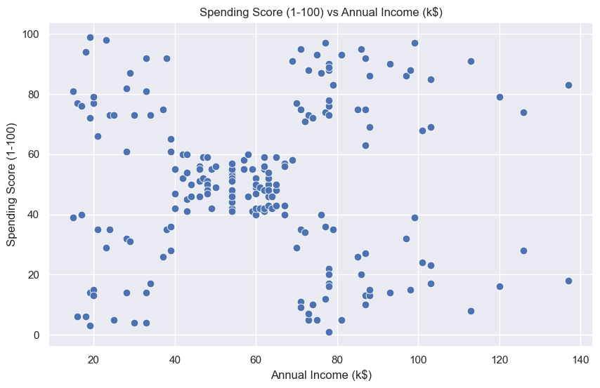
visualizations
Scatter Plot :
Spending score of customers based on their annual incomes.

Slide 19
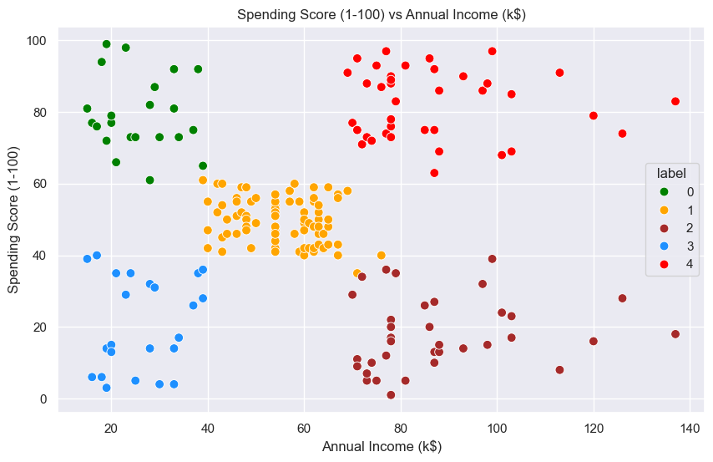
visualizations
Scatter Plot :
Clusters of customers info is scattered based on their income and spending score and labelling the clustered data

Slide 20
conclusion
Mall customer segmentation is essential for personalizing marketing, enhancing customer experience, and boosting sales. By categorizing customers based on demographics and behavior, malls can tailor promotions and improve resource allocation. While challenges like data integration and privacy concerns exist, the benefits of targeted engagement and customer loyalty make segmentation a key strategy for long-term success.

Slide 21
Thank you….!

