Slide 1
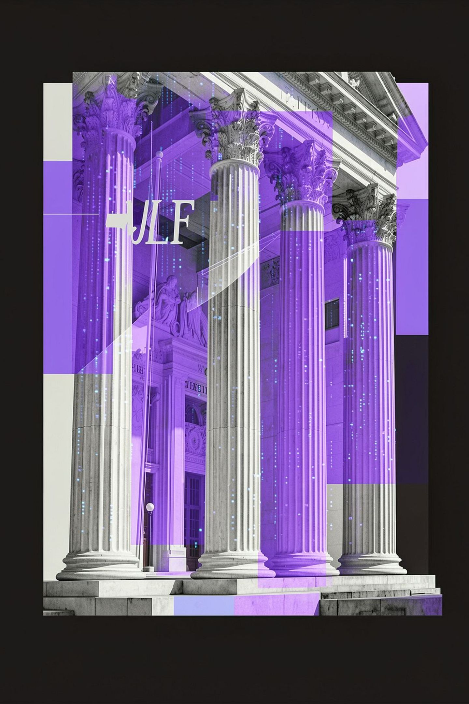
Hello Everyone
Welcome to a new era of legal enterprise intelligence.

Slide 2

Meet the Creators
The minds behind RAG2Law — building enterprise-grade legal AI from the ground up.
Kanak Khavate
Sumit Patil
Co-Creator & Architect
Co-Creator & Architect
Sharya Dalwai
Co-Creator & Architect
Introducing RAG2Law: Enterprise-Grade Legal AI Intelligence

Slide 3
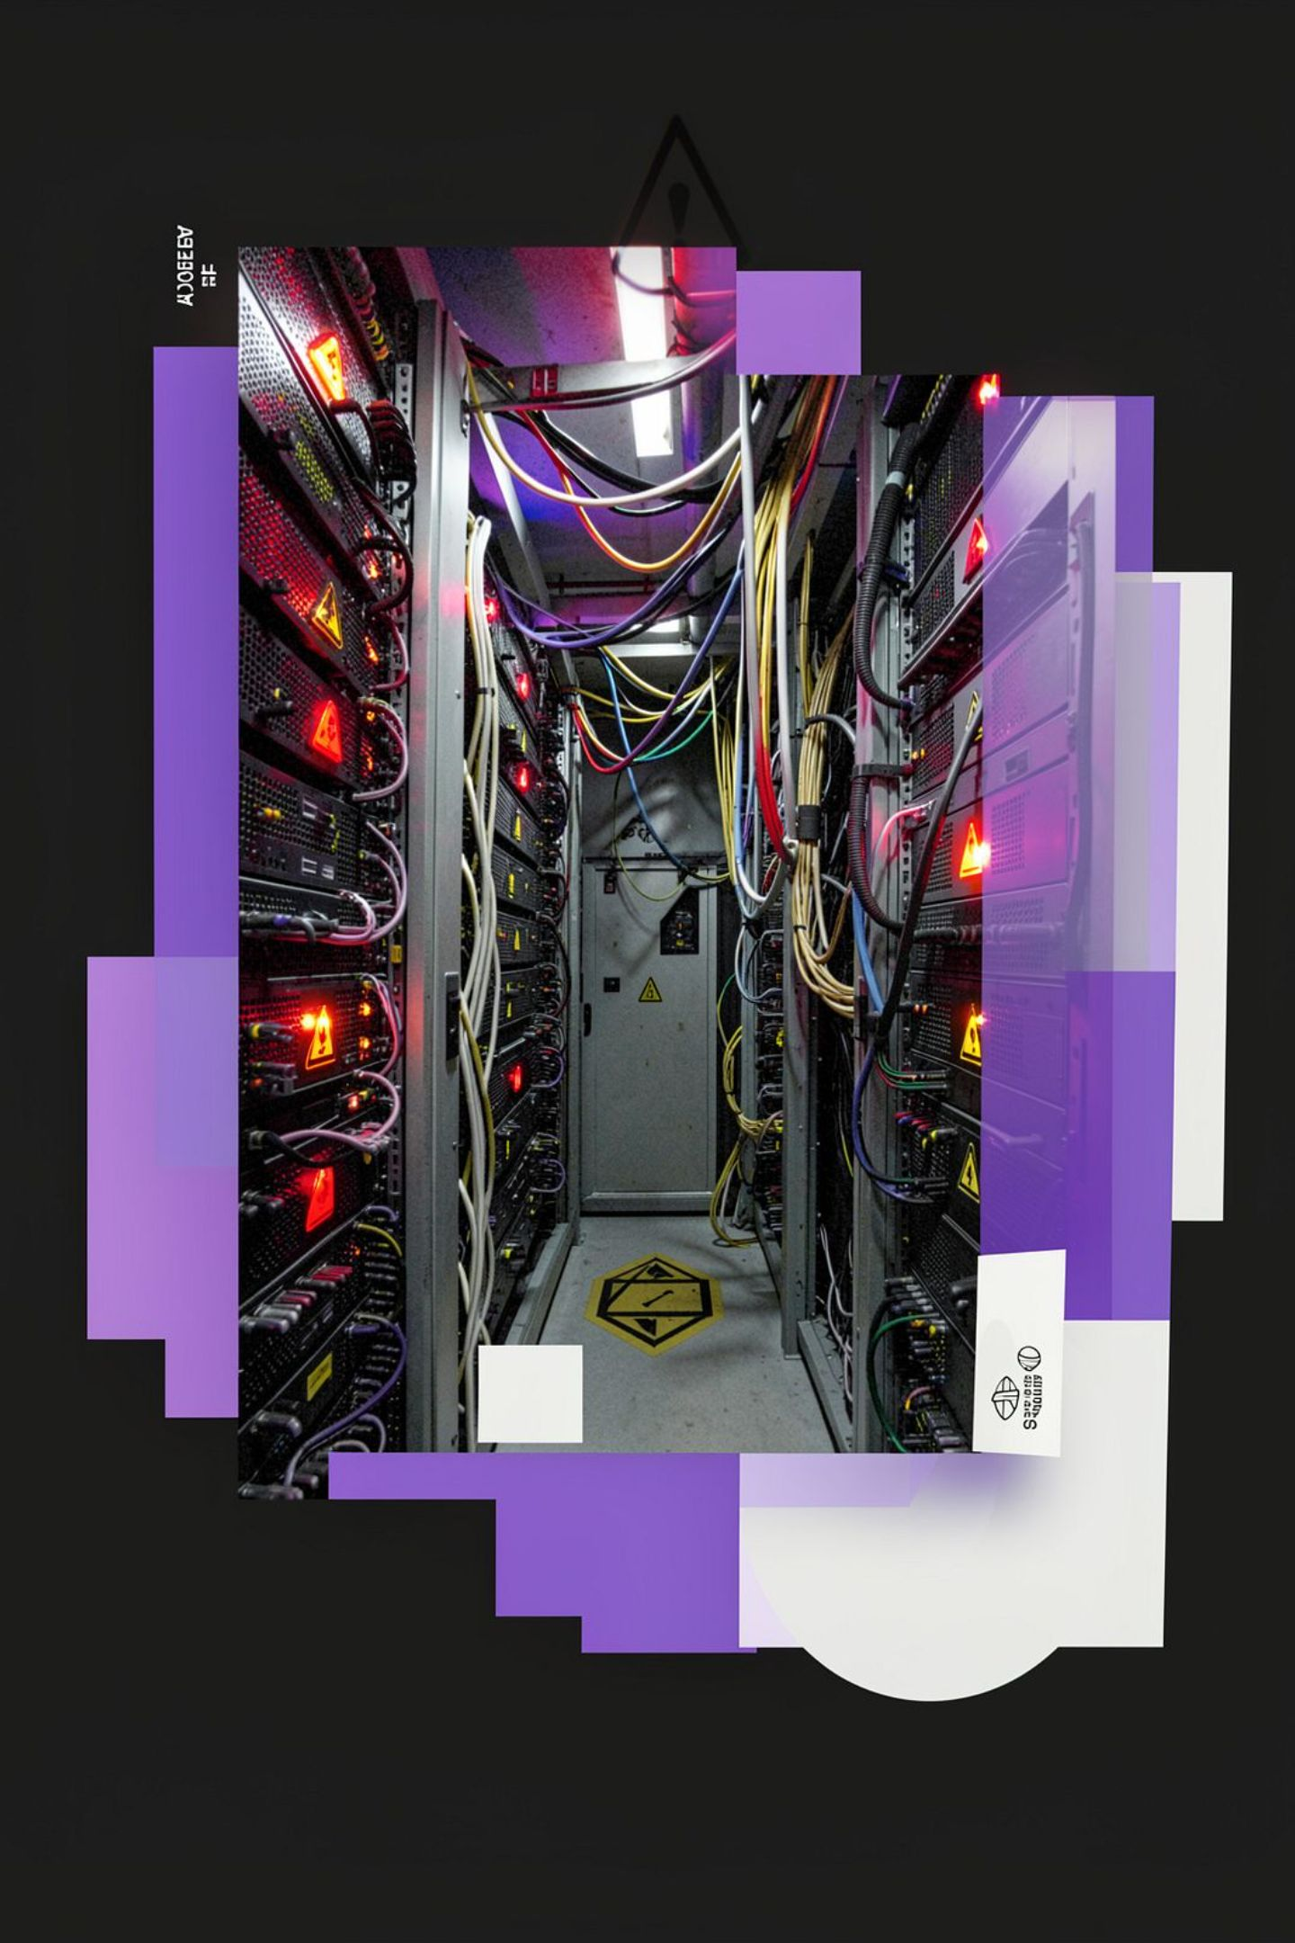


The Enterprise AI Crisis
Accelerating Adoption, Catastrophic Risk
Enterprise AI adoption is accelerating — but raw LLM deployments expose sensitive legal data to catastrophic risk with every single prompt.
Data That Cannot Be Trusted to Public Pipelines
Proprietary contracts, financial records, and court filings cannot be trusted to public cloud inference pipelines. The exposure is not theoretical — it is structural.
What RAG2Law Delivers
Harnessing full AI power without leaking company data or burning cloud budgets — this is precisely what RAG2Law delivers.

Slide 4

CHAPTER
The Three Critical Problems
Privacy. Scale. Truth. Every legal AI deployment must confront these three failure vectors — RAG2Law was built to eliminate all three.

Slide 5

PROBLEM #1
Data Privacy Exposure
The Exposure Vector
Proprietary Contracts & Proofs
Every prompt submitted to a public LLM API is a potential data exfiltration event. Without strict local boundaries, enterprise AI becomes an uncontrolled liability surface.
Passing sensitive corporate agreements to public cloud LLMs risks data theft and regulatory compliance breaches across GDPR, HIPAA, and attorney-client privilege mandates.
Financial & Property Damage
A single data leak via a public AI prompt can cause irreversible property damage, competitive harm, and direct legal liability.

Slide 6
PROBLEM #2
Token Limits & Scale
The Million-Record Constraint
Astronomical Token Costs
Latency & Model Breakdown
Even the largest frontier models cap at ~128K tokens — a fraction of a real legal case's document volume. Dump-pasting raw files burns through cloud API budgets within hours of production use.
Real-world legal cases involve thousands of documents. They physically cannot fit inside an AI context window — full stop.
Oversized prompts degrade model attention mechanisms, causing high response latency, incoherent outputs, and cascading model failure.

Slide 7
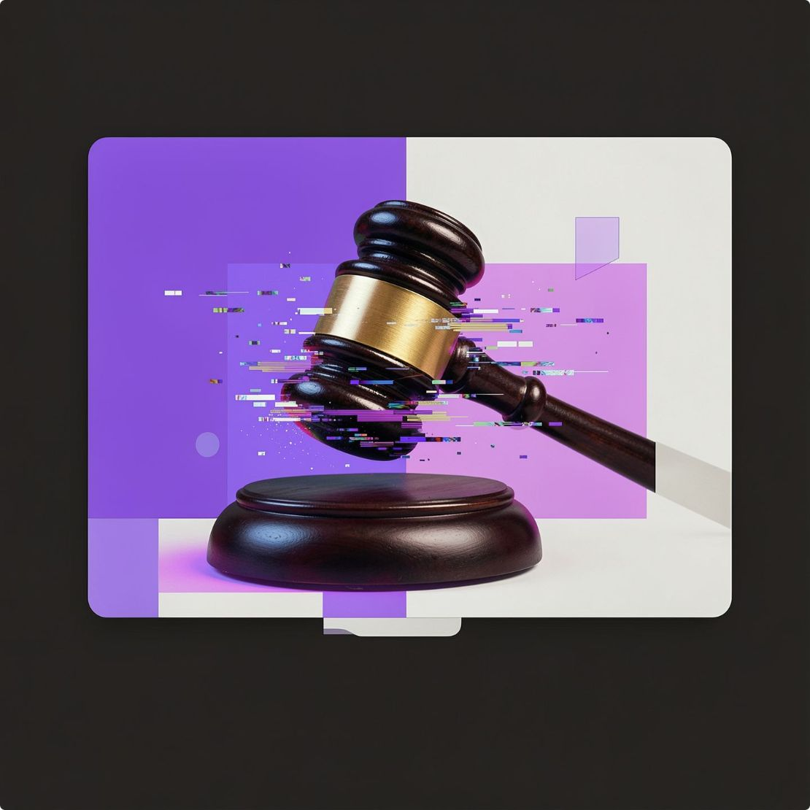

PROBLEM #3
AI Hallucinations
The Legal AI Mandate
Fabricated Laws & Sections
Case-Invalidating Consequences
Legal AI must never guess. Every claim, citation, and conclusion must be tied to a verifiable, line-item document citation with exact source file, page number, and extractable text.
Standard AI models confidently invent non-existent statutes, section numbers, and regulatory provisions when unsupported by exact, in-context source material.
A single fabricated section or precedent submitted in a court filing or contract invalidates the entire document and exposes counsel to sanctions.

Slide 8
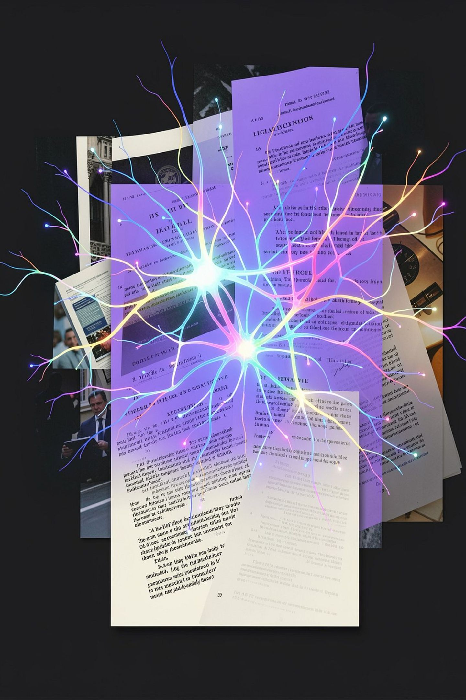
CHAPTER
The RAG2Law Solution
Retrieval-Augmented Generation — applied surgically, safely, and at enterprise scale for legal intelligence.

Slide 9

Mastering RAG: The Innovation That Changes Everything
Retrieve
Reason
Respond
Safe
Surgical
At Scale
All retrieval happens within local, air-gapped boundaries — zero public cloud exposure.
Only the most relevant fragments are retrieved — eliminating token waste and cost blowout.
Handles millions of records across thousands of documents without degrading model performance.

Slide 10



CORE ADVANTAGES
Three Core Advantages
Local & Secure Data
95%+ Token Cost Savings
Zero Hallucinations
Proprietary documents stay in local vector indices. Data is never fed to open cloud training sets, eliminating all third-party data exposure risk entirely
Queries retrieve ONLY the top 2–3 relevant text pages instead of dumping 10,000 pages into the prompt — slashing API costs by orders of magnitude in production
Enforces strict prompt boundaries — the AI answers only using verified document context. No invented laws. No fabricated precedents. No guesswork

Slide 11
The Legal Enterprise Cannot Afford Guesswork
RAG2Law enforces precision, privacy, and performance at every layer of the intelligence stack.
Anything less is not a legal AI tool — it is a liability generator.

Slide 12


The Three Architectural Layers
Privacy Layer
Speed Layer
Accuracy Layer
All data processing — OCR, embedding, retrieval — executes within the local enterprise perimeter. Zero exfiltration surface
Groq LPU + FAISS ANN search delivers sub-second end-to-end query latency from user question to cited answer
LangChain strict context boundaries + Qwen 3.6 reasoning + citation enforcement = zero hallucination guarantee

Slide 13





Technology Stack Overview
Frontend
Backend Microservice
Multimodal OCR
React 18 · TailwindCSS · HTML5 Canvas · Lucide Icons · React-Dropzone
Python 3.11 · Flask · Werkzeug · CORS
RapidOCR (ONNX Runtime) · PyMuPDF · pdfplumber · python-docx
RAG & Vector Engine
Hardware & LLM
LangChain v0.3+ · FAISS · SentenceTransformers (all-MiniLM-L6-v2)
Groq LPU Tensor Acceleration · Qwen 3.6 27B Reasoning Model

Slide 14
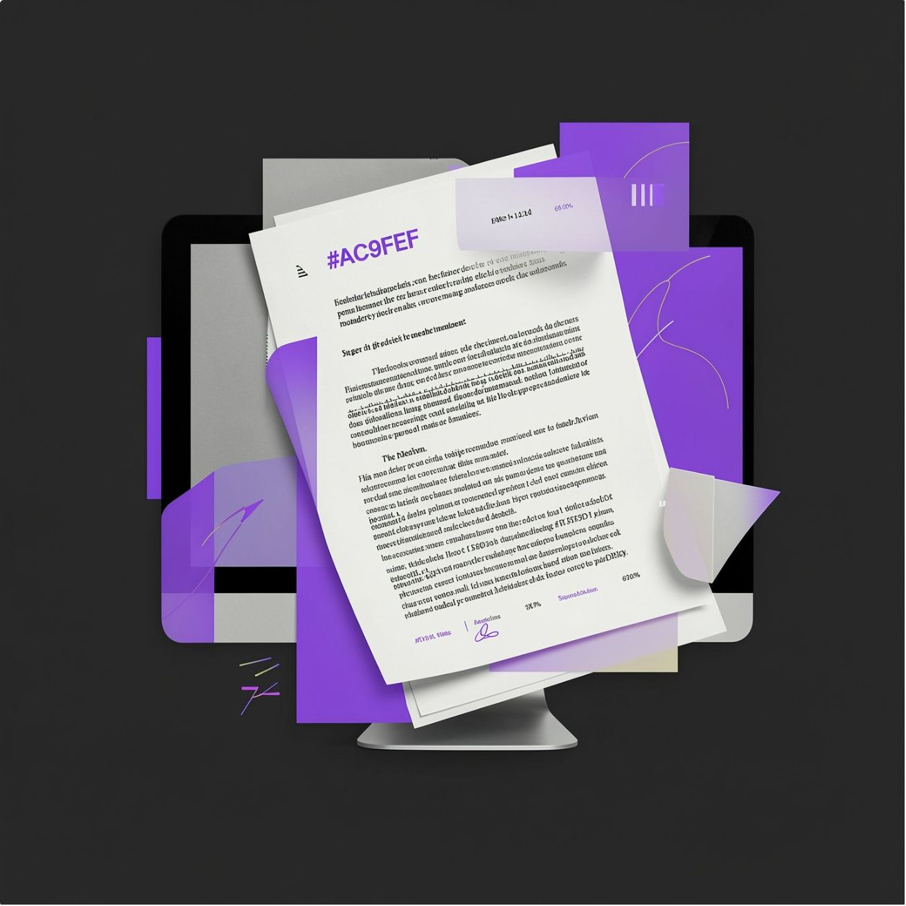


Breaking the Scanned Document Barrier
SOLUTION DETAIL
1
The Scanned Document Problem
Over 70% of real legal records are scanned paper copies or mobile images — entirely inaccessible to standard AI text pipelines without a dedicated extraction layer
2
Why Edge Matters
Cloud OCR services require document upload to external servers. This is legally impermissible for privileged materials. Edge OCR keeps every pixel inside the enterprise firewall
3
Edge OCR Technology
Integrated RapidOCR + PyMuPDF extracts text locally on CPU without third-party cloud tools. Scanned court orders, handwritten receipts, and photographed agreements are indexed as cleanly as native digital PDFs

Slide 15

Advanced Capabilities
Breaking the Scanned Document Barrier

Slide 16
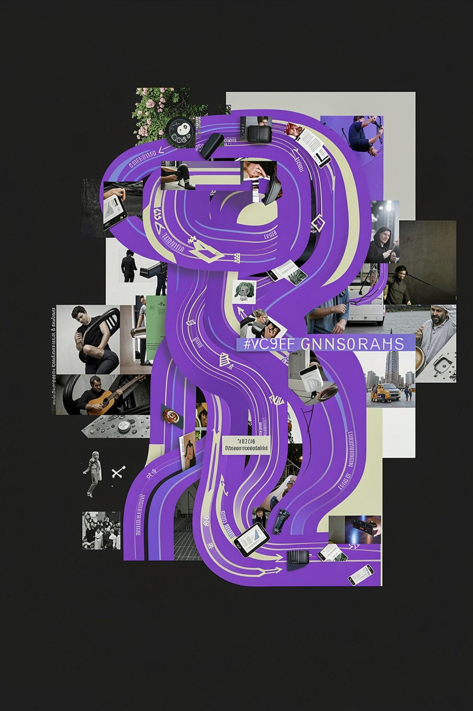




Solution Architecture
The Four-Stage Intelligence Pipeline
Ingest
Reads multi-format text documents and scanned paper files including PDFs, DOCX, images, and court-issued paper records through integrated multimodal OCR
Index
Stores 1,000-character chunks locally in FAISS vector embeddings — a high-performance similarity index that never leaves the enterprise compute boundary
Retrieve
Dynamically fetches exact relevant clauses upon user query using semantic similarity search — returning only the 2–3 most contextually precise document fragments
Answer
Generates instant answers paired with exact document name and page citations — every response is fully auditable and traceable to its source material

