Slide 1
Pharma drug sales analysis
SumiT Nerkar

Slide 2
Pharma drug sales analysis dashboard overview
The dashboard provides a comprehensive view of pharmaceutical drug sales performance across multiple years and categories.
Visualizes key metrics such as weekly/monthly/quarterly/yearly sales, category-wise distribution, and hourly sales volume.
Aids in identifying trends, high-performing drug categories, and areas for improvement

Slide 3
Key business challenge
Lack of visibility into granular drug sales data across different timeframes and categories.
Difficulty in identifying sales contribution by specific drug categories and optimizing stock/distribution strategy.
No clear insight into peak sales hours or seasonal trends, impacting resource allocation.

Slide 4
Key performance indicators
Weekly sales contribution: $202.5 from top drug (ND02BE).
Highest count of drug sold in one hour: 251 units.
Total monthly sales: $126.59K | average monthly sales: $15.82k
Year with highest sales: 2019 with $127,595.50.
Top contributing category: 49.8% of daily sales.
Peak selling hours: between 10 am to 3 pm.
Quarterly trends: Q4 consistently outperforms other quarters.

Slide 5
Sales performance summary
Sales have shown consistent growth with notable peaks in Q4 and the year 2019.
A small group of drug categories dominate the overall revenue.
Midday hours show higher sales volume—indicating operational focus should align with these hours.
Weekly sales are relatively stable, indicating predictable demand patterns.

Slide 6
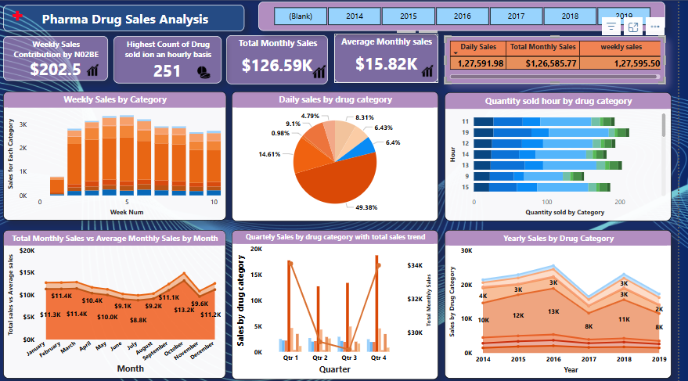
Dashboard

Slide 7
Strategic recommendations
Inventory optimization: focus stock on high-performing drug categories contributing nearly 50% of sales.
Sales strategy: align marketing and sales campaigns with q4 and peak selling hours.
Resource allocation: ensure workforce availability during 10 am–3 pm when sales are highest.
Category expansion: explore opportunities in underperforming categories for diversification.
Forecasting tools: integrate predictive analytics to plan quarterly stock and marketing budgets.

Slide 8
THANK YOU

