Slide 1

SOFTWARE PROJECT DEVELOPMENT – SWP391
Kizuna Nihongo
An AI-powered, personalized platform for learning Japanese — JLPT N5 to N1.
Personalized Roadmap
AI Sensei
絆
Kizuna Nihongo Team · 2026

Slide 2
AGENDA
What we’ll cover
I
Project Overview
II
Reference Systems
III
Actors & Use Cases
IV
Database Design
V
Code Package
● Kizuna Nihongo · Software Project Development
02 / 27

Slide 3
I · PROJECT OVERVIEW — PROBLEM
One path for everyone doesn’t work
Self-study today: one track for everyone, no timely feedback.
01 Generic roadmap One fixed curriculum, whatever the learner’s level.
02 No instant feedback Writing, speaking and kanji go uncorrected.
03 Tutors don’t scale 1-on-1 help is costly and hard to book.
04 Passive content Textbooks can’t adapt to weak points.
● Kizuna Nihongo · Software Project Development
03 / 27

Slide 4
I · PROJECT OVERVIEW — SOLUTION
A personalized, AI-assisted platform
AI woven through learning, authoring and assessment.
AI Personalized roadmap Plans the path from current level to target JLPT.
AI AI Sensei tutor Answers questions and reads the learner’s own data.
AI AI-assisted authoring Teachers generate readings, questions and audio.
AI Proctored assessment Webcam face detection, auto + AI grading.
● Kizuna Nihongo · Software Project Development
04 / 27

Slide 5
I · PROJECT OVERVIEW — SCOPE & TECH STACK
Scope & Tech Stack
SCOPE · JLPT N5 → N1
TECHNOLOGY STACK
Learn — courses, lessons, vocab, kanji, grammar
Frontend React 18 · Vite · Tailwind
Practice — flashcards, reading, writing, speaking
Backend Node.js · Express REST API (JWT)
Assess — quizzes, proctored JLPT mock exams
Data · Auth Supabase — PostgreSQL, GoTrue, Storage
Personalize — AI roadmap & AI Sensei chat
AI FPT AI Factory (OpenAI-compatible)
Author — teachers author content with AI
Extras MediaPipe proctoring · SMTP · SePay
● Kizuna Nihongo · Software Project Development
05 / 27

Slide 6
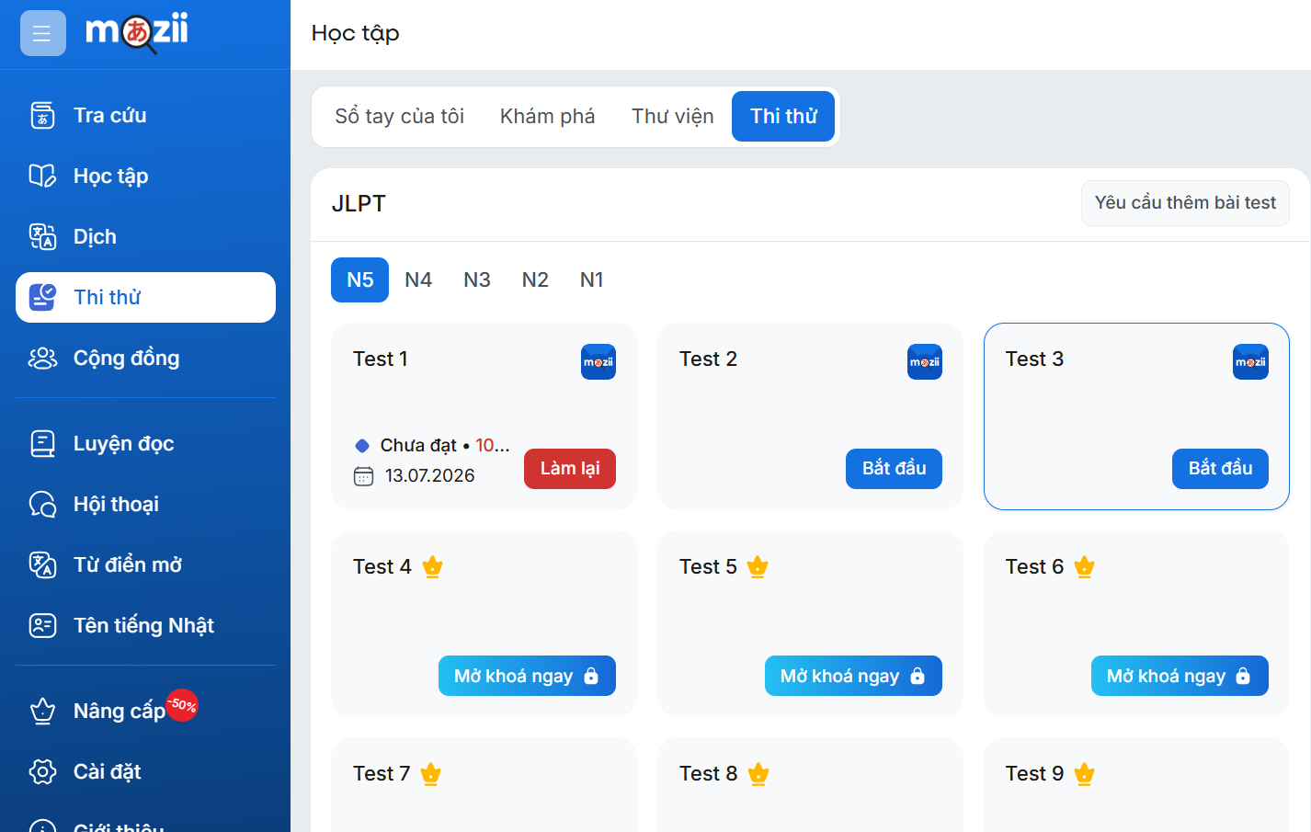
II · REFERENCE SYSTEMS — MAZII
Mazii — the dictionary everyone has
WHAT IT IS
A Japanese–Vietnamese dictionary app (web + mobile): word and kanji lookup, example sentences, saved word lists and JLPT practice tests.
WHAT WE ADOPTED
Its layered lexical model — entry → sense → kanji → example — became our dictionary_module (~17k entries, 28k senses), plus lookup-then-save-to-study-list.
GAPS WE CLOSE
No structured course path, no teacher-authored lessons, no adaptive study plan and no proctored exam. It is a reference tool, not a curriculum.
● Kizuna Nihongo · Software Project Development
06 / 27

Slide 7
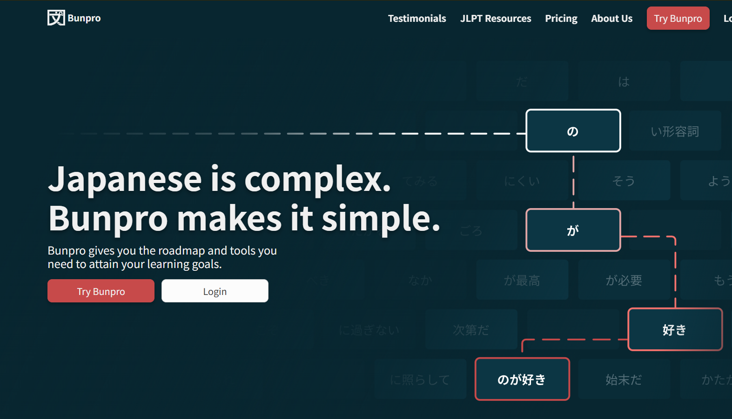
II · REFERENCE SYSTEMS — BUNPRO
Bunpro — spaced repetition, done well
WHAT IT IS
A grammar-first study platform: every grammar point and word is tagged by JLPT level and drilled through a spaced-repetition review queue.
WHAT WE ADOPTED
JLPT-level tagging on every item and per-item progress — the shape of our language_module and flashcard_module (folders → sets → cards → progress).
GAPS WE CLOSE
English-only UI, grammar-centred (little listening, speaking or writing), no live teachers and no full three-section JLPT simulation.
● Kizuna Nihongo · Software Project Development
07 / 27

Slide 8
III · ACTORS & USE CASES — ACTORS
Actors
🧭
🎓
🧑‍🏫
🛡
Guest Browses, registers, signs in.
Student Learns, practises, takes exams.
Teacher Authors content, grades exams.
Admin Manages users, content & revenue.
External · AI Service (FPT)
External · Payment Gateway
External · SMTP Email
● Kizuna Nihongo · Software Project Development
08 / 27

Slide 9
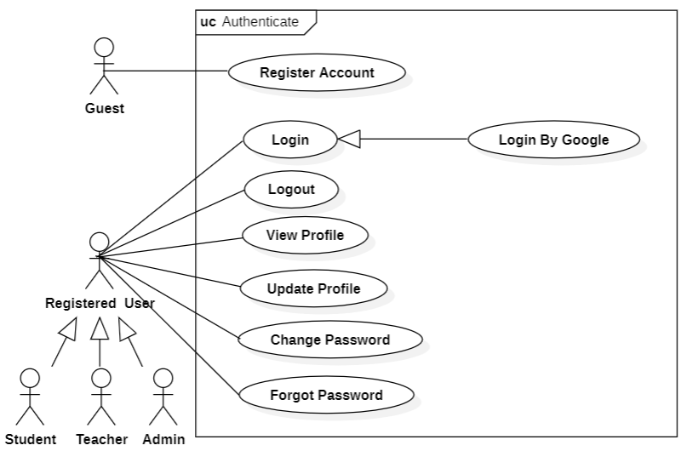
III · ACTORS & USE CASES — AUTHENTICATION
Use Case · Authentication
ACTOR · Guest / User
Register with email + 6-digit OTP
Log in — password or Google OAuth
Forgot / reset password via OTP
Change password — re-authentication required
Role-based routing after login
● Kizuna Nihongo · Software Project Development
09 / 27

Slide 10
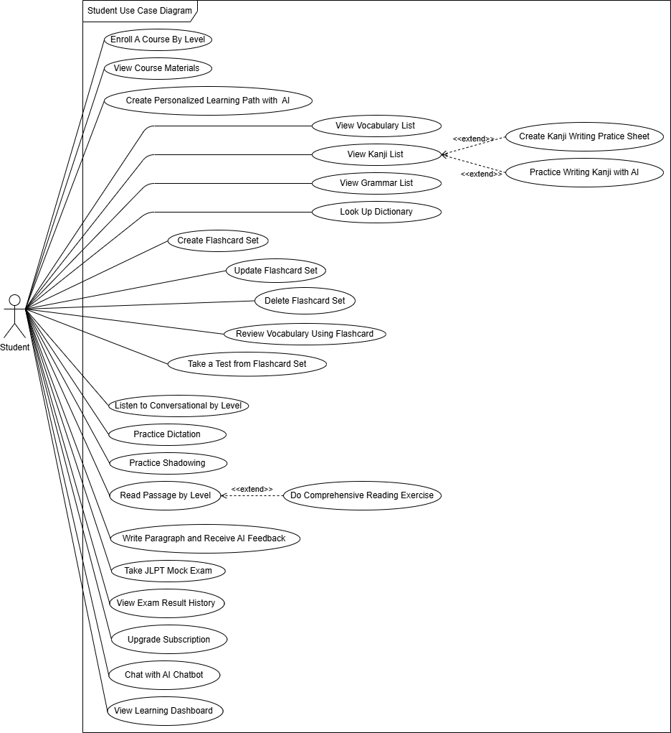
III · ACTORS & USE CASES — STUDENT
Use Case · Student
ACTOR · Student
Learn — courses, lessons, vocab, kanji, grammar
Practice — flashcards, reading, writing, kanji
Assess — quizzes, mock exams, leaderboard
Personalize — AI roadmap & AI Sensei
Account — profile & subscription
● Kizuna Nihongo · Software Project Development
10 / 27

Slide 11
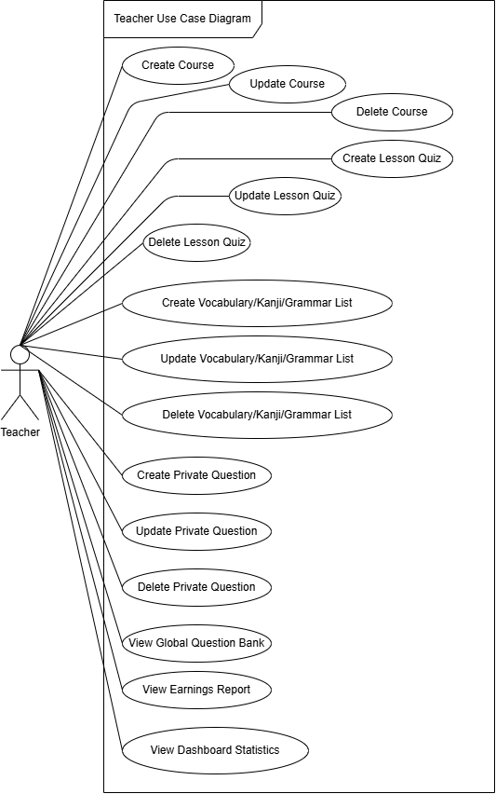
III · ACTORS & USE CASES — TEACHER
Use Case · Teacher
ACTOR · Teacher
Apply to teach — AI screens the application
Author content with AI — reading passages & listening
Question bank — private bank, manual or AI
Exams — create exams, review attempts
Earnings — monthly share of content usage
● Kizuna Nihongo · Software Project Development
11 / 27

Slide 12
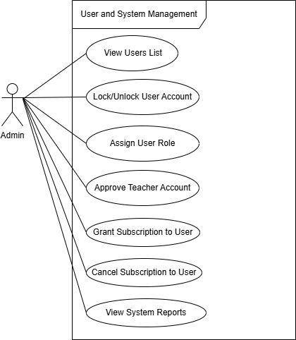
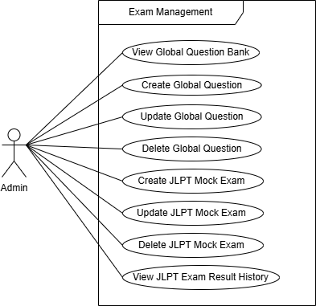
III · ACTORS & USE CASES — ADMIN
Use Case · Admin
ACTOR · Admin
User management — roles, accounts, audit logs
Content — courses, corpus, approvals
Assessment — question bank, mock exams
Monetization — subscriptions, payments, payouts
Operations — system health, teacher applications
● Kizuna Nihongo · Software Project Development
12 / 27

Slide 13
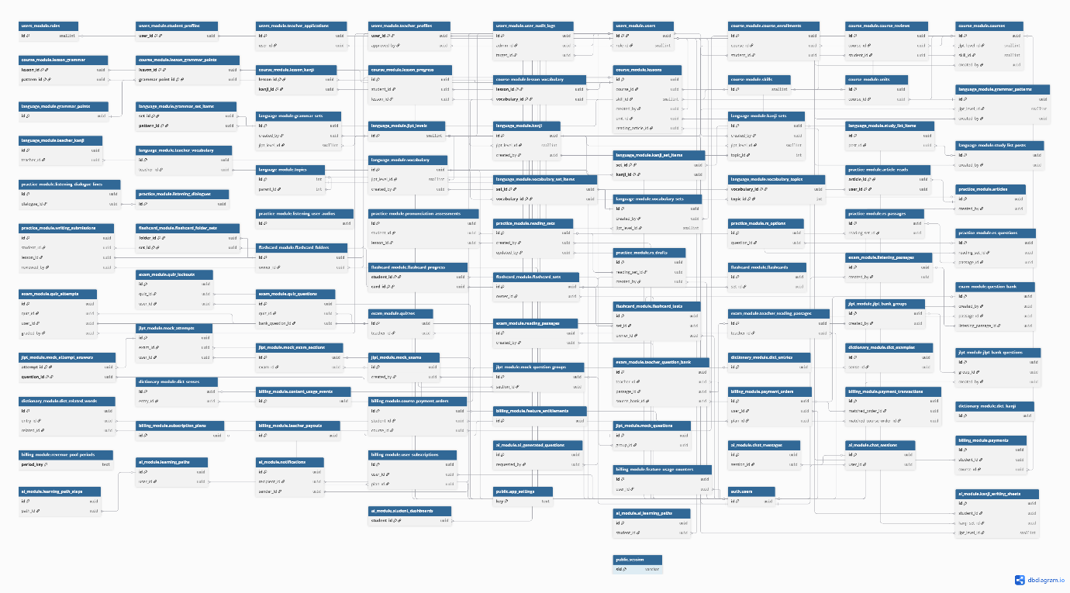
IV · DATABASE DESIGN — OVERVIEW
One database, 10 domain schemas
Every feature area owns its own schema.
● Kizuna Nihongo · Software Project Development
13 / 27

Slide 14
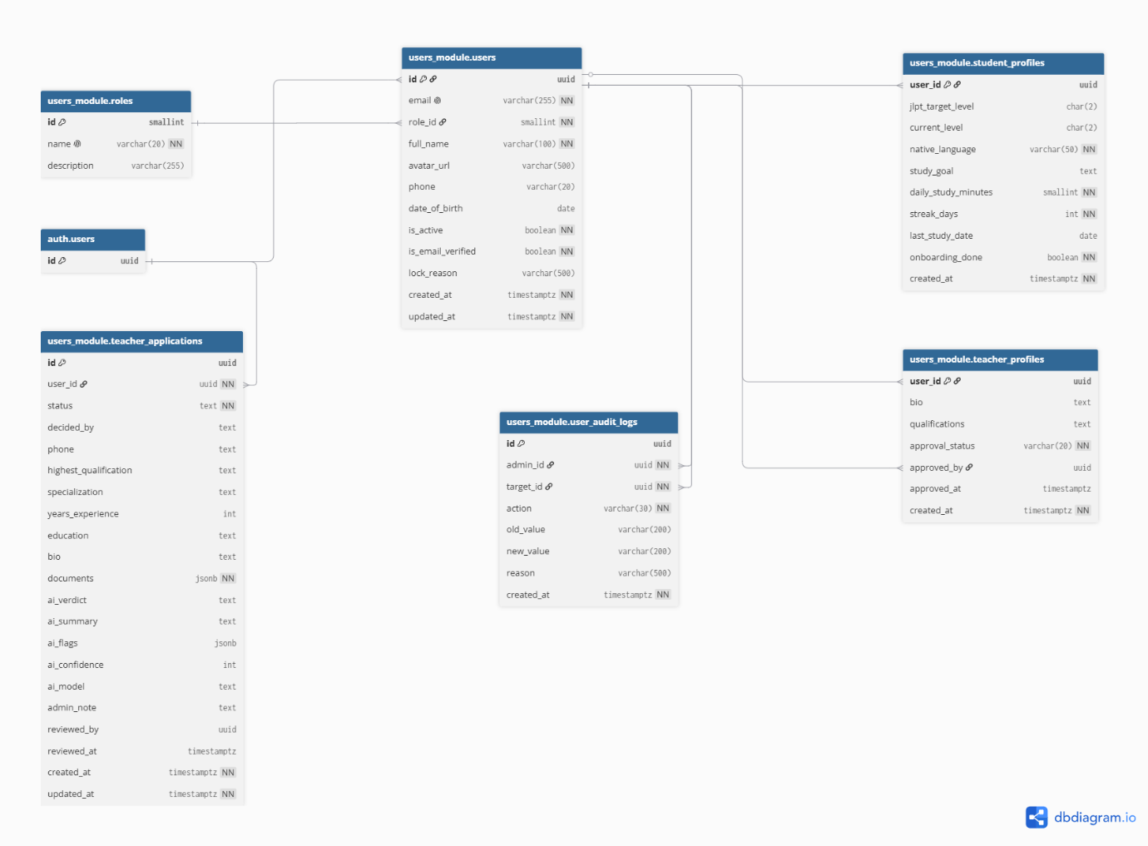
IV · DATABASE DESIGN — 1 / 11
users_module · 6 tables
Identity & profiles — users, student/teacher profiles, teacher applications, audit log.
● Kizuna Nihongo · Software Project Development
14 / 27

Slide 15
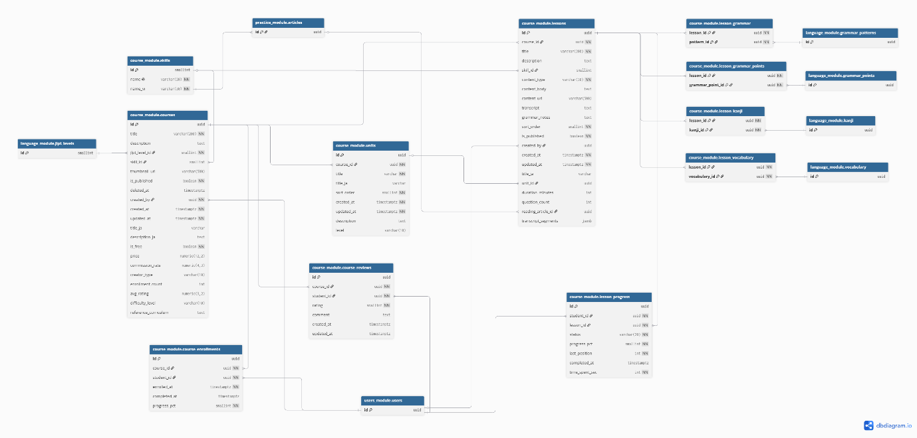
IV · DATABASE DESIGN — 2 / 11
course_module · 11 tables
Courses → units → lessons, enrollments, lesson progress, course reviews.
● Kizuna Nihongo · Software Project Development
15 / 27

Slide 16
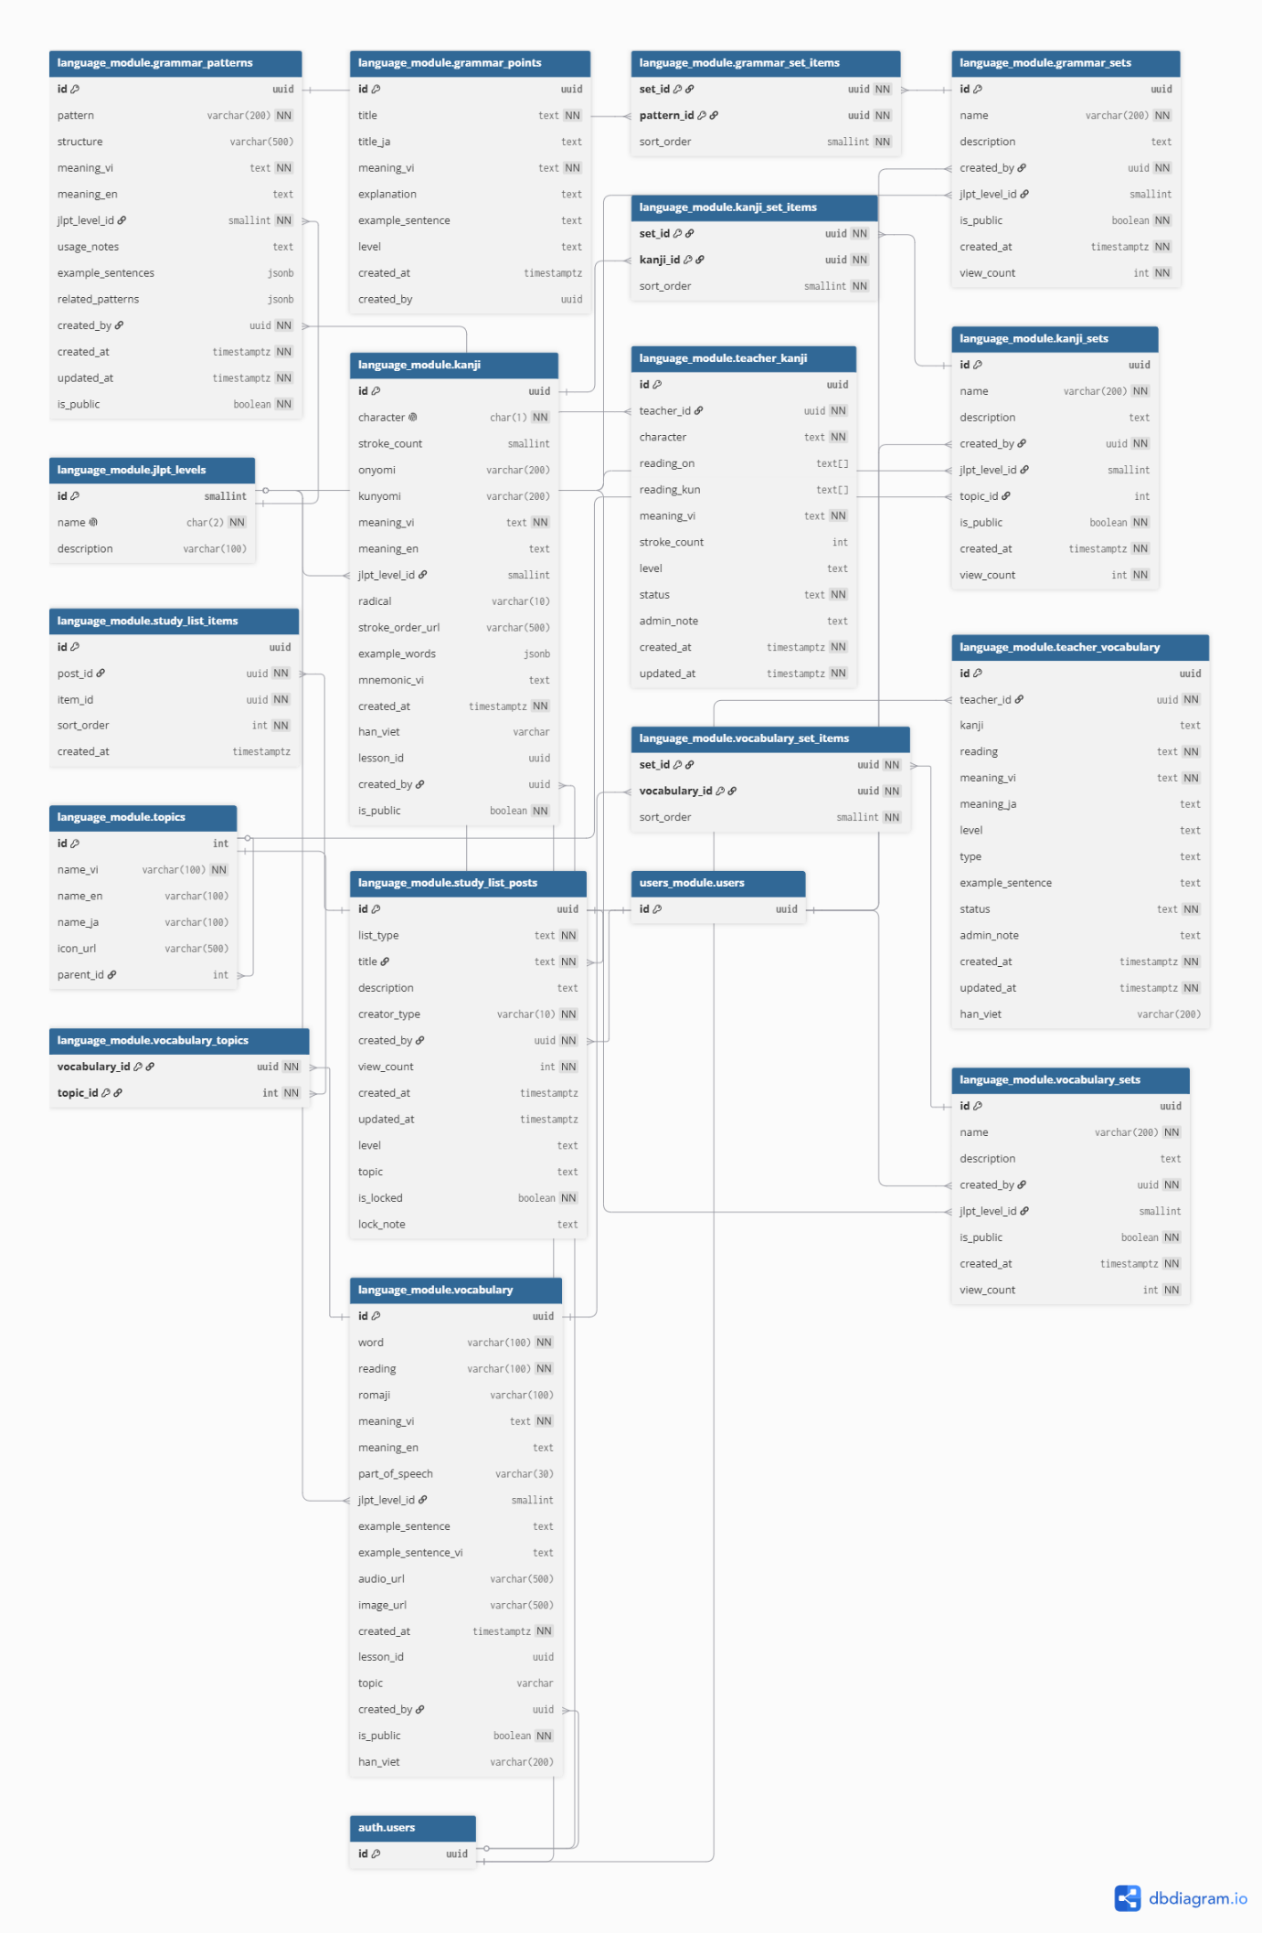
IV · DATABASE DESIGN — 3 / 11
language_module · 17 tables
Shared corpus — vocabulary, kanji, grammar points & patterns, study-list posts.
● Kizuna Nihongo · Software Project Development
16 / 27

Slide 17
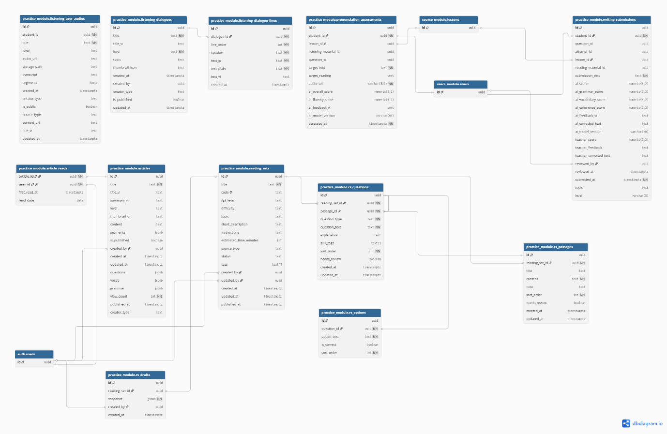
IV · DATABASE DESIGN — 4 / 11
practice_module · 12 tables
Four skills — reading sets, listening dialogues, writing submissions, pronunciation.
● Kizuna Nihongo · Software Project Development
17 / 27

Slide 18
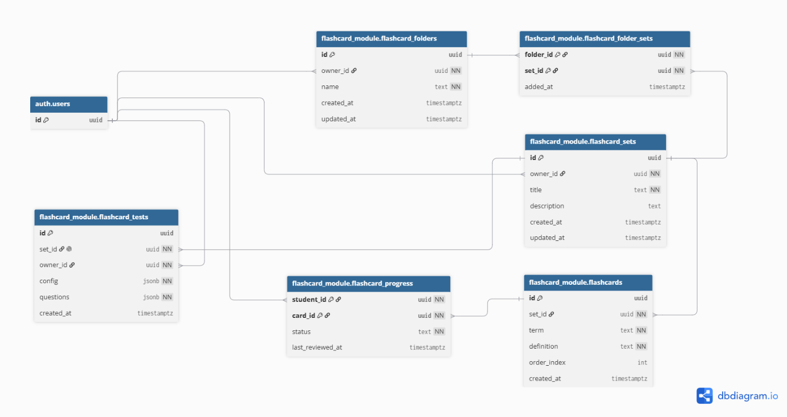
IV · DATABASE DESIGN — 5 / 11
flashcard_module · 6 tables
Folders ↔ sets ↔ cards, per-card progress, one AI-generated test per set.
● Kizuna Nihongo · Software Project Development
18 / 27

Slide 19
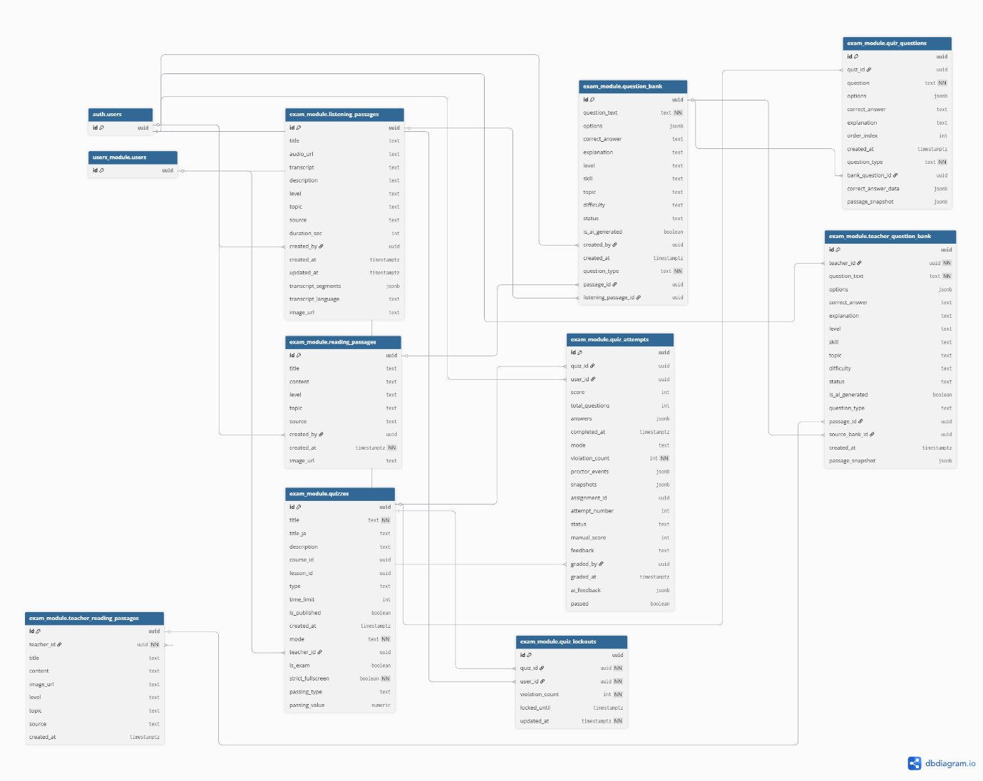
IV · DATABASE DESIGN — 6 / 11
exam_module · 9 tables
Course quizzes, proctoring lockouts, admin & teacher question banks.
● Kizuna Nihongo · Software Project Development
19 / 27

Slide 20
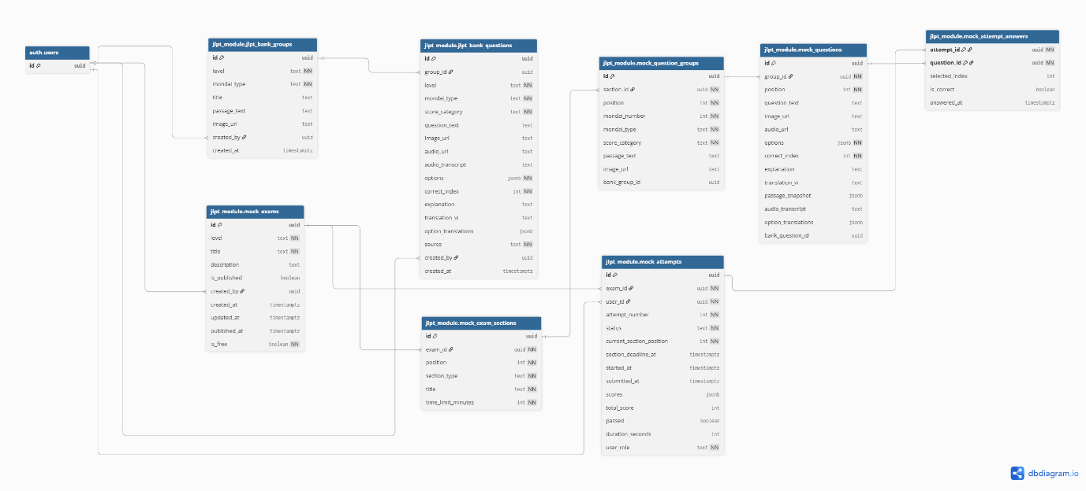
IV · DATABASE DESIGN — 7 / 11
jlpt_module · 8 tables
Mock exams → sections → mondai groups → questions, attempts, reusable bank.
● Kizuna Nihongo · Software Project Development
20 / 27

Slide 21
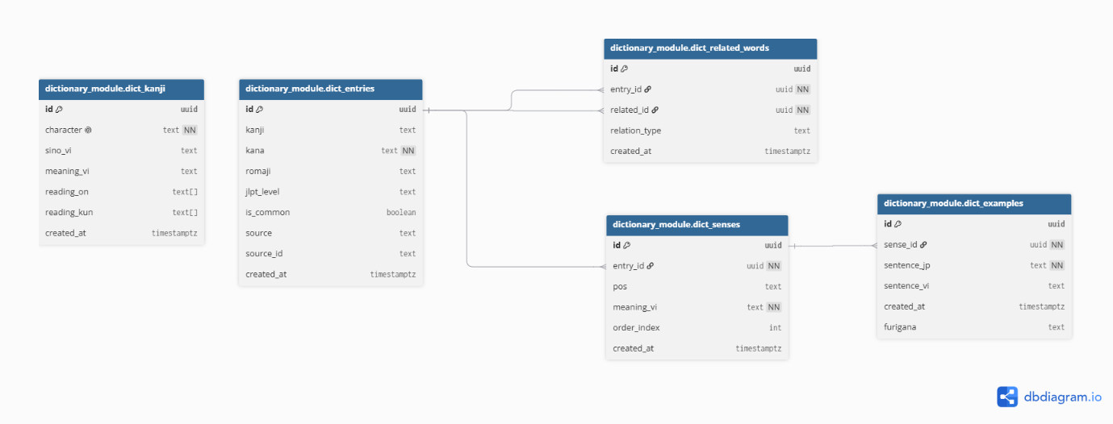
IV · DATABASE DESIGN — 8 / 11
dictionary_module · 5 tables
JP–VI dictionary — ~17k entries, 28k senses, 10k kanji, 10k examples.
● Kizuna Nihongo · Software Project Development
21 / 27

Slide 22
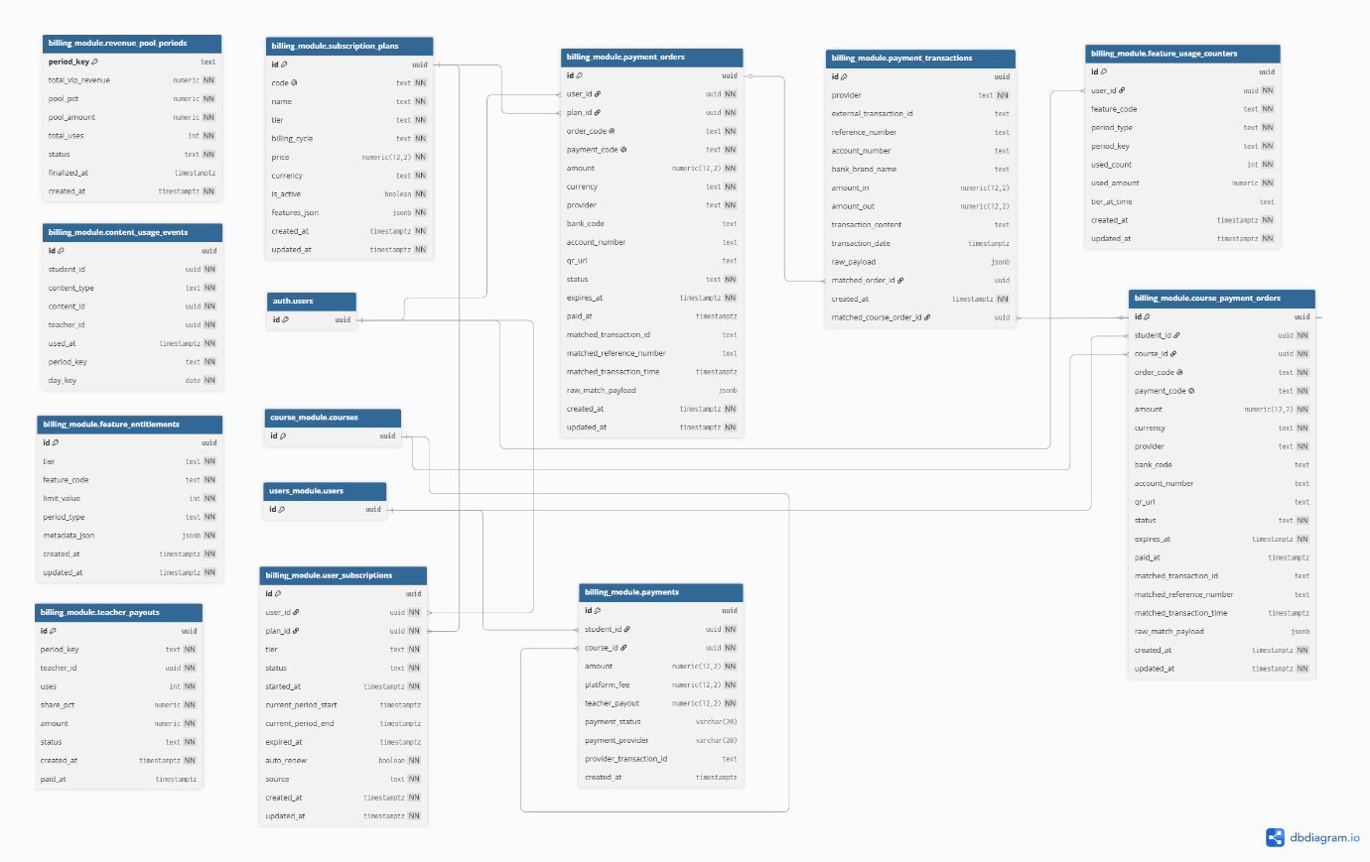
IV · DATABASE DESIGN — 9 / 11
billing_module · 11 tables
Subscriptions, SePay orders & transactions, feature quotas, teacher payouts.
● Kizuna Nihongo · Software Project Development
22 / 27

Slide 23
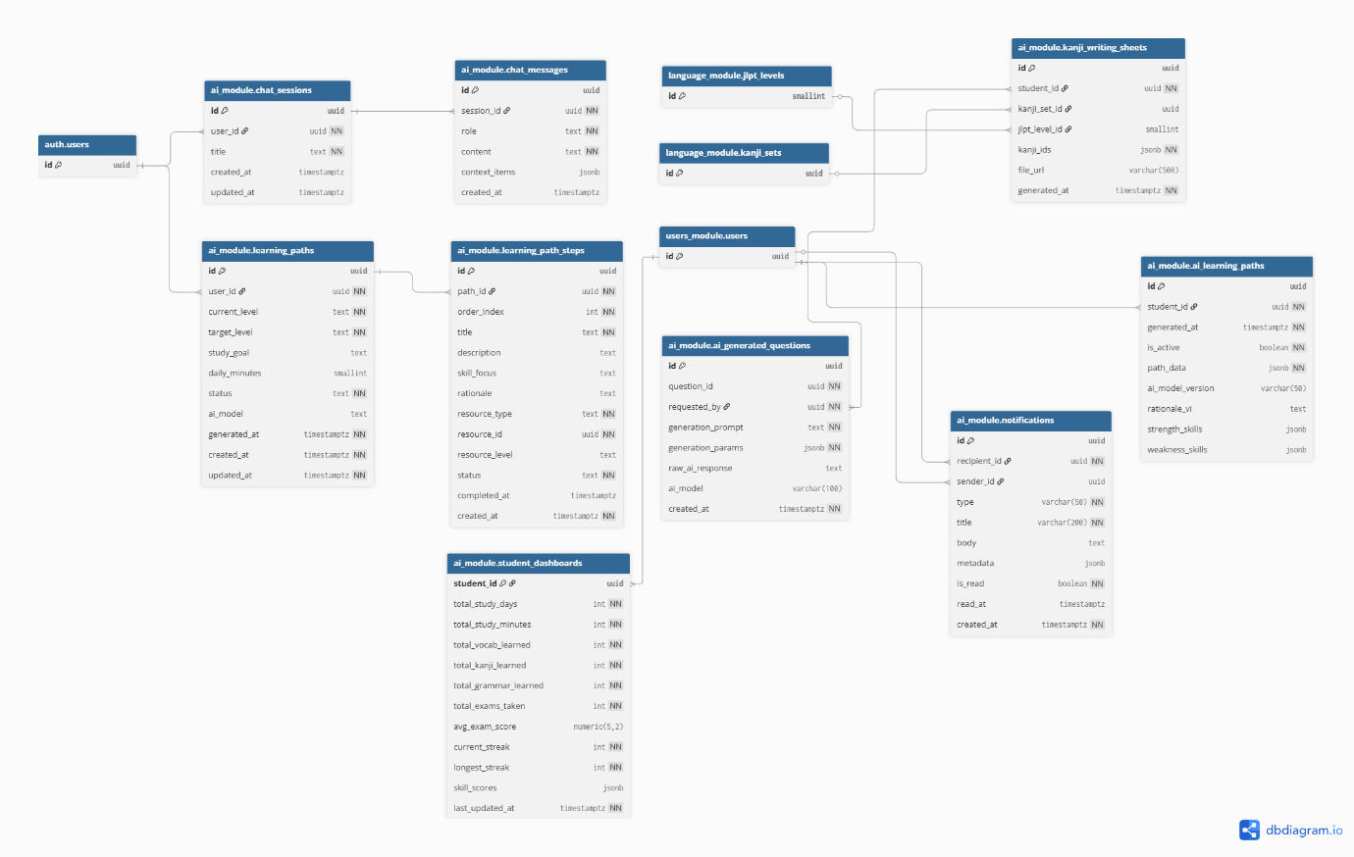
IV · DATABASE DESIGN — 10 / 11
ai_module · 9 tables
AI Sensei chat, learning paths & steps, student dashboards, notifications.
● Kizuna Nihongo · Software Project Development
23 / 27

Slide 24
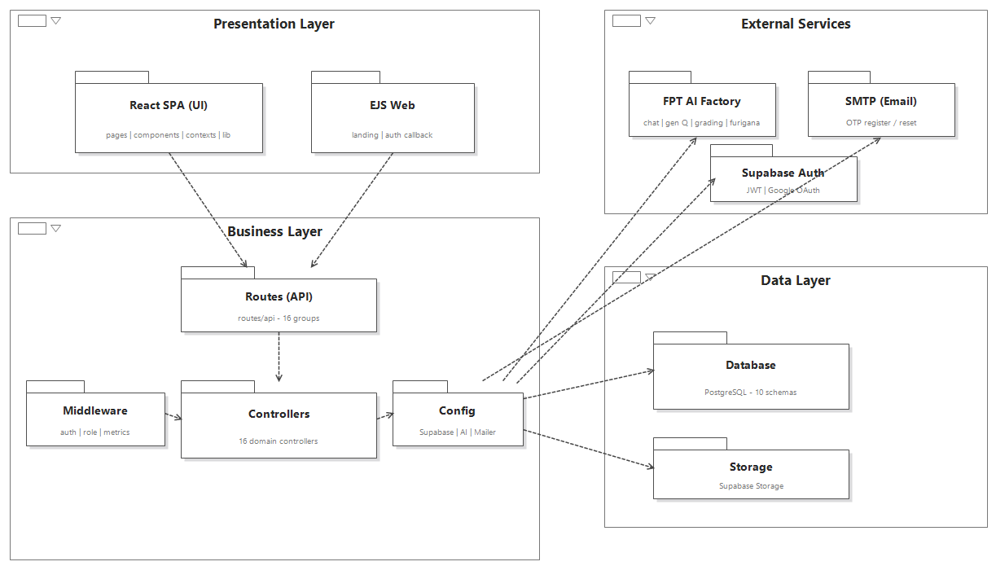
V · CODE PACKAGE — COMPONENT DIAGRAM
Package & component structure
● Kizuna Nihongo · Software Project Development
25 / 27

Slide 25

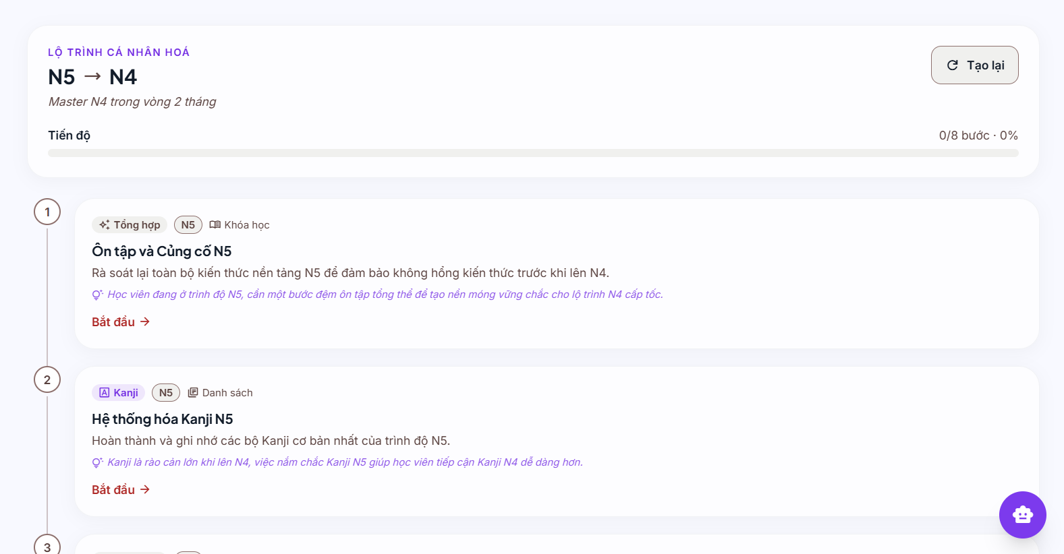
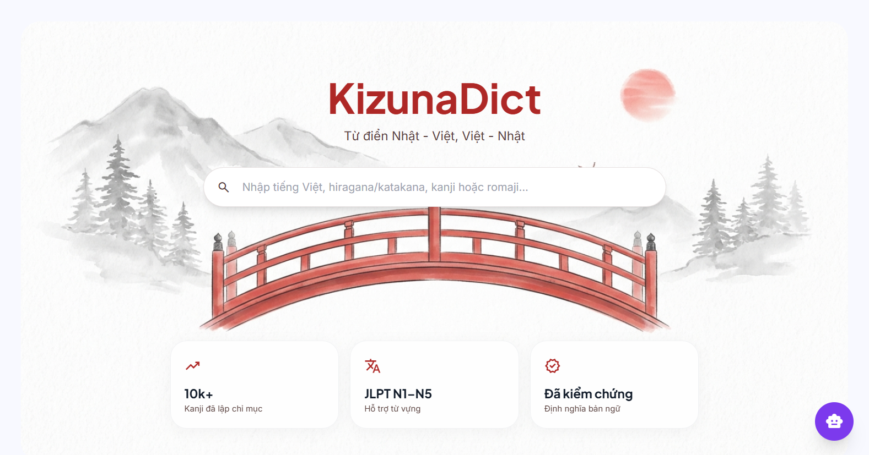
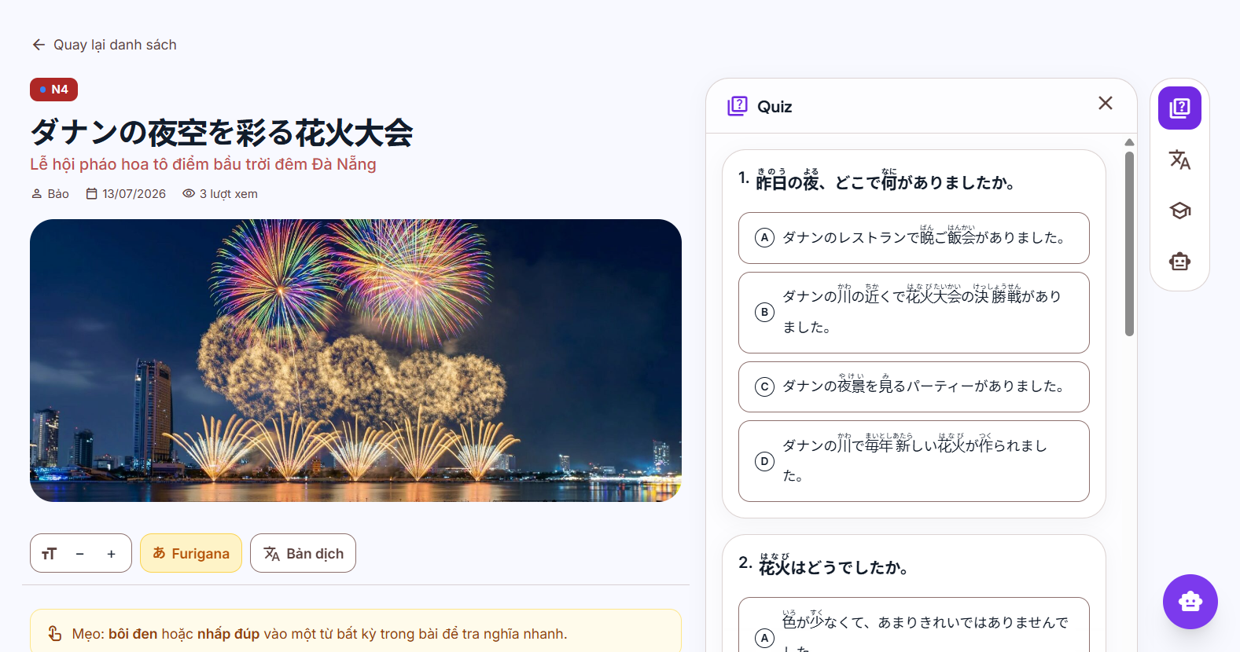
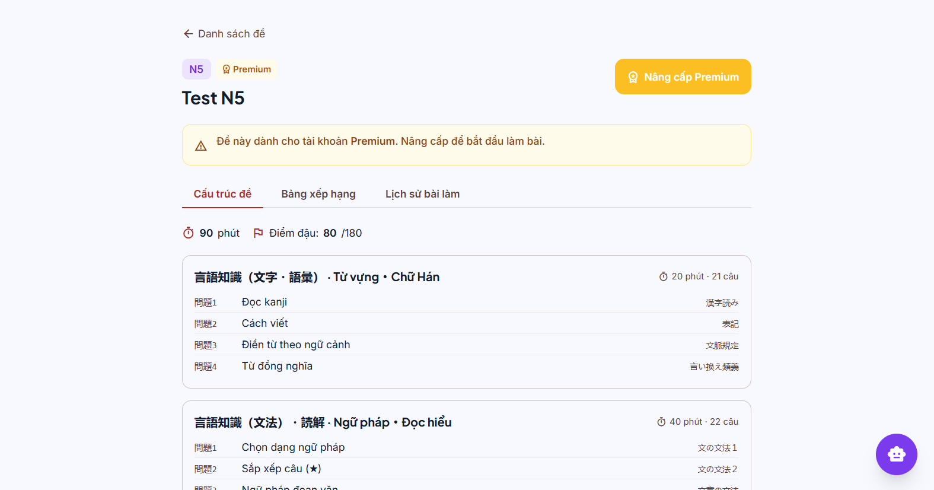
DEMO — THE PRODUCT
See it in action
● Kizuna Nihongo · Software Project Development
26 / 27

Slide 26
絆
Thank you
Kizuna Nihongo — connecting learners to Japanese, with AI.
Questions & Answers · Kizuna Nihongo Team · 2026

