Slide 1

SOFTWARE REQUIREMENT / SYSTEM ANALYSIS & DESIGN
Kizuna Nihongo
An AI-powered, personalized platform for learning Japanese — JLPT N5 to N1.
Personalized Roadmap
AI Sensei
絆
Kizuna Nihongo Team · React · Express · Supabase · FPT AI Factory · 2026

Slide 2
AGENDA
What we’ll cover
01
Introduction Problem, proposed solution & technology stack
02
Requirement Analysis Actors, use cases, functional & non-functional requirements
03
System Design Architecture, database, security & authorization
04
Live Demo Landing page & key product screens
● Kizuna Nihongo · SRS & System Design
02 / 19

Slide 3
01 · INTRODUCTION — PROBLEM
One path for everyone doesn’t work
Traditional Japanese study forces every learner down the same track — and leaves them without timely feedback.
01 Generic roadmap Everyone follows a single fixed curriculum, ignoring their real level, pace and goal.
02 No instant feedback Writing, speaking and kanji practice go uncorrected — mistakes stick.
03 Tutors don’t scale 1-on-1 guidance is costly, hard to book and unavailable on demand.
04 Passive content Static textbooks can’t adapt to the exact points a learner struggles with.
● Kizuna Nihongo · SRS & System Design
03 / 19

Slide 4
01 · INTRODUCTION — SOLUTION
A personalized, AI-assisted platform
Kizuna Nihongo turns a fixed curriculum into an adaptive experience — with AI woven through learning, authoring and assessment.
AI Personalized roadmap AI builds a step-by-step study plan from the learner’s current level to their target JLPT.
AI AI Sensei tutor An agentic assistant that answers, reads the learner’s own data, and acts only with confirmation.
AI AI-assisted authoring Teachers & admins generate readings, questions and audio in minutes, then review.
AI Proctored assessment Exams run with webcam face-detection and anti-cheat, plus auto & AI-assisted grading.
● Kizuna Nihongo · SRS & System Design
04 / 19

Slide 5
01 · INTRODUCTION — PRODUCT & TECH STACK
What we built & how
SCOPE · JLPT N5 → N1
TECHNOLOGY STACK
Learn — courses, lessons, vocabulary, kanji, grammar & a JP-VI dictionary
Practice — flashcards, reading with furigana, writing & kanji handwriting
Assess — quizzes, proctored mock exams, placement test & leaderboards
Personalize — AI learning roadmap & AI Sensei chat
Author — teachers & admins generate content with AI (readings, questions, audio)
Frontend SPA React 18 · Vite · Tailwind CSS
Backend API Node.js · Express REST (Bearer JWT)
SSR Web EJS · Express (landing & auth)
Data · Auth · Storage Supabase — PostgreSQL, GoTrue, Storage
AI Services FPT AI Factory (OpenAI-compatible)
Proctoring · Email MediaPipe Vision · SMTP
● Kizuna Nihongo · SRS & System Design
05 / 19

Slide 6
02 · REQUIREMENT ANALYSIS — ACTORS
Actors & stakeholders
🧭
🎓
🧑‍🏫
🛡
Guest Browses public content, registers & signs in.
Student Learns, practices, takes exams & uses AI features.
Teacher Authors content & question banks, grades exams.
Admin Manages users, content, monetization & the system.
External · AI Service (FPT)
External · Payment Gateway
External · SMTP Email
Roles (student / teacher / admin) are carried in the Supabase Auth JWT user_metadata.role and drive every route guard.
● Kizuna Nihongo · SRS & System Design
06 / 19

Slide 7
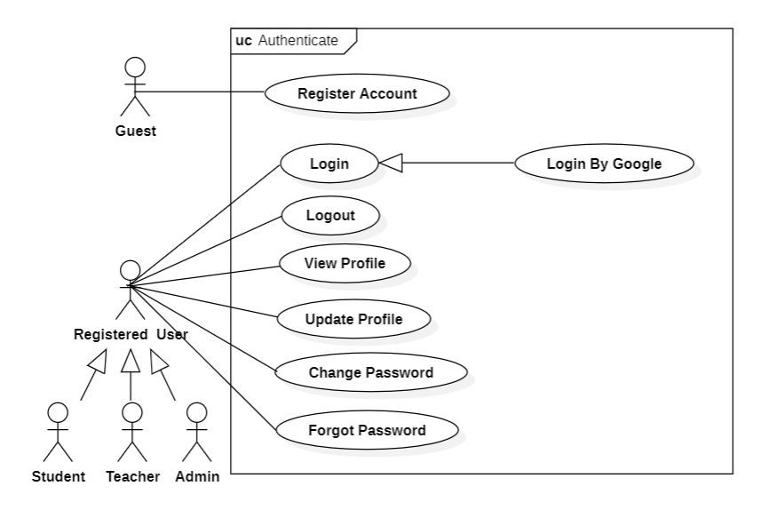
02 · REQUIREMENT ANALYSIS — USE CASES
Use Case · Authentication
ACTOR · Guest / User
Register with email & 6-digit OTP verification
Log in — email/password or Google OAuth
Forgot / reset password via OTP (neutral response)
Change password — re-authentication required
Role-based routing after login (BR-05)
● Kizuna Nihongo · SRS & System Design
07 / 19

Slide 8
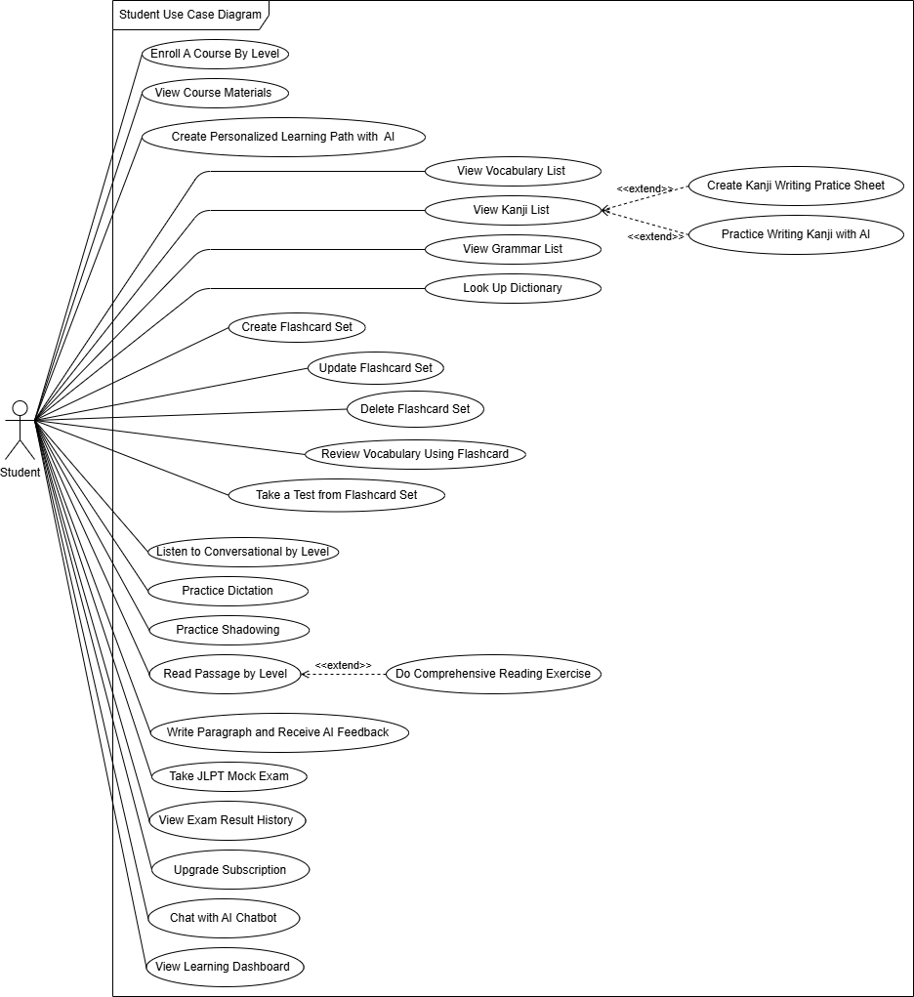
02 · REQUIREMENT ANALYSIS — USE CASES
Use Case · Student
ACTOR · Student
Learn — enroll in courses, study lessons, vocab, kanji & grammar
Practice — flashcards (AI-define / AI test), reading, writing, kanji
Assess — quizzes, proctored mock exams, placement test, leaderboard
Personalize — AI learning roadmap & AI Sensei chat
Account — profile, subscription & upgrade
● Kizuna Nihongo · SRS & System Design
08 / 19

Slide 9
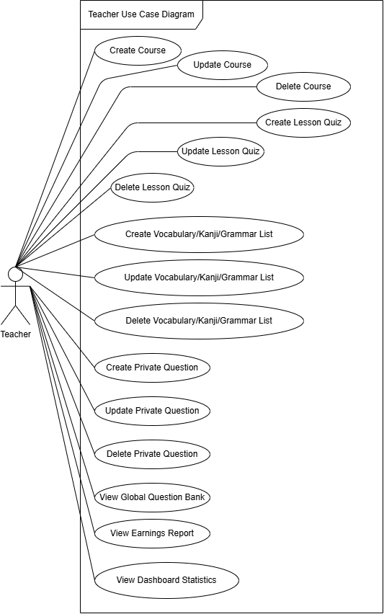
02 · REQUIREMENT ANALYSIS — USE CASES
Use Case · Teacher
ACTOR · Teacher
Apply to become a teacher — AI screening of the application
Author content with AI — reading passages (4-step pipeline) & listening
Question bank — manual & AI-generated items in a private bank
Exams — create exams & review attempts (AI grading assist)
Earnings — monthly revenue share based on content usage
● Kizuna Nihongo · SRS & System Design
09 / 19

Slide 10
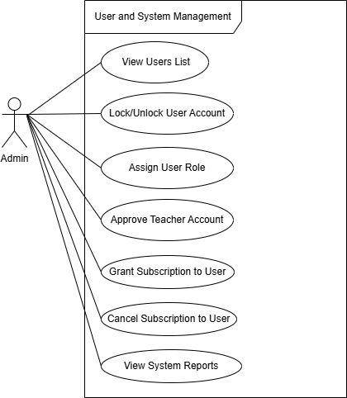
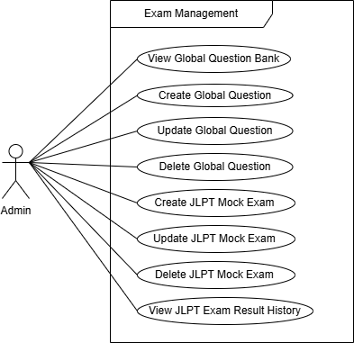
02 · REQUIREMENT ANALYSIS — USE CASES
Use Case · Admin
ACTOR · Admin
User management — roles, accounts & audit logs
Content — course builder, vocab/kanji/grammar & approvals
Assessment — question bank, mock exams (AI + TTS), placement config
Monetization — subscriptions, payments & teacher revenue pool
Operations — system health (App/DB/AI) & teacher-application review
● Kizuna Nihongo · SRS & System Design
10 / 19

Slide 11
02 · REQUIREMENT ANALYSIS — FUNCTIONAL
Functional requirements
FR-1 Account & Auth Registration with OTP, login & OAuth, password reset, profile, role-based access control.
FR-2 Learning Content Browse courses & lessons, vocabulary/kanji/grammar, dictionary lookup, progress tracking.
FR-3 Assessment & Proctoring Quizzes, mock exams, proctored mode (webcam & face detection), auto + AI grading, leaderboard.
FR-4 AI Personalization Learning roadmap, AI Sensei, flashcard AI-define/test, writing & kanji feedback, furigana.
FR-5 Content Authoring Teachers & admins generate reading passages, quiz questions & mock-exam audio with AI, then review.
FR-6 Admin & Monetization User management, subscriptions & payments, teacher revenue share and system monitoring.
● Kizuna Nihongo · SRS & System Design
11 / 19

Slide 12
02 · REQUIREMENT ANALYSIS — NON-FUNCTIONAL
Non-functional requirements
🔒 Security JWT-based RBAC, hashed OTP, service-role / RLS isolation, private storage with signed URLs.
⚡ Performance Paginated, indexed APIs; AI calls run asynchronously with graceful fallbacks.
🎯 Usability Bilingual UI (VI / JA), furigana support, responsive layout, shared UI component library.
🔁 Reliability Per-plan quota guards and graceful handling when the AI service is unavailable (MSG40).
📈 Scalability Modular schema across 10 domains; stateless REST + JWT enables horizontal scaling.
⚖ Integrity & Compliance Neutral password-reset responses, content-ownership rules and user audit logging.
● Kizuna Nihongo · SRS & System Design
12 / 19

Slide 13
02 · REQUIREMENT ANALYSIS — BUSINESS RULES
Business rules (highlights)
ID | Category | Rule
BR-04 | Authorization | Teacher applications are auto-approved by AI screening when complete & verifiable; otherwise queued for an administrator.
BR-10 | Structural | Exiting full-screen during a proctored attempt is logged as a violation, and the AI Sensei is locked for the attempt.
BR-18/19 | Structural | A section auto-submits when its timer hits zero; the leaderboard ranks only each student’s first completed attempt.
BR-21 | Authorization | Users may edit/publish only content they own; an admin’s access to a teacher’s course is read-only preview.
BR-08…25 | Action-Enabler | Roadmap, AI-define, flashcard-test, reading & chat features are quota-limited per plan; upgrading unlocks more.
BR-25 | Computation | Each teacher’s payout is proportional to content usage and finalized monthly by an administrator.
● Kizuna Nihongo · SRS & System Design
13 / 19

Slide 14
03 · SYSTEM DESIGN — ARCHITECTURE
A layered architecture
Presentation CLIENT
React SPA (student · teacher · admin) · EJS SSR (landing · auth callback)
▼
Business Logic SERVER
Express REST API (routes/api/*) · Route guards (requireAuth · requireRole) · Controllers · Metrics middleware
▼
Data & Auth SUPABASE
PostgreSQL (10 module schemas) · GoTrue Auth (JWT · Google OAuth) · Storage (private buckets · signed URLs)
▼
External SERVICES
FPT AI Factory (chat · generation · grading) · SMTP (OTP email) · Payment gateway
● Kizuna Nihongo · SRS & System Design
14 / 19

Slide 15
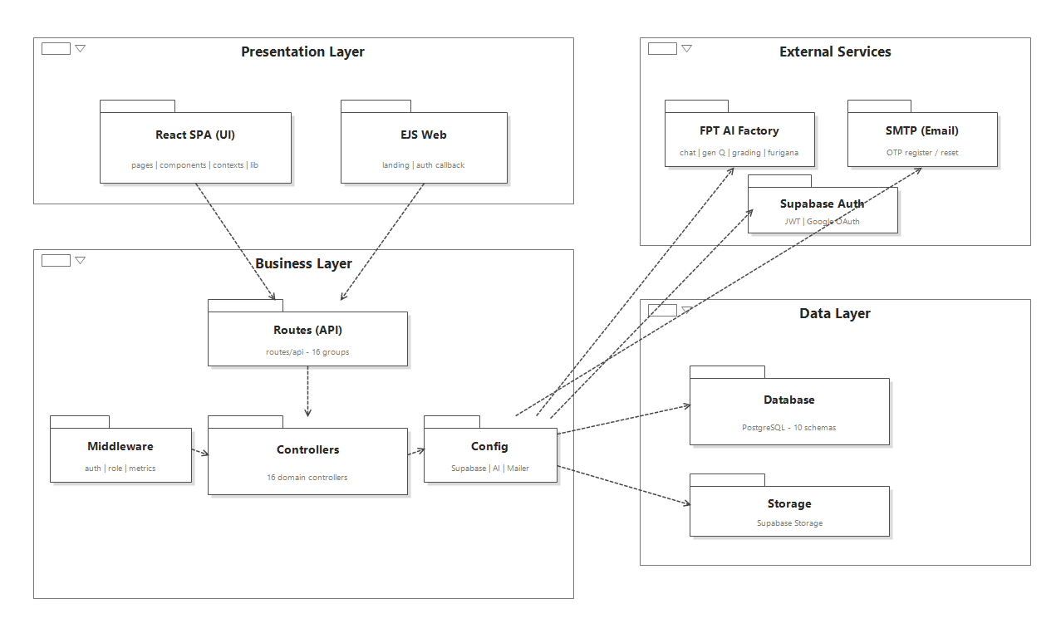
03 · SYSTEM DESIGN — PACKAGE VIEW
Package & component structure
● Kizuna Nihongo · SRS & System Design
15 / 19

Slide 16
03 · SYSTEM DESIGN — DATABASE
Database — modular schemas
A domain-per-schema PostgreSQL design; the public schema exposes compatibility views over the modules.
users_module
content_module
10 module schemas (+ public)
users · student_profiles · teacher_profiles · roles
courses · units → lessons · lesson_progress · enrollments
vocabulary_module
exam_module
vocabulary · kanji · grammar_patterns · jlpt_levels
quizzes · quiz_questions · quiz_attempts · question_bank
100+ tables across domains
flashcard_module
dictionary_module
flashcard_sets · flashcards · folders · progress
dict_entries · dict_senses · dict_kanji · examples
76k+ dictionary rows indexed
ai / materials
public (compat)
student_dashboards · ai_learning_paths · writing · listening
chat · learning_paths · subscriptions · payments · views
● Kizuna Nihongo · SRS & System Design
16 / 19

Slide 17
03 · SYSTEM DESIGN — SECURITY
Security & authorization
🔑 Authentication Supabase GoTrue JWT. OTP is SHA-256 hashed, expires in 10 min, max 5 attempts, 60s resend cooldown.
👤 Authorization (RBAC) Role in JWT user_metadata.role; frontend Protected/Teacher/Admin routes + backend requireAuth / requireRole.
🗄 Data access Service-role client only in the trusted backend; RLS on tables; the anon key stays tightly scoped.
🖼 Private storage Proctor snapshots, audio & avatars live in private buckets, served via short-lived signed URLs.
🤖 AI safety Whitelisted tools; every write action requires user confirmation; AI is locked during exams (BR-11).
🎥 Proctoring Fullscreen lockdown, in-browser face detection and violation logging deter exam cheating.
● Kizuna Nihongo · SRS & System Design
17 / 19

Slide 18

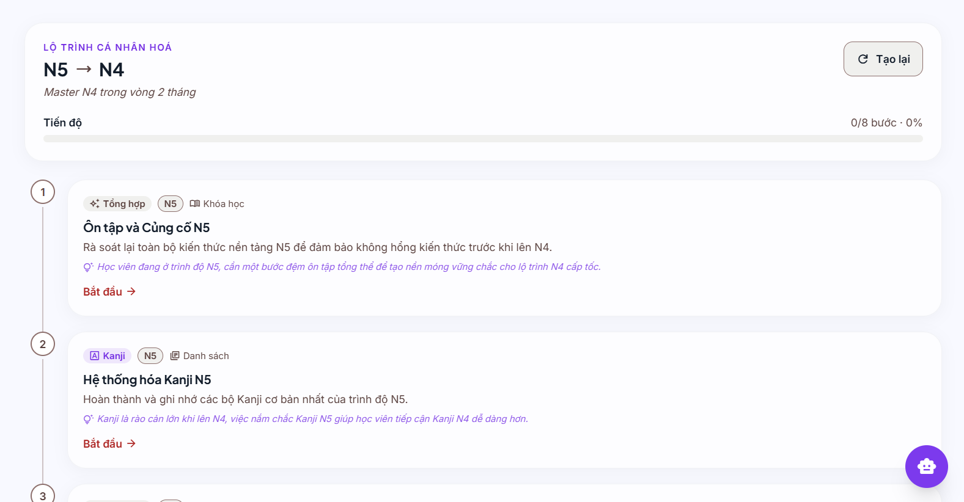
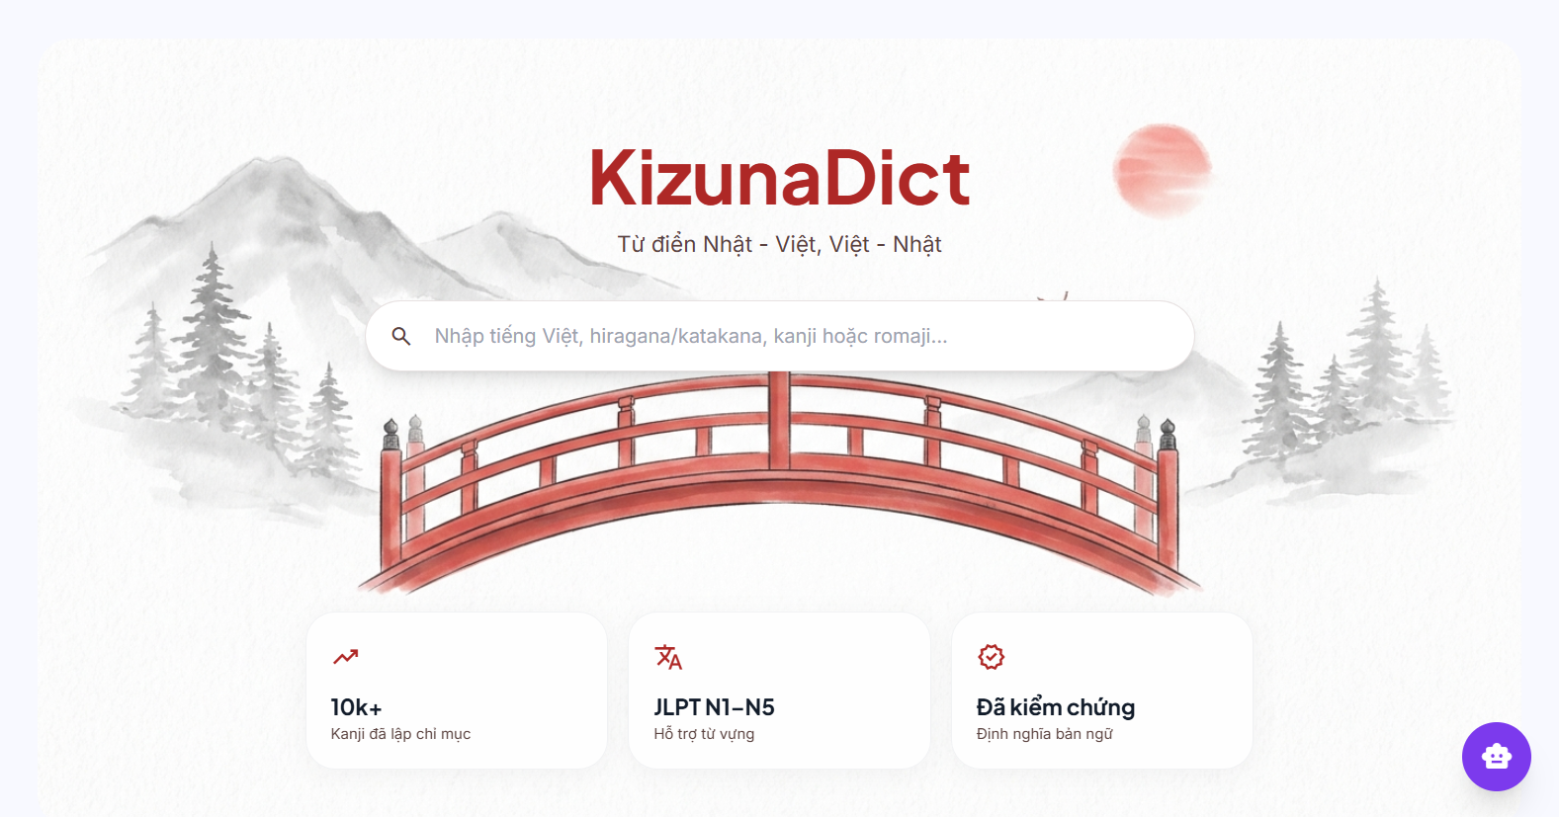
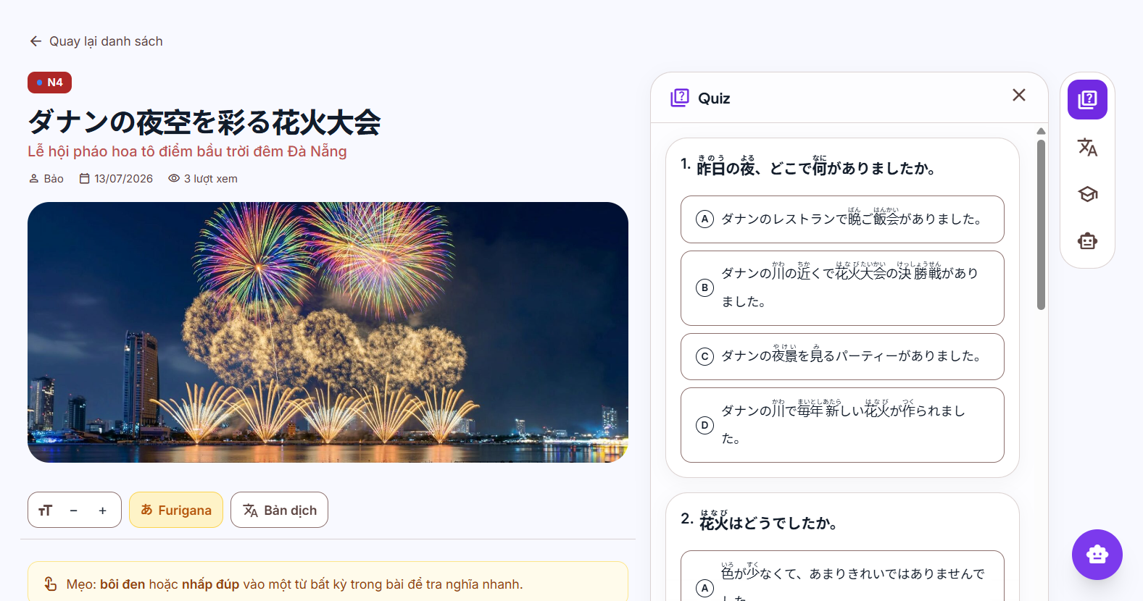
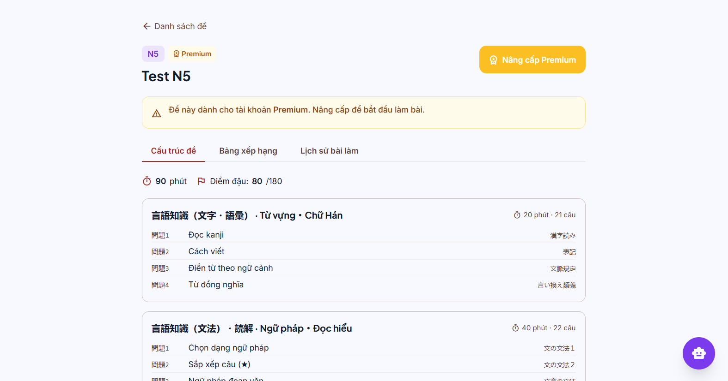
04 · LIVE DEMO
See it in action
● Kizuna Nihongo · SRS & System Design
18 / 19

Slide 19
絆
Thank you
Kizuna Nihongo — connecting learners to Japanese, with AI.
Questions & Answers · Kizuna Nihongo Team · 2026

