Slide 1
Music That Changes With The Game
Samar Khajuria, T00714740
COMP 4980

Slide 2
Introduction
Game music is normally a fixed audio file
It plays the same way on every replay
It does not know what the player is doing
PCG means the computer builds content instead
This project does that for the music

Slide 3
What I Built
A program that writes music for each level
A level number goes in, a music file comes out

Slide 4
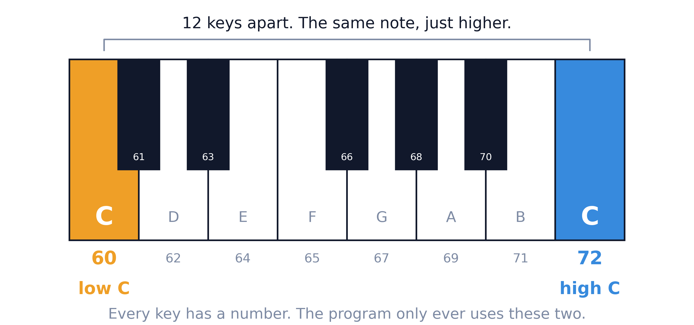
A Note Is Just A Number

Slide 5
Three More Words
A beat is the pulse you tap your foot to
Tempo is beats per minute, so higher is faster
A MIDI file is not a recording
It is a list of which note to play and when
That is why one level is only 600 bytes

Slide 6
How The Music Is Made
Only two notes, a low C and a high C
One note per beat, thirty two notes in total
Each beat, the program rolls 0 to 99
75 out of 100, swap to the other note
25 out of 100, repeat the same note
A repeat shifts the pattern, so levels differ

Slide 7
Where This Sits In PCG
Stochastic, because it uses randomness
Constructive, it builds in one pass
Automatic, no human picks the notes
Adaptive, the output follows the game

Slide 8
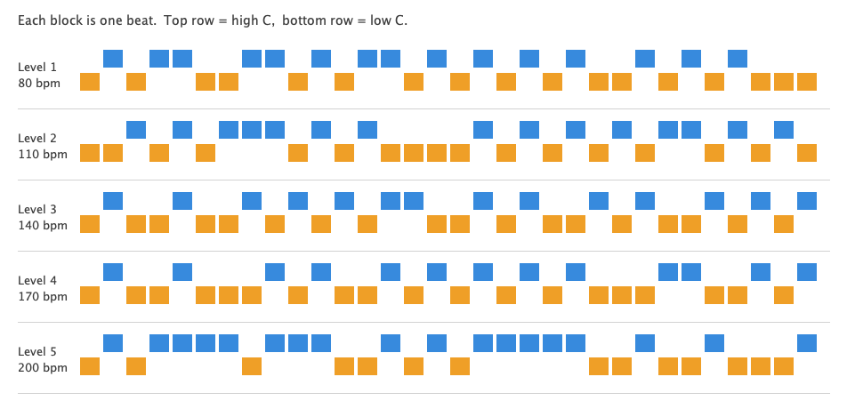
Five Levels, Five Patterns

Slide 9

Difficulty Sets The Speed
Level 1, 80 beats per minute, 24.0 seconds
Level 2, 110 beats per minute, 17.5 seconds
Level 3, 140 beats per minute, 13.7 seconds
Level 4, 170 beats per minute, 11.3 seconds
Level 5, 200 beats per minute, 9.6 seconds
Each level adds 30 beats per minute
Level 1
Level 5

Slide 10
What It Does Not Do
Two notes is not really a melody
The rhythm never changes
Difficulty only controls the speed

Slide 11
Where I Would Take It Next
Use a few more notes, so it can suggest a key
Let difficulty change the randomness too
Vary the drum as well as the speed

Slide 12
Thank You
Questions

