Slide 1
Loan Approval Prediction System
Predicting loan approval, amount, and rejection reasons using Machine Learning
Python | SQL | Pandas | Scikit-learn | Power BI

Slide 2
What Is This Project?
• A system that looks at a loan applicant's details and makes a real lending decision.
• It answers 3 questions:
- 1. Should the loan be Approved or Rejected?
- 2. If approved, how much amount should be given?
- 3. If rejected, what is the exact reason?
• Built end-to-end: raw data -> cleaning -> machine learning -> business decision -> dashboard.

Slide 3
Technology Used
Data & Modeling
Reporting
• Python - cleaning data & building the model
• Pandas - organizing & transforming data
• Scikit-learn - training & comparing ML models
• SQL (SQLite) - storing & querying applicant records
• Power BI - dashboards for approval rate, risk, income trends
• Joblib - saving the trained model for reuse
• Matplotlib/Seaborn - confusion matrix charts

Slide 4
How It Works - The Pipeline
1. Clean Data
2. Load to SQL
3. Engineer Features
4. Train & Compare Models
5. Predict & Decide

Slide 5
Dataset Overview
• 5,000 sample loan applicant records
• Includes: Gender, Marital Status, Education, Employment Status, Income, Co-applicant Income
• Also includes: Loan Amount, Loan Term, Credit Score, Credit History, Existing Loans
• Target column: Loan_Status - Approved (Y) or Rejected (N)
• Data is realistic - includes missing values, duplicate entries, and inconsistent text, just like real bank data.

Slide 6
Data Cleaning & Feature Engineering
Data Cleaning
New Features Created
• Fill missing values (mode for categories, median for numbers)
• Fix inconsistent text (spacing, capitalization)
• Remove duplicate applications
• Fix out-of-range values
• Total Income (applicant + co-applicant)
• EMI - estimated monthly installment
• Balance Income - income left after EMI
• Debt-to-Income Ratio
• Risk Category - Low / Medium / High

Slide 7
Machine Learning Models Compared
• Logistic Regression - simple, adds up weighted factors to decide. Easy to explain.
• Decision Tree - works like a flowchart of yes/no questions.
• Random Forest - builds many decision trees and lets them vote together.
• All 3 were trained on the same data and compared fairly using the same test set.

Slide 8
Model Comparison - Results
Model | Accuracy | Precision | Recall | F1-Score
Logistic Regression | 0.73 | 0.73 | 0.87 | 0.80
Decision Tree | 0.69 | 0.72 | 0.83 | 0.77
Random Forest | 0.71 | 0.71 | 0.88 | 0.79

Slide 9
Model Comparison - Chart

Slide 10
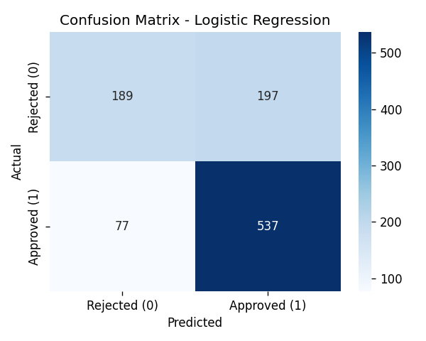
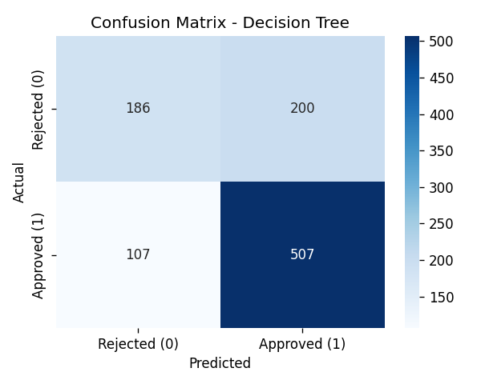

Confusion Matrices - Where Each Model Went Right or Wrong
Logistic Regression
Decision Tree
Random Forest

Slide 11
Best Model Selected
• Winner: Logistic Regression
• Accuracy: 72.6% | Precision: 73.2% | Recall: 87.5% | F1-Score: 79.7%
• Selected using F1-Score, because it balances two types of mistakes:
- Approving a risky applicant (bad for the bank)
- Rejecting a good applicant (bad for the customer)
• Saved using joblib as best_model.pkl - ready to reuse without retraining.

Slide 12
From Prediction to Real Decision
ML Model (Approve/Reject)
Affordability Check
Final Decision + Amount + Reason

Slide 13
Loan Decision Logic (Simple Explanation)
• Step 1: The ML model predicts if the applicant is creditworthy (Approve / Reject).
• Step 2: A simple rule checks how much loan the applicant can actually afford, based on income.
• Result: Approved (full amount), Partially Approved (reduced amount), or Rejected.
• If rejected, the system lists plain-language reasons - low credit score, high debt, unemployment, etc.
• All amounts are shown in Rupees (e.g. Rs 1,20,000).

Slide 14
Power BI Dashboard
• A single ready-to-use file: loan_dashboard_data.csv
• Dashboard shows: Approval rate, Rejection rate, Risk category breakdown
• Also shows: Credit score analysis, Income analysis, Loan amount trends
• Also shows: Applicant profile summary, Approved amount vs. requested amount
• Business teams can explore this without touching any code.

Slide 15
Business Insights
• Credit history is the strongest predictor of loan approval.
• High debt-to-income ratio leads to rejection, even for small loan amounts.
• Unemployed applicants are rejected more often, even at similar income levels.
• The affordability check catches cases where a good applicant asks for too much money.
• Outcome: faster, consistent, explainable loan decisions - less manual work for loan officers.

Slide 16
Conclusion
• Built a complete, working loan approval system - from raw data to final decision.
• Compared 3 machine learning models and picked the best one using proper evaluation.
• Added a real-world decision layer: approved amount + rejection reason, not just yes/no.
• Delivered a live Power BI dashboard for business reporting.
• Fully deployable: saved model + preprocessing pipeline, ready to reuse.

Slide 17
Thank You
Questions?
Loan Approval Prediction System

