Slide 1
CONTROLLING

Slide 2
Controlling
    The process of evaluating and regulating ongoing activities to ensure that goals are achieved.

Slide 3
The Nature of Control
The regulation of organizational activities so that some targeted element of performance remains within acceptable limits.
    Provides organizations with indications of how well they are performing in relation to their goals.
    Provides a mechanism for adjusting performance to keep organizations moving in the right direction.

Slide 4
Why To Control?
    Managing people performance
    Coping with uncertainty
    Detecting Irregularities
    Identifying opportunities
    Handling complex situations
    Delegation
    Minimizing Costs
    Basis for planning

Slide 5
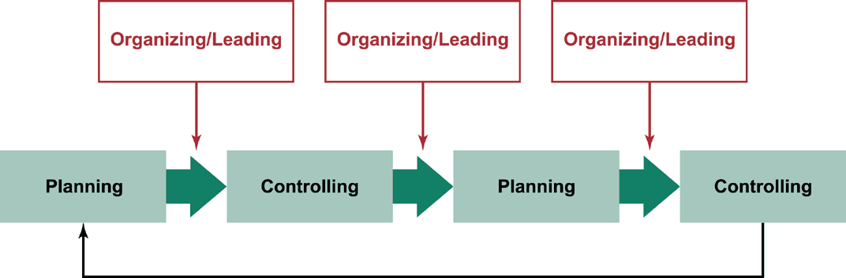
The Planning—Controlling Link

Slide 6
AREAS OF CONTROL
  Physical resources—inventory management, quality control, and equipment control.
  Human resources—selection and placement, training and development, performance appraisal, and compensation.
  Information resources—sales and marketing forecasts, environmental analysis, public relations, production scheduling, and economic forecasting.
  Financial resources—managing capital funds and cash flow, collection and payment of debts.

Slide 7
Levels of Control
Levels of Control
Strategic
control
Tactical
control
Operations
        control
Figure 14.2

Slide 8
Steps in the Control Process
1
2
3
4
Compare
Determine need
Establish
Measure
performance
against standards
for corrective
action
standards
performance
Maintain the
Correct the
Change
status quo
deviation
standards

Slide 9
TYPES OF CONTROL
Feedforward Control
  The active anticipation and prevention of problems, rather than passive reaction.
Concurrent Control
  Monitoring and adjusting ongoing activities and processes.
Feedback Control
  Checking a completed activity and learning from mistakes.

Slide 10
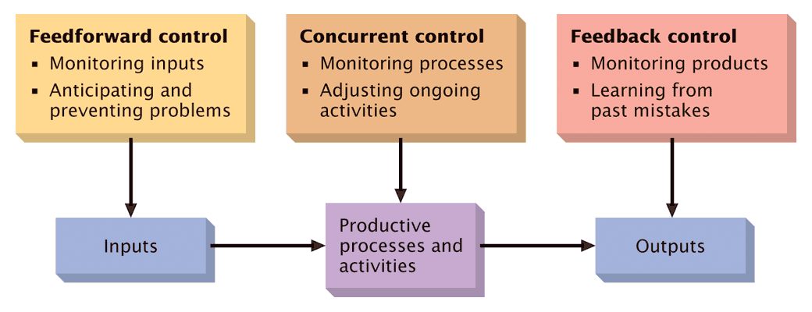
TYPES OF CONTROL

Slide 11
Characteristics of Effective Control
  Integration with Planning
    the more control is linked to planning, the more effective the control system.
  Flexibility
    the control system must be flexible enough to accommodate change.
  Accuracy
    Inaccurate information results in bad decision making and inappropriate managerial actions.
  Timeliness
    A control system should provide information as often as necessary.
  Objectivity
    A control system must be free from bias
    and distortion

Slide 12
CONTROL TECHNIQUES

Slide 13
Levels of Control
Levels of Control
Financial
control
Budgetary and Quality
control
Inventory
        control
Figure 14.2

Slide 14
Financial Control
Financial Statements
  A financial statement is a profile of some aspect of an organization’s financial circumstances.
  Balance sheet
    A listing of assets (current and fixed), liabilities (short- and long-term), and stockholders’ equity at a specific point in time (typically year-ending) that summarizes the financial condition of the organization.
  Income statement
    Summary of financial performance—revenues less expenses as net income (i.e., profit or loss)—over a period of time, usually one year.
  Cash Flow Statement

Slide 15
Financial Control (cont’d)
Ratio Analysis
  The calculation of of one or more financial ratios to assess some aspect of the organization’s financial health
    Liquidity Ratio (e.g. Current Ratio –
    current assets/current liabilities)
    Activity Ratio (e.g. Inventory Turnover Ratio – Cost of goods sold/Inventory)
    Debt Management Ratio (e.g. Debt Ratio –
    Total Liabilities / Total Assets)
    Profitability Ratio (e.g. Net Profit Margin –
    Net Income / Net Sales)

Slide 16

Budgetary Control
Budgets may be established at any organizational level.
Budgets are typically for one year or less.
Budgets may be expressed in financial
terms, units of output, or
other quantifiable factors.

Slide 17

Budgetary Control (cont’d)
Budgets serve four purposes:
    Help managers coordinate resources and projects.
    Help define the established standards for control.
    Provide guidelines about the
    organization’s resources
    and expectations.
    Enable the organization
    to evaluate the
    performance of
    managers and
    organizational units.

Slide 18
Responsibility Centers
  Standard Cost Centers
    Production Unit
  Discretionary Expense Centers
    R&D
  Revenue Centers
    Sales Department
  Profit Centers
    Business Unit
  Investment Centers
    Project

Slide 19
Strengths and Weaknesses of Budgeting
Strengths
  Budgets facilitate effective operational controls.
  Budgets facilitate coordination and communication between departments.
  Budgets establish records of organizational performance, which can enhance planning.
Weaknesses
  Budgets can hamper operations if applied too rigidly.
  Budgets can be time consuming to develop.
  Budgets can limit innovation and change.

Slide 20

Structural Control
Bureaucratic Control
  A form of organizational control characterized by formal and mechanistic structural arrangements.
Clan Control
  An approach to organizational
  control characterized by
  informal and organic
  structural arrangements.

