Slide 1
Fundamentals of Organizing

Slide 2
Organizing
The deployment of organizational resources to achieve strategic goals.
The deployment of resources is reflected in the division of labor.
Formal lines of authority and mechanisms for coordinating diverse organization tasks.

Slide 3
Fundamental Concepts of Organizing
Differentiation means that the organization is composed of units that work on specialized tasks using different work methods and requiring employees with unique competencies.
Integration means that the various units must be put back together so that work is coordinated.

Slide 4
Mechanistic Versus Organic Structures
High horizontal differentiation
Rigid hierarchical relationships
Fixed duties
High formalization
Formalized communication channels
Centralized decision authority
Low horizontal differentiation
Collaboration
(vertical and horizontal)
Adaptable duties
Low formalization
Informal communication
Decentralized decision authority

Slide 5
Open Vs Closed System

Slide 6
Open System Characteristics
Cycle of Events
Negative Entropy (Don’t let the system break down)
Feedback
Kreitner’s Dynamic Homeostasis (maintaining optimal state)
Differentiation

Slide 7
Equifinality (In business, equifinality implies that firms may establish similar competitive advantages based on substantially different competencies)

Slide 8

Span of Management
The number of employees reporting to a supervisor.
Traditional view, seven or so per manager.
Many organizations today, 30 or more per manager.
Generally if supervisors must be closely involved with employees, span should be small.

Slide 9
Factors Determining Span of Control
Subordinates’ location
Support available for the manager
Amount of non-supervisory tasks
The competence of both the manager and the employee.
The similarity or dissimilarity of tasks being supervised.
The incidence of new problems in the manager’s department.
The extent of clear operating standards and rules.

Slide 10
Tall Versus Flat Structure
Tall structure has an overall narrow span of management and more levels in the hierarchy
Flat structure has a wide span, is horizontally dispersed, and has fewer hierarchical levels
The trend is toward larger spans of management as a way to facilitate delegation.

Slide 11
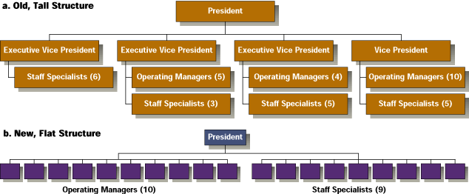
Tall vs. Flat Structure

Slide 12
Entrepreneuring & Intrapreneuring
(Gifford Pinchot)

Slide 13
Organizing Process
Differentiation
Specialization
Delegation of Authority
Integration

Slide 14
Organizational Structure

Slide 15
Organization Structure
Defined as:
1. The set of formal tasks assigned to individuals and departments.
2. Formal reporting relationships.
3. The design of systems to ensure effective coordination of employees across departments.

Slide 16
The Elements of Structure
Organization design
  A process in which managers develop or change their organization’s structure.
Work specialization
  A component of organization structure that involves having each discrete step of a job done by a different individual rather than having one individual do the whole job.

Slide 17
Four Points About
the Organization Chart
Visual representation
Set of formal tasks
Formal
reporting relationships
Framework
for vertical control

Slide 18
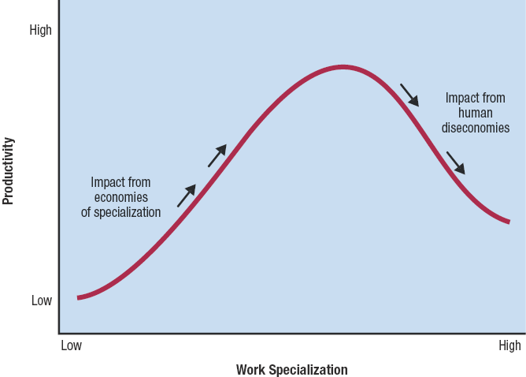
Economies and Diseconomies
of Work Specialization

Slide 19
Work Specialization
Tasks are subdivided into individual jobs.
Employees perform only the tasks relevant to their specialized function.
Jobs tend to be small, but they can be performed efficiently.
There is a concern that employees may become isolated, and do only a single boring job.
Many organizations are moving away from this principle.

Slide 20
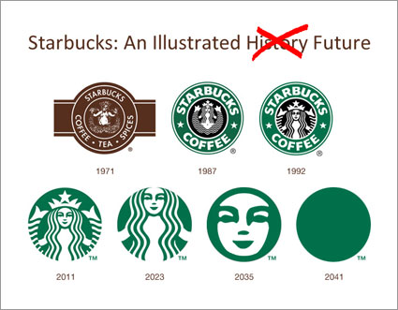
JOURNEY OF STARBUCKS

Slide 21
Chain of Command
Unbroken line of authority that links all persons in an organization.
Underlying principles
  Unity of Command.

Slide 22
Departmentalization

Slide 23
Departmentalization
Basis for grouping job positions into departments and departments into the total organization.
Internal Operations Oriented
  Functional
  Network (Virtual)
Output Oriented
  Divisional
    Product
    Geographic
    Customer
  Team (Cluster)
Combinations
  Hybrid (different types at different places in an org.)
  Matrix (different types at simultaneous at the same places in an org.)

Slide 24
Departmentalization
The basis on which individuals are
grouped into departments
Five structural alternatives
Vertical functional approach. People are grouped together in departments by common skills.
Divisional approach. Grouped together based on a common product, customer or geographical region.
Matrix approach. Functional and divisional chains of command are implemented. Two chains of command exists.
Team-based approach. Created to accomplish specific tasks.
Network approach. Small, central hub electronically connected to their other organizations that perform vital functions. Departments are independent, and can be located anywhere.

Slide 25
Functional Design
Functional design means grouping managers and employees according to their areas of expertise and the resources they use to perform their jobs.

Slide 26
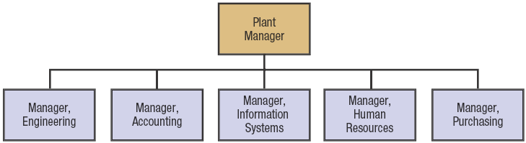
Functional Structure

Slide 27
Functional Design
Potential Pitfalls
Inadequate communication
Difficulties with interunit coordination
Focus on departmental rather than organizational issues and goals
Potential Benefits
Supports skill specialization
Reduces duplication of resources & increases coordination
Enhances career development & training within functional area
Allows superiors and subordinates to share common expertise
Promotes high-quality technical
decision making

Slide 28
Product Design
Product design means that all functions that contribute to a product are organized under one manager.

Slide 29
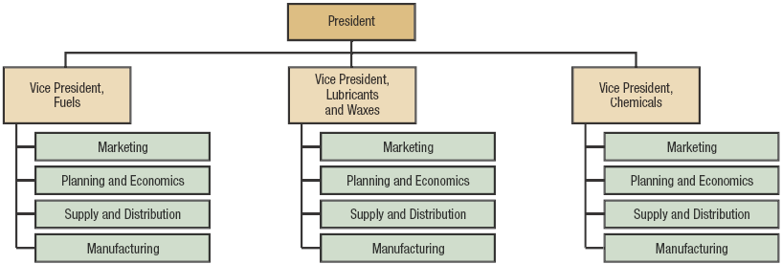
Product Design

Slide 30
Product Design
Potential Benefits
Permits fast changes in a product line
Allows greater product line visibility
Fosters a concern for customer demand
Clearly defines responsibilities for each product line
Develops managers who can think across functional lines
Potential Pitfalls
Not allowing efficient utilization of skills and resources
Not fostering coordination of activities across product
Encourages politics and conflicts in resource allocation across product lines
Limits career mobility for personnel outside their own product lines

Slide 31
Geographical Design
Geographical design organizes activities around location.

Slide 32
Geographical Structure
for Apple Computer
CEO
Apple
Middle East
Apple
America
Apple
Europe
Apple
Pacific
Canada
France
Australia
Latin
America/
Caribbean
Japan
Asia
USA

Slide 33
Geographical Design
Potential Benefits
Has facilities and the equipment used for production and/or distribution all in one place, saving time and costs
Able to develop expertise in solving problems unique to one location
Gaining an understanding of customers’ problems and desires
Getting production closer to raw materials and suppliers
Potential Pitfalls
Duplication of functions, to varying degrees, at each regional or individual unit location
Conflict between each location's goals and the organization's goals
Adds levels of management and extensive use of rules and regulations to coordinate and ensure uniformity of quality among locations

Slide 34
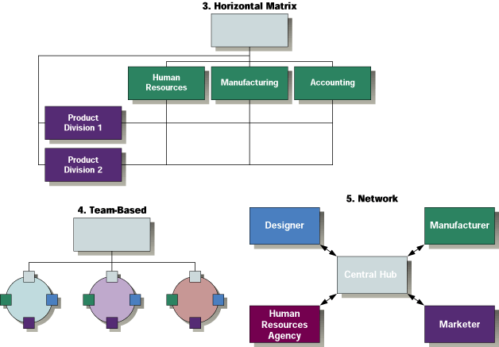
Matrix, Team and Network

Slide 35
Matrix Design
Functional and divisional chains of command simultaneously
Dual lines of authority
Functional hierarchy of authority runs vertically
Divisional hierarchy runs laterally
Violates the unity of command concept.

Slide 36
Matrix Organization
Engineering
Manager
Production
Manager
Marketing
Manager
Quality
Manager
Project Mgr
6
112
4
2
Project Mgr
5
153
3
3
Project Mgr
8
240
6
4
Project Mgr
8
186
6
4

Slide 37
Matrix Design
Potential Benefits
More efficient use of resources than single hierarchy
Adaptable to changing environment
Development of both general and specialists management skills
Expertise available to all divisions
Enlarged tasks for employees.
Potential Pitfalls
Dual chain of command
High conflict between two sides of matrix
Many meetings to coordinate activities
Need for human relations training
Power domination by one side of matrix.

Slide 38
Team Approach
Cross-functional teams consist of employees from various functional departments
Interdisciplinary approach to management
Permanent team = to solve ongoing problems
Reengineering = radical redesign for improvements in cost, quality, service and speed.

Slide 39
Team Approach
Potential Benefits
Same advantages as functional structure
Reduced barriers among departments
Quicker response time
Better morale
Potential Pitfalls
Dual loyalties and conflict
Time and resources spent on meetings
Unplanned decentralization.

Slide 40
Network Approach
Organization divides major functions into separate companies brokered by a small headquarters organization
Especially appropriate for international operations
Held together with phones, faxes, and other electronic technology.

Slide 41
Network Approach
Potential Benefits
Global competitiveness
Work force flexibility
Reduced administrative overhead.
Potential Pitfalls
No hands-on control
Loss of part of the organization severely impacts remainder of organization
Employee loyalty weakened.

Slide 42
Hybrid Structure
President
Functional
Structure
Chief
Counsel
Human
Resources
Director
Technology
Vice
President
Financial
Services
Vice Pres.
Product
Structure
Fuels
Vice
President
Lubricants
Vice
President
Chemicals
Vice
President

Slide 43
Other Forms of Departmentalization
Simple Number
Time
Process
Virtual Organization

Slide 44
Determinants of Organizational Structure
The environment
The size of the organization
Technology
The organization’s strategy

Slide 45
Organization Structure Determinants and Outcomes
Causes
Performance
and
Satisfaction
Strategy
Size
Technology
Environment
Structures
Determines
Mechanistic
Organic
Moderated by
individual differences
and cultural norms

Slide 46
Elements of Design

Slide 47
Five Elements of Design
Hierarchy
Span of control
Authority, Responsibility, and Accountability
Centralization or Decentralization
Delegation

Slide 48
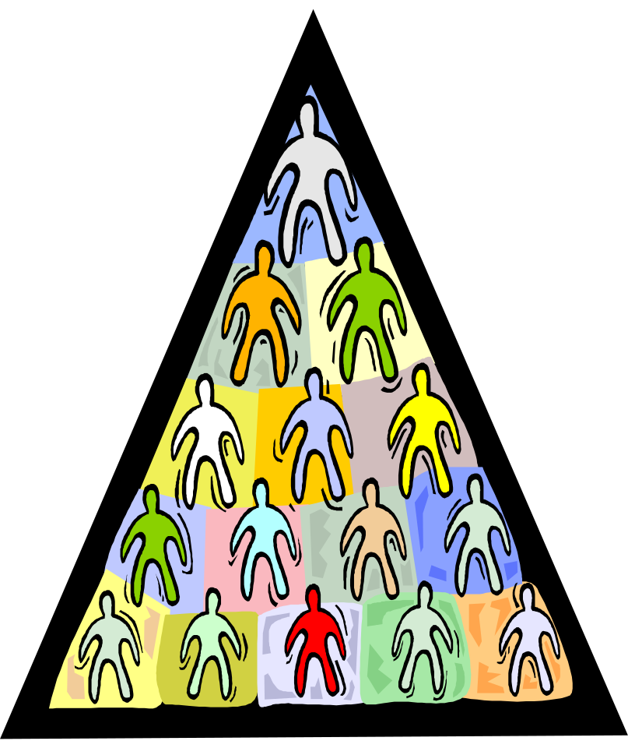
Hierarchy
Hierarchy is a pyramid showing relationships among levels.

Slide 49
Authority, Responsibility, and Accountability

Slide 50
Authority
Formal and legitimate right of a manager to make decisions, issue orders, and to allocate resources to achieve organizationally desired outcomes.
Authority is distinguished by three characteristics:
Authority is vested in organizational positions, not people.
Authority is accepted by subordinates.
Authority flows down the vertical hierarchy.

Slide 51
Responsibility
The duty to perform the task or activity an employee has been assigned.
Managers need authority commensurate with responsibility.

Slide 52
Accountability
Mechanism through which authority and responsibility are brought into alignment.
People are subject to reporting and justifying task outcomes to those above them in the chain of command.
Can be built into the organization structure.

Slide 53
Power
An individual’s capacity to influence decisions.

Slide 54
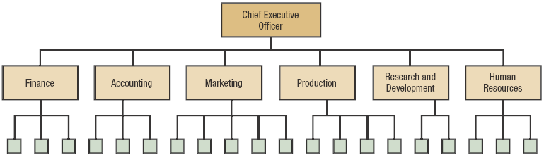
Authority Versus Power: Authority

Slide 55
Types of Power
Coercive power Power based on fear.
Reward power Power based on the ability to distribute
something that others value.
Legitimate power Power based on one’s position in the
formal hierarchy.
Expert power Power based on one’s expertise,
special skill, or knowledge.
Referent power Power based on identification with a
person who has desirable resources or
personal traits.

Slide 56
Line & Staff Function

Slide 57
Line
Line departments perform tasks that reflect the organization's primary goal and mission
Line authority means that managers have formal authority to direct and control immediate subordinates.

Slide 58
Staff
Staff departments include all those who provide specialized skills in support of line departments
Staff authority is generally more narrow than line authority
Staff authority includes the right to advise, recommend, and counsel in the staff specialists' area of expertise.

Slide 59
Types of Organizational Authority
Line authority
  The position authority (given and defined by the organization) that entitles a manager to direct the work of operative employees.
Staff authority
  Positions that have some authority (e.g., organization policy enforcement) but that are created to support, assist, and advise the holders of line authority.
Functional Authority

Slide 60
Line & Staff Conflict
Line
Theory Bias
Dilution of Authority
Lack of Accountability
Staff
Lack of Authority
Sidelined

Slide 61
Centralization & Decentralization

Slide 62
Centralization
Decision authority is located near the top of the organization.

Slide 63
Decentralization
Decision authority is pushed down the chain of command to lower levels.

Slide 64
Decentralization Tends To
Make greater use of human resources
Reduce burdens of top managers
Cause decisions to be made close to the action
Permit rapid response to changes.

Slide 65
Centralization versus Decentralization
Greater change and uncertainty in the environment are usually associated with decentralization.
The amount of centralization or decentralization should fit the firm’s strategy.
In times of crisis or risk of company failure, authority may be centralized at the top.

Slide 66
Factors That Influence Centralization/Decentralization
Amount of change and uncertainty
Availability of competent managers
Corporate culture
Geographical dispersion
Size of organization
Efficiency of communication and control systems.
Cost and risk of failure

Slide 67
DELEGATION

Slide 68
Delegation
Process managers use to transfer
authority.
Organization encourage managers
to delegate authority to lowest possible level.

Slide 69
Factor Affecting Delegation
Love for Authority (Boss)
Fear of losing position (Boss)
Lack of Trust (Boss)
Fear of Criticisms (Both)
Low Self confidence (Subordinate)
Absence of rewards (Subordinate)

Slide 70
Give thorough instructions
Maintain feedback
Evaluate and reward performance
Effective Delegation Techniques
Delegate the whole task
Ensure that authority equals responsibility
Select the right person

Slide 71
Effective Organizing
Spotting Inflexibility
    Missing Opportunity
    Obsolete Products
    Delay in decision making
Reorganizing
    New Product technologies
    Consolidation
    New government policies
    Domino Effect
Bringing Clarification
    Organization Charts
    Position Descriptions
    Understanding Importance of grapevine

Slide 72
Organizational Culture

Slide 73
Organizational Culture
A system of shared values, assumptions, beliefs, and norms that unite the members of an organization.
Reflects employees’ views about “the way things are done”
The culture specific to each firm affects how employees feel and act and the type of employee hired and retained by the company.

Slide 74
Characteristics of Organization Culture
It is distinctive
It is based on certain Norms
It promotes Stable values
It leads to common behavioral aspects
It shapes philosophy and rules
Its strength varies

Slide 75
Layers of Organizational Culture
Cultural Symbols
Shared Behaviors
Cultural Values
Shared Assumptions

Slide 76
Functions Performed By Organizational Culture
Employee Self-Management
  Sense of shared identity
  Facilitates commitment
Stability
  Sense of continuity
  Satisfies need for predictability, security, and comfort
Socialization
  Internalizing or taking organizational values as one’s own
Implementation Support
  If strategy and culture reinforce each other, employees find it natural to be committed to the strategy

Slide 77
Steps in Socialization
7. Role model to sustain culture
6. Rituals, taboos, rites, and stories to reinforce culture
5. Adoption of cultural value policies
Removal of Employees who deviate from culture
4. Rewards that sustain the culture
3. Training to develop capabilities consistent with culture
2. Challenging early work assignments
1. Careful selection
Removal of candidates who do not “fit” culture

