Slide 1

Training and Developing Employees

Slide 2
Orienting employees
Why orientation is important
Using orientation to reduce stress
The training process
Why the training business is booming
The 5-step training & development process
Training and learning
Make learning meaningful
Make skills transfer easy

Slide 3
Motivate the learner
Legal aspects of training
Analyzing training needs
Task analysis: assessing new employees’ training needs
Performance analysis: assessing current employees’ training needs

Slide 4
Traditional training methods
On-the-job training
Step 1 prepare the learner
Step 2 present the operation
Step 3 do a tryout
Step 4 follow up
Apprenticeship training
Informal learning
Job instruction training
Lectures
Programmed learning
Audiovisual tools
Simulated training
Projective techniques

Slide 5

Thematic apperception test (projective technique)

Slide 6

WORD ASSOCIATION TEST

Slide 7
ANIMAL METPHOR TEST
Cute as a ( ttuonb)
Warm as a (stota)
Light as (ira)
Gentle as (blam)
Rough as (dappersan)
Playful as a (tikent)

Slide 8
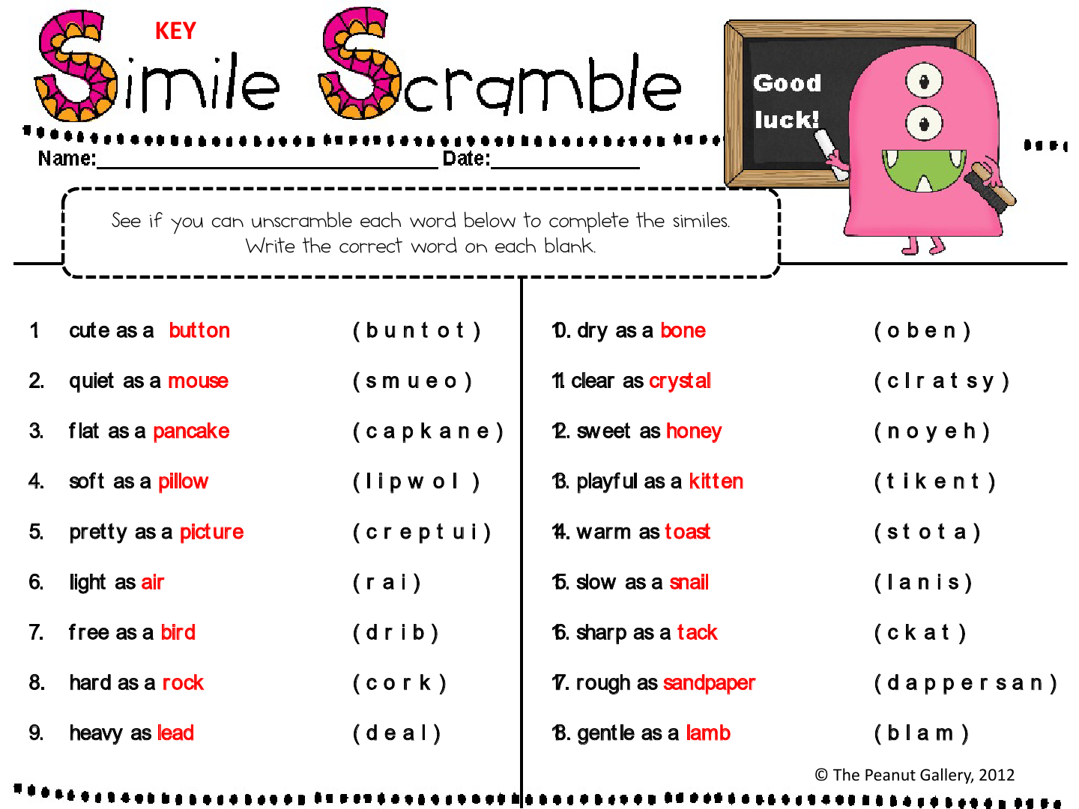
ANIMAL METAPHOR TEST

Slide 9
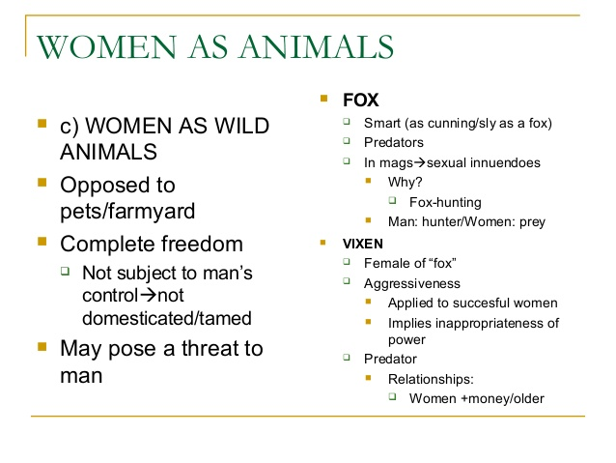

Slide 10
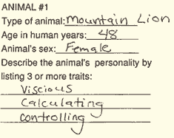

Slide 11

Rorschach inkblot test

Slide 12
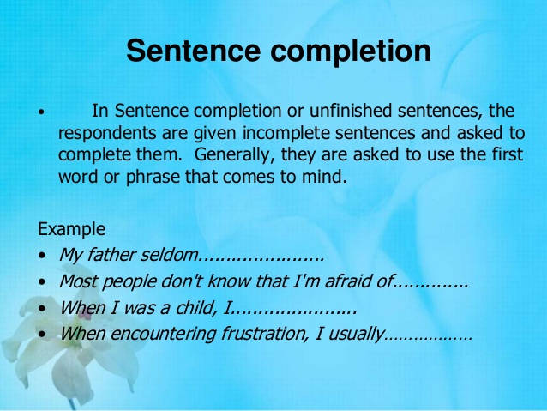

Slide 13
Electronic training
Computer-based training
Electronic performance support systems (EPSS)
Distance and internet-based training
Tele-training
Videoconferencing
Training via the internet
Learning portals:
A web site that acts as a central directory/repository for various types of learning and training materials used by learners is known as a learning portal

Slide 14
Training for special purposes
Literacy training techniques
Training for global business
Diversity training
Customer service training
Teamwork training
Providing lifelong learning

Slide 15
Managerial development & training
What is management development?
The new leadership development methods
Managerial on-the-job training
Job rotation
Coaching/understudy approach
Action learning
Research insight

Slide 16
Managerial development & training (Cont.)
Off-the-job training & development techniques
Vestibule training
Outside seminars
University-related programs

Slide 17
Managerial development & training (Cont.)
Role playing
Behavior modeling
Corporate universities and in-house development centers
Executive development in global companies

Slide 18
Evaluating the training effort
Designing the study
Training effects to measure
Summary

