Slide 1
Outline
Introduction
Background
Distributed Database Design
Database Integration
Semantic Data Control
Distributed Query Processing
Distributed Transaction Management
Data Replication
Consistency criteria
Replication protocols
Replication and failure management
Parallel Database Systems
Distributed Object DBMS
Peer-to-Peer Data Management
Web Data Management
Current Issues

Slide 2
Replication
Why replicate?
System availability
Avoid single points of failure
Performance
Localization
Scalability
Scalability in numbers and geographic area
Application requirements
Why not replicate?
Replication transparency
Consistency issues
Updates are costly
Availability may suffer if not careful

Slide 3
Execution Model
There are physical copies of logical objects in the system.
Operations are specified on logical objects, but translated to operate on physical objects.
One-copy equivalence
The effect of transactions performed by clients on replicated objects should be the same as if they had been performed on a single set of objects.
Write(x)
x
Logical data item
Write(x₁)
Write(x₂)
Write(x_{n})
x₁
x₂
…
x_{n}
Physical data item (replicas, copies)

Slide 4
Replication Issues
Consistency models - how do we reason about the consistency of the “global execution state”?
Mutual consistency
Transactional consistency
Where are updates allowed?
Centralized
Distributed
Update propagation techniques – how do we propagate updates to one copy to the other copies?
Eager
Lazy

Slide 5
Consistency
Mutual Consistency
How do we keep the values of physical copies of a logical data item synchronized?
Strong consistency
All copies are updated within the context of the update transaction
When the update transaction completes, all copies have the same value
Typically achieved through 2PC
Weak consistency
Eventual consistency: the copies are not identical when update transaction completes, but they eventually converge to the same value
Many versions possible:
Time-bounds
Value-bounds
Drifts

Slide 6
Transactional Consistency
How can we guarantee that the global execution history over replicated data is serializable?
One-copy serializability (1SR)
The effect of transactions performed by clients on replicated objects should be the same as if they had been performed one at-a-time on a single set of objects.
Weaker forms are possible
Snapshot isolation
RC-serializability

Slide 7
Example 1
Site A Site B Site C
x x, y x, y, z
T₁: x ← 20 T₂: Read(x) T₃: Read(x)
Write(x) x ← x+y Read(y)
Commit Write(y) z ← (x∗y)/100
Commit Write(z)
Commit
Consider the three histories:
H_{A}={W₁(x_{A}), C₁}
H_{B}={W₁(x_{B}), C₁, R₂(x_{B}), W₂(y_{B}), C₂}
H_{C}={W₂(y_{C}), C₂, R₃(x_{C}), R₃(y_{C}),W₃(z_{C}), C₃, W₁(x_{C}),C₁}
Global history non-serializable: H_{B}: T₁→T₂, H_{C}: T₂→T₃→T₁
Mutually consistent: Assume x_{A}=x_{B}=x_{C}=10, y_{B}=y_{C}=15,y_{C}=7 to begin; in the end x_{A}=x_{B}=x_{C}=20, y_{B}=y_{C}=35,y_{C}=3.5

Slide 8
Example 2
Site A Site B
x x
T₁: Read(x) T₂: Read(x)
x ← x+5 x ← x∗10
Write(x) Write(x)
Commit Commit
Consider the two histories:
H_{A}={R₁(x_{A}),W₁(x_{A}), C₁, W₂(x_{A}), C₂}
H_{B}={R₁(x_{B}), W₂(x_{B}), C₂, W₁(x_{B}), C₁}
Global history non-serializable: H_{A}: T₁→ T₂, H_{B}: T₂→ T₁
Mutually inconsistent: Assume x_{A}=x_{B}=1 to begin; in the end x_{A}=10, x_{B}=6

Slide 9
Update Management Strategies
Depending on when the updates are propagated
Eager
Lazy
Depending on where the updates can take place
Centralized
Distributed
Centralized
Distributed
Eager
Lazy

Slide 10
Eager Replication
Changes are propagated within the scope of the transaction making the changes. The ACID properties apply to all copy updates.
Synchronous
Deferred
ROWA protocol: Read-one/Write-all
Transaction
updates
commit
❸
❶
❷
Site 1
Site 2
Site 3
Site 4

Slide 11
Lazy Replication
Lazy replication first executes the updating transaction on one copy. After the transaction commits, the changes are propagated to all other copies (refresh transactions)
While the propagation takes place, the copies are mutually inconsistent.
The time the copies are mutually inconsistent is an adjustable parameter which is application dependent.
Transaction
updates
commit
❶
❷
❸
Site 1
Site 2
Site 3
Site 4

Slide 12
Centralized
There is only one copy which can be updated (the master), all others (slave copies) are updated reflecting the changes to the master.
Site 1
Site 2
Site 3
Site 4
Site 1
Site 2
Site 3
Site 4

Slide 13
Distributed
Changes can be initiated at any of the copies. That is, any of the sites which owns a copy can update the value of the data item.
Transaction
updates
commit
Site 1
Site 2
Site 3
Site 4
Transaction
updates
commit
Site 1
Site 2
Site 3
Site 4

Slide 14
Forms of Replication
Eager
No inconsistencies (identical copies)
Reading the local copy yields the most up to date value
Changes are atomic
A transaction has to update all sites
Longer execution time
Lower availability
Lazy
A transaction is always local (good response time)
Data inconsistencies
A local read does not always return the most up-to-date value
Changes to all copies are not guaranteed
Replication is not transparent
Centralized
No inter-site synchronization is necessary (it takes place at the master)
There is always one site which has all the updates
The load at the master can be high
Reading the local copy may not yield the most up-to-date value
Distributed
Any site can run a transaction
Load is evenly distributed
Copies need to be synchronized

Slide 15
Replication Protocols
The previous ideas can be combined into 4 different replication protocols:
Eager
Eager centralized
Eager distributed
Lazy
Lazy centralized
Lazy distributed
Centralized
Distributed

Slide 16
Eager Centralized Protocols
Design parameters:
Distribution of master
Single master: one master for all data items
Primary copy: different masters for different (sets of) data items
Level of transparency
Limited: applications and users need to know who the master is
Update transactions are submitted directly to the master
Reads can occur on slaves
Full: applications and users can submit anywhere and the operations will be forwarded to the master
Operation-based forwarding
Four alternative implementation architectures, only three are meaningful:
Single master, limited transparency
Single master, full transparency
Primary copy, full transparency

Slide 17
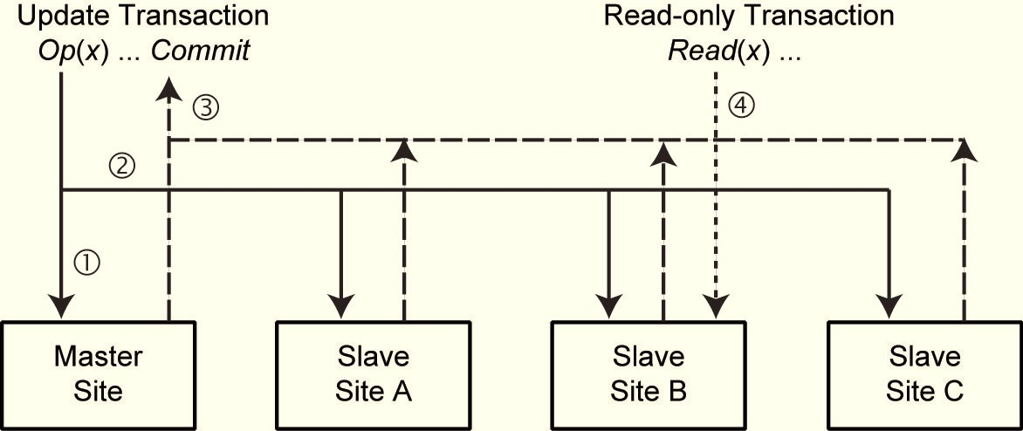
Eager Single Master/Limited Transparency
Applications submit update transactions directly to the master
Master:
Upon read: read locally and return to user
Upon write: write locally, multicast write to other replicas (in FFO timestamps order)
Upon commit request: run 2PC coordinator to ensure that all have really installed the changes
Upon abort: abort and inform other sites about abort
Slaves install writes that arrive from the master

Slide 18
Eager Single Master/Limited Transparency (cont’d)
Applications submit read transactions directly to an appropriate slave
Slave
Upon read: read locally
Upon write from master copy: execute conflicting writes in the proper order (FIFO or timestamp)
Upon write from client: refuse (abort transaction; there is error)
Upon commit request from read-only: commit locally
Participant of 2PC for update transaction running on primary

Slide 19
Eager Single Master/ Full Transparency
Applications submit all transactions to the Transaction Manager at their own sites (Coordinating TM)
Coordinating TM
Send op(x) to the master site
Send Read(x) to any site that has x
Send Write(x) to all the slaves where a copy of x exists
When Commit arrives, act as coordinator for 2PC
Master Site
If op(x) = Read(x): set read lock on x and send “lock granted” msg to the coordinating TM
If op(x) = Write(x)
Set write lock on x
Update local copy of x
Inform coordinating TM
Act as participant in 2PC

Slide 20
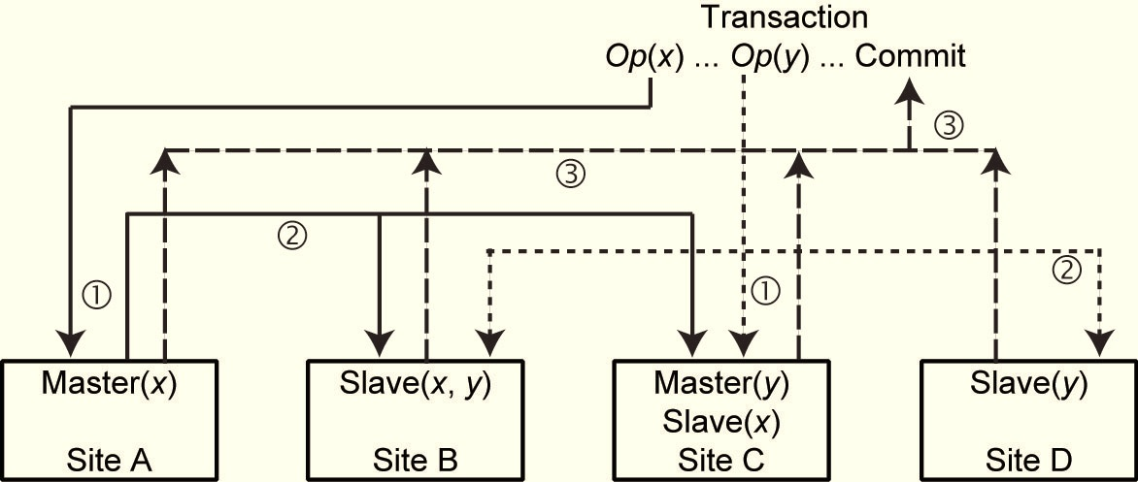
Eager Primary Copy/Full Transparency
Applications submit transactions directly to their local TMs
Local TM:
Forward each operation to the primary copy of the data item
Upon granting of locks, submit Read to any slave, Write to all slaves
Coordinate 2PC

Slide 21
Eager Primary Copy/Full Transparency (cont’d)
Primary copy site
Read(x): lock xand reply to TM
Write(x): lock x, perform update, inform TM
Participate in 2PC
Slaves: as before

Slide 22
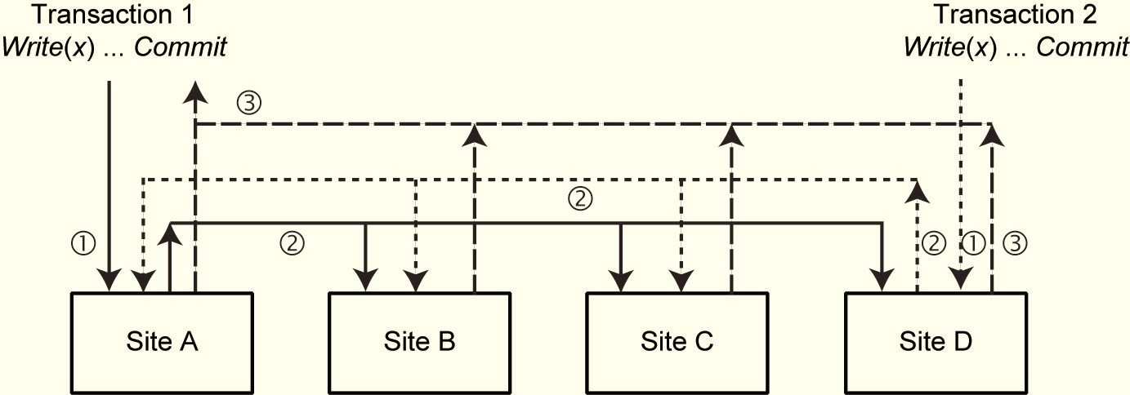
Eager Distributed Protocol
Updates originate at any copy
Each sites uses 2 phase locking.
Read operations are performed locally.
Write operations are performed at all sites (using a distributed locking protocol).
Coordinate 2PC
Slaves:
As before

Slide 23
Eager Distributed Protocol (cont’d)
Critical issue:
Concurrent Writes initiated at different master sites are executed in the same order at each slave site
Local histories are serializable (this is easy)
Advantages
Simple and easy to implement
Disadvantage
Very high communication overhead
n replicas; m update operations in each transaction: n*m messages (assume no multicasting)
For throughput of k tps: k* n*m messages
Alternative
Use group communication + deferred update to slaves to reduce messages

Slide 24
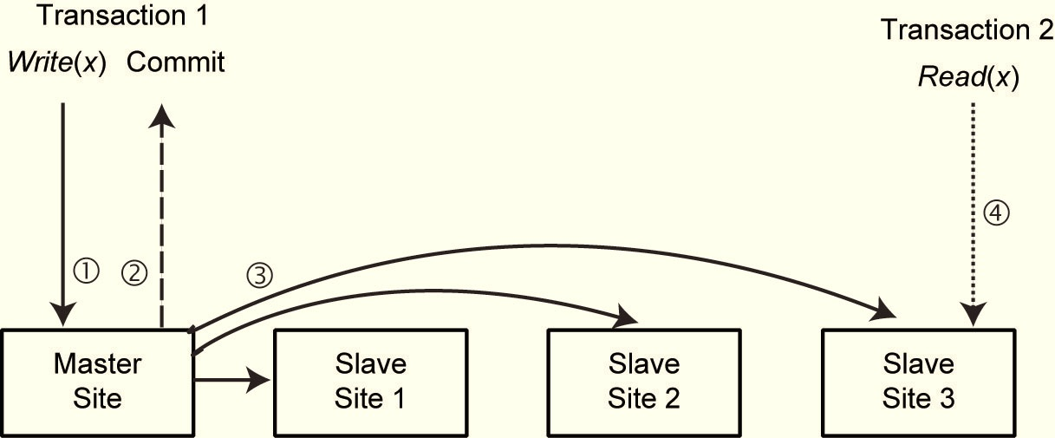
Lazy Single Master/Limited Transparency
Update transactions submitted to master
Master:
Upon read: read locally and return to user
Upon write: write locally and return to user
Upon commit/abort: terminate locally
Sometime after commit: multicast updates to slaves (in order)
Slaves:
Upon read: read locally
Refresh transactions: install updates

Slide 25
Lazy Primary Copy/Limited Transparency
There are multiple masters; each master execution is similar to lazy single master in the way it handles transactions
Slave execution complicated: refresh transactions from multiple masters and need to be ordered properly

Slide 26
Lazy Primary Copy/Limited Transparency – Slaves
Assign system-wide unique timestamps to refresh transactions and execute them in timestamp order
May cause too many aborts
Replication graph
Similar to serialization graph, but nodes are transactions (T) + sites (S); edge 〈T_{i},S_{j}〉exists iff T_{i} performs a Write(x) and x is stored in S_{j}
For each operation (op_{k}), enter the appropriate nodes (T_{k}) and edges; if graph has no cycles, no problem
If cycle exists and the transactions in the cycle have been committed at their masters, but their refresh transactions have not yet committed at slaves, abort T_{k}; if they have not yet committed at their masters, T_{k}waits.
Use group communication

Slide 27
Lazy Single Master/Full Transparency
This is very tricky
Forwarding operations to a master and then getting refresh transactions cause difficulties
Two problems:
Violation of 1SR behavior
A transaction may not see its own reads
Problem arises in primary copy/full transparency as well

Slide 28
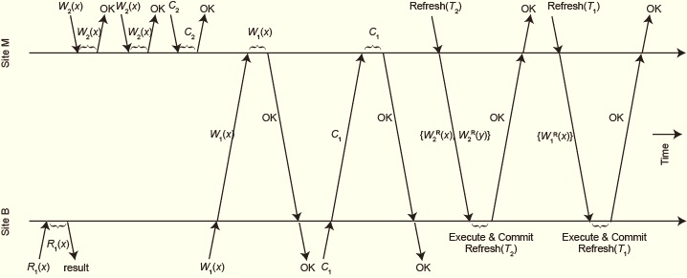
Example 3
Site M (Master) holds x, y; SiteB holds slave copies of x, y
T₁: Read(x), Write(y), Commit
T₂: Read(x), Write(y), Commit

Slide 29
Example 4
Master site M holds x, site C holds slave copy of x
T₃: Write(x), Read(x), Commit
Sequence of execution
W₃(x) submitted at C, forwarded to M for execution
W₃(x) is executed at M, confirmation sent back to C
R₃(x) submitted at C and executed on the local copy
T₃ submits Commit at C, forwarded to M for execution
M executes Commit, sends notification to C, which also commits T₃
M sends refresh transaction for T₃ to C (for W₃(x) operation)
C executes the refresh transaction and commits it
When C reads x at step 3, it does not see the effects of Write at step 2

Slide 30
Lazy Single Master/ Full Transparency - Solution
Assume T = Write(x)
At commit time of transaction T, the master generates a timestamp for it [ts(T)]
Master sets last_modified(x_{M}) ← ts(T)
When a refresh transaction arrives at a slave site i, it also sets last_modified(x_{i}) ← last_modified(x_{M})
Timestamp generation rule at the master:
ts(T) should be greater than all previously issued timestamps and should be less than the last_modified timestamps of the data items it has accessed. If such a timestamp cannot be generated, then T is aborted.

Slide 31
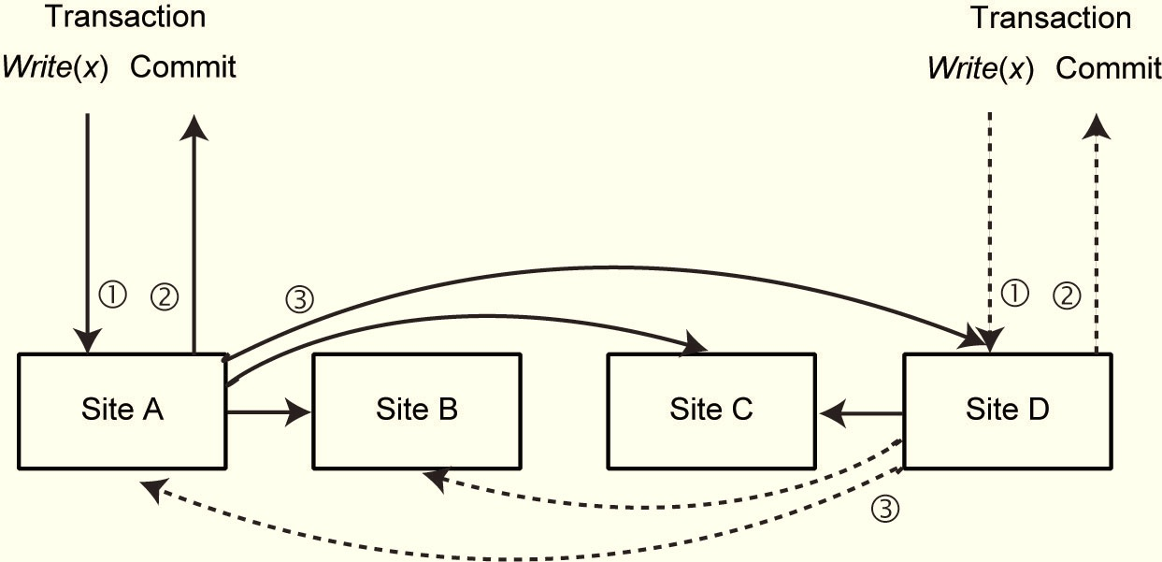
Lazy Distributed Replication
Any site:
Upon read: read locally and return to user
Upon write: write locally and return to user
Upon commit/abort: terminate locally
Sometime after commit: send refresh transaction
Upon message from other site
Detect conflicts
Install changes
Reconciliation may be necessary

Slide 32
Reconciliation
Such problems can be solved using pre-arranged patterns:
Latest update win (newer updates preferred over old ones)
Site priority (preference to updates from headquarters)
Largest value (the larger transaction is preferred)
Or using ad-hoc decision making procedures:
Identify the changes and try to combine them
Analyze the transactions and eliminate the non-important ones
Implement your own priority schemas

Slide 33
Replication Strategies
Updates do not need to be coordinated
No inconsistencies
Longest response time
Only useful with few updates
Local copies are can only be read
No inconsistencies
Elegant (symmetrical solution)
Long response times
Updates need to be coordinated
Eager
No coordination necessary
Short response times
Local copies are not up to date
Inconsistencies
No centralized coordination
Shortest response times
Inconsistencies
Updates can be lost (reconciliation)
Lazy
Centralized
Distributed

Slide 34
Group Communication
A node can multicast a message to all nodes of a group with a delivery guarantee
Multicast primitives
There are a number of them
Total ordered multicast: all messages sent by different nodes are delivered in the same total order at all the nodes
Used with deferred writes, can reduce communication overhead
Remember eager distributed requires k*m messages (with multicast) for throughput of ktps when there are n replicas and m update operations in each transaction
With group communication and deferred writes: 2k messages

Slide 35
Failures
So far we have considered replication protocols in the absence of failures
How to keep replica consistency when failures occur
Site failures
Read One Write All Available (ROWAA)
Communication failures
Quorums
Network partitioning
Quorums

Slide 36
ROWAA with Primary Site
READ = read any copy, if time-out, read another copy.
WRITE = send W(x) to all copies. If one site rejects the operation, then abort. Otherwise, all sites not responding are “missing writes”.
VALIDATION = To commit a transaction
Check that all sites in “missing writes” are still down. If not, then abort the transaction.
There might be a site recovering concurrent with transaction updates and these may be lost
Check that all sites that were available are still available. If some do not respond, then abort.

Slide 37
Distributed ROWAA
Each site has a copy of V
V represents the set of sites a site believes is available
V(A) is the “view” a site has of the system configuration.
The view of a transaction T [V(T)] is the view of its coordinating site, when the transaction starts.
Read any copy within V; update all copies in V
If at the end of the transaction the view has changed, the transaction is aborted
All sites must have the same view!
To modify V, run a special atomic transaction at all sites.
Take care that there are no concurrent views!
Similar to commit protocol.
Idea: Vs have version numbers; only accept new view if its version number is higher than your current one
Recovery: get missed updates from any active node
Problem: no unique sequence of transactions

Slide 38
Quorum-Based Protocol
Assign a vote to each copy of a replicated object (say V_{i}) such that ∑_{i}V_{i} = V
Each operation has to obtain a read quorum (V_{r}) to read and a write quorum (V_{w}) to write an object
Then the following rules have to be obeyed in determining the quorums:
V_{r}+ V_{w}>V an object is not read and written by two transactions
concurrently
V_{w}>V/2 two write operations from two transactions cannot occur
concurrently on the same object

Slide 39
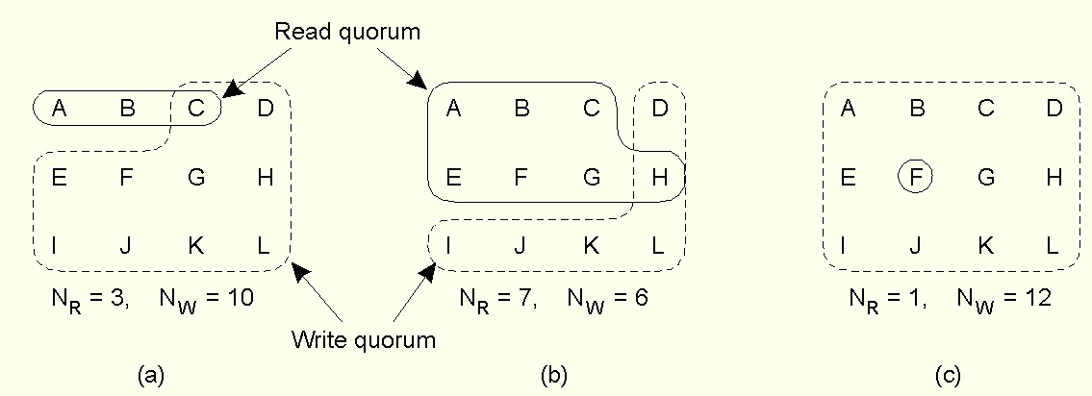
Quorum Example
Three examples of the voting algorithm:
A correct choice of read and write set
A choice that may lead to write-write conflicts
ROWA
From Tanenbaum and van Steen, Distributed Systems: Principles and Paradigms © Prentice-Hall, Inc. 2002

