Slide 1
Outline
Introduction
Background
Relational database systems
Computer networks
Distributed Database Design
Database Integration
Semantic Data Control
Distributed Query Processing
Multidatabase Query Processing
Distributed Transaction Management
Data Replication
Parallel Database Systems
Distributed Object DBMS
Peer-to-Peer Data Management
Web Data Management
Current Issues

Slide 2
Relational Model
Relation
A relation R with attributes A = {A₁, A₂, …, A_{n}} defined over n domains D = {D₁, D₂, ..., D_{n}} (not necessarily distinct) with values {Dom₁, Dom₂, ..., Dom_{n}} is a finite, time varying set of n-tuples ⟨d₁, d₂, ..., d_{n}⟩ such that d₁ ∈Dom₁, d₂ ∈ Dom₂, ..., d_{n} ∈ Dom_{n}, and A₁ ⊆ D₁, A₂ ⊆ D₂, ..., A_{n} ⊆ D_{n}.
Notation: R(A₁, A₂, …, A_{n}) or R(A₁: D₁, A₂: D₂, …, A_{n}: D_{n})
Alternatively, given R as defined above, an instance of it at a given time is a set of n-tuples:
{⟨A₁: d₁, A₂: d₂, …, A_{n}: d_{n}⟩ | d₁ ∈ Dom₁, d₂ ∈ Dom₂, ..., d_{n} ∈ Dom_{n}}
Tabular structure of data where
R is the table heading
Attributes are table columns
Each tuple is a row

Slide 3
Relation Schemes and Instances
Relational scheme
A relation scheme is the definition; i.e., a set of attributes
A relational database scheme is a set of relation schemes:
i.e., a set of sets of attributes
Relation instance (simply relation)
An relation is an instance of a relation scheme
a relation r over a relation scheme R = {A₁, ..., A_{n}} is a subset of the Cartesian product of the domains of all attributes, i.e.,
r ⊆ Dom₁ × Dom₂ × … × Dom_{n}

Slide 4
Domains
A domain is a type in the programming language sense
Name: String
Salary: Real
Domain values is a set of acceptable values for a variable of a given type.
Name: CdnNames = {…},
Salary: ProfSalary = {45,000 - 150,000}
Simple/Composite domains
Address = Street name+street number+city+province+ postal code
Domain compatibility
Binary operations (e.g., comparison to one another, addition, etc.) can be performed on them.
Full support for domains is not provided in many current relational DBMSs

Slide 5
Relation Schemes
EMP
ENO
ENAME
TITLE
SAL
PNO
RESP
DUR
PROJ
PNO
PNAME
BUDGET
EMP(ENO, ENAME, TITLE, SAL, PNO, RESP, DUR)
PROJ (PNO, PNAME, BUDGET)
Underlined attributes are relation keys (tuple identifiers).
Tabular form

Slide 6
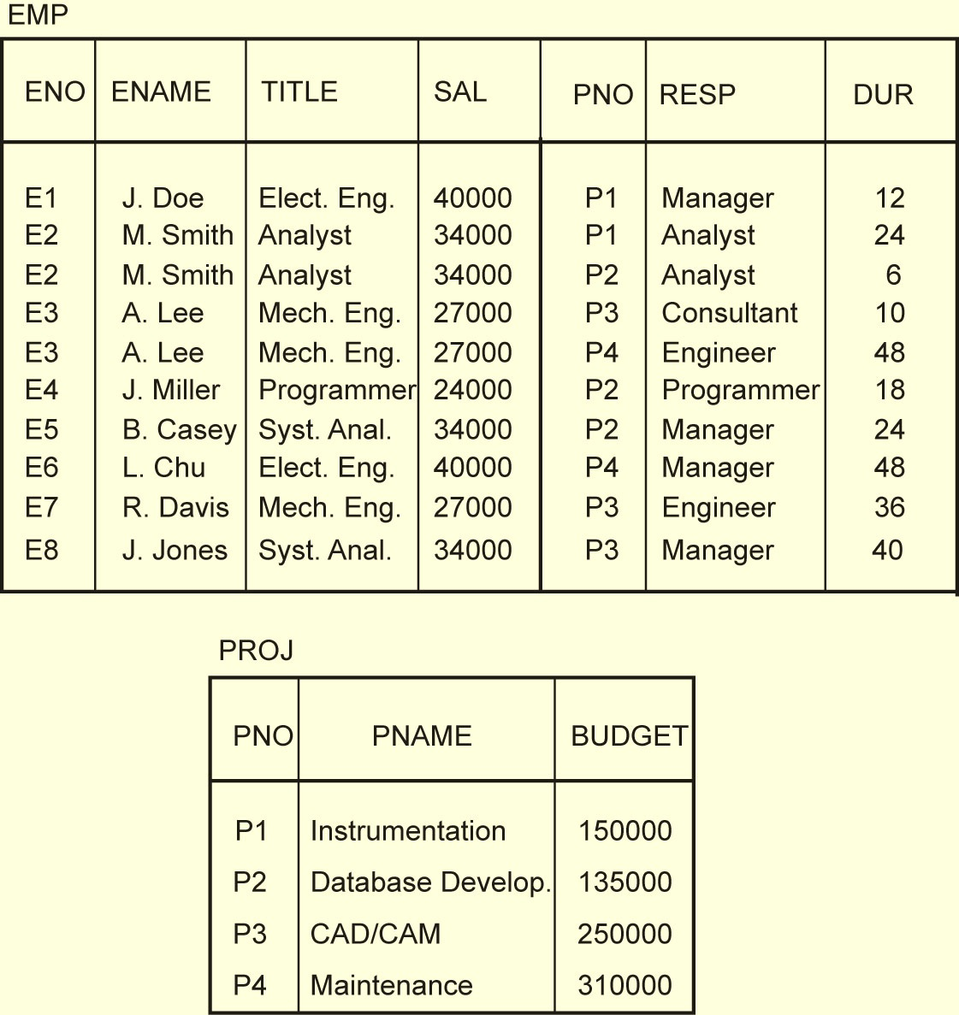
Example Relation Instances

Slide 7
Repetition Anomaly
The NAME,TITLE, SAL attribute values are repeated for each project that the employee is involved in.
Waste of space
Complicates updates
EMP
ENO
ENAME
TITLE
SAL
PNO
RESP
DUR
E1
J. Doe
Elect. Eng.
40000
P1
Manager
12
E2
M. Smith
Analyst
34000
P1
Analyst
24
E2
M. Smith
Analyst
34000
P2
Analyst
6
E3
A. Lee
Mech. Eng.
27000
P3
Consultant
10
E3
A. Lee
Mech. Eng.
27000
P4
Engineer
48
E4
J. Miller
Programmer
24000
P2
Programmer
18
E5
B. Casey
Syst. Anal.
34000
P2
Manager
24
E6
L. Chu
Elect. Eng.
40000
P4
Manager
48
E7
R. Davis
Mech. Eng.
27000
P3
Engineer
36
E8
J. Jones
Syst. Anal.
34000
P3
Manager
40

Slide 8
Update Anomaly
If any attribute of project (say SAL of an employee) is updated, multiple tuples have to be updated to reflect the change.
EMP
ENO
ENAME
TITLE
SAL
PNO
RESP
DUR
E1
J. Doe
Elect. Eng.
40000
P1
Manager
12
E2
M. Smith
Analyst
34000
P1
Analyst
24
E2
M. Smith
Analyst
34000
P2
Analyst
6
E3
A. Lee
Mech. Eng.
27000
P3
Consultant
10
E3
A. Lee
Mech. Eng.
27000
P4
Engineer
48
E4
J. Miller
Programmer
24000
P2
Programmer
18
E5
B. Casey
Syst. Anal.
34000
P2
Manager
24
E6
L. Chu
Elect. Eng.
40000
P4
Manager
48
E7
R. Davis
Mech. Eng.
27000
P3
Engineer
36
E8
J. Jones
Syst. Anal.
34000
P3
Manager
40

Slide 9
Insertion Anomaly
It may not be possible to store information about a new project until an employee is assigned to it.
EMP
ENO
ENAME
TITLE
SAL
PNO
RESP
DUR
E1
J. Doe
Elect. Eng.
40000
P1
Manager
12
E2
M. Smith
Analyst
34000
P1
Analyst
24
E2
M. Smith
Analyst
34000
P2
Analyst
6
E3
A. Lee
Mech. Eng.
27000
P3
Consultant
10
E3
A. Lee
Mech. Eng.
27000
P4
Engineer
48
E4
J. Miller
Programmer
24000
P2
Programmer
18
E5
B. Casey
Syst. Anal.
34000
P2
Manager
24
E6
L. Chu
Elect. Eng.
40000
P4
Manager
48
E7
R. Davis
Mech. Eng.
27000
P3
Engineer
36
E8
J. Jones
Syst. Anal.
34000
P3
Manager
40

Slide 10
Deletion Anomaly
If an engineer, who is the only employee on a project, leaves the company, his personal information cannot be deleted, or the information about that project is lost.
May have to delete many tuples.
EMP
ENO
ENAME
TITLE
SAL
PNO
RESP
DUR
E1
J. Doe
Elect. Eng.
40000
P1
Manager
12
E2
M. Smith
Analyst
34000
P1
Analyst
24
E2
M. Smith
Analyst
34000
P2
Analyst
6
E3
A. Lee
Mech. Eng.
27000
P3
Consultant
10
E3
A. Lee
Mech. Eng.
27000
P4
Engineer
48
E4
J. Miller
Programmer
24000
P2
Programmer
18
E5
B. Casey
Syst. Anal.
34000
P2
Manager
24
E6
L. Chu
Elect. Eng.
40000
P4
Manager
48
E7
R. Davis
Mech. Eng.
27000
P3
Engineer
36
E8
J. Jones
Syst. Anal.
34000
P3
Manager
40

Slide 11
What to do?
Take each relation individually and “improve” it in terms of the desired characteristics
Normal forms
Atomic values (1NF)
Can be defined according to keys and dependencies.
Functional Dependencies ( 2NF, 3NF, BCNF)
Multivalued dependencies (4NF)
Normalization
Normalization is a process of concept separation which applies a top-down methodology for producing a schema by subsequent refinements and decompositions.
Do not combine unrelated sets of facts in one table; each relation should contain an independent set of facts.
Universal relation assumption
1NF to 3NF; 1NF to BCNF

Slide 12
Normalization Issues
How do we decompose a schema into a desirable normal form?
What criteria should the decomposed schemas follow in order to preserve the semantics of the original schema?
Reconstructability: recover the original relation ⇒ no spurious joins
Lossless decomposition: no information loss
Dependency preservation: the constraints (i.e., dependencies) that hold on the original relation should be enforceable by means of the constraints (i.e., dependencies) defined on the decomposed relations.
What happens to queries?
Processing time may increase due to joins
Denormalization

Slide 13
Functional Dependence
Given relation R defined over U = {A₁, A₂, ..., A_{n}} where X ⊆ U, Y ⊆ U. If, for all pairs of tuples t₁ and t₂ in any legal instance of relation scheme R,
t₁[X] = t₂[X] ⇒ t₁[Y] = t₂[Y],
then the functional dependency X → Y holds in R.
Example
In relation EMP
(ENO, PNO) → (ENAME, TITLE, SAL, DUR, RESP)
In relation PROJ
PNO → (PNAME, BUDGET)

Slide 14
Normal Forms Based on FDs
1NF eliminates the relations within relations or relations as attributes of tuples.
Lossless &
Dependency
preserving
First Normal Form (1NF)
eliminate the partial functional dependencies of non-prime attributes to key attributes
Second Normal Form (2NF)
eliminate the transitive functional dependencies of non-prime attributes to key attributes
Third Normal Form (3NF)
Lossless
eliminate the partial and transitive functional dependencies of prime (key) attributes to key.
Boyce-Codd Normal Form (BCNF)
Notes:
Animated slide

Slide 15
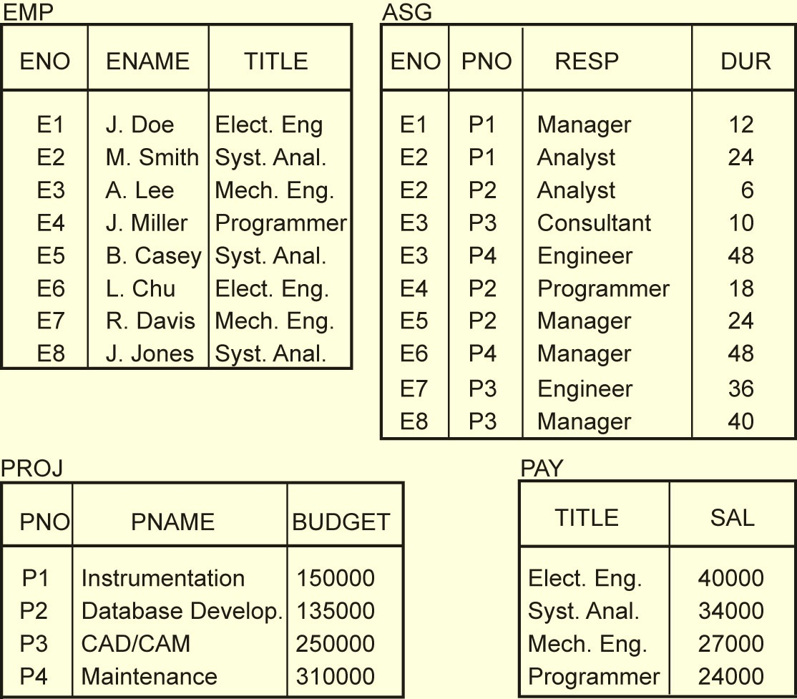
Normalized Relations – Example

Slide 16
Relational Algebra
Specify how to obtain the result using a set of operators
Form
⟨Operator⟩_{⟨parameters⟩} ⟨Operands⟩ → ⟨Result⟩
↓ ↓
Relation (s) Relation

Slide 17
Relational Algebra Operators
Fundamental
Selection
Projection
Union
Set difference
Cartesian product
Additional
Intersection
θ-join
Natural join
Semijoin
Division
Union compatibility
Same degree
Corresponding attributes defined over the same domain

Slide 18
Selection
Produces a horizontal subset of the operand relation
General form
σ_{F}(R)={t |t∈R and F(t) is true}
where
R is a relation, t is a tuple variable
F is a formula consisting of
operands that are constants or attributes
arithmetic comparison operators
<, >, =, ≠, ≤, ≥
logical operators
∧, ∨, ¬

Slide 19
Selection Example
EMP
ENO
ENAME
TITLE
E1
J. Doe
Elect. Eng.
E2
M. Smith
Syst. Anal.
σ_{TITLE='Elect. Eng.'}(EMP)
E3
A. Lee
Mech. Eng.
ENO
ENAME
TITLE
E4
J. Miller
Programmer
E5
B. Casey
Syst. Anal.
E1
J. Doe
Elect. Eng
E6
L. Chu
Elect. Eng.
E6
L. Chu
Elect. Eng.
E7
R. Davis
Mech. Eng.
E8
J. Jones
Syst. Anal.

Slide 20
Projection
Produces a vertical slice of a relation
General form
Π_{A1,…,An}(R)={t[A₁,…, A_{n}] | t∈R}
where
R is a relation, t is a tuple variable
{A₁,…, A_{n}} is a subset of the attributes of R over which the projection will be performed
Note: projection can generate duplicate tuples. Commercial systems (and SQL) allow this and provide
Projection with duplicate elimination
Projection without duplicate elimination

Slide 21
Projection Example
PROJ
Π_{PNO,BUDGET}(PROJ)
PNO
PNAME
BUDGET
PNO
BUDGET
P1
Instrumentation
150000
P1
150000
P2
Database Develop.
135000
P2
135000
P3
CAD/CAM
250000
P3
250000
P4
Maintenance
310000
P4
310000

Slide 22
Union
Similar to set union
General form
R ∪ S={t | t ∈ R or t ∈ S}
where R, S are relations, t is a tuple variable
Result contains tuples that are in R or in S, but not both (duplicates removed)
R, S should be union-compatible

Slide 23
Set Difference
General Form
R – S = {t |t ∈ R and t ∉ S}
where R and S are relations, t is a tuple variable
Result contains all tuples that are in R, but not in S.
R – S ≠ S – R
R, S union-compatible

Slide 24
Cartesian (Cross) Product
Given relations
R of degree k_{1 ,} cardinality n₁
S of degree k_{2 ,} cardinality n₂
Cartesian (cross) product:
R × S = {t [A₁,…,A_{k1}, A_{k1+1},…,A_{k1+k2}] | t[A₁,…,A_{k1}] ∈ R and t[A_{k1+1},…,A_{k1+k2}] ∈ S}
The result of R ⋅ S is a relation of degree (k₁+ k₂) and consists of all (n₁* n₂)-tuples where each tuple is a concatenation of one tuple of R with one tuple of S.

Slide 25
Cartesian Product Example
EMP
EMP × PAY
ENO
ENAME
TITLE
ENO
ENAME
EMP.TITLE
PAY.TITLE
SALARY
E1
J. Doe
Elect. Eng
E1
J. Doe
Elect. Eng.
Elect. Eng.
55000
E2
M. Smith
Syst. Anal.
E1
J. Doe
Elect. Eng.
Syst. Anal.
70000
E3
A. Lee
Mech. Eng.
E1
J. Doe
Elect. Eng.
Mech. Eng.
45000
E4
J. Miller
Programmer
E1
J. Doe
Elect. Eng.
Programmer
60000
E5
B. Casey
Syst. Anal.
E2
M. Smith
Syst. Anal.
Elect. Eng.
55000
E6
L. Chu
Elect. Eng.
E2
M. Smith
Syst. Anal.
Syst. Anal.
70000
E7
R. Davis
Mech. Eng.
E2
M. Smith
Syst. Anal.
Mech. Eng.
45000
E8
J. Jones
Syst. Anal.
E2
M. Smith
Syst. Anal.
Programmer
60000
E3
A. Lee
Mech. Eng.
Elect. Eng.
55000
PAY
E3
A. Lee
Mech. Eng.
Syst. Anal.
70000
E3
A. Lee
Mech. Eng.
Mech. Eng.
45000
TITLE
SALARY
E3
A. Lee
Mech. Eng.
Programmer
60000
Elect. Eng.
55000
E8
J. Jones
Syst. Anal.
Elect. Eng.
55000
Syst. Anal.
70000
E8
J. Jones
Syst. Anal.
Syst. Anal.
70000
Mech. Eng.
45000
E8
J. Jones
Syst. Anal.
Mech. Eng.
45000
Programmer
60000
E8
J. Jones
Syst. Anal.
Programmer
60000

Slide 26
Intersection
Typical set intersection
R ∩S = {t | t ∈ R and t ∈ S}
= R – (R – S)
R, S union-compatible

Slide 27
θ−Join
General form
R ⋈_{F(R.Ai,S.Bj)} S={t[A₁,…,A_{n},B₁,…,B_{m}] |
t[A₁,…,A_{n}] ∈ R and t[B₁,…,B_{m}] ∈ S
and F(R.A_{i}, S.B_{j}) is true}
where
R, S are relations, t is a tuple variable
F (R.A_{i}, S.B_{j})is a formula defined as that of selection.
A derivative of Cartesian product
R ⋈_{F} S = σ_{F}(R × S)

Slide 28
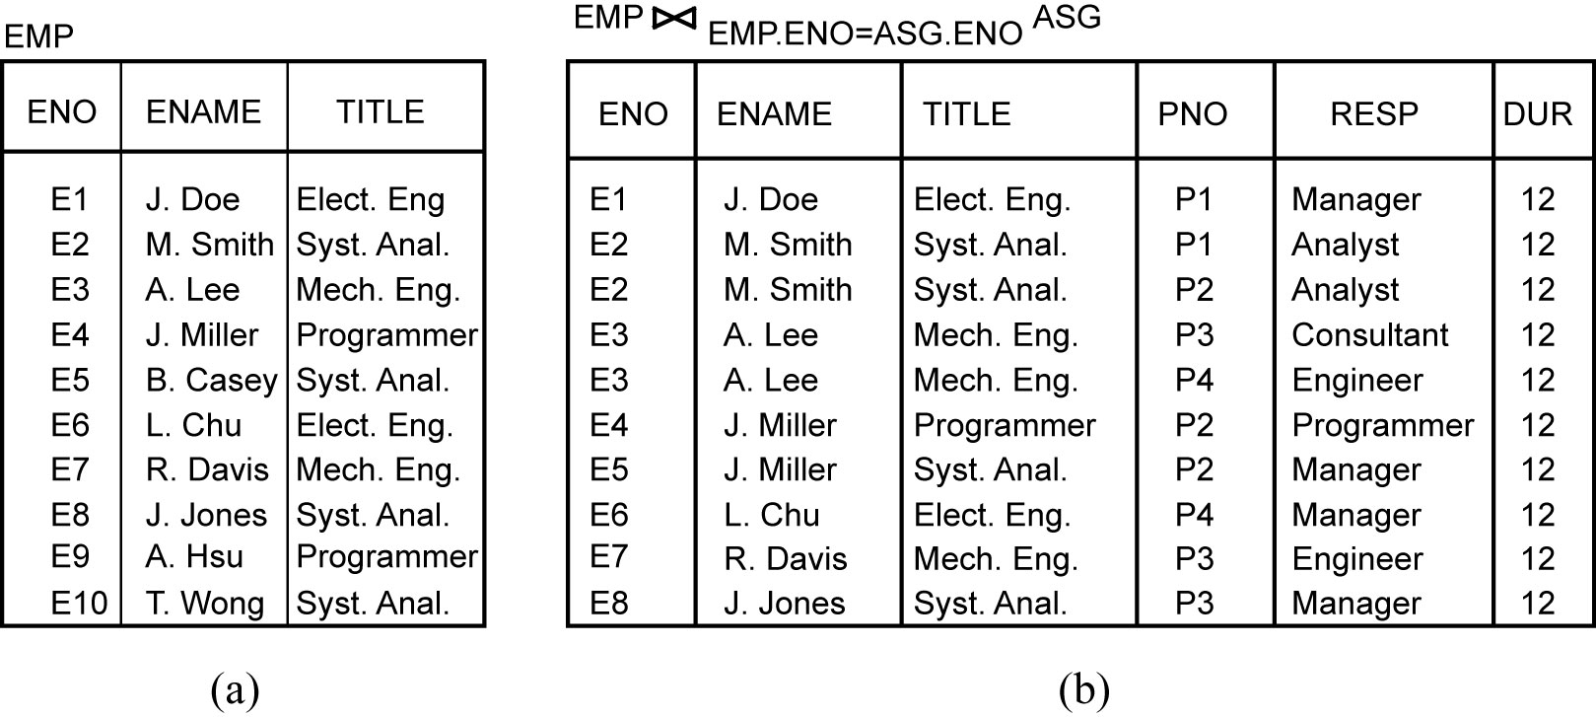
Join Example

Slide 29
Types of Join
Equi-join
The formula F only contains equality
R ⋈_{R.A=S.B} S
Natural join
Equi-join of two relations R and S over an attribute (or attributes) common to both R and S and projecting out one copy of those attributes
R ⋈ S = Π_{R∪S}σ_{F}(R × S)

Slide 30
Natural Join Example
EMP
ENO
ENAME
TITLE
EMP ⋈ PAY
E1
J. Doe
Elect. Eng
E2
M. Smith
Syst. Anal.
ENO
ENAME
TITLE
SALARY
E3
A. Lee
Mech. Eng.
E4
J. Miller
Programmer
E1
J. Doe
Elect. Eng.
55000
E5
B. Casey
Syst. Anal.
E2
M. Smith
Analyst
70000
E6
L. Chu
Elect. Eng.
E3
A. Lee
Mech. Eng.
45000
E7
R. Davis
Mech. Eng.
E8
J. Jones
Syst. Anal.
E4
J. Miller
Programmer
60000
PAY
E5
B. Casey
Syst. Anal.
70000
E6
L. Chu
Elect. Eng.
55000
TITLE
SALARY
E7
R. Davis
Mech. Eng.
45000
Elect. Eng.
55000
E8
J. Jones
Syst. Anal.
70000
Syst. Anal.
70000
Mech. Eng.
45000
Join is over the common attribute TITLE
Programmer
60000

Slide 31
Types of Join
Outer-Join
Ensures that tuples from one or both relations that do not satisfy the join condition still appear in the final result with other relation’s attribute values set to NULL
Left outer join
Right outer join
Full outer join

Slide 32
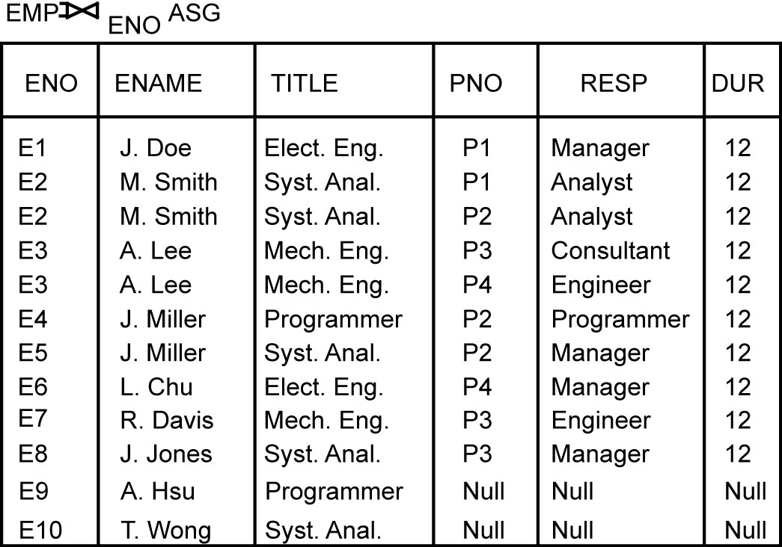
Outer Join Example
Left outer join

Slide 33
Semijoin
Derivation
R ⋉_{F} S = Π_{A}(R ⋈_{F} S) = Π_{A}(R) ⋈ Π_{A∩B}(S) = R ⋈_{F} Π_{A∩B}(S)
where
R, S are relations
A is a set of attributes

Slide 34
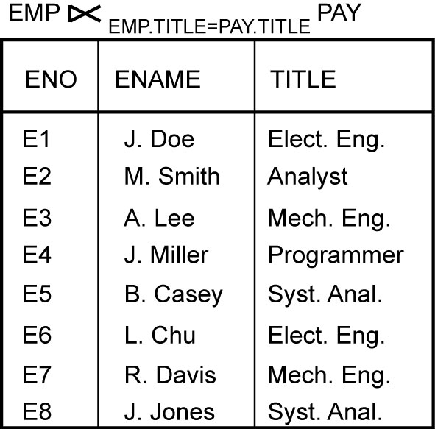
Semijoin Example

Slide 35
Division (Quotient)
Given relations
R of degree k₁ (R = {A₁,…,A_{k1}})
S of degree k₂ (S = {B₁,…,B_{k2}})
Let A = {A₁,…,A_{k1}} [i.e., R(A)] and B = {B₁,…,B_{k2}} [i.e., S(B)] and B ⊆ A.
Then, T = R ÷ S gives T of degree k₁-k₂ [i.e., T(Y) where Y = A-B] such that for a tuple t to appear in T, the values in t must appear in R in combination with every tuple in S.
Derivation
R ÷ S = Π_{Y}(R) – Π_{Y}((Π_{Y}(R) × S) – R)

Slide 36
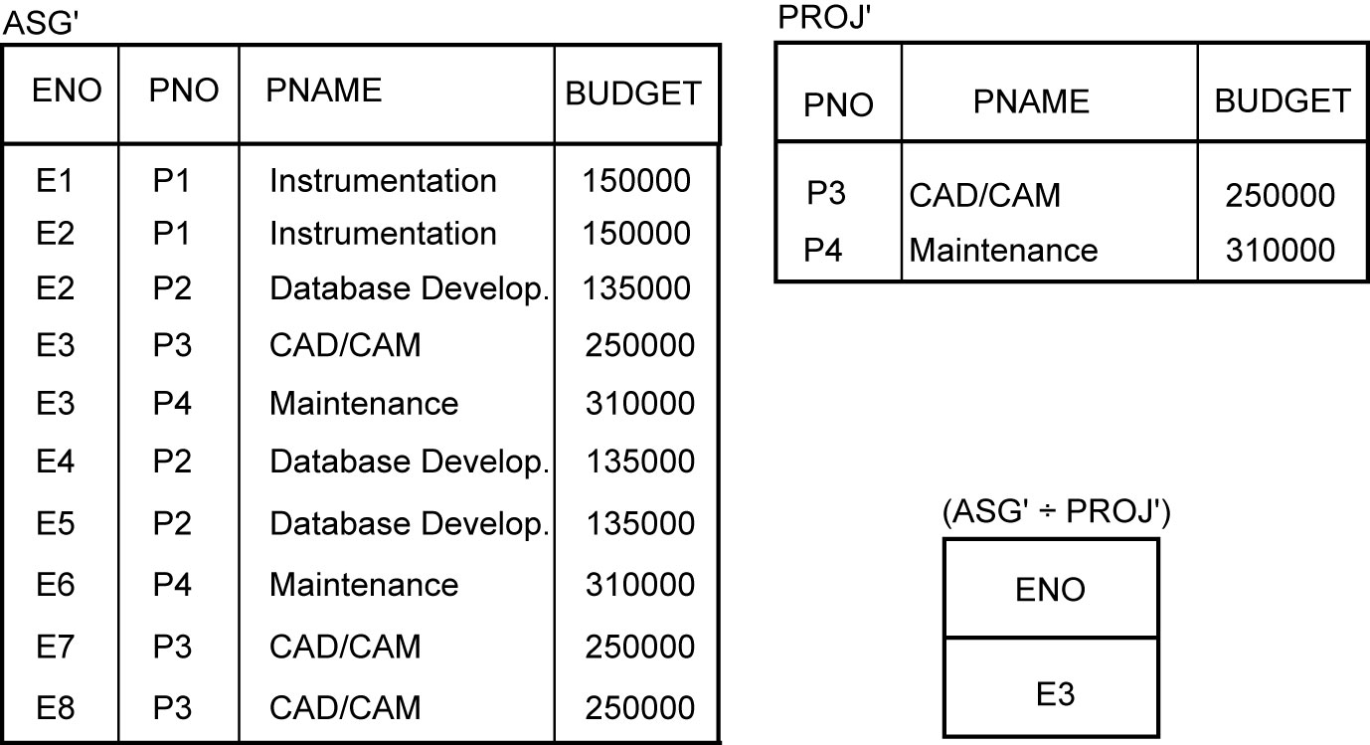
Division Example

Slide 37
Relational Calculus
Specify the properties that the result should hold
Tuple relational calculus
Domain relational calculus

Slide 38
Tuple Relational Calculus
Query of the form {t|F{t}} where
t is a tuple variable
F is a well-formed formula
Atomic formula
Tuple-variable membership expressions
R.t or R(t) : tuple t belongs to relation R
Conditions
s[A] θ t[B]; s and t are tuple variables, A and B are components of s and t, respectively, θ ∈ {<,>, =,≠, ≤, ≥}; e.g., s[SAL] > t[SAL]
s[A] θ c; s, A, and θ as defined above, c is a constant; e.g., s[ENAME] = ‘Smith’
SQL is an example of tuple relational calculus (at least in its simple form)

Slide 39
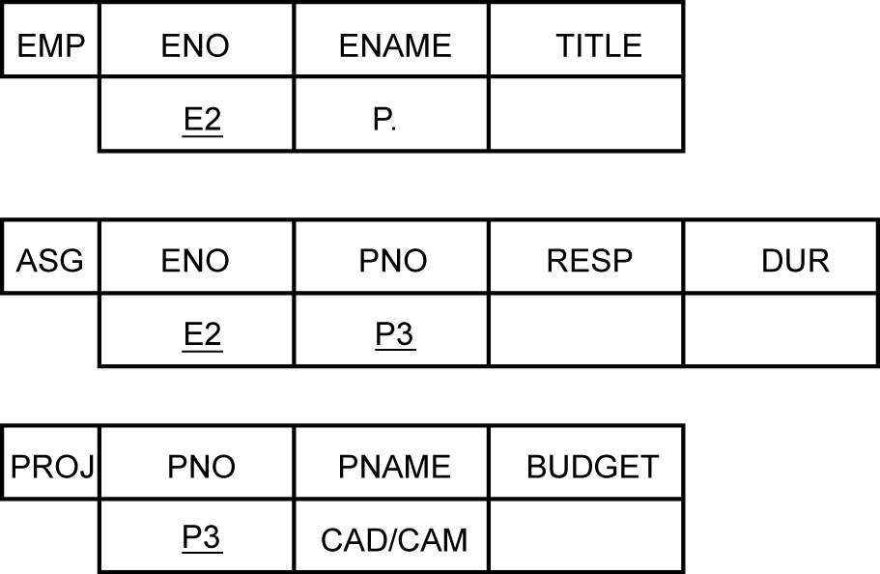
Domain Relational Calculus
Query of the form x₁, x₂, …, x_{n}|F(x₁, x₂, …, x_{n}) where
F is a well-formed formula in which x₁, x₂, …, x_{n} are the free variables
QBE is an example

Slide 40
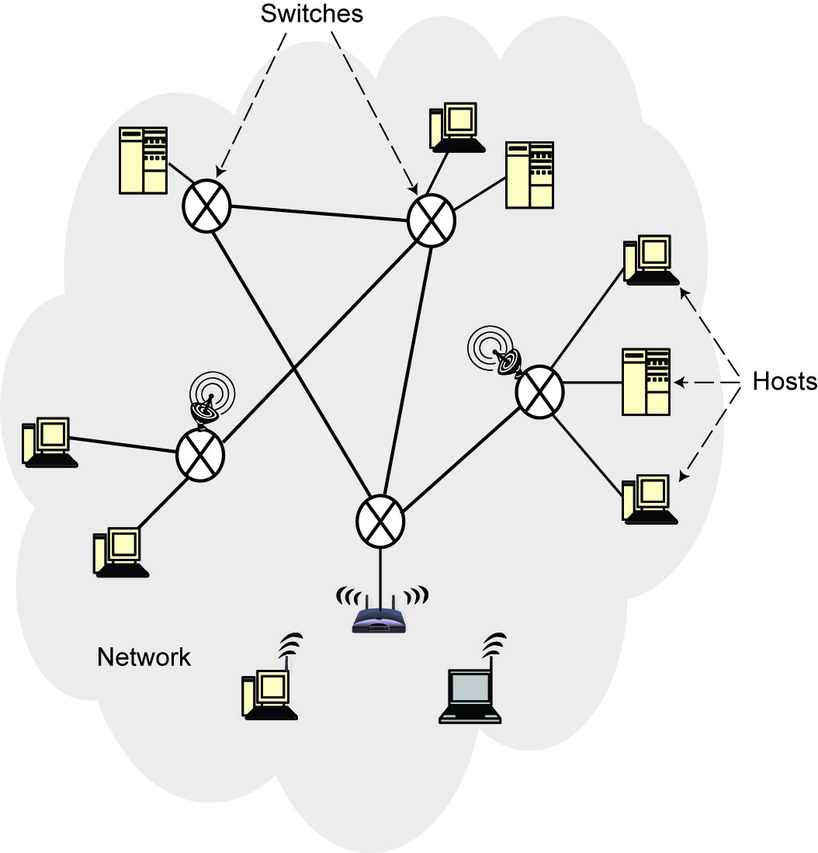
Computer Network
An interconnected collection of autonomous computers that are capable of exchanging information among themselves.
Components
Hosts (nodes, end systems)
Switches
Communication link

Slide 41
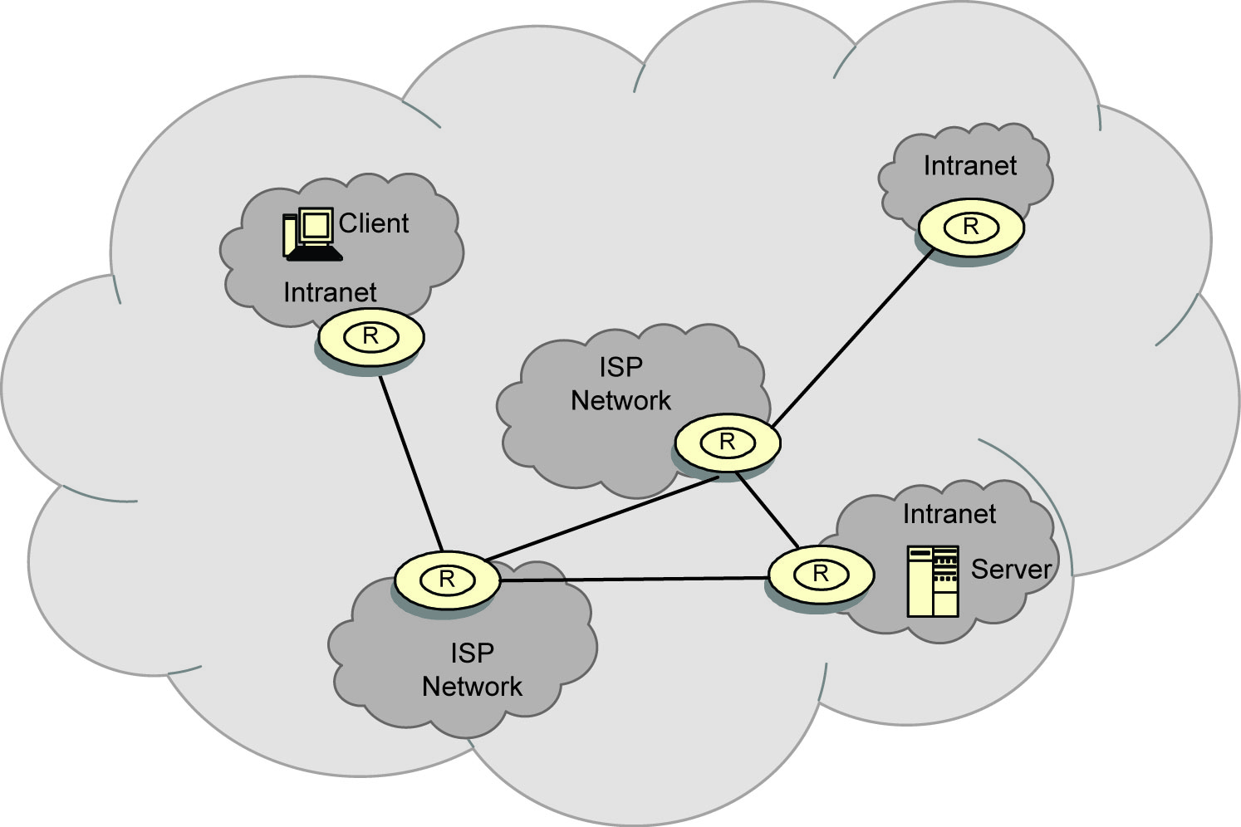
Internet
Network of networks

Slide 42
Types of Networks
According to scale (geographic distribution)
Wide are network (WAN)
Distance between any two nodes > 20km and can go as high as thousands of kms
Long delays due to distance traveled
Heterogeneity of transmission media
Speeds of 150Mbps to 10Gbps (OC192 on the backbone)
Local area network (LAN)
Limited in geographic scope (usually < 2km)
Speeds 10-1000 Mbps
Short delays and low noise
Metropolitan area network (MAN)
In between LAN and WAN

Slide 43
Types of Networks (cont’d)
Topology
Irregular
No regularity in the interconnection – e.g., Internet
Bus
Typical in LANs – Ethernet
Using Carrier Sense Medium Access with Collision Detection (CSMA/CD)
Listen before and while you transmit
Star
Ring
Mesh

Slide 44
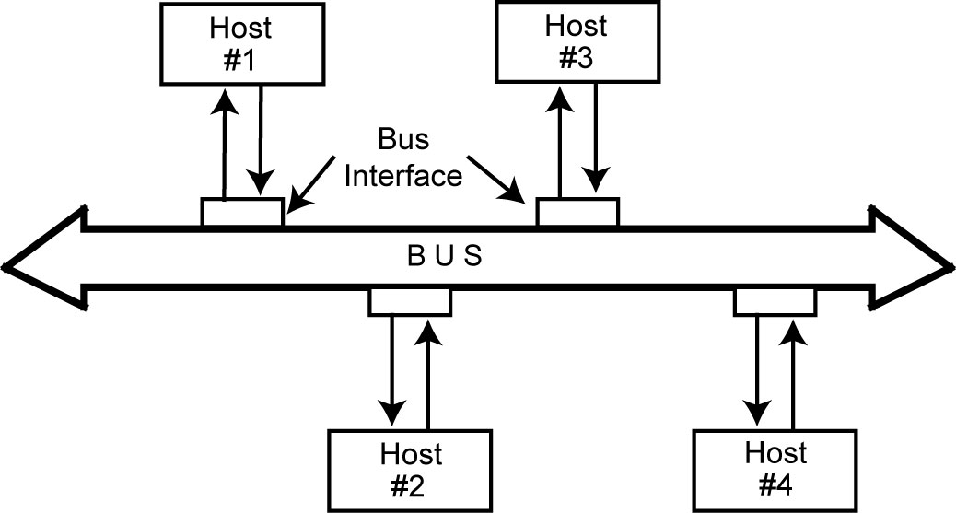
Bus network

Slide 45
Communication Schemes
Point-to-point (unicast)
One or more (direct or indirect) links between each pair of nodes
Communication always between two nodes
Receiver and sender are identified by their addresses included in the message header
Message may follow one of many links between the sender and receiver using switching or routing
Broadcast (multi-point)
Messages are transmitted over a shared channel and received by all the nodes
Each node checks the address and if it not the intended recipient, ignores
Multi-cast: special case
Message is sent to a subset of the nodes

Slide 46
Communication Alternatives
Twisted pair
Coaxial
Fiber optic cable
Satellite
Microwave
Wireless

Slide 47
Data Communication
Hosts are connected by links, each of which can carry one or more channels
Link: physical entity; channel: logical entity
Digital signal versus analog signal
Capacity – bandwidth
The amount of information that can be trnsmitted over the channel in a given time unit
Alternative messaging schemes
Packet switching
Messages are divided into fixed size packets, each of which is routed from the source to the destination
Circuit switching
A dedicated channel is established between the sender and receiver for the duration of the session

Slide 48
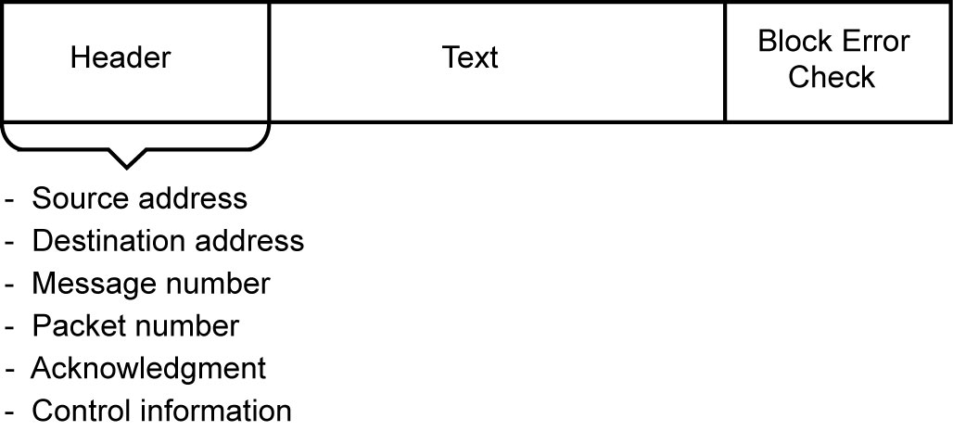
Packet Format

Slide 49
Communication Protocols
Software that ensures error-free, reliable and efficient communication between hosts
Layered architecture – hence protocol stack or protocol suite
TCP/IP is the best-known one
Used in the Internet

Slide 50
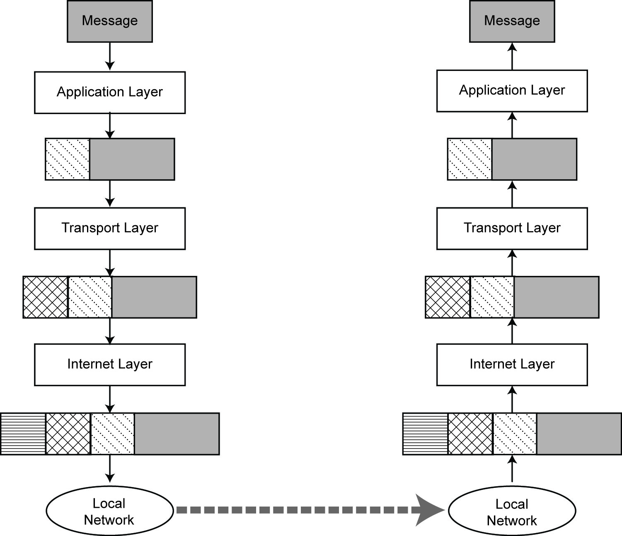
Message Transmission using TCP/IP

Slide 51
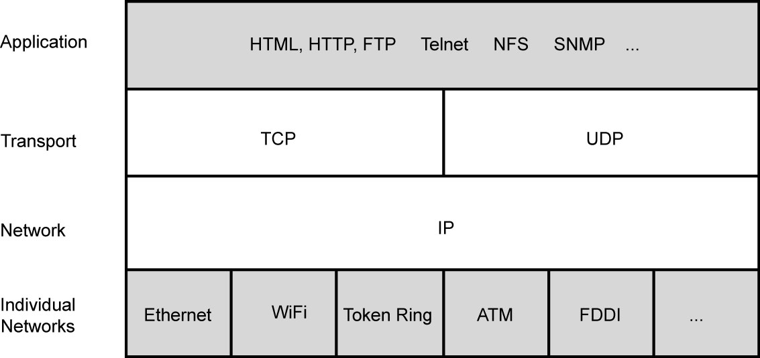
TCP/IP Protocol

