Slide 1
SECRET KNOCK DETECTION AND UNLOCKING

Slide 2
PROJECT MENTOR : MR. ABHISHEK JAVALI [ ASSISTANT PROFESSOR ]

Slide 3
Hello!
THIS IS PRESENTED BY :
SHAMIRAN BEHERA – [1CR17EC180]
SANGAM MISHRA – [1CR17EC173]
UTKARSH PATEL – [1CR17EC207]

Slide 4
Acknowledgment
I have taken efforts in this project. However, it would not have been possible without the kind support and help of many individuals. I would like to extend my sincere thanks to all of them.
I am highly indebted to our project mentor for their guidance and constant supervision as well as for providing necessary information regarding the project & also for their support in completing the project.
I would like to express my gratitude towards my parents for their kind co-operation and encouragement which help me in completion of this project.
My thanks and appreciations also go to my colleague in developing the project and people who have willingly helped me out with their abilities.

Slide 5
Description
Security is a major concern in our day to day life, and digital locks have become an important part of these security systems. There are many types of security systems available to secure our place. Some examples are PIR based Security System, RFID based Security System, Digital Lock System, bio-matrix systems, Electronics Code lock. In this post, let us build a Secret Knock Detecting Door Lock using ATMEGA 328P Micro-controller which can detect the pattern of your knocks at the door and will only open the lock if the knocking pattern matches with the correct pattern.

Slide 6
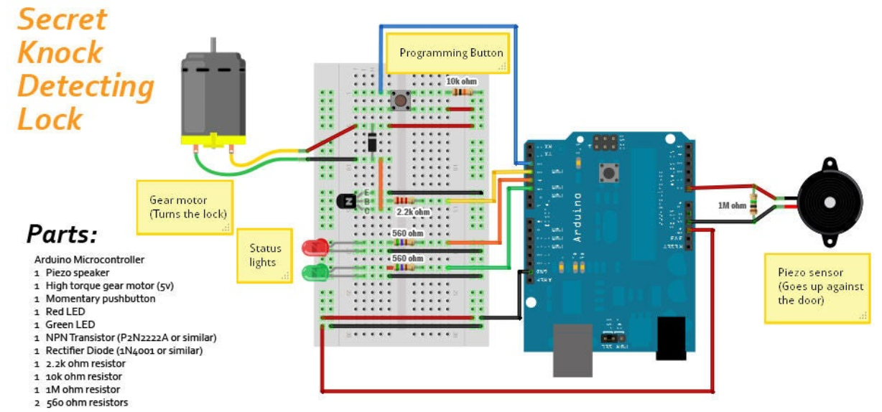
Transition headline
Block Diagram
1
Let’s start with the first set of slides

Slide 7

BILLS OF MATERIALS
Atmega 328P Micro-controller.
Piezo speaker.
SPST momentary pushbutton.
Red LED
Green LED
NPN Transistor P2N2222A.
Rectifier Diode (1N4001).
9 volt battery clip and 9v battery.
Small piece of bread board.
Resistors.
2.2k ohm resistor (1/4 watt)
1 10k ohm resistor (1/4 watt)
1 1M ohm resistor (1/4 watt)

Slide 8
WORKING EXPLAINATION
Working of Knock based Smart Lock is simple. First we have to save a pattern in the system. So we have to press and hold push button until we knock 6 times. Here in this project, I have used 6 knocks but the user may change it as they want. After six times knock, Arduino find the knock pattern and save that in EEPROM. Now after saving the input pattern, press and immediately released the push button for taking input from the sensor to Arduino to open the lock. Now we have to knock 6 times. After it, Arduino decodes it and compares with saved pattern. If a match occurs then Arduino open the gate by driving servo motor.

Slide 9
ADVANTAGES
The users who know the knocking pattern can open the door anytime without a key
This system completely removes the fear of replication as there is no key involved to be replicated.
The only way to change the secret pattern is by unlocking it first through the secret knock.
the main advantage of a keyless door lock is not needing to carry a key. ... Just as you can forget your keys and be locked out of your home

Slide 10
Our process is easy
KNOCK INPUT
COMPARING
THE
RYTHM OF KNOCK
LOCKING /
UNLOCKING

Slide 11
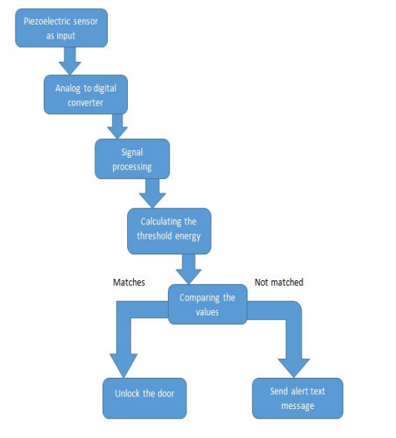
WORKING ALGORITHM
20%
40%
60%
80%
100%

Slide 12
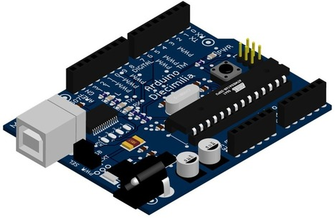
MODULE – 1 ARDUINO UNO

Slide 13
MODULE - 1
Arduino is an open-source electronics platform based on easy-to-use hardware and software. Arduino boards are able to read inputs - light on a sensor, a finger on a button, or a Twitter message - and turn it into an output - activating a motor, turning on an LED, publishing something online. You can tell your board what to do by sending a set of instructions to the microcontroller on the board. To do so you use the Arduino programming language (based on Wiring), and the Arduino Software (IDE), based on Processing. There are many other microcontrollers and microcontroller platforms available for physical computing. Parallax Basic Stamp, Netmedia's BX-24, Phidgets, MIT's Handyboard, and many others offer similar functionality. All of these tools take the messy details of microcontroller programming and wrap it up in an easy-to-use package. Arduino also simplifies the process of working with microcontrollers, but it offers some advantage for teachers, students, and interested amateurs over other systems:

Slide 14
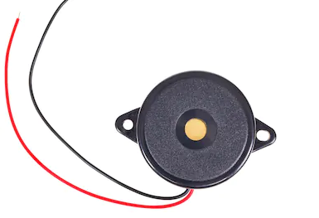
MODULE – 2 PEIZO TRANSDUCER

Slide 15
MODULE – 2
TA piezoelectric sensor is a device that uses the piezoelectric effect, to measure changes in pressure, acceleration, temperature, strain, or force by converting them to an electrical charge. The prefix Piezo- is Greek for 'press' or 'squeeze'.

Slide 16
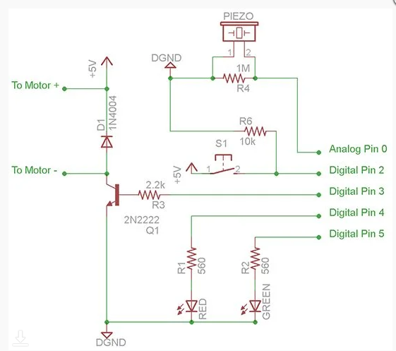
CIRCUIT

Slide 17

PROGRAM

Slide 18
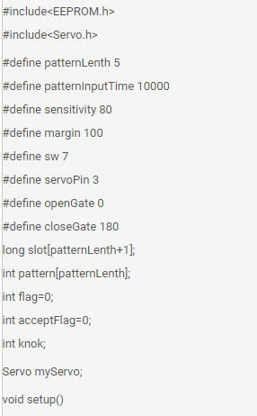

Slide 19
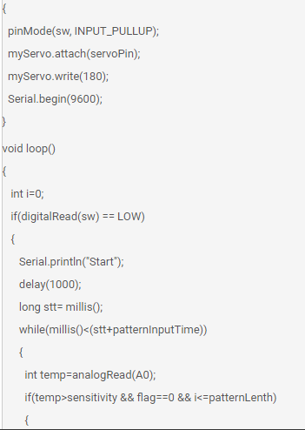

Slide 20
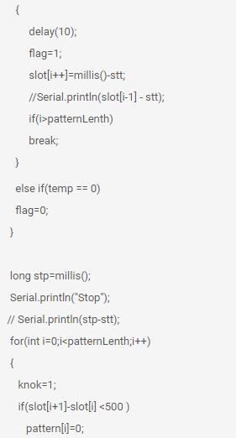

Slide 21
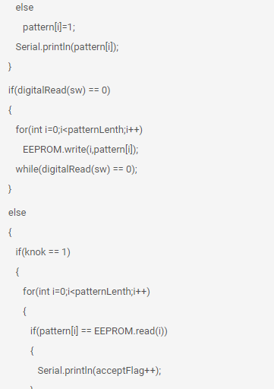

Slide 22
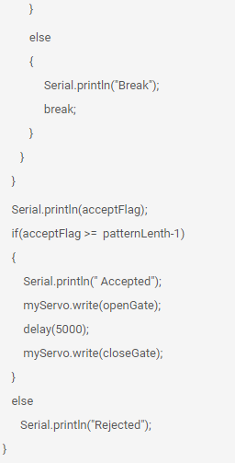

Slide 23
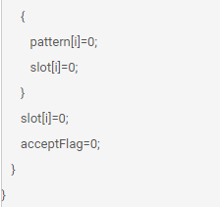

Slide 24
CONCLUSIONS
In this generation of advanced technology, theft and crime has taken the aid of technology itself in achieving its results many times. To avoid such circumstances, sometimes even small things can lead to a great change. Thus, implementation of smart devices in Security Control like the Knock Based Security System can prove to be very valuable to the person using it and also to the valuables themselves. In this paper, the issue of safety is being addressed through easily and affordable technology like piezo sensor, GSM module, Push button, and Arduino microcontroller. This can also be improved by interfacing with various technologies like finger print reader, voice detection etc., thus making it much more secure while not being too costly and out of reach in terms of availability.

Slide 25
Thanks!
Life is a process, not a problem. The question is only, have you prepared yourself for the process or not.

