Slide 1
CSC3060 – Computer Architecture Chapter 4 Control
Prof. Wei Chung Hsu
School of Data Science
Chinese University of Hong Kong, Shenzhen

Slide 2
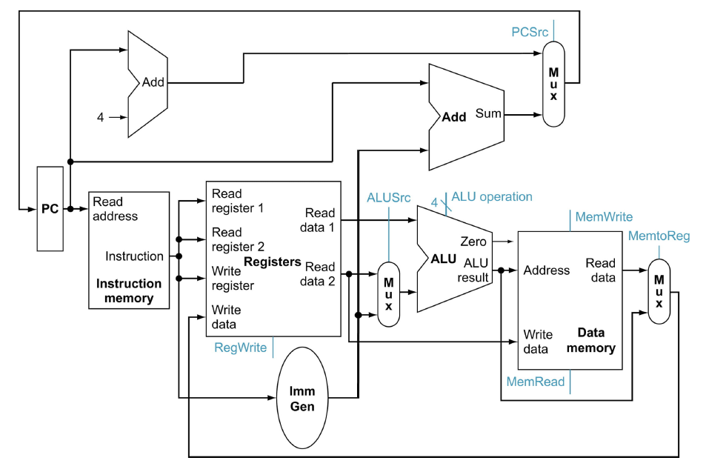
A Single Cycle Data Path
Add this path for JAL
WBsel

Slide 3
Control Points and Signals
Instruction<31:0>
Inst.
Memory
<12:14>
<15:19>
<20:24>
<7:11>
<20:31>
Addr
Op
Funct
Rs1
Rs2
Rd
Imm12
Control
PCsrc
RegWr
MemRd
ALUSrc
ALUctr
MemWr
WBsel
Equal
Datapath

Slide 4
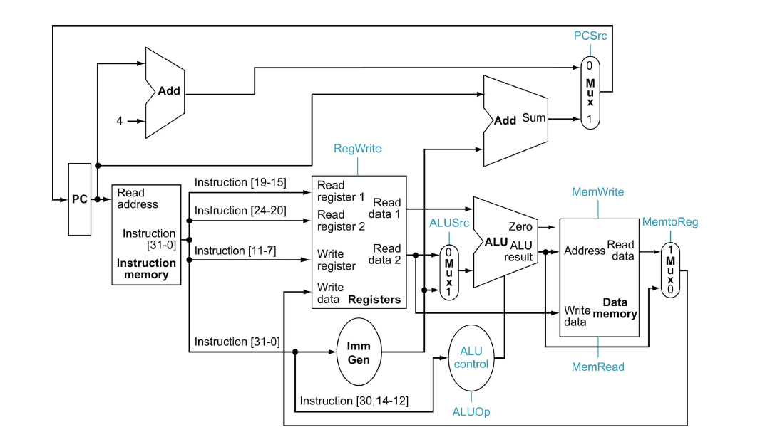
Step 4 - Control Points and Signals
Add this path for JAL
WBsel
Control point

Slide 5
High Level Control Signal Expressions
PCSrc = ((Branch or JAL) ? 1: 0)
RegWr = ( (Branch or Store)? 0: 1)
MemRd= (Load ? 1:0)
MemWr= (Store ? 1:0)
ALUSrc = (R-type? 0:1)
WBsel = (Load: 0 | R-type : 1 | JAL : 2)
HDL (Hardware Description Languages), such as Verilog and VHDL, can be used to specify the control signals. HDL codes are hardware-synthesizable. Feed them into a design compiler (Synopsys and Cadence tools) to get a netlist (a graphical logic representation).
Designer’s perspective or the programmer’s perspective?
Notes:
Silicon compiler was the term, but less commonly used. It is probably too aggressive.
Chip logic design and IC design are now separated.

Slide 6
ALUcontrol
ALUcontrol signal depends on a) operation type (ALUop) and b) funct3 and funct7 bits
always_comb begin case (alu_op)
2'b00: alu_control = ALU_ADD;
2'b01: alu_control = ALU_SUB;
2'b10: begin
case (funct3) 3'b000: begin
if (funct7_bit5) alu_control = ALU_SUB; else alu_control = ALU_ADD; end
3'b001: alu_control = ALU_SLL; // SLL / SLLI
3'b010: alu_control = ALU_SLT; // SLT / SLTI
3'b100: alu_control = ALU_XOR; // XOR / XORI
3'b101: begin
if (funct7_bit5) alu_control = ALU_SRA; else alu_control = ALU_SRL; end
3'b110: alu_control = ALU_OR; // OR / ORI
3'b111: alu_control = ALU_AND; // AND / ANDI
default: alu_control = ALU_ADD;
endcase
end
default: alu_control = ALU_ADD;
endcase
Notes:
Silicon compiler was the term, but less commonly used. It is probably too aggressive.
Chip logic design and IC design are now separated.

Slide 7
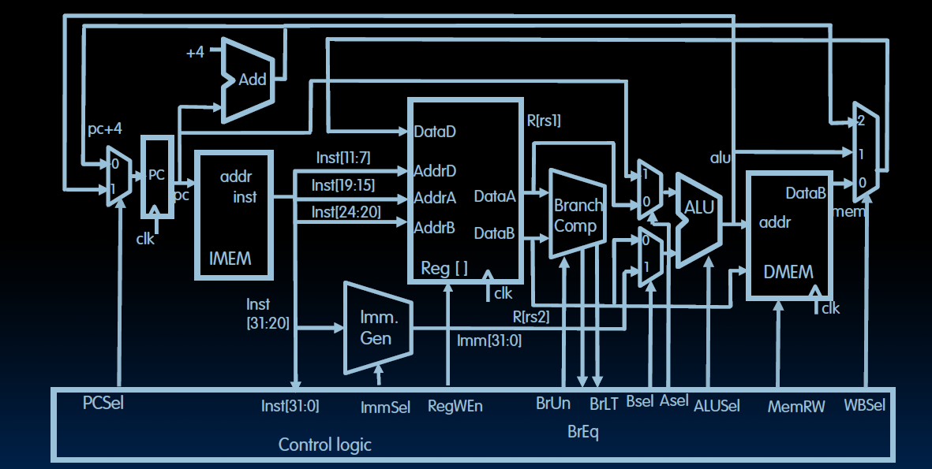
A More Complete RV32I Single Cycle Data Path
Notes:
This data path supports the RV32I core, including all user level instructions including JALR, Shift, and so on.

Slide 8
A More Complete RV32I Single Cycle Data Path
Wbsel:
0:? Which inst?
1:?
2:?
RegWen:
0:?
1:?
Bsel:
0:?
1:?
Asel:
0:?
1:?
Notes:
This data path supports the RV32I core, including all user level instructions including JALR, Shift, and so on.

Slide 9
A More Complete RV32I Single Cycle Data Path
WBsel:
0:? ld
1:? R-type
2:? Jal or jalr
RegWen:
0:sw or br
1:all others
Bsel:
0:rs2
1:imm
Asel:
0:rs1
1:pc
Notes:
This data path supports the RV32I core, including all user level instructions including JALR, Shift, and so on.

Slide 10
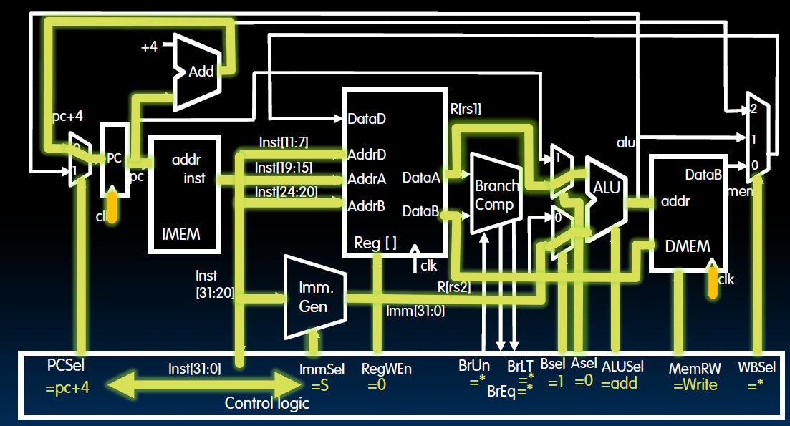
Example: SW X2, offset(X1)

Slide 11
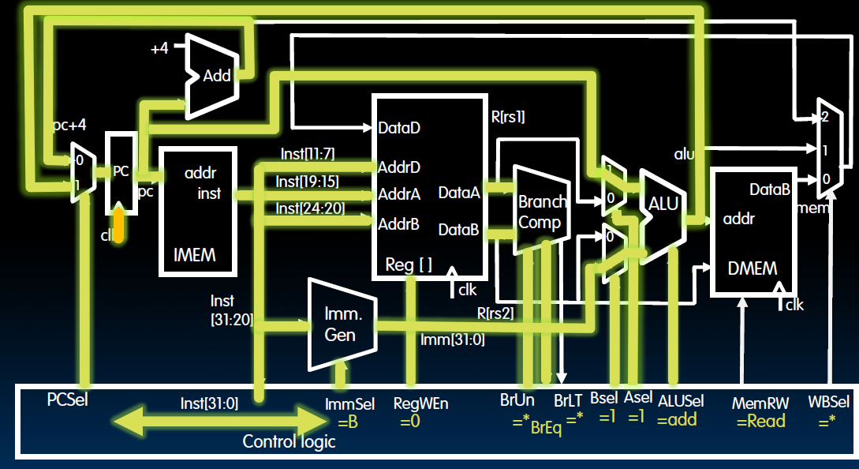
Example: BEQ X1,X2, immediate

Slide 12
A RV32I Single Cycle Processor
Data Path
Control
Notes:
This data path supports the RV32I core, including all user level instructions including JALR, Shift, and so on.

Slide 13
Drawback of Single-Cycle Design
Long cycle time
Cycle time must be long enough for the load instruction (the one with longest cycle time)
PC’s Clock-to-Q +
Instruction Memory Access Time +
Register File Access Time +
ALU Delay (address calculation) +
Data Memory Access Time +
Register File Setup Time +
Clock Skew
Cycle time for load is much longer than needed for all other instructions
Notes:
Well, the last slide pretty much illustrate one of the biggest disadvantage of the single cycle implementation: it has a long cycle time.
More specifically, the cycle time must be long enough for the load instruction which has the following components: Clock to Q time of the PC, ....
Having a long cycle time is a big problem but not the the only problem.
Another problem of this single cycle implementation is that this cycle time, which is long enough for the load instruction, is too long for all other instructions.
We will show you why this is bad and what we can do about it in the next few lectures.
That all for today.
+2 = 79 min (Y:59)

Slide 14
Summary of Single Cycle RV
Single cycle datapath means CPI=1, but
the clock cycle time is long
RISC-V simplifies control implementation
Fixed size Instructions
Regular format: source registers (rs1 and rs2) are always in the same places
Immediates have the same size (12b or 20b)
Operations are always computed on registers/immediates
RISC-V simplifies designs, lower the cost of design and test.

