Slide 1
CSC3060 – Computer Architecture Chapter 4 Pipeline Hazards
Prof. Wei Chung Hsu
School of Data Science
Chinese University of Hong Kong, Shenzhen

Slide 2
Hazards: Pipeline Challenges
Our introduction to pipelining may present an overly optimistic perspective. You might expect that a pipelined implementation will enhance performance by a factor equal to the number of pipeline stages.
In addition to the imperfect work distribution at each stage and the overhead caused by "fill" and "drain," a pipelined implementation must address three major challenges: data hazards, structural hazards, and control hazards.
These hazards prevent the subsequent instructions from overlapping with previously issued instructions. They are typically blocked (stalled) at the ID stage. Such “stalls” significantly reduce pipeline efficiency.
Notes:
Throughput vs response time
13 logic levels may not be evenly divided by 4, 3—3—3--4

Slide 3
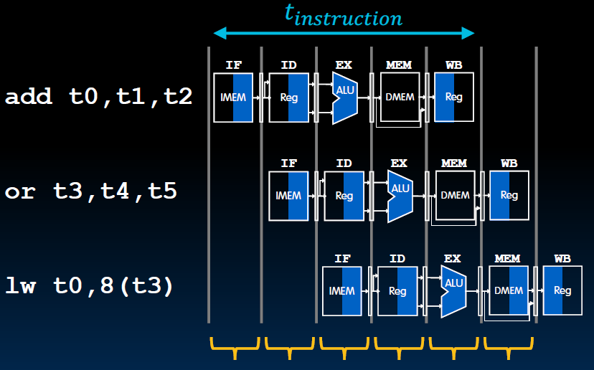
Fill and Drain of a Pipeline
Pipe Full
Drain
Fill

Slide 4
Structure Hazards
This refers to a conflict arising due to hardware resource limitations within the pipeline.
For instance, in a pipelined data path, we require both an instruction memory and a data memory. If we use the Von Neumann architecture, a conflict occurs when one instruction accesses data during the MEM stage, preventing the instruction fetch from proceeding in the IF stage. This results in two instructions competing for the same resource simultaneously.
Another example of such a conflict is when two division instructions are placed next to each other in the pipeline – a division will occupy the functional unit for many cycles (e.g., 32 or 64, …)

Slide 5
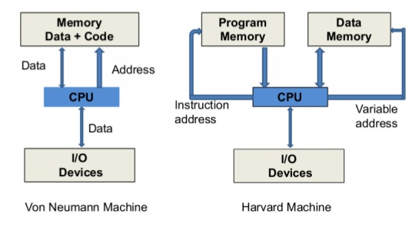
Structure Hazards
Structure hazards are less
frequent in scalar architectures,
since registers have sufficient
number of ports, functional units
are either single-cycle execution
or are pipelined (except for divide),
instruction and data memory are
separated. We may need two adders since each instruction needs to increment PC and calculate arithmetic.
Notes:
Harvard architecture was named because Harvard had Mark I, II, III computers developed. They used separate instruction and data memory. Originally not an architecture choice, but limited to technology.

Slide 6
Avoiding Structure Hazards
Pipeline stalls:
The hardware checks for structural hazards and stalls the pipeline. The newer instruction must wait at the ID stage until the previous one completes its work, causing pipeline bubbles.
Multiple resources:
Adding resources, such as we use I-cache and D-cache. We can add multiple multiply/divide units (It would be better if the unit could be pipelined) to avoid structured hazards.
Instruction Reordering: by compiler (static scheduling) or by hardware (dynamic scheduling)
ISA design: for example, the post-increment instructions will require more register write ports. Another example is disallowing memory operands in ALU operations.

Slide 7
Related Example: R-type instruction
IF: fetch the instruction from the Instruction Memory
ID: registers fetch and instruction decode
EX: ALU operates on the two register operands
WB: write ALU output back to the register file
R-type instructions do not access data memory, so can they write back to register early?
Cycle 1
Cycle 2
Cycle 3
Cycle 4
R-type
IF
ID
Exec
WB
Notes:
The R-type instruction does NOT access data memory so it only takes four clock cycles, or in our new pipeline terminology, four stages to complete.
The Ifetch and Reg/Dec stages are identical to the Load instructions. Well they have to be because at this point, we do not know we have a R-type instruction yet.
Instead of calculating the effective address during the Exec stage, the R-type instruction will use the ALU to operate on the register operands.
The result of this ALU operation is written back to the register file during the Wr back stage.
+1 = 15 min. (55)

Slide 8
Early WB Causes Structural Hazards
Cycle 1
Cycle 2
Cycle 3
Cycle 4
Cycle 5
Cycle 6
Cycle 7
Cycle 8
Cycle 9
Clock
R-type
IF
ID
Exec
WB
oops! We have a problem!
R-type
IF
ID
Exec
WB
Load
IF
ID
Exec
Mem
WB
R-type
IF
ID
Exec
WB
R-type
IF
ID
Exec
WB
Notes:
Well, we have a problem here!!!
We end up having two instructions trying to write to the register file at the same time!
Why do we have this problem (the write ubble??
Well, the reason for this problem is that there is something I have not yet told you.
+1 = 16 min. (X:56)

Slide 9
Data Hazards
Data hazards happen when the pipeline must stall because previous instructions in the pipeline have not yet generated the data needed for the current instruction.
Data hazards arise from data dependencies. For example,
Add X9, X0, X1 // results are ready at the end of the EXE stage, and write back to reg X9 at WB
Sub X10, X9,X3 // needs to read data at the ID stage (stage 2)
In the worst-case scenario, the pipeline may be stalled until the previous instruction writes back the data to register X9. Only then can the new instruction begin to read during the Instruction Decode (ID) stage. This would result in three wasted cycles, creating three pipeline bubbles.
Three cases to discuss further:
Register accesses
ALU results
Load data hazards

Slide 10
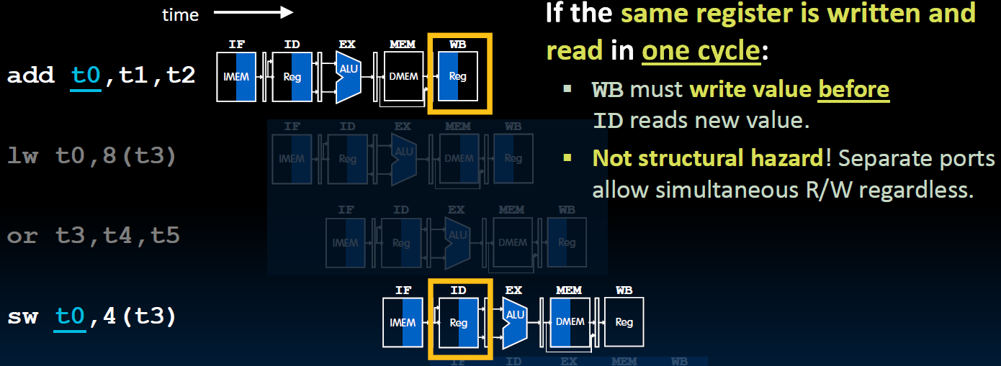
Register Access Issues
Register file should write-then-read
in the same cycle. (indicated by
Shading in the diagram)
This is common in today’s
microprocessor

Slide 11
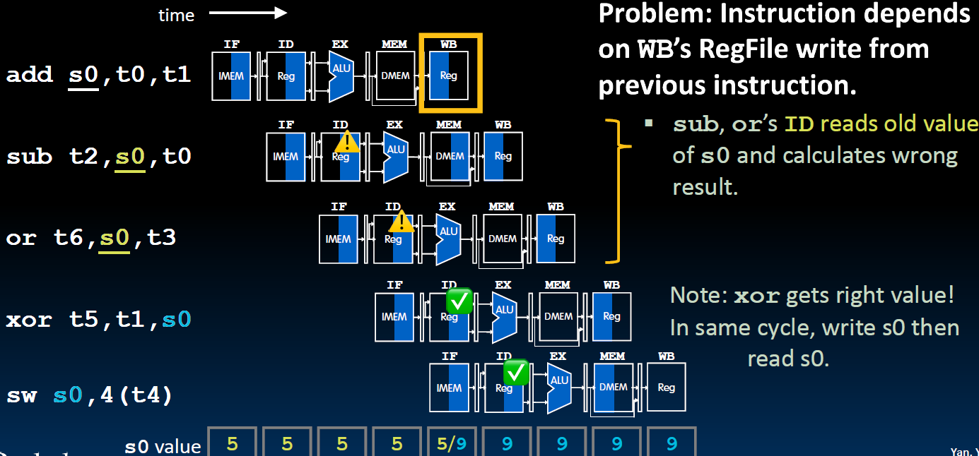
ALU Result Access Issue

Slide 12
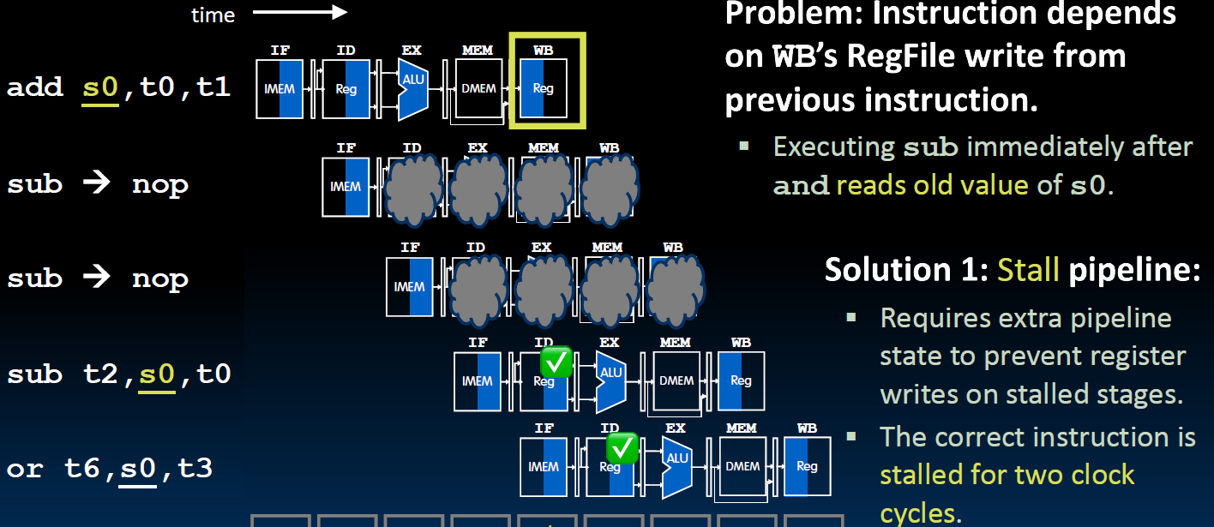
Solution 1: Pipeline Stall at ID stage (Interlocking)
Delayed by two clock cycles

Slide 13
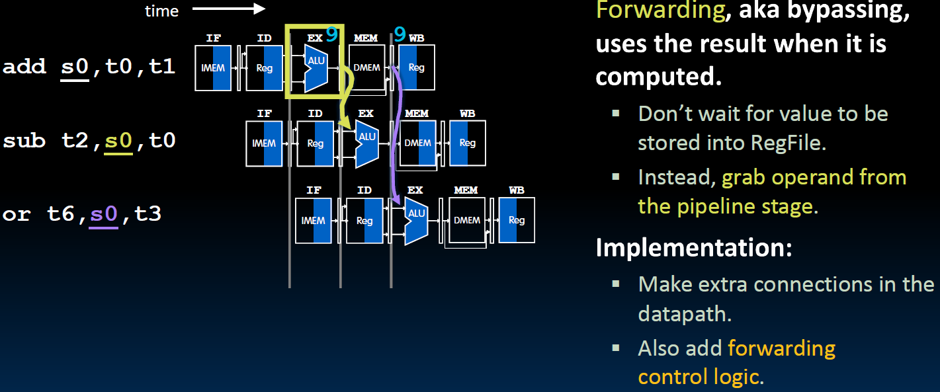
Solution 2: Data Forwarding (Bypassing)

Slide 14
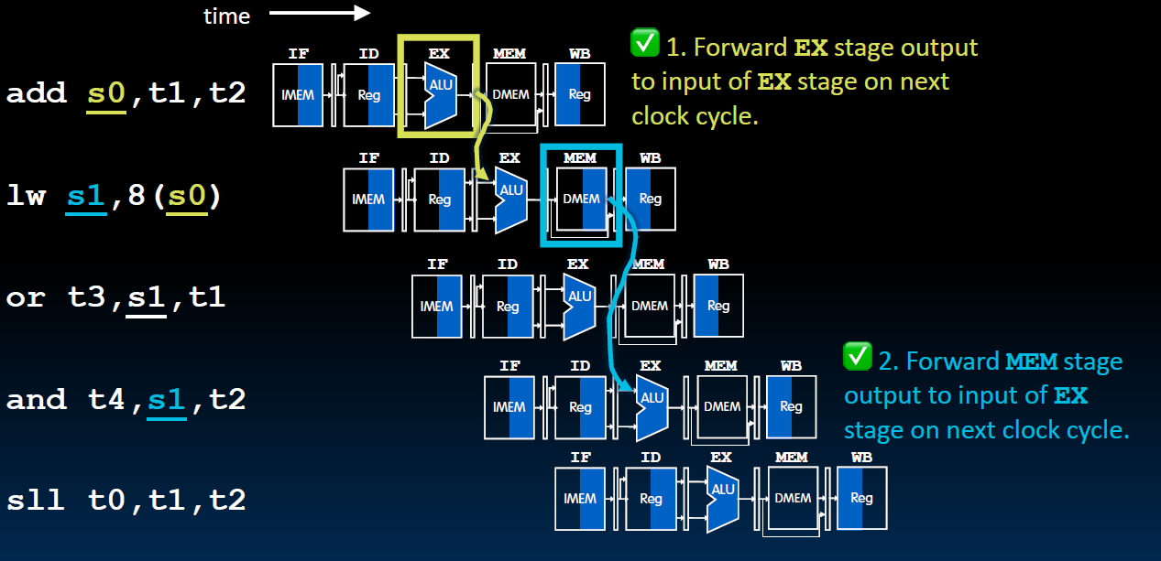
Data Forwarding for Load Instructions

Slide 15
Data Forwarding for Load Instructions
This forwarding does not work!
Must stall !

Slide 16
Detect Data Hazards (1)
Hazard conditions
1a. EX/MEM.RegRd = ID/EX.RegRs1
1b. EX/MEM.RegRd = ID/EX.RegRs2
2a. MEM/WB.RegRd = ID/EX.RegRs1
2b. MEM/WB.RegRd = ID/EX.RegRs2
Some corner cases
Do not forward if the instruction does not write to the register => check if RegWr is asserted
Do not forward if the destination register is $0 => check if RegRd = 0
IF
ID
Exec
MEM
WB
Forward from EX/MEM pipeline registers
EXE-EXE
Forward from MEM/WB pipeline registers
MEM-EXE

Slide 17
Solution 3: Compiler Code Transformations
MIPS (Micro-Processor without Interlocked Pipe Stages) implemented a micro-processor with no pipelined interlocks (1985). To deal with data hazards, the compiler must reorder instructions. If no instructions are to be placed between a generate-and-use gap, NOPs must be inserted.
Most pipelined microprocessors do have hardware interlocks. So the compiler reorders instructions to reduce the number of interlocks (or stalls) that occur at runtime.
Reordering at compile time is very cost-effective, except for
Memory dependences are often unknown
Scheduling (reordering) scope is often limited by branches, indirect branches, and call/ret.
Notes:
Reasons that MIPS was failed: compatibility, portability and scalability

Slide 18
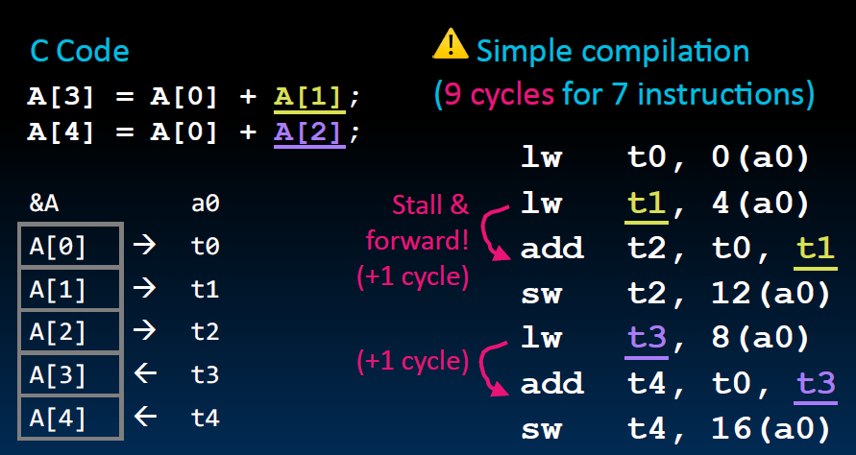
Compiler Code Scheduling Example (1)

Slide 19
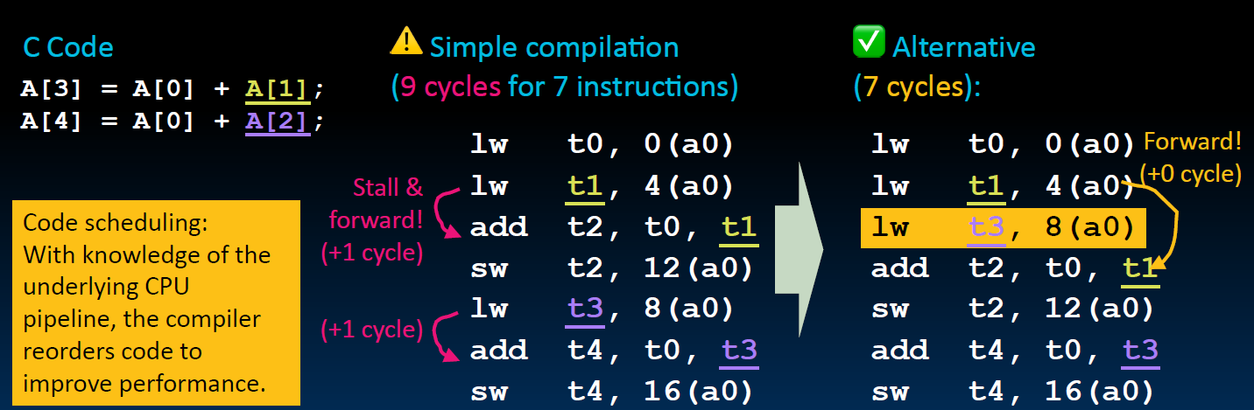
Compiler Code Scheduling Example (2)

Slide 20
Dependence DAG: Scheduling Constraints
1 lw $pr1, a
2 lw $pr2, b
3 add $pr3, $pr1,$pr2
4 mul $pr4, $pr3, 3
5 mul $pr5, $pr1, $pr2
add $pr6, $pr4, 2
sw $pr6, 0($pr5)
lw $pr1, c
lw $pr7, d
sw $pr7, 0($pr4)
add $pr8,$pr7,$pr1
1
2
DAG:
Directed
Acyclic
Graph
3
5
9
4
8
6
10
11
Each node represents an instruction Each arc represents a dependence
7

Slide 21
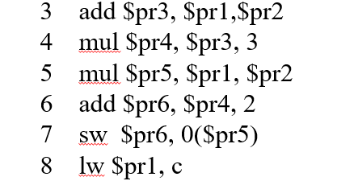
Three Types of Register Data Dependence
1
2
Flow dependence (RAW)
3
5
9
Anti-dependence
(WAR)
4
8
6
10
11
Output-dependence
(WAW)
7

Slide 22
Memory Dependency (due to potential aliasing)
1
2
1 lw $pr1, a
2 lw $pr2, b
3 add $pr3, $pr1,$pr2
4 mul $pr4, $pr3, 3
5 mul $pr5, $pr1, $pr2
add $pr6, $pr4, 2
sw $pr6, 0($pr5)
lw $pr1, c
lw $pr7, d
sw $pr7, 0($pr4)
add $pr8,$pr7,$pr1
3
5
9
A pointer
4
8
6
10
11
7

Slide 23
Memory Dependency (due to potential aliasing)
1
2
Scheduling memory instructions can be quite challenging:
Memory dependencies may be unknown
Memory latencies are often unknown
Speculative load/store may trap
Memory resources are often shared:
DRAM
Bus
Interconnection network
Volatile variables (in OS kernels)
and the compiler must be conservative
1 lw $pr1, a
2 lw $pr2, b
3 add $pr3, $pr1,$pr2
4 mul $pr4, $pr3, 3
5 mul $pr5, $pr1, $pr2
add $pr6, $pr4, 2
sw $pr6, 0($pr5)
lw $pr1, c
lw $pr7, d
sw $pr7, 0($pr4)
add $pr8,$pr7,$pr1
3
5
9
4
8
6
10
11
7

Slide 24
A Legal Schedule
1
2
Any topological sort of the DAG will represent a correct schedule.
Topological sort is the enumeration of the nodes in which each node appears before its children.
3
5
9
4
8
6
10
11
Some legal schedules:
1,2,3,5,9,4,8,6,10,11,7
9,1,2,3,4,10,6,5,8,7,11
7

Slide 25
A Legal Schedule
1
2
Any topological sort of the DAG will represent a correct schedule.
Topological sort is the enumeration of the nodes in which each node appears before its children.
Code scheduling involves listing all legal schedules and choosing
the best one.
This seems easy: there are only a limited number of legal permutations.
However, the number of permutations could grow exponentially!
If there are N instructions, possible schedules could be N!
For example, if N is 50, N! = 3 x 10^64
if N is 100, N! = 9 x 10^158
3
5
9
4
8
6
10
11
Some legal schedules:
1,2,3,5,9,4,8,6,10,11,7
9,1,2,3,4,10,6,5,8,7,11
7
Notes:
Corrina Lee ATC Chief Architect

Slide 26
Operation Latency: Weight of Arcs
1
2
Weight indicates the
operation latency
Here we assume a
Load takes 2 cycles
Multiply takes 3 cycles
Add takes 1 cycle
2
2
2
2
3
5
9
1
2
4
8
3
2
3
2
3
6
10
11
1
7

Slide 27
Critical Paths
1
2
2
A critical path is the longest dependency path in the instruction dependency graph, measured in execution time (or cycles).
2
2
2
3
5
9
1
2
4
8
General guideline:
Nodes on the critical paths
should be scheduled
as early as possible
3
2
3
2
3
6
10
11
1
7

Slide 28
Identify Critical Paths
1 (7)
2 (7)
Traversing the DAG from the leaves towards the roots labeling each node with the maximum possible delay from that node to the end of the block. (Reverse Topological Sort)
2
2
2
2
3(5)
5 (3)
9 (2)
1
2
4(4)
8 (2)
3
2
Maximum delay of each node is computed as:
MD = max ( each child’s MD + arc_weight )
3
2
3
6 (1)
10 (0)
11 (0)
1
7 (0)

Slide 29
Mark each node with Maximum Delay (yellow number)
7
7
1 (7)
2 (7)
2
2
2
2
5
3
3
3(5)
5 (3)
9 (2)
1
4
2
4(4)
3
3
8 (2)
2
3
2
1
3
1
6 (1)
10 (0)
0
11 (0)
1
0
7 (0)

Slide 30
List Scheduling
Basic Block scheduling
Build Dependence DAG
Mark each node with maximum delay to the end of block
Traverse the DAG from the root toward the leaves, selecting nodes from a candidate list to schedule. Keep tracking of the current cycle to minimize possible stalls.

Slide 31
Commonly Used Heuristics
The following heuristics are often used
Favor nodes that can start without stalling
If there is a tie, favor nodes with the maximum delay to the end of the block
If there is a tie,
Favor the original order
Favor nodes that have a large number of children
Favor nodes that are the final use of a reg

Slide 32
Example
1 (7)
2 (7)
Candidate list ={1, 2, 9}
Select 1,
Select 2,
Clist = {3,5,9}
Select 9 – why?
Clist = {3,5}
Select 3 – why?
Clist = {4,5}
Select 4
Clist = {6,10,5}
Select 5
Clist = {6,10,8}
Select 8
Clist = {6,10,11}
Select 6
2
2
2
2
3(5)
5 (3)
9 (2)
1
2
4(4)
8 (2)
3
2
3
2
3
6 (1)
10 (0)
11 (0)
1
7 (0)

Slide 33
Execution Cycle Comparison
Issue cycle
Issue cycle
0 1 3 4 5 7 8 9 10 12 13
1 lw $pr1, a
2 lw $pr2, b
3 add $pr3, $pr1,$pr2
4 mul $pr4, $pr3, 3
5 mul $pr5, $pr1, $pr2
add $pr6, $pr4, 2
sw $pr6, 0($pr5)
lw $pr1, c
lw $pr7, d
sw $pr7, 0($pr4)
add $pr8,$pr7,$pr1
0 1 2 3 4 5 6 7 8 9 10
1 lw $pr1, a
lw $pr2, b
9 lw $pr7, d
3 add $pr3, $pr1,$pr2
4 mul $pr4, $pr3, 3
mul $pr5, $pr1, $pr2
8 lw $pr1, c
add $pr6, $pr4, 2
10 sw $pr7, 0($pr4)
7 sw $pr6, 0($pr5)
11 add $pr8,$pr7,$pr1
Original code
Scheduled code

Slide 34
Control Hazards
Control hazards are due to branch instructions (conditional jumps) and JAL/JALR instructions (unconditional jumps).
For branch instructions, the pipeline can't know for sure which instruction will be executed next until the branch condition is evaluated.
For both Branch (conditional jump) and Jump (unconditional jump), we need to wait for the target addresses (PC+immed) to be computed.
Control hazards are crucial because branch instructions occur frequently, ranging from 15% to 30%. Historical studies indicate that there is one branch per 4 to 5 instructions.

Slide 35
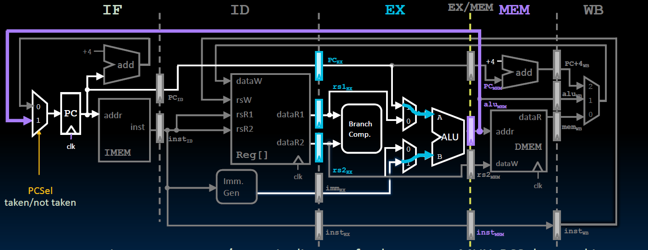
Branch Outcome Available at EXE stage

Slide 36
Condition and Target Address are Ready at the EXE Stage
Instruction | Cycle 1 | Cycle 2 | Cycle 3 | Cycle 4 | Cycle 5 | Cycle 6 | Cycle 7
01 ADD
02 BEQ X1,X2,L1
03 SUB
04 LW
05 L1: LW
IF
ID
EXE
MEM
WB
IF
ID
EXE
MEM
WB
IF
ID
EXE
MEM
WB
IF
ID
EXE
MEM
IF
ID
EXE
Both the comparison condition and the target address are computed at the EXE stage, assume the condition is true, so the branch is TAKEN.
The correct target instruction is fetched at the next clock cycle.
Instructions 03 and 04 issued to the pipeline must be flushed

Slide 37
Stall the Pipeline at Every Branch/Jump
Instruction | Cycle 1 | Cycle 2 | Cycle 3 | Cycle 4 | Cycle 5 | Cycle 6 | Cycle 7
01 ADD
02 BEQ X1,X2,L1
bubble
bubble
05 L1: LW
IF
ID
EXE
MEM
WB
IF
ID
EXE
MEM
WB
IF
ID
EXE
If we always stall the pipeline for every branch and jump instruction, two bubbles will always be inserted. The cost of each branch/jump instruction would be 3. Since 20% of instructions are branch/jump instructions, the average CPI may be 0.2*3 + 0.8*1 = 1.4.

Slide 38
Predict the Branch Not Taken
Instruction | Cycle 1 | Cycle 2 | Cycle 3 | Cycle 4 | Cycle 5 | Cycle 6 | Cycle 7
01 ADD
02 BEQ X1,X2,L1
03 SUB
04 LW
05 L1: LW
IF
ID
EXE
MEM
WB
IF
ID
EXE
MEM
WB
IF
ID
EXE
MEM
WB
IF
ID
EXE
MEM
IF
ID
EXE
We can simply predict that the branch instruction is NOT TAKEN, so the pipeline can continue to fetch and issue instructions.
In reality, more branches are TAKEN than NOT TAKEN (because loops dominate execution time). So, why not predict the branch is TAKEN? While predicting the branch is TAKEN improves the accuracy, it is important to note that the TAKEN target address must be computed after the ID stage. In contrast, the fall-through address (PC+4) is available immediately.

Slide 39
Condition and Target Address are Ready at the EXE Stage
Instruction | Cycle 1 | Cycle 2 | Cycle 3 | Cycle 4 | Cycle 5 | Cycle 6 | Cycle 7
01 ADD
02 BEQ X1,X2,L1
03 SUB
04 LW
05 L1: LW
Performance penalty could be as high as 20-50%
Assuming:
20% of branches
50% of the branches taken
Average CPI = 1
Penalty = 2 (flushed inst) * 0.2 * 0.5 = 0.2 CPI
So the penalty would be 20%
IF
ID
EXE
MEM
WB
IF
ID
EXE
MEM
WB
IF
ID
EXE
MEM
WB
IF
ID
EXE
MEM
IF
ID
EXE

Slide 40
Condition and Target Address are Ready at the EXE Stage
Instruction | Cycle 1 | Cycle 2 | Cycle 3 | Cycle 4 | Cycle 5 | Cycle 6 | Cycle 7
01 ADD
02 BEQ X1,X2,L1
03 SUB
04 LW
05 L1: LW
A more realistic estimation:
Performance penalty could be as high as 20-30%
Assuming:
20% of branches
70% of the branches taken
Average CPI = 1
Penalty = 2 (flushed inst) * 0.2 * 0.7 = 0.28 CPI
So the penalty could be 28%
IF
ID
EXE
MEM
WB
IF
ID
EXE
MEM
WB
IF
ID
EXE
MEM
WB
IF
ID
EXE
MEM
IF
ID
EXE

Slide 41
Static Branch Prediction
Branch prediction could be determined at compile time.
Compiler sets the prediction
Hardware can assist, for example
Predict a backward branch as taken (because loop back branches are likely to take)
Predict a forward branch as fall-through (because the compiler always puts the then part in the fall-through path).
The ISA may reserve a bit in branch instructions as a prediction bit
HP (Hewlett Packard) used the register order to indicate prediction.
Example: (beq r3,r4,8 → predict not taken) (beq r4,r3,8 → predict taken)

Slide 42
Dynamic Branch Prediction
Dynamic Branch Predictions are made at Runtime
Static predictions typically have low accuracy, ranging from 65% to 80% (90% with profiles), while dynamic predictions can achieve accuracy levels as high as 90% to 99%.
One common approach is to have a branch history table
Indexed by recent branch instruction addresses
Stores branch outcomes (taken/not taken)
To execute a branch
Check the prediction table; expect the same outcome
Start fetching from fall-through or target
If wrong, flush the pipeline and change the prediction
Notes:
Graduate students researching on predictors
This is the conversation we often heard:
What is your research
Branch prediction
How accurate can you predict now?
From 98% increased to 99%
Only 1%?
No, miss rate dropped from 2% to 1%, that is 2X improvement.

Slide 43
A Simple Branch History Table
Tag / Key
000001110010
000001110110
000001111000
Branch History
0
1
Program
bne
beq
ld
sw
Predict not taken
PC addresses
Predict taken
One bit history here, but could be multi-bits
Branch prediction table may not have tag/key: history data has only 1 or 2 bits, but tag takes 30-46 bits !!
In practice, the lower several bits of the PC address are used to index the BHT !
Notes:
Graduate students researching on predictors
This is the conversation we often heard:
What is your research
Branch prediction
How accurate can you predict now?
From 98% increased to 99%
Only 1%?
No, miss rate dropped from 2% to 1%, that is 2X improvement.

Slide 44
Branch Prediction at IF Stage
Branch prediction should occur at the instruction fetch (IF) stage.
But the instruction fetched at the IF stage may not be a branch
Cannot wait until the instruction is decoded – too late
At the IF stage, the instruction address (i.e. PC) is used to index the BHT
If the BHT entry lacks history, predict NT (Not Taken).
For a branch instruction, the branch outcome updates the BHT entry.
If the BHT is not tagged, “aliased” entries could result in higher branch mispredictions.
Untagged BHT is simple, fast, has low power consumption, and is less costly.
However, high-performance microprocessors tend to use tagged BHT
Notes:
Graduate students researching on predictors
This is the conversation we often heard:
What is your research
Branch prediction
How accurate can you predict now?
From 98% increased to 99%
Only 1%?
No, miss rate dropped from 2% to 1%, that is 2X improvement.

Slide 45
1-bit Predictor
Inner loop branches mispredicted twice!
outer: … … inner: …
…
beq …, …, inner … beq …, …, outer
Loop exit
11111110 111111110
Mispredict as taken on the last iteration of the inner loop
Then mispredict as not taken on the first iteration of the inner loop next time around

Slide 46
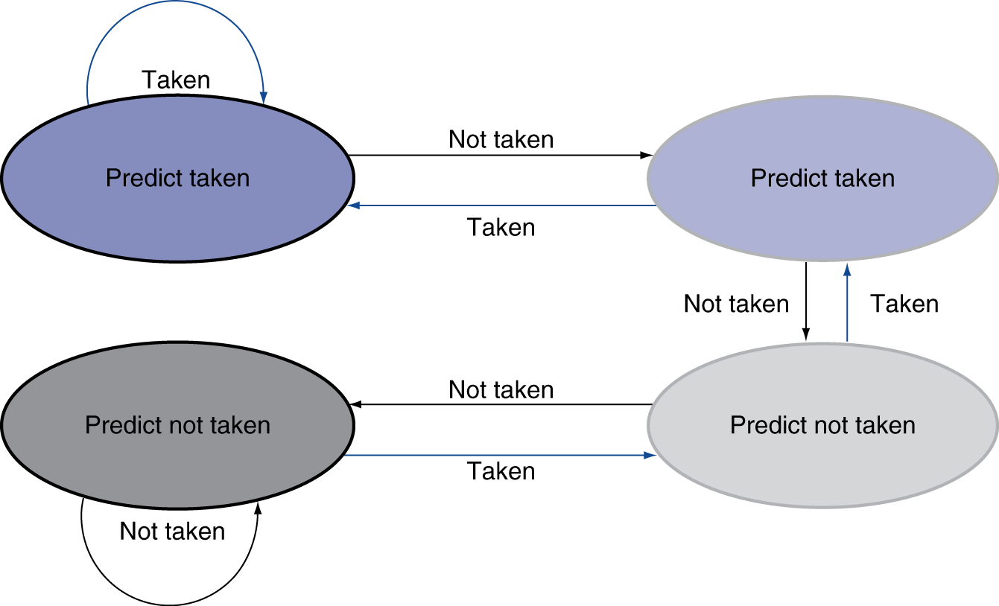
2-bit Predictor (FSM)
Only change prediction on two successive mispredictions
11
10
A Finite State
Machine (FSM)
00
01

Slide 47
Correlated Prediction
Correlated Branch Prediction is also called 2-level adaptive branch prediction.
Global Branch History Register
Shift Register: A global branch history register (GHB) tracks the recent outcomes of several branches. It's typically implemented as a shift register, where each bit represents a recent branch's outcome (taken or not taken).
Shifting on Branch: Whenever a branch is executed, its outcome is shifted into the GHB, pushing out the oldest history bit.
Pattern History Table (PHT)
Indexed by GHB: The PHT is a table of 2-bit saturating counters. Each entry corresponds to a unique pattern of recent branch outcomes captured by the GHB.
Indexing: The GHB's contents are used to index the PHT.
Counter Update: The 2-bit counter at the indexed entry is incremented if the branch is taken and decremented if it's not taken. This counter effectively tracks the branch's behavior for that specific pattern of recent branch history.

Slide 48
2-level adaptive branch prediction
GHB
Branch History
00
10
Global branch history
0
1
1
1
0
0
1
0
hash
Program
bne
ld
sw
beq
PC addresses
Notes:
Graduate students researching on predictors
This is the conversation we often heard:
What is your research
Branch prediction
How accurate can you predict now?
From 98% increased to 99%
Only 1%?
No, miss rate dropped from 2% to 1%, that is 2X improvement.

Slide 49
Why Correlated Prediction Works
Example 1:
if (a==2) a=0; Branch 1
if (b==2) b=0; Branch 2
if (a!=b) {…}; Branch 3
If Branch 1 is taken and Branch 2 is taken
Then Branch 3 is NOT taken
GHB 11 → Branch 3 will fall through
GHB 00/01/10 → needs prediction
Example 2
Branch
Branch
Branch

Slide 50
Branch Prediction Accuracy
Always predict fall‑through: about 30-40%.
Backward‑taken / forward‑not‑taken: 60-70%.
Static prediction based on compiler analysis 80-85%
Static prediction guided with program profiles: 80–90%.
Single‑bit dynamic BHT: 70–80%.
Two‑bit FSM (saturating counter): 85–95%.
Global two-level correlated branch prediction: 94-96%
Local two-level prediction: 93-97%
Tournament prediction: 96-97%
TAGE predictor: 97-99% (Intel,AMD,ARM, APPLE,..)

Slide 51
Prediction: Whether and Where
Whether: need to predict the branch is taken or not
Where: need to know where does the branch jump to?
Even with predictor, still need to calculate the target address
1-cycle or 2-cycle penalty for a taken branch (depends on whether the target address is calculated in the ID or in the EXE stage)
Branch Target Buffer (BTB)
Cache of target addresses
Target addresses are usually unchanged (immediate is not changed)
Indexed by PC when instruction fetched
If hit and instruction is branch predicted taken, it can fetch the target immediately
How about indirect branch? Function returns? Function pointers?

Slide 52
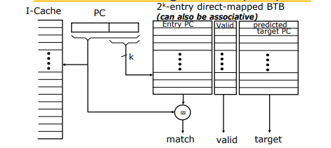
Branch Target Buffer

Slide 53
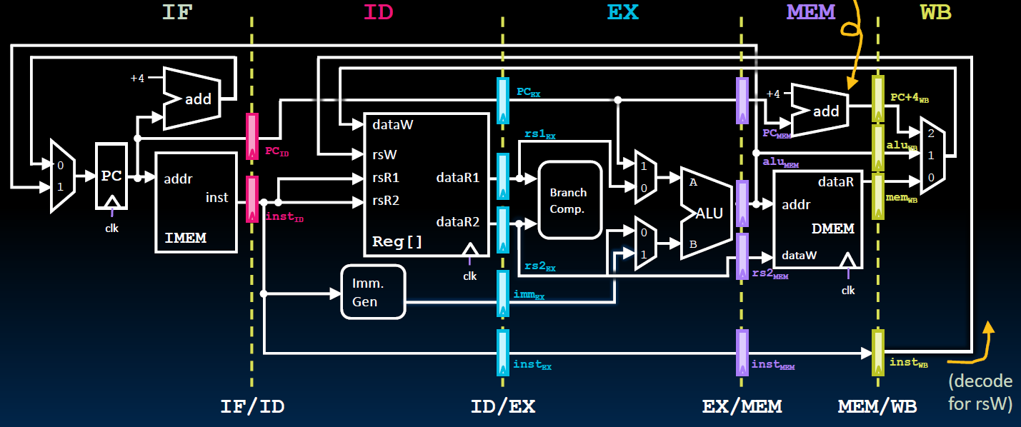
Control Signals Used at Each Stage
ID stage
Data path: rs1, rs2 designators
Control: immed_sel,
Rd, and WRen, are actually from the WB stage (Unlike the single cycle data path !!)
EX stage
Data Path: rs1, rs2 contents, PC, immed value,
Control: Asel, Bsel, ALUsel
MEM stage
Data path: ALUout(Address), rs2 content,
Control: MemRW (read/write),BrLt,Breq
WB stage
Data path: ALUout, PC+4(for link reg), MEMout,
Control: Wbsel, rd designator, WRen

Slide 54
Control Signals at Each Stage
Signals for EX (ALUOp, A/Bsel, ALUctl...) are used 1 cycle later
Signals for MEM (MemWr, Branch) are used 2 cycles later
Signals for WB (MemtoReg, MemWr) are used 3 cycles later
RedDst (rd) will also be passed along to the WB stage
ID
EX
MEM
WB
ALUctl
ALUSrc
A/Bsel
ALUOp
ALUOp
Main
Control
MemRd
MemRd
MemRd
MemWr
ID/Ex Register
MemWr
Ex/MEM Register
MEM/WB Register
IF/ID Register
MemWr
Branch
Branch
Branch
MemtoReg
MemtoReg
MemtoReg
MemtoReg
RegWr
RegWr
RegWr
RegWr
RegDst
RegDst
RegDst
RegDst
Notes:
The main control here is identical to the one in the single cycle processor. It generate all the control signals necessary for a given instruction during that instruction Reg/Decode stage.
All these control signals will be saved in the ID/Exec pipeline register at the end of the Reg/Decode cycle.
The control signals for the Exec stage (ALUSrc, ... etc.) come from the output of the ID/Exec register. That is they are delayed ONE cycle from the cycle they are generated.
The rest of the control signals that are not used during the Exec stage is passed down the pipeline and saved in the Exec/Mem register.
The control signals for the Mem stage (MemWr, Branch) come from the output of the Exec/Mem register. That is they are delayed two cycles from the cycle they are generated.
Finally, the control signals for the Wr stage (MemtoReg & RegWr) come from the output of the Exec/Wr register: they are delayed three cycles from the cycle they are generated.
+2 = 45 min. (Y:45)

Slide 55

Predictions
Branch predictions, Value predictions, Data prefetching, …
Most predictions are based on past behavior.
Branch predictions are based on branch history
Page/Block replacements are based on past reference behavior
AI predictions are based on pre-training
Could we use the future to make predictions?
Scout threads
To create separate software threads that "scout ahead" in the program's execution to pre-compute or prefetch data that the main thread will likely need.
This lightweight thread is a backward slice of code extracted at compile time from the point at which you would like to make a prediction.
Notes:
Back to the future
A scout is someone who gathers information

Slide 56
Scout Thread Prediction
Shared cache
Private $
Private $
Private $
Private $
☺
core
core
core
core
First Core
time
First
Core
Main thread
Event
Miss
Cache miss avoided
Trigger to activate (About x cycles delay)
Second core
Second
Core
Scout thread
Advance to the point for prediction
Spin Waiting
Spin again waiting for the next trigger
Dynamic Scout thread Implemented on the SUN Panther processors

