Slide 1
CSC3060 – Computer Architecture Chapter 4 Pipelined Implementation
Prof. Wei Chung Hsu
School of Data Science
Chinese University of Hong Kong, Shenzhen

Slide 2
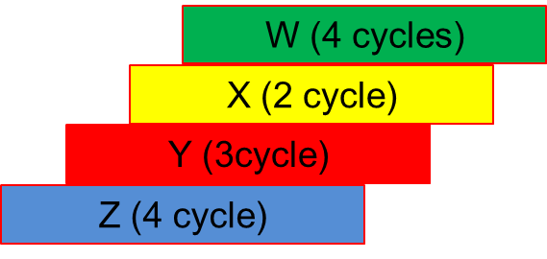
Pipelining
Pipelining is an implementation technique in which multiple instructions are overlapped in execution, much like an assembly line.
Single-cycle
4 X long cycles
(16 x short cycles)
Multi-cycle
13 X short cycles
Pipelined
7 X short cycles

Slide 3
Five Stages of the Simple Data Path
Five stages, one step per stage
IF: Instruction fetch from (instruction) memory
ID: Instruction decode & register read
EX: Execute operation or calculate address
MEM: Access (data) memory operand
WB: Write the result back to register
Initially, this partition is for multi-cycle implementation:
an instruction can finish at stage 3, stage 4 or stage 5

Slide 4
Divide the Single Cycle Data Path into 5 Stages

Slide 5
Instruction Timing and Clock Cycle Time
Assume time for a stage is
100 ps for register to read or write
200 ps for other stages (Mem and ALU)
Instruction | IF = 200ps | ID=100ps | ALU=200ps | Mem=200ps | WB=100ps | Total
add | X | X | X |  | X | 600ps
beq | X | X | X |  |  | 500ps
jal | X | X | X |  | X | 600ps
lw | X | X | X | X | X | 800ps
sw | X | X | X | X |  | 700ps
Maximum clock frequency for single-cycle implementation= 1/800ps = 1.25 GHz
For multi-cycle implementation, 1/200ps = 5 GHz

Slide 6
Overlapped Execution in Pipeline
Instruction | Cycle 1 | Cycle 2 | Cycle 3 | Cycle 4 | Cycle 5 | Cycle 6 | Cycle 7 | Cycle 8
LW
ADD
BEQ
SUB
IF
ID
EXE
MEM
WB
IF
ID
EXE
MEM
WB
IF
ID
EXE
MEM
WB
IF
ID
EXE
MEM
WB
Every instruction takes 5 short cycles
Issue one instruction and retire one instruction per short cycle
Throughput is one instruction per clock cycle
One instruction per 200ps
Single cycle implementation will be one instruction per 800ps

Slide 7
Single cycle, Multi-cycle, Pipelining
Using the table from the previous slides
LW takes 5 clock cycles, Add/sub takes 4 clock cycles, Branch takes 3 cycles, and SW takes 4 cycles
Now, for the following code sequence (assuming all instructions are independent)
LW, LW, ADD, SUB, BEQ, SW, SW
Single-cycle
7 X long cycles
(35 short cycles)
Multi-cycle
5x2 + 4x2 + 3 + 4x2 = 29 short cycles
Pipelined
7 X short cycles + 4 pipe drain = 11 short cycles

Slide 8

Pipelining Analogy
Four students A, B, C, and D, each have one load of cloth to wash, dray, fold, and put away.
Washer takes 30 minutes
Dryer takes 30 minutes
Folder takes 30 minutes
Stasher takes 30 minutes to put folded cloth into drawer.
Notes:
1. Place one dirty load of clothes in the washer.
2. When the washer is fi nished, place the wet load in the dryer.
3. When the dryer is fi nished, place the dry load on a table and fold.
4. When folding is fi nished, ask your roommate to put the clothes away.

Slide 9
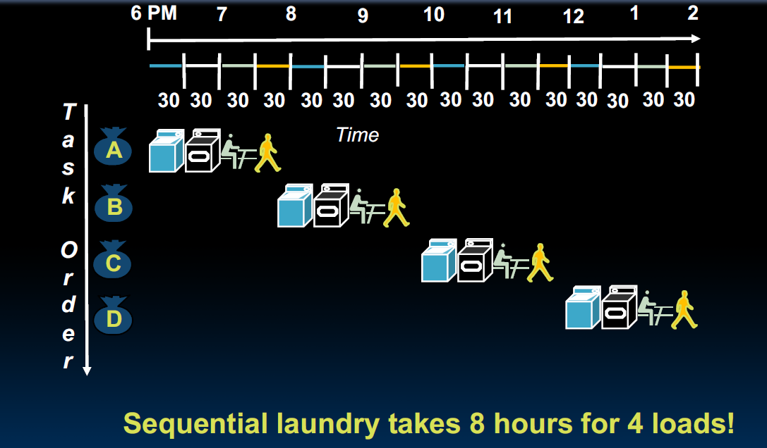
Sequential Laundry
Notes:
假设每个半小时
1. Place one dirty load of clothes in the washer.
2. When the washer is fi nished, place the wet load in the dryer.
3. When the dryer is fi nished, place the dry load on a table and fold.
4. When folding is fi nished, ask your roommate to put the clothes away.

Slide 10
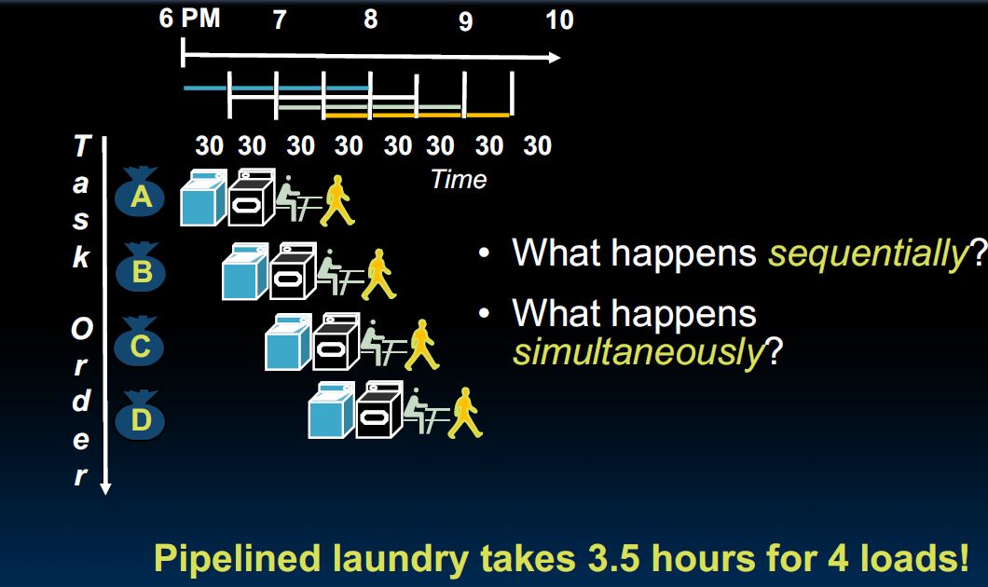
Pipelined Laundry
Notes:
假设每个半小时
1. Place one dirty load of clothes in the washer.
2. When the washer is fi nished, place the wet load in the dryer.
3. When the dryer is fi nished, place the dry load on a table and fold.
4. When folding is fi nished, ask your roommate to put the clothes away.

Slide 11
Pipelined Laundry
Notes:
假设每个半小时
1. Place one dirty load of clothes in the washer.
2. When the washer is fi nished, place the wet load in the dryer.
3. When the dryer is fi nished, place the dry load on a table and fold.
4. When folding is fi nished, ask your roommate to put the clothes away.

Slide 12
Yale Patt’s Analogy
An African tribe leader wants to have 10 children in one-two years. He calls upon his advisor, who suggests a plan:
Traditional Method (No Pipelining):
The wife carries a child for 9 months (gestation period).
This process is repeated 10 times to have 10 children, taking a total of 9 months/child * 10 children = 90 months (7.5 years).
Pipelined Method
Start conception for child #1
Begin conception for child #2 after 1 month.
Repeat this process for all 10 children.
This process takes 19 months (1.5 year).
This does not work!
The tribe leader is required to have ten wives.

Slide 13



Slide 14
Single cycle vs. multi-cycle vs. pipeline
Cycle 1
Cycle 2
Clk
Single Cycle:
Load
Beq
Waste
Cycle 1
Cycle 2
Cycle 3
Cycle 4
Cycle 5
Cycle 6
Cycle 7
Cycle 8
Cycle 9
Cycle 10
Clk
Multi-cycle:
IF
ID
EX
MEM
WB
IF
ID
EX
Pipeline
Load
IF
ID
EX
MEM
WB
store
IF
ID
EX
MEM
WB
R-type
IF
ID
EX
MEM
WB

Slide 15
Pipeline Speedup
If all stages are balanced, i.e., all take the same time, in an ideal situation
If not perfectly balanced, speedup would be less
The speedup is a result of increased throughput.
Instruction Latency, which refers to the time it takes for each instruction to be executed, does not decrease; in fact, it may even increase.
Time between instructions _{pipelined} = | Time between instructions _{nonpipelined}
 | Number of pipeline stages

Slide 16
Pipeline-oriented ISA Design
RISC-V ISA is designed for pipelining
All instructions are fixed length: 32-bits (except for the C extension)
Easier to fetch and decode in one cycle
c.f. x86: 1- to 17-byte instructions
Few and regular instruction formats
Decode and read registers in one step
Only load/store instructions accessing memory
Calculate address in the 3rd stage, access memory in the 4th stage
If the operand is in memory, additional execution stages are needed after stage 4.
Instructions are simple and do not require a large number of steps

Slide 17
Pipeline Lessons
Pipeline does not help the latency of a single instruction, but the throughput of the entire program
Pipeline rate is limited by the slowest stage; unbalanced stage length limits the perfect speedup
Multiple tasks are working at the same time using different resources
Potential/Ideal speedup = Number of pipeline stages
Time to “fill” & “drain” the pipeline reduces speedup
Need to reduce possible fill and drain (e.g., I-cache misses and branch
misprediction)
Avoid pipeline bubbles from data and control dependencies

Slide 18
Pipeline Everywhere
Aside from the instruction pipeline, many other areas have implemented pipelined architectures.
DRAM pipeline
Row activation, column selection, data transfer
Cache pipeline
Address decoding, Way selection, tag match, data retrieval
Floating point unit pipeline
Exponent alignment, operation, normalization, rounding, …
GPU pipeline
vertex processing, rasterization, fragment processing
Network pipeline
packet header processing, routing table lookup, and packet forwarding
If you need to have a higher throughput, think about pipelining.

Slide 19
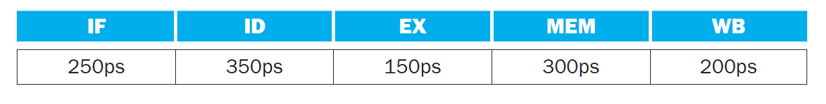
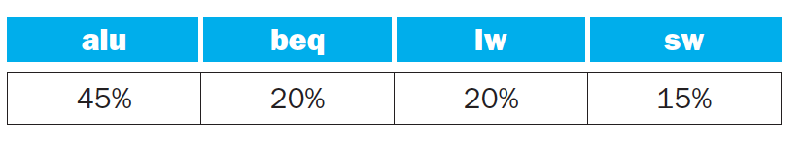
Exercise-1
Assume individual stages of the datapath have the following latencies:
Assume that instructions executed by the processor are broken down as follows:
What is the clock time for non-pipeline version and pipeline version ？
1250, 350

Slide 20
Exercise-1
Assume individual stages of the datapath have the following latencies:
Assume that instructions executed by the processor are broken down as follows:
What is the clock time for non-pipeline version and pipeline version？
What is the latency of an LW instruction in a pipelined and non-pipelined processor?
Non-pipelined: 1250, Pipelined: 1750 (350*5)

Slide 21
Exercise-1
Assume individual stages of the datapath have the following latencies:
Assume that instructions executed by the processor are broken down as follows:
What is the clock time for non-pipeline version and pipeline version？
What is the latency of an LW instruction in a pipelined and non-pipelined processor?
If we can split a stage, which stage should we split? What is the new cycle time?
1250, 350
1250, 350*5
ID,
MEM 300 ps

Slide 22
Exercise-1
Assume individual stages of the datapath have the following latencies:
Assume that instructions executed by the processor are broken down as follows:
What is the clock time for non-pipeline version and pipeline version ？
What is the total latency of an LW instruction in a pipelined and non-pipelined processor?
If we can split a stage, which stage should we split? What is the new cycle time?
Compare to multi-cycle implementation, assume lw needs 5 short cycles, ALU needs 4, beq and sw need 3, compute the ideal speedup of Ex(single-cycle/pipeline) and Ex(multi-cycle/pipeline)?
1250, 350
1250, 350*5
ID, 300 ps
1250/350
1250/350
(0.2*5+0.45*4+0.35*3)

Slide 23
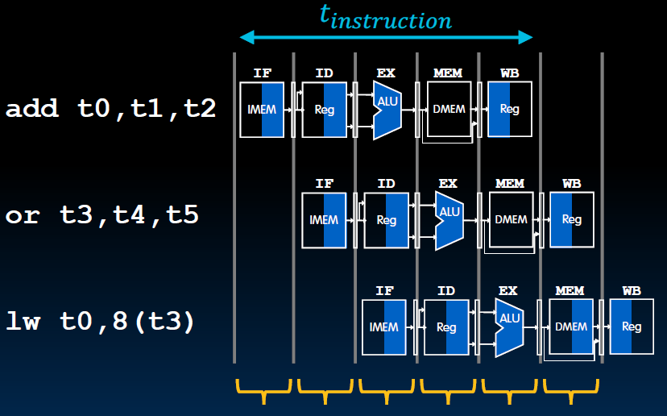
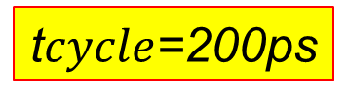
Pipelined RV32I Data Path
The label of each box
indicates its state element
e,g, IMEM, DMEM, Reg
Blue shade means
the element is active
Black shade means
the element is inactive
t$cycle$=200ps

Slide 24
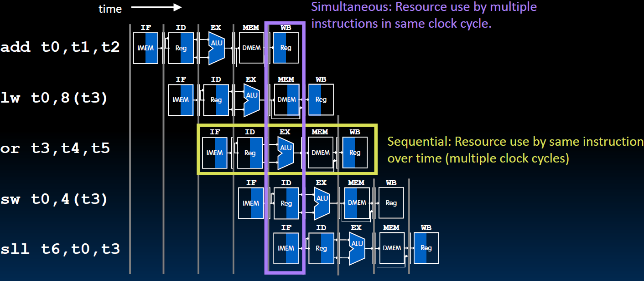
What happens Sequentially? Simultaneously?

Slide 25
Latency vs Throughput
Latency:
Single cycle data path: 800 ps
Pipelined: cycle time=200ps, one instruction takes 5 cycles
200ps x 5 = 1000 ps
Throughput:
Single cycle data path: one instruction every 800 ps
Pipelined: one inst per cycle ➔ one instruction every 200 ps
Pipelined throughput is 4X the single cycle data path method

Slide 26
What happens to long latency operations?
Two options:
Stall: the next instruction stalls
at the EXE stage
2) Have a separate long latency
pipeline. Subsequent instructions
can continue to proceed (such as
FP instructions).
Be aware, instructions are typically
retired at the WB stage in order.
So even if the later instructions are
completed sooner than this long
latency operation, they should wait
at the WB stage. This is due to the
possibility of traps.
RISC-V avoids arithmetic exceptions.
So, out-of-order retirement is viable.
DIV
Div execution →

Slide 27
Single Cycle Data Path
RegWr
WBsel
ALUsrc
ALUop
Instruction decode:
Generate control signals, No ambiguity

Slide 28
Multiple Instructions On-the-Fly in Pipeline
Which Rd to write?
The Rd from the instruction at the WB stage
or the Rd from the instruction at the ID stage?
Which immediates to take from?
Which rs1/rs2 to take from?
From instruction at the EXE stage
or instruction from the ID stage?

Slide 29
Multiple Instructions On-the-Fly in Pipeline
Which Rd to write?
The Rd from the instruction at the WB stage
or the Rd from the instruction at the ID stage?
RegWr
SW t0,8(t1)
ADD t0, t1,t2
AND t3, t1,t2

Slide 30
Key to Pipelining: Inserting Pipeline Registers

Slide 31
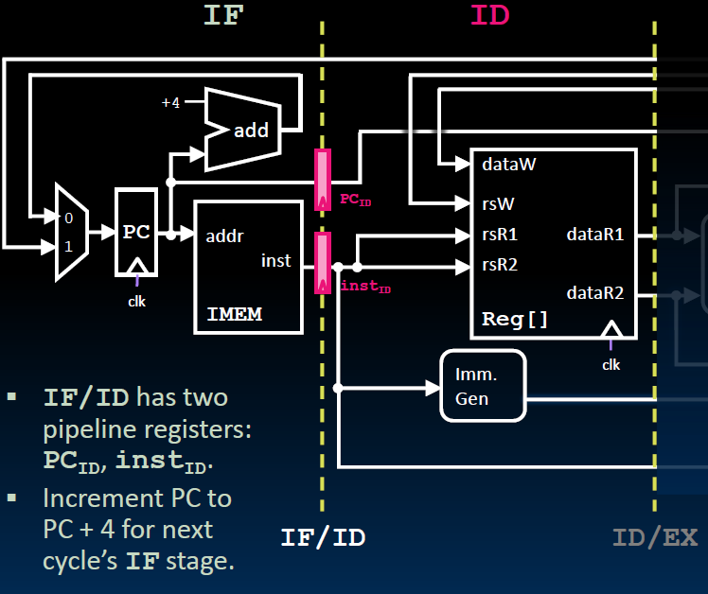
Instruction Fetch/Instruction Decode Pipeline Register

Slide 32
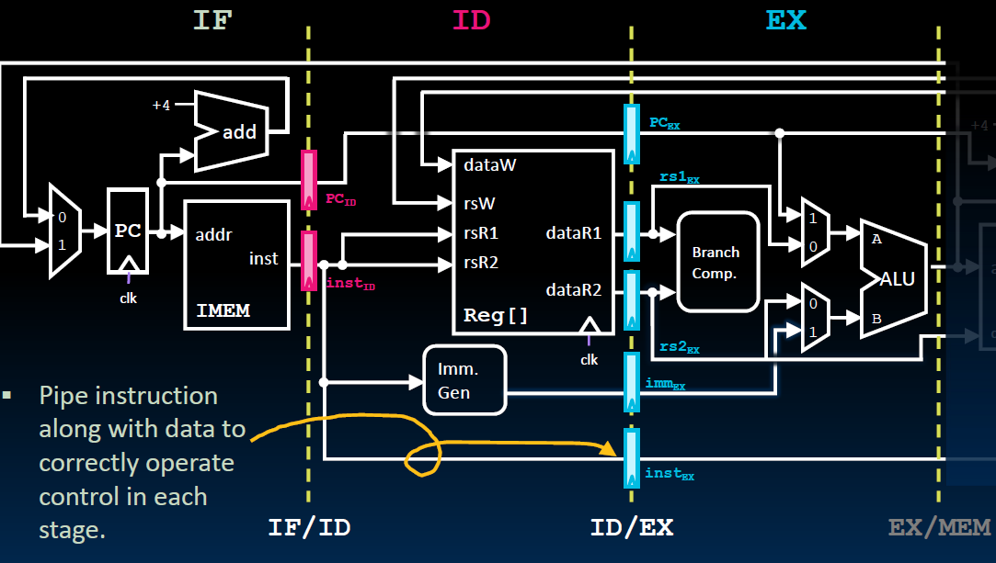
ID/EX Pipeline Register

Slide 33
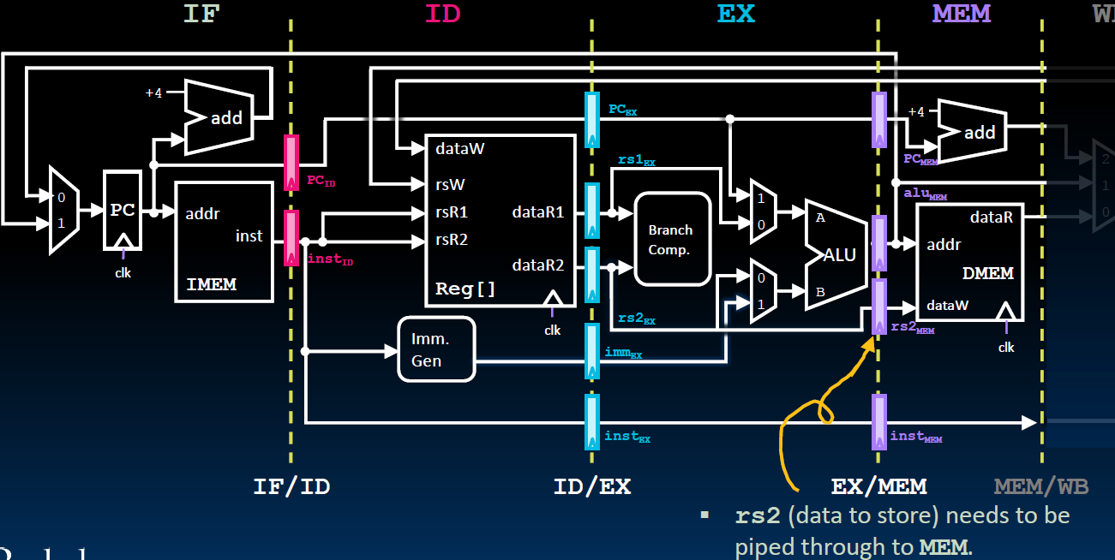
EX/MEM Pipeline Register
JAL

Slide 34
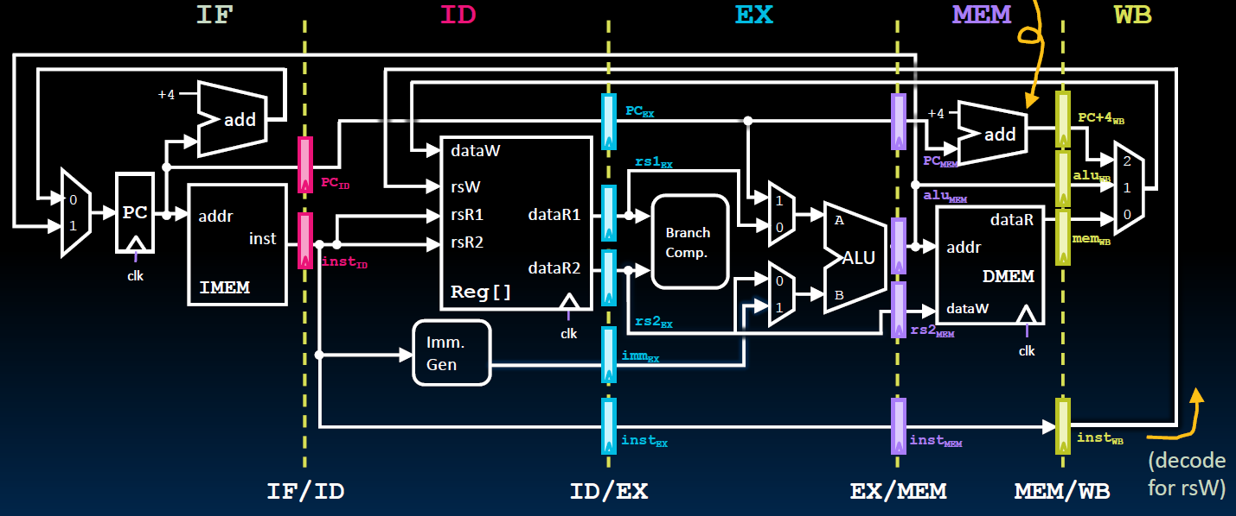
MEM/WB Pipeline Register

Slide 35
Are Pipelined Registers Architecture States?
No! Pipelined registers are NOT architectural states.
Architecture states
Registers (general purpose, fp, vector, flags,…)
PC
Memory
Micro-architecture states
Pipelined registers
Branch predictors
Caches
Buffers and Quenes
Counters
…
Architecture states are saved during a context switch:
User-level switch, such as a procedure call
Registers are saved on the runtime program stack
2) System-level switch, such as a process switch
Registers are saved on the PCB (Process Control
Block) or the kernel stack.

Slide 36
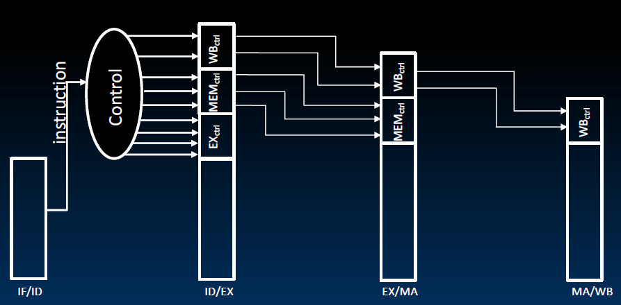
Control Signals in Pipelined Data Path
Control signals are derived from instruction bits, that is, after the ID stage.
Control information for later stages are also stored in the pipeline registers

