Slide 1
CSC3060 – Computer Architecture Chapter 4 Processor Architecture & Logic Designs
Prof. Wei Chung Hsu
School of Data Science
Chinese University of Hong Kong, Shenzhen

Slide 2
Processors and Logic Designs
So far, we have covered data representation and machine languages such as ISA and instruction encoding.
This chapter will discuss the processor and basic logic designs for various microarchitectures.
Computer architectures
ISA family: Intel x86, IBM 360, ARM, RISC-V, …
Processor Microarchitectures
Different implementations of the same ISA: Single cycle, Multi-cycle, Pipelined, Superscalar, Out-Of-Order, Speculative Execution, Cache Hierarchies, and Various Predictions.
Different implementations support various performance and cost

Slide 3
Processors and Logic Designs
So far, we have covered data representation and machine languages such as ISA and instruction encoding.
This chapter will discuss the processor and basic logic designs for various microarchitectures.
Computer architectures
ISA family: Intel x86, IBM 360, ARM, RISC-V, …
Processor Microarchitectures
Different implementations of the same ISA: Single cycle, Multi-cycle, Pipelined, Superscalar, Out-Of-Order, Speculative Execution, Cache Hierarchies, and Various Predictions.
Different implementations support various performance and cost
Intel x86 u-arch | Multi- cycle | Pipelined | Super- scalar | Out-of-Order | OOO Era | SMT Hyper-threading | SIMD/AVX Vector | Hetero- geneous
Example | 8086 80286 80386 | 80486 | Pentium P5 | Pentium- pro P6 | P6, Pentium II Core,Core2 | Nehalem | Sandy bridge Rocket lake | Alder lake Raptor lake P-core+E-core
64bit
AVX

Slide 4
Computer Organization

Slide 5
The Processor: Datapath & Control
Data Path
Handles the actual processing of data (arithmetic operations, data movement, etc.), e.g., ALU, Register, Memory interface, Buses
Manages Data Flow
The “Brawn”
Control
Handles the flow of instructions and signals within the processor, such as PC, Instruction fetch, and Control signal generation
Manages Instruction flow
The “Brain”

Slide 6
RV32I Data Path and Control
We focus on the implementation of a subset of the RV32I core:
Memory reference instructions: lw, sw
Arithmetic/logical instructions: add, sub, and, or
Control flow instructions: beq, jal
A subset, but sufficient to illustrate the key principles in creating a data path and designing the control.

Slide 7
Instruction Execution Cycle
Use the program counter (PC) to supply the instruction address and fetch the instruction from memory
Decode the instruction (and read registers)
Execute the instruction
Use ALU to calculate
Arithmetic result
Memory address for load/store
Branch target address
Access data memory for load/store
PC ← target address or PC + 4
Cycle:
Fetch-Decode-Execute
Fetch PC=PC+4
Execute
Decode

Slide 8
Instruction Execution
Use the program counter (PC) to supply the instruction address and fetch the instruction from memory
Decode the instruction (and read registers)
Execute the instruction
Use ALU to calculate
Arithmetic result
Memory address for load/store
Branch target address
Access data memory for load/store
PC ← target address or PC + 4
Cycle:
Fetch-Decode-Execute
Fetch PC=PC+4
Ld/St
Decode
Branch
ALU

Slide 9
Single Cycle vs. Multi-Cycles
Single cycle: Each instruction is executed in a single clock cycle, which means that all operations—fetching, decoding, executing, accessing memory, and writing back—happen within that one cycle. This requirement requires a longer clock cycle to accommodate the slowest instruction, often resulting in a lower clock frequency. The complexity of a given instruction can influence the cycle time. (This leads to the revolution of RISC architecture)
Multi-cycle: Instructions are broken down into multiple steps, each taking one clock cycle. This allows for a shorter clock cycle, higher clock frequency, and more efficient use of hardware resources.
By the way, before RISC, cycle time was about 1us in the late 70’s
After RISC, MIPS(1985) cycle time was 40 ns, SPARC(1987), 28ns

Slide 10
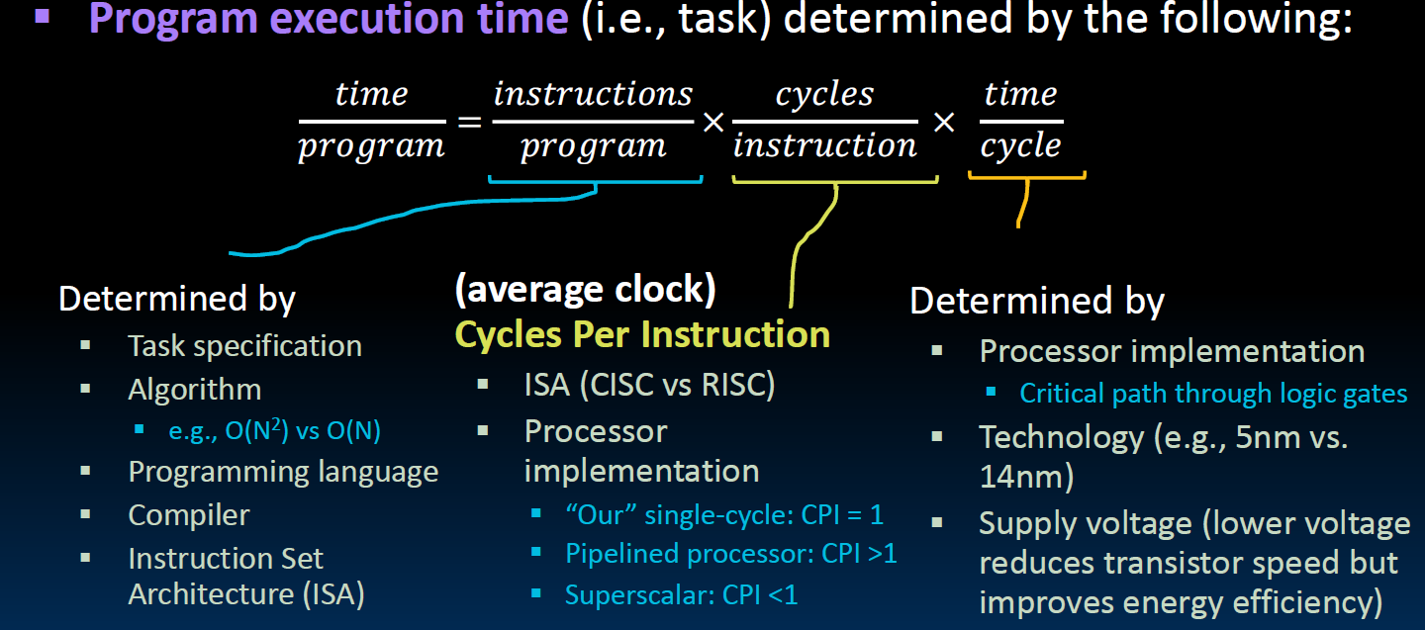
CPU Time = Inst count X CPI X Clock cycle time
Notes:
clock time： the time to complete a task

Slide 11
CISC vs RISC Examples
CPU Time = Inst count X CPI X Clock cycle time
CISC machines: Lower instruction count, higher CPI, longer cycle time
RISC machines: higher instruction count, lower CPI, shorter cycle time
How about modern x86 processors? Their cycle times are pretty short.
Modern x86 processors take x86 instructions in, translate in hardware into micro-operations for execution (and cached). Those micro-operations are RISC.

Slide 12
CPU Time = Inst count X CPI X Clock cycle time
Assuming we have 4 instructions to execute, w,x,y, and z,:
Single cycle: CPI = 1, long cycle time
Multi-cycle: CPI = m, short cycle time
Pipelining: CPI = ~1, short cycle time
z
y
x
w
Z (4 cycle)
Y (3cycle)
X (2 cycle)
W (4 cycles)
W (4 cycles)
X (2 cycle)
Fully overlapped
Y (3cycle)
Z (4 cycle)

Slide 13
CPU Time = Inst count X CPI X Clock cycle time
Assuming we have 4 instructions to execute, w,x,y, and z,:
Single cycle: CPI = 1, long cycle time
Multi-cycle: CPI = m, short cycle time
Pipelining: CPI = ~1, short cycle time
Assume 1 long cycle = 4 short cycles
z
y
x
w
16 short cycles
Z (4 cycle)
Y (3cycle)
X (2 cycle)
W (4 cycles)
13 short cycles
W (4 cycles)
X (2 cycle)
Fully overlapped
7 short cycles
Y (3cycle)
Z (4 cycle)

Slide 14
4.2 Logic Design Basics
IF you have no background in logic designs, please read Appendix A in the reference book
Information encoded in binary
Low voltage = 0, High voltage = 1
One wire per bit, Multi-bit data encoded on multi-wire buses
Three major components:
Combinational element
Operate on data
Output is a function of input
State (sequential) elements
Store information
Clock signals
Regulate the updating of the memory elements
Notes:
The datapath elements in the MIPS implementation consist of two different types of logic elements: elements that operate on data values and elements that contain state.
Recall the previous figure, The instruction and data memories, as well as the registers, are all examples of state elements.
Logic components that contain state are also called sequential element, because their outputs depend on both their inputs and the contents of the internal state.

Slide 15
4.2 Logic Design Past and Now
At one time, hardware designers created circuit designs by drawing schematic diagrams of logic circuits (with paper and pencil) or writing Boolean expressions.
Nowadays, most designs are expressed in a hardware description language (HDL), a textual notation that looks similar to a programming language, but is used to describe hardware structures rather than program behaviors.
The most commonly used HDLs are Verilog, SystemVerilog, VHDL, and Chisel.
The textbook defines Hardware Control Language (HCL) to describe control logics.
SW
High-Level Language (C/C++)
Compiler
Assembly program / Machine language program
High-Description Language (Verilog)
Logical Synthesizer
(⊂ Silicon Compiler)
Boolean equations + FSM
HW
Notes:
SystemVerilog is a superset of Verilog, Chisel is used by SiFive for RISC-V
Recall the previous figure, The instruction and data memories, as well as the registers, are all examples of state elements.
Logic components that contain state are also called sequential element, because their outputs depend on both their inputs and the contents of the internal state.

Slide 16
4.2 Logic Design Basics
Information encoded in binary
Low voltage = 0, High voltage = 1
One wire per bit, Multi-bit data encoded on multi-wire buses
Three major components:
Combinational element
Operate on data
Output is a function of input
State (sequential) elements
Store information
Clock signals
Regulate the updating of the memory elements
What is the difference between combinational logic and sequential logic?
One is stateless, output purely depends on the inputs. e.g. ALU
The other has states, output depends on the inputs and the states, e.g. register
One is stateless, output purely depends on the inputs. e.g. ALU
The other has states, output depends on the inputs and the states, e.g. register
Notes:
The datapath elements in the MIPS implementation consist of two different types of logic elements: elements that operate on data values and elements that contain state.
Recall the previous figure, The instruction and data memories, as well as the registers, are all examples of state elements.
Logic components that contain state are also called sequential element, because their outputs depend on both their inputs and the contents of the internal state.

Slide 17
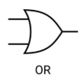

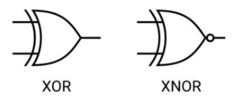
4.2.1 Logic Gates
AND-gate
Y = A && B
OR-gate
Y = A II B
A
A
Y
Y
B
B
Not-gate
Y = !A
XOR and XNOR
A
Y

Slide 18
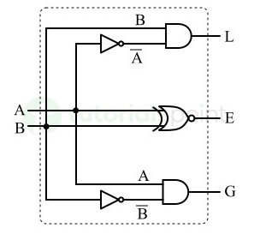
4.2.2 Combinational Elements
Adder
Y = A + B
Multiplexer
Y = S ? I1 : I0
A
I0
M u x
Y
+
Y
I1
B
S
Arithmetic/Logic Unit
Y = F(A, B)
Comparator
L = A < B
E = A == B
G = A > B
A
ALU
Y
B
F

Slide 19
4.2.2 Combinational Elements
Adder
Y = A + B
Multiplexer
Y = S ? I1 : I0 or Y=(S&&I0)||(!S&&I1)
A
I0
M u x
Y
+
Y
I1
B
S
Arithmetic/Logic Unit
Y = F(A, B)
Comparator
L = A < B
E = A == B
G = A > B
Logic gates and combinational circuits are always active: if the inputs change, the outputs also change after some delay.
The propagation delay of a combinational circuit is determined by the delay of the critical path, which is the longest path of logic gates from any input to any output.
A
ALU
Y
B
F

Slide 20
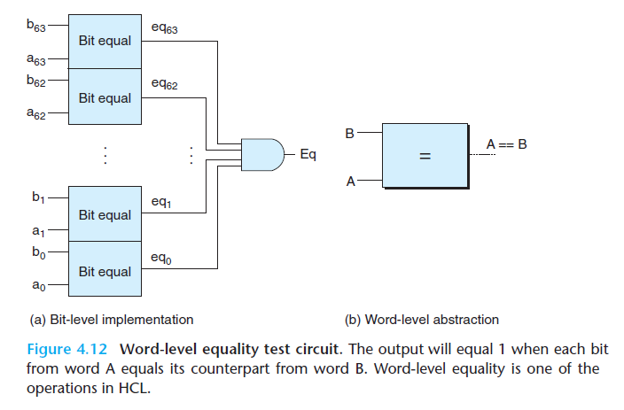
4.2.3 Word-Level Combinational Circuits
Adder
Y = A + B where A and B are words
HCL expression
Bool eq= (A == B)
A
+
Y
B
Multiplexer
Y = S ? A : B
B
M u x
Y
A
s

Slide 21
Sequential Elements（1）
Register: stores data in a circuit
Use a clock signal to determine when to update the stored value
Edge-triggered: update when Clk changes from 0 to 1
D
Q
Clk
D
Clk
Q
Notes:
Sequential element: state element + logic

Slide 22
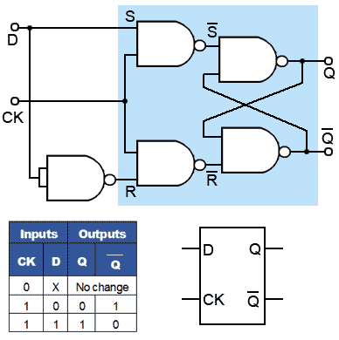
Sequential Elements（1）
Register: stores data in a circuit
Use a clock signal to determine when to update the stored value
Edge-triggered: update when Clk changes from 0 to 1
D
Q
Clk
Notes:
Sequential element: state element + logic

Slide 23
Sequential Elements（2）
For general purpose register updates, WRITE is 0 for what RV instructions?
Register with write control
Only updates on clock edge when write control input is 1
Used when stored value is required later
Branches and Stores
Clk
D
Q
Write
Write
Clk
D
Q
Notes:
This one includes a “write” control

Slide 24
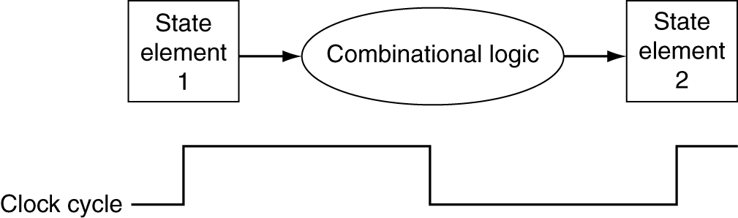
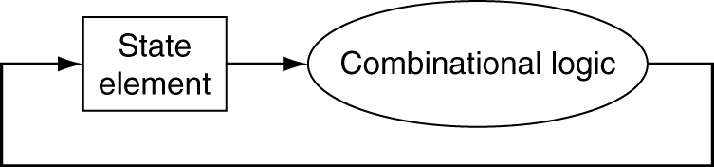
Clocking Methodology
Combinational logic transforms data during clock cycles
Between clock edges, edge triggered clocking
Input from state elements, output to state element
Longest delay determines clock period
enable read and write in a same clock

Slide 25
Abstract View of RV32I Subset
Load
Store
Add
BEQ
4
ADD
ADD
Registers
Data
addr
Register rs1
Data
Memory
PC
addr
inst
ALU
Register rs2
Instruction
Memory
Register rd
data
Notes:
在这个抽象图里面我 simplified 2 places，一个是多路输入

Slide 26
Multiplexers Required
Can’t just join wires together
Must use multiplexers
4
ADD
ADD
Registers
Data
addr
Register rs1
Data
Memory
PC
addr
inst
ALU
Register rs2
Instruction
Memory
Register rd
data
Notes:
在这个抽象图里面我 simplified 2 places，一个是多路输入

Slide 27
Adding Multiplexer
PCSrc = ((BEQ or JAL) ? 1: 0)
mux
I0
M u x
Y
I1
4
ADD
S
ADD
mux
Registers
Data
addr
Register rs1
Data
Memory
PC
addr
inst
mux
ALU
Register rs2
Instruction
Memory
Register rd
data
Notes:
在这个抽象图里面我 simplified 2 places，一个是多路输入

Slide 28
Adding Control Signals
How to select between PC+4
and PC+immediate?
mux
If a branch is taken
or a jal instruction
select pc+immed
Otherwise
select pc+4
4
How to select data from
the memory or the ALU?
If load select Mem
If R-type select Alu
ADD
ADD
mux
Registers
Data
addr
Register rs1
Data
Memory
PC
addr
inst
mux
ALU
Register rs2
Instruction
Memory
Register rd
data
How to select data from
Immediate or reg[rs2]?
If R-type select rs2
If I-type select immed
Notes:
在这个抽象图里面我 simplified 2 places，一个是多路输入

Slide 29
Adding Other Control Signals
mux
4
ADD
ADD
mux
Registers
ALUop
MemRead
Data
addr
Register rs1
Data
Memory
PC
addr
inst
mux
ALU
Register rs2
Instruction
Memory
Register rd
data
MemWrite
RegWrite
Notes:
在这个抽象图里面我 simplified 2 places，一个是多路输入

Slide 30
How to Design a Processor
1. Analyze the required instruction set (data path requirements)
The register transfers give the meaning of each instruction Datapath must include a storage element
Datapath must support each register transfer
2. Select a set of data path components and establish a clocking methodology
3. Assemble data path meeting the requirements
4. Analyze the implementation of each instruction to determine the setting of control points affecting register transfers
5. Assemble the control logic
Check data
path requirements
Assemble data
path components
Adding control
signals

Slide 31
Step 1 - Analyze Instruction Set
Subset of RISC-V instructions are 32 bits long with 4 formats
R-type
I-type
S-type/B-type
J-type
The different fields are:
opcode: Operation of the instruction
rs1,rs2, rd: Source and destination registers
funct3: Selects variant of the “opcode” field
Immediate: for computing memory addresses (data and instruction)
7
5
5
3
5
7
funct7
rs2
rs1
funct3
rd
opcode
Subset:
Lw/Sw
Add/Sub
And/Or
Beq/Jal
12
5
3
5
7
imm[11:0]
rs1
funct3
rd
opcode
7
5
5
3
5
7
imm[11:5]
rs2
rs1
funct3
imm[4:0]
opcode
20
5
7
imm[31:12]
rd
opcode
Notes:
One of the most important thing you need to know before you start designing a processor is how the instructions look like.
Or in more technical term, you need to know the instruction format. One good thing about the RV instruction set is that it is very simple.
First of all, all RV instructions are 32 bits long.
The different fields of the R-type instructions are:
(a) OP specifies the operation of the instruction.
(b) Rs1, Rs2, and Rd are the source and destination register specifiers.
(c) Shamt specifies the amount you need to shift for the shift instructions.
(d) Funct selects the variant of the operation specified

Slide 32
Our Example: RV32I Subset
R-Type
add rd, rs1, rs2
sub rd, rs1, rs2
and rd, rs1, rs2
or rd, rs1, rs2
Load/Store
lw rd,rs1,imm12
sw rs2,rs1,imm12
Immediate operand
addi rd,rs1,imm12
Branch
beq rs1,rs2,imm12
Jump
jal rd, target
7
5
5
3
5
7
funct7
rs2
rs1
funct3
rd
opcode
12
5
3
5
7
imm[11:0]
rs1
funct3
rd
opcode
7
5
5
3
5
7
imm[11:5]
rs2
rs1
funct3
imm[4:0]
opcode
1
6
5
5
3
4
1
7
imm[12]
imm[10:5]
rs2
rs1
funct3
imm[4:1]
imm[11]
opcode
1
10
1
8
5
7
imm[20]
imm[10:1]
imm
imm[19:12]
rd
opcode
Notes:
In today lecture, I will show you how to implement the following subset of RV32I instructions: add, subtract, and/or immediate, load, store, branch, and the jump instruction.
The Add and Subtract instructions use the R format. The Op together with the Func fields specified all the different kinds of add and subtract instructions.
Rs1 and Rs2 specifies the source registers. And the Rd field specifies the destination register.
The Or immediate instruction uses the I format. It only uses one source register, Rs1. The other operand comes from the immediate field. The Rd field is used to specified the destination register. (Note that dest is the Rt field!
The difference is that the load instruction will load the data from memory into Rd while the store instruction will store the data in Rs2 into the memory.
The branch on equal instruction also uses the I format. Here Rs and Rt are used to specified the registers we need to compare.
If these two registers are equal, we will branch to a location offset by the immediate field.
Finally, the jump instruction uses the J format and always causes the program to jump to a memory location specified in the address field.
I know I went over this rather quickly and you may have missed something. But don worry, this is just an overview. You will keep seeing these (point to the format) all day today.
+3 = 13 min. (X:53)

Slide 33
Logical Register Transfer
All start by fetching the instruction, reading registers, then use ALU => simplicity and regularity help
format = op | rs1 | rs2 | rd | funct or = op | rs1 | rs2 | Imm12 or = op | Imm20
Inst Register transfers
ADD R[rd] <- R[rs1] + R[rs2]; PC <- PC + 4
SUB R[rd] <- R[rs1] - R[rs2]; PC <- PC + 4
LOAD R[rd] <- MEM[ R[rs1] + sign_ext(Imm12)]; PC <- PC + 4
STORE MEM[ R[rs1] + sign_ext(Imm12) ] <-R[rs2]; PC <- PC + 4
ADDI R[rd] <- R[rs1] + sign_ext(Imm12)]; PC <- PC + 4
BEQ if (R[rs1] == R[rs2]) then PC <- PC + sign_ext(Imm12)]
else PC <- PC + 4

Slide 34
Regularity in RISC-V Instruction Format
Opcode: The major opcode is always in bits 0-6.
Destination register (rd): when present, is always in bits 7-11.
First source register (rs1): when present, is always in bits 15-19.
Second source register (rs2): when present, is always in bits 20-24.
Instructions are fixed length: 16 or 32
Immediate values are placed in the high bits of the instructions (branch and store have some bits use the “rd” field)

Slide 35
Data Path Requirements
After checking the register transfers, we can see that data path needs the followings:
Memory
Store instructions and data (we have I-cache and D-cache)
Registers (32 x 32b)
Read RS1
Read RS2
Write RD
PC
Extender for zero- or sign-extension
Add and sub register or extended immediate (ALU)
Add 4 or extended immediate to PC

Slide 36
Step 2a - Combinational Components for Datapath
Basic building blocks of combinational logic elements
CarryIn
Select
A
32
A
Adder
Sum
32
32
MUX
Y
32
B
CarryOut
B
32
32
Adder
MUX
ALU control
4
A
32
ALU
Result
32
B
32
ALU
Notes:
Based on the Register Transfer Language examples we have so far, we know we will need the following combinational logic elements.
We will need an adder to update the program counter. We may end up with three adders!!
A MUX to select the results.
And finally, an ALU to do various arithmetic and logic operation.
+1 = 30 min. (Y:10)

Slide 37
Step 2b - Sequential Components for Datapath
Register
Similar to the D Flip Flop except
N-bit input and output
Write Enable input
Write Enable
negated (0): Data Out will not change
asserted (1): Data Out will become Data In
Write Enable
Data In
Data Out
N
N
Clk
Notes:
As far as storage elements are concerned, we will need a N-bit register that is similar to the D flip-flop I showed you in class. （D触发器）
The significant difference here is that the register will have a Write Enable input.
That is the content of the register will NOT be updated if Write Enable is not asserted (0).
The content is updated at the clock tick ONLY if the Write Enable signal is asserted (1).
+1 = 31 min. (Y:11)

Slide 38
Storage Element - Register File
Consists of 32 registers
Two 32-bit output buses (busA and busB)
Two output buses are usually called two read ports
One 32-bit input bus: busW (one write port)
Register is selected by
Rs1 selects the register to put on busA (data)
Rs2 selects the register to put on busB (data)
Rd selects the register to be written via busW (data) when Write Enable is 1
Clock input (CLK)
The CLK input is a factor ONLY during write operation
During read, behaves as a combinational circuit
Rd
Rs1
Rs2
Write Enable
5
5
5
busA
busW
32-bit
Registers
32
32
Clk
busB
32
How many read ports needed for
a 2-wide superscalar processor?
How many read ports are needed for
the fma (fused mul-add) instruction?
Notes:
register File: 寄存器堆，包含32个通用寄存器。 BusA和BusB是读两个寄存器的值，busW是写，RA、Rb、RW是寄存器的编号
We will also need a register file that consists of 32 32-bit registers with two output busses (busA and busB) and one input bus.
The register specifiers Ra and Rb select the registers to put on busA and busB respectively.
When Write Enable is 1, the register specifier Rw selects the register to be written via busW.
In our simplified version of the register file, the write operation will occurs at the clock tick.
Keep in mind that the clock input is a factor ONLY during the write operation.
During read operation, the register file behaves as a combinational logic block.
That is if you put a valid value on Ra, then bus A will become valid after the register file access time.
Similarly if you put a valid value on Rb, bus B will become valid after the register file access time. In both cases (Ra and Rb), the clock input is not a factor.
Intel can issue 4-6 instruction per clock cycle. This does not mean the registers should support 12 read ports. Because 4-6 are a mix of int/fp instructions.
Today’s high-end processors usually support 10-12 read ports.

Slide 39
Storage Element - Memory
Memory
One input bus: Data In
One output bus: Data Out
Word is selected by
Address selects the word to put on Data Out
Write Enable = 1: address selects the memory word to be written via the Data In bus
Mem Write
Address
Data In
DataOut
32
32
Mem Read
Notes:
The last storage element you will need for the datapath is the idealized memory to store your data and instructions.
This idealized memory block has just one input bus (DataIn) and one output bus (DataOut).
When Write Enable is 0, the address selects the memory word to put on the Data Out bus.
When Write Enable is 1, the address selects the memory word to be written via the DataIn bus at the next clock tick.
Once again, the clock input is a factor ONLY during the write operation.
During read operation, it behaves as a combinational logic block.
That is if you put a valid value on the address lines, the output bus DataOut will become valid after the access time of the memory

Slide 40
Step 3a - Datapath Assembly
Instruction fetch unit: common operations
Fetch the instruction: mem[PC]
Update the program counter
Sequential code: PC <- PC + 4
Branch and Jump: PC <- “Something else”

Slide 41
Step 3b - Branch Operations
beq rs1, rs2, imm12
mem[PC] /*Fetch inst. from memory */
Equal <- R[rs1] == R[rs2] /* Calculate branch condition */
if (Equal) /* Calculate next inst. Address */
PC <- PC + ( SignExt(imm12) x 2 )
else
PC <- PC + 4
Notes:
How does the branch on equal instruction work?
Well it calculates the branch condition by subtracting the register selected by the Rs2 field from the register selected by the Rs1 field.
If the result of the subtraction is zero, then these two registers are equal and we take a branch. Otherwise, we keep going down the sequential path (PC <- PC +4).
+1 = 65 min. (Y:45)

Slide 42
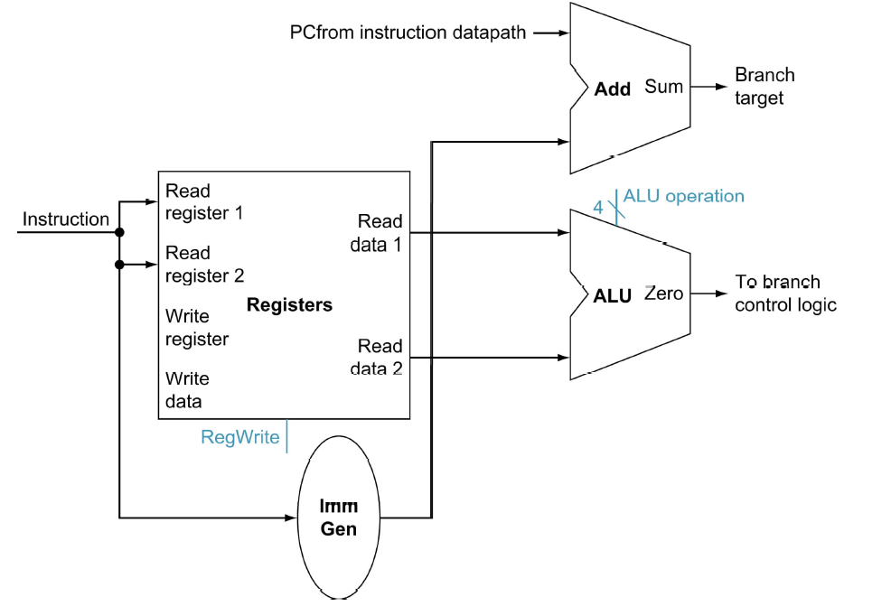
Datapath for Branch Operations
beq rs1, rs2, imm12
Why do we need two adders? Is one enough?
Notes:
The datapath for calculating the branch condition is rather simple.
All we have to do is feed the Rs and Rt fields of the instruction into the Ra and Rb inputs of the register file.
For the branch, usually a subtraction is performed, but what if the subtraction overflowed?
Bus A will then contain the value from the register selected by Rs.
And bus B will contain the value from the register selected by Rt.
The next thing to do is to ask the ALU to perform a subtract operation and feed the output Zero to the next address logic.
How does the next address logic block look like?
Well, before I show you that, let take a look at the binary arithmetics behind the program counter (PC).
+2 = 67 min. (Y:47)

Slide 43
Alert: Branch with Subtraction
Intuitively, a compare and branch instruction could be handled by a subtraction. The output condition is positive, 0, or negative. This output can be used to guide the branch direction.
The above implementation is cost-effective because we have the ALU to support ADD/SUB operations. The same ALU could be used.
The trouble is, what if the subtraction caused an overflow? So, the sign of the result is incorrect, and cannot be used to decide the branch outcome.
If overflow, the trap handler can handle this, but RISC-V does not support such hardware traps. It requires explicit software checks. Does that mean we always generate a check for overflow for each compare and branch?
One way to handle this correctly is to use a true comparison operation instead of the subtraction. However, this increases the cost and the complexity of the design. In practice, most RV processor implementations will include V (overflow) and C (Carry) flags in a temporary status register if they use subtraction to determine conditions.

Slide 44
Step 3b - Add and Subtract
R[rd] <- R[rs1] op R[rs2] Ex: add rd, rs1, rs2
Ra, Rb, Rw come from instruction’s rs1, rs2, and rd fields
ALU and RegWrite: control logic after decode
rs1
4
A
L
U
o
p
e
r
a
t
i
o
n
(funct)
R
e
a
d
r
e
g
i
s
t
e
r
1
R
e
a
d
rs2
R
e
a
d
d
a
t
a
1
I
n
s
t
r
u
c
t
i
o
n
r
e
g
i
s
t
e
r
2
Z
e
r
o
rd
R
e
g
i
s
t
e
r
s
A
L
U
A
L
U
W
r
i
t
e
r
e
s
u
l
t
r
e
g
i
s
t
e
r
R
e
a
d
W
r
i
t
e
d
a
t
a
2
d
a
t
a
R
e
g
W
r
i
t
e
Notes:
And here is the datapath that can do the trick.
First of all, we connect the register file Ra, Rb, and Rw input to the Rd, Rs1, and Rs2 fields of the instruction bus (points to the format diagram).
Then we need to connect busA and busB of the register file to the ALU.
Finally, we need to connect the output of the ALU to the input bus of the register file.
Conceptually, this is how it works.
The instruction bus coming out of the Instruction memory will set the Rs1 and Rs2 to the register specifiers Rs1 and Rs2.
This causes the register file to put the value of register Rs1 onto busA and the value of register Rs2 onto busB, respectively.
By setting the ALUctr appropriately, the ALU will perform either the Add and Subtract for us.
The result is then fed back to the register file where the register specifier Rw should already be set to the instruction bus Rd field.
Since the control, which we will design in our next lecture, should have already set the RegWr signal to 1, the result will be written back to the register file at the next clock tick (points to the Clk input).
+3 = 42 min. (Y:22)

Slide 45
Step 3c - Load/Store Operations
R[rd]<-Mem[R[rs1]+SignExt[imm12]] Ex: lw rd,rs1,imm12
rs1
4
rs2
rd
12
Notes:
Once again we cannot use the instruction Rd field for the Register File Rw input because load is a I-type instruction and there is no such thing as the Rd field in the I format.
So instead of Rd, the Rt field is used to specify the destination register through this two to one multiplexor.
The first operand of the ALU comes from busA of the register file which contains the value of Register Rs (points to the Ra input of the register file).
The second operand, on the other hand, comes from the immediate field of the instruction.
Instead of using the Zero Extender I used in datapath for the or immediate datapath, I have to use a more general purpose Extender that can do both Sign Extend and Zero Extend.
The ALU then adds these two operands together to form the memory address.
Consequently, the output of the ALU has to go to two places:
(a) First the address input of the data memory.
(b) And secondly, also to the input of this two-to-one multiplexer.
The other input of this multiplexer comes from the output of the data memory so we can place the output of the data memory onto the register file input bus for the load instruction.
For Add, Subtract, and the Or immediate instructions, the output of the ALU will be selected to be placed on the input bus of the register file.
In either case, the control signal RegWr should be asserted so the register file will be written at the end of the cycle.
+3 = 60 min. (Y:40)

Slide 46
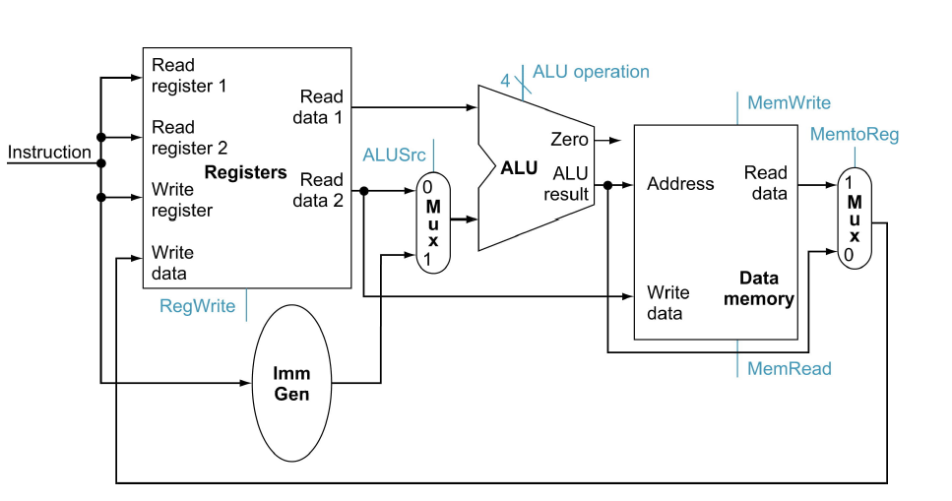
Combine Mem and R-type Instructions
Notes:
To create a datapath with only a single register fi le and a single ALU, we must
support two diff erent sources for the second ALU input, as well as two diff erent
sources for the data stored into the register fi le. Th us, one multiplexor is placed
at the ALU input and another at the data input to the register fi le.

Slide 47
A Single Cycle RISC-V Processor
On every tick of the clock, the processor executes one instruction
Current outputs of the state elements drive the inputs to the combinational logic.
The outputs of the combinational logic settle at the inputs to the state elements before the rising of the next clock edge.
At the next rising edge of the clock
All state elements are updated with the combinational logic outputs
The execution moves to the next clock cycle

Slide 48
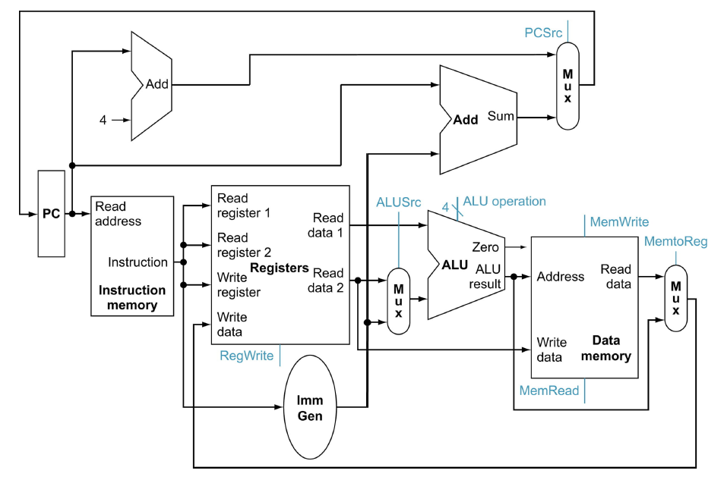
A Single Cycle Data Path
Add this path for JAL
WBsel

Slide 49
Limitations of a Single-Cycle Implementation
Resources cannot be reused. So there are multiple adders – for PC updates, and for ALU.
Instruction memory and data memory are separated. In a single cycle, you may not go through the same combinational logic or the state more than once.
Do we need duplicated register file? How to read two registers, and write one at the same time? We will need two read ports and one write port.
A single cycle design, registers are updated at the rise of the clock, and the registers are updated, and then the outputs from registers are send to the combinational logic.

Slide 50
Inefficiency in a Single Cycle Implementation
Some computations are iterative such as multiply and divide.
Multiply and divide may need to iterate through the same combinational logic resources many times. In a single-cycle implementation, the logic must be replicated many times.
The above implementation is way too expensive. So, one way to reduce the cost is to allow the implementation to iterate through the same resource using a counter. However, that means we need to use a faster clock to sync each step. Such instructions then become multi-cycle instructions.
Multi-cycle implementation is one step between single-cycle implementation and pipelined implementation.

Slide 51
Data Flow during add rd, rs1, rs2
1
Add this path for JAL
WBsel
100..0100
12

Slide 52
Step 4 - Control Points and Signals
Instruction<31:0>
Inst.
Memory
<12:14>
<15:19>
<20:24>
<7:11>
<20:31>
Addr
Op
Funct
Rs1
Rs2
Rd
Imm12
Control
PCsrc
RegWr
MemRd
ALUSrc
ALUctr
MemWr
MemtoReg
Equal
Datapath

Slide 53
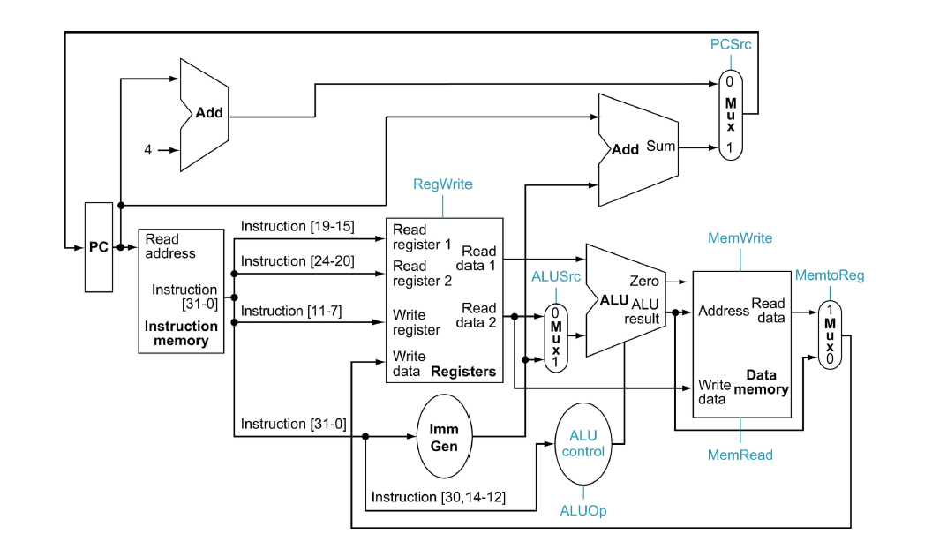
Step 4 - Control Points and Signals
Add this path for JAL
WBsel
Control point

