Slide 1
CSC3060 – Computer Systems
Prof. Wei Chung Hsu
School of Data Science
Chinese University of Hong Kong, Shenzhen
Notes:
I would like to welcome everyone for the new semester here. This semester I will be the instructor of CSC3050.

Slide 2
Class Information
Instructor
Wei Chung HSU (徐慰中) (hsuweichung@cuhk.edu.cn)
Office: Dao Yuan Building 道远楼 509a
Office Hours: Mon and Wed, 5:00 to 6:00
Course TA & USTF
Lead TA: (刘毓昊)(yuhaoliu2@link.cuhk.edu.cn)
TA: Wenhai Lai, Liangsen Wang, Jiamu Zhao
USTF: Mingyi Bao, Kevin William, Ming Wen, Xiaoying Zeng
Lectures
Tuesday 10:30 – 12:20 AB E205
Thursday 10:30 – 12:20 AB E205
Tutorials
Tutorials are scheduled on Tuesday (6-8) and Thursday (6-8). TAs will announce the details on BB.
Homepage
bb.cuhk.edu.cn
Note that the lecture slides posted on BB may be updated frequently

Slide 3
TA Office Hours

Slide 4







Instructor CS Background
Computer architect at Cray Research (Supercomputers)
Compiler engineer for Cray-XMP/YMP, Cray-C90, Cray-2, Cray-3
Tech lead of Hewlett-Packard (HP) optimizing compiler group
Compiler architect for Intel/HP Itanium (IA-64) Processors
Professor at U. of Minnesota. Research on Binary Translation (BT) for Itanium, Sun SPARC, x86, MIPS, and ARM processors
Professor at NTU, Research on BT, Virtual Machines, Runtime Optimization systems, and Finalizer for HSAIL (Heterogenous System Architecture Intermediate Language)
Intel GPU Compiler Principal Engineer
Notes:
To Combine Tradition and Modernity
Bring together China to the West
To combine SW and HW
Bring together Practice to the Theory

Slide 5
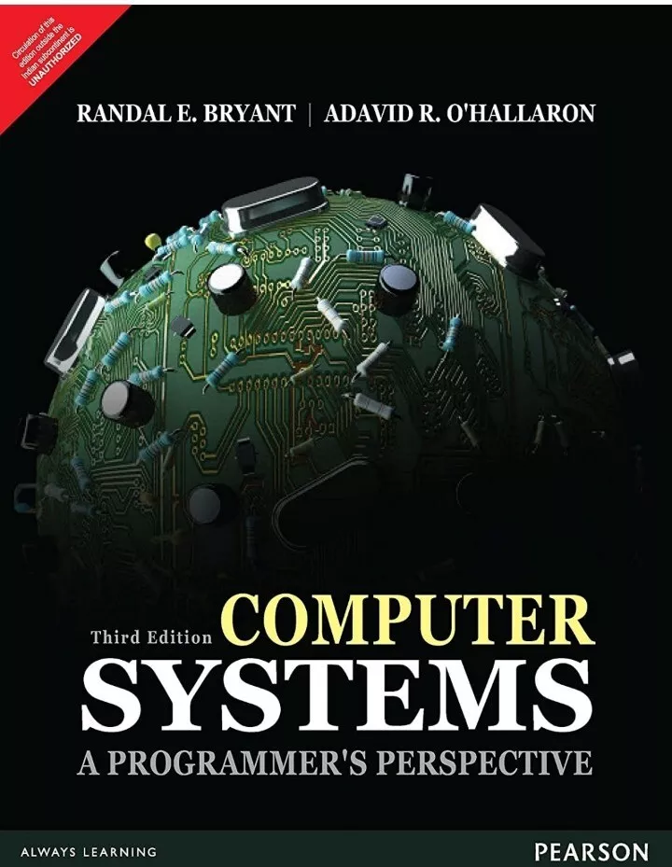
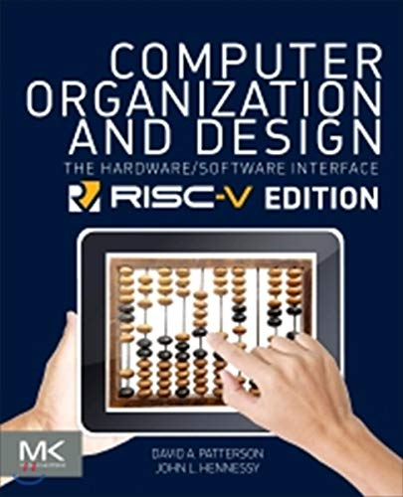
Textbook & Reference
(Textbook) CS:APP
Computer Systems: A Programmer's Perspective by Randal Bryant and David O'Hallaron, 3e, INTERNATIONAL EDITION
(Reference book)
Computer Organization and Design: The Hardware/Software Interface (RISC-V Edition)
David A. Patterson and John L. Hennessy
Notes:
This is an excellent textbook for computer organization, the most widely used. Clear explanation and comprehensive coverage of fundamentals.
However, the ISA used there was a little too old. So we adopt the latest ISA on the market, the RISC-V edition.
P&H: Stanford/UCB
B&O: CMU, UofWashington, Harvard, UCSD.

Slide 6
Difference Between CSC3060 and CSC3050
CSC3060 covers the whole stack of how programs execute on real machines: machine-level code, data representation, memory hierarchy, linking, processes and threads, virtual memory, concurrency, and networking.
CSC3050 focuses on the computer itself: ISA, Data Path and Control, Pipelining, Caches, and Performance.
CSC3060 is programmer‑centric: “How does a system execute my C code?”
CSC3050 is more design-centric: “How is a processor built?”
CSC3060 emphasizes systems skills: debugging, bit‑level reasoning, memory behavior, and writing low‑level C.
CSC3050 emphasizes ISA designs, micro-architecture structures, and performance analysis.
Notes:
Sounds a little risky
RISC-V V also means “Vector”

Slide 7
What makes "CS:APP," Popular?
Many top universities use CS:APP as the primary text for their “computer systems” or “systems programming” course.
Other schools mix it with Patterson & Hennessy (computer architecture) or Silberschatz/Tanenbaum (operating systems).
It covers core systems topics: machine code, caching, virtual memory, linking, processes/threads, and concurrency.
It integrates computer architecture, compilers, operating systems, and networking into one coherent storyline
It is practical, integrated, and teaches concepts every systems programmer actually uses.
Notes:
Sounds a little risky
RISC-V V also means “Vector”

Slide 8
What makes "CS:APP," Popular?
Many top universities use CS:APP as the primary text for their “computer systems” or “systems programming” course.
Other schools mix it with Patterson & Hennessy (computer architecture) or Silberschatz/Tanenbaum (operating systems).
It covers core systems topics: machine code, caching, virtual memory, linking, processes/threads, and concurrency.
It integrates computer architecture, compilers, operating systems, and networking into one coherent storyline
It is practical, integrated, and teaches concepts every systems programmer actually uses.
Carnegie Mellon University
University of California, Berkeley University of Illinois Urbana‑Champaign Georgia Institute of Technology University of Texas at Austin University of Washington University of Michigan Purdue University Cornell University University of Pennsylvania
University of Minnesota
Tsinghua University Peking University
Notes:
Sounds a little risky
RISC-V V also means “Vector”

Slide 9
Downsides of CS:APP
The main referenced computer architecture in this textbook is x86
Although x86 remains vital in servers, high‑end PCs, and legacy‑dependent workloads, its dominance is eroding in a rapidly diversifying computing landscape. ARM and RISC‑V offer better power efficiency and lower cost
GPUs/accelerators now handle much of the performance‑critical work. Cloud providers are shifting to ARM for cost/performance. Consumer laptops and mobile devices already favor ARM. RISC‑V is growing in embedded and will slowly move upward.
X86 and ARM can be claimed as US/UK/Japan Technology, RISC-V is an open architecture and is embraced by China
x86 is an old man, ARM is mid-aged, and RISC-V is a teenager.
Notes:
Sounds a little risky
RISC-V V also means “Vector”

Slide 10
What is RISC-V
RISC
A broad term for “Reduced Instruction Set Computer”, as opposed to CISC (Complex Instruction Set Computers).
Many commercial processors like HP PA, SUN SPARC, ARM, IBM Power and PowerPC, DEC Alpha, MIPS, Intel i860/i960 are RISC processors.
RISC-I, RISC-II, RISC-III, RISC-IV, RISC-V
These are ISA (Instruction Set Architecture) developed at UC Berkeley.
RISC-V is the fifth generation.
Notes:
Sounds a little risky
RISC-V V also means “Vector”

Slide 11
Why adopt RISC-V?
It is an Open architecture.
Its standard is open for collaboration, and is maintained by the non-profit RISC-V foundation.
Unlike Intel x86 and ARM, RISC-V cannot be claimed as USA/UK/Japan-owned technology
It is license-free, royalty-free.
It is an advanced RISC ISA.
It is simple, flexible, extensible, and scalable. computing, from micro-controllers to supercomputers
Notes:
Three popular CPU architectures on the market: x86, ARM, RISC-V

Slide 12
Misconceptions about RISC-V
RISC-V is often connected with two key words
Open
Free
That caused misconceptions.
Open: RISC-V offers an open standard, but not open source code. Designs in RTL or HDL (e.g. Verilog and VHDL) are proprietary. However, some designs are open source, such as Rocket (in-order), BOOM (out-of-order) and PicoRV32.
Free: There are NO free processor chips. Free means the use of the ISA is royalty-free, and free of license fee.
Notes:
ARM charges royalty and license fee. Each micro-controller may cost you 1-2% of , APPLE pays license fee, MTK pays royalty

Slide 13
License Free, Royalty Free
Two dominant CPU ISAs are both proprietary:
X86
AMD used to pay Intel license fees, but since AMD came up with x64 ISA, both sides are license-free.
ARM
Upfront license $1M-$10M, varied by designs
Royalty 1-2% of the cost of each shipped product.
Architecture license (Apple, Qualcomm,…)
Notes:
Only a few companies have x86 license: AMD, Via, others expired

Slide 14
A Strong Software Ecosystem
Royalty-free could be a significant incentive to initially attract embedded system developers.
Once a critical mass has formed, open-source system software has the potential to become a robust software ecosystem driving the RISC-V market's growth, creating a positive feedback loop (virtuous circle).
For example, ARM started with embedded systems and gradually expanded into mobile computing, desktops, and servers. RISC-V seems to be following a similar path of advancement and expansion.

Slide 15
Trend of Software First
In the '60s and '70s, hardware designers were the primary architects and decision-makers. (For example, Seymore Cray designed the CPU, then the scientists wrote programs for the machines.)
Today, software – encompassing system software and application software, plays an increasingly influential role in computer architecture.
Currently, software is the driving force behind the development of computer architecture. The API, the OS, and killer applications (such as DNN, ML, and LLM) shape the direction of the development.
Software-defined radio, software-defined network, …, software-defined everything
Groq claims it is a software-defined LLM accelerator,
TESLA designs around a software platform.
The ISA/platform that attracts more developers will eventually win.
Notes:
OpenCL, OpenGL, OpenMP, JavaAPI,DirectX, SAPI, SDL
For example, since virtual machines have become popular in cloud computing, architectures must support VMs.

Slide 16
Course Syllabus
A Tour of Computer Systems
Representing and Manipulating Information
Machine-Level Representation of Programs
Instruction Set Architecture (ISA): RISC-V
Processor Architecture
Logic Design and sequential implementation
Pipelining
Large and Fast: the Memory Hierarchy
Linking
Optimizing Program Performance

Slide 17
Course Assessment
Class attendance and participation (5%)
In-class pop quizzes
In-Class Written Quizzes (25%)
A couple of written quizzes are scheduled and will be announced two weeks in advance.
Homework: Programming Projects (45%)
Project#1: Data Lab (8%)
Project#2: Assembly debugging (8%) – the bomb lab
Project#3: Pipelining and Code Scheduling (8%)
Project#4: A Data Cache simulator (10%)
Project#5: Code Optimization Competition (11%)
Final Exam (25%)

Slide 18
Academic Honesty
Zero Tolerance
Plagiarism, cheating, misconduct in test/exam will be reported to the School for handing.
Consequences
Zero marks for the concerned assignments/test/exam/whole course, demerits, suspension of study, dismissal from University.
University Policy for Academic Honesty
http://www.cuhk.edu.cn/departsite/ar/en/Academic.html

Slide 19
MISC. (1)
Open book exams
Exams are open books and notes but no longer open laptops, tablets, or cell phones.
Makeup exam policy
If a makeup exam is requested and approved for acceptable reasons, it will be conducted orally in my office. Makeup exams will receive a 10% discount.
Reference letter
If you need my reference letter, please leave a good impression so I can remember our interactions.

Slide 20
MISC. (2)
Reading Assignments
Reading the textbook is a student’s obligation. There will be reading assignments on book chapters. If you follow the assignments, you will comprehend more from the lectures.
Using AI tools (e.g. ChatGPT, GitHub Co-Pilot, Gemini, DeepSeek,… )
Permitted in your homework (to increase your productivity)
You must understand the contents of your dialogue. If you use AI tools, you must include your dialogue with the tool in your submission.
Simulator Assignments
Project#4 and project#5 are more challenging. We allow each team to have two students. The simulator is written in C/C++, and the programs to be optimized are also in C/C++.
Application for Incomplete:
Health and Mental Conditions: Please inform me immediately if you have any health or mental conditions. Applications submitted just one day before the final exam will not be accepted.
Extenuating Circumstances: These are case-by-case and may require supporting documentation.

