Slide 1
CSC3060 Chapter 2: Integer Arithmetic
Prof. Wei Chung Hsu
School of Data Science
Chinese University of Hong Kong, Shenzhen
Notes:
Group of bits (byte, word, double word) can encode char, numbers, color/audio, logic, instructions…..
This chapter will look at a more complex encoding: FP numbers.
How does HW do */div complex arithmetic?
How does HW handle overflows/underflows?

Slide 2
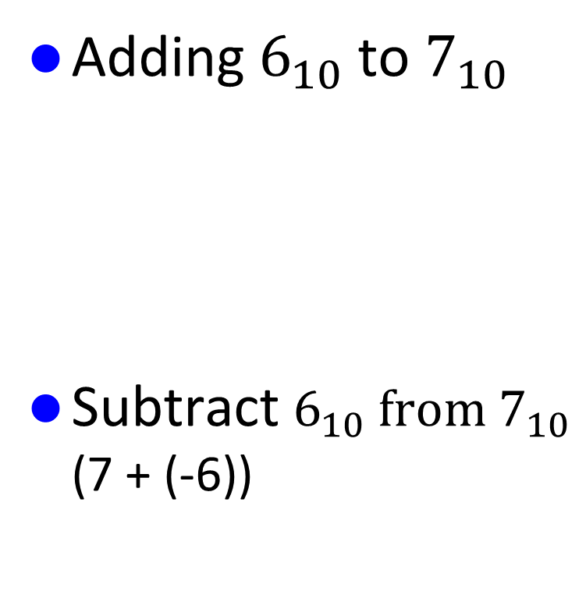
Addition and Subtraction (I)
Adding $6_{10}$to $7_{10}$
Subtract $6_{10} from$ $7_{10}$ (7 + (-6))
00000110
00000111
Assuming 8bit signed integers
+
00001101
-6 (2’s complement)
11111010
00000111
+
00000001

Slide 3
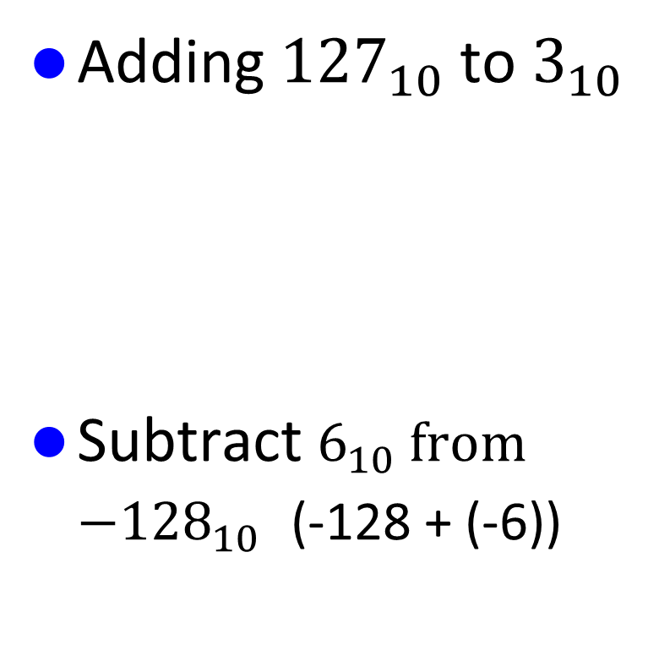
Addition and Subtraction (II)
Adding ${127}_{10}$to $3_{10}$
Subtract $6_{10} from$ ${−128}_{10}$ (-128 + (-6))
01111111
00000011
Assuming 8bit signed integers
+
10000010
Overflowed, result is negative
-6 (2’s complement)
11111010
10000000
+
Overflowed, result is positive
Carry from the MSB is lost.
01111010

Slide 4
Integer Overflows
Why are there overflows?
We have a limited number of bits to represent integers (or numbers). When computed results exceed the limit, an overflow occurs.
It is dangerous to use incorrect results. What should a system do?
Many systems do not throw an error, because
a) performance
b) historical designs c) integer 2’s complement arithmetic has a well-defined wrap-around behavior (hashing/cryptography relies on)
But “Silent” Errors have caused serious failures
What should be done?
Python: dynamic size to avoid overflow
Rust or C#, use checked arithmetic
Raise exceptions: Fortran and Ada require HW to raise exceptions.
Saturation arithmetic: using MMX/SSE multimedia instructions
Notes:
Ariane rocket in 1996 and Boeing 787 counter overflow caused the airplane to lose all electricity
To use saturation arithmetic, you may use intrinsics, or call libraries because C does not have such data types.

Slide 5
Overflow Detections
Overflow detection for 2’s complement numbers
Operation | Operand A | Operand B | Result indicating overflow
A + B | >= 0 | >= 0 | < 0
A + B | < 0 | < 0 | >= 0
A - B | >= 0 | < 0 | < 0
A - B | < 0 | >= 0 | >= 0
Overflow detection for unsigned numbers (need to use test/branch)
For addition, if the sum is less than either of the addends
For subtraction, if the difference is greater than the minuends.

Slide 6
Overflow Detections
(NOT (sign_A XOR sign_B)) AND (sign_A XOR new_sign)
Overflow detection for 2’s complement numbers
Operation | Operand A | Operand B | Result indicating overflow
A + B | >= 0 | >= 0 | < 0
A + B | < 0 | < 0 | >= 0
A - B | >= 0 | < 0 | < 0
A - B | < 0 | >= 0 | >= 0
If two operands have the same sign but the result has a different sign
Overflow detection for unsigned numbers (need to use branch instructions)
For addition, if the sum is less than either of the addends
For subtraction, if the difference is greater than the minuends.
c = a + b
overflow= (c < a)

Slide 7

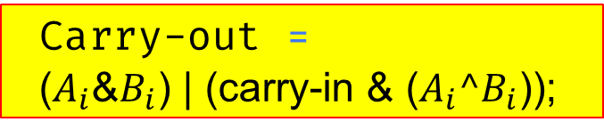
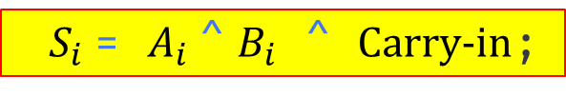


One Bit Full Adder
$$A_{i}$$
$$B_{i}$$
$S_{i}$= $A_{i}$^ $B_{i}$ ^ Carry-in;
One bit full adder
Carry-in
Carry-out
Carry-out = ${\text{(}A_{i}\text{\&}B_{i}\text{) | (}\text{c}\text{arry}\text{−}\text{in}\text{ \& (}A_{i}\text{^}B_{i}\text{));}}_{ }$
$$S_{i}$$
Three cases:
Both A and B are 1’s
A==1, B==0, and Carry==1
A==0, B==1, and Carry ==1

Slide 8
An 1-bit ALU – And, Or, and Add Operations
CarryIn
Operation
and
A
0
or
Result
1
Mux
1-bit
Full
Adder
add
2
B
CarryOut

Slide 9
A 4-bit ALU – And, Or, and Add Operations
1-bit ALU
4-bit ALU
CarryIn
CarryIn0
Operation
Operation
A0
1-bit
ALU
A
Result0
B0
CarryIn1
CarryOut0
A1
1-bit
ALU
Result1
Result
B1
Mux
CarryOut1
CarryIn2
A2
1-bit
ALU
Result2
B2
1-bit
Full
Adder
CarryOut2
CarryIn3
B
A3
1-bit
ALU
Result3
B3
CarryOut
CarryOut3
Notes:
Now that I have shown you how to build a 1-bit full adder, we have all the major components needed for this 1-bit ALU.
In order to build a 4-bit ALU, we simply connect four 1-bit ALUs in series to feed the CarryOut of one ALU to the CarryIn of the next ALU.
Adders have multiple different implementation, ripple carry or carry lookahead, or carry skip, parallel prefix adder. With sufficient transistors, adder can be faster.
Even though I called this an ALU, I actually lied a little. There is something missing about this ALU. This ALU can NOT perform the subtract operation.
Let see how can we fix this problem.
2 min = 35 min. (Y:15)

Slide 10
Subtraction Operation
2’s complement: Take inverse of every bit and add 1 (at c_{in} of first stage)
A + B’ + 1 = A + (B’ + 1) = A + (-B) = A - B
Bit-wise inverse of B is B’
Subtract
(Bnegate)
CarryIn
Operation
A
ALU
Result
Sel
B
0
Mux
1
B’
CarryOut
Notes:
Normally, Carry at the first stage is 0. For subtraction, we can set it to 1

Slide 11
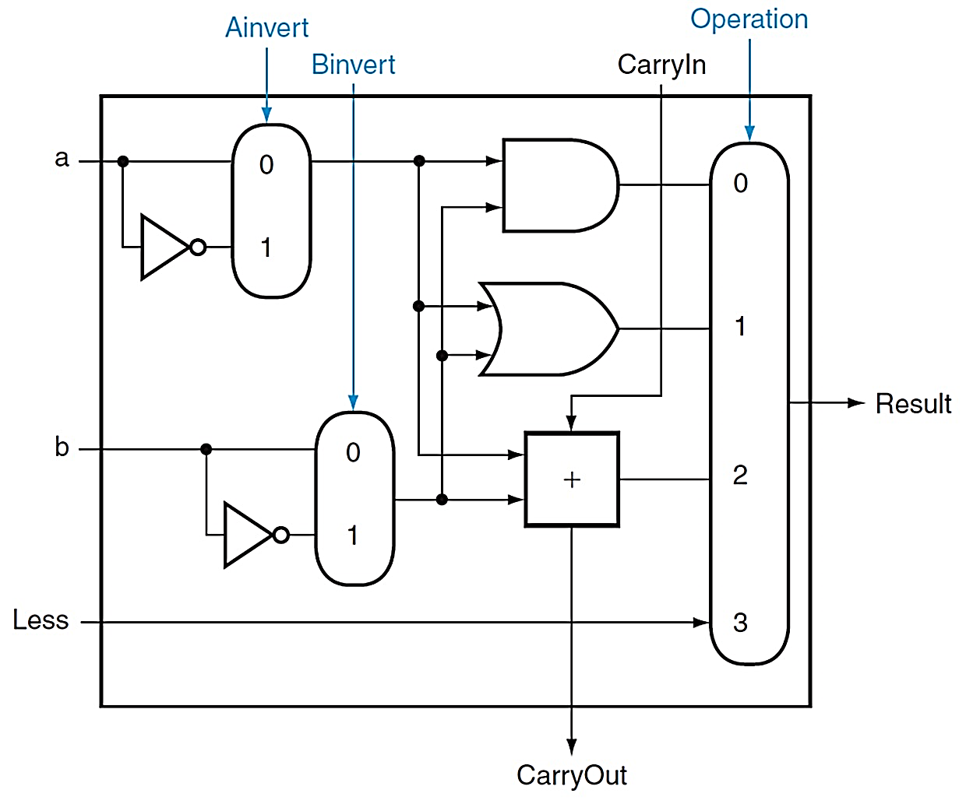
(Simplified) 1-bit ALU
and, or, add, sub, slt
A nor B = ~A and ~B
SLT A,B is computed as
taking the sign bit from
A-B

Slide 12
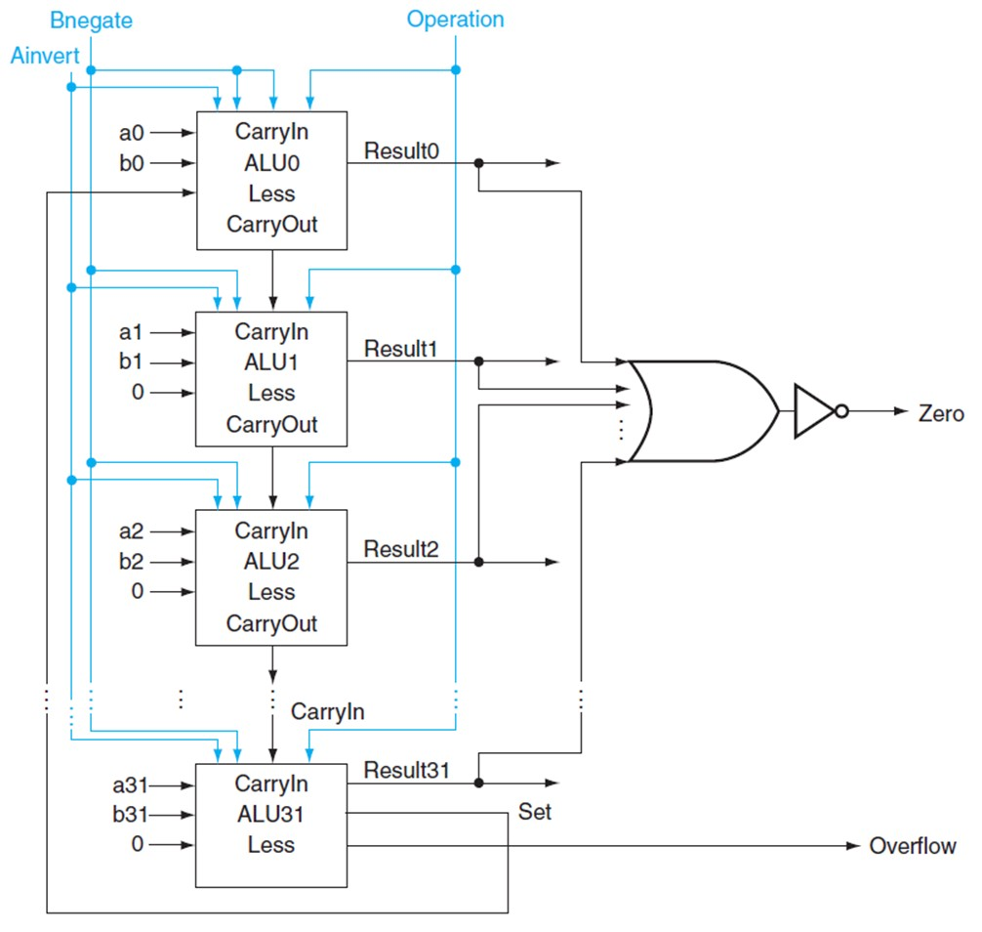
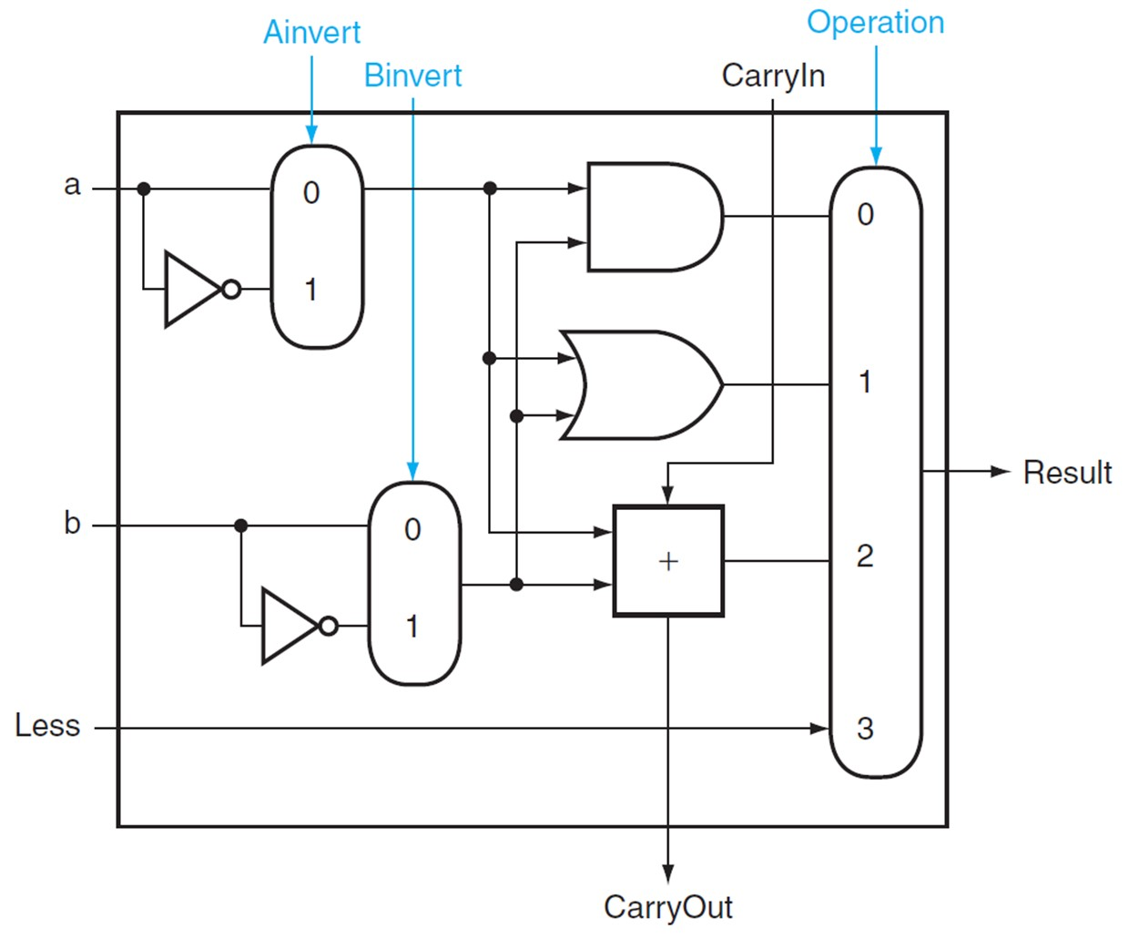
(Simplified) 32-bit ALU
1-bit ALU
Notes:
CLA: Carry Lookahead Adder. Just based on the previous four bits of a and b, I could know what would be the carry from the previous group.

Slide 13
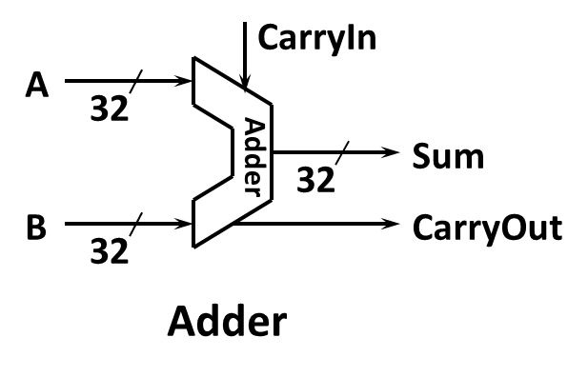
Carry Lookahead Adder
In a ripple-carry adder, the carry bit from each stage must propagate to the next stage before the sum can be calculated. This carry propagation delay can become significant for large binary numbers (e.g. 64b adder), slowing down the overall addition process.
In a ripple-carry adder
$C_{i}$ = ${(A}_{i}$ $∗$ $B_{i}$ ) + ${(A}_{i}$ $∗$ $C_{i−1}$ ) + ${(B}_{i}$ $∗$ $C_{i−1}$ )
In a carry lookahead adder
${ g}_{i}$ = ${(A}_{i}$ $∗$ $B_{i}$ )
${ p}_{i}$ = ${(A}_{i}$ xor $B_{i}$ )
${ C}_{1}$ = $g_{0}$ + ${(p}_{0}$ * $C_{0}$)
${ C}_{2}$ = $g_{1}$ + ${(p}_{1}$ * ${g_{0})+(p_{1}\text{ ∗ }{p_{0}∗C}_{0})}_{}$
${ C}_{3}$ = $g_{2}$ + ${(p}_{2}$ * ${g_{1})+(p_{2}\text{ ∗ }{p_{1}∗g}_{0})+(p_{2}\text{ ∗ }{p_{1}∗p}_{0}∗C_{0})}_{}$
Now, the carry propagation chain disappears

Slide 14
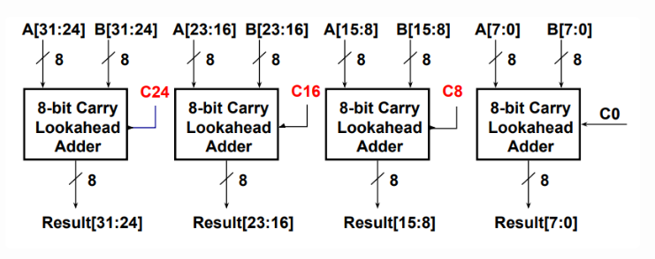
A Practical Carry Lookahead Adder

Slide 15
Multiplication
More complicated than addition
Can be accomplished via shifting and adding
Double precision product is produced
More time and more area are required
0010
× 1011
0010
00100
000000
0010000
00010110
(multiplicand)
(multiplier)
(partial product array)
(product)
Notes:
第一个数叫被乘数 multiplicand，第二个数是乘数multiplier，

Slide 16
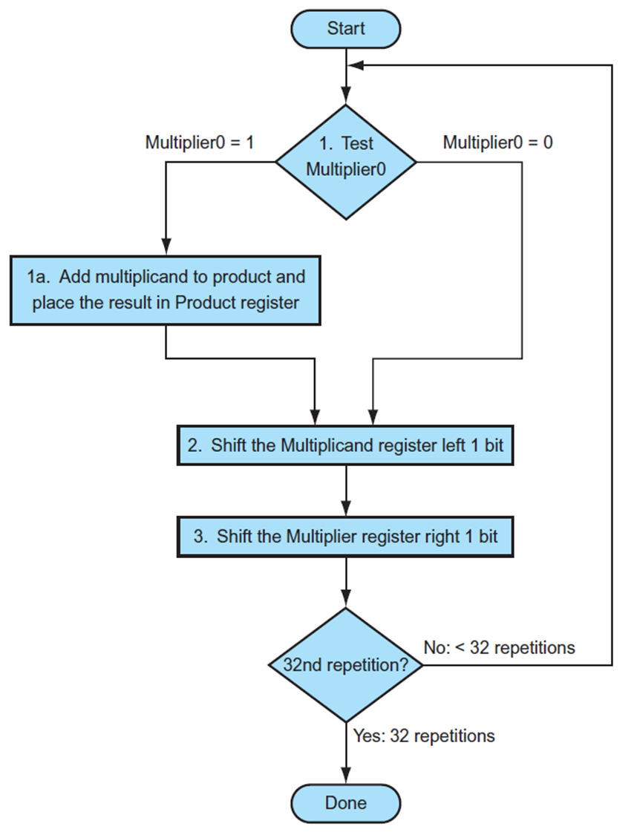
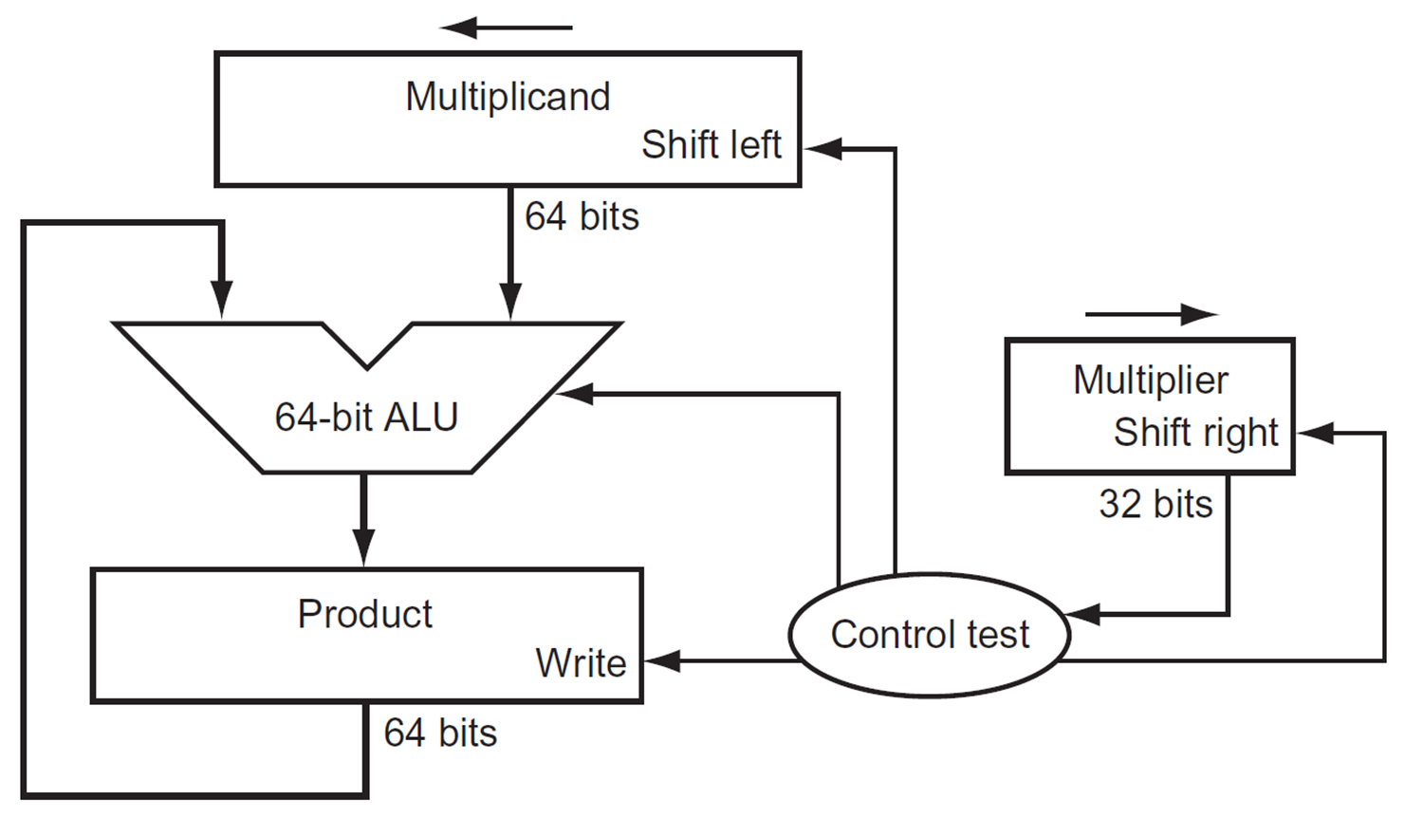
Multiplication Hardware (1st Version)

Slide 17
Signed Multiplication
Convert multiplier and multiplicand to positive numbers.
Remember their original signs.
Multiply as before, leaving the sign out of the calculation
We negate the product only if the original signs disagree.
A×B=(signA⊕signB)×(∣A∣×∣B∣)
On modern computers (after 70’s and 80’s), when 2’s complement was adopted as standards. Signed integer multiplication just works like unsigned multiplication. (If you treat two’s‑complement numbers as unsigned bit patterns and multiply them, the low N bits of the result are correct for signed multiplication)

Slide 18
Shift and Add to replace Multiply
Compilers are clever at replacing multiplication with shifts and adds, especially when dealing with multiplication by constants.
Decompose the constant:
The compiler breaks down the constant into a sum of powers of 2.
For example:
10 = 8 + 2 (2^3 + 2^1)
13 = 8 + 4 + 1 (2^3 + 2^2 + 2^0)
So, x*13 = (x << 3) + (x << 2) + x
Exercise: X*1054 = (2^? + 2^? - 2^?)
So, x*1054 = (x << ?) + (x << ?) +…

Slide 19
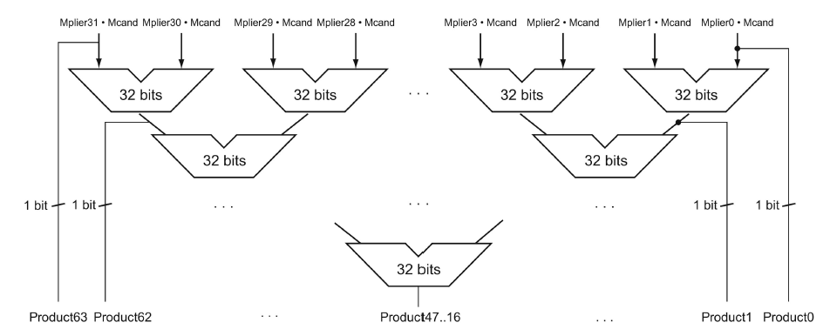
Faster Multiplication
With Moore’s law, we could use more transistors to make the multiplication go faster. Whether the multiplicand should be added at each step can be predetermined by looking at the respective bit in the multiplier. So 31 adders could be used in a pyramid. The delay could be reduced from 31 to 5 or even lower.
Notes:
In computer industry, this is often called the pyramid in a multiplier.

Slide 20
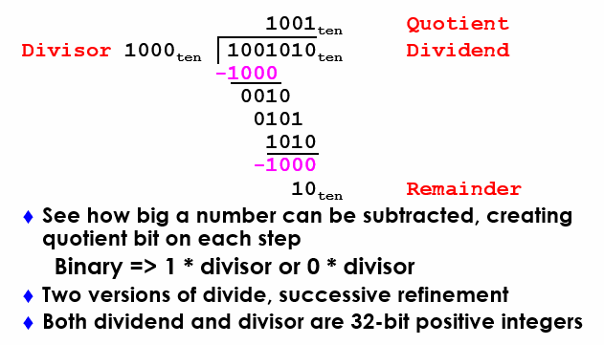
Divide: Paper & Pencil

Slide 21
Divide Hardware - Version 1 (1)
64-bit Divisor register (initialized with 32-bit divisor in left half), 64-bit ALU, 64-bit Remainder register (initialized with 64-bit dividend), 32-bit Quotient register
Divisor
Shift Right
64 bits
Quotient
Shift Left
64-bit ALU
32 bits
Remainder
Write
Control
64 bits

Slide 22
Divide Hardware - Version 1 (2)
0111 / 0010
Quot. Divisor Rem.
0000 00100000 00000111 11100111 00000111 0000 00010000 00000111 11110111 00000111 0000 00001000 00000111 11111111 00000111 0000 00000100 00000111 00000011 0001 00000011 0001 00000010 00000011 00000001 0011 00000001 0011 00000001 00000001
Start: Place Dividend in Remainder
1. Subtract Divisor register from
Remainder register, and place the
result in Remainder register
Remainder ≥ 0
Test Remainder
Remainder < 0
2a. Shift Quotient register to left, setting new rightmost bit to 1
2b. Restore original value by adding Divisor to Remainder, place sum in Remainder, shift Quotient to the left, setting new least significant bit to 0
3. Shift Divisor register right 1 bit
33rd
repetition?
No: < 33 repetitions
Yes: 33 repetitions
Done
Notes:
Q: 0000 D: 0010 0000 R: 0000 0111  = 1110 0000
1: R = R Q: 0000 D: 0010 0000 R: 1110 0111
2b: +D, sl Q, 0 Q: 0000 D: 0010 0000 R: 0000 0111
3: Shr D Q: 0000 D: 0001 0000 R: 0000 0111  = 1111 0000
1: R = R Q: 0000 D: 0001 0000 R: 1111 0111
2b: +D, sl Q, 0 Q: 0000 D: 0001 0000 R: 0000 0111
3: Shr D Q: 0000 D: 0000 1000 R: 0000 0111  = 1111 1000
1: R = R Q: 0000 D: 0000 1000 R: 1111 1111
2b: +D, sl Q, 0 Q: 0000 D: 0000 1000 R: 0000 0111
3: Shr D Q: 0000 D: 0000 0100 R: 0000 0111  = 1111 1100
1: R = R Q: 0000 D: 0000 0100 R: 0000 0011
2a: sl Q, 1 Q: 0001 D: 0000 0100 R: 0000 0011
3: Shr D Q: 0000 D: 0000 0010 R: 0000 0011  = 1111 1110
1: R = R Q: 0000 D: 0000 0010 R: 0000 0001
2a: sl Q, 1 Q: 0011 D: 0000 0010 R: 0000 0001
3: Shr D Q: 0011 D: 0000 0001 R: 0000 0001
Recommend show 2 comp of divisor, show lines for subtract divisor and restore remainder

Slide 23
Signed Division
Dividend = Quotient X Divisor + Remainder
+7 div +2 = +3 , remainder +1
-7 div +2 = -3, remainder -1 ➔ why not quotient -4, remainder +1
Rule: the dividend and the remainder must have the same sign
Division steps:
Remember signs, make positive, complement quotient and remainder if necessary
Let Dividend and Remainder have same sign and negate Quotient if Divisor sign & Dividend sign disagree.

Slide 24
Multiply/Divide by Power of 2
Multiply by power of 2 can use shift left
X * 2 = X << 1, X * 4 = X << 2, …
-X *2 = (-X) << 1, -X *4 = (-X) << 2
How about division?
X div 2 = X >> 1. This works for positive numbers
How about negative number such as -7/2?
Assume 8bit integer, 7 is 00000111 and -7 is 11111001
11111001 >> (SRA) 1 = 1111100 -4, this quotient is wrong, it should be -3
The correct way to use >> for X div N, where X is a negative number, and N is a power of 2, is as follows:
(X+(N−1)) ≫ log2​(N)
For example, -7/2, should use (-7+1) >> 1
-9/4 ?
(-9+3)>> 2
= -2
Notes:
Note that remainder should be the same sign as the dividend.

Slide 25
Backup Slides

Slide 26
Let HW Traps on Overflow
Performance impact
Checking for overflow incurs significant overhead (not HW, but to SW)
Traps are expensive to handle
Overflows are rare cases. Adding checking and trapping overhead slows down everyone.
Exception handling increases the complexity of high-performance implementations (pipelining, out-of-order execution).
Flexibility
Some applications want the wraparound behavior of the unsigned integers
The potential performance impact and added complexity of traps have led to alternative approaches that rely on software or compiler support for overflow detection and handling.
Notes:
C/C++ often leaves overflow as undefined behavior. Leaving the responsibility to programmers.
Some people think overflow rarely happens, can we have the HW to generate a trap? This introduces a challenging issue: precise interrupts
Early days, checking are expensive, so it was undefined behavior. Later this becomes a compatibility requirements.
Java defines overflow as wrapped around.

Slide 27
Overflow Handling in RISC-V
RISC-V shifts the burden of arithmetic exception handling to software. It does not require the hardware to generate traps.
For signed/unsigned integer operations, the responsibility is shifted to software. If the program needs to check for overflows, the compiler should explicitly generate instructions to do so. (e.g., -fsanitize=undefined, or –ftrapv )
For floating point operations, the hardware sets flags (fflags in fcsr) to indicate that the overflow/underflow has occurred. The software must explicitly check the flags if it cares about such exceptions.
Shifting overflow/underflow detection responsibility to software is not new for RISC machines. However, MIPS/ARM/Power ISA still provides instructions to demand the hardware to trap. RISC-V simply does not support such instructions in the core set. (if you really want that, add them to some extensions)

Slide 28
Overflow Handling in RISC-V
RISC-V shifts the burden of arithmetic exception handling to software. It does not require the hardware to generate traps.
For signed/unsigned integer operations, the responsibility is shifted to software. If the program needs to check for overflows, the compiler should explicitly generate instructions to check for overflows.
For floating point operations, the hardware sets a flag to inform that the overflow/underflow has occurred. The software must explicitly check the flags if it cares about such exceptions.
Shifting overflow/underflow detection responsibility to software is not new for RISC machines. However, MIPS/ARM/Power ISA still provides instructions to demand the hardware to trap. RISC-V simply does not support such instructions in the core set. (if you really want that, add them to some extensions)
To support such traps, the hardware must have precise exceptions.
This necessitates that the execution pipeline retires instructions in order.
Such requirements limit the efficiency of pipeline implementation.

Slide 29
Instruction Execution Orders
Example code
1 LD X2, 4(X10)
2 ADD X3, X2, X4
3 DIV X5, X6, X7
4 ADD X8, X5, X9
5 AND X13, X11,X12
6 …
In order execution
Out of order execution
latency
Architecture states are
updated in order:
X2
X3
X5
X8
X13
If any inst generates an
exception, the updated
Arch states are precise.
What if the execution order
is
1 LD, X2, …
3 DIV, X5, …
5 AND X13, ….
AND, instruction 5 would
finish before inst 3.
If inst 3 generates a
Trap (e.g., div by 0),
X13 may be incorrectly updated.
latency

Slide 30
Precise Exception
A precise exception is a type of exception or interrupt that
allows a program to be stopped and then resumed in a
well-defined state.
Think of it like hitting "pause" on a movie—
you can resume from the exact frame where you stopped.
Precise
Clean state
Re-startable
The program can be resumed from the exact instruction that caused
the exception
Consistent execution
It is as if the exception never happened
Precise exception makes out-of-order execution difficult to implement.

