Slide 1
CSC3060 – Computer Systems
Data Representations
Prof. Wei Chung Hsu
School of Data Science
Chinese University of Hong Kong, Shenzhen

Slide 2
2.1 Information Storage
how the content in a block of bytes is interpreted
Byte: A group of 8 bits. It is the smallest "addressable" unit of memory.
Address: A unique numerical identifier that points to a specific location in the computer’s memory.
Virtual address space: The set of all possible addresses is known as the virtual address space
Pointer in C: It is the virtual address of the first byte of some block of storage
Type of a pointer: determines how the content in a block of bytes is interpreted
byte
address
0
1
2
3
n
n+1
Notes:
In C, non-zero is true
This course only require students to do RVI32 machines

Slide 3
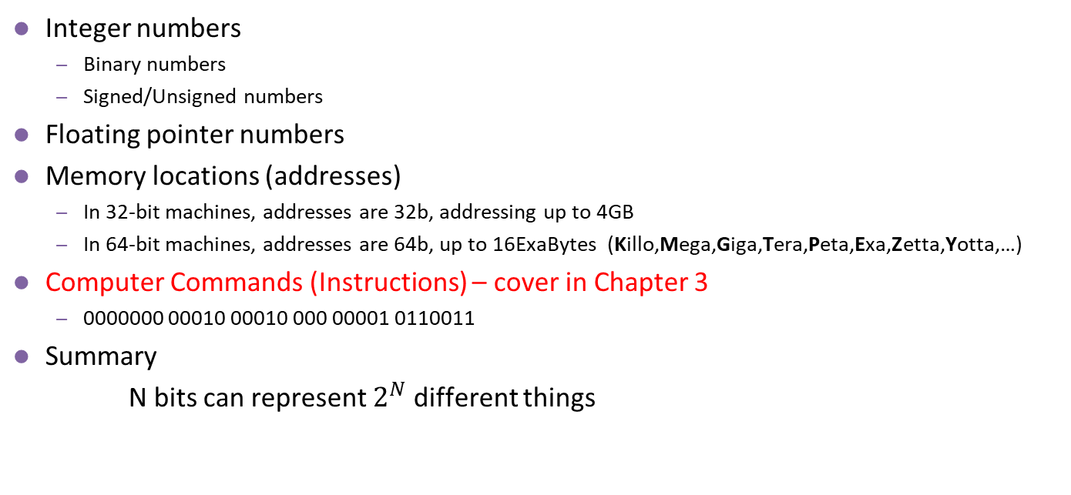
Bits can Represent Any Information
Integer numbers
Binary numbers
Signed/Unsigned numbers
Floating pointer numbers
Memory locations (addresses)
In 32-bit machines, addresses are 32b, addressing up to 4GB
In 64-bit machines, addresses are 64b, up to 16ExaBytes (Killo,Mega,Giga,Tera,Peta,Exa,Zetta,Yotta,…)
Computer Commands (Instructions) – cover in Chapter 3
0000000 00010 00010 000 00001 0110011
Summary
N bits can represent $2^{N}$ different things
Notes:
In C, non-zero is true
This course only require students to do RVI32 machines

Slide 4
Integer Representation: Radix or Base
An ordered set of symbols, called digits, with relations defined for addition, subtraction, multiplication and division
Radix or base of the number system is the total number of digits allowed in the number system
Notes:
Base two only allows 0 and 1 two digits, base 10 allows 0 to 9, 10 digits

Slide 5
Decimal, Binary, Octal and Hexadecimal
System Name | Decimal | Binary | Octal | Hexadecimal
Radix | 10 | 2 | 8 | 16
 | 0 | 0000 | 0 | 0
 | 1 | 0001 | 1 | 1
 | 2 | 0010 | 2 | 2
 | 3 | 0011 | 3 | 3
 | 4 | 0100 | 4 | 4
 | 5 | 0101 | 5 | 5
 | 6 | 0110 | 6 | 6
 | 7 | 0111 | 7 | 7
 | 8 | 1000 | 10 | 8
 | 9 | 1001 | 11 | 9
 | 10 | 1010 | 12 | A
 | 11 | 1011 | 13 | B
 | 12 | 1100 | 14 | C
 | 13 | 1101 | 15 | D
 | 14 | 1110 | 16 | E
 | 15 | 1111 | 17 | F
 | 16 | 10000 | 20 | 10
Notes:
Oct and Hex numbers are easier to read, reducing possible errors.

Slide 6
Number Systems
Decimal numbers
Binary numbers
1’s column
10’s column
100’s column
1000’s column
five
thousands
three
hundreds
seven
tens
four
ones
8’s column
4’s column
2’s column
1’s column
one
eight
one
four
zero
two
one
one
Notes:
10的3次幂： ten to the power of three
乘以： multiply

Slide 7

Number Systems (II)
Octal numbers
Hexadecimal numbers
1’s column
8’s column
64’s column
512’s column
${1234}_{8}=1 x$ $8^{3}+2 x{ 8}^{2}$ $+3 x{ 8}^{1 }$ $+4 x{ 8}^{0 }$= 668
1’s column
16’s column
256’s column
4096’s column
${AB01}_{16}=10 x$ ${16}^{3}+11 x{ 16}^{2}$ $+0 x{ 16}^{1 }$ $+1 x{ 16}^{0 }$= 43777
Notes:
10的3次幂： ten to the power of three
乘以： multiply

Slide 8
Exercise (practice problem 2.1)
Ex : Converting 0x25B9D2 to binary
0b0010 0101 1011 1001 1101 0010
Ex : Converting 1010111001001001 to hexadecimal
1010 1110 0100 1001
A E 4 9
Notes:
36₈=011 110₂
36₁₀=100100₂

Slide 9
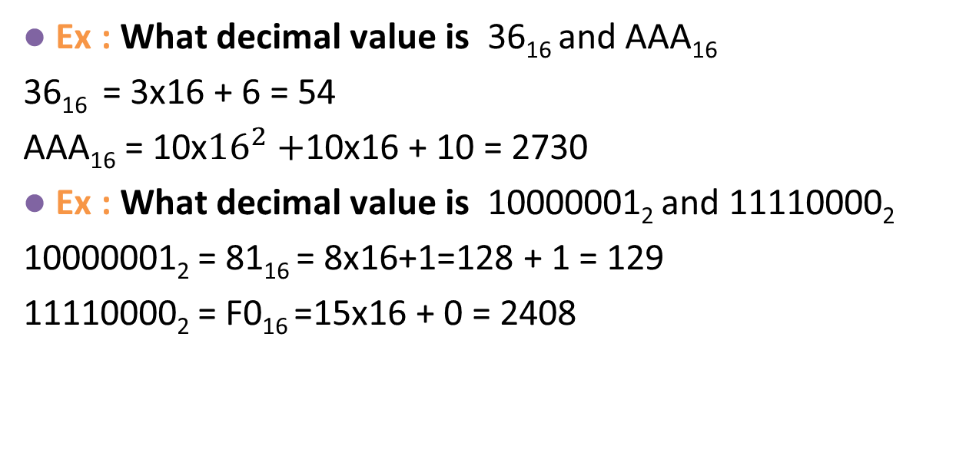
Exercise: conversion to decimal values
Ex : What decimal value is 36₁₆ and AAA₁₆
36₁₆ = 3x16 + 6 = 54
AAA₁₆ = 10x${16}^{2}+$10x16 + 10 = 2730
Ex : What decimal value is 10000001₂ and 11110000₂
10000001₂ = 81₁₆ = 8x16+1=128 + 1 = 129
11110000₂ = F0₁₆ =15x16 + 0 = 2408
Notes:
36₈=011 110₂
36₁₀=100100₂

Slide 10
Converting Decimal to Binary
Binary to decimal conversion:
Convert 10011₂ to decimal
16×1 + 8×0 + 4×0 + 2×1 + 1×1 = 19₁₀
Decimal to binary conversion:
Convert 47₁₀ to binary
32×1 + 16×0 + 8×1 + 4×1 + 2×1 + 1×1 = 101111₂
47 / 2 remainder 1
23 / 2 remainder 1
11 / 2 remainder 1
5 / 2 remainder 1
2 / 2 remainder 0
1 / 2 remainder 1
Decimal to binary conversion
Answer is 101111
Decimal to Octal
47 / 8 remainder 7
5 / 8 remainder 5
57₈
= 101 111
Decimal to Hexadecimal
47 / 16 remainder 15
2 / 16 remainder 2
2F₁₆
= 10 1111
If divide by 2 is too slow
try going thru Octal or
Hexadecimal indirectly.
Notes:
Address range of 32b? 1-4GB

Slide 11
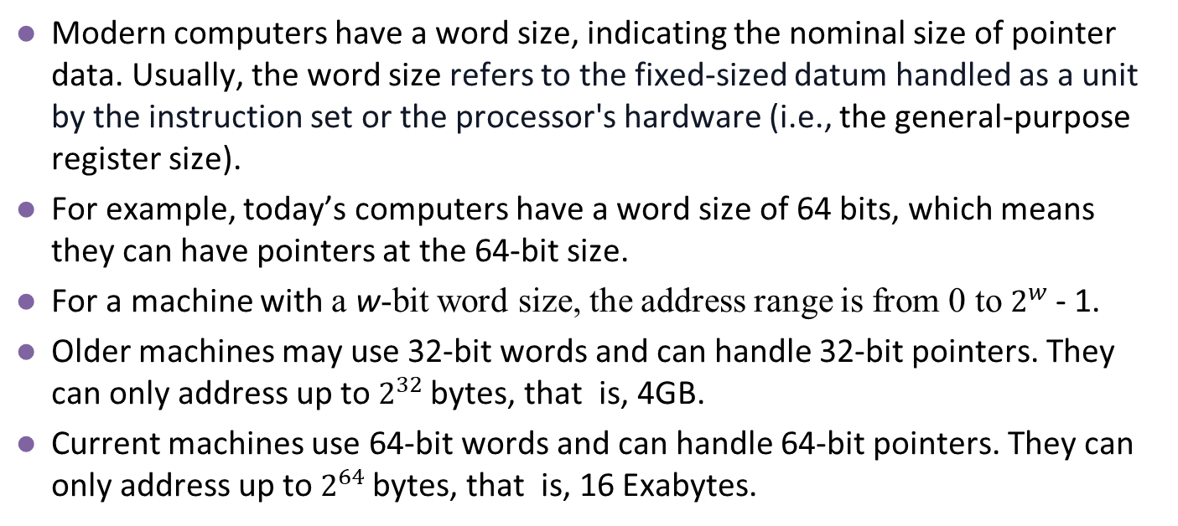
2.1.2 Data Sizes and Pointer Sizes
Modern computers have a word size, indicating the nominal size of pointer data. Usually, the word size refers to the fixed-sized datum handled as a unit by the instruction set or the processor's hardware (i.e., the general-purpose register size).
For example, today’s computers have a word size of 64 bits, which means they can have pointers at the 64-bit size.
For a machine with a w-bit word size, the address range is from 0 to $2^{w}$- 1.
Older machines may use 32-bit words and can handle 32-bit pointers. They can only address up to $2^{32}$bytes, that is, 4GB.
Current machines use 64-bit words and can handle 64-bit pointers. They can only address up to $2^{64}$bytes, that is, 16 Exabytes.

Slide 12
32 bit and 64 bit Machines and Programs
Word Size | Common Architecture | Well-known Examples
32 bit | Intel x86 (IA-32), ARMv7, RV32 (RISC-V) | Windows XP PCs, iPhone 4, PS1
64 bit | Intel x86-64, IA-64, ARMv8, RV64 (RISC-V) | Modern MacBooks, iPhone5S, PS5, AMD Ryzen PCs
Most 64-bit machines can also run programs compiled for use on 32-bit machines, a form of backward compatibility.
linux> gcc –m32 prog.c
then this program will run correctly on either a 32-bit or a 64-bit machine.
linux> gcc –m64 prog.c
this program will only run on a 64-bit machine.
We will therefore refer to programs as being either “32-bit programs” or “64-bit programs,”

Slide 13
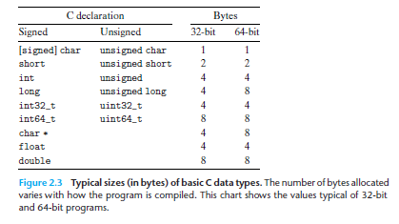
Sizes of Data Types in C/C++
Data sizes are mostly identical between 32-bit and 64-bit machines. However, the pointer (char *) and int/long size could be different.
On 32-bit machines, int is 4 bytes, on 64-bit machines, int may be 4 bytes or 8 bytes.
In late 90’s, when Unix vendors were moving from 32-bit to 64-bit, two models were in fierce fight: ILP64 and LP64
ILP64: int, long, and pointers are all 64 bits, LP64: int 4 bytes, long and pointers are 64 bits

Slide 14
LP64 won against ILP64.
Arguments for ILP64
In 32-bit machines, integers and pointers have the same width, which allows programmers to store pointers in integer variables. If integers occupy 4 bytes and pointers require 8 bytes, porting old programs would be extremely challenging. Therefore, it is better to maintain the same size for both integers and pointers to avoid complications during porting.
Arguments for LP64
If integers are 8 bytes, the storage requirement doubles. For a large array of integers, this leads to a significant increase in memory usage, potentially resulting in more cache misses and requiring higher memory bandwidth. In the late 90’s, both memory and the bandwidth needed for memory operations were quite expensive.
Initially, I was for ILP64, because when there is a tradeoff between performance and software portability, we always favor software portability. However, LP64 has another very strong argument: data portability – if some old data files were integers, can your ILP64 programs read them? Data files are more difficult to fix than source code. So, eventually, LP64 won.

Slide 15
2.1.3 Addressing and Byte Ordering
A multi-byte object is stored as a contiguous sequence of bytes, with the address of the object given by the smallest address of the bytes used.
Example:
A variable X of type int has address 0x100; Then the 4 bytes of X would be stored in memory
locations 0x100, 0x101, 0x102, and 0x103
Suppose the hexadecimal value of this integer X is 0x01234567
00000001 00100011 01000101 01100111
Most Significant
Least Significant
0x100
0x101
0x102
0x103
……
01
23
45
67
……
Big Endian
0x100
0x101
0x102
0x103
Little Endian
……
67
45
23
01
……

Slide 16
Big Endian vs. Little Endian (I)
Big-endian means most significant byte first, and Little-endian means least significant byte first.
Why do they matter?
Network Communication (Data Transmission)
If a Little-endian machine sends the integer 0x12345678 to a Big-endian machine without translation, the receiver will read it as 0x78563412
Binary File Portability
When a binary file is opened on a different endian machine, the data will be interpreted incorrectly:
If you write as an integer (or fp) and read as an integer (fp), it will be OK. But what if you read as a sequence of bytes?
Type Casting and Pointer Aliasing
Byte order matters when you access the same memory location using pointers of different sizes
Bit fields in C/C++
Assembly code reading

Slide 17
Big Endian vs. Little Endian (II)
In the late 1980s and throughout the 1990s, the "Endianness War" was essentially a battle between the PC/Consumer market and the High-end Workstation/Server market.
Big Endian camp
IBM: IBM’s Mainframes, CRAY, SGI, MIPS, HP, CISCO
Motorola (68000 Series), Sun Microsystems (SPARC)
Arguments: if you look at a memory dump of value 0x12345678, it is 12 34 56 78, not 78 56 34 12
Little Endian camp
Intel, DEC, AMD
Argument: If you store 0x12345678 as a sequence of bytes, the least significant byte should be at the low address, and the most significant byte should be at the high address.
Today, most machines (Intel x86, ARM, RISC-V) are either little-endian or bi-endian (both big and little endian).

Slide 18
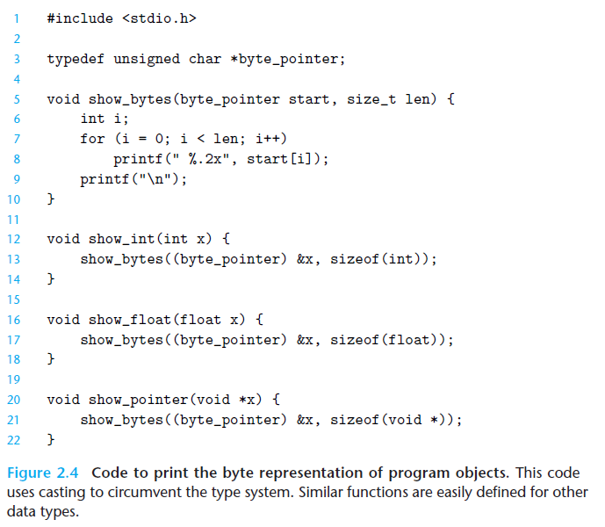
The show_bytes() routine
The main function of Show_bytes() is to expose the physical reality of the machine; it proves that everything in memory is just a sequence of bytes.
The difference between int and float is not what they are, but how the processor interprets them.
You may also see the byte ordering by running the code on big-endian and little-endian machines. (It is not easy since almost all machines today are little-endian)
2 digit of
Hexadecimal format

Slide 19
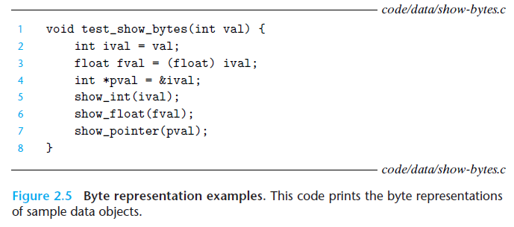
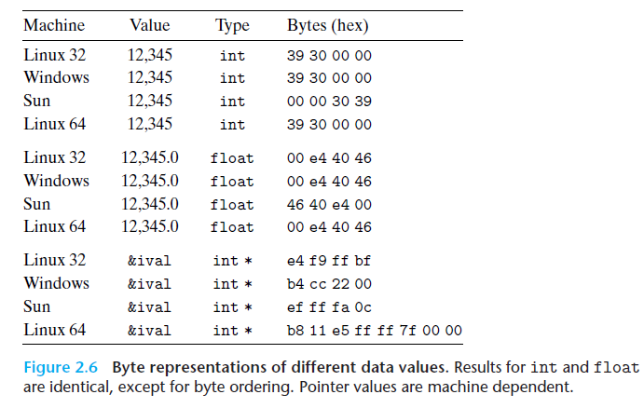
The show_bytes() Routine Exercise
Argument val is 12345

Slide 20
2.1.4 Representing Strings
A string in C is encoded by an array of characters terminated by the null (having value 0) character.
Each character is represented by some standard encoding, with the most common being ASCII.
If we run our routine show_bytes with arguments "12345" and 6 (to include the terminating character), we get the result 31 32 33 34 35 00.
This same result would be obtained on any system using ASCII as its
character code, independent of the byte ordering and word size
conventions.
As a consequence, text data are more platform-independent than binary data.

Slide 21
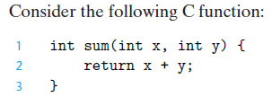
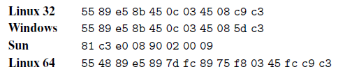
2.1.5 Representing Programs
The instruction codings vary significantly; different machine types utilize distinct instructions and encodings.
Binary code is seldom portable across different combinations of machine and operating system: this is called ABI incompatible.
ABI means Application Binary Interface. It is based on three key components: the computer ISA, the OS, and the calling convention.
For example, the executable of x86/Windows does not run on ARM/Linux

Slide 22
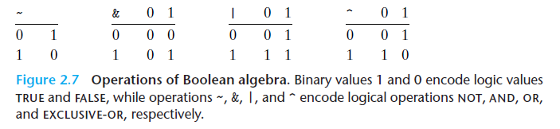
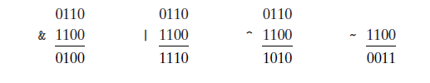
2.1.6 Boolean Algebra
Boolean algebra plays a central role in the design and analysis of digital systems.
We extend the four Boolean operations to operate on bit vectors, strings of zeros and ones of some fixed length w. The following example shows w=4, for bit vectors 0110 and 1100.

Slide 23
2.1.7 Bit-Level Operations in C
C/C++ supports bitwise Boolean operations. These operations can be applied to
any “integral” data type, such as char, short, int, and long. Here are some examples of expression evaluation for data type char:
C Expression | Binary Expression | Binary Result | Hexadecimal Result
~0x41 | ~[0100 0001] | [1011 1110] | 0xBE
~0x00 | ~[0000 0000] | [1111 1111] | 0xFF
0x69 & 0x55 | [0110 1001]&[0101 0101] | [0100 0001] | 0x41
0x69 | 0x55 | [0110 1001] | [0101 0101] | [0111 1101] | 0x7D

Slide 24

Exercise (practice problem 2.10)
Assume a is a bit vector. a ^ a = 0. We could swap the content of two variables with the following inplace_swap() routine.
Swap without using
a temporary
Steps | *X | *Y
Initially | A | B
Step 1 | A | A^B
Step 2 | A^(A^B)= (A^A)^B = B | A^B
Step 3 | B | B^(A^B)=(B^B)^A= A
Notes:
36₈=011 110₂
36₁₀=100100₂

Slide 25
2.1.8 Logical Operations in C
C provides a set of logical operators ||, &&, and !, which correspond to the or, and, and not operations of logic.
The logical operations treat any nonzero argument as true and argument 0 as false.
! is a logic NOT operation, ~ is a bitwise NOT operation.
&& and || are called short-circuit operations –
For &&, if the first argument is not true, the second argument does not need evaluation.
For ||, if the first argument is true, the second argument does not need evaluation.
In C, the expression A && N/A will not see div-by-0 errors
Expression if (p && p->next) will not encounter a NULL ref
Expression | Result
! 0x41 | 0x00
! 0x00 | 0x01
!! 0x41 | 0x01
0x69 && 0x55 | 0x01
0x69 !! 0x55 | 0x01

Slide 26
2.1.9 Tricky Bug in Common C Code
It has been quite often that we wanted to write
if (A && B)
but accidentally missed one “&” and the above statement becomes
if (A & B)
when A = 2 (10) and B = 1 (01)
A&&B is true, but
A&B is false

Slide 27
2.1.9 Shift Operations in C
C provides a set of shift operations for shifting bit patterns to the left and to
the right.
Left shift: x << k
x is shifted k bits to the left, dropping off the k most significant bits and filling the right end with k zeros.
[01100011] << 4 = [00110000]
Right Shift: x >> k
Logic shift: x is shifted k bits to the right, dropping off the k least significant bits and filling the left end with k zeros
Arithmetic shift: x is shifted k bits to the right, dropping off the k least significant bits and filling the left end with k repetitions of the most significant bit

Slide 28
2.1.9 Right Shift Examples
Right shift has two versions: Logic shift and Arithmetic shift
Example:
Logic shift is used for unsigned integers, and arithmetic shift is used for signed integers.
Each machine has two different types of right shift instructions. SRL and SRA
The C compiler selects the correct version of the right shift based on the data types.
Operation | Value 1 | Value 2
Argument X | [01100011] | [10010101]
X >> 4 (logical) | [00000110] | [00001001]
X >> 4 (arithmetic) | [00000110] | [11111001]

Slide 29
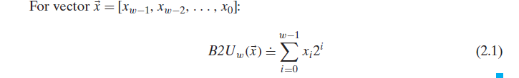
2.2 Integer Representation
Two different ways bits can be used to encode integers— one that can only represent nonnegative numbers (unsigned), and one that can represent
negative, zero, and positive numbers (signed).
We also investigate the effect of expanding or shrinking an encoded integer
to fit a representation with a different length (e.g., from a byte to a word or vice
versa)
Unsigned integer

Slide 30
Signed Number Representations
Signed magnitude: a simple representation for an integer with two as base. The first bit is a sign bit.
0 001 -> positive number, +1
1 001 -> negative number, -1
Inverse form (1’s Complement): same as the signed magnitude for a positive number; for a negative number, keep the sign the same and invert the rest
0001 → positive +1
1110 → negative -1
2’s Complement: same as the true form for a positive number; for a negative number, keep the sign the same, invert the rest, and add 1
2's Complement is the widely adopted standard for integer representation.

Slide 31
Signed Numbers
2's Complement: same as the true form for positive numbers; for negative numbers, keep the sign the same, invert the rest, and add 1
2:
0000 0010
0000 0010
0000 0010
-2:
1000 0010
1111 1101
1111 1110
Signed magnitude
inverse
2's complement

Slide 32
Example of Addition/Subtraction
Addition
3+2 0011 + 0010
=5 =0101
Subtraction
3 – 2 0011 + 1110 (inverse of 0010, then +1)
= 1 = 1 0001 (overflowed bit discarded)
Notes:
In 2’s complement, the carry out is not an overflow. Overflow is only considered when the two signs are equal.

Slide 33
Why not 1‘s complement
Inverse form (1’s complement) was not used widely
They have two zero’s 000000…..000 and 111111…111, +0 and -0
They have end-round carry out issues
For example: 5 -3
1’s complement 2’s complement
5 is 0101 5 is 0101
-3 is the inverse of 0011 -3 is 1101
which is 1100
0101 + 1100 = 1 0001 0101+1101 = 1 0010
The end carry-out bit needs to add back the result is 2
to the LSB
Notes:
In 2’s complement, the carry out is not an overflow. Overflow is only considered when the two signs are equal.

Slide 34
Exercise
Ex 3: For a n-bit 2’s complement signed binary numeral system, what’s the largest positive number and the smallest negative number?
Ex 4: For a n-bit 2’s complement signed binary numeral system, what is decimal value of 1111 1111 1111 1010 ?
Notes:
_{最大的数是2的n次方-1，最小的数是-2的n次方}

Slide 35
Exercise
Ex 3: For a n-bit 2’s complement signed binary numeral system, what’s the largest positive number and the smallest negative number?
Ex 4: For a n-bit 2’s complement signed binary numeral system, what is decimal value of 1111 1111 1111 1010 ?
2^{n-1}-1 = 01111111…..1111
2^{n-1}-1, -2^{n-1}
-2^{n-1} = 10000000……0000
-6
Notes:
_{最大的数是2的n次方-1，最小的数是-2的n次方}

Slide 36
Sign Extension
Sign extension is a method to increase the number of bits of a binary number while preserving its sign (positive or negative) and value. When extending the number to a larger bit width, the sign bit is replicated in all the new higher-order bits.
Example:
C allows 8b, 16b, 32b, 64b singed integers stored in memory.
The registers are 32b/64b wide, respectively.
So when moving a 8b number to a register, sign extension must be applied.
Assuming the number is +4 : 00000100
When moving to a 32b register, the sign bit, 0, is replicated 24 times 000000…… 00000100
2) Assuming the number is -4 : 11111100
When moving to a 32b register, the sign bit, 1, is replicated 24 times 111111…… 11111100
Without sign extension, the value moved to the register would be incorrect
It might be either 0000000……11111100 or 10000000 …. 1111110
Load instructions typically have signed/unsigned versions. Signed loads require sign extensions.
Notes:
_{最大的数是2的n次方-1，最小的数是-2的n次方}

Slide 37
Right Shift of Signed Integer
Left Shift is straight forward
Example
5 << 2 00000101 << 2 00010100 → 20
-5 << 2 11111011 << 2 11101100 → -20
How about right shift?
5 >> 2 00000101 >> 2 00000001
-5 >> 2 11111011 >> 2 00111110 ?? This is incorrect!
So right shift has two versions: Logical shift and Arithmetic shift
Logical shift filled with 0
Arithmetic shift filled with the sign bit.
Notes:
_{最大的数是2的n次方-1，最小的数是-2的n次方}

