Slide 1
CSC3060 – Computer Systems FP Numbers and Computation
Prof. Wei Chung Hsu
School of Data Science
Chinese University of Hong Kong, Shenzhen

Slide 2
2.4 Floating-Point Numbers
Representation for non-integral (real) numbers
Include very small and very large numbers
Like scientific notation (i.e. single digit to the left of the decimal point)
–2.34 × 10⁵⁶
+0.002 × 10^{–4}
In binary, normalized numbers are represented as
±1.xxxxxxx₂ × 2^{yyyy}
Types float and double in C
Int32: max = 4 × 10^9
int64: max ≈ 9 × 10^18
float64: max ≈ 1.8 × 10^308
Example of very large numbers
Number of atoms
Diameter of Milky Way / Universe
Atomic or quantum events
Energy of a supernova
….
(normalized: has no leading zeros)
(not normalized) ➔ normalized to 2.0 X 10^{–7}
Fractional numbers
½, 3.14159, 0.001
1.0e-9
Notes:
Real numbers as opposed to “imaginary numbers”
小数点左边只有一位非0数字的，叫做normalized number. 2.0x10^{–7} = 0.002x10^{–4}
Scientific notation allows the decimal point to float. The Exponent value determines the decimal point.

Slide 3
2.4 Floating-Point Numbers
Representation for non-integral (real) numbers
Include very small and very large numbers
Like scientific notation (i.e. single digit to the left of the decimal point)
–2.34 × 10⁵⁶
+0.002 × 10^{–4}
In binary, normalized numbers are represented as
±1.xxxxxxx₂ × 2^{yyyy}
Types float and double in C
Why normalization?
Unique representation
Maximize precision
Standards
(normalized: has no leading zeros)
(not normalized) ➔ normalized to 2.0 X 10^{–7}
0.0001₂ x 2¹⁰
Left shift ➔ decrement exp
Right shift ➔ increment exp
1.0₂ x 2⁶
Notes:
Real numbers as opposed to “imaginary numbers”
小数点左边只有一位非0数字的，叫做normalized number. 2.0x10^{–7} = 0.002x10^{–4}
Scientific notation allows the decimal point to float. The Exponent value determines the decimal point.

Slide 4
Number Systems
Decimal numbers
Binary numbers
1’s column
10’s column
100’s column
1000’s column
five
thousands
three
hundreds
seven
tens
four
ones
1101.1011
8’s column
4’s column
2’s column
1’s column
one
eight
one
four
zero
two
one
one
Notes:
10的3次幂： ten to the power of three
乘以： multiply

Slide 5
FP to Decimal conversion
Convert 1.1011 to decimal
1 x 2⁰ + 1 x 2⁻¹ + 0 x 2⁻² + 1 x 2⁻³ + 1 x 2⁻⁴
^{= 1.6875}
Convert 0.5 to binary
0.1
= 1.0 x 2^{-1 (normalized)}
Convert 0.7 to binary
0.1011001….
Getting close to 0.7 (0.6953125..)
How about
0.11111
1.000001
0.11111
= 31/32
1.000001
= 1+1/64
0.7 x 2 | 1.4 | 1
0.4 x 2 | 0.8 | 0
0.8 x 2 | 1.6 | 1
0.6 x 2 | 1.2 | 1
0.2 x 2 | 0.4 | 0
0.4 x 2 | 0.8 | 0
0.8 x 2 | 1.6 | 1

Slide 6
Floating-Point Standard
±1.xxxxxxx₂ × 2^{yyyy}
Defined by the IEEE 754-1985 standard.
Developed to address inconsistencies in data representation and manipulation.
Portability issues arise for scientific code and data.
Now nearly universally adopted.
Two main representations exist:
Single precision (32-bit).
Double precision (64-bit).

Slide 7
IEEE Floating-Point Format
±1.xxxxxxx₂ × 2^{yyyy}
Hidden 1
1 bit
8 bits
23 bits
s
exponent
fraction/mantissa
Single-Precision
Biased exponent
x = (−1)^{s} × (1+fraction) × 2^{(exponent−127)}
exponent | fraction | Value represented
00000000 | 0 | 0
00000000 | nonzero | denormalized
1111 1111 | 0 | ±∞
1111 1111 | non-zero | NaN
For denormalized numbers,
there is no hidden 1.
Special values
Double-Precision
1 bit
11 bits
52 bits
s
exponent
fraction/mantissa
x = (−1)^{s} × (1+fraction) × 2^{(exponent−1023)}
Notes:
IEEE 754 uses a bias of 127 for single precision, double precision的bias是1023

Slide 8
IEEE Single Precision Floating-Point Numbers
1 bit
8 bits
23 bits
s
exponent
fraction/mantissa
Single-Precision
x = (−1)^{s} × (1+fraction) × 2^{(exponent−127)}
(1+fraction) is called the significand
The largest SP number is (1+0.111111…) x 2⁽²⁵⁴⁻¹²⁷⁾
which is 2¹²⁷×(2−ϵ) ~ 3.4028235 × 10³⁸ The bit pattern is 0 11111110 11111111111111111111111
The smallest SP number (normalized) is (1+0.00000…) x 2⁽¹⁻¹²⁷⁾
which is 2⁻¹²⁶ The bit pattern is 0 00000001 00000000000000000000000
However, smaller values can be represented using denormalized numbers, where the exponent is 0, and the leading bit of the mantissa is no longer assumed to be 1,
so the smallest number would be 2⁻¹⁴⁹
Notes:
IEEE 754 uses a bias of 127 for single precision, double precision的bias是1023

Slide 9
Exponents in Biased Form
The biased representation simplifies comparisons. We can sort floating-point numbers like integers. A number with a larger exponent will be greater than a number with a smaller exponent (i.e. just call an integer sort routine to sort a group of floating point numbers)
If the exponent is represented in 2’s complement numbers, then a comparison of the exponents must be separated out, not as part of an integer number. Since if treated as part of an integer number, the exponents will be compared like unsigned numbers.
Notes:
Real numbers as opposed to “imaginary numbers”
小数点左边只有一位非0数字的，叫做normalized number. 2.0x10^{–7} = 0.002x10^{–4}
Scientific notation allows the decimal point to float. The Exponent value determines the decimal point.

Slide 10
Denormalized Numbers
For denormalized numbers, the hidden one is going away
x = (−1)^{s} × (0+fraction) × 2⁻¹²⁶
Always -126
x = (−1)^{s} × (0+fraction) × 2⁽⁰⁻¹²⁷⁾
WRONG!
Notes:
Real numbers as opposed to “imaginary numbers”
小数点左边只有一位非0数字的，叫做normalized number. 2.0x10^{–7} = 0.002x10^{–4}
Scientific notation allows the decimal point to float. The Exponent value determines the decimal point.

Slide 11
Why not Fixed-Point Numbers
The largest SP number is ~ 3.4028235 × 10³⁸ The bit pattern is 0 11111110 11111111111111111111111
The smallest SP number (normalized) is 2⁻¹²⁶ The bit pattern is 0 00000001 00000000000000000000000
Denormalized numbers, where the exponent is 0, and the leading bit of the mantissa is no longer assumed to be 1, the smallest denorm is 2⁻¹⁴⁹
The range of real numbers we can represent in floating-point numbers is
10³⁸ to 10⁻³⁸
What if we use a fixed-point representation:
xxxxx.yyyyy where the binary point is fixed.
Assume 32-bit numbers are divided into two parts: the integer part (xxxxx) and the fraction part yyyyy. Each takes 16 bits. What range can this number system cover?

Slide 12
Why not Fixed-Point Numbers
The largest SP number is ~ 3.4028235 × 10³⁸ The bit pattern is 0 11111110 11111111111111111111111
The smallest SP number (normalized) is 2⁻¹²⁶ The bit pattern is 0 00000001 00000000000000000000000
denormalized numbers, where the exponent is 0, and the leading bit of the mantissa is no longer assumed to be 1, the smallest denorm would be 2⁻¹⁴⁹
The range of real numbers we can represent in floating point numbers is
10³⁸ to 10⁻³⁸
What if we use a fixed point representation:
xxxxx.yyyyy where the binary point is fixed.
Assume 32 bit are divided into two parts: the integer part (xxxxx) and the fraction part yyyyy. Each takes 16 bits. What range can this number system cover?
~2¹⁵ to ~2⁻¹⁶
~10⁵ to 10⁻⁵
Floating point number system can cover a much more extensive range!!
~10³⁸ to 10⁻³⁸
Notes:
Real numbers as opposed to “imaginary numbers”
小数点左边只有一位非0数字的，叫做normalized number. 2.0x10^{–7} = 0.002x10^{–4}
Scientific notation allows the decimal point to float. The Exponent value determines the decimal point.

Slide 13
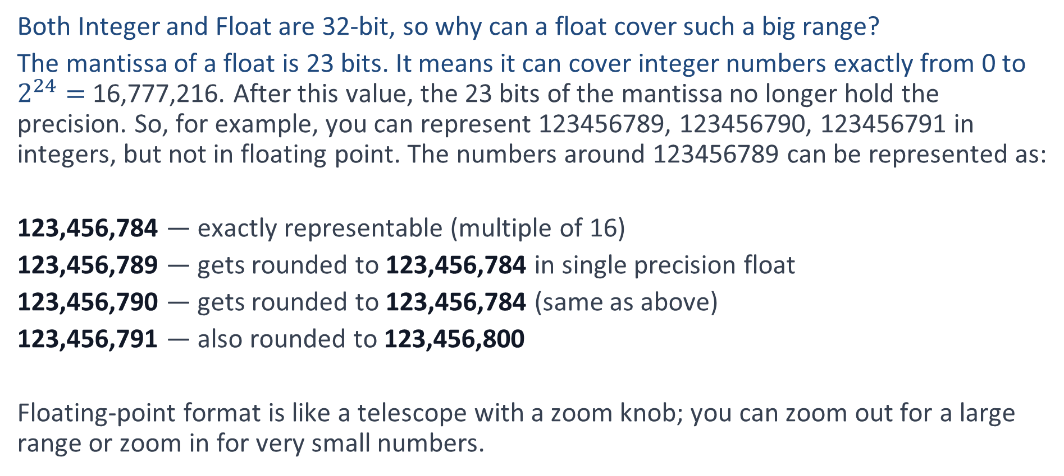
Why does Float cover a Large Range
Both Integer and Float are 32-bit, so why can a float cover such a big range?
The mantissa of a float is 23 bits. It means it can cover integer numbers exactly from 0 to $2^{24}=$16,777,216. After this value, the 23 bits of the mantissa no longer hold the precision. So, for example, you can represent 123456789, 123456790, 123456791 in integers, but not in floating point. The numbers around 123456789 can be represented as:
123,456,784 — exactly representable (multiple of 16)
123,456,789 — gets rounded to 123,456,784 in single precision float
123,456,790 — gets rounded to 123,456,784 (same as above)
123,456,791 — also rounded to 123,456,800
Floating-point format is like a telescope with a zoom knob; you can zoom out for a large range or zoom in for very small numbers.

Slide 14

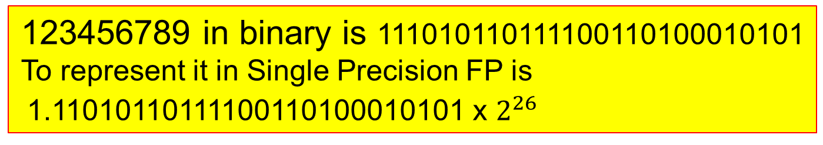
Why does Float cover a Large Range
123456789 in binary is 111010110111100110100010101
To represent it in Single Precision FP is
1.11010110111100110100010101 x $2^{26}$
Both Integer and Float are 32-bit, so why can a float cover such a big range?
The mantissa of a float is 23 bits. It means it can cover integer numbers exactly from 0 to $2^{24}=$16,777,216. After this value, the 23 bits of the mantissa no longer hold the precision. So, for example, you can represent 123456789, 123456790, 123456791 in integers, but not in floating point. The numbers around 123456789 can be represented as:
123,456,784 — exactly representable (multiple of 16)
123,456,789 — gets rounded to 123,456,784 in single precision float
123,456,790 — gets rounded to 123,456,784 (same as above)
123,456,791 — also rounded to 123,456,800
Floating-point format is like a telescope with a zoom knob; you can zoom out for a large range or zoom in for very small numbers.
But the fraction part has only 23 bits
1.11010110111100110100010101 x $2^{26}$
11010110111100110100010 101
101 has no room to be kept
It must be rounded to 1 in the LSB
So the final representation is
1 10011001 11010110111100110100011
To cover a broader range, you need to sacrifice some precision.

Slide 15
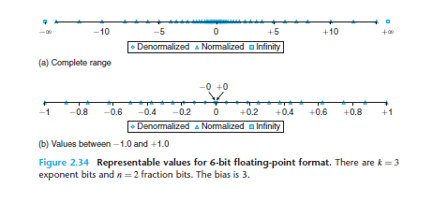
2.4.3 Example Numbers
S
e
e
e
f
f
64 patterns, 32 positive, 32 negative
Positive numbers, 4 denormalized
24 normalized, 4 for inf and NaN
1 is 0 011 00
-1 is 1 011 00
How many bit patterns between 1 and -1?
24 bit-patterns
0010xx 1010xx xx means 00 01 10 11
0001xx 1001xx
0000xx 1000xx
6-bit FP format

Slide 16
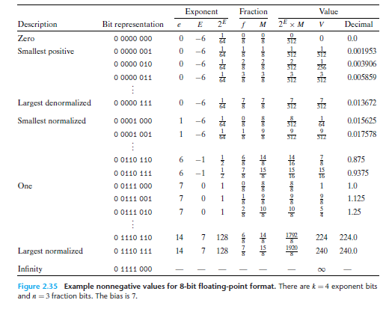

Figure 2.35 Bit Patterns from 0 to $∞$
Denormalized values
Normalized values
8-bit FP format

Slide 17
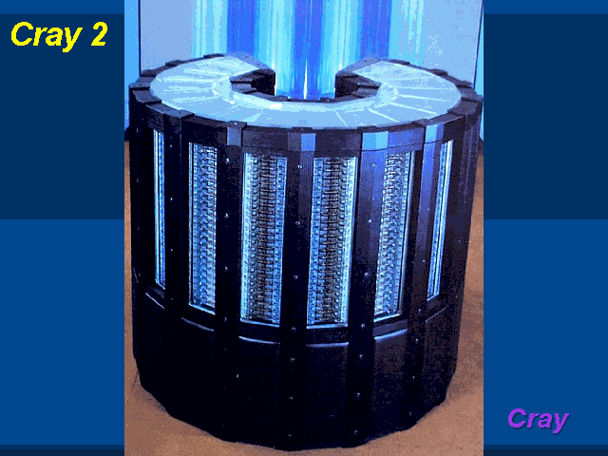
Traditional Supercomputers Are FP Machines
Notes:
Binary: [0][100 0000 1][100 0000 0000 0000 0000 0000]
Sign: +
Exponent: 129 – 127 = +2
Mantissa: 0b1.1
x = +0b1.1 x 2^(2) = +0b110 = +6

Slide 18
Exercise 1
What is the IEEE single precision number 0x40C00000 representing in decimal?
0x40C00000 = 0100 0000 1100 0000 0000 0000 0000 0000
x = (−1)^{s} × (1+fraction) × 2^{(exponent−127)}
0x40C00000 = 0 100 0000 1 100 0000 0000 0000 0000 0000
= (−1)⁰ × (1+0.100…000) × 2⁽¹²⁹⁻¹²⁷⁾
= 1.100…000 × 2²
= 1102
= 6
Notes:
Binary: [0][100 0000 1][100 0000 0000 0000 0000 0000]
Sign: +
Exponent: 129 – 127 = +2
Mantissa: 0b1.1
x = +0b1.1 x 2^(2) = +0b110 = +6

Slide 19
Exercise 2
How to represent –0.5 in IEEE single precision binary floating-point format?
–0.5 = (−1)¹ × 0.5 (decimal)
= (−1)¹ × 1/2 (decimal)
= (−1)¹ × 1.0 × 2⁻¹ (binary)
x = (−1)^{s} × (1+fraction) × 2^{(exponent−127)}
1 011 1111 0 000 0000 0000 0000 0000 0000
Notes:
0.5 = 0b0.1 = 0b1 x 2^(-1)
Exponent: (-1)+127 = 126 = 0b01111110
Sign = 1
Mantissa: 0000 … 0000
Answer:
1 01111110 000 0000 0000 0000 0000 0000

Slide 20
Exercise 3
How to represent 1/3 in IEEE single precision binary floating-point format?
Notes:
0.5 = 0b0.1 = 0b1 x 2^(-1)
Exponent: (-1)+127 = 126 = 0b01111110
Sign = 1
Mantissa: 0000 … 0000
Answer:
1 01111110 000 0000 0000 0000 0000 0000

Slide 21
Exercise 3
How to represent 1/3 in IEEE single precision binary floating-point format?
Multiply by 2, then fetch the integral part
0.3333 x 2 = 0.6666 0
0.6666 x 2 = 1.3332 1
0.3332 x 2 = 0.6664 0
0.6664 x 2 = 1.3328 1
0.3328 x 2 = 0.6656 0
0.6656 x 2 = 1.3312 1
0.010101…. Normalize to 1.0101… x 2⁻²
Final bit pattern is
0 01111101 01010101010101010101010
x = (−1)^{s} × (1+fraction) × 2⁽¹²⁵⁻¹²⁷⁾
Notes:
We cannot represent 1/3 exactly, we only get an approximation
Exponent: (-1)+127 = 126 = 0b01111110
Sign = 1
Mantissa: 0000 … 0000
Answer:
1 01111110 000 0000 0000 0000 0000 0000

Slide 22
Exercise 4
What are the SP FP values of the following binary numbers
0 00000000 00000000000000000000000
0 00000000 00000000000000000000001
0 00000000 10000000000000000000000
0 00000001 00000000000000000000000
0 10000000 00000000000000000000000
0 01111111 00000000000000000000000
0 11111111 10000000000000000000000
1 11111111 00000000000000000000000
Notes:
0.5 = 0b0.1 = 0b1 x 2^(-1)
Exponent: (-1)+127 = 126 = 0b01111110
Sign = 1
Mantissa: 0000 … 0000
Answer:
1 01111110 000 0000 0000 0000 0000 0000

Slide 23
Exercise 4
What are the SP FP values of the following binary numbers
0 00000000 00000000000000000000000
0 00000000 00000000000000000000001
0 00000000 10000000000000000000000
0 00000001 00000000000000000000000
0 10000000 00000000000000000000000
0 01111111 00000000000000000000000
0 11111111 10000000000000000000000
1 11111111 00000000000000000000000
0.0
2⁻¹⁴⁹
For denormalized
values, the exponent
is always set to -126
denom
2⁻¹²⁷
2⁻¹²⁶
2.0
1.0
NaN
-∞
Notes:
0.0 is neither a normalized nor a denormalized number
Exponent: (-1)+127 = 126 = 0b01111110
Sign = 1
Mantissa: 0000 … 0000
Answer:
1 01111110 000 0000 0000 0000 0000 0000

Slide 24
2.4.4 FP Rounding
Floating-point arithmetic can only approximate real arithmetic, since the representation
has a limited range and precision.
Rounding is the task of getting the “closest” matching value x that can be represented in the floating-point format.
IEEE offers 4 rounding modes: Round-to-even, Round-towards 0, Round down, and Round up. The most commonly used (and default) mode is round-to-even.
Round-to-even is also called Round-to-nearest, Ties to even mode.
Round-to-Nearest is easy to understand. What is “ties to even”?
Example:
Value Binary (Fraction) Situation Result (Ties to Even)
12.5 1100.1 Halfway between 12 and 13 12 (Even, 1100)
13.5 1101.1 Halfway between 13 and 14 14 (Even, 1110)

Slide 25
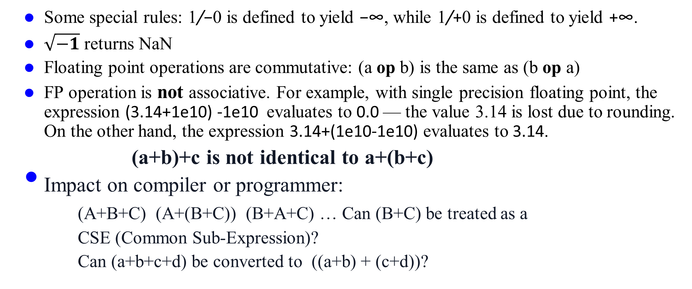
2.4.5 FP Operations
Some special rules: 1/−0 is defined to yield −∞, while 1/+0 is defined to yield +∞.
$\sqrt{−1}$ returns NaN
Floating point operations are commutative: (a op b) is the same as (b op a)
FP operation is not associative. For example, with single precision floating point, the expression (3.14+1e10) -1e10 evaluates to 0.0 — the value 3.14 is lost due to rounding. On the other hand, the expression 3.14+(1e10-1e10) evaluates to 3.14.
(a+b)+c is not identical to a+(b+c)
Impact on compiler or programmer:
(A+B+C) (A+(B+C)) (B+A+C) … Can (B+C) be treated as a
CSE (Common Sub-Expression)?
Can (a+b+c+d) be converted to ((a+b) + (c+d))?

Slide 26
2.4.5 FP/Int Type Casting
What would happen when casting values to different types?
From int to float, the number cannot overflow, but it may be rounded.
From int or float to double, the exact numeric value can be preserved
Double has both a greater range and a greater precision.
From double to float, the value can overflow to +∞ or −∞, since the range is smaller. Otherwise, it may be rounded, because the precision is smaller.
From float or double to int, the value is rounded toward zero.
For example, 1.999 will be converted to 1, while −1.999 will be converted to −1.
Furthermore, the value may overflow. The C standards do not specify
a fixed result for this case. Intel-compatible microprocessors designate the
bit pattern [10 . . . 00] (TMinw for word size w) as an integer indefinite value.
Any conversion from floating point to integer that cannot assign a reasonable
integer approximation yields this value. Thus, the expression (int) +1e10 yields -21483648,
generating a negative value from a positive one.

Slide 27
Floating-Point Addition (1)
Consider a 4-digit decimal example
9.999 × 10¹ + 1.610 × 10^{–1}
1. Align decimal points
Shift number with smaller exponent
9.999 × 10¹ + 0.016 × 10¹
2. Add significands
9.999 × 10¹ + 0.016 × 10¹ = 10.015 × 10¹
3. Normalize result & check for over/underflow
1.0015 × 10²
4. Round and renormalize if necessary
1.002 × 10²

Slide 28
Floating-Point Addition (2)
Now consider a 4-digit binary example
1.000₂ × 2^{–1} + –1.110₂ × 2^{–2} (0.5 + –0.4375)
1. Align binary points
Shift number with smaller exponent
1.000₂ × 2^{–1} + –0.111₂ × 2^{–1}
2. Add significands
1.000₂ × 2^{–1} + –0.111₂ × 2^{–1} = 0.001₂ × 2^{–1}
3. Normalize result & check for over/underflow
1.000₂ × 2^{–4}, with no over/underflow
4. Round and renormalize if necessary
1.000₂ × 2^{–4} (no change) = 0.0625

Slide 29
FP Adder Hardware (1)
Much more complex than integer adder
Doing it in one clock cycle would take too long
Much longer than integer operations
Slower clock would penalize all instructions
FP adder usually takes several cycles
Can be pipelined

Slide 30
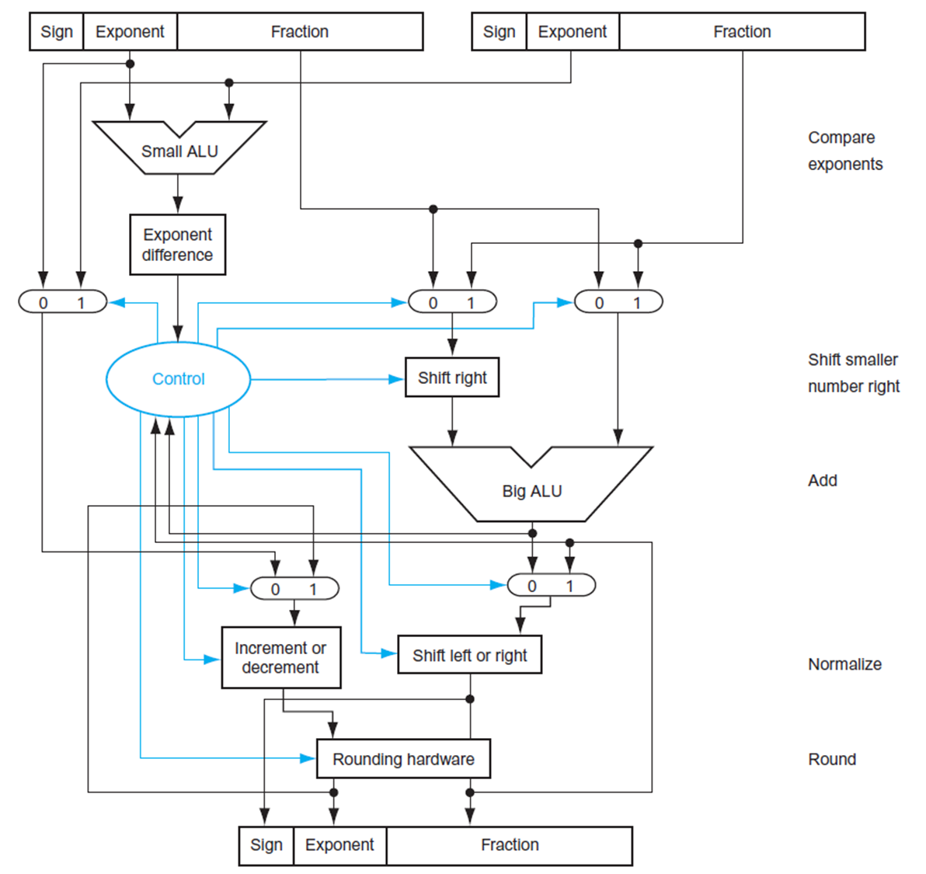
FP Adder Hardware (2)
Step 1
Step 2
Step 3
Step 4

Slide 31
FP Arithmetic Hardware
FP multiplier is of similar complexity to FP adder
But uses a multiplier for significands instead of an adder
FP arithmetic hardware usually does
Addition, subtraction, multiplication, division, reciprocal, square-root
FP ↔ integer conversion
(conversion is a relatively expensive operation partly due to the separate FP and Int register files)
Operations usually takes several cycles
Can be pipelined (the conversion unit may be not)
Notes:
reciprocal

Slide 32
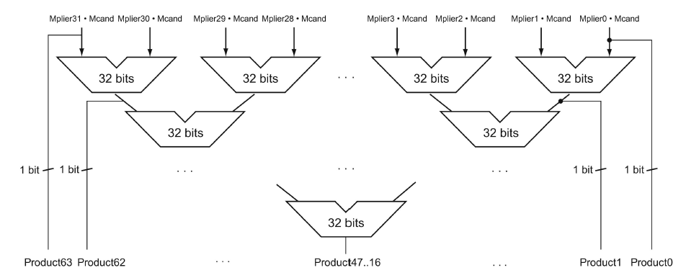
FP Multiply Hardware
FP multiply skips the first step of exponent alignment
They do partial products and add two exponents, two operations in parallel.
Then reduction, normalization, and rounding.
So FP multiply usually takes 4-5 cycles. One cycle longer than FADD.
Reduction

Slide 33
FMA or FMAC Instructions (1)
Fused Multiply and Add (FMA) or Fused Multiply and Accumulate (FMAC) combines multiply and add in one instruction.
Latency is still 5-6 cycles:
The intermediate product is not rounded before the addition — the addition happens with the full-precision product, and only one rounding is done at the end. So the four steps look like
1. Partial Product Generation
2. Partial Product Reduction
3. Final add together with the last step of reduction
4. Normalization & Rounding
A*B + C

Slide 34
FMA or FMAC Instructions (2)
FMA (FMAC) offers
higher throughput (two FLOPs per cycle),
Lower latency
higher precision (one rounding instead of two),
smaller code size, and greater energy efficiency.
Unfortunately, FMA generation is not on by default! You need to turn on some compiler flags:
gcc -O3 -march=native -mfma -ffp-contract=fast
This is because the greater precision may cause the answers generated from FMA to be different from those obtained by separately multiplying and adding – legacy and compatibility issue.

Slide 35
Quadruple Precision, Half-float and minifloat
Quad-precision float and half float format were defined in IEEE 754-2008.
Quad precision: 1, 15, 112
Double precision: 1, 11, 52
Single precision: 1, 8, 23
Half precision: 1, 5, 10 (fp16),
bfloat16 (1,8,7) has the same range as fp32
Mini-float: 1, 4, 3 (fp8)
FP4: 1,2,1
Half-float, mini-float, and fp4, are defined to support AI applications.
Defined by IEEE 754 standard
Starting in Tesla P100, in 2016
Defined by Google, first adopted by TPU, then NVIDIA
Starting in Hopper H100 tensor core, in 2022
Starting in Blackwell B100/B200 tensor core, in 2025
AI/LLM is based on predictions – approximation does not require high precision
Notes:
reciprocal

Slide 36
Quick Review Quiz

Slide 37
Quick Review
If you are concerned that your integer (data type int) computation may occasionally exceed 4 B (billion), but always < 32 Billion, and want to avoid wrap-around results, what options do you have?
Use data type long or long long instead of int
Use double data type instead of int
Check for integer overflows explicitly to protect from using incorrect data
Run your programs on 64-bit machines (assuming the LP64 model)
Answer: A, B, C

Slide 38
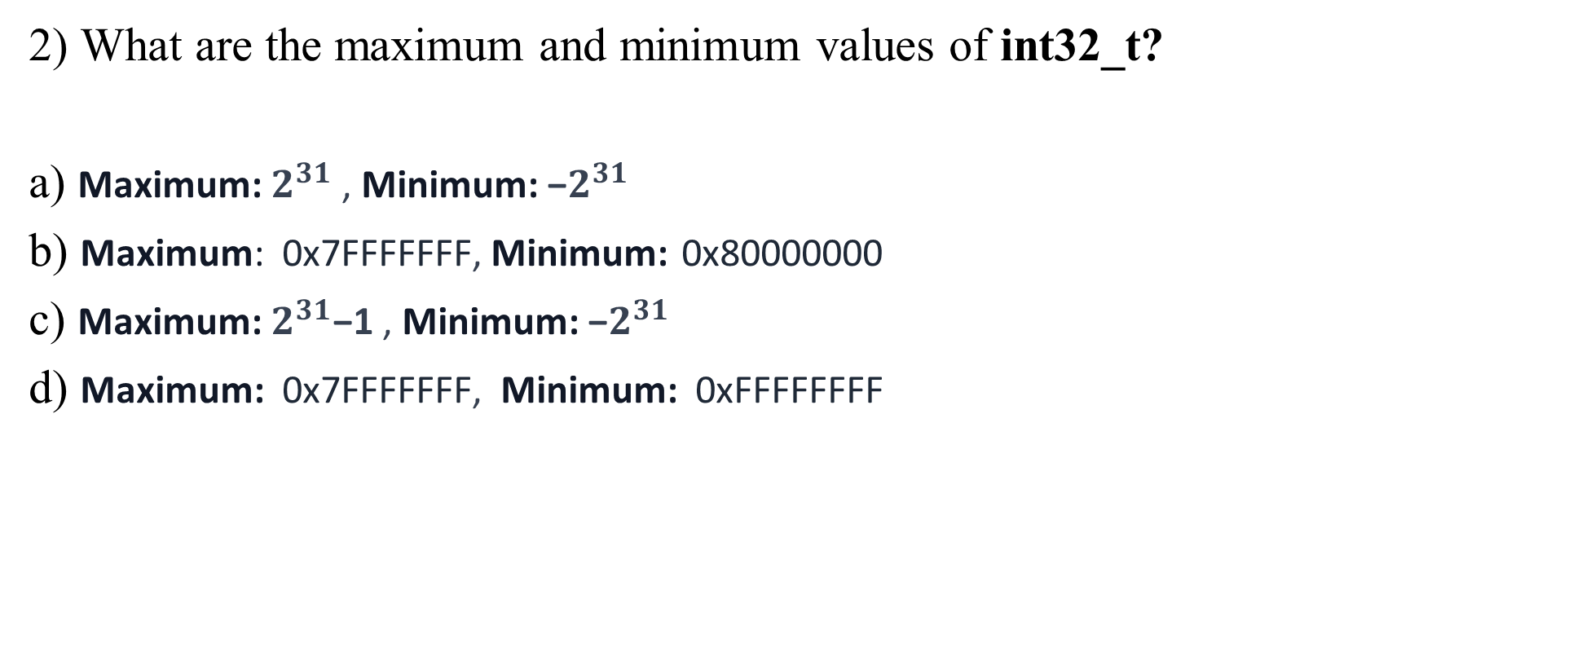
Quick Review
2) What are the maximum and minimum values of int32_t?
a) Maximum: $2^{31}$ , Minimum: −$2^{31}$
b) Maximum: 0x7FFFFFFF, Minimum: 0x80000000
c) Maximum: $2^{31}$−1 , Minimum: −$2^{31}$
d) Maximum: 0x7FFFFFFF, Minimum: 0xFFFFFFFF
Answer: B,C
Notes:
A jump instruction may be out of the 1MB range

Slide 39
Quick Review
3) What is the standard defined for single-precision (SP) and double-precision (DP) floating-point representation and operations?
IEEE 754-2008
MXFP standards
ACM 754-1985
IEEE 754-1985
Answer: D

Slide 40
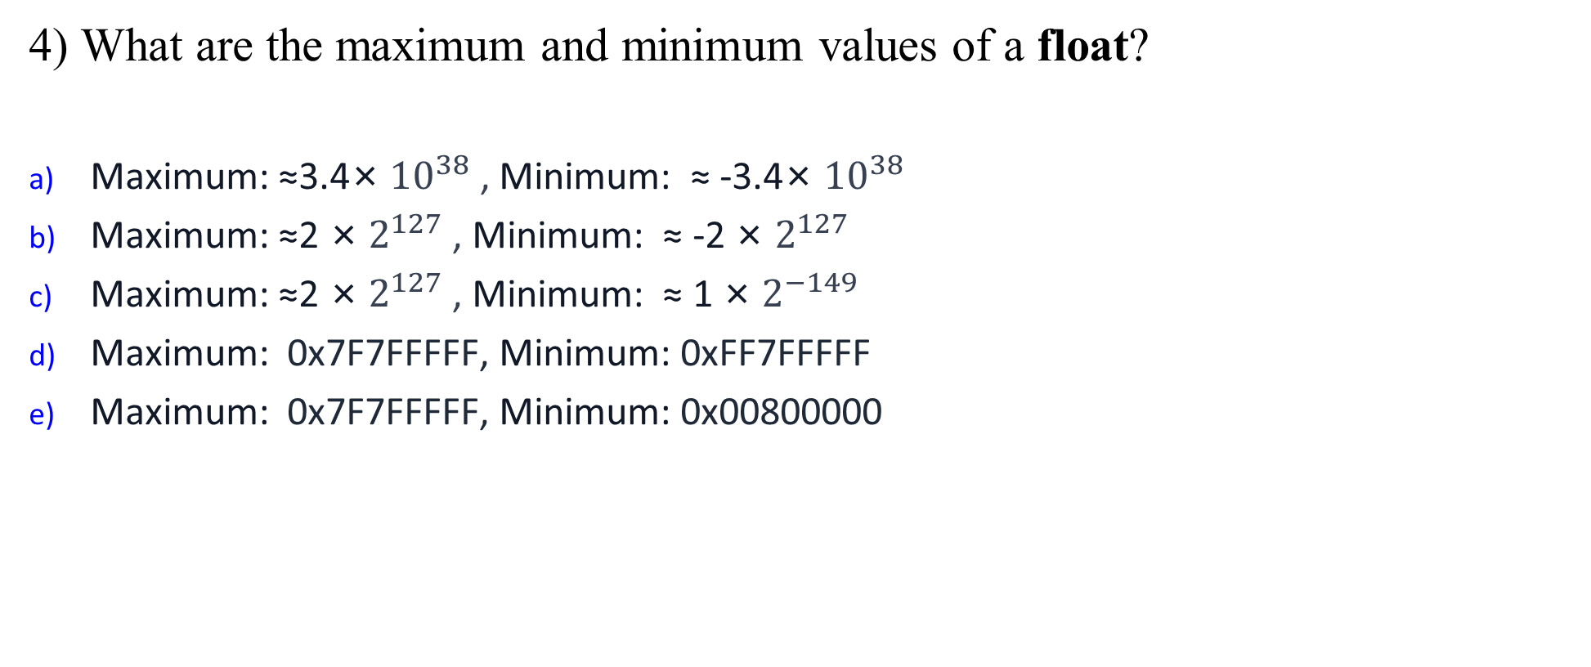
Quick Review
4) What are the maximum and minimum values of a float?
Maximum: ≈3.4× ${10}^{38}$ , Minimum: ≈ -3.4× ${10}^{38}$
Maximum: ≈2 × $2^{127}$ , Minimum: ≈ -2 × $2^{127}$
Maximum: ≈2 × $2^{127}$ , Minimum: ≈ 1 × $2^{−149}$
Maximum: 0x7F7FFFFF, Minimum: 0xFF7FFFFF
Maximum: 0x7F7FFFFF, Minimum: 0x00800000
Answer: A,B,D

Slide 41
Quick Review
5) What might happen when you cast a double to a float in a C program?
Everything works fine
Loss of precision
Overflow (may set the result to infinity)
Underflow (will be converted to a denormalized value or 0)
Answer: B, C, D

Slide 42
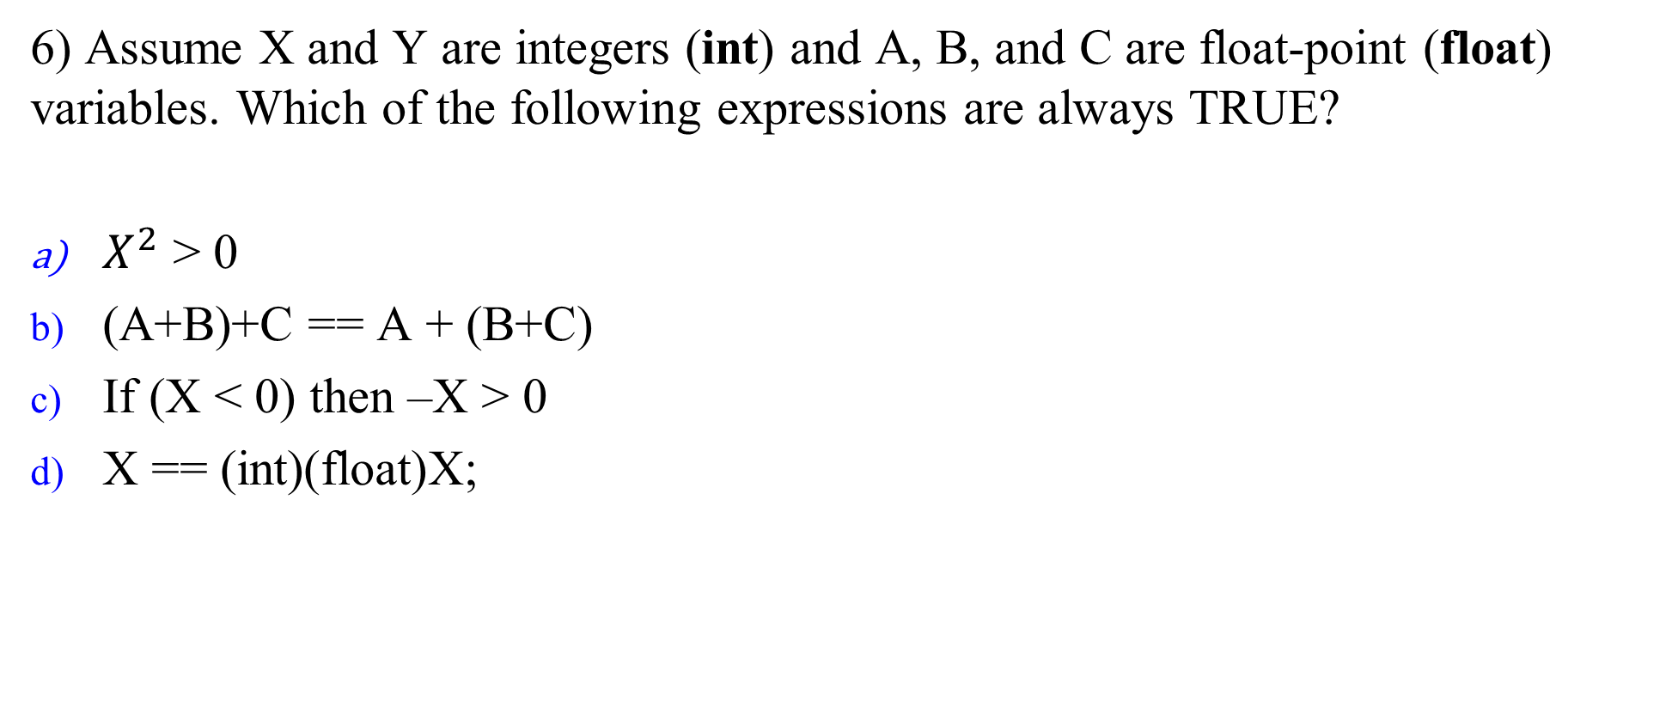
Quick Review
6) Assume X and Y are integers (int) and A, B, and C are float-point (float) variables. Which of the following expressions are always TRUE?
$X^{2}$ > 0
(A+B)+C == A + (B+C)
If (X < 0) then –X > 0
X == (int)(float)X;
Answer: None

Slide 43
Quick Review
7) Which of the following 32-bit patterns are special values in the IEEE 754 single-precision numbers?
0x00000000
0x80000000
0x7F800000
0xFF8FFFFF
Answer: A,B,C,D

Slide 44
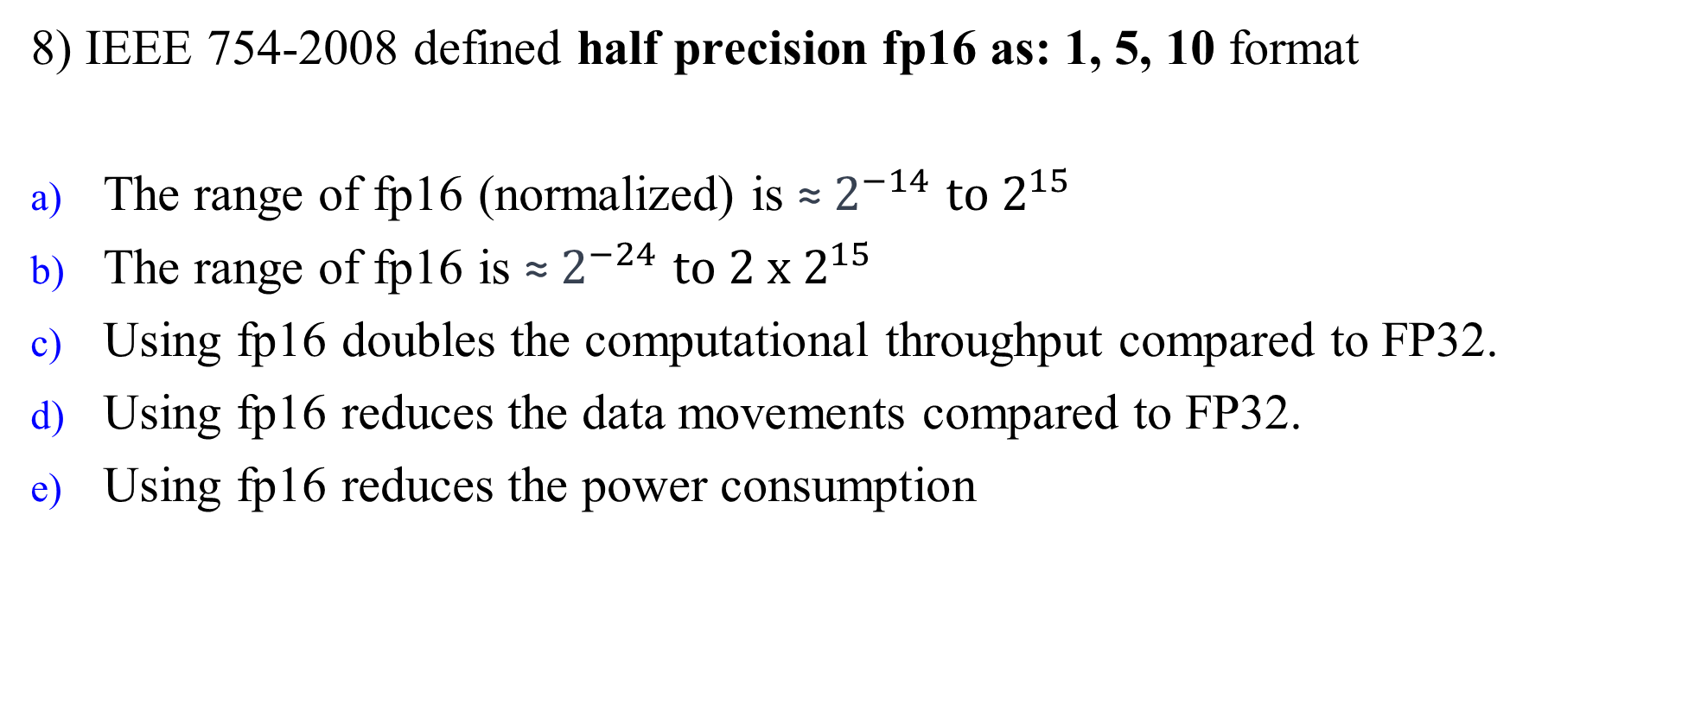
Quick Review
8) IEEE 754-2008 defined half precision fp16 as: 1, 5, 10 format
The range of fp16 (normalized) is ${\text{≈} 2}^{−14}$ ${to 2}^{15}$
The range of fp16 is ${\text{≈} 2}^{−24}$ ${to 2 x 2}^{15}$
Using fp16 doubles the computational throughput compared to FP32.
Using fp16 reduces the data movements compared to FP32.
Using fp16 reduces the power consumption
Answer: B,C,D,E

Slide 45
Quick Review
9) Which statements about the FMA instruction are TRUE?
It yields a higher throughput
It yields a lower latency
It increases the computation accuracy
It is the default code generation by the compiler
Answer: A,B,C

Slide 46
Quick Review
10) Which of the following standards for data representations have been widely adopted?
Two’s complement integers
One’s complement integers
ASCII/Unicode for text and characters
IEEE 754 for floating-point data
ELF for Unix executable and object files
Answer: A,C,D,E

