Slide 1
CSC3060 – Computer Systems
Chapter 1
A Tour of Computer Systems
Notes:
When you drive a car, you only need to know how to use the steering wheel, the brake, and the pedal. You do not need to know the details of how the engine works, how the transmission works, how the brake works!

Slide 2
Technological Advancements Driven by Computers
Computer and IC Technology
The performance of computers has improved by trillion-to-quadrillion times.
Computers everywhere, from the cloud to PCs and smartphones
Internet
WWW, e-commerce, search engine, big data
Social media and IoT
AI
ML, Generative AI, Self-driving, Medical instruments and treatments
Renewable energy resources
Solar, Wind, Hydroelectrical, Geothermal, …
Notes:
¾ of a centry, Most impactful technical advancements are pushed by the computers

Slide 3
Driving Force behind Information Revolution
Moore’s law:
Moore's Law is a prediction made by Gordon Moore, co-founder of Intel, in 1965. It originally stated that the number of transistors on a microchip would double every year while the costs would be halved. In 1975, Moore revised this forecast to doubling approximately every two years. It has been holding remarkably well for 50 years.
Other related predictions are mistakenly considered Moore’s law, such as “computer performance doubles every 18 months.”
Implications
Each time the cost or performance improves by 10x, new applications emerge. Economically infeasible applications suddenly became practical.
Had the transportation industry matched the progress of the computer industry, we would be able to travel to the moon in 0.001 second.
Notes:
Faster than the speed of light
Many applications used to be “science fiction”, now become reality: computers in automobiles, cell phone, human genome, WWW, search engine, self-driving cars, google glass, cashless society

Slide 4
More Transistors ➔ Higher Performance
More transistors enable increased performance, but how those transistors are used matters.
Computer Architecture determines how those transistors are used to achieve high performance effectively
Multiplier/Divider
Pipelining
Superscalar/VLIW/Out-of-Order
Multi-cores
Cache hierarchy
Vector/SIMD units
Notes:
Adding more registers (to keep frequently used data) ? Or adding more functional units (for computation). Sometimes, it is the functionality! For example, should you support 32b addressing or 64b addressing.

Slide 5
Driving Force behind Information Revolution
Moore’s law:
Moore's Law is a prediction made by Gordon Moore, co-founder of Intel, in 1965. It originally stated that the number of transistors on a microchip would double every year while the costs would be halved. In 1975, Moore revised this forecast to doubling approximately every two years. It has been holding remarkably well for 50 years.
Other related predictions are mistakenly considered Moore’s law, such as “computer performance doubles every 18 months.”
Implications
Each time the cost or performance improves by 10x, new applications emerge. Economically infeasible applications suddenly became practical.
Had the transportation industry matched the progress of the computer industry, we would be able to travel to the moon in 0.001 second.
Notes:
Faster than the speed of light
Many applications used to be “science fiction”, now become reality: computers in automobiles, cell phone, human genome, WWW, search engine, self-driving cars, google glass, cashless society

Slide 6


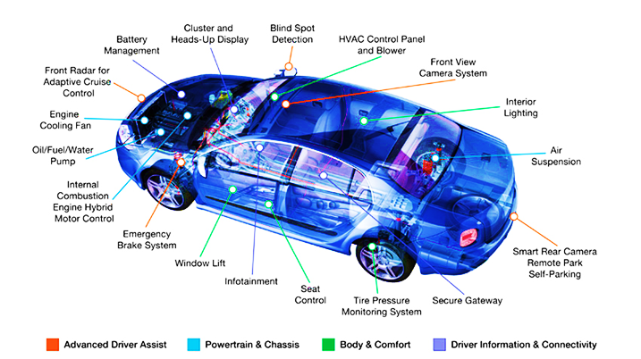
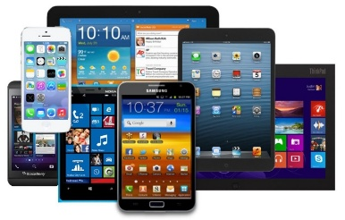
Classes of Computers
Supercomputers
Warehouse-Scale Computers
Servers/Mainframes
Desktop computers (PC/Workstations)
Embedded computers
Mobile computers (cell phones, pads, tablets, PDA)

Slide 7
What is a Computer System?
A computer system consists of hardware and system software that work together to run application programs.
All computer systems (no matter what classes they are) have similar hardware and software components that perform similar functions.
This course is designed to help you understand how the components of a computer system work and how they affect the correctness and performance of your programs.
The components include architectures, micro-architectures, system programs (OS, Compilers, Linkers,…), and networking
Notes:
Almost all technical advancements are pushed by the computers

Slide 8
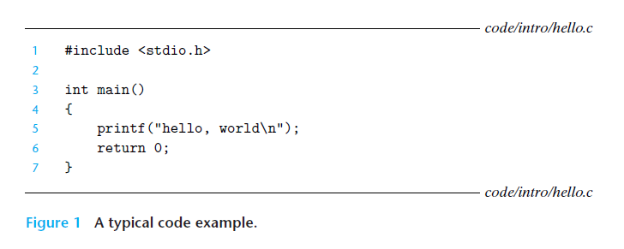
Tracing the Lifetime of “Hello”
Lifetime: From the time this program is created by a programmer until it runs on
a system, prints its simple message, and terminates.
Notes:
Almost all technical advancements are pushed by the computers

Slide 9
1.1 Information is bits + context
Memory consists of bits represented as 0s and 1s.
These bits can represent various types of information, including:
- Instructions
- Character strings
- Integer numbers
- Floating-point numbers
- Media data, such as colors and audio
- Structured data
- Arrays
Memory is usually addressed by bytes (8bits), though some machines may use word (32bits) or double word (64bits) addressing.
For example, 4 bytes of 0 (i.e., 4 bytes, each is 00000000) could mean integer 0, or a NOP instruction, a floating point value +0.0, a memory address, or a sequence of characters.
0
1
2
3
byte

Slide 10
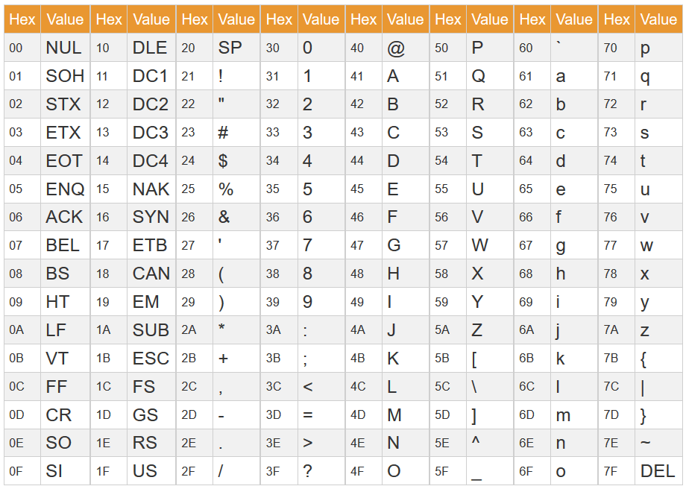

Bits can Represent Any Information
Character
Characters are represented in 7 bits (ASCII code), or 8 bits (extended ASCII)
26 characters (upper and lower cases ➔ 52) + punctuations are represented in ASCII code
Standard code to cover all the world’s languages: Unicode
Logical value (0/1)
Colors/Audio
Memory locations (addresses)
Commands (Instructions)
Summary
N bits can represent $2^{N}$ different things
ABC → 0100 0001 0100 0010 0100 0011
41
42
43

Slide 11
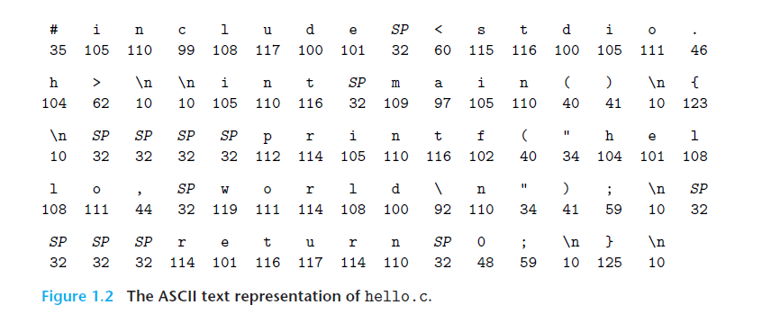
Interpretation of the “Hello” File
hello.c is stored as a sequence of characters.
Their respective decimal byte values are shown below.
Notes:
Almost all technical advancements are pushed by the computers

Slide 12
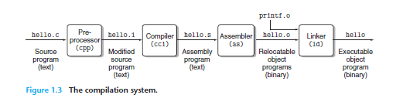
1.2 Program Compilation
The individual C statements must be compiled into a sequence of low-level machine-language instructions. These instructions are then packaged into an executable object program and stored as a binary disk file. Object programs are also called executable object files.
The process of translating a source program into an executable object program is shown above. On Unix, the command is gcc –o hello hello.c

Slide 13
1.2 Program Compilation
The individual C statements must be compiled into a sequence of low-level machine-language instructions. These instructions are then packaged into an executable object program and stored as a binary disk file. Object programs are also called executable object files.
The process of translating a source program into an executable object program is shown above. On Unix, the command is gcc –o hello hello.c
CSC4180
Compiler
Chapter 7

Slide 14
1.2 Program Compilation
The individual C statements must be compiled into a sequence of low-level machine-language instructions. These instructions are then packaged into an executable object program and stored as a binary disk file. Object programs are also called executable object files.
The process of translating a source program into an executable object program is shown above. On Unix, the command is gcc –o hello hello.c
4 phases in Figure 1.3
Pre-processing: .c ➔ .i
Compiling: .i ➔ .s
Assembling: .s ➔ .o
Linking: .o ➔ executable
4 phases
Pre-processing: handles include/define, strips off comments, and conditional compilation #ifdef.
Compiling: scan/parse/semantic check/code gen/opt
Assembling: from assembly to machine code
Linking: relocation, reference resolution

Slide 15
1.3 It Pays to Understand How Compilation Systems Work
It pays to understand how the compiler translates code
Is “switch” always faster than a nested “if-then-else”?
What is the overhead for a function call?
Why is (a+b)+(c+d) faster than (((a+b)+c)+d)
Why is memcpy(*restrict dest,*restrict src,…) much faster than without restrict?
Have you ever turned on the compiler optimization flag (-O)?
The performance loss might be 2x-20x, depending on the target app/machines.
Do you know how the linker works?
How do you resolve linker-reported error messages?
What is the difference between static and dynamic libraries?
How to avoid security holes in your program?
Must understand how data and control information are stored on the program stack

Slide 16
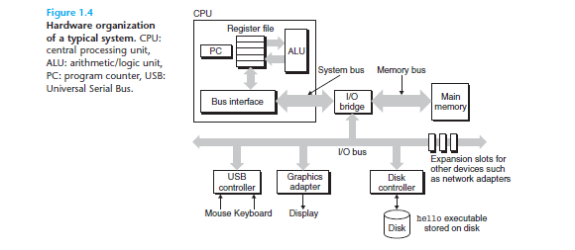
1.4 Processors Read and Interpret Insts Stored in Memory
To run the executable file on a Unix system, we type its name to an application program known as a shell:
linux> ./hello
hello, world
linux>
Hardware organization of
a system
Buses
I/O devices
Main Memory
CPU (or Processor)
Shell is a command
line interpreter

Slide 17
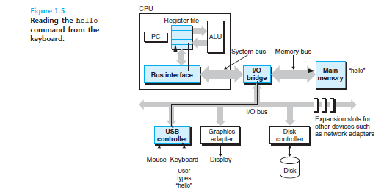
1.4.2 Running the “Hello” Program
Steps
Typing ./hello from the keyboard
The shell loads the object file “hello”
into memory, prepare for execution
DMA (Direct Memory Access) moves
data of the object file “hello” to memory
directly without going through the processor.
This is shown in Figure 1.6
DMA is usually used for high-speed and bulk data transfers, controlled by system programmers
Notes:
DMA is only used for high-speed, bulk data.

Slide 18
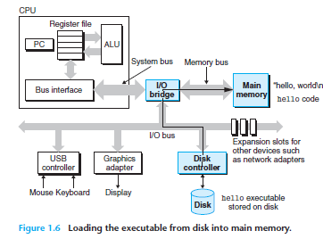
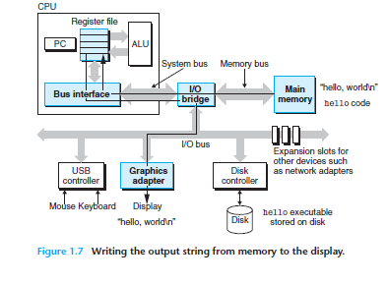
1.4.2 Running “Hello” (cont.)
Steps
Once the code and data are loaded into
memory, the processor begins executing
the machine-language instructions in the
“hello” program’s main routine.
These instructions copy the bytes in the
hello, world\n string from memory to the
register file, and from there to the display
device, where they are displayed as
shown in Figure 1.7

Slide 19
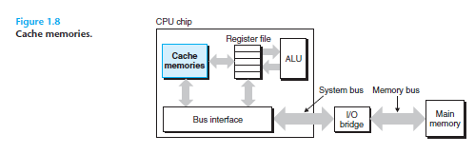
1.5 Caches Matter
An important lesson from this simple example is that a system often spends considerable time transferring information from one location to another, such as moving data from memory to registers.
The significant distance between main memory and CPU registers results in substantial latency, which can extend to hundreds of clock cycles in modern systems. To bridge the processor-memory gap, system designers implement smaller, faster storage devices known as cache memories (or simply caches). These caches serve as temporary staging areas for information that the processor is likely to require in the near future.

Slide 20
1.5 Caches Matter (cont.)
Although the cache serves as a transparent fast memory, application programmers who are aware of it can exploit it to improve the performance of their programs by an order of magnitude.
Cache works because of two types of localities:
temporal locality
If data A is referenced, it is likely to be referenced again in the near future
Instructions in a loop are likely to be executed again and again
spatial locality
If data A is referenced, its nearby neighbors, such as A+1, A+2, and A-1, A-2, are likely to be referenced again in the near future.

Slide 21
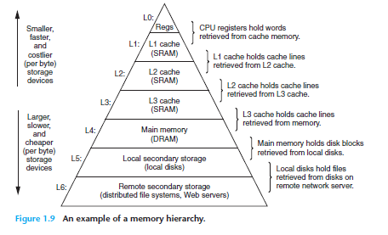
1.6 Storage Devices Form a Hierarchy
Small, Fast, Expensive
The notion of inserting a smaller, faster storage device (e.g., cache memory) between the processor and a larger, slower device (e.g., main memory) turns out to be a general idea.
The storage devices in every computer system are organized as a memory hierarchy similar to Figure 1.9 on the left.
The storage at one level serves as a
cache for storage at the next lower
level. For example, the main memory
can act as a cache for the disk (e.g.
disk cache).
Large, Slow, Cheap

Slide 22

1.7 OS Manages the Hardware
OS is a software layer interposed between the hardware and application software.
OS is responsible for
Make the machine easier to use by applications (such as GUI, Shell, TouchScreen interface, …)
Resource manager and allocator (memory, CPU, I/O)
Controller of the system hardware (various schedulers: processor, IO, memory, network, device,..)
Security and Protection
Applications use system calls to request operating system services for interacting with I/O devices.

Slide 23
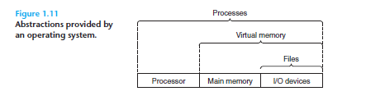
1.7.0 Three OS Abstractions (Virtualization)
The operating system offers three fundamental abstractions shown in Figure 1.11: processes, virtual memory, and files.
Files are abstractions for I/O devices
Virtual memory is an abstraction for both the main memory and disk I/O devices
Processes are abstractions for the processor, main memory, and I/O devices.

Slide 24
1.7.0 Three OS Abstractions (Virtualization)
The operating system offers three fundamental abstractions shown in Figure 1.11: processes, virtual memory, and files.
Files are abstractions for I/O devices
Virtual memory is an abstraction for both the main memory and disk I/O devices
Processes are abstractions for the processor, main memory, and I/O devices.
Virtualization: often related to multiplicity, fake versions, and sharing
For example:
Only one physical memory, but it can be shared by many virtual address spaces (Virtual Memory)
Only one CPU, but it can be shared by many processes
Only one machine, but it can be shared by multiple OSes at the same time. (Virtual Machines)

Slide 25
1.7.0 Three OS Abstractions (Virtualization)
The operating system offers three fundamental abstractions shown in Figure 1.11: processes, virtual memory, and files.
Files are abstractions for I/O devices
Virtual memory is an abstraction for both the main memory and disk I/O devices
Processes are abstractions for the processor, main memory, and I/O devices.

Slide 26
1.7.1 Processes
Program: A passive file.
Process: An active execution of a program
A process is the operating system’s abstraction for a running program. Multiple processes can run concurrently on the same system, and each process appears to have exclusive use of the hardware.
A single-core (CPU) system only executes one program at a time, while newer multicore systems can execute several programs simultaneously.
A single-core can appear to execute multiple processes concurrently by having the processor switch among them. The OS performs this interleaving with a mechanism known as context switching.
The OS keeps track of all the state information that the process needs to run. This state, which is known as the context (e.g., PC, registers, flags).

Slide 27
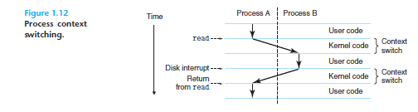
1.7.1 Process Context Switching
The OS kernel manages the transition from one process to another.
The kernel is the heart of the OS; it serves applications’ requests and manages HW resources.
There are two concurrent processes in our example scenario: the shell process and the hello process.
Initially, the shell process is running alone, waiting for input on the command line. When we ask it to run the hello program, the shell carries out our request by invoking a system call that passes control to the OS.
The OS saves the shell’s context, creates a new hello process, and then passes control to the new hello process.

Slide 28
1.7.2 Threads
A process can actually consist of multiple execution units, called threads, each running in the context of the process and sharing the same code and global data.
A thread is a light-weight process:
A process switch is like moving to a new house.
A thread switch is like changing which chore you are doing in the same house
Pros | Processes | Threads
 | High isolation | Low overhead
 | More secured | Fast communication
 | Scalable | Efficient
Notes:
Example: you want to process an image with 1000 threads at the same time.

Slide 29
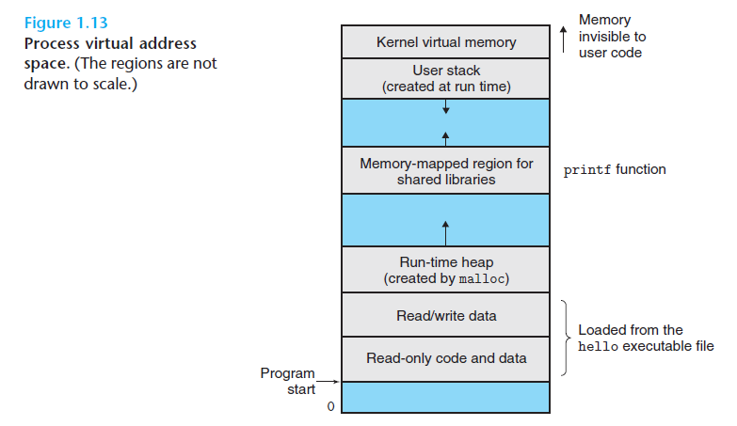
1.7.3 Virtual Memory
Virtual memory is an abstraction
that provides each process with the
illusion that it has exclusive use of the main memory.
Each process has its own virtual address space
The virtual address space for Linux processes is shown in Figure 1.13.
The highest address space is for the OS kernel.
The address 0’s page is not used. This is to prevent NULL pointer dereferences.
The heap grows upwards, and the stack grows downwards.

Slide 30
Program: executable object
Process
Thread
OS manages all processes and threads
Context Switch
Process context: container of a program. PCB (process control block)
Thread context: a line of execution. Architecture states (PC+reg+flags)
Virtual memory
Virtual often implies multiplicity, a fake version, and sharing

Slide 31
1.7.3 Main Memory as a Cache for VM
Virtual address space can be greater than the physical memory. All modern architectures support a 64-bit address space, but real machines support only a 48-bit physical address space.
Memory serves as a cache for virtual memory. Virtual address space is allocated on disk, and pages are dynamically moved to memory as needed.
Support multiprogramming: multiple processes can co-exist on the same system. When one process is doing I/O, the OS can schedule the CPU to a different process
Allow multiple processes to share data: map different virtual pages to the same physical page. For example, a shared library can be implemented that way.
Process1
VA1p1
Main Memory
VA1p2
P1
VA1p3
P2
VA1p4
P3
Process2
P4
VA2p1
VA2p2
VA2p3
Mapping multiple virtual
address spaces to the
memory
VA2p4
VA2p5
VA2p6

Slide 32
1.7.4 Files
A file is a sequence of bytes, nothing more and nothing less.
Every I/O device, including disks, keyboards, displays, and even networks, is modeled as a file.
All input and output in the system is performed by reading and writing files, using a small set of system calls known as Unix I/O.
Basic operations: Open(), Close(), Read(), Write(), Lseek()
This simple abstraction is very powerful because it provides applications with a uniform view of all the varied I/O devices that might be contained in the system. For example, reading disk files does not require knowledge of the specific disk technology.

Slide 33
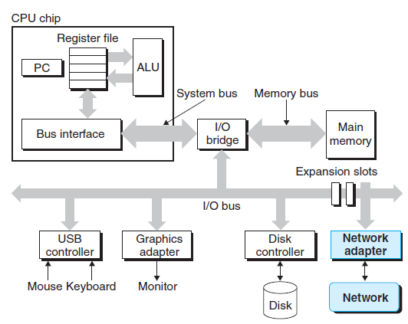
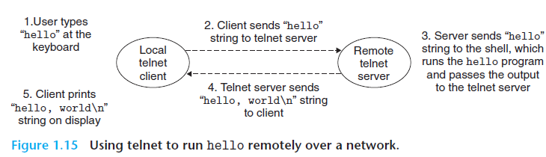
1.8 Systems Communicate with Networks
Modern systems are often linked
to other systems by networks
We may run the “hello” program remotely. Log in to the remote machine and run a shell, then the 5 steps in Figure 1.15 will be
involved.
Figure 1.14
A network is another I/O device

Slide 34
1.8 Systems Communicate with Networks
Modern systems are often linked
to other systems by networks
We may run the “hello” program remotely. Log in to the remote machine and run a shell, then the 5 steps in Figure 1.15 will be
involved.
Figure 1.14
A network is another I/O device
Telnet has been replaced by SSH due to security requirements. SSH uses encryption to create a secure tunnel, so all the SSH sessions are secure.

Slide 35
1.9 Important Themes
A system is a collection of intertwined hardware and system software that must cooperate to achieve the goal of running application programs.
By knowing the details of a system, you can write faster, more reliable, and more secure programs.
Several important concepts that cut across all aspects of computer systems
Amdahl’s Law
Concurrency and Parallelism
Instruction-Level Parallelism
Single-Instruction, Multiple-Data (SIMD) Parallelism
Abstractions

Slide 36

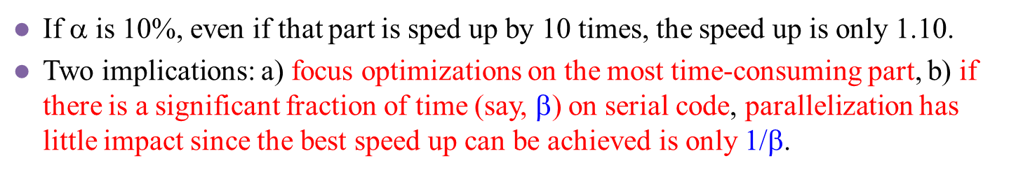
1.9.1 Amdahl’s Law
Gene Amdahl made a simple but insightful observation about the effectiveness of improving the performance of one part of a system.
Consider a system in which executing some application requires time Told. Suppose some part of the system requires a fraction α of this time, and that we improve its performance by a factor of k. The new time would be:
$T_{new }$= $\left(1−\text{a}\right){ T}_{old }$+ α(${ T}_{old }$)/k
Speedup = ${ T}_{old }$/ $T_{new }$= 1 / ($\left(1−\text{a}\right)$+ α / k)
If α is 10%, even if that part is sped up by 10 times, the speed up is only 1.10.
Two implications: a) focus optimizations on the most time-consuming part, b) if there is a significant fraction of time (say, β) on serial code, parallelization has little impact since the best speed up can be achieved is only 1/$\text{b}$.

Slide 37
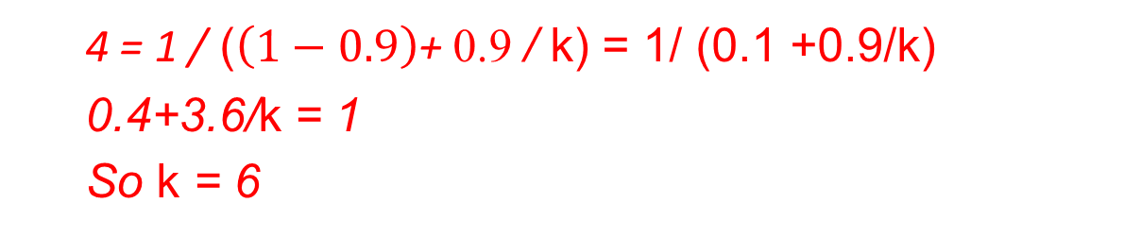
1.9.1 Amdahl’s Law Example (problem 1.2)
A car company has promised its customers that the next release of a new engine will show a 4X performance improvement. You have been assigned the task of delivering on that promise. You have determined that only 90% of the engine can be improved. How much (i.e., what value of k) would you need to improve this part to meet the overall performance target of the engine?
Speedup = 1 / ($\left(1−\text{a}\right)$+ α / k)
4 = 1 / ($\left(1−\text{0.9}\right)$+ 0.9 / k) = 1/ (0.1 +0.9/k)
0.4+3.6/k = 1
So k = 6

Slide 38
1.9.2 Concurrency and Parallelism
Concurrency refers to the general concept of a system with multiple, simultaneous activities.
Example:
A time-sharing system: multiple users are using the same system.
Multiprogramming: On a single-core system, multiple programs coexist in memory at the same time, but only one can run on the CPU.
Parallelism refers to the use of concurrency to make a system run faster.
Example:
Using 4 CPU cores to process 4 parts of an image at the same time.
Here, we have sufficient resources to support simultaneous execution.

Slide 39

1.9.2 ILP and DLP
Modern processors can execute multiple instructions at one time, a property known as instruction-level parallelism (ILP).
Micro-architecture techniques such as pipelining, superscalar, and out-of-order execution exploit ILP to speed up instruction processing.
Another type of parallelism is data-level parallelism (DLP), where one instruction can process multiple data. For example, an instruction A+B can process $A_{1}{+B}_{1}$, $A_{2}{+B}_{2}$, $A_{3}{+B}_{3}$, $A_{4}{+B}_{4} at the same time.$
SIMD (Single Instruction Multiple Data) and Vector instructions exploit DLP.
GPU (e.g., NVIDIA GPU) is another type of DLP machines.

Slide 40
1.10 Summary
A computer system consists of hardware and system software.
Information inside the computer is represented as groups of bits.
Programs are compiled into machine instructions in a binary executable.
Processors read and interpret binary instructions
Computers spend most of the time copying data, so the memory/storage hierarchy is critical to performance.
The OS kernel serves as an intermediary between the application and the hardware. It provides three abstractions: (1) Files, (2) Virtual memory, and (3) Processes.
Networks provide ways for computer systems to communicate with one another.

Slide 41
Quick Review Example
What is a computer system?
a) A computer system consists of hardware and system software that work together to run application programs
b) A computer system is a machine that stores information
c) A computer system is a computer with the internet.
d) A computer system is software that runs programs.
Answer: A

Slide 42
Quick Review
1) Why do caches work?
Programs exhibit spatial locality
Programs exhibit structural locality
Programs exhibit temporal locality
Programs exhibit special locality
Answer: A, C

Slide 43
Quick Review
2) In the command "gcc -o hello hello.c“, gcc serves as a driver. What processing does it initiate?
a) Executing hello
b) Linking hello.o with stdio library
c) Compiling hello.i to hello.s
d) Preprocessing hello.c to hello.i
e) Assembling hello.s to hello.s
Answer: B,C,D,E
Notes:
A jump instruction may be out of the 1MB range

Slide 44
Quick Review
3) A program has 80% of its code that can be parallelized. If you are given 1000 processors, what is the maximum speedup you can achieve for your program?
800 X
200 X
20 X
5 X
Answer: D

Slide 45
Quick Review
4) What computer architecture will be used as a reference in this course?
ARM
Intel x86-64
RISC-V
IBM PC
NVIDIA GPU
Answer: C

Slide 46
Quick Review
5) Which of the following statements about virtual memory is correct?
Every program has its own virtual address space.
The size of a virtual address space should be smaller than the physical memory size
The OS is responsible for protecting the privacy and security of each virtual address space.
The compiler is responsible for mapping virtual memory to physical memory
Answer: A, C

