Slide 1
CSC3060 – Computer Systems Chapter 6: The Memory Hierarchy
Prof. Wei Chung Hsu
School of Data Science
Chinese University of Hong Kong, Shenzhen

Slide 2

Memory Hierarchy
So far, we view the memory as a linear array of bytes, and the CPU can access each memory location in one cycle.
In practice, a memory system is a hierarchy of storage devices with different capacities, costs, and access times.
CPU registers hold the most frequently used data. Small, fast memory (cache) acts as a staging area for main memory, and main memory acts as a staging area for disks or network devices.
The higher-level hierarchy is much more active than the lower-level hierarchy. So this hierarchy gives you the illusion: memory is fast, large, and inexpensive.

Slide 3
PC Memory/Storage Size and Latency
Year | Typical RAM Size (Main Memory) | Typical Disk Size (HDD/SSD) | Typical Memory Access Latency
1985 | 640 KB – 1 MB | 10 MB – 20 MB (HDD) | ~200 ns
1995 | 8 MB – 16 MB | 500 MB – 1.2 GB (HDD) | ~100 ns
2005 | 512 MB – 1 GB | 80 GB – 160 GB (HDD) | ~60 ns
2015 | 8 GB – 16 GB | 1 TB (HDD) / 256 GB (SSD) | ~50 ns
2025 | 32 GB – 64 GB | 2 TB – 4 TB (NVMe SSD) | ~60 ns*

Slide 4
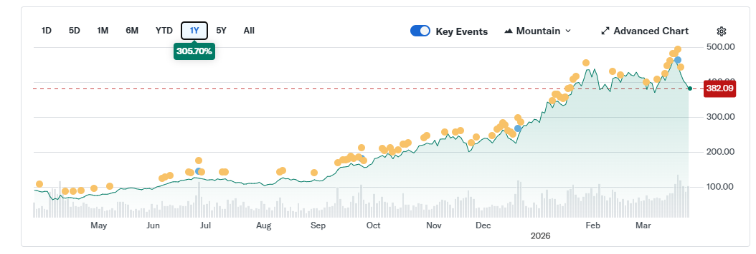
PC Memory/Storage Size and Latency
Have you noticed that MICRON (DRAM company) draws more attention than Nvidia (GPU company)?
Year | Typical RAM Size (Main Memory) | Typical Disk Size (HDD/SSD) | Typical Memory Access Latency
1985 | 640 KB – 1 MB | 10 MB – 20 MB (HDD) | ~200 ns
1995 | 8 MB – 16 MB | 500 MB – 1.2 GB (HDD) | ~100 ns
2005 | 512 MB – 1 GB | 80 GB – 160 GB (HDD) | ~60 ns
2015 | 8 GB – 16 GB | 1 TB (HDD) / 256 GB (SSD) | ~50 ns
2025 | 32 GB – 64 GB | 2 TB – 4 TB (NVMe SSD) | ~60 ns*
AI workload creates a Memory bottleneck
AI workload requires both “size” and “bandwidth”

Slide 5
6.1 Random Access Memory (RAM)
Random access memory
Access time is the same for all locations
SRAM (Static Random Access Memory)
Low density, high power, expensive, fast
Static: content will last forever until it loses power
Address not divided
Use for caches, local memory
DRAM (Dynamic Random Access Memory)
High density, low power, cheap, slow
Dynamic: need to be refreshed regularly
Addresses in 2 halves (memory as a 2D matrix)
RAS/CAS (Row/Column Access Strobe)
Use for main memory
Typically 4-8 transistors and 2 resistors as one cell
The switch state of the resistor to represent a bit
No need to refresh
Expensive due to more transistors
1 transistor and 1 capacitor as a cell
Charge of the capacitor represent a bit
need periodically refreshed after access
Much denser and cheaper
Notes:
The technology we used to build our memory hierarchy can be divided into two categories: Random Access and Not-so-Random Access.
Unlike all other aspects of life where the word random usually associates with bad things, random, when associates with memory access, for the lack of a better word, is good!
Because random access means you can access any random location at any time and the access time will be the same as any other random locations.
Which is NOT the case for disks or tape where the access time for a given location at any time can be quite different from some other random locations at some other random time.
As far as Random Access technology is concerned, we will concentrate on two specific technologies: Dynamic RAM and Static RAM.
The advantages of Dynamic RAMs are high density, low cost, and low power so we can have a lot of them without burning a hole in our budget or our desktop.
The disadvantages of DRAM are they are slow. Also they will forget what you tell them if you don remind them constantly (Refresh). We will talk more about refresh later today.
SRAM only has one redeeming feature: it is fast. Other than that, they have low density, expensive, and burn a lot of power. Oh, SRAM actually has another redeeming feature. They will not forget what you tell them. They will keep whatever you write to them forever.
Well orever?is a long time. So lets just say it will keep your data as long as you don pull the plug on your computer.
In the next two lectures, we will be focusing on DRAMs and SRAMs.
Register is also one. One bit

Slide 6
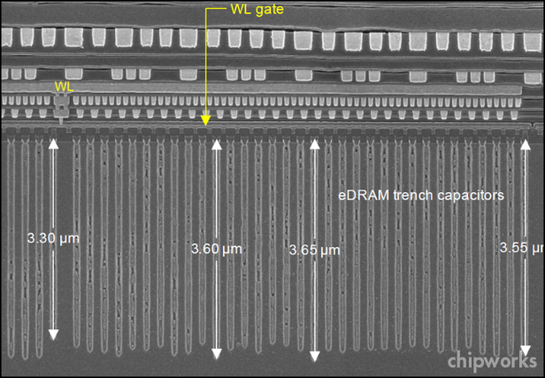
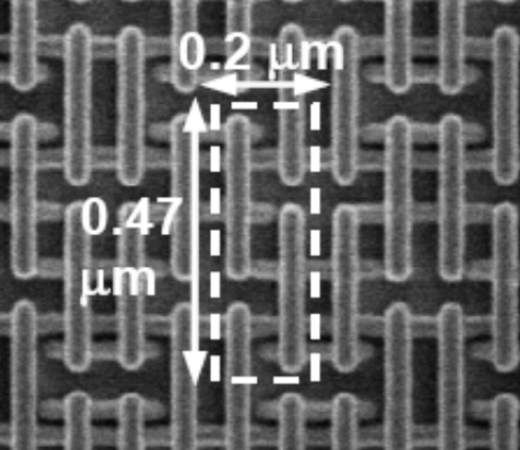
RAM Technologies
DRAM
1 Transistor + 1 capacitor/bit
Capacitor oriented vertically
Must refresh state periodically
SRAM
6 transistors / bit
Holds state indefinitely

Slide 7
SRAM vs DRAM Summary
Trans. Access Needs Needs
per bit time refresh? EDC? Cost Applications
SRAM 6 or 8 1x No Maybe 100x Cache memories
DRAM 1 10x Yes Yes 1x Main memories,
frame buffers
EDC: Error detection and correction
Trends
SRAM scales with semiconductor technology
Reaching its limits
DRAM scaling is limited by the need for minimum capacitance
Aspect ratio limits how deep a capacitor can be made
Also reaching its limits

Slide 8
Conventional DRAM Organization
d x w DRAM:
d⋅ w total bits organized as d supercells of size w bits
16 x 8 DRAM chip
cols
0
1
2
3
2 bits
/
0
addr
1
rows
Memory
controller
2
supercell
(2,1)
(to/from cores)
3
8 bits
/
data
Internal row buffer

Slide 9
Reading DRAM Supercell (2,1)
Step 1(a): Row access strobe (RAS) selects row 2.
Step 1(b): Row 2 copied from DRAM array to row buffer.
16 x 8 DRAM chip
Cols
RAS = 2
0
1
2
3
2
/
0
addr
1
Memory
controller
Rows
2
8
/
3
data
Internal row buffer

Slide 10
Reading DRAM Supercell (2,1)
Step 2(a): Column access strobe (CAS) selects column 1.
Step 2(b): Supercell (2,1) copied from buffer to data lines, and eventually back to the CPU.
Step 3: All data written back to row to provide refresh
16 x 8 DRAM chip
Cols
CAS = 1
0
1
2
3
2
/
0
addr
To Cores
1
Memory
controller
Rows
2
supercell
(2,1)
3
8
/
data
supercell
(2,1)
Internal row buffer

Slide 11
Conventional DRAM Organization
d x w DRAM:
d⋅ w total bits organized as d supercells of size w bits
16 x 8 DRAM chip
cols
0
1
2
3
In this example, 16 is the number of addresses, and 8 is the data width.
On the market, you can buy 1Gx8
Chips.
2 bits
/
0
addr
1
rows
Memory
controller
2
supercell
(2,1)
(to/from cores)
3
If you want to transfer 64bits per clock from the memory to CPU, you need at least 8 memory chips: 8bit per chip x 8 = 64bits.
8 bits
/
data
Internal row buffer

Slide 12
Memory Modules
addr (row = i, col = j)
: supercell (i,j)
DRAM 0
64 MB
memory module
consisting of
eight 8Mx8 DRAMs
DRAM 7
bits
56-63
bits
48-55
bits
40-47
bits
32-39
bits
24-31
bits
16-23
bits
8-15
bits
0-7
63
56
55
48
47
40
39
32
31
24
23
16
15
8
7
0
63
56
55
48
47
40
39
32
31
24
23
16
15
8
7
0
Memory
controller
64-bit word main memory address A
64-bit word

Slide 13
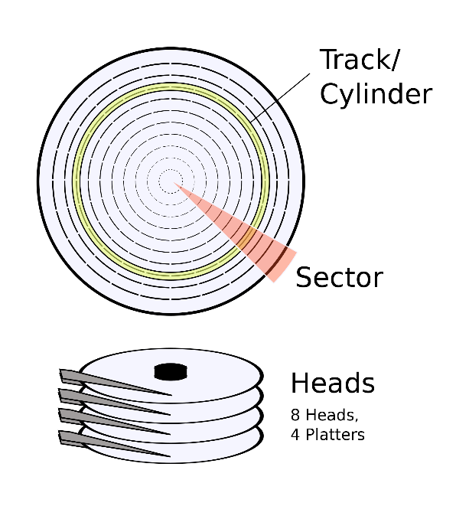
Enhanced DRAMs, NV, and Disks
Fast Page Mode DRAM (FPM DRAM)
Extended Data out DRAM (EDO DRAM)
Synchronous DRAM (SDRAM)
Dual Data Rate SDRAM (DDR SDRAM)
Rambus DRAM (RDRAM)
Video RAM (VRAM)
Embedded DRAM (eDRAM)
Flash Memory (NV memory)
Will not lose data when the power is cut
electrically erasable programmable read-only memory (EEPROM)
Flash memory card, USB device, etc
Magnetic Disk and Tape
For long-term storage
DDR SDRAM dominates Computer
Memory market today
All unconventional DRAM chips offer much higher bandwidth, but the latency remains the same.
Notes:
The technology we used to build our memory hierarchy can be divided into two categories: Random Access and Non-so-Random Access.
Unlike all other aspects of life where the word random usually associates with bad things, random, when associates with memory access, for the lack of a better word, is good!
Because random access means you can access any random location at any time and the access time will be the same as any other random locations.
Which is NOT the case for disks or tape where the access time for a given location at any time can be quite different from some other random locations at some other random time.
As far as Random Access technology is concerned, we will concentrate on two specific technologies: Dynamic RAM and Static RAM.
The advantages of Dynamic RAMs are high density, low cost, and low power so we can have a lot of them without burning a hole in our budget or our desktop.
The disadvantages of DRAM are they are slow. Also they will forget what you tell them if you don remind them constantly (Refresh). We will talk more about refresh later today.
SRAM only has one redeeming feature: it is fast. Other than that, they have low density, expensive, and burn a lot of power. Oh, SRAM actually has another redeeming feature. They will not forget what you tell them. They will keep whatever you write to them forever.
Well orever?is a long time. So lets just say it will keep your data as long as you don pull the plug on your computer.
In the next two lectures, we will be focusing on DRAMs and SRAMs.
We will not get into disk until the Virtual Memory lecture a week from now.
+3 = 19 min. (X:59)

Slide 14
Comparisons of Speed and Cost
Memory
technology
Typical access
time
$USD per GB
SRAM
0.5 – 2.5 ns
$1000 – $5,000
DRAM
50 – 70 ns
$2,$3 – $20
Magnetic
disk
5,000,000 –
20,000,000 ns
HDD: $0.02 – $0.05
SSD: $0.06 – $0.20
Why is SRAM disproportionately more expensive than DRAM?
Yields, density, volume, design complexity, …

Slide 15
Accessing Main Memory
A bus is a collection of parallel wires that carry address, data, and control signals.
Buses are typically shared by multiple devices.
CPU chip
Register file
ALU
Memory bus
Main
memory
Memory Controller

Slide 16
Memory Read Transaction (1)
CPU places address A on the memory bus.
Register file
Load operation: LW X1,4(X2)
X1-X31
ALU
Main memory
A
0
Memory Controller
x
A

Slide 17
Memory Read Transaction (2)
Main memory reads A from the memory bus, retrieves word x, and places it on the bus.
Register file
Load operation: LW X1,4(X2)
X1-X31
ALU
Main memory
0
Memory Controller
x
A

Slide 18
Memory Read Transaction (3)
CPU reads word x from the bus and copies it into register X1.
Register file
Load operation: LW X1,4(X2)
X1-X31
ALU
x
Main memory
0
Memory Controller
x
A

Slide 19
Memory Write Transaction (1)
CPU places address A on bus. Main memory reads it and waits for the corresponding data word to arrive.
Register file
Store operation: SW X1, 4(X2)
X1-X31
ALU
y
Main memory
0
A
Memory Controller
A

Slide 20
Memory Write Transaction (2)
CPU places data word y on the bus.
Register file
Store operation: SW X1, 4(X2)
X1-X31
ALU
y
Main memory
0
y
Memory Controller
A

Slide 21
Memory Write Transaction (3)
Main memory reads data word y from the bus and stores it at address A.
Register file
Store operation: SW X1, 4(X2)
X1-X31
ALU
y
Main memory
0
Memory Controller
y
A
The above read/write pictures are oversimplified. There are CACHEes sit between the registers and the memory controller.

Slide 22
The CPU-Memory Gap
The gap widens between DRAM, disk, and CPU speeds.
Disk
SSD
DRAM
CPU

Slide 23
Processor/Memory Latency Gap
1000
Proc
60%/yr.
(2X/1.5 yr)
Moore’s Law
100
Processor-memory
performance gap: (grows 50% / year)
Performance
10
DRAM (main memory)
9%/yr.
(2X/10 yrs)
1
1980
Year
1981
1982
1983
1984
1985
1986
1987
1988
1989
1990
1991
1992
1993
1994
1995
1996
1997
1998
1999
2000
Notes:
Y-axis is performance
X-axis is time
Latency
Clich?
Not e that x86 didn have cache on chip until 1989

Slide 24
Impact from the Power Wall
1000
Proc
60%/yr.
(2X/1.5 yr)
Moore’s Law
100
Processor-memory
performance gap: (grows 50% / year)
Performance
10
DRAM (main memory)
9%/yr.
(2X/10 yrs)
1
1980
Year
1981
1982
1983
1984
1985
1986
1987
1988
1989
1990
1991
1992
1993
1994
1995
1996
1997
1998
1999
2000
Notes:
Y-axis is performance
X-axis is time
Latency
Clich?
Not e that x86 didn have cache on chip until 1989

Slide 25
Clock Frequency Stays Flat, But …
Processors are still getting more powerful:
Super-scalar
Out-of-order
SIMD/Vector
Multi-core
GPU
Memory Wall remains a challenge.
Memory is far away
Memory bandwidth is insufficient
1000
Proc
60%/yr.
(2X/1.5 yr)
Moore’s Law
100
Processor-memory
performance gap: (grows 50% / year)
Performance
10
DRAM (main memory)
9%/yr.
(2X/10 yrs)
1
1980
Year
1981
1982
1983
1984
1985
1986
1987
1988
1989
1990
1991
1992
1993
1994
1995
1996
1997
1998
1999
2000
Notes:
Y-axis is performance
X-axis is time
Latency
Clich?
Not e that x86 didn have cache on chip until 1989

Slide 26
Memory Wall
In computer architecture, the "memory wall" refers to the growing gap between the speed of processors and the speed of main memory (DRAM).
Latency
Reduction: Cache, Local Memory, NUMA, PIM, CIM
Hiding: Multi-threading/Hyper-threading, WARP interleaving, chip-multithreading
Bandwidth
Memory bandwidth: Multi-banks and interleaved memory, SDRAM, HBM
Communication bandwidth: wider bus, interconnection network
In HPC (High-Performance Computing), including ML/LLM, memory performance is often the primary bottleneck.
GPUs excel at parallel processing, and HBM gives the needed high memory bandwidth. But due to its limited HBM size, data transfers still pose a challenge.

Slide 27
Memory Wall
In computer architecture, the "memory wall" refers to the growing gap between the speed of processors and the speed of main memory (DRAM).
Latency
Reduction: Cache, Local Memory, NUMA, PIM, CIM
Hiding: Multi-threading/Hyper-threading, WARP interleaving, chip-multithreading
Bandwidth
Memory bandwidth: Multi-banks and interleaved memory, SDRAM, HBM
Communication bandwidth: wider bus, interconnection network
In HPC (High-Performance Computing), including ML/LLM, memory performance is often the primary bottleneck.
GPUs excel at parallel processing, and HBM gives the needed high memory bandwidth. But due to its limited HBM size, data transfers still pose a challenge.
In the past, it referred to
Latency gap
Nowadays, it refers to
Performance gap

Slide 28
6.1.4 Storage Technology Trends
SRAM
Metric 1985 1990 1995 2000 2005 2010 2015 2015:1985
$/MB 2,900 320 256 100 75 60 25 116
access (ns) 150 35 15 3 2 1.5 1.3 115
DRAM
Metric 1985 1990 1995 2000 2005 2010 2015 2015:1985
$/MB 880 100 30 1 0.1 0.06 0.02 44,000
access (ns) 200 100 70 60 50 40 20 10
size (MB) 0.256 4 16 64 2,000 8,000 16.000 62,500
Disk
Metric 1985 1990 1995 2000 2005 2010 2015 2015:1985
$/GB 100,000 8,000 300 10 5 0.3 0.03 3,333,333
access (ms) 75 28 10 8 5 3 3 25
size (GB) 0.01 0.16 1 20 160 1,500 3,000 300,000

Slide 29
6.2 Locality
Principle of Locality: Many Programs tend to use data and instructions with addresses near or equal to those they have used recently.
Temporal locality:
Recently referenced items are likely to be referenced again in the near future
Spatial locality:
Items with nearby addresses tend to be referenced close together in time
All levels of modern computer systems, from the hardware to the operating system to application programs, are designed to take advantage of locality.

Slide 30
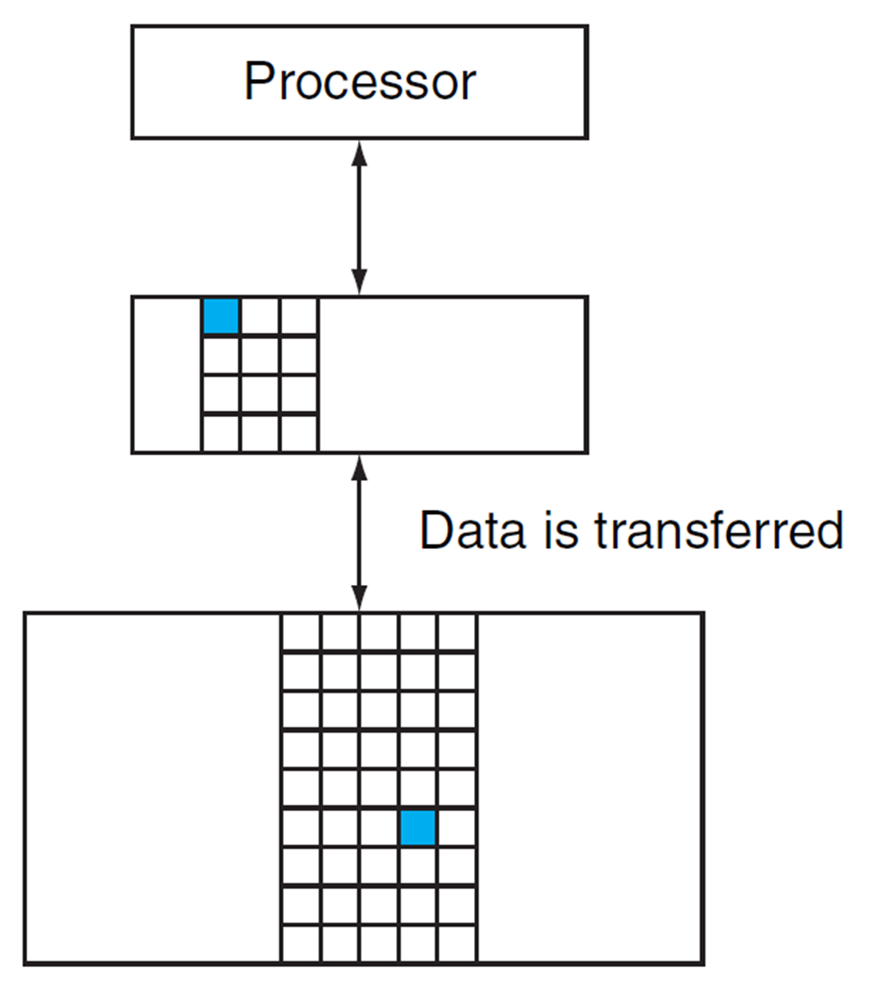
6.3 Memory Hierarchy
Block (aka line): unit of copying
May be multiple words
If accessed data is present in the upper-level
Hit: access satisfied by upper level
Hit ratio: hits/accesses
If accessed data is absent
Miss: block copied from lower level
Miss penalty: extra time taken
Miss ratio: misses/accesses = (1 – hit ratio)
Then accessed data supplied from the upper-level
Hit time << Miss penalty
Closer
Smaller
More expensive

Slide 31
Levels of Memory Hierarchy
Upper Level
Staging
Transfer Unit
faster
Registers
Instruction Operands
Programmer/Compiler
Cache Hierarchy
lw t1,4(s1)
Cache / LM
lw.lm t1,4(s1)
Blocks/Lines
Cache Controller
Memory
Virtual Memory
Pages
Operating System
Disk
Files
User/Operator
Larger
Tape
Lower Level
Notes:
LM is programmable cache
How about vector registers?

Slide 32
Adding Vector Registers
Upper Level
Staging
Transfer Unit
Registers
V Registers
faster
Instruction Operands
Programmer/Compiler
Cache Hierarchy
Cache / LM
Blocks/Lines
Cache Controller
Memory
Pages
Operating System
Virtual Memory
Disk
Files
User/Operator
Tape
Larger
Lower Level
Notes:
LM is programmable cache.
How about vector registers?

Slide 33
Why Memory Hierarchy Works
Upper Level
Staging
Transfer Unit
The Upper Levels
are Fast but Small
faster
Majority of
References
are here
Registers
V Registers
Instruction Operands
Programmer/Compiler
Cache / LM
Blocks/Lines
Cache Controller
Memory
Your
Program and Data
Stored here
Pages
The Lower Levels
are Slow but Large
and Cheap
Operating System
Disk
Files
User/Operator
Tape
Larger
Lower Level
This gives you Large, Cheap memory, but Fast access
Notes:
LM is programmable cache.
How about vector registers?

Slide 34
How Is the Memory Hierarchy Managed
Registers <-> Memory
By compiler (programmer?)
Cache <-> Memory / Local memory <-> Memory
By the hardware / by the compiler/programmer
Memory <-> Disks
By the hardware and operating system (virtual memory)
By the programmer (files)
Disks <-> Tapes
By the hardware
By the operator/programmer
Notes:
注意通常数据的访问不会跨太多级别，比如cache不会直接访问disk上的data。But a TLB miss may trigger a page fault…

Slide 35
Summary of Memory Hierarchy (1)
Memory wall
Latency: getting longer
Bandwidth: insufficient
Solution:
Memory Hierarchy
A small, fast memory close to the CPU
low latency
high bandwidth (not limited by refresh cycles, pin-bandwidth)
Transparent solution
Caches
Explicit management
Local memory (e.g. ARM scratch-pad memory or NVIDIA’s shared memory)
Story about
IBM 360/91 and 360/85
Notes:
Example: IBM 360/91 vs 360/85

Slide 36
Summary of Memory Hierarchy (2)
DRAM is slow but cheap and dense
Good for presenting users with a BIG memory system
SRAM is fast but expensive, not very dense
Good choice for on-chip memory
Good for providing FAST access and high bandwidth
Two different types of locality
Temporal Locality (Locality in Time)
Spatial Locality (Locality in Space)
Use the principle of locality
Present the user with as much memory as is available in the cheapest technology (keep the cost low)
Provide access at the speed offered by the fastest technology
Notes:
Let summarize today lecture. The first thing we covered is the principle of locality.
There are two types of locality: temporal, or locality of time and spatial, locality of space.
We talked about memory system design.
The key idea of memory system design is to present the user with as much memory as possible in the cheapest technology while by taking advantage of the principle of locality, create an illusion that the average access time is close to that of the fastest technology.
As far as Random Access technology is concerned, we concentrate on 2: DRAM and SRAM.
DRAM is slow but cheap and dense so is a good choice for presenting the use with a BIG memory system.
SRAM, on the other hand, is fast but it is also expensive both in terms of cost and power, so it is a good choice for providing the user with a fast access time.
I have already showed you how DRAMs are used to construct the main memory for the SPARCstation 20.
On Friday, we will talk about caches.

Slide 37
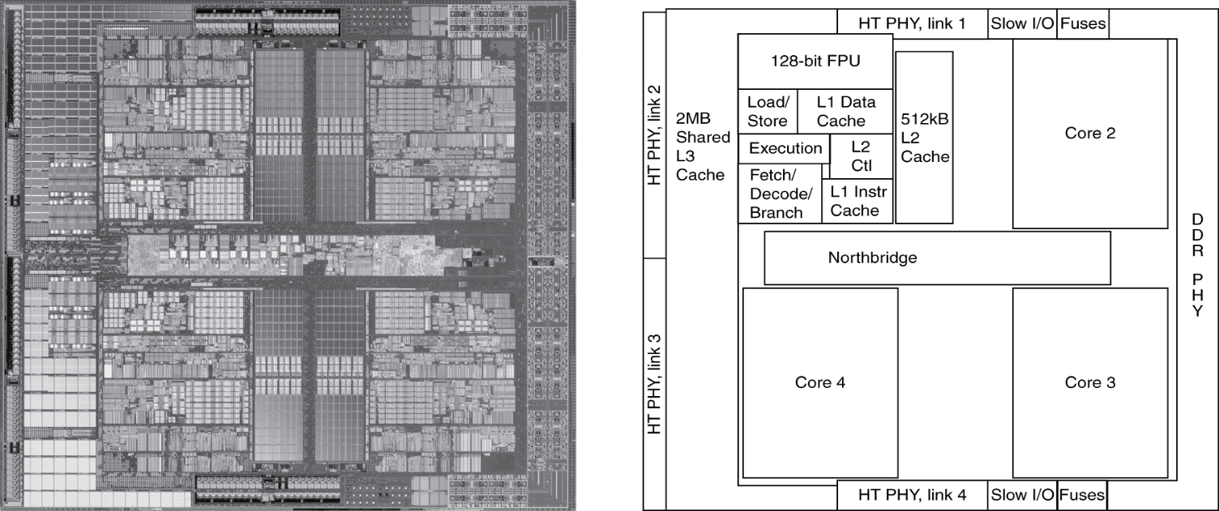
6.4 Cache Memories
Cache: A smaller, faster storage device that acts as a staging area for a subset of the data in a larger, slower device.
AMD Barcelona (2007): 4 processor cores

Slide 38
Four Questions for Cache Design
Q1: Where can a block be placed in the upper level? => Block placement
Q2: How is a block found if it is in the upper level? => Block finding
Q3: Which block should be replaced on a miss? => Block replacement
Q4: What happens on a write? => Write strategy
Remember: The byte address of a data item determines where a block is placed and how
the block is found.
Notes:
Same questions we ask for accessing a table structure
Difference: this is cache: temporary space, data come and goes. It is a fix, small space. If no room for a new one, replace the old one.

Slide 39
Two Simple Caches
0101
tag
01
tag
0001
0101
0101
Cache 1
Cache 2
00
01
10
11
0001
Where do I place this yellow block?
00
In cache 1, I can place the yellow block in any one
of the four blocks?
In cache 2, I can place the yellow block only at
the cache block with identical lower two bits
Cache1 is fully associative?
Cache2 is direct-mapped
0000
0001
0010
0011
0100
0101
0110
0111
Each block is a cache line with 64Bytes
These are cache line (aka block) address

Slide 40
Which one is better?
0001
0101
0101
Cache 1
Cache 2
00
01
10
11
0001
Where do I place this yellow block?
In cache 1, I can place the yellow block in any one
of the four blocks?
In cache 2, I can place the yellow block only at
the cache block with identical lower two bits
Cache1 is fully associative?
Cache2 is direct-mapped
Hit better, fewer misses
Faster to find, cheaper (small tag)
0000
0001
0010
0011
0100
0101
0110
0111

Slide 41
Tags and Valid Bits - Block Finding
How do we know which particular block is stored in a cache location
Store the block address as well as the data
Actually, only need the high-order bits
Called the tag
What if there is no data in a location
Valid bit: 1 = present, cache line valid
Valid bit = 0
When a cache line of data has not come back from memory yet
Cache line is currently being replaced
Cache is flushed
Tag (block address)
Byte offset
Tag
Set selection
Byte offset
Notes:
tag用来标识地址信息，valid表示用来标识当前的数据是否有效

Slide 42
Cache Example (1)
8-blocks, 1 word/block, direct-mapped
Initial state of cache
A set is a group of lines that can hold memory blocks.
Index | V | Tag | Data
000 | N
001 | N
010 | N
011 | N
100 | N
101 | N
110 | N
111 | N
8 sets

Slide 43
Cache Example (2)
Step 1
Check hit/miss
determine the set #
Address (decimal) | Address (binary) | Hit/miss | Cache block
22 | 10 110 | Miss | 110
Index | V | Tag | Data
000 | N
001 | N
010 | N
011 | N
100 | N
101 | N
110 | N
111 | N
Step 2
Check tag
Determine hit/miss
Step 3
If miss
Copy from Mem to $
Setting Valid bit
Setting tag
110 | Y | 10 | Memory[10110₂]

Slide 44
Cache Example (3)
Address (decimal) | Address (binary) | Hit/miss | Cache block
26 | 11 010 | Miss | 010
Index | V | Tag | Data
000 | N
001 | N
010 | N
011 | N
100 | N
101 | N
110 | Y | 10 | Memory[10110₂]
111 | N
010 | Y | 11 | Memory[11010₂]

Slide 45
Cache Example (4)
Address (decimal) | Address (binary) | Hit/miss | Cache block
22 | 10 110 | Hit | 110
26 | 11 010 | Hit | 010
Index | V | Tag | Data
000 | N
001 | N
010 | Y | 11 | Memory[11010₂]
011 | N
100 | N
101 | N
110 | Y | 10 | Memory[10110₂]
111 | N

Slide 46
Cache Example (5)
Address (decimal) | Address (binary) | Hit/miss | Cache block
16 | 10 000 | Miss | 000
16 | 10 000 | Hit | 000
3 | 00 011 | Miss | 011
Index | V | Tag | Data
000 | N
001 | N
010 | Y | 11 | Memory[11010₂]
011 | N
100 | N
101 | N
110 | Y | 10 | Memory[10110₂]
111 | N
000 | Y | 10 | Memory[10000₂]
011 | Y | 00 | Memory[00011₂]

Slide 47
Cache Example (6)
Address (decimal) | Address (binary) | Hit/miss | Cache block
18 | 10 010 | Miss | 010
Index | V | Tag | Data
000 | Y | 10 | Memory[10000₂]
001 | N
010 | N
011 | Y | 00 | Memory[00011₂]
100 | N
101 | N
110 | Y | 10 | Memory[10110₂]
111 | N
010 | Y | 10 | Memory[10010₂]

Slide 48
A Quick Review of Cache
A cache is divided into smaller units called Cache Lines (or blocks).
Each cache line typically contains:
Data Block: The actual data fetched from main memory or the lower-level cache.
Tag: A unique identifier containing part of the memory address to indicate exactly which block of main memory is currently stored in that line.
Valid Bit: A single bit indicating whether the cache line is valid or is invalid.
Notes:
tag用来标识地址信息，valid表示用来标识当前的数据是否有效

Slide 49
Set Associative Caches
Cache Structure: Sets and Ways
A cache is divided into a fixed number of Sets.
Each Set contains a fixed number of cache lines (i.e. blocks). This number is known as the Associativity or the number of Ways.
So, a cache described as "N-way set-associative" means there are N cache lines within each set.
Example:
A 4-way set-associative cache has 4 cache lines in every set.
A direct-mapped cache is a one-way cache: each set has only one line
A fully associative cache is a one-set cache. All lines are kept in one set.
Notes:
tag用来标识地址信息，valid表示用来标识当前的数据是否有效

Slide 50
Exercise 1
We have a 16KB cache, and the line (block) size is 64B.
Question: How many cache lines (blocks) are in this cache?
16KB/64B = 256. This cache has 256 lines
What if this cache is direct mapped? How many sets are there?
A direct-mapped cache has one line per set. So there are 256 sets.
What if this cache is two-way associative? How many sets are there?
A two-way set associative cache has two lines per set. So there are 128 sets.

Slide 51
Associativity Structures
Example: An 8-block cache
Direct-Mapped
Two-Way
Set-Associative
Four-Way
Set-Associative
Fully
Associative

Slide 52
Address Subdivision for Set Associative Caches (1)
Assume a 16KB cache, line (block) size is 64B.
Case 1: direct mapped
31
14
13
6
5
0
256 sets
Tag
Set selection / Index
Byte offset
Case 2: Fully associative
31
6
5
0
1 set
Tag
Byte offset
Case 3: Two-way set associative
31
13
12
6
5
0
128 sets
Tag
Set selection
Byte offset
Case 4: Four-way set associative
31
12
11
6
5
0
64 sets
Tag
Set selection
Byte offset

Slide 53
Address Subdivision for Set Associative Caches (2)
Assume a 64KB cache, line (block) size is 128 B.
Case 1: direct mapped
31
?
?
?
?
0
? sets
Tag
Set selection
Byte offset
Case 2: Fully associative
31
?
?
0
1 set
Tag
Byte offset
Case 3: Two-way set associative
31
?
?
?
?
0
? sets
Tag
Set selection
Byte offset
Case 4: Four-way set associative
31
?
?
?
?
0
? sets
Tag
Set selection
Byte offset

Slide 54
Address Subdivision for Set Associative Caches (2)
Assume a 64KB cache, line (block) size is 128 B.
Case 1: direct mapped
31
16
15
7
6
0
512 sets
Tag
Set selection
Byte offset
Case 2: Fully associative
31
7
6
0
1 set
Tag
Byte offset
Case 3: Two-way set associative
31
15
14
7
6
0
256 sets
Tag
Set selection
Byte offset
Case 4: Four-way set associative
31
14
13
7
6
0
128 sets
Tag
Set selection
Byte offset

Slide 55
Exercise 2
We have a 64KB direct mapped cache, the line (block) size is 64B, indicate how each part of the address bits are used in reading the cache.
Basic information: Assume the address is
The cache is direct-mapped. 0x0000AAAA
It has 64KB/64B = 1024 sets 0000 0000 0000 0000 1010 1010 10 101010
31
16
15
6
5
0
Tag
Set selection
Byte offset
Valid | Tag | Data
Set 0
Set 1
…….
Set 1023

Slide 56
Exercise 3
How many total bits are required for a direct-mapped cache with 16 KB of data and 16-word blocks?
A block size of 16 words means the line size is 64B, so 16K/64 = 256. There are 256 blocks:
For each block
Data part: 64x8 bits (i.e., 64B)
Tag part: 32-8-6 = 18 bits
Valid bit: 1 bit
Total: 256 * (64x8 + 18 + 1) = 136 Kb
Tag
Set
Byte offet

Slide 57
Exercise 3: A Case for Direct Mapped Cache
Assuming 32b addresses, how many a) tag bits and b) number of sets are used for the following direct-mapped caches?
Cache Size | Block (Line) size | Tag bits | Number of Sets
16KB | 64B
32KB | 64B
32KB | 32B
1MB | 64B
1MB | 32B
4MB | 64B
8MB | 64B
18
256
17
512
17
1024
12
16K
12
32K
10
64K
8
256K

Slide 58
Example: Intrinsity FastMATH (1)
Cache size:
Line size:
Number of Sets
Direct mapped:
If Fully associative:
Set associative
Tag bits:
Valid bit:
16KB
64B
256
1
32 – 6 – 8 = 18
1
Question: How to reduce the cost of the tag?
Answer: Increase the line size and the number of sets
Notes:
Intrinsity is a company, it was acquired by Apple in 2010
Designed for signal processing, graphics, and scientific computing

Slide 59
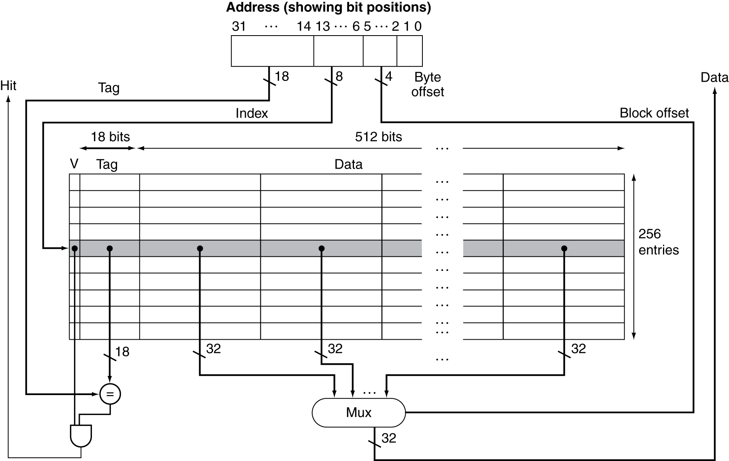
Example - Intrinsity FastMATH (2)
Cache: 16KB
256 blocks × 16 words/block

Slide 60
Block Size Considerations
Larger blocks should reduce miss rate
Higher spatial locality
Also reduce tag cost
But in a fixed-sized cache
Larger blocks ⇒ fewer blocks
More competition ⇒ increased the miss rate
Lower temporal locality
Larger miss penalty
Larger blocks ⇒ pollution
Transfer overhead (multiple bus cycles)
Can override the benefit of reduced miss rate
Early restart and critical-word-first can help to reduce transfer latency.
Small caches
Need balance
Large caches
like larger lines
Notes:
Lower temporal locality
Common bus widths are 64-128b
GPU has wider bus: 256-512

Slide 61
Cache Hit and Miss
Cache read
Read hit
Read miss
Cache write
Write hit
Write-through
Write-back
Write miss
Write allocate
No-write allocate
Write-through: every time the CPU writes data to the cache,
that same data is simultaneously written directly to main
Memory (or the next level of cache)
Write-back: the CPU writes data only to the cache initially.
Main memory (or the next level) is not updated right away.
Update happens only when the cache line is replaced.
Write-allocate: If the data being written is not in the cache, the entire block containing that data is first read from main memory and loaded into the cache, and then the write operation is performed on the cached copy
No-write-allocate: If the data being written is not already in the cache, it is written directly to main memory, and the cache is bypassed.

Slide 62
Cache Hit and Miss
Question: How do we know when to use
write-allocate? when to use no-write-allocate?
For example:
In strcpy(), memset(), memcpy(),
initialization of arrays, … no-allocate
In local variable updates
In array element updates write-allocate
….
Cache read
Read hit
Read miss
Cache write
Write hit
Write-through
Write-back
Write miss
Write allocate
No-write allocate
Most caches today are using write-back and
write-allocation policy

Slide 63
Write Allocate vs Write-no-allocate
On a write miss:
Write-Allocate:
The system first loads the missing data block from main memory into the cache, then writes the new data to the cache line.
Often work with copy-back caches.
The initial cost is high, and the reuse is fast.
Write-NoAllocate:
The system bypasses the cache and writes directly to main memory, without loading the block into the cache. The write may be sent to a write buffer waiting for a write-combining opportunity, rather than writing to memory directly.
Often work with write-through cache.
Initial action is fast, but the reuse would be slow. Best case: writing logs.
Notes:
Modern caches are non-blocking: stall on miss or stall-on use

Slide 64
Cache Read
Read Hit
On a cache hit, CPU proceeds normally
Read Miss
On a cache miss
Stall the CPU pipeline (for blocking or lockup cache)
Fetch block from next level of hierarchy
Instruction cache miss
Restart instruction fetch
Data cache miss
Complete data access
Notes:
Modern caches are non-blocking: stall on miss or stall-on use

Slide 65
Non-Blocking Cache
On a blocking cache
A cache miss stalls the CPU pipeline.
Called Stall-on-Miss
Non-blocking cache
On a cache miss, the CPU doesn't stall the pipeline; it can continue working on other instructions while the data is being fetched. A stall occurs only when the fetched data is required.
Use the Miss Status Holding Register (MSHR) to track outstanding misses
Called Stall-on-Use
Two standard models: Hit-under-miss and Miss-under-miss
Non-blocking caches (also called lockup-free caches) support MLP (Memory Level Parallelism)
Notes:
Modern caches are non-blocking: stall on miss or stall-on use

Slide 66
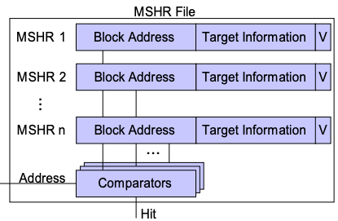
Non-Blocking Cache
On a blocking cache
A cache miss stalls the CPU pipeline.
Called Stall-on-Miss
Non-blocking cache
On a cache miss, the CPU doesn't stall the pipeline; it can continue working on other instructions while the data is being fetched. A stall occurs only when the fetched data is required.
Use the Miss Status Holding Register (MSHR) to track outstanding misses
Called Stall-on-Use
Two standard models: Hit-under-miss and Miss-under-miss
Non-block caches (also called lockup-free caches) support MLP (Memory Level Parallelism)
Notes:
Modern caches are non-blocking: stall on miss or stall-on use

Slide 67
Instruction Cache Miss Handling
On instruction cache miss
Send the original PC value to the memory.
Instruct main memory to perform a read and wait for the memory to complete its access.
Write the cache entry, putting the data from memory in the data portion of the entry, writing the upper bits of the address into the tag field, and turning the valid bit on.
Restart the instruction execution at the first step, which will re-fetch the instruction, this time finding it in the cache.
Instruction cache prefetching is a commonly used hardware optimization to reduce instruction cache misses.
Question 3:Why does the GPU prefetch for the next 10-12 lines, but the CPU only prefetches for 1-2 lines?
Question 1: Can you prefetch for
instruction cache in software?
Question 2:If we prefetch on every miss, why not just use a larger cache line size?
Notes:
GPU would prefetch for the next 10-12 instruction cache lines

Slide 68
Instruction Cache Miss Handling
Large line increases the cost of every miss
Branches make huge lines wasteful
Large lines reduce effective cache capacity – more likely to cause conflict
Prefetch is more flexible
In summary: large line and small line+prefetch only similar for sequential execution, not for all cases.
For a large line, fetch the code block, and pay for the next few code blocks
For smaller lines + prefetch, it is like fetching the current block, and fetching the next block if it is deemed useful.
Main() {
.....
for() {
…..
….
…
If () {f1();.. f2();}
prefetch (&f3())
…
…
…
f3(); // I$ miss
…
}
On instruction cache miss
Send the original PC value to the memory.
Instruct main memory to perform a read and wait for the memory to complete its access.
Write the cache entry, putting the data from memory in the data portion of the entry, writing the upper bits of the address into the tag field, and turning the valid bit on.
Restart the instruction execution at the first step, which will re-fetch the instruction, this time finding it in the cache.
Instruction cache prefetching is a commonly used hardware optimization to reduce instruction cache misses.
Notes:
GPU would prefetch for the next 10-12 instruction cache lines

Slide 69
Write Hit - Write-Through Policy
Write through: Also update data in memory
Advantage: Ensure fast retrieval while making sure the data is in the backing store and is not lost in case the cache is disrupted
Disadvantage: Writing data will experience latency as you have to write to two places every time
Increase the traffic to memory
Writes take longer
If base CPI = 1, 10% of instructions are stores, write to memory takes 100 cycles, e.g., Effective CPI = 1 + 0.1×100 = 11
Solution: Write Buffer
Hold data waiting to be written to memory
CPU continues immediately
Only stalls on write if the write buffer is full
Notes:
分为直写法 write through和 写缓冲 write buffer

Slide 70
Avoid Waiting for Memory in Write Through
Use a write buffer (WB)
Processor: Writes data into cache and WB
Memory controller: Write WB data to memory
Write Buffer is just a FIFO
Typical number of entries: 4
Memory system designer’s nightmare
Store frequency > 1 / DRAM write cycle
Write buffer saturation => CPU stalled
Write buffer allows write-coalescing/combining to reduce traffic to memory
Yet another reason to go for
write-back cache
Processor
Cache
DRAM
Memory controller
Store Buffer
Notes:
一个比较麻烦的情况是store instruction的频率要比写进主存的频率要快，那么这个时候write buffer就会填满，这个时候CPU发生阻塞， stalled
You are right, memory is too slow. We really didn't write to the memory directly. We are writing to a write buffer.
Once the data is written into the write buffer and assuming a cache hit, the CPU is done with the write. The memory controller will then move the write buffer contents to the real memory behind the scene.
The write buffer works as long as the frequency of store is not too high. Notice here, I am referring to the frequency with respect to time, not with respect to number of instructions.
Remember the DRAM cycle time we talked about last time. It sets the upper limit on how frequent you can write to the main memory.
If the store are too close together or the CPU time is so much faster than the DRAM cycle time, you can end up overflowing the write buffer and the CPU must stop and wait.
+2 = 60 min. (Y:40)

Slide 71
Write Hit - Write-Back Policy
Just update the block in cache
Keep track of whether each block is dirty, one dirty bit is required
When a dirty block is replaced
Write it back to memory
Can use a write buffer to allow a replacing block to be read first
Data in cache and memory is inconsistent (what if the other processor wants to read the shared data)
Advantage: Low latency and high throughput for write-intensive applications. Much lower memory traffic (Significant for multi-processor systems).
Disadvantage: There is a data availability risk because the cache could fail (and so suffer from data loss) before the data is persisted to the backing store (This is why caches are often enhanced with ECC for protection against errors)
Notes:
The story of HP 4 core system vs 6-core system. Some existing solutions: ECC, battery backup, duplicated cache, NVM as cache

Slide 72
Writeback-buffer
Writeback buffer:
Sit between the copyback data cache and the next lower-level memory. Dirty cache lines can be written to memory asynchronously, reducing stall time.
Improves overall memory throughput: Reads can proceed while writes sit in the buffer
Processor
Copy-back
Data Cache
Writeback
buffer
Memory
Notes:
We usually do not worry about write-allocate or no-allocate. The commonly used cache is copy back cache.

Slide 73
Example - Intrinsity FastMATH
Embedded MIPS processor
12-stage pipeline
Instruction and data access on each cycle
Split cache: Separate I-cache and D-cache
Each 16KB: 256 blocks × 16 words/block
D-cache: Write-through or write-back
SPEC2000 miss rates
I-cache: 0.4%
D-cache: 11.4%
Weighted average: 3.2%
SPEC2000 benchmarks are desktop apps
Instruction locality is higher
DBMS apps, Virtual machines, Interpreters,
JIT compilers, and object-oriented programs
tend to have more I-cache misses
Notes:
This is for vector/matrix operations. So I-cache miss rate is extremely low. This is not true for DBMS such as oracle. In HP PA-RISC processor, I-cache is 1MB.

Slide 74
Review
Cache organization
Set associative cache
Where in the address are the index (set selection) bits?
Where in the address are the tag bits
Cache Hit
Write-through // write-buffer
Write-back // Significantly cut down the memory traffic, extremely important for multi-core systems. Have a writeback buffer.
Cache Miss
Write-noallocate // bypass the cache
Write-allocate // presume data will be used later
Non-blocking cache // Support MLP (Memory Level Parallelism)
Notes:
Miss penalty may be different

Slide 75
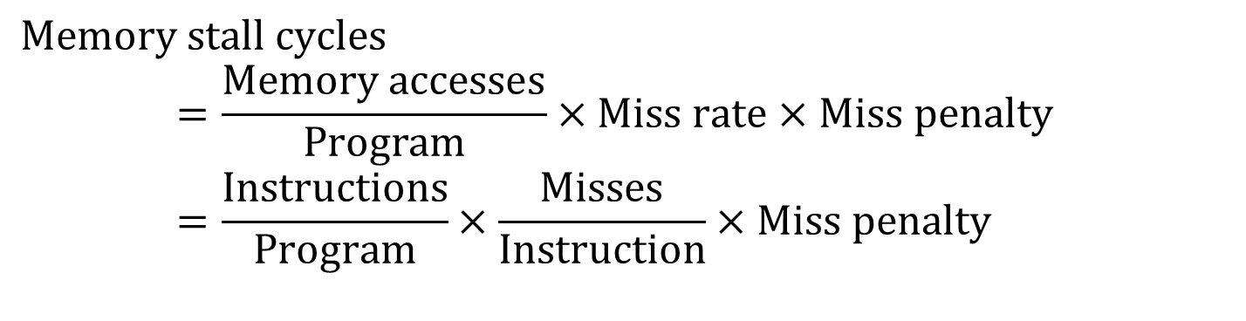
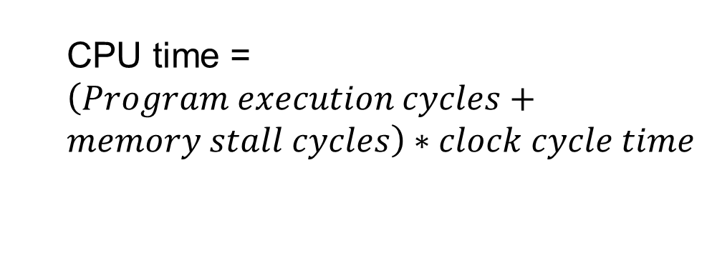
Measuring Cache Performance
Components of CPU time
Program execution cycles
Includes cache hit time
Memory stall cycles
Mainly from cache misses
With simplified assumptions (equal penalty for read/write)
CPU time = $\left(Program execution cycles+memory stall cycles\right)∗clock cycle time$
$$Memory stall cycles \\ =\frac{Memory accesses}{Program}×Miss rate×Miss penalty \\ =\frac{Instructions}{Program}×\frac{Misses}{Instruction}×Miss penalty$$
Notes:
Miss penalty may be different

Slide 76
Cache Performance Exercise
Given
I-cache miss rate = 2%
D-cache miss rate = 4%
Miss penalty = 100 cycles
Base CPI (ideal cache) = 2
Load & stores are 36% of instructions
Compute the actual CPI and how many times faster it would be with a perfect cache?
Notes:
36% is conservative
CPI = 2 is probably too high. Typical ratio is 1.1 to 1.5

Slide 77
Cache Performance Exercise
Given
I-cache miss rate = 2%
D-cache miss rate = 4%
Miss penalty = 100 cycles
Base CPI (ideal cache) = 2
Load & stores are 36% of instructions
Compute the actual CPI and how many times faster if with perfect cache?
Miss cycles per instruction
I-cache: 0.02 × 100 = 2
D-cache: 0.36 × 0.04 × 100 = 1.44
Actual CPI = 2 + 2 + 1.44 = 5.44
5.44/2 =2.72 times faster
Typical CPI of a pipelined processor with
perfect caches may be 1.1 – 1.5.
If you see a benchmark reporting a CPI of 10,
What would be the performance bottleneck?
Notes:
这是书上的一个例子

Slide 78
Average Memory Access Time (1)
Hit time is also important for performance (hit may take > 1 cycle)
Average memory access time (AMAT)
Data Cache AMAT = Hit time + Miss rate × Miss penalty
Overall AMAT = %instr x (Instruction cache AMAT) + %data x (Data Cache AMAT)
Example
CPU with 1ns clock, hit time = 1 cycle, miss penalty = 20 cycles, cache miss rate = 5%
AMAT = 1 + 0.05 × 20 = 2ns
2 cycles per instruction

Slide 79
Hit time is also important for performance (hit may take > 1 cycle)
Average memory access time (AMAT)
Data Cache AMAT = Hit time + Miss rate × Miss penalty
Overall AMAT = %instr x (Instruction cache AMAT) + %data x (Data Cache AMAT)
Example
CPU with 1ns clock, hit time = 1 cycle, miss penalty = 20 cycles, cache miss rate = 5%
AMAT = 1 + 0.05 × 20 = 2ns
2 cycles per instruction
Typical L1D hit latency Today
Intel Skylake/Ice lake | 4-5 cycles
AMD Zen | 4-5 cycles
ARM | 3-4 cycles
VA to PA, index | Tag comparison | Align, ECC | Forwarding/reg

Slide 80
AMAT (2)
Hit time is also important for performance
Average memory access time (AMAT)
Data Cache AMAT = Hit time + Miss rate × Miss penalty
Overall AMAT = %instr x (Instruction cache AMAT) + %data x (Data Cache AMAT)
%instr refers to the percentage of instruction accesses in relation to the total memory accesses, while %data represents the percentage of data accesses compared to the total memory accesses.
Usually, %instr is higher than %data. But I-cache hits better.
With SIMD/Vector loads/stores, %data could be higher than %instr

Slide 81
AMAT No Longer Accurate
AMAT was a popular and accurate way to estimate memory performance during the 80s-90s.
Blocking caches
In-order execution processors
AMAT faded away as cache miss latency can be hidden
Out-of-Order Execution Processors
Non-blocking caches with miss-under-miss
Cache prefetching
Split I/D cache
Notes:
small, Direct mapped,
Associative,
Multi-level

Slide 82
Low Hit Latency
Small and Simple
small is fast
Direct-map or low associativity
Prediction (predict which way to compare first)
Virtual address cache or virtual index and physical tagged cache
avoid or overlap with address translation delay
Cache layout closer to CPU to minimize signal delay.
More
Advanced
Techniques
Notes:
small, Direct mapped,
Associative,
Multi-level

Slide 83
Lower Misses: Associative Caches
Fully associative
Allow a given block to go in any cache entry
Requires all entries to be searched at once
Comparator per entry (expensive and slow)
n-way set associative
Each set contains n entries
Block number determines which set
(Block number) modulo (#Sets in cache)
Search all entries in a given set at once
n comparators (less expensive and fast)
Set number
Cache block (line) number
Byte offset
Address
Notes:
fully associative is 1-set set-associative
Direct mapped is 1-way set associative

Slide 84
Pop Quiz
Which of the following statements are true?
A fully associative cache is a 1-way cache
A Direct-mapped cache is a 1-set cache
A 2-way set associative cache has more sets than a 4-way one.
A direct mapped cache has the least tag overhead
A fully associative cache has more cache lines than a direct mapped cache.
3,4
Notes:
fully associative is 1-set set-associative
Direct mapped is 1-way set associative

Slide 85
Pop Quiz on set associative caches
Which of the following statements are true?
A fully associative cache is a 1-way cache
A Direct-mapped cache is a 1-set cache
A 2-way set associative cache has more sets than a 4-way one.
A direct mapped cache has the least tag overhead
A fully associative cache has more cache lines than a direct mapped cache.
N-way cache,
N is the number of cache line
1-way cache,
It has N sets
One tag per cache line
Least number of tag bits
Same number
Number of cache lines is
determined by the cache size
and the line size
Notes:
fully associative is 1-set set-associative
Direct mapped is 1-way set associative

Slide 86
Associativity Example (1)
Compare 4-block caches
Direct mapped (1-way), 2-way set associative, fully associative (4-way)
Assume block access sequence: 0, 8, 0, 6, 8
Direct mapped
Compulsory miss
Conflict miss
Block address | Cache index | Hit/miss | Cache content after access
 |  |  | 0 | 1 | 2 | 3
0 (0000) | 0 | miss | Mem[0]
8 (1000) | 0 | miss | Mem[8]
0 (0000) | 0 | miss | Mem[0]
6 (0110) | 2 | miss | Mem[0] |  | Mem[6]
8 (1000) | 0 | miss | Mem[8] |  | Mem[6]
time

Slide 87
Associativity Example (2)
2-way set associative (0, 8, 0, 6, 8)
Block address | Cache index | Hit/miss | Cache content after access
 |  |  | Set 0 |  | Set 1
0 (0000) | 0 | miss | Mem[0]
8 (1000) | 0 | miss | Mem[0] | Mem[8]
0 (0000) | 0 | hit | Mem[0] | Mem[8]
6 (0110) | 0 | miss | Mem[0] | Mem[6]
8 (1000) | 0 | miss | Mem[8] | Mem[6]
time
Fully associative (0, 8, 0, 6, 8)
Block address |  | Hit/miss | Cache content after access
0 |  | miss | Mem[0]
8 |  | miss | Mem[0] | Mem[8]
0 |  | hit | Mem[0] | Mem[8]
6 |  | miss | Mem[0] | Mem[8] | Mem[6]
8 |  | hit | Mem[0] | Mem[8] | Mem[6]
time

Slide 88
Conflicts in set-associative caches
In the above example, the cache has only 4 blocks.
For a direct-mapped cache, the following sequence of block addresses will run into intensive conflict misses.
0, 4, 8, 12, 16, 20… or 1,5,9,13,17,21… or 2,6,10, 14, 18….
As long as the distance is a multiple of the cache size
For set-associative caches, each set can accommodate more lines so that misses would reduce.
Notes:
关联度：associativity
边际递减效应

Slide 89
Conflict Misses
Conflict misses occur when multiple lines are mapped to the same set
Their set select bits (index bits) are identical !!
When the address distance between two lines is multiple of the cache size, the set selection bit will be identical.
Example: 4KB direct mapped cache, with 64B cache line. There are 64 sets
If the distance to another line address is +4096
31
12
11
6
5
0
Tag
0
Set selection
Byte offset
Identical
31
12
11
6
5
0
Tag
1
Set selection
Byte offset

Slide 90
Common Cases for Conflict Misses
Assuming direct-mapped caches, cache size 4KB, line size 64B.
Scenario 1
I-cache:
Procedure A calls Procedure B, the distance between A and B is a multiple of 4K
Scenario 2
D-cache
Float A[1024][1024];
loop on j
{B[i] =A[i][j] + A[i+1][j];}
Scenario 3
D-cache
Double A[1024], B[1024], C[1024];
for(i) {C[i] = A[i] + B[i];}

Slide 91
Common Cases for Conflict Misses
Assuming direct-mapped caches, cache size 4KB, line size 64B.
Scenario 1
Icache:
Procedure A calls Procedure B, the distance between A and B is multiple of 4K
Scenario 2
Dcache
Float A[1024][1024];
loop
{B[i] =A[i][j] + A[i+1][j];}
Scenario 3
Dcache
Double A[1024], B[1024], C[1024];
for(i) {C[i] = A[i] + B[i];}
Code Repositioning: Layout B next to A
A[1024][1040]
A[1024], Dummy0[8], B[1024], Dummy1[8], C[1024]
However, this may not always work, since the compiler may
remove dummy[] because they are not used.

Slide 92
Cache Block Replacement
Direct mapped: No choice; each set has only one line
Set associative or fully associative
Random
LRU (Least Recently Used)
Hardware keeps track of the access history and replaces the block that has not been used for the longest time
An example of a pseudo LRU (for a two-way set associative)
Use a pointer to point at each block in turn
Whenever access to the block the pointer is pointing at, move the pointer to the next block
When need to replace, replace the block currently pointed at
FIFO (First-In First Out)
Replacing older data
True LRU needs to use a stack, but stack ops
are expensive
Assume a set has 3 blocks. A calls B, B returns, A calls C, C calls D.
The cache set now has A, B, and C blocks. When D is referenced, which block should be replaced? LRU → B, FIFO → A

Slide 93
Cache Block Replacement
General LRU Strategy Implementation:
e.g. for a 4-block/set cache, use a log_2(4) = 2 bit counter for each block
Reset the counter to 0 whenever the block is accessed
Counters of other blocks in the same set should be incremented
On cache miss, replace/ uncache a block with a counter reaching 3
Optimal Replacement
Belady’s algorithm
Replace the block that will be referenced in the farthest future
(or Replace the item not needed for the longest time)
This gives the optimal hit rate, but not the least memory traffic (because replacing a clean block is cheaper)
Not implementable because we do not know the future.
Notes:
Laszlo Belady

Slide 94
A Case that DM is better than FA
If a loop has 5 cache lines, line 0, line 1, line 2, line 3, line 4.
the cache is a Direct-Mapped (DM) with 4 blocks. So line 0 and line 4 will be mapped to the same set, while line 1,2, and 3 each map to different sets. The loop will have 60% of hit rate – line 1, line 2 and line 3 will hit, and line 0 and line 4 will conflict with each other all the time.
If the cache is Fully Associative (FA), and the replacement algorithm is LRU, then the loop will have 0% of hit. All lines will be missed in the cache. 0,1,2,3,4 (line4 misses, will replace 0), 0 misses, will replace 1, 1 misses, will replace 2, 2 misses, will replace 3…
Why not consider using random replacement?
What could be a better combination? Some adaptive approach?

Slide 95
Classifying Cache Misses (3 C’s or 4 C’s)
Compulsory (or Cold) Miss
when a piece of data is requested for the very first time
and needs to be brought into the cache
1,4,3,5,7
Conflict (or Collision) Miss
Multiple references are mapping to the same set, and
The set is not large enough to hold them. “Collision”
caused misses.
3,4,8,11,12,19, 4
0 | 1 | 2 | 3 | 4 | 5 | 6 | 7
0 | 1 | 2 | 3 | 4 | 5 | 6 | 7
Capacity Miss
Cache is not large enough to hold needed
Blocks
1,2,3,4,5,6,7,8,9,1,2,3,4,5,6,7,8,9
Coherency Miss
Occurs when invalidation requests are issued by other processors in a multiprocessor system to maintain coherence of cached data
0 | 1 | 2 | 3 | 4 | 5 | 6 | 7
3C is foundational, 4C is more advanced

Slide 96
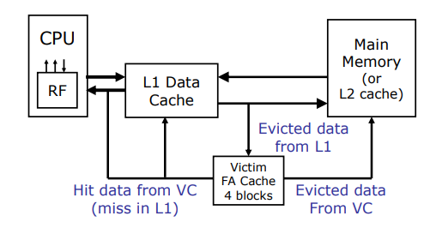
Victim Cache
A small fully-associative backup cache, called victim cache, could be added to a direct-mapped L1 cache to hold evicted cache lines recently.
To defend for cases where some repeated access patterns (maybe bursty) incur multiple power-of-two addresses and cause intensive conflict misses.
The victim cache is small, usually 4-8 lines, so it can be accessed quickly.
Consider a sequence:
0, 4, 8, 2, 3, 12, 4, 8, 0, 12, 4, 0, 5,6,……
0, 4, 8, 12 may be mapped to the same set,
so the hit rate is low, but all of them could be
sitting in the victim cache.

Slide 97
Victim Cache
A small fully-associative back up cache, called victim cache, could be added to a direct-mapped L1 cache to hold recently evicted cache lines.
To defend for cases where some repeated access patterns incur multiple power-of-two addresses and cause intensive conflict misses. Note that such conflict misses are often occur within a small number of sets
The victim cache is small, usually 4-8 lines, so it can be accessed quickly.
Combining the advantages of a direct
mapped cache and the benefit of a fully
associative cache.

Slide 98
Associativity and Miss Rates
In general, increased associativity decreases miss rate
But with diminishing returns
Simulation of a system with 64KB D-cache, 16-word blocks, SPEC2000
1-way: 10.3%
2-way: 8.6%
4-way: 8.3%
8-way: 8.1%
A more general estimation
Associativity | General miss rate
Direct-mapped | 3% - 10%
2-way | 2% - 7%
4-way | 1.5% - 5%
8-way | 1% - 4.5%
A sweet spot
Notes:
关联度：associativity
边际递减效应

Slide 99
DM+VC or Two-way Associative Cache?
Both Direct-mapped cache enhanced with a Victim cache and a two-way set-associative cache can reduce conflict misses. Which one is better?
Victim cache
Good at handling repetitive references to clustered conflict misses
Higher temporal locality
For example: 4,8,12,16, 20, 24, 4,8,12,16,20, …..
Two-way set-associative cache
Good at handling evenly distributed conflict misses from many sets.
Lower temporal locality
For example: 4,8,4,7, 11,15, 8, 6, 10, 8, 6, 7, 8, 11, 10, 15…..
In general-purpose systems (e.g., desktops, servers, laptops), two-way set associative caches are far more common. Direct-mapped caches + victim cache are more specialized and are typically found in embedded systems, older designs, or cost-driven applications.
Here, we assume the cache has
4 lines. 4, 8, 12 are cache line (block)
Address. Line 4 and line 8 map to the
same set.
Line 7, 11, 15 map to the same set.
Line 6, 10 map to the same set.

Slide 100
Pop Quiz
My application experiences intensive conflict misses. After reviewing the computer configuration, I discovered that the L1D cache is direct-mapped. Which of the following may reduce the cache misses in my application?
A larger L1D cache
A higher associative L1D cache
A larger line size
A larger tag
Redesign the algorithm of the application
1,2,5
Notes:
fully associative is 1-set set-associative
Direct mapped is 1-way set associative

Slide 101
Pop Quiz
Assume the L1D cache is 4KB, and the line size is 64B
Array A and B are defined as double A[4096], B[4096];
Which loops will experience frequent conflict misses in a direct-mapped cache?
for (i=0; i<n; i++) A[i]=B[i];
for (i=0; i<n; i++) A[i]=A[i-1]+A[i+1];
for (i=0;i<n;i++) A[i] = 0;
for (j=0; j<m; j++)
for (i=0; i<10; i++) A[i] += A[i+1024]*C;
1,4
Notes:
fully associative is 1-set set-associative
Direct mapped is 1-way set associative

Slide 102
Improving Cache Performance
Reduce the cache hit time
Decrease the cache miss ratio
Decrease the cache miss penalty
Average memory access time =
hit time + miss-rate X miss-penalty
Notes:
small, Direct mapped,
Associative,
Multi-level

Slide 103
Multilevel Caches
Primary cache is next to the CPU
Small and fast
Level-2 cache services misses from the primary cache
Larger, slower, but still much faster than main memory
High-end systems often include an L3 cache, L3 cache is usually shared by multiple cores on the same chip.
We need to maintain consistency across different levels of the cache.

Slide 104
Multilevel Cache AMAT
AMAT = L1 hit time + L1 miss rate * L1 miss penalty
L1 miss penalty = L2 hit time + L2 miss rate * L2 miss penalty
So in total:
AMAT = L1 hit time + L1 miss rate * (L2 hit time + L2 miss rate * L2 miss penalty )
Beware, the L2 miss rate here is a relative miss rate: the ratio of L1 misses that miss the L2.
Typical Hit Rates (Approximate):
L1 Cache: 80-95%
L2 Cache: 50-80% (L2 accesses are L1 misses)
L3 Cache: 20-40% (L3 accesses are L2 misses, the references to L3 are tough memory references)

Slide 105
Multilevel Cache Example (1)
Given
CPU base CPI = 1, clock rate = 4GHz
Miss rate/instruction = 2%
Main memory access time = 100ns
With just primary cache (L1)
Miss penalty = 100ns/0.25ns = 400 cycles
Effective CPI = 1 + 0.02 × 400 = 9

Slide 106
Multilevel Cache Example (2)
Once again, AMAT is only an approximation,
It is not accurate when the cache miss penalty
can be overlapped with other instruction executions
Now add an L2 cache
L1 miss rate to L2 = 2%
L2 access time = 5ns (to M: 100ns)
L2 miss rate to main memory = 50%
Primary miss with L2 hit (2%)
Penalty to access L2 = 5ns/0.25ns = 20 cycles
Primary miss with L2 miss (20%) // assuming 80% hit in L2
Penalty to access memory = 400 cycles
CPI = 1 + 0.02 × (20 + 0.2 × 400) = 1 + 2 = 3
Performance ratio = 9/3 = 3
Notes:
这个是书上的计算公式，可能是错的，

Slide 107
Multilevel Cache Considerations
L1 cache
Focus on minimal hit time, must be fast
Spatial locality more important
Write-through to L2 is one option.
L2 cache
Focus on low miss rate to avoid going to main memory (reduce latency as well as both memory and bus traffic)
Hit time has less overall impact
Temporal locality more important
Write back is more common

Slide 108
Alternatives to Reduce Cache Miss Penalty
Critical word first and early restart
Fetch the requested (critical word) from memory before the rest of the cache line, and resume execution immediately after receiving the critical word.
Non-blocking caches
Allow multiple misses to overlap
Cache prefetching
Trigger the miss to occur earlier
Write buffer for copy-back cache
Cache-aware code scheduling
Attempt to hide the miss penalty

Slide 109
Cache Coherence in Multiprocessors
Processor
Processor
Processor
Processor
Cache
Cache
Cache
Cache
Memory
With a write-back cache policy

Slide 110
Processor
Processor
Processor
Processor
2
1
Cache
Cache
Cache
Cache
u
:5
u
:5
Memory
u
:5
With a write-back cache policy

Slide 111
Potential Problem (Data Coherence)
Processor
Processor
Processor
Processor
P
3
u
= ?
u
= ?
u
= 7
Cache
Cache
5
Cache
Cache
4
3
u
:5
u
:7
Memory
With a write-back cache policy
u
:5

Slide 112
Incoherent Data
Processor
Processor
Processor
Processor
P
3
u
= ?
u
= ?
u
= 7
Cache
Cache
5
Cache
Cache
4
3
u
:5
u
:7
Memory
Write through doesn’t help!
u
:7

Slide 113

Snoopy Cache Coherence Schemes
Basic Idea:
All coherence-related activities are broadcast to all processors
e.g., on a global bus
Each processor (i.e. cache controller) monitors (aka“snoops”) these actions and reacts to those relevant to current contents of its cache
Examples:
If one processor wishes to write to a cache line, it needs to“invalidate” all copies in other caches
If another processor wishes to read a line for which this cache has a dirty copy, it needs to supply and share the copy
Example machines:
SGI Challenge, SUN Enterprise, multiprocessor PCs, etc.
Notes:
My advisor: James Goodman
Snoopy cartoon : creator from Minnesota

Slide 114
Implementing a Snoopy Protocol
MESI protocol
four states:
M: Modify state
E: Exclusive
S: shared
I: invalid
Cache controller receives inputs from both sides:
Requests from processor,
Bus requests/responses from snooper in cache controller
In either case, takes zero or more actions
Updates state, responds with data, generates new bus transactions
Protocol is a distributed algorithm: cooperating state machines
Set of states, state transition diagram, actions
Granularity of coherence is a cache block
Similar to allocation in cache and transfer to/from cache

Slide 115
Exclusive/Inclusive Caches
Inclusive caches (assuming L1/L2)
Every line in L1 must be presented in L2
Suitable for L1/L2.
Exclusive caches
If a line, A, is in L1, it must NOT be presented in L2 (L1/L2 exclusive)
Greater capacity efficiency. AMD had adopted this for L2/L3
NINE (Non-Inclusive and Non-Exclusive)
More suitable for L2/L3

Slide 116
Advantages of Exclusive/Inclusive Caches
Inclusive caches (assuming L1/L2)
In a multiprocessor architecture with private L1 caches, when a processor issues a write request to its L1 cache, it must invalidate the corresponding cache lines in the L1 caches of other processors. With an inclusive L2 cache, the invalidation check can be performed in the L2 cache, which usually has more cycles available to manage coherence traffic effectively.
Exclusive caches
Inclusion property will cause duplications of lines. L1 lines must be duplicated in L2. So if L1 is 16KB, and L2 is 64KB, then 25% of cache space in L2 is wasted.
More modern processors are using inclusive caches than exclusive caches.

Slide 117
Special Operations of Exclusive/Inclusive Caches
Inclusive caches (assuming L1/L2)
If L2 evicts a line, it must invalidate the respective line in L1.
Exclusive caches
If L1 evicts a line, this line moves to L2
If both L1 and L2 misses, the new line moves from the main memory, and placed in L1 only.
If L1 miss, but hit in L2, the L2 line migrates to L1
Inclusive caches allow lower level caches to have larger line sizes.
Exclusive caches usually have the same cache line size

Slide 118
Operations of Inclusive Caches
X
X
L1
L1
L1
L1
L1
Y
Y
Back-invalidated
X
X
X
X
Y
Y
L2
L2
L2
L2
L2
Case 1: Initial state
Case 2: X miss in L1
Case 4: X evicted from L1
Case 3: Y miss in L1
Case 5: Y evicted from L2

Slide 119
Operations of Exclusive Caches
X
X
L1
L1
L1
L1
Y
Y
X
L2
L2
L2
L2
Case 1: Initial state
Case 2: X miss in L1,
moved from memory
to L1 directly
Case 4: X evicted from L1,
must be placed in L2.
Case 3: Y miss in L1

Slide 120
Interactions with Advanced CPUs
Out-of-order (OOO) CPUs can execute instructions during a cache miss
Independent instructions continue
With non-blocking caches, OOO can trigger multiple cache misses to overlap
The effect of a cache miss depends on the program data flow
Much harder to analyze
Use system simulations – this is why you need to know how to write $-simulator
Collect cache miss profiles
Cache misses are likely to be correlated – imagine an AI-based cache prefetcher! Is it possible to use ML to detect such correlations?

Slide 121
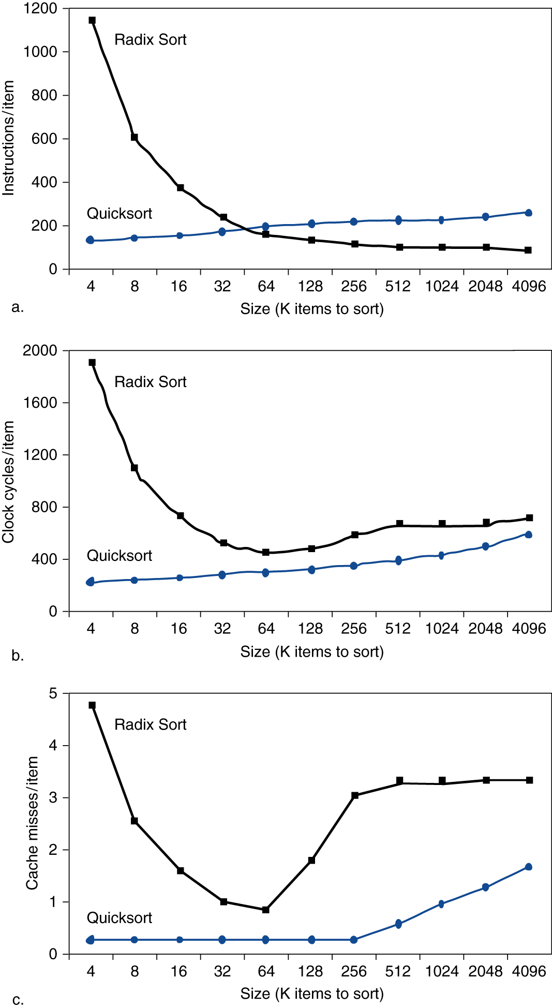
Interactions with Software
Figure a shows that when the size of data is large, Radix sort needs fewer operations than quicksort!
Figure b shows that when the size of data is large, the runtime of Radix sort is not faster!
Figure c shows that, when the size of data is large, Radix sort would suffer from more cache misses.
O(N log N) vs. O(N)
a
b
c

Slide 122
Interactions with Software
Figure a shows that when the size of data is large, Radix sort needs fewer operations than quicksort!
Figure b shows that when the size of data is large, the runtime of Radix sort is not faster!
Figure c shows that, when the size of data is large, Radix sort suffers from more cache misses.
Locality matters!!
Quicksort has highly locality
a
b
c

Slide 123
Application of Caches
Akamai is a global content delivery network (CDN) provider that delivers content quickly and reliably to users. Due to rapid growth, they encountered a scale-up problem in late 90’s that the network traffic jam caused serious performance impact for customers. How did they solve that problem?
Cache: contents are cached at distribution stations
GPU tend to have a very large register file. For example, Nvidia 4090 has 144SMs, each SM has 64K registers. With such a large register file, the register access time will increase. What should you do if the access time is increased to 10 clock cycles?
Cache: Use a cache to speed up register accesses!
The register number used as operands in each instruction is the address of each cache reference.

