Slide 1
CSC4303: Network Programming
Tutorial 9: Introduction to Assignment 5
JSON RPC Library
Fang Zihao
March 30th, 2026

Slide 2
Overview
A basic JSON RPC Library.
C Server
Receive function calls and execute functions
Send results
Python Client
Send function calls
Receive results

Slide 3
Overview
Implementation Language
C
Python
Environment
Unix-like Operating System (POSIX-compatible)
GCC or Clang compiler
GNU Make
Python 3 Interpreter

Slide 4
Overview
main.c: 9 TODOs
Implement handler functions and function registrations
rpc_connection.c: 3 TODOs
Implement wrappers for sending and receiving data
rpc_server_stub.c: 4 TODOs
Implement internal logic of JSON RPC server
rpc_client_stub.py: 6 TODOs
Implement internal logic of JSON RPC client

Slide 5
What is JSON?
An open standard file format and data interchange format that uses human-readable text to store and transmit data objects.
Data Types:
Number: No distinction between integer and floating-point
String
Boolean: true or false
Array
Object
Null

Slide 6
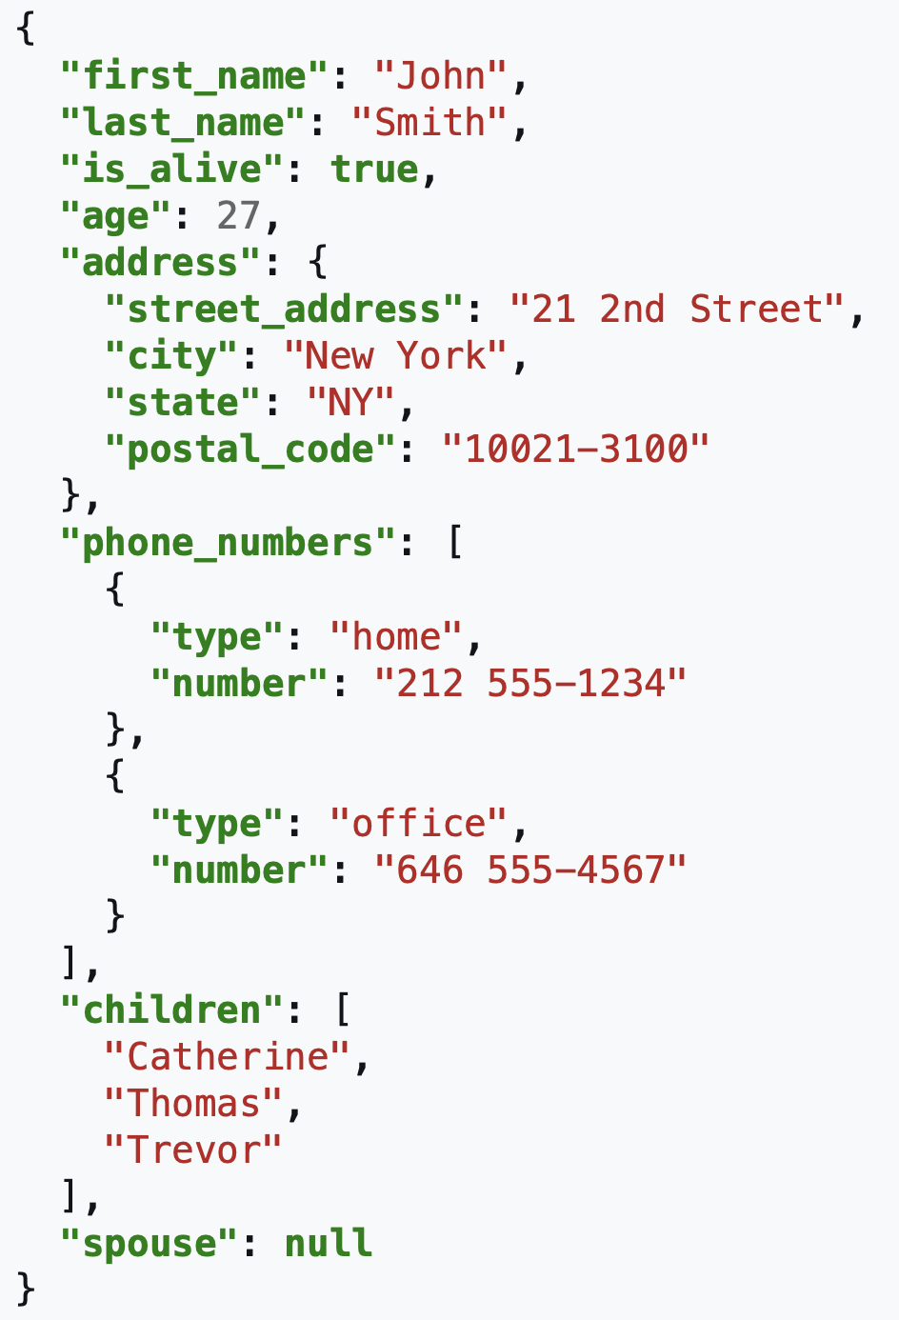
JSON example

Slide 7
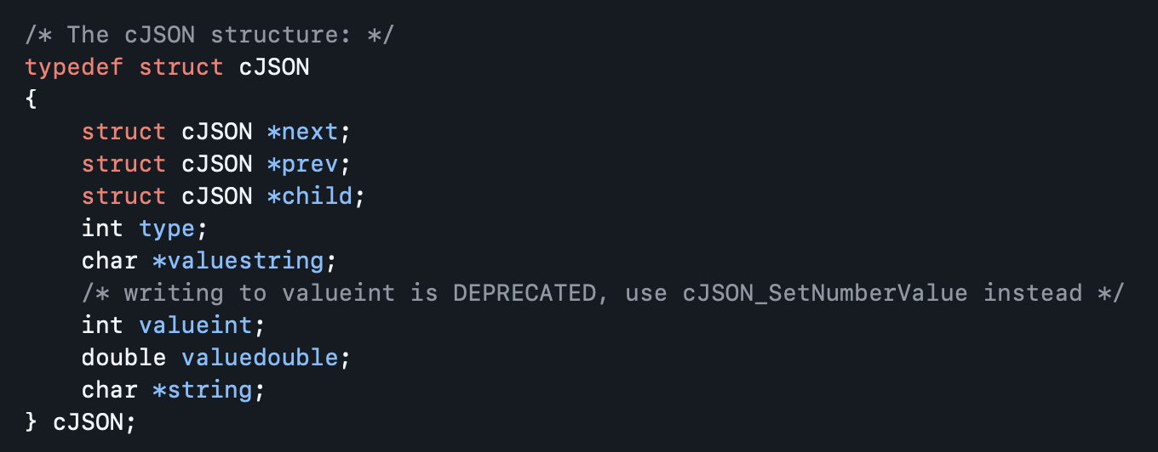
What is cJSON?
Ultralightweight JSON parser in C
cJSON represents JSON data using the cJSON struct data type:

Slide 8
cJSON Functions
cJSON_Parse: Turn a JSON string into a JSON object
cJSON_CreateObject: Create a new JSON object
cJSON_AddItemToObject: Add a key-value pair to the object
cJSON_CreateString: Create a new JSON string from a C string
cJSON_CreateArray: Create a new JSON array
cJSON_AddItemToArray: Add an item to the array

Slide 9
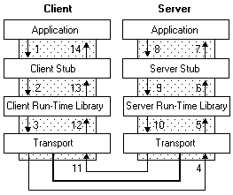
What is RPC?
The clients wrap the function call into some representation.
The clients transmit the representation to server.
The server unwrap the representation, execute the function, and wrap the result into some representation.
The clients unwrap the representation and get the result

Slide 10
JSON and RPC
JSON as some kind of representation!
JSON corresponding to:
Number: int and float in both Python and C
String: string in Python, char* in C
Boolean: bool in both Python and C
Array: list in Python, array in C
Object: dict in Python. No corresponding data structure in C, but you can construct a struct that represents it.
Null: None in Python, NULL in C

Slide 11


A Good Choice?
JSON: human-readable text to store and transmit data objects.
Not efficient for machines!
Binary forms are more efficient:
gRPC
Protobuf

Slide 12
Thank You!

