Slide 1
CSC4303: Network Programming
Tutorial 6:
Flooding and TTL Control
Fang Zihao
March 9th, 2025

Slide 2
Overview
Techniques used in this assignment:
Flooding Mechanism
Loop Avoidance
TTL Control

Slide 3
Requirements
Basic Query Flooding: Confirm that a query packet is distributed to all neighboring servers
Loop Avoidance: Ensure the system prevents endless looping of query packets in a network with loops.
TTL Control: Verify that the Time-to-Live (TTL) mechanism restricts query packet propagation.

Slide 4
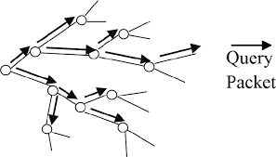

Flooding
Iterate all the packets in the neighbor list.
If the neighbor is not the sender, forward the packet to it.
Otherwise, skip and continue.

Slide 5
Flooding: Pseudo Code
neighbors := List of neighbors
for each neighbor in neighbors
if neighbor.addr = sender.addr and neighbor.port = sender.port then
continue
end if
send packet to neighbor
end for

Slide 6
Loop Avoidance
Method 1: Prevent sending the packet to servers already passed
Algorithm:
Maintain a list in the packet.
When a server receives the packet, it will add itself to the list.
When a server floods the packet, it will check if the target is in the list. If so, do not send the packet to the target.
Time complexity: O(mn). Difficult to realize!

Slide 7
Loop Avoidance
Method 2: Discard the packet when sending to servers already passed.
Algorithm:
Maintain a list in the server.
When a packet passed the server, it will record its packet ID in the list.
When a server receives a packet whose ID is already in the list, discard the packet.
Recommended

Slide 8
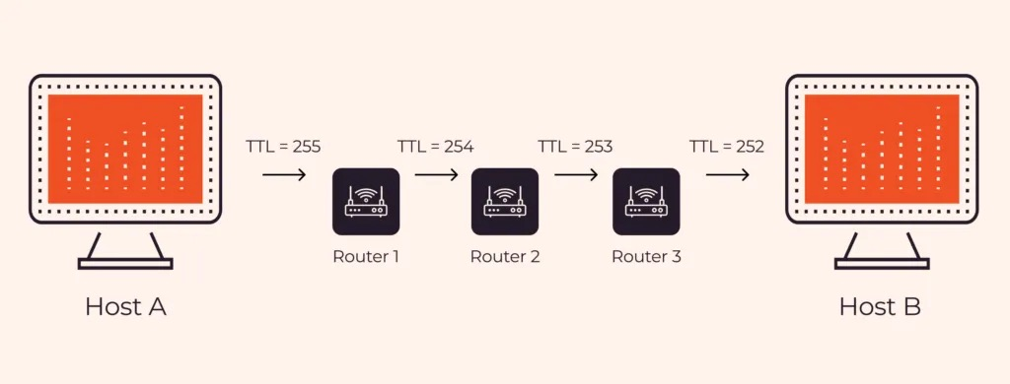
TTL Control
When a packet passes a machine, the TTL will reduce by 1.
If the packet’s TTL becomes 0, it will be discarded.
Preventing the packet traveling in a long route.

Slide 9
memcpy and strcpy
From the header “string.h”
strcpy: Copies the null-terminated byte string pointed to by src, including the null terminator, to the character array dest.
char* strcpy( char* dest, const char* src );
memcpy: Copies count charcters from src to dest.
void* memcpy( void *dest, const void *src, size_t count );

Slide 10
struct and typedef struct
For struct, you should define the name right after the “struct” keyword. When using the struct, you should refer to the type as struct structName.
For typedef struct, you should define the name after the struct has been defined. When using the typedef struct, you can directly refer to it as structName.

Slide 11

Thank You!

