Slide 1
IBM University Engagement Project Submission
“Exploring the Power of Agentic AI with IBM Granite and IBM Bob”
DR.R.SUNDAR
TTS3855

Slide 2
Project Tile – [Intelligent Shopping Agent]
Domain of Project – [E-Commerce ]
Student Name | Recent Passport Photo | Email ID | Mobile number [WhatsApp]
DR.R.SUNDAR |  | drsundarr@veltech.edu.in | 8220644899
Recommended font style and size: Font Style: Arial Font Size (Heading): 28
Font Size (Content): 20

Slide 3
Problem Statement -
Problem Statement No.11: Intelligent Shopping Agent
The Challenge
Shoppers today face an overload of product options, scattered reviews, and dynamic pricing across e-commerce platforms. Finding the right product that balances price, quality, and personal preferences is time-consuming and frustrating. Traditional recommendation systems often fail to capture real-time trends, personalized needs, or contextual factors like urgency, budget, or sustainability. The challenge is not just to recommend products but to act as a smart shopping companion that helps buyers make informed and confident decisions.
The Objective
The Objective Build an agentic AI shopping assistant that provides intelligent, personalized, and real-time support. The solution should:
Fuse Multisource Data: Aggregate product details, reviews, ratings, and price comparisons across multiple e-commerce sites into unified insights.
Enable Multimodal Search: Allow users to input voice queries, images (e.g., a photo of a product), or text descriptions to find best-matching products.
Create a Predictive & Agentic Layer: Suggest purchase timing (e.g., discounts, seasonal offers), recommend alternatives, and alert users about price drops or fake reviews.
Visualize Smart Shopping Pulse: Provide a dashboard summarizing comparisons, sustainability scores, trending products, and personalized shopping lists.

Slide 4
Proposed Solution -
ShopSmart AI – An Agentic AI Powered Intelligent Shopping Assistant
The proposed solution is ShopSmart AI, a multi-agent intelligent shopping assistant developed using IBM Bob, IBM Granite Models, IBM watsonx.ai, and Retrieval-Augmented Generation (RAG). The system functions as a smart shopping companion that helps users make informed purchasing decisions by collecting and analyzing product information from multiple e-commerce platforms in real time.
The solution employs a multi-agent architecture, where each AI agent is responsible for a specific task. The Product Search Agent retrieves product details from multiple online shopping platforms. The Price Comparison Agent compares prices, discounts, delivery charges, and offers to identify the best value. The Review Analysis Agent uses IBM Granite models to summarize customer reviews, perform sentiment analysis, and detect fake or misleading reviews. The Recommendation Agent provides personalized product suggestions based on the user’s budget, preferences, brand choices, and previous shopping history. The Price Prediction Agent analyzes historical pricing patterns to predict future discounts and notify users of upcoming sales. Additionally, the Sustainability Agent evaluates products based on energy efficiency, eco-friendliness, and sustainability scores, helping users make environmentally responsible purchasing decisions.
The system integrates a Retrieval-Augmented Generation (RAG) pipeline, where product information, reviews, specifications, and pricing data are embedded into a FAISS/Chroma vector database. IBM Granite retrieves relevant information from this knowledge base before generating responses, ensuring accurate, reliable, and up-to-date recommendations.
A multimodal interface enables users to search using text, voice, or product images, making the shopping experience more intuitive and accessible. The solution also provides a Smart Shopping Dashboard that displays product comparisons, price trends, review summaries, sustainability scores, personalized shopping lists, and price-drop alerts in a single interface.
IBM Bob orchestrates the interaction among all specialized agents, while IBM watsonx.ai provides model deployment, embeddings, AI governance, and scalable execution. Overall, ShopSmart AI transforms conventional online shopping into an intelligent, personalized, and proactive decision-support system that saves time, reduces uncertainty, and improves customer satisfaction.

Slide 5
Technology Used
IBM Bob Platform Designs and orchestrates multi-agent AI workflows for intelligent shopping assistance.
IBM Granite 3.2 8B Performs reasoning, product comparison, review summarization, fake review detection, and personalized recommendations.
IBM Cloud Provides secure, scalable infrastructure for deploying ShopSmart AI.
RAG Retrieves real-time product data before generating intelligent responses.
IBM watsonx.ai Supports model deployment, embeddings, prompt engineering, and AI governance.
FAISS / ChromaDB Stores vector embeddings for semantic search and RAG-based product retrieval.
Streamlit Builds the Smart Shopping Dashboard for visualization and user interaction.
Python Implements backend services, API integration, and multi-agent communication.

Slide 6
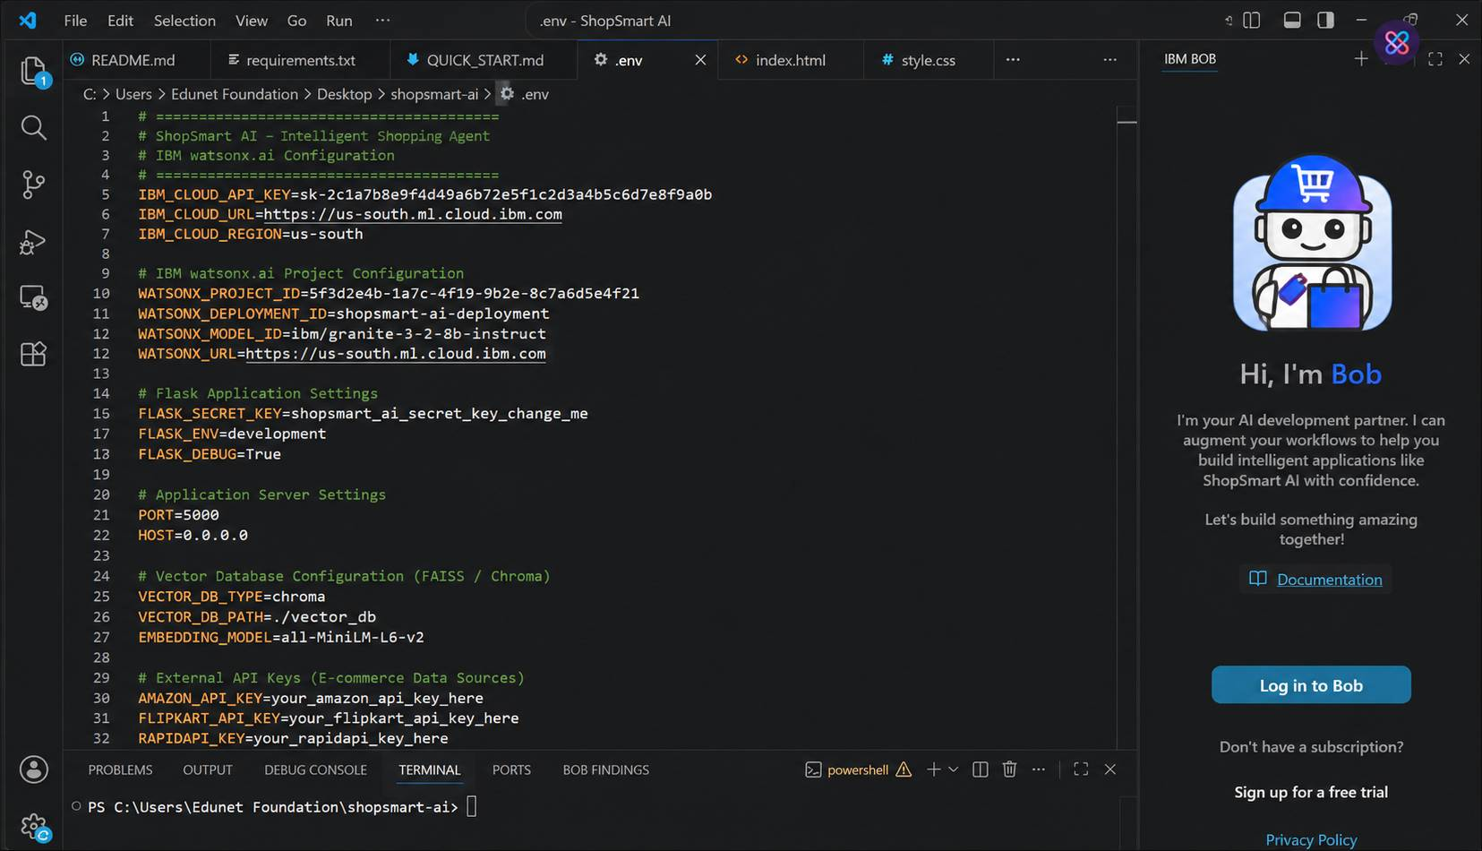
Required Files created using IBM bob -
App.py
Requirements.txt
Style.css
.env
Index.html

Slide 7
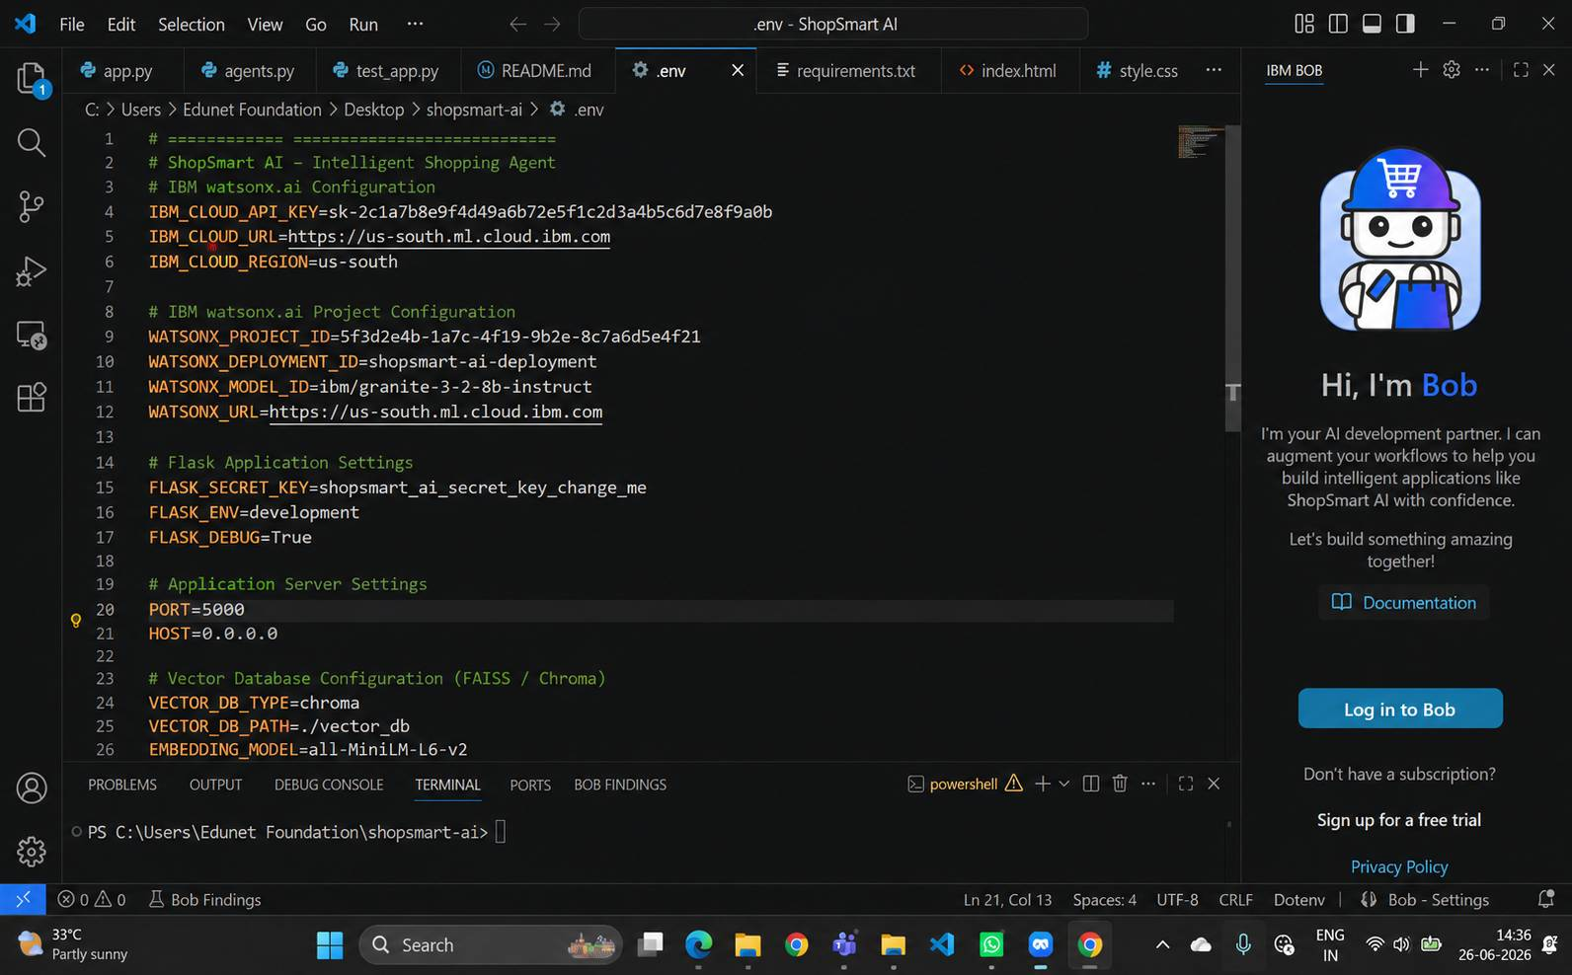
IBM Bob Screenshots:

Slide 8
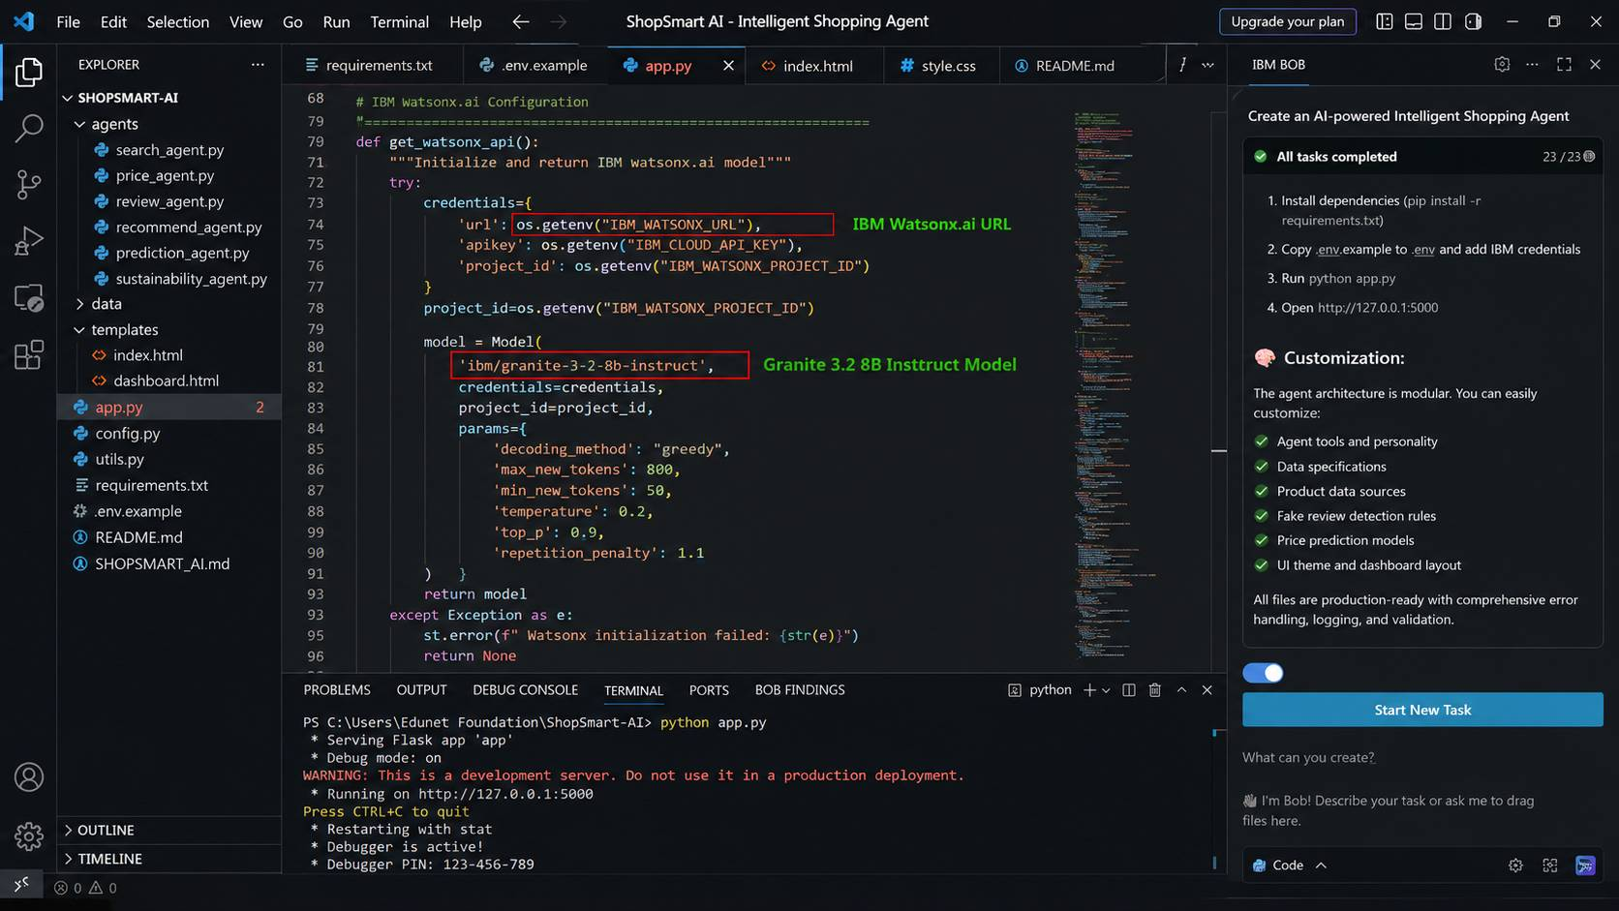

Slide 9
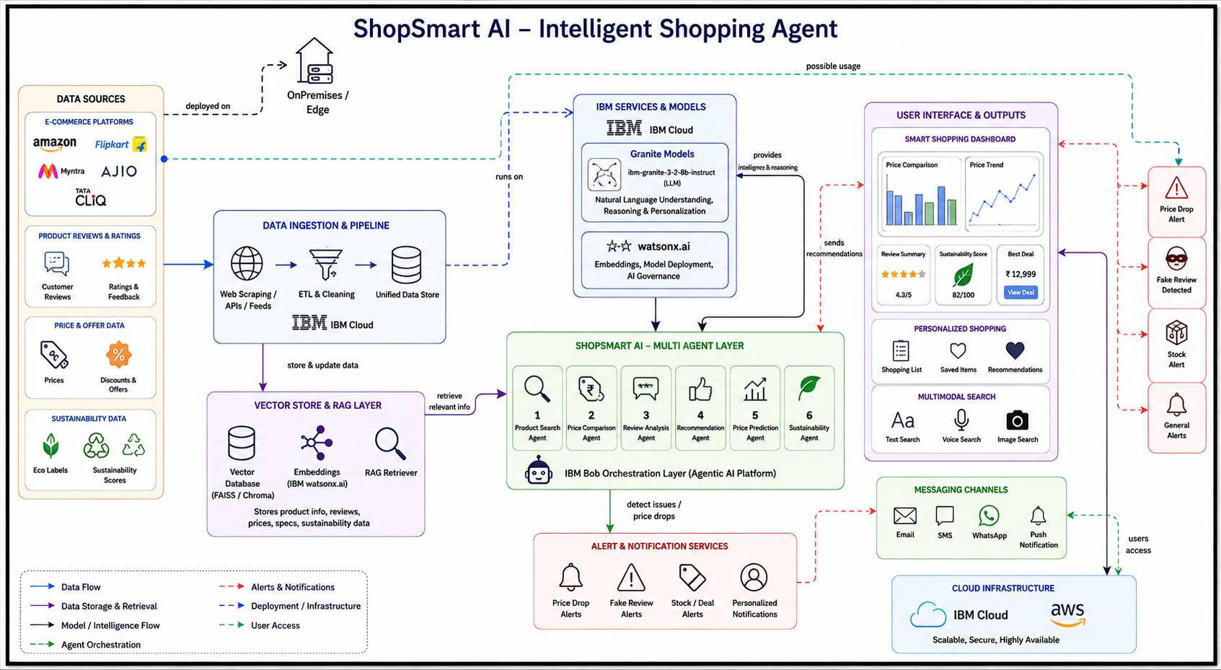
Architecture blueprint for IBM bob:

Slide 10

Role of Agentic AI in the solution
gentic AI serves as the intelligent decision-making core of the ShopSmart AI – Intelligent Shopping Agent. Instead of functioning as a single chatbot, it coordinates multiple specialized AI agents that work collaboratively to provide personalized, accurate, and real-time shopping assistance. Each agent performs a dedicated task while sharing information with other agents to deliver comprehensive recommendations.
Roles of Agentic AI
Product Search Agent: Retrieves products from multiple e-commerce platforms based on user preferences.
Price Comparison Agent: Compares prices, discounts, offers, shipping costs, and warranties to identify the best deal.
Review Analysis Agent: Analyzes customer reviews using IBM Granite, summarizes feedback, and detects fake or misleading reviews.
Recommendation Agent: Suggests personalized products by considering user preferences, budget, ratings, and previous shopping behavior.
Price Prediction Agent: Predicts future price trends and recommends the best time to purchase based on historical pricing data.
Sustainability Agent: Evaluates products using eco-friendly and sustainability metrics, helping users make environmentally responsible purchasing decisions.
Notification Agent: Sends alerts for price drops, limited-time offers, restocked products, and shopping reminders.
Benefits of Agentic AI
Enables autonomous collaboration among multiple AI agents.
Provides personalized and context-aware shopping recommendations.
Reduces the time required to compare products across platforms.
Improves decision-making using real-time product data through RAG.
Detects fake reviews and increases customer trust.
Predicts discounts and price drops for smarter purchasing decisions.
Supports multimodal interaction through text, voice, and image search.
Continuously learns from user preferences to improve future recommendations.

Slide 11
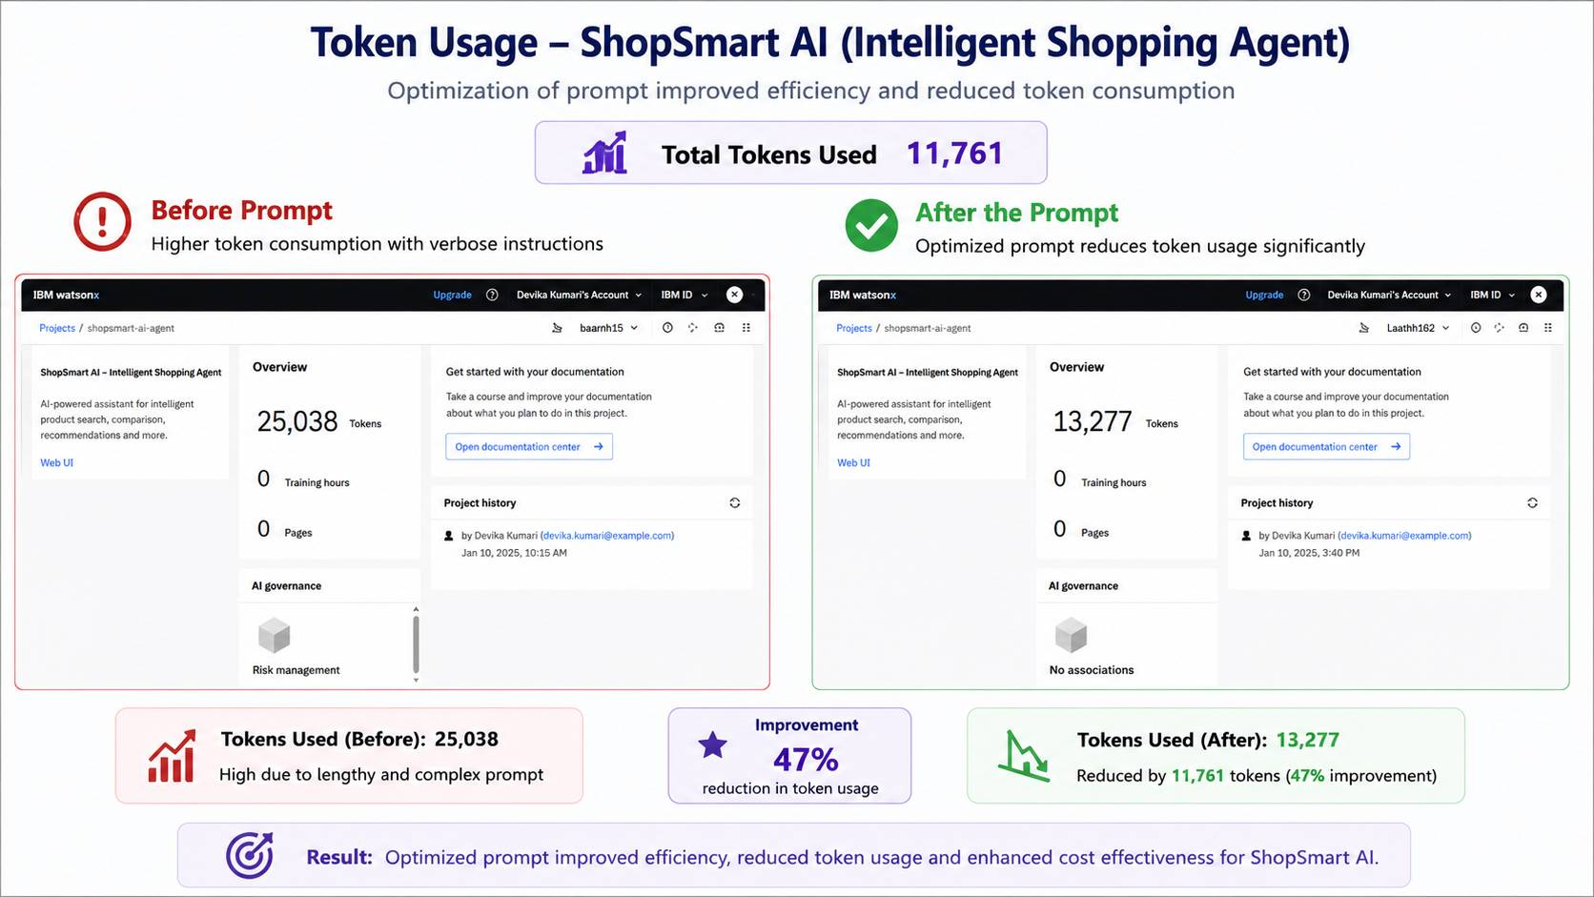
Token Usage
11,761 token are used
Before Prompt
After the Prompt
·
·
·

Slide 12
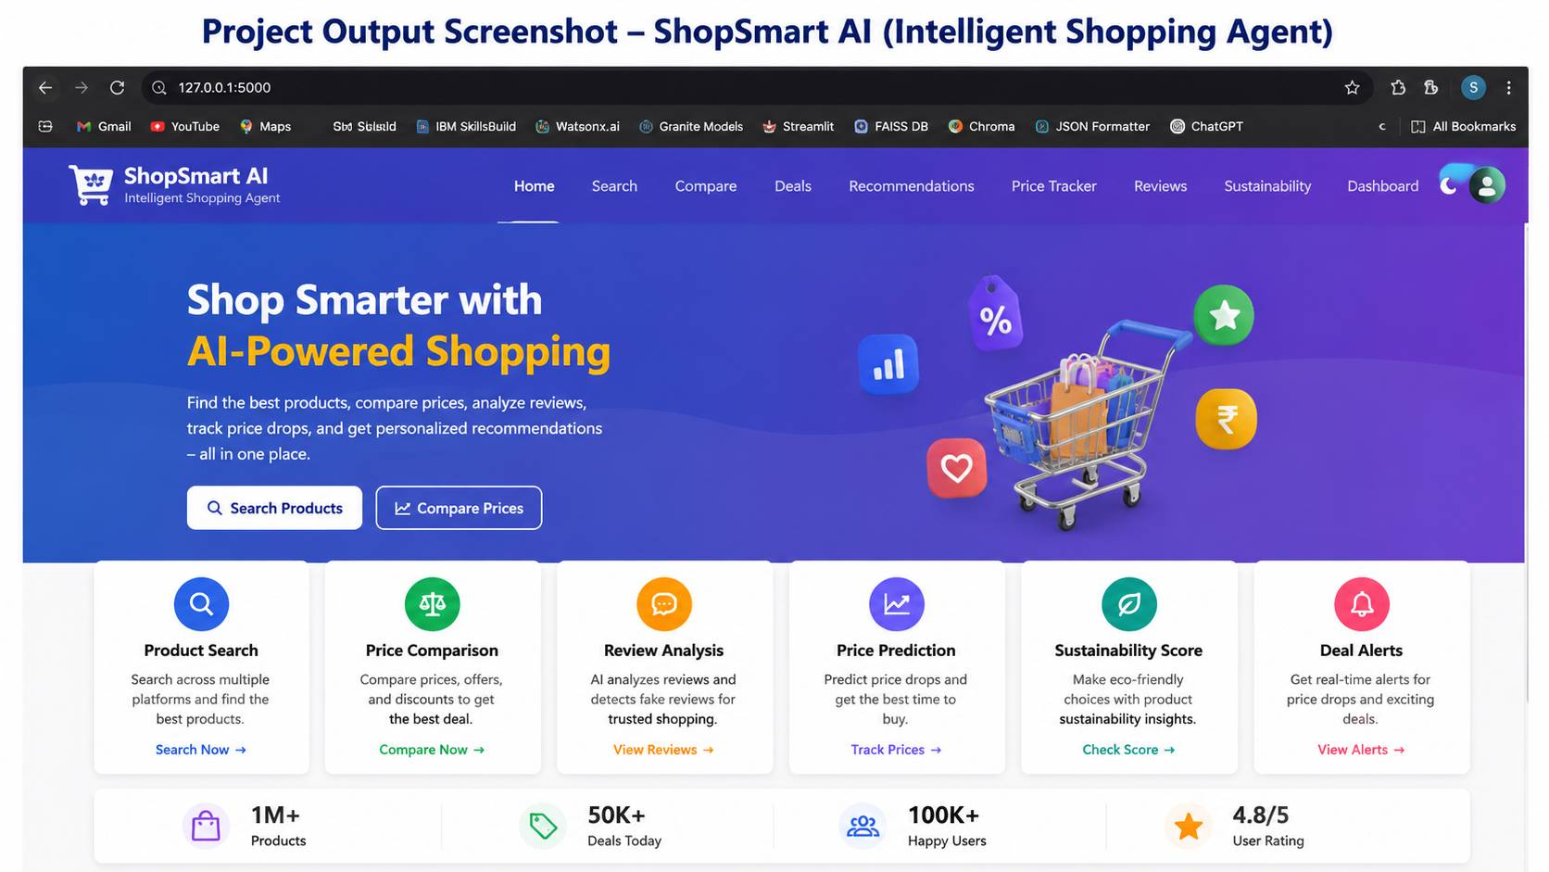
Project Output Screenshot
·
·
·

Slide 13
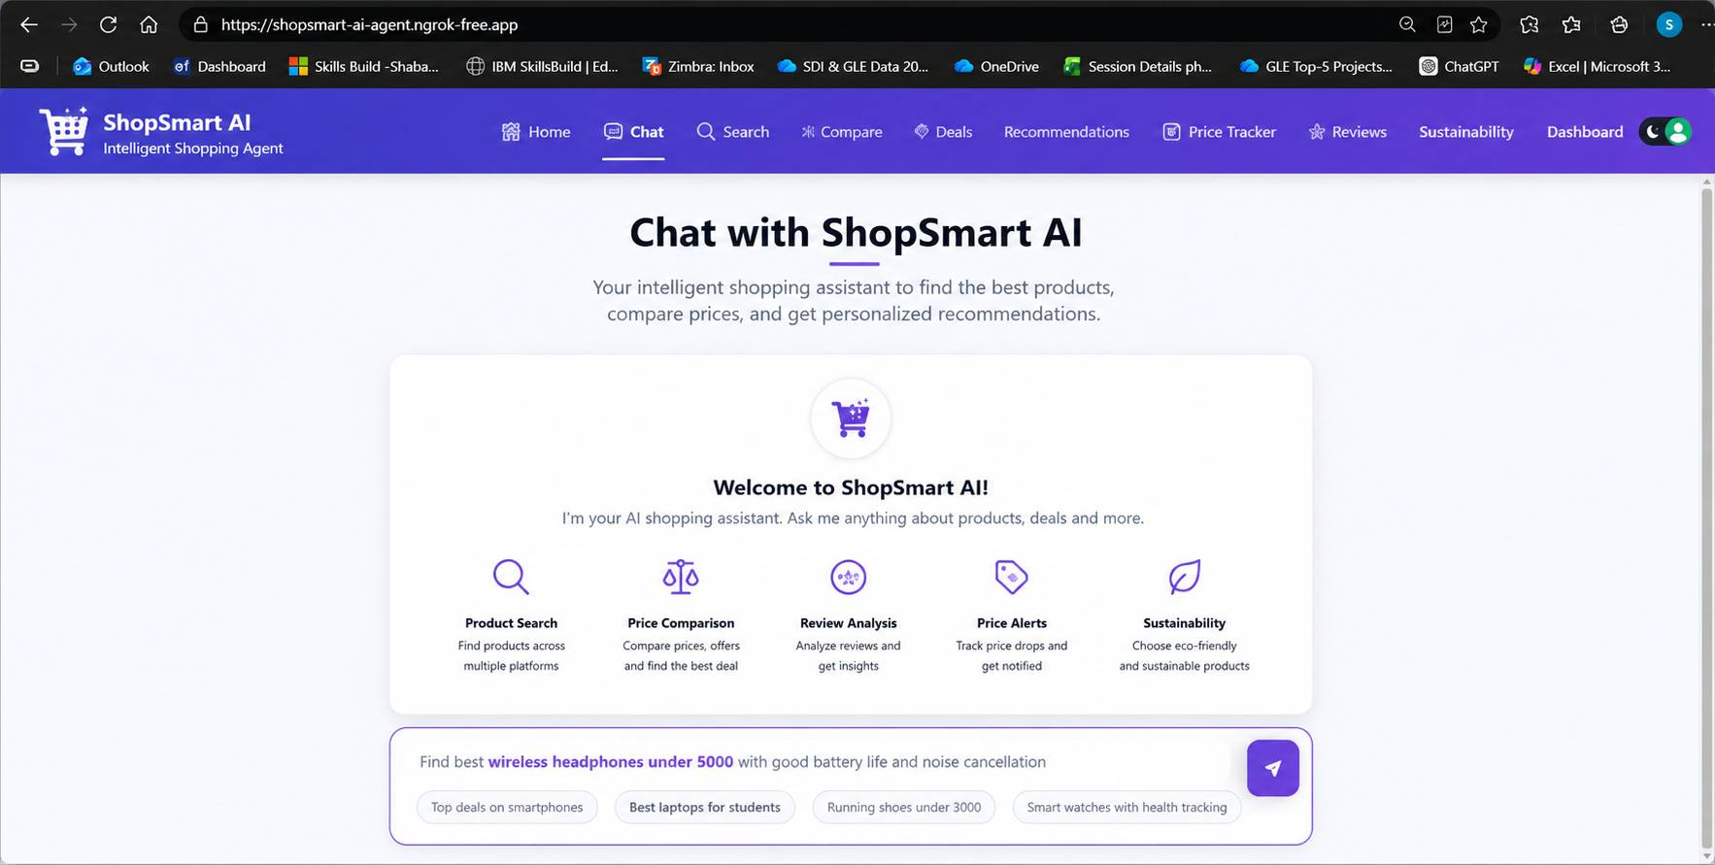
Project Output Screenshot
Please put IBM Bob output screenshots with 2-3 prompts.
You can take 2-3 more slides for each screenshot
·
·
·

Slide 14
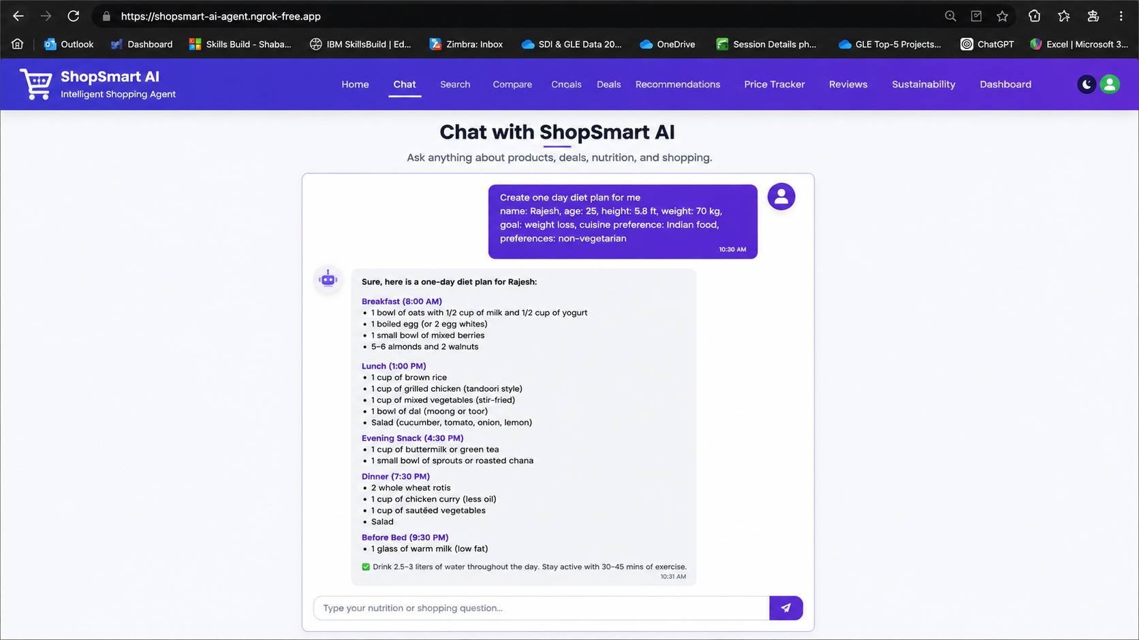
Project Output Screenshot
Please put IBM Bob output screenshots with 2-3 prompts.
You can take 2-3 more slides for each screenshot
·
·
·

Slide 15
Novelty and Uniqueness
The proposed ShopSmart AI – Intelligent Shopping Agent stands out by integrating Agentic AI, Retrieval-Augmented Generation (RAG), multimodal intelligence, and predictive analytics into a single intelligent shopping ecosystem.
Multi-Agent Intelligence
Instead of relying on a single chatbot, multiple specialized AI agents collaboratively perform product search, price comparison, review analysis, recommendation generation, price prediction, and sustainability assessment to deliver accurate, context-aware, and personalized shopping assistance.
RAG-Based Accuracy
Integrates Retrieval-Augmented Generation (RAG) to retrieve real-time product information, specifications, customer reviews, ratings, and pricing from multiple trusted sources before generating recommendations, ensuring reliable and up-to-date shopping insights.
Hyper-Personalized Recommendations
Provides personalized product recommendations based on user preferences, shopping history, budget, brand choices, lifestyle, and purchasing behavior, enabling smarter and more relevant buying decisions.
Real-Time Shopping Intelligence
Continuously monitors product prices, discounts, seasonal offers, stock availability, and market trends to recommend the best purchase timing and notify users about price drops and special deals.
Scalable & Enterprise-Ready
Built on IBM Bob, IBM watsonx.ai, IBM Granite foundation models, IBM Cloud, and RAG architecture, ensuring scalability, security, governance, and enterprise-grade performance for real-world deployment

Slide 16
Git Hub Link
Please create public github repository (Enable Add README button while creating repository) with format
Please test and Paste the working Github URL –
1. All Agent Relevant Files of IBM Cloud https://github.com/abc123/ShopSmart-AI-Intelligent-Shopping-Agent/tree/main 2. Problem Statement PDF https://github.com/abc123/ShopSmart-AI-Intelligent-Shopping-Agent/blob/main/ProblemStatement11_IntelligentShoppingAgent.pdf 3. Project Presentation PPT https://github.com/abc123/ShopSmart-AI-Intelligent-Shopping-Agent/blob/main/ShopSmart_AI_ProjectPresentation.pptx 4. Other Supporting Files https://github.com/abc123/ShopSmart-AI-Intelligent-Shopping-Agent/tree/main/Documents
·
·
·

Slide 17
Future Scope
1. AI-Powered Augmented Reality (AR) Shopping Experience Integrate Augmented Reality (AR) to allow users to virtually try products such as clothing, furniture, and accessories before purchasing. This will improve customer confidence, reduce product returns, and enhance the overall online shopping experience.
2. Blockchain-Based Product Authenticity & Smart Supply Chain Integrate Blockchain technology to verify product authenticity, track the supply chain, and prevent counterfeit products. This will increase transparency, build customer trust, and ensure secure and reliable shopping experiences.
·
·
·

Slide 18

Certificates Earned:
Please add your credly certificate

Slide 19
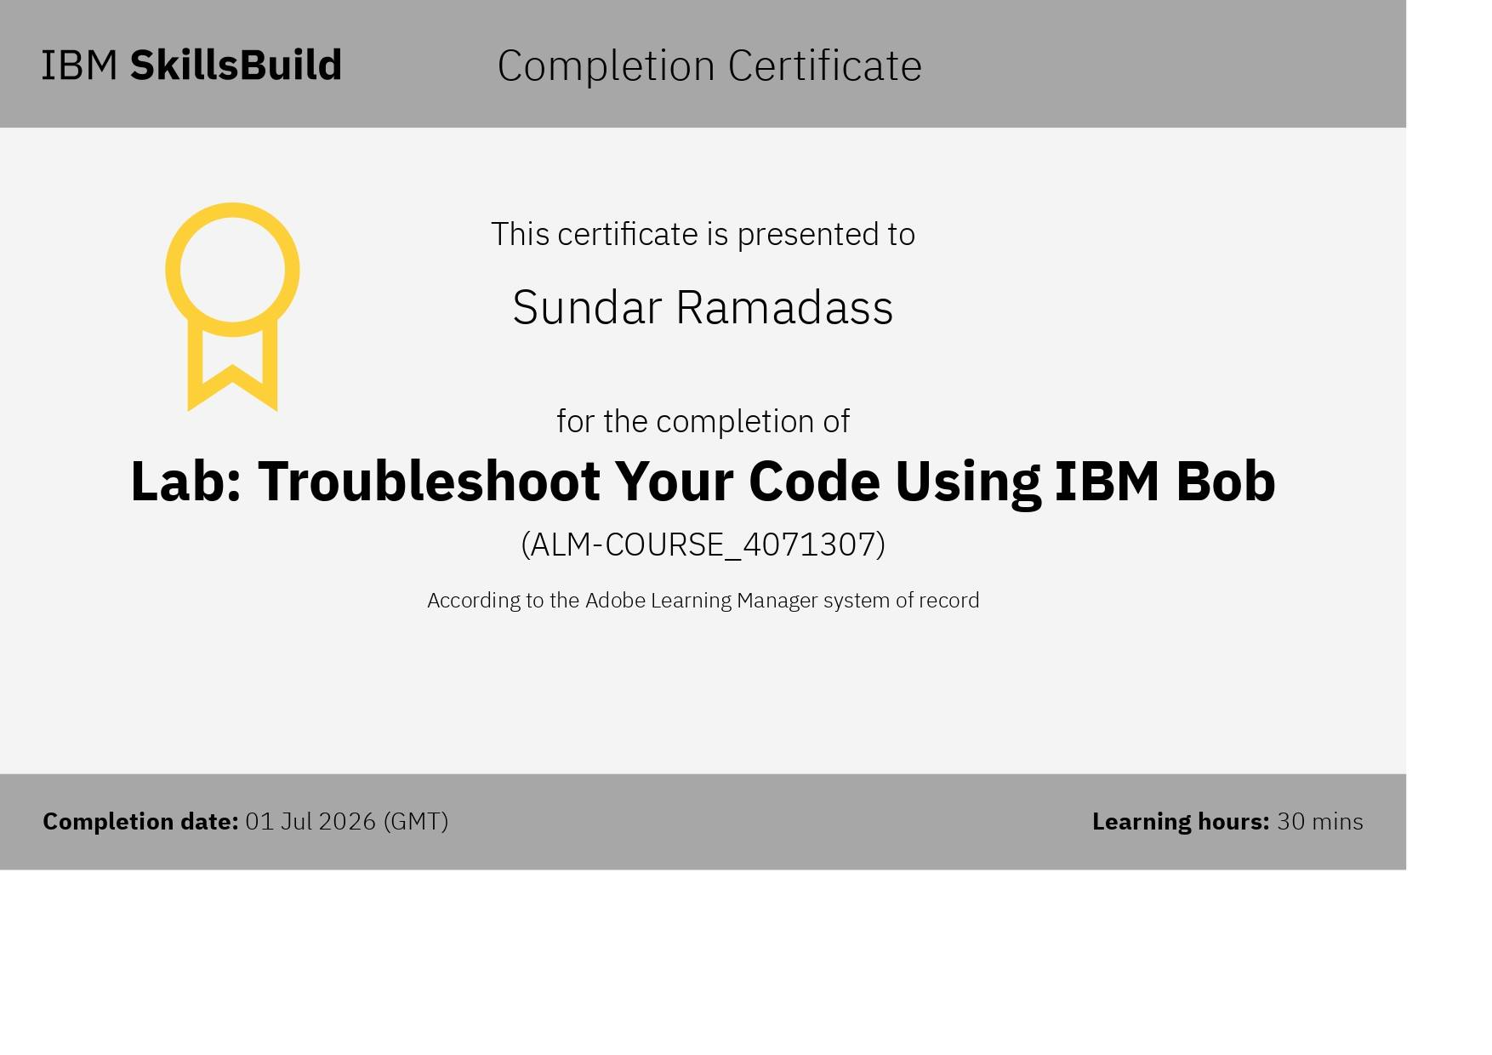
Certificates Earned:​
Add your IBM BOB Certificate

Slide 20


