Slide 1
THE FAISS LIBRARY
Matthijs Douze, Alexandr Guzhva, Chengqi Deng, Jeff Johnson, Gergely Szilvasy, Pierre-Emmanuel Mazaré, Maria Lomeli, Lucas Hosseini, Hervé Jégou
FAIR (Fundamental AI Research), Meta
[v2] Fri, 6 Sep 2024 15:08:03 UTC (384 KB)
黃泰揚

Slide 2
Outline
Introduction
Related works
Architecture
Experimental
Conclusion

Slide 3
Outline
Introduction
Related works
Architecture
Experimental
Conclusion

Slide 4
Introduction - Issue
Efficiently managing and searching large collections of embedding vectors in AI applications.
Increasing data volume demands high-speed, accurate search solutions.

Slide 5
Introduction - contributions
Introduces Faiss, a library for scalable vector similarity search.
Provides a flexible toolkit for indexing, clustering, compression, and transformations.
Optimized for Approximate Nearest Neighbor Search (ANNS) on both CPU and GPU.
Enables fast, accurate similarity search across massive datasets and diverse applications.

Slide 6
Outline
Introduction
Related works
Architecture
Experimental
Conclusion

Slide 7
Related Works
Early Approaches: Traditional similarity search using methods like brute-force, tree-based indexing …
Modern Methods: Approximate nearest neighbor (ANN) methods such as product quantization (PQ) and hierarchical graph-based methods like HNSW.
Existing Tools: Similar libraries like FLANN, NMSlib, and Google’s SCANN, which focus on specific indexing methods compared to Faiss's flexible toolkit approach.

Slide 8
Outline
Introduction
Related works
Architecture
Experimental
Conclusion

Slide 9
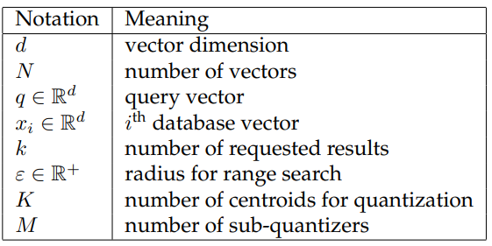
Notations

Slide 10



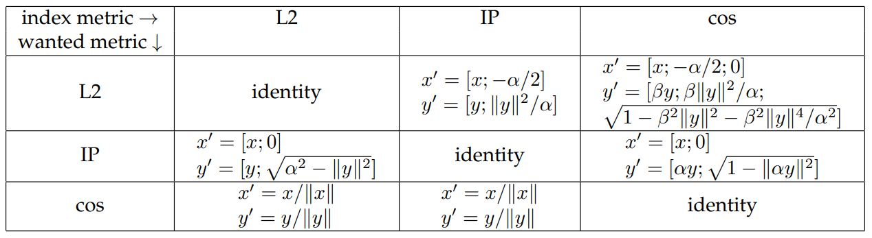
Notations – II
What’s the problem?
Top_K (* = ignore)
Range search (threshold)
Transformation?
IP = inner product ; x, y = query vector, data vector

Slide 11
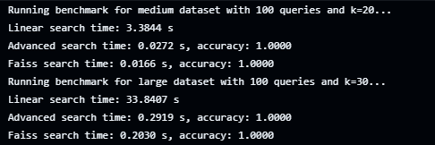
Overview – Core
The core library is a collection of source files written in standard C++ without dependencies. (Package to Python)

Slide 12
Overview – Factor
Modular Design: Faiss consists of multiple index types that can be mixed and matched based on Time, Mem, and Accuracy.
Training time = Building time
CPU or GPU
Vector comparison function
inner product, L2, cosine similarity …
Query type
Top-k, Range search (E) ...

Slide 13
Indexing Methods – Basic
Flat Index (IndexFlat): Uses brute-force but highly optimized, mostly for small datasets.
KNN, binary heap …
Slowly → approximate nearest neighbor search (ANNS) !
Question, how to calculate the accuracy of ANNS?
For Top-k:
n-recall@k (n<=k) Correct n neighbors in k results​ / n
For range search:
precision P = |R ∩ R’| / |R’|, recall R = |R ∩ R’| / |R|

Slide 14
Compression Methods
What are the benefits?
reduces memory usage by encoding vectors
faster distance calculations (e.g. Double -> Float)
Types of Quantization (Compression) Method
Vector Quantizer (VQ)
Product Quantizer (PQ)
Residual Quantizer (RQ)
Additive Quantizers
Binary Quantizers

Slide 15
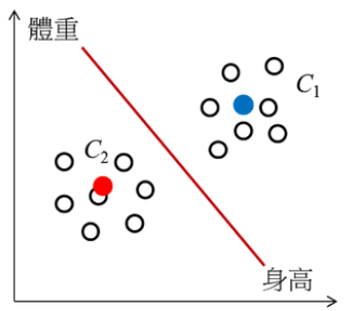
Compression Methods – VQ Vector Quantizer
Vector quantization assigns each vector to a nearest centroid from a predefined set.
Benefits: Simple and effective for basic compression needs.
Limitations: Less practical for large datasets.
e.g. K-means

Slide 16
Compression Methods – PQ Product Quantizer
Splits each vector into smaller sub-vectors, which are then quantized independently.
Process:
The vector is divided into 𝑀 sub-vectors.
Each sub-vector is quantized independently using a quantizer with 𝐾 centroids. (e.g. K-means)
x = [3, 1, 5, 0, 6, 7]
Divide to x1[3, 1] x2[5, 0] x3[6, 7]
search each sub-vectors
meage all result (may produce err)
Benefits: Fast + Reduces memory usage

Slide 17
Compression Methods – RQ Residual Quantizer
Quantify multiple times until target requirements are achieved
Benefit: security
How to avoid errors? → Reconstruction
Vector after quantized: 𝑥 = [ 10 , 15 ]
Codebook for Stage 1~n ( two centroids, n=2):
𝑐 1_1 = [ 8 , 14 ] 𝑐 1_2 = [ 13 , 18 ] ( Choose c1 )
Reconstruction
x’ = c1(1) ​+ c2(?) ​= [8,14] + [1,1] = [ 9 , 15 ]
Reconstructed Vector: 𝑥’ = [ 9 , 15 ]

Slide 18
Compression Methods – Additive Quantizers
PRQ = PQ+RQ
Benefit: PQ+RQ
Local Search Quantizer (LSQ): Uses iterative refinement and local search techniques to optimize quantization.
Benefit: For datasets with complex distribution characteristics.
Some common high-precision quantizers (e.g. video)
Limitation
computationally intensive
may require more memory

Slide 19
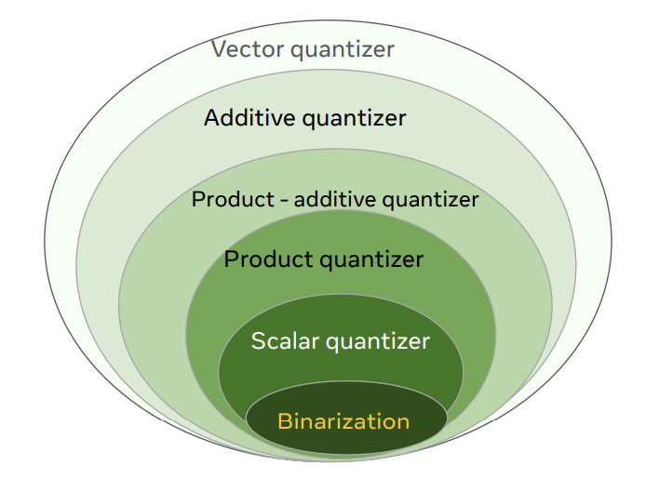
Compression Methods – Binary Quantizers
Converts vectors to binary representations, allowing distance calculations in Hamming space.
e.g., using XOR for fast comparisons
Benefit
Fast
Reducing storage
Limitation
Error
The hierarchy of quantizers

Slide 20
(Non-exhaustive) Search Methods
What are the benefits?
useful for very large datasets ( >= 10k vectors).
Types of Indexing (Search) Method
Inverted File (IVF) Indexing
Graph based indexing
When the data size is less than 1 million, graph indexes have advantages in accuracy and search speed.
As the size exceeds 10 million, build time and memory requirements may become limiting, and IVF may be a more appropriate choice.

Slide 21
Search Methods – IVF Inverted File
The quantizer divides the library vector into K_IVF ​ Different clusters, each cluster represents a centroid, and vectors are assigned to different "inverted lists" based on these centroids.
Only search the top P_IVF clusters.
Just like k-means, what’s the different to VQ?

Slide 22
Search Methods – Graph based indexing
Search like dijkstra's algorithm
set/find an init node
search the node which connect to init node
push them into a priority queue (heap)
find the next node which has highest priority
repeat b ~ d until find target.
HNSW（Hierarchical Navigable Small World）
vectors can be added dynamically
NSG（Navigating Spreading-out Graph）
Base on k-NN

Slide 23
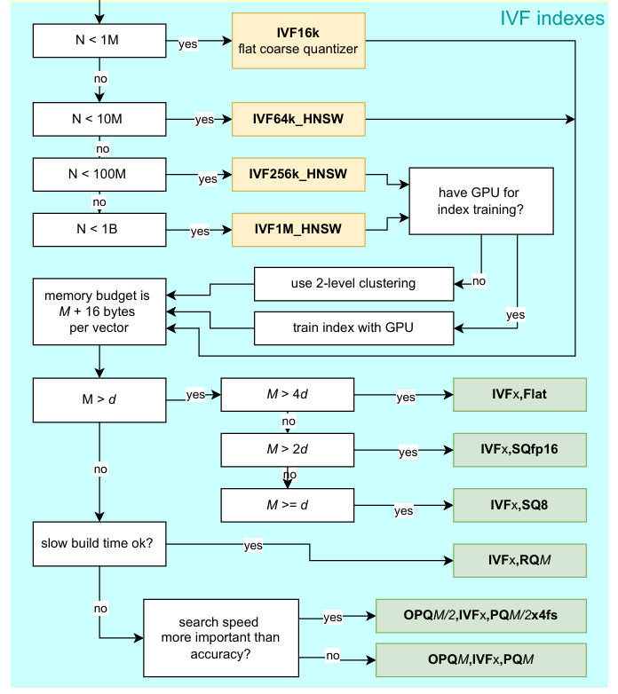
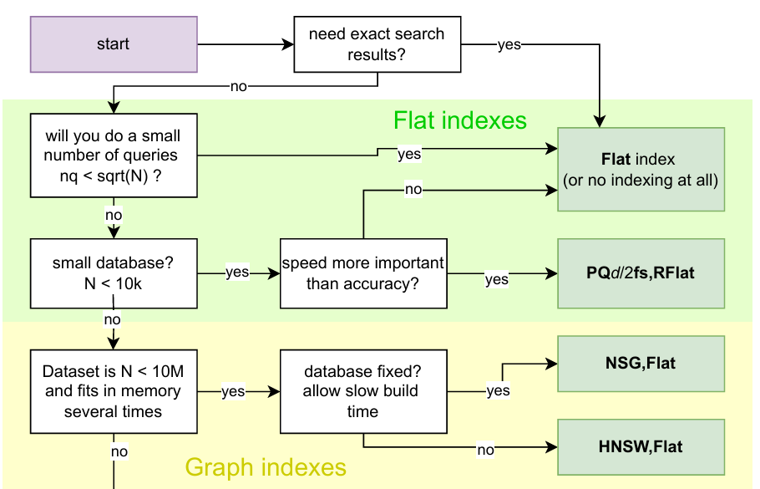
How to choose an index?
Decision Tree (fixed)

Slide 24
Outline
Introduction
Related works
Architecture
Experimental
Conclusion

Slide 25
Experimental – Dataset
BIGANN: A commonly used dataset for similarity search benchmarking, containing 128-dimensional SIFT (Scale-Invariant Feature Transform) features.
Deep1B: Another benchmark dataset consisting of 96-dimensional image features extracted using neural networks like Google LeNet.
Contriever1M: A newer dataset introduced in the paper, containing 768-dimensional embeddings derived from English Wikipedia passages.

Slide 26
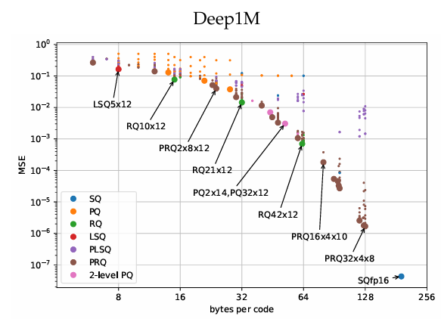
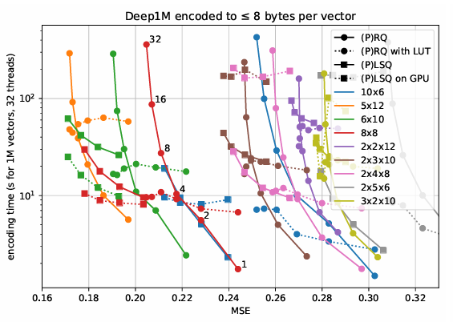
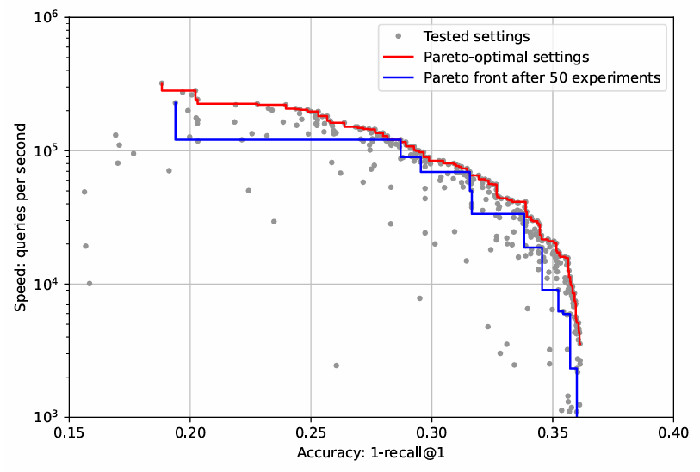
Experimental
Encoding times
Compressed size
PQ 6x10 for a product quantizer with 6 sub-vectors each encoded in 10 bits (M=6,K=210).
Overall (Deep100M)

Slide 27
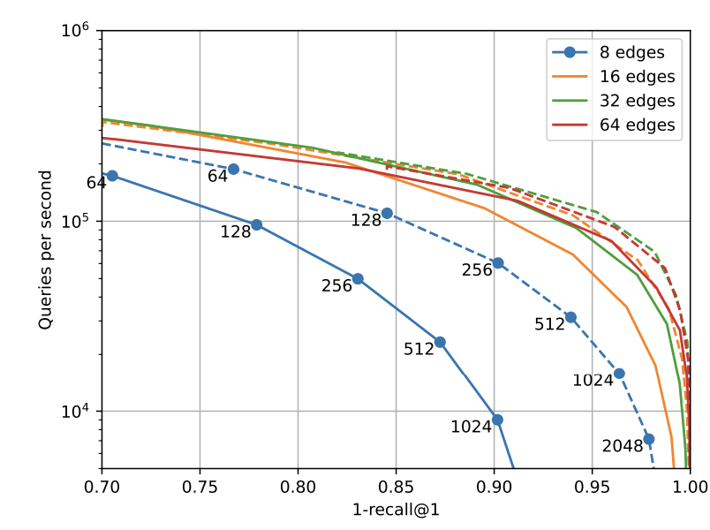
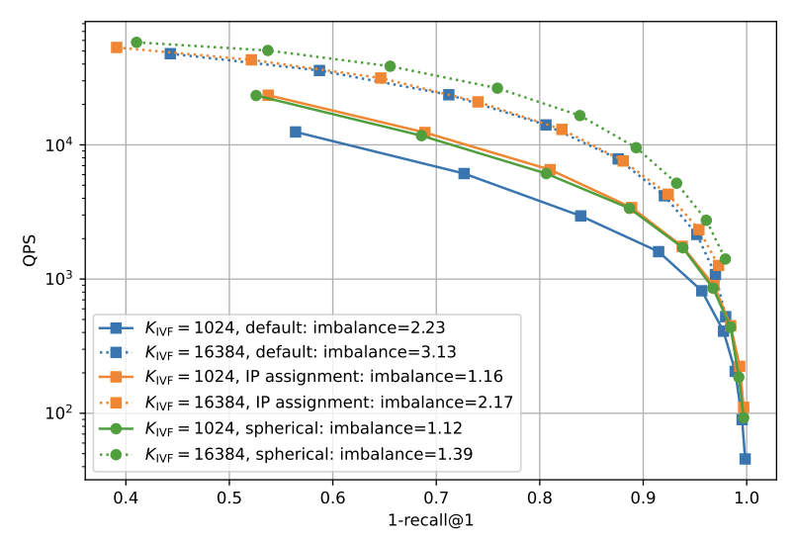
Experimental
Graph (Base on search steps)
Precision vs. speed for K_INF
(Change the P_INF to get different QPS)
Imbalance = variation in the number of vectors in each cluster
QPS = query per second

Slide 28
Outline
Introduction
Related works
Architecture
Experimental
Conclusion

Slide 29
Conclusion
Faiss is dedicated to efficiently searching open source libraries, achieving a good balance between memory usage, search speed and accuracy, and has performed well in many large-scale search applications in the market and academia.
Future work
More function for original method (e.g. dynamic push data)
More hardware support
Incorporate more types of search and quantification techniques

