Slide 1

Our Problem Definition
Choosing fewer vertices to store in GTT can make the average page space usage higher.
Our goal is to use as few vertices as possible to store in GTT.
Where have I seen this problem?

Slide 2
Our Problem Definition
Prove - This problem belongs to NP (Vertex cover)
Vertex cover of a graph is a set of vertices that includes at least one endpoint of every edge of the graph.
Select a point to be stored in GTT, and its neighbors will also be put into the page → Equivalent to the selected vertex, all its connected edges (even one more vertex) will also be covered.
Since this problem → vertex cover, it belongs to NP #
P

Slide 3
Our Proposed Method
Since this is an NP problem, we give up on finding the best solution and try to find an approximate solution.
Find the connected pair with the smallest number, put these two vertices into GTT, and put their neighbors into page, then remove these two vertices and their neighbors, repeat until the graph is empty.
V1
V2
V3
V4
V5

Slide 4
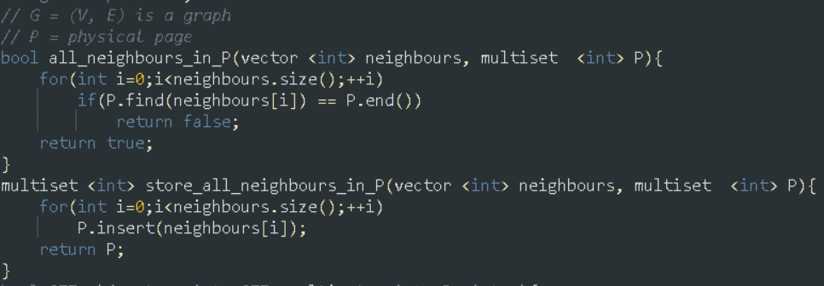
Original Algorithm (Speculation)
In order to simplify the problem, the following implementations assume that the graph is an undirected graph, and ensure that it is connected.

Slide 5
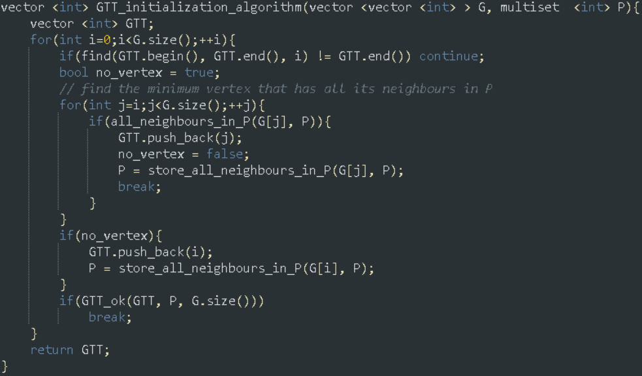
Original Algorithm (Speculation)

Slide 6
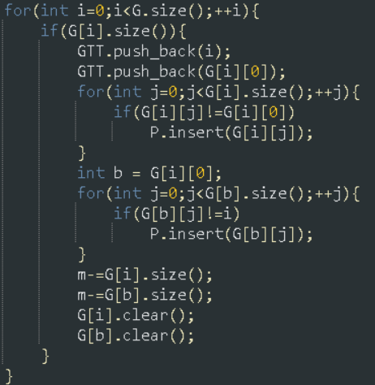
Our Algorithm
TC : O(m), m = |edges|.
Since this is an algorithm
developed based on large graphs, any
solution requiring more than O(m)
is not considered.
The number of nodes put
into GTT is always less than best*2.

Slide 7
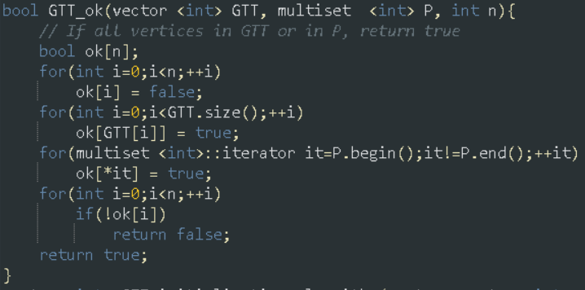
Check for correctness

Slide 8
Our Experiment / Evaluation
The following definitions are used to evaluate :
data usage efficiency = 1 - (( |GTT| + |page| ) / ( |vertices| + |edges| ))
vertices are stored in GTT = |GTT| / |vertices|
page waste rate = (page space used) / (page available space)
Duplicate data rate = (|Duplicate edges| + |edges|) / |edges| - 1
e.g. A – B = B – A (in undirected graph)

Slide 9




Our Experiment / Evaluation
V1
V2
V3
V4
V5
For example single-chain node
For randomly generated large sparse graphs (n = 1000, m = 1050)

