Slide 1


Online Voting System Using Blockchain
E-Chunab
Poush 21, 2078
Presented By :
1. Arash Thapa
2. Doleshwor Khadka
3. Prabesh Guragain
Submitted to :
Department of Bsc.CSIT
Venue:
Godawari College
Itahari-9, Sunsari

Slide 2

Project Outline
Introduction
Objectives
System Analysis
System Design
Implementation
Testing
Conclusion & Future Work
System Design
Implementation
Testing
Conclusion & Future Work

Slide 3



Introduction
“eChunab” is a online web based voting system which allows specific audience or mass public to cast their vote safely and easily without breaking the daily routine.
The web page to caste vote is developed using Django which uses: Python, HTML5, CSS3. While the transaction of ETH is done by Ganache and Metamask which represent the Voting mechanism as if any fraudent tries to happen, the ETH transaction will be halt and the voting process will be terminated.

Slide 4

Objectives
Security
Automation
Transparency
To develop highly secured voting system which can save money as well as time.
To bring automation from registration process to casting vote.
To improve the transparency in counting and voting process.

Slide 5

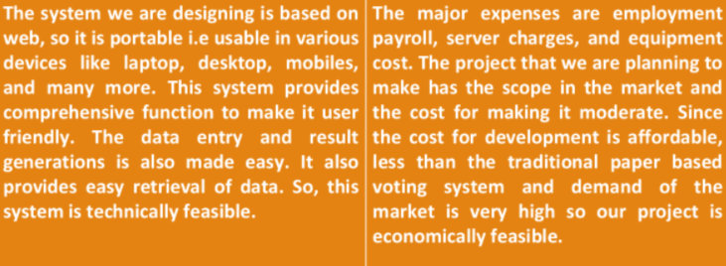
System Analysis
Feasiblity Study:
Is Technically Feasible?
Is Economically Feasible?

Slide 6
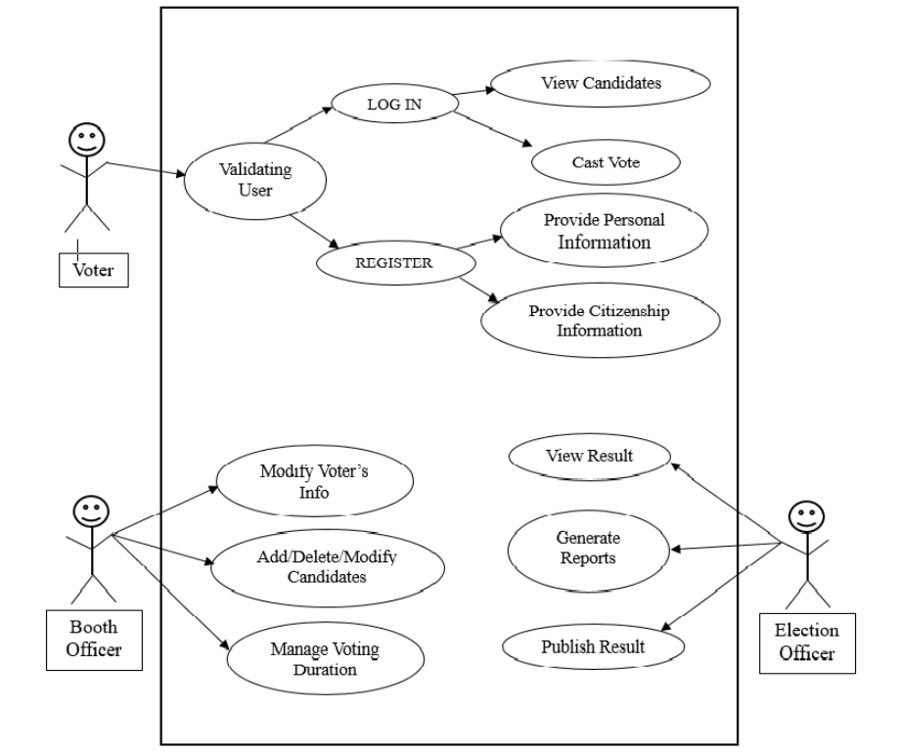
System Analysis
Use Case Diagram:
Fig: Use case diagram of web app

Slide 7
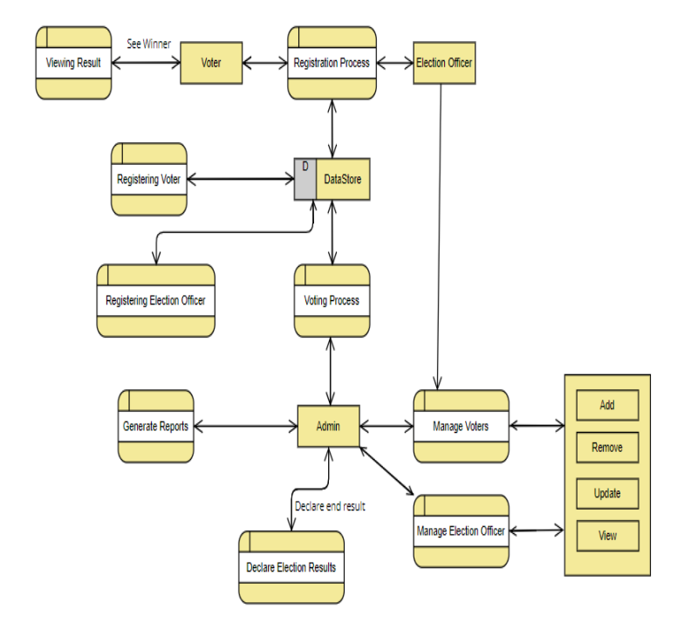
System Analysis
DFD Diagram:
Fig: DFD diagram of web app

Slide 8
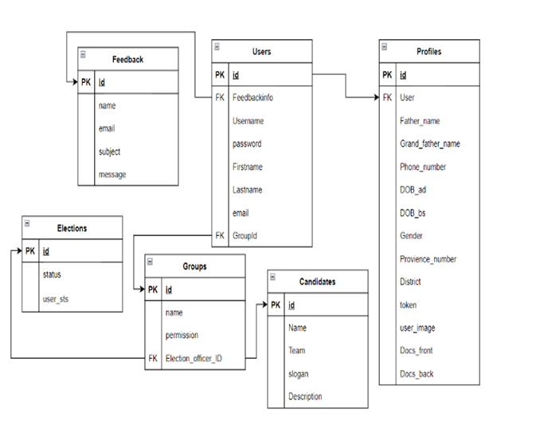
System Design
Relational model:
Fig: Relational Diagram

Slide 9
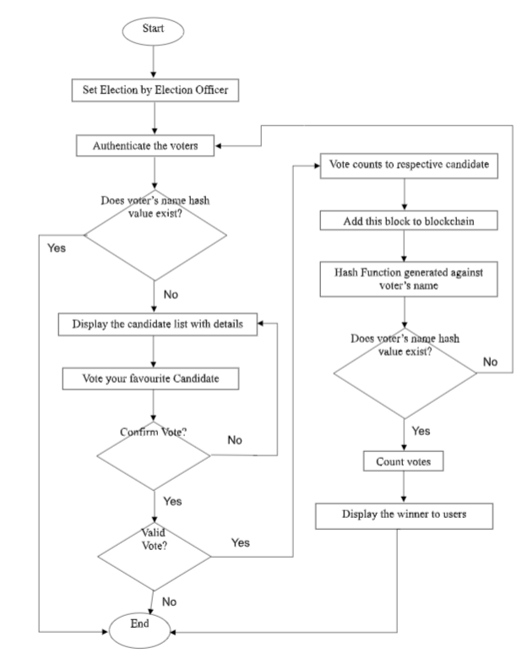
System Design
Flow Chart:
Fig: Flow Chart

Slide 10










Implementation
The Ideas and possibilities which were proposed in the propose document were came into reality by using various Tools Technologies like: Github, Google Meet,Programming Languages like: Python, Solidity, JavaScript. Scripting Languages like: HTML, CSS. Framework like: Bootstrap, Django.
Tools &
Technologies
Programming
Languages
Scripting
Languages
Web
Frameworks

Slide 11
Testing
Unit Testing:
Test ID | Test Description | Input Test Data | Expected Result | Actual Result | Status
1 | Enter valid Details | Citizenship ID, First Name, Last Name, Email, Password, Password Confirmation, Gender, Father's Name, Grand Father's Name, Provience No, District, Phone Number, DOB, Images | Redirect to LoginPage | Redirect Successfull | Pass
2 | Enter Incomplete Details | Citizenship ID, First Name, Last Name, Email, Password, Password Confirmation, Gender, Father's Name, Grand Father's Name, Provience No, Disrict, Phone Number, DOB, Images | Error message appeared Redirect to Signup Page | Error message appeared Redirected to Signup Page | Pass
Fig: Test Case for Signup page

Slide 12
Testing
Unit Testing:
Test ID | Test Description | Input Test Data | Expected Result | Actual Result | Status
1 | Enter valid login Details | Citizenship ID, Password | Redirect to Dashboard | Redirect Successfull | Pass
2 | Invalid login credintials | Wrong Citizenship ID, Password | Redirect to LoginPage | Error message appeared | Pass
3 | logout | null | Redirect to LandingPage | Redirect Successfull | Pass
Fig: Test Case for Login page
Test ID | Test Description | Input Test Data | Expected Result | Actual Result | Status
1 | When Voting Process started | null | Show the Candidates | Show the Candidates | Pass
2 | When Voting Process isn't started | null | Redirect to NotStarted | Redirect to NotStarted | Pass
3 | When Result isn't published | null | Redirect to NoResult | Redirect to NoResult | Pass
4 | When Result is published | null | Show Result | Show Result | Pass
5 | When user submit Query | Name,Email,Subject,Message | Query Submitted | Query Submitted | Pass
6 | When user is Idle for 20 Minute | null | Logout User | Logout User | Pass
Fig: Test Case for Dashboard page

Slide 13
Testing
Unit Testing:
Test ID | Test Description | Input Test Data | Expected Result | Actual Result | Status
1 | When User Clicked Vote Now Button | Null | Voted Successfully | Voted Successfully | Pass
Fig: Test Case for Vote Now page
Test ID | Test Description | Input Test Data | Expected Result | Actual Result | Status
1 | Election is live | Token assigned to User | Show End Election option in officer dashboard and Run the election | Show End Election option in officer dashboard and Run the election | Pass
2 | Election isnt started | null | Show Start Election option in officer dashboard | Show Start Election option in officer dashboard | Pass
3 | Officer clicked Candidates button | null | Officer CRUD candidates | Officer CRUD candidates | Pass
4 | Officer Clicked User Button | null | Officer CRUD User | Officer CRUD User | Pass
5 | Officer Clicked User Quaries | null | User Query shown | User Query Shown | Pass
Fig: Test Case for Officer page

Slide 14
Testing
Integration Testing:
Test ID | Test Case Objective | Test Case Description | Expected Result | Actual Result | Status
1 | Check the interface linked between Signup and login module | Enter Required details and click signup button | To be directed to the login page | To be directed to the login page | Pass
2 | Check the interface linked between login module and Dashboard Module | Enter Required details and click Login button | To be directed to the Dashboard page | To be directed to the Dashboard page | Pass
3 | Check the interface linked between Dashboard page and Vote now module | Click Vote now button | To be directed to the Voting page | To be directed to the Voting page | Pass
4 | Check the interface linked between Dashboard page and Result module | Click Result button | To be directed to the result page | To be directed to the result page | Pass
5 | Check the interface linked between Dashboard page and Query module | Click query button and fill the details | Details stored on DB and reflected to Officer module | Details stored on DB and reflected to Officer module | Pass
6 | Check the interface linked between login module and Officer Module | Enter officer login details | To be directed to Officer page | To be directed to Officer page | Pass
Fig: Test Case for Vote Now page
Fig: Integration testing

Slide 15

Conclusion
This project is aimed at simplifying the process of polling and counting votes and hence provide the exact number of vote count to the election officer.
This whole process is decentralized using a Blockchain which makes it more secure, faster, distributed and better than the traditional system.
The voters/users involved are highly authorized by the system so that on false users cast the votes.
Finally, the election officer involved helps to publish the result to the public after the time limit ends.

Slide 16
Conclusion
Overall Satisfaction
Accessibility
Speed
Cost Reduction
Reduce Manual effort
Limitations
Language
Threat to hash function
Disable Voters
Unchangeable

Slide 17
Future Recommendation
Integrating the voice command for disabled voters.
Biometric validation of the users can be added.
Developing mobile, desktop app for simplicity in voting process.

Slide 18

References
N. Darlington, A.Rosic, Blockgeeks, and R. Mitra, “Blockchain For Beginners: What Is Block chain Technology? A Step-by-Step Guide,” Blockgeeks, 22-sep-2021. [Online]. Available: https://blockgeeks.com/guides/what-is-blockchain-technology/. [Accessed: 30-Jun-2021].
Ahmed Ben Ayed, “A Conceptual Secure Blockchain based Electronic Voting System”, IJNSA, Vol.9, No.3, May 2017.
D. Zhu, "Fraud detections for online businesses: a perspective from blockchain technology," December 2016.

Slide 19
Thank You !!!
Any Queries ?

