Slide 1
eChunab
Itahari-9, Sunsari
22/06/2078
Godawari College
Authors:
1. Arash Thapa
2. Doleshwor Khadka
3. Prabesh Guragain
Submitted to:
Department of Bsc.CSIT

Slide 2
Outline
Introduction
Problem Statement
Objectives
Methodology
Outcome & Conclusion
References

Slide 3
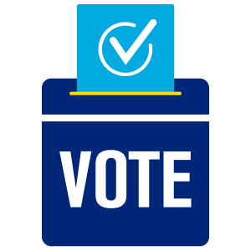

1. Introduction
“eChunab” is a online web based voting system which allows specific audience or mass public to cast their vote safely and easily without breaking the daily routine.

Slide 4
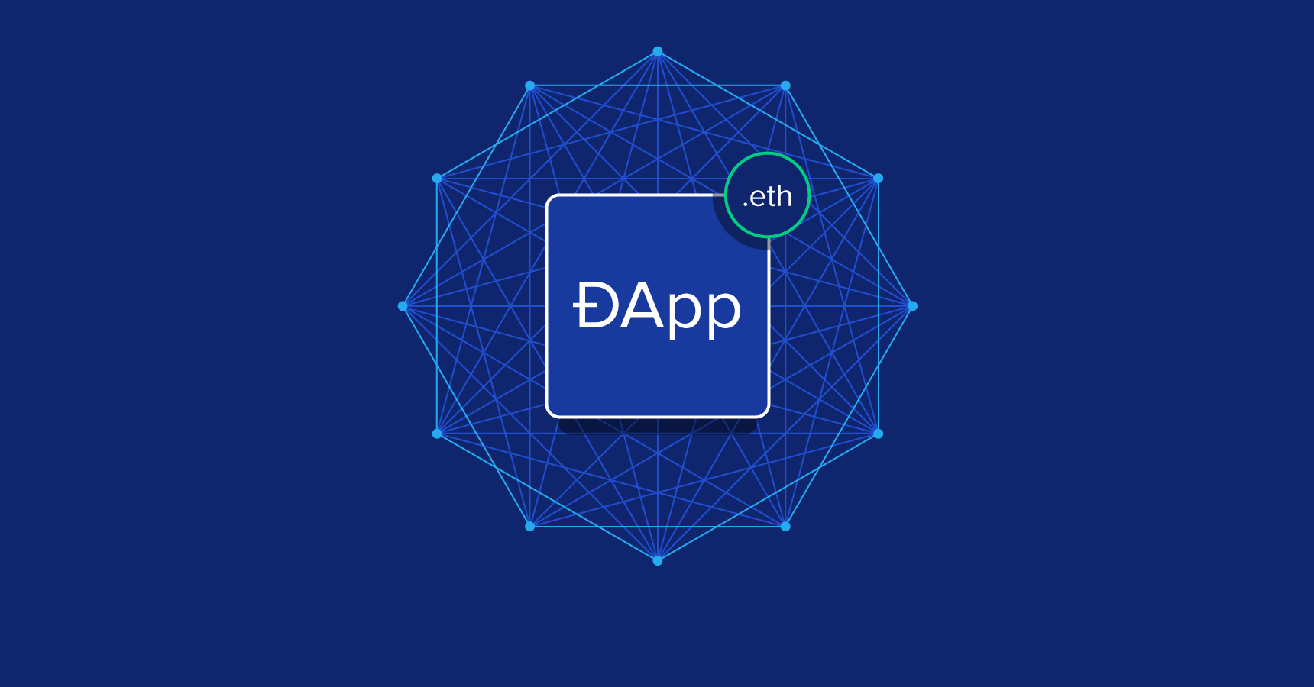
1. Introduction
On our Web app we used Ethereum which enables the deployment of smart contracts and decentralized applications (dapps) to be built and run without any downtime, fraud, control or interference from a third party.

Slide 5
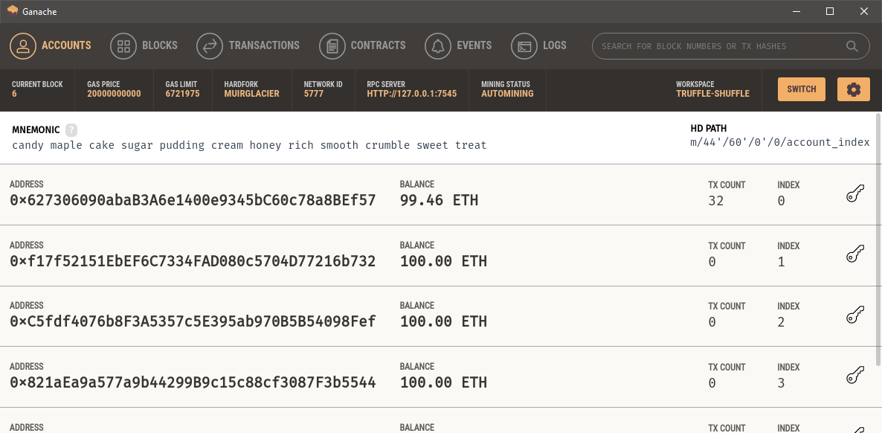
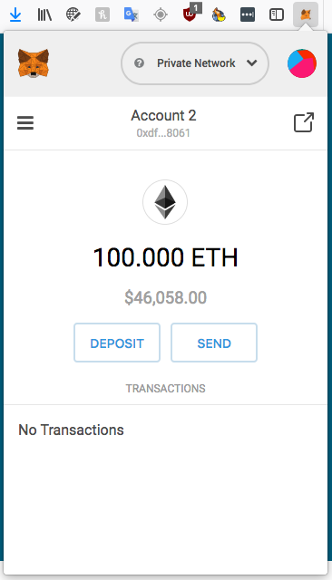
1. Introduction
The web page to caste vote is developed using Django which uses: Python, HTML5, CSS3. While the transaction of ETH is done by Ganache and Metamask which represent the Voting mechanism as if any fraudent tries to happen, the ETH transaction will be halt and the voting process will be terminated.
Fig. Sample view of Ganache
Fig. Sample view of MetaMask

Slide 6
2. Problem Statement
In Traditional voting systems
Expensive
Insecure (as we heard booth capturing news)
Time consuming
Faults may rise in counting process
In Normal E-voting systems
Data can be changed
Multiple entries can be registered
Manipulation of the result
Hacking of the entire system
So, to solve above problem we’re going to develop an E-voting web app using Ethereum based Blockchain technology.

Slide 7
3. Objectives
To provide a safe and secure voting platform for any local bodies, nation and organization.
To speed the process of vote counting and publish result
To reduce the cost of paying staffs to count the vote manually
To make the voting process and result transparent
To unauthorize the illegal and multiple votes
improve the voting experience
To improve the registration process

Slide 8
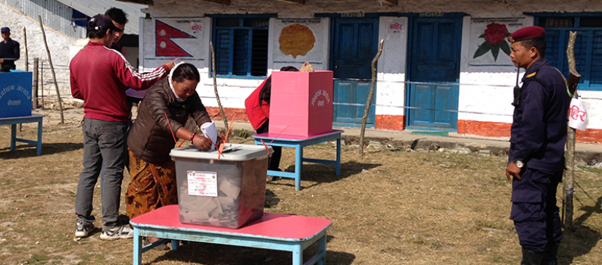
4. Methodology
Requirement Identification:
Since the establishment of voting system in Nepal, there has been paper based voting system. This is called as ballot Paper system.
Voters had to go to polling booth and tick on paper to cast their vote. Manual counting of votes leads the declaration of winner.
Due to over population, the ballot paper voting is not much reliable and time consuming.
There are high chances of replacement of ballot paper boxes and performing multiples marking on vote.
But there’s no any system being built yet to solve those problem.

Slide 9
4. Methodology
Requirement Collection:
The major requirements for our system are listed below:
Users having citizenship should possess vote throughout the world.
Secured and accurate so that correct result publishes.
Avoid multiple votes.
Authenticate the voter’s nationality and age criteria.
Confirm the respective voter votes in the system.
Avoid Election officers or system administrator interception in counting vote.

Slide 10
4. Methodology
Feasibility Study:
Is Technically Feasible ?
Is Economically Feasible ?
The system we are designing is based on web, so it is portable i.e usable in various devices like laptop, desktop, mobiles, and many more. This system provides comprehensive function to make it user friendly. The data entry and result generations is also made easy. It also provides easy retrieval of data. So, this system is technically feasible. | The major expenses are employment payroll, server charges, and equipment cost. The project that we are planning to make has the scope in the market and the cost for making it moderate. Since the cost for development is affordable, less than the traditional paper based voting system and demand of the market is very high so our project is economically feasible.

Slide 11
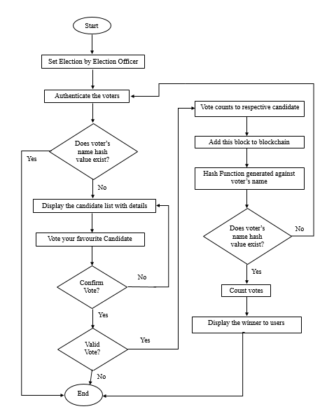
4. Methodology
System Design:
Fig: Flow Chart

Slide 12
5. Outcome & Conclusion
This project is aimed at simplifying the process of polling and counting votes and hence provide the exact number of vote count to the election officer.
This whole process is decentralized using a Blockchain which makes it more secure, faster, distributed and better than the traditional system.
The voters/users involved are highly authorized by the system so that on false users cast the votes.
Finally, the election officer involved helps to publish the result to the public after the time limit ends.

Slide 13
6. References
[1] http://blockgeeks.com/guides/what-is-blockchain-technology/
[2] https://www.trufflesuite.com/docs/ganache/overview
[3] https://docs.metamask.io/guide/#account-management
[4] https://www.investopedia.com/articles/investing/031416/bitcoin-vs-ethereum-driven-
different-purposes.asp
[5] Ahmed Ben Ayed, “A Conceptual Secure Blockchain based Electronic Voting
System”, IJNSA, Vol.9, No.3, May 2017.
[6]https://www.researchgate.net/publication/311444386_Fraud_detection_for_onli
ne_businesses_a_perspective_from_blockchain_technologylo
[7] https://en.wikipedia.org/wiki/Feasibility_study

