Slide 1
Region-CNN
a.k.a R-CNN

Slide 2
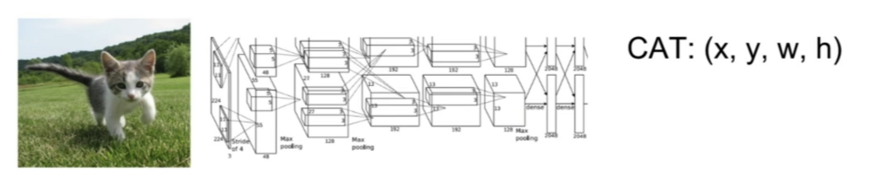
Problem : Object Detection
Input : image
Output : class, bounding box(specified by center location and size)

Slide 3
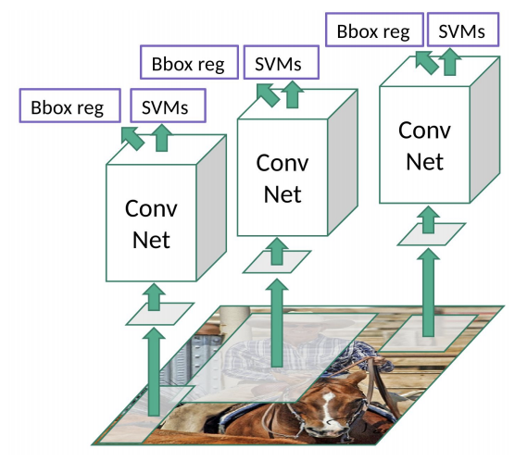
One Solution
Class : classification
Bounding box : regression
Use CNN to extract features

Slide 4
Challenge: multiple objects in one image
Solution : segment image to several regions before predicting
Exhaustive search : computationally expensive
Selective search : bottom-up approach

Slide 5
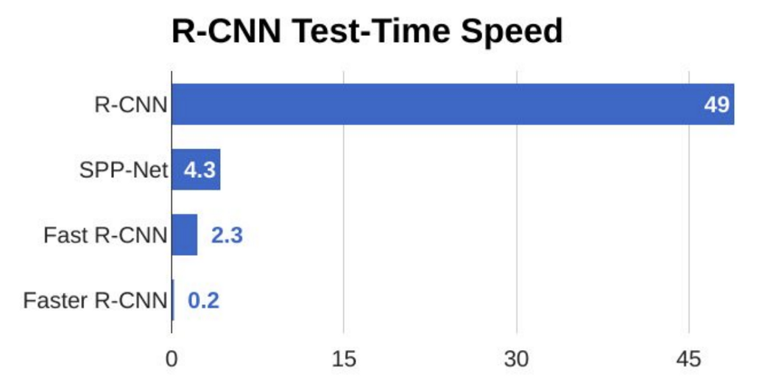
Problem with R-CNN
Still takes huge amount of time to train and test
Cannot be used in real time prediction (still slow)
Fixed search algorithm : can lead to bad candidates generation

Slide 6
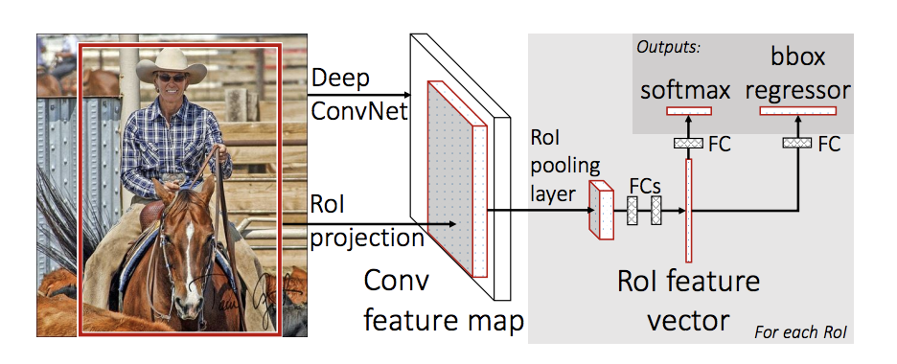
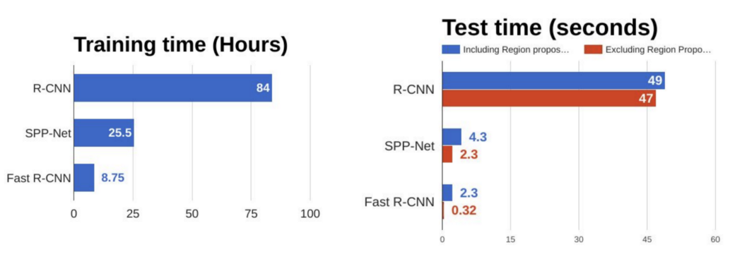
Improve on R-CNN : Fast R-CNN
Feed input image to CNN instead of region proposals, reducing unnecessary convolution operation

Slide 7
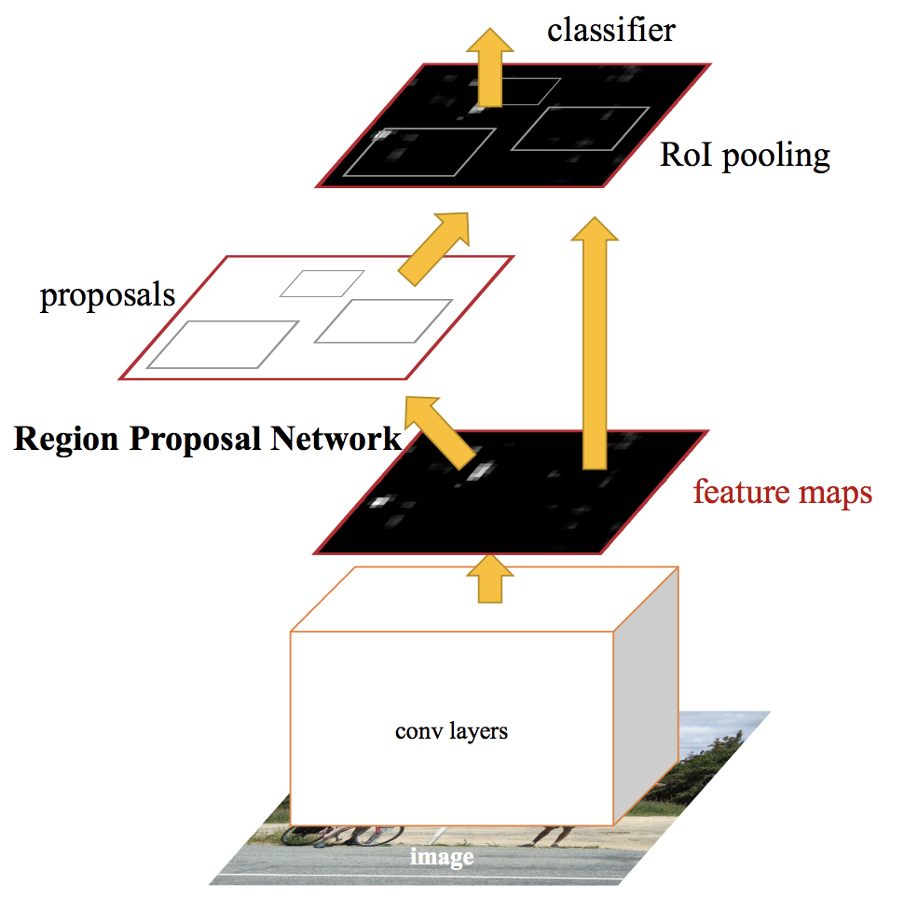
Further improve : Faster R-CNN
Eliminate selective searching, let the network learn the region proposals, speeding up the procedure
Support real time prediction

Slide 8
References
J.R.R. Uijlings et al, Selective Search for Object Recognition
Shaoqing ren et al, Faster R-CNN: Towards Real-Time Object
Detection with Region Proposal Networks

Slide 9
Thanks for listening!

