Slide 1
Data profiling analysis
XI LI (Sunny)
Team Name: VICSUN DUSBRI Realty Group

Slide 2
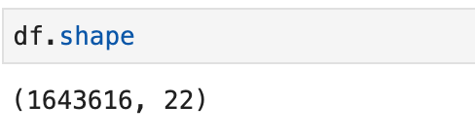
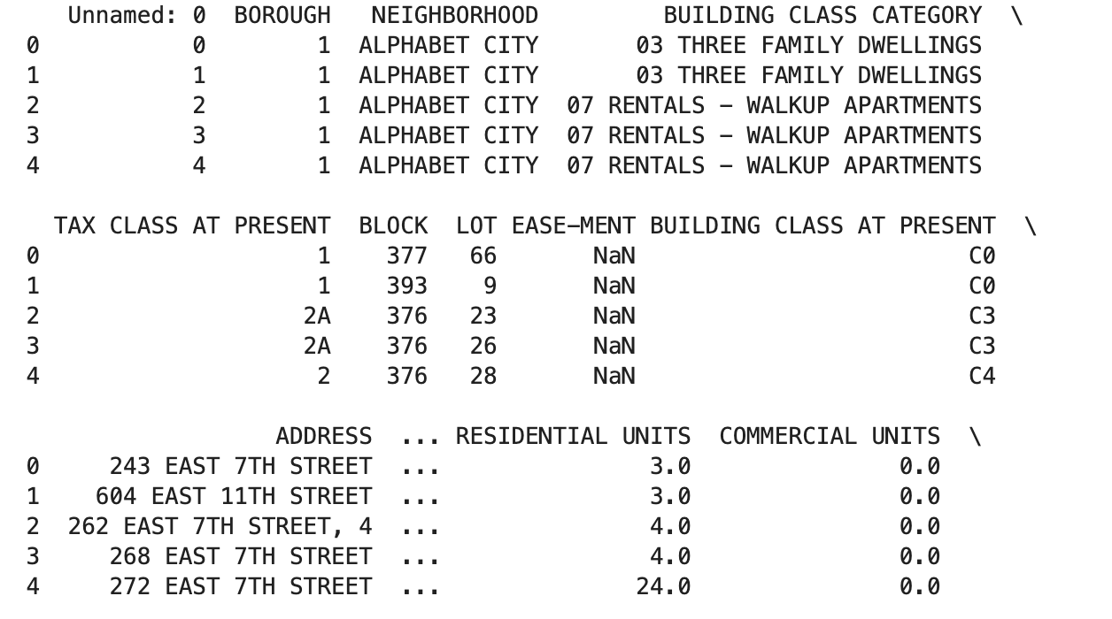
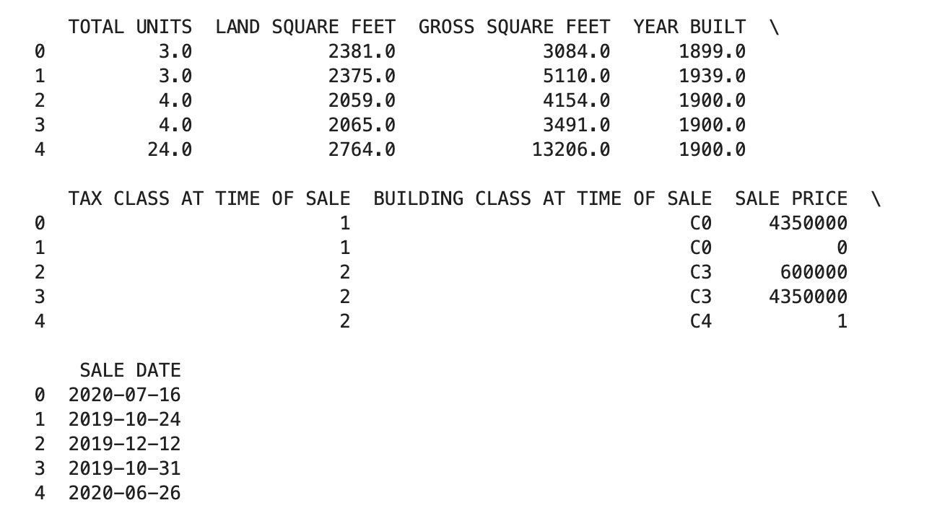
There are 22 columns and 1643616 raw in our datasets
’Unnamed: 0’ and ‘EASE-MENT’ columns are unmeaningful for our project, so I deleted these 2 columns

Slide 3
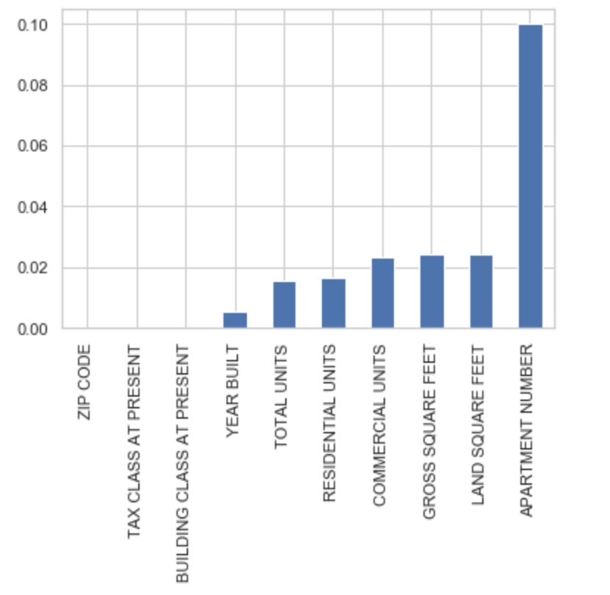
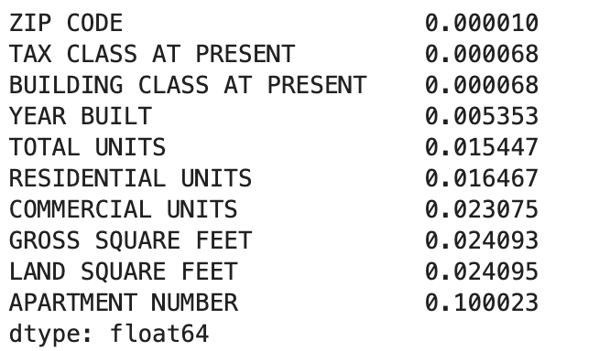
Below are missing values in each column,
and shows how many percent the missing values in each attribute stand in the dataset.
Apartment Number has the highest percent
of ‘null’ value, but it makes sense because there is no apartment number of townhouse or house

Slide 4
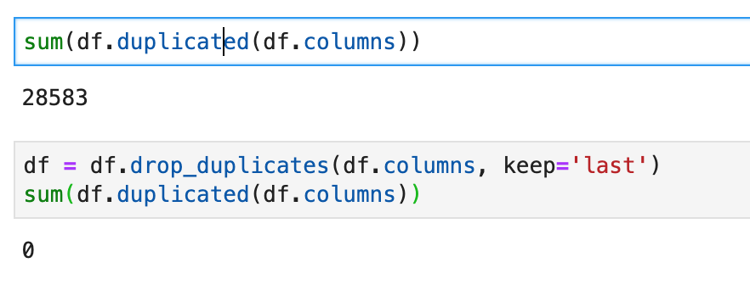
Check and delete the duplicates
We have 28583 duplicate records in the dataset.

Slide 5
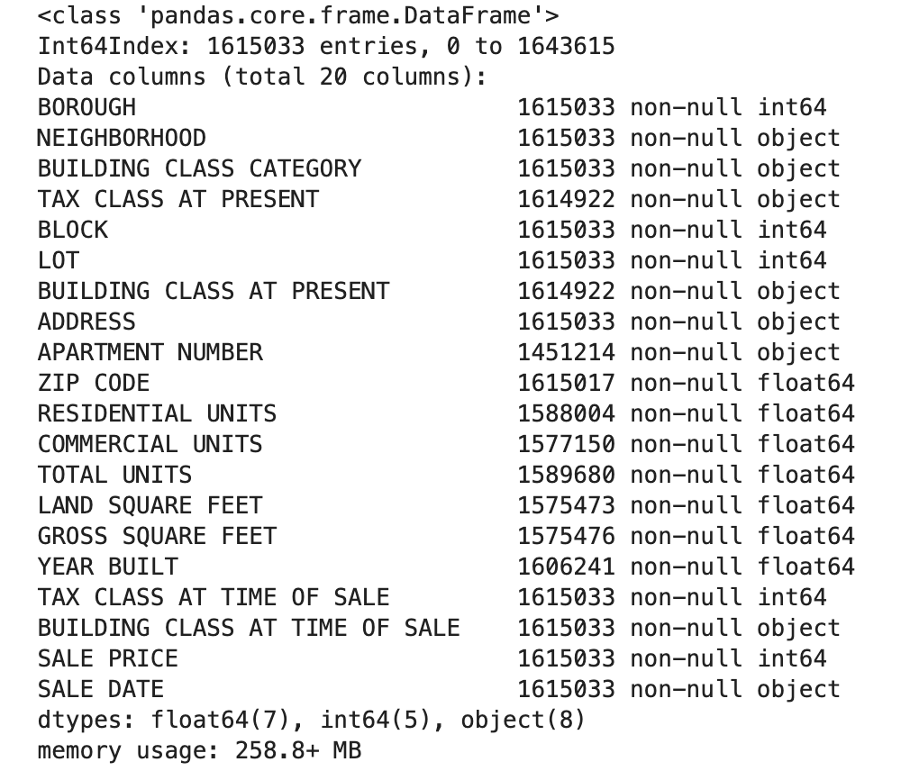
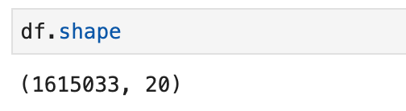
There are 20 columns and 1615033 raw left after cleansing the dataset

Slide 6
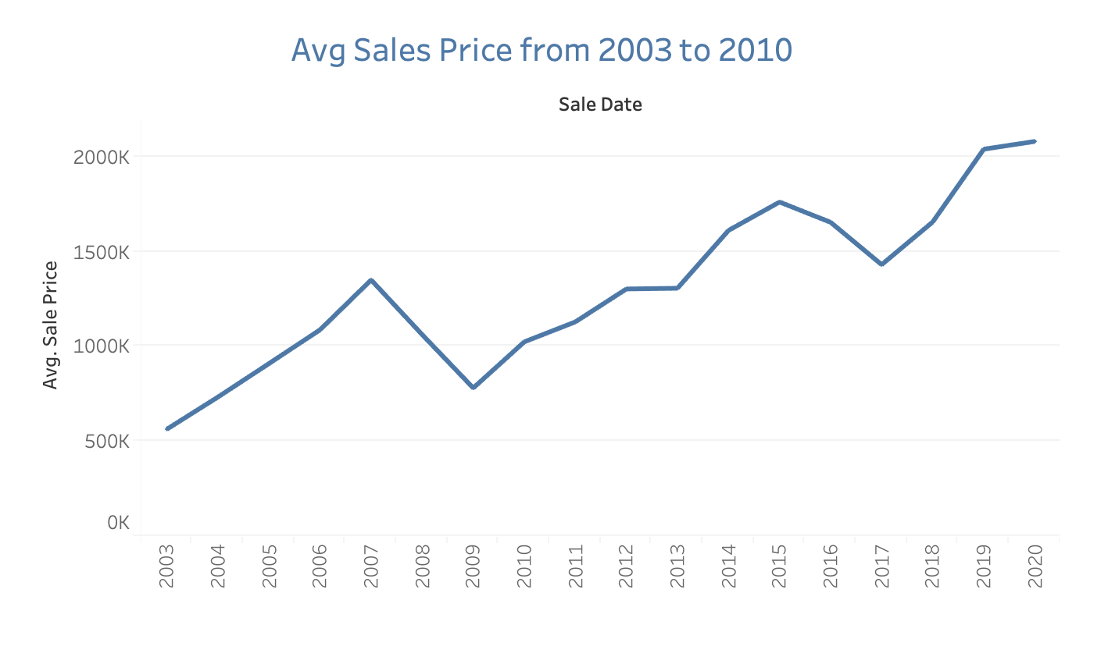
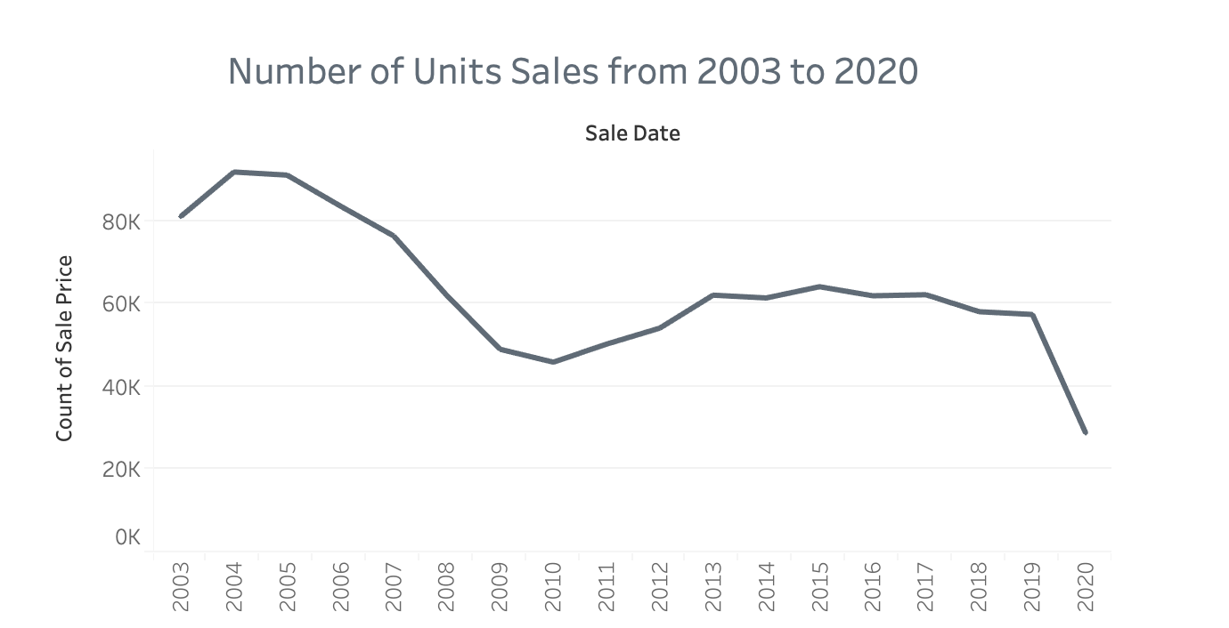
Overall, this graphic shows that the average price of real estate is going up from 2003 to 2020.
Even though the price is going up, but the number of units‘ sale is on a downward trend, especially this year.

Slide 7
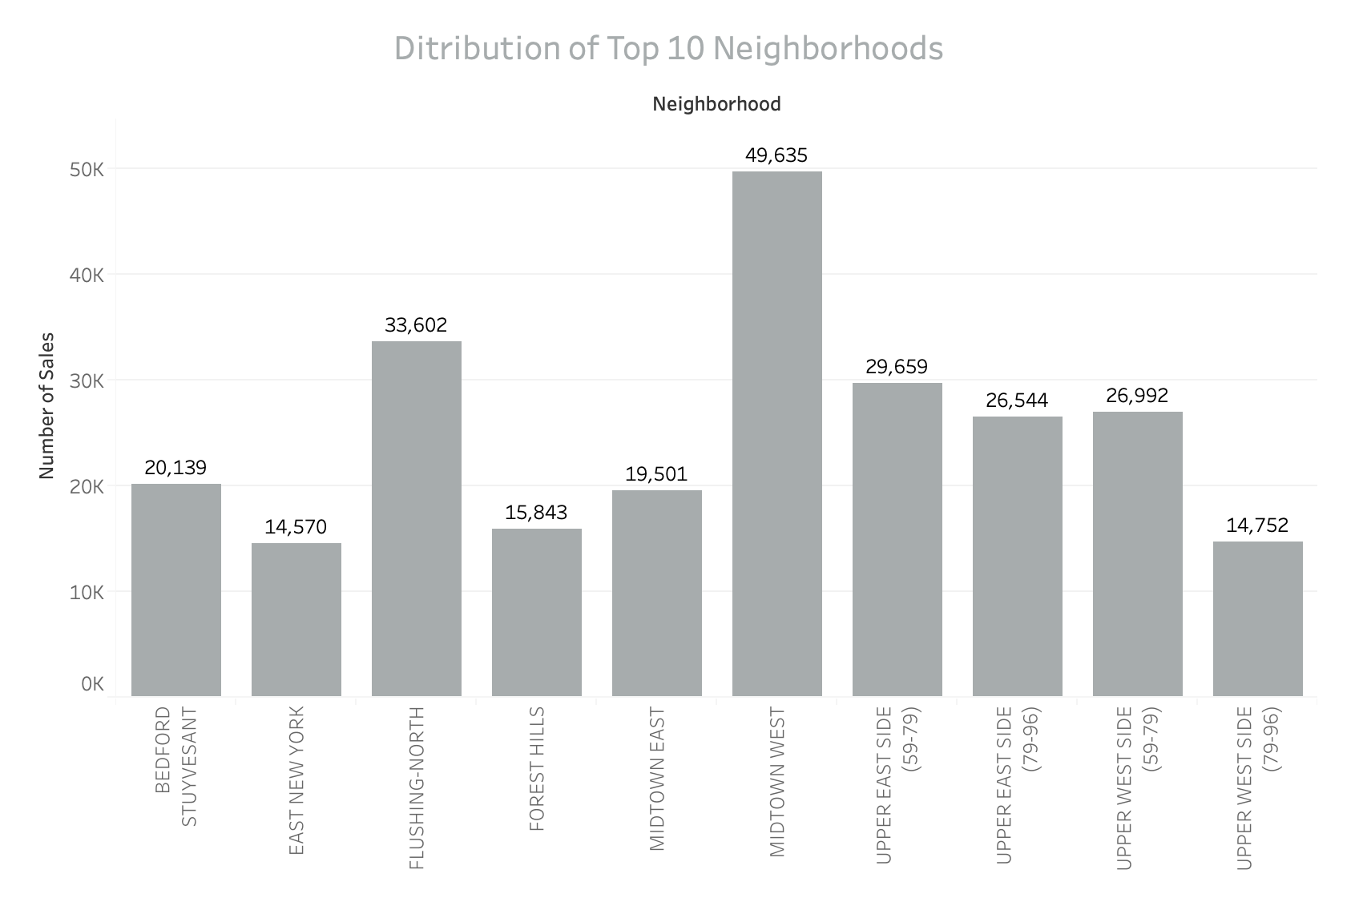
We can see that the most popular neighborhoods is Midtown West in Manhattan, and the next is Flushing North

Slide 8
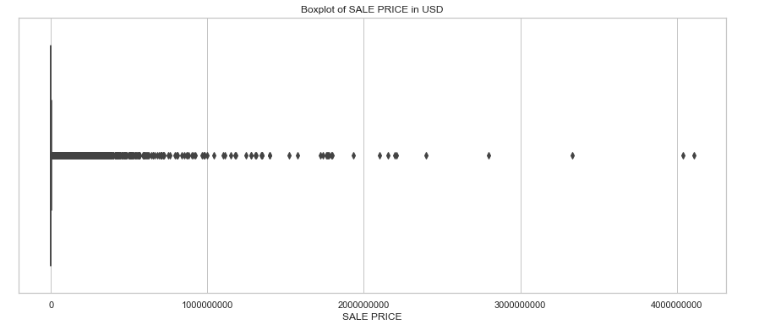
This chart shows all the sale price from 2003 to now, we can see the price gap is huge.

Slide 9
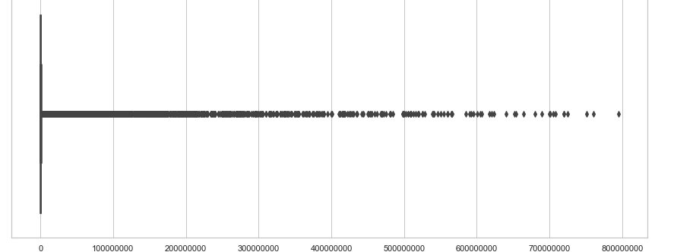
I kept data that the sale prices are from 100000 to 800000000 in order to better understand the dataset.

Slide 10
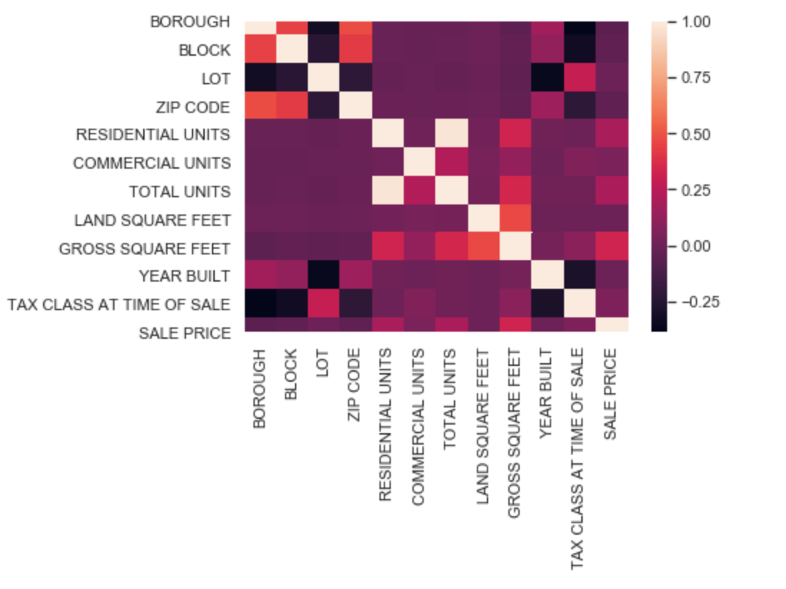
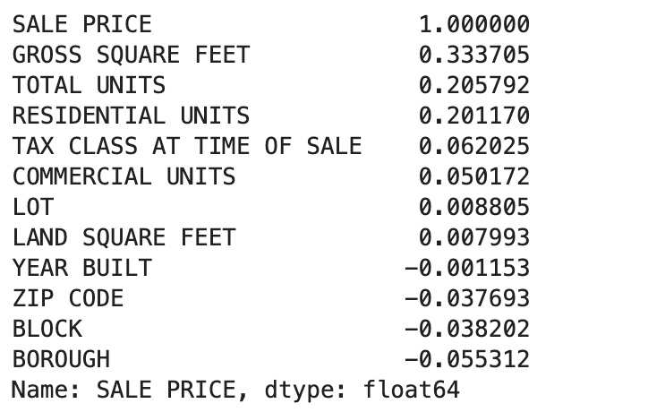
This heatmap shows the correlations between the attributes
The right list is the correlation of sale price with each attribute

Slide 11
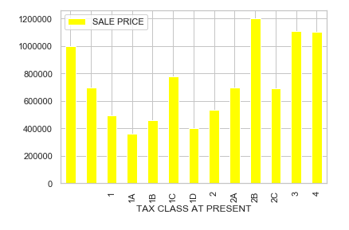
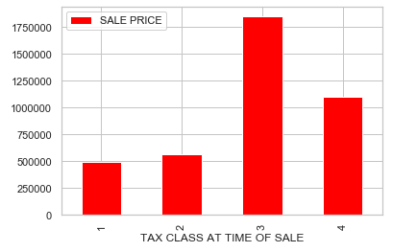
TAX CLASS AT PRESENT(median)
TAX CLASS AT TIME OF SALE(median)

Slide 12
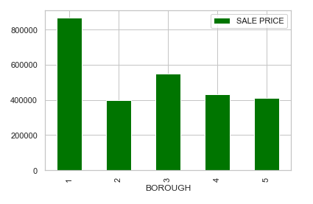
Borough VS Sale Price(median) Manhattan (1), Bronx (2), Brooklyn (3), Queens (4), and Staten Island (5) We can see Manhattan is the most expensive, Bronx has the lowest median price.

