Slide 1


Module 3
File created on: 8/10/20 5:47:01 PM EDT

Slide 2
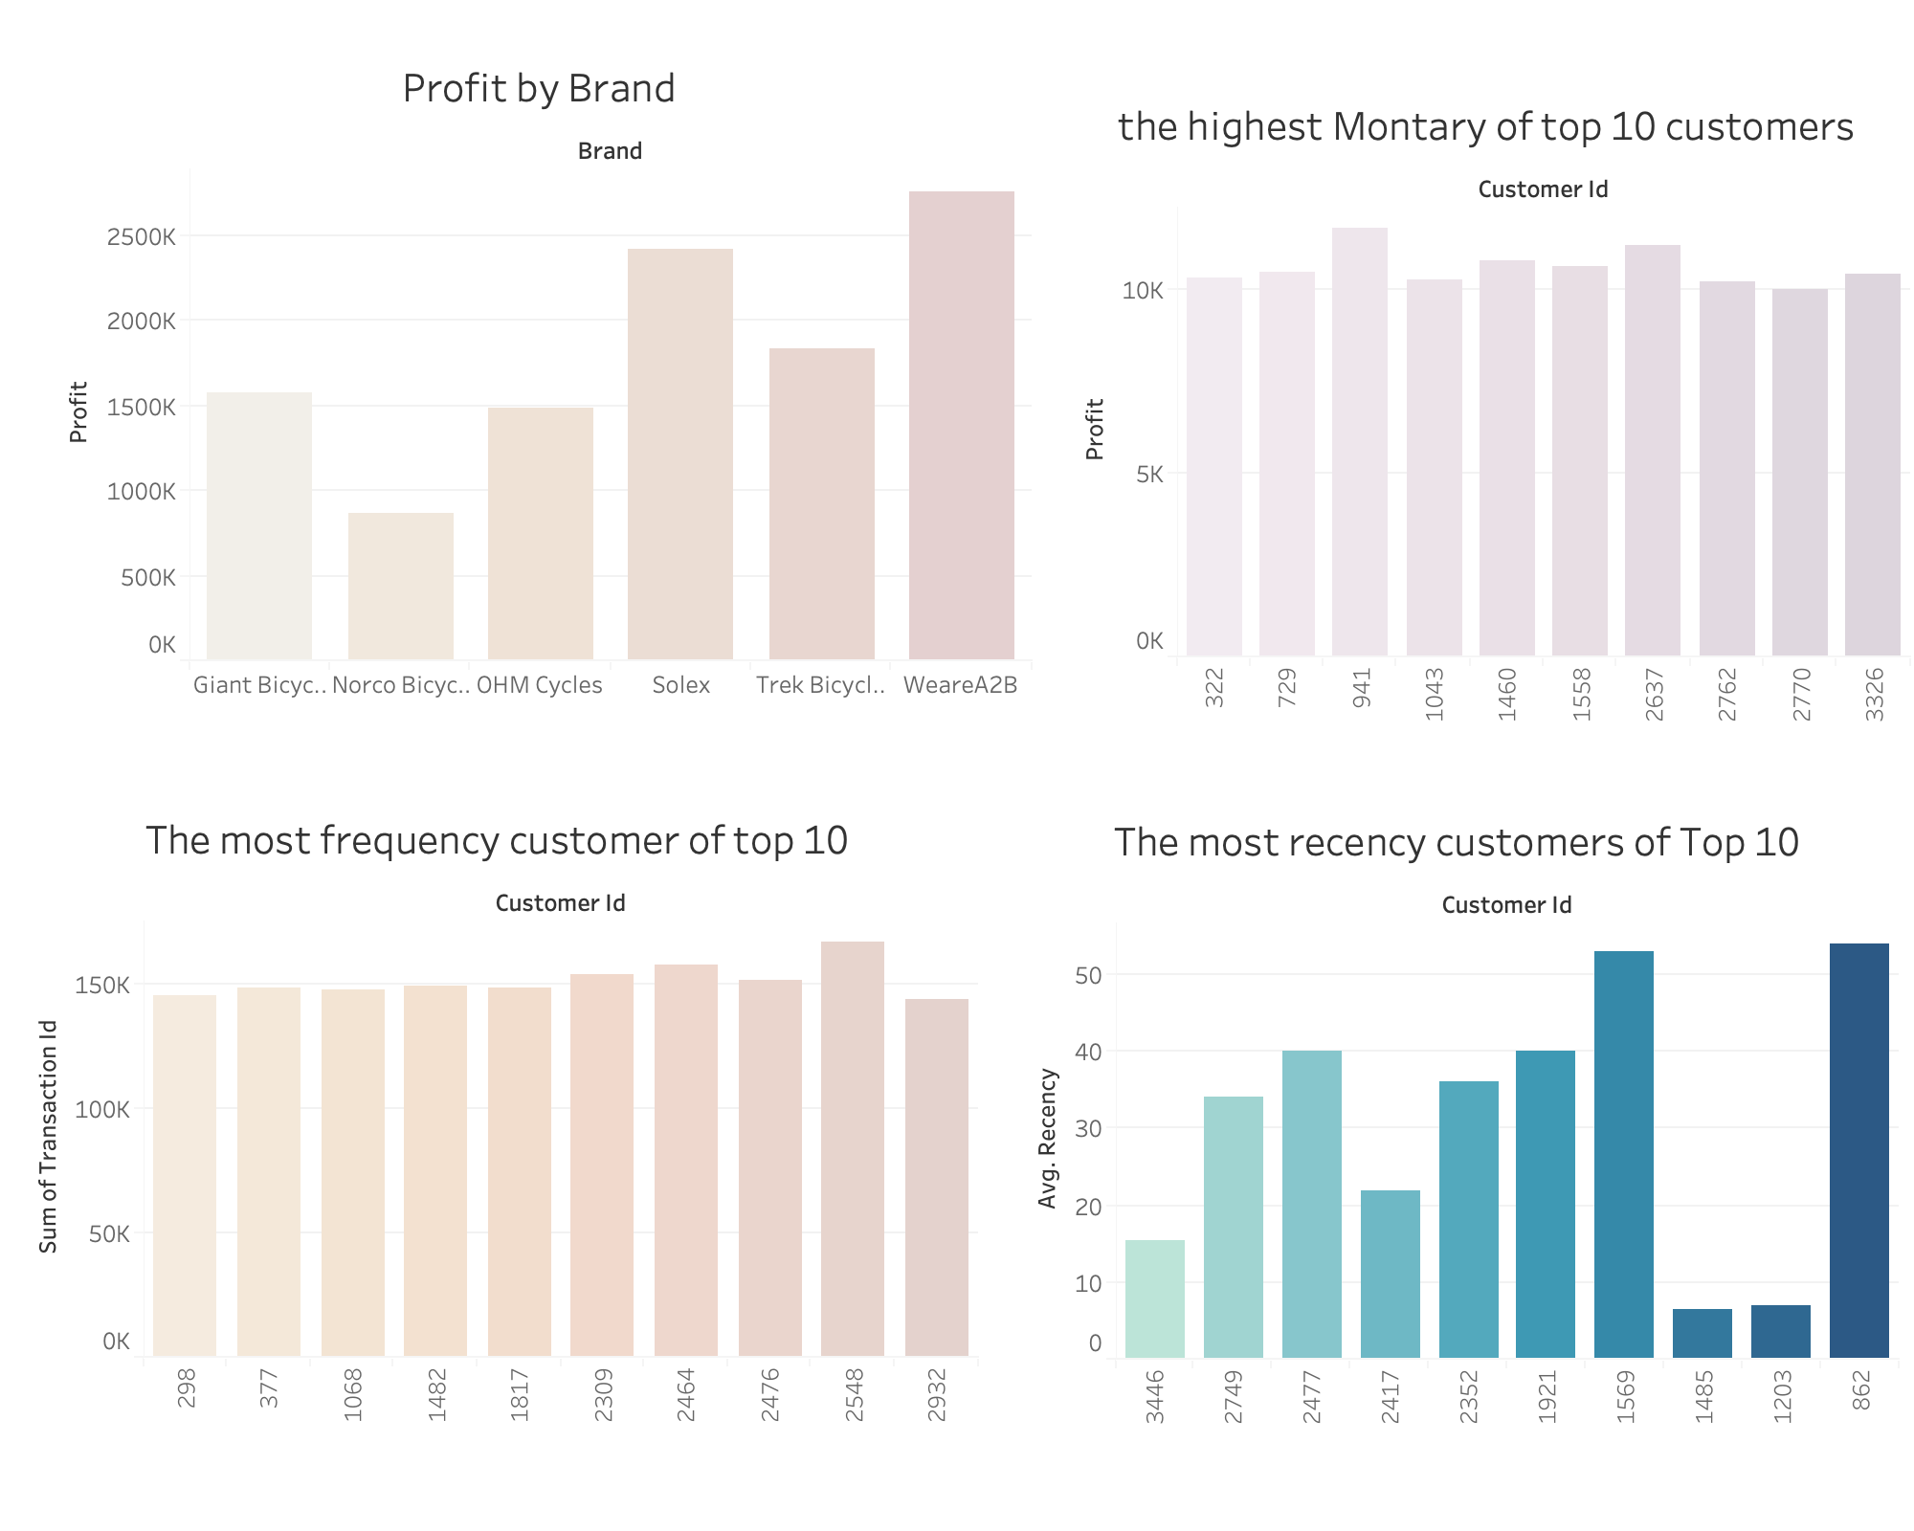

Slide 3
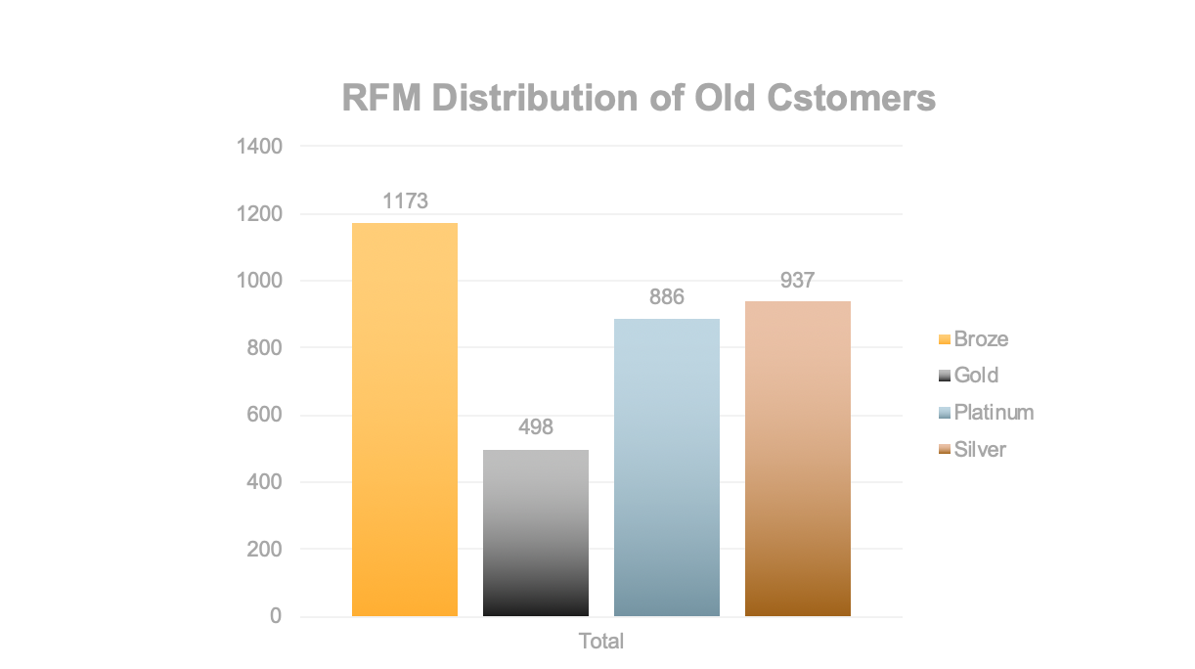
Customer Type

Slide 4
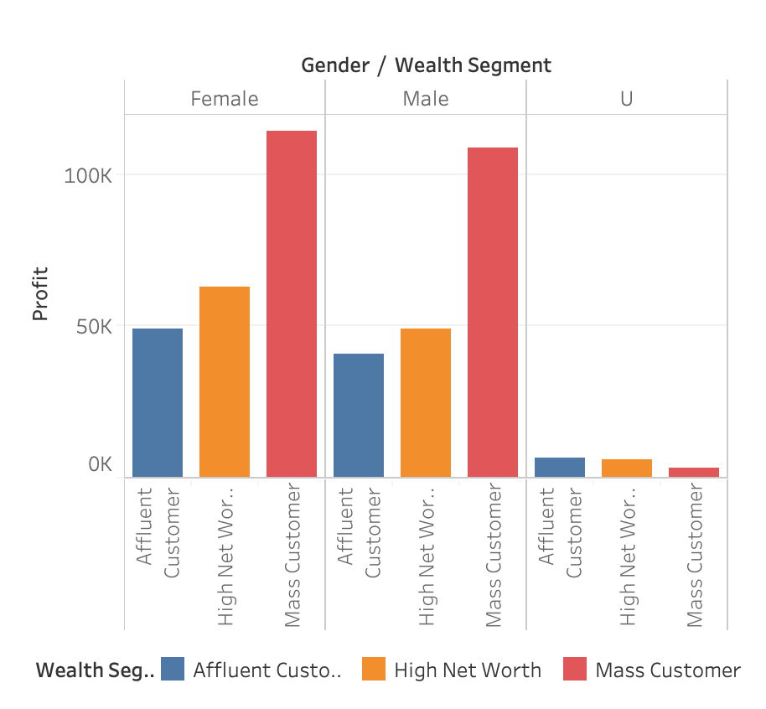
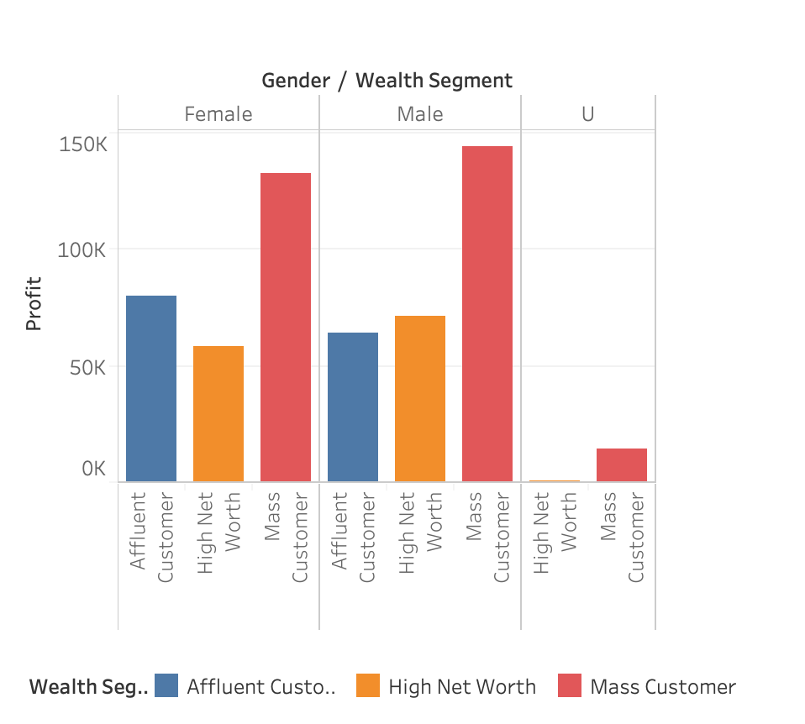
Age Distribution of customers
Platinum & Gold Customers
Silver & Bronze Customers

Slide 5
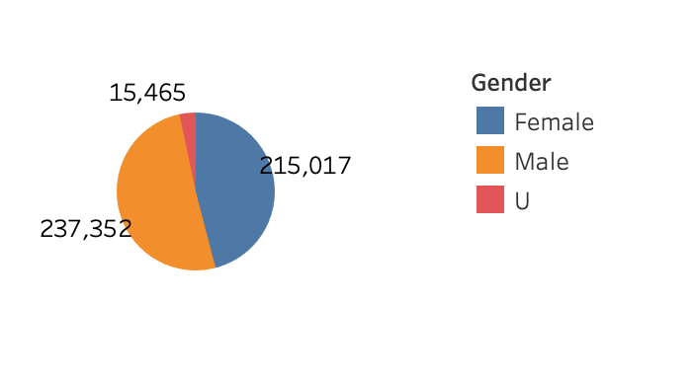
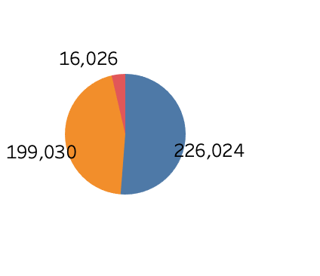
Gender Distribution
Platinum & Gold Customers
Silver & Bronze Customers

Slide 6
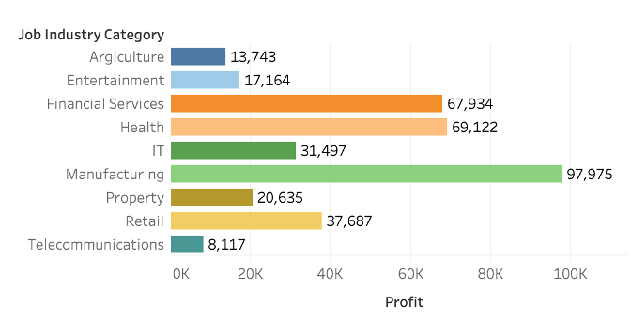
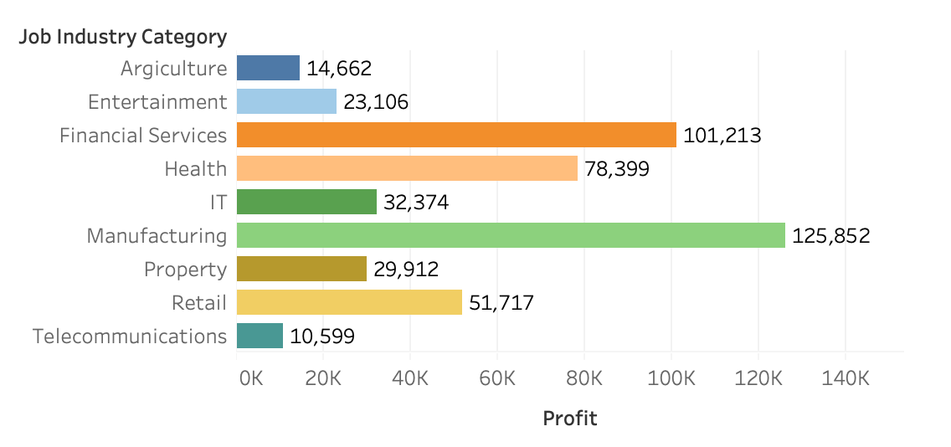
Job Industry Distribution
Platinum & Gold Customer
Sliver & Bronze Customer

Slide 7
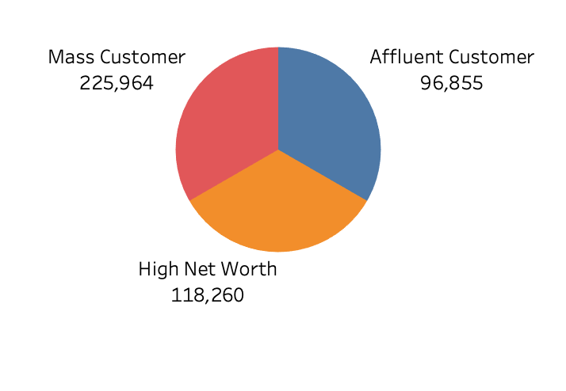
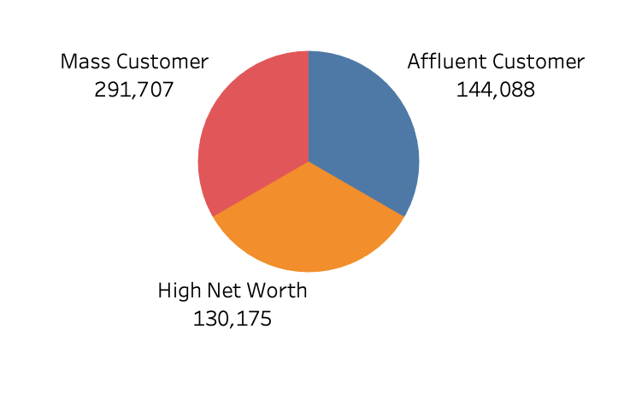
Wealth Segment Distribution
Platinum & Gold Customer
Sliver & Bronze Customer

Slide 8
Summary
After analyzing the dataset from Sprocket Central Pty Ltd, man is more interested in bike than woman; more people who are platinum and gold type work in financial services and health area. And the age from 40 to 49 has highest number of buying bikes. I will suggest Sprocket Central Pty Ltd could invest more in financial services and health industry to absorb more platinum and gold customers. For silver and bronze customers, RFM score shows that there is a long time that sliver and bronze customers are not come to buy. Sprocket Central Pty Ltd could contact these customers more frequently in order to have more of them to visit Sprocket Central Pty Ltd again.

