Slide 1
My 2015

Slide 2
My Life
Spring
Summer
Autumu
Winter

Slide 3
1.Spring
stay at school
study&have a good time with friends

Slide 4
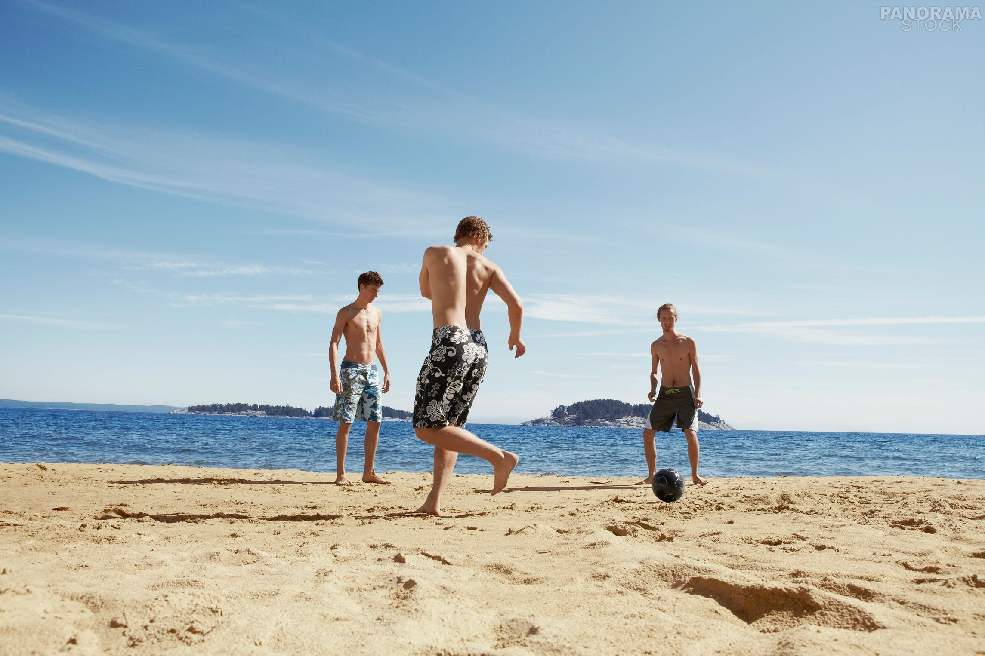
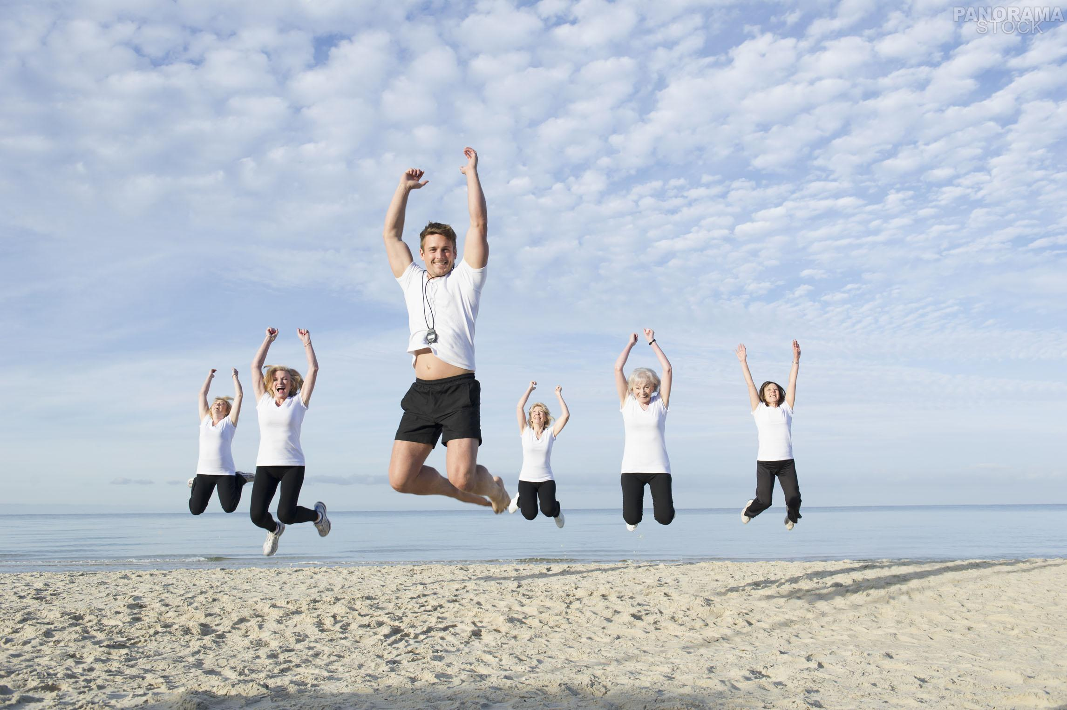
2.summer&holiday
travel&fun
Walking on the ancient road makes us back to our sense.

Slide 5

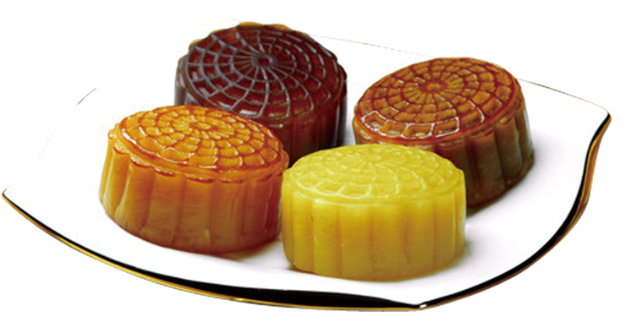
3.autumn
On Mid - autumn Festival , eating mooncakes and an the full moon with family

Slide 6

4.winter
Φ
↓
blue sky,cloud,snow,and the final test
Ψ
↓
θ
↓
Ω
ɑ
↓
α
↓
β
↓
θ

Slide 7
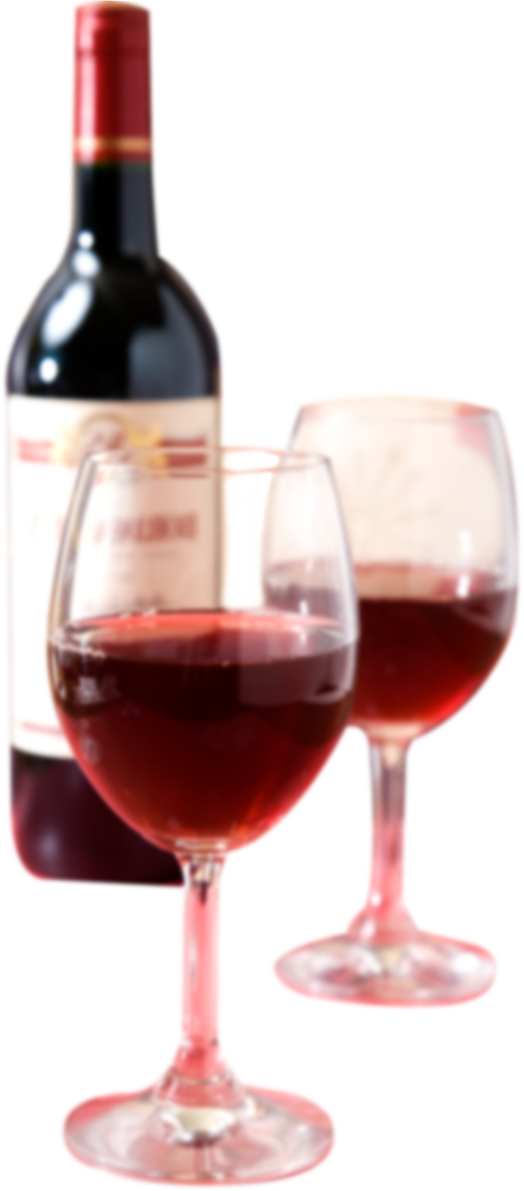

Life like red wine,rich and fruity
with the time going,we will grow up one day

